Slide 1

感恩遇见，相互成就，本课件资料仅供您个人参考、教学使用，严禁自行在网络传播，违者依知识产权法追究法律责任。
更多教学资源请关注
公众号：溯恩高中英语
知识产权声明

Slide 2

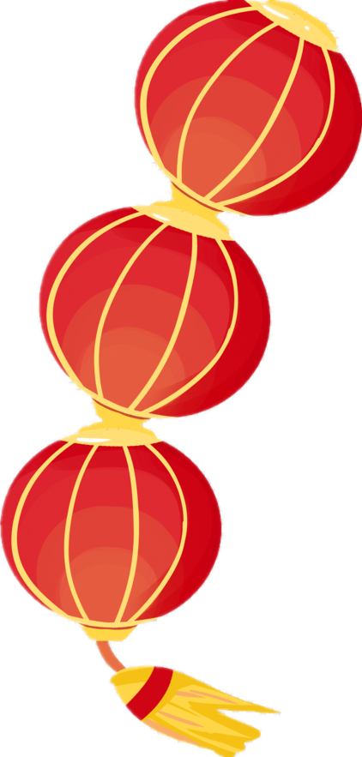
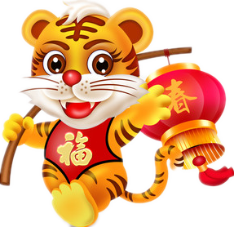

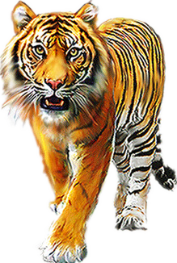
开
第
课
学
一
2022年春季
Take the Bull by the Horns！
Overstep the Dream！
不畏艰难 超越梦想
杭州二中树兰高级中学 郭合英

Slide 3
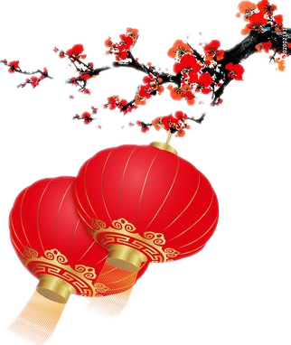
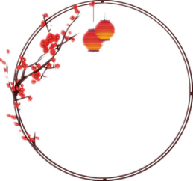
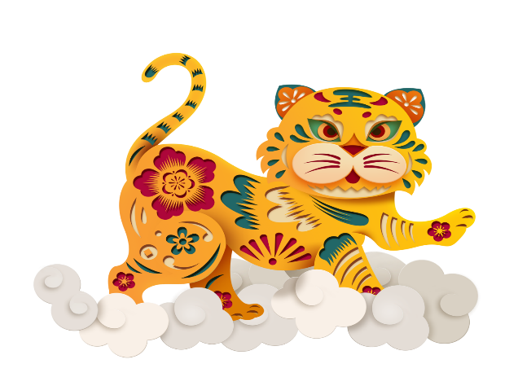
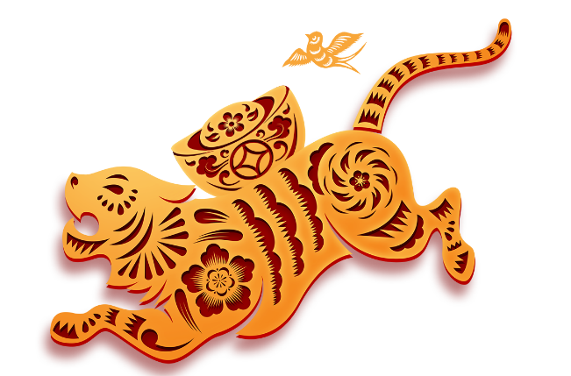

CONTENTS
1
The Year of the Tiger
2
Beijing Winter Olympics
3
About students

Slide 4
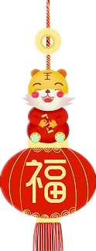
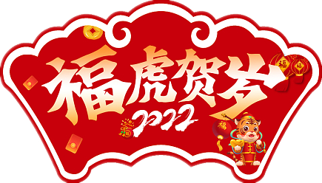
1
The Year of the Tiger

Slide 5

According to the lengend, why were there no Zodiac Tiger in the first place?

Slide 6
In ancient times, there were lions and no tigers in the zodiac. Because the lion was too cruel and had a bad reputation, the Jade Emperor wanted to remove the lion. Thinking twice, he thought of the tiger that had learned eighteen martial arts from the cat and became a warrior in the mountain forest. He issued a decree to pass on the tiger to heaven. The tiger became the front guard of the Heavenly Palace.
However, the birds and animals on the ground began to run amok when they saw that no one was in charge, causing a disaster to the world. The land god hurriedly reported it to heaven. The Jade Emperor sent the tiger down to earth, and the tiger asked him to carve a “一” every time he won. The Jade Emperor agreed with the tiger's request. When he came to the mortal world, the tiger learned lions, bears and horses were the three most powerful animals. It specifically challenged the three animals. Ultimately, he defeated them. Back in the sky, the tiger was carved three horizontal lines on its forehead. Later, the world was harassed by the East Sea turtle monster and shrimps and crabs did evil in the world. The tiger was sent to the earth
In ancient times, there were lions and no tigers in the zodiac. Because the lion was too cruel and had a bad reputation, the Jade Emperor wanted to remove the lion. Thinking twice, he thought of the tiger that had learned eighteen martial arts from the cat and became a warrior in the mountain forest. He issued a decree to pass on the tiger to heaven. The tiger became the front guard of the Heavenly Palace.
However, the birds and animals on the ground began to run amok when they saw that no one was in charge, causing a disaster to the world. The land god hurriedly reported it to heaven. The Jade Emperor sent the tiger down to earth, and the tiger asked him to carve a “一” every time he won. The Jade Emperor agreed with the tiger's request. When he came to the mortal world, the tiger learned lions, bears and horses were the three most powerful animals. It specifically challenged the three animals. Ultimately, he defeated them. Back in the sky, the tiger was carved three horizontal lines on its

Slide 7
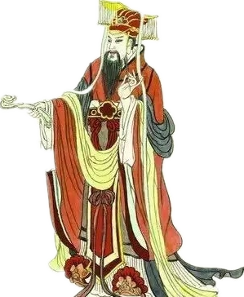
forehead. Later, the world was harassed by the East Sea turtle monster and shrimps and crabs did evil in the world. The tiger was sent to the earth again and bit the turtle monster to death. The Jade Emperor was gratified, adding a vertical to the three horizontal lines on the tiger’s forehead. So a striking word "王" appeared on the tiger's forehead. Since then, the tiger has been the king of beasts.
After the notoriety of lions came to Heaven, the Jade Emperor decided to remove the title of lion's genus and make up
the beast king tiger. From then on, the tiger
became a genus, while the lion was demoted
to the far south. Of course, the tiger also went
down to the earth from the guards in front of
the Jade Emperor's temple to keep the lower
world peaceful forever.

Slide 8
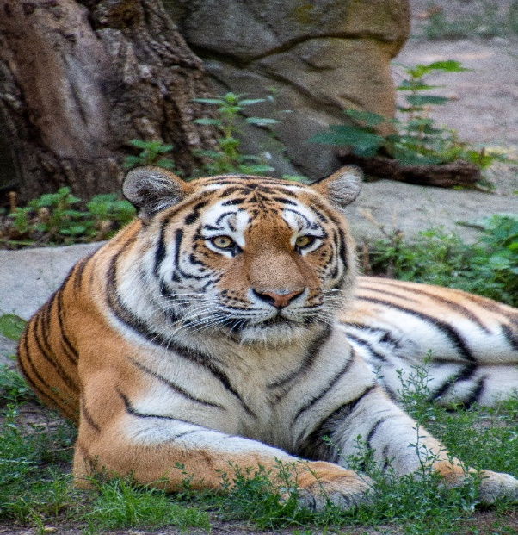
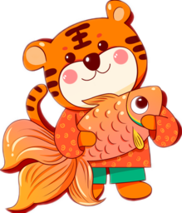
Choose the best answer
1. What do we know about the tiger’s capability?
A. He got it from the cat.
B. He got it from the Jade Emperor.
C. The lion’s ability is better than the tiger’s.
D. The tiger’s ability is no better than the turtle monster’s.
2. How did the tiger get the “王” ?
A. He beat the lion. B. He bit the turtle to death.
C. He beat lions, bears and horses and turtle.
D. The Jade Emperor offered to carve it for him.
3. What does the underlined word “vertical” mean?
A. noble B. curved C. upright D. honourable
4. What is the text?
A. A novel B. A report C. A notice. D. A mythology.

Slide 9
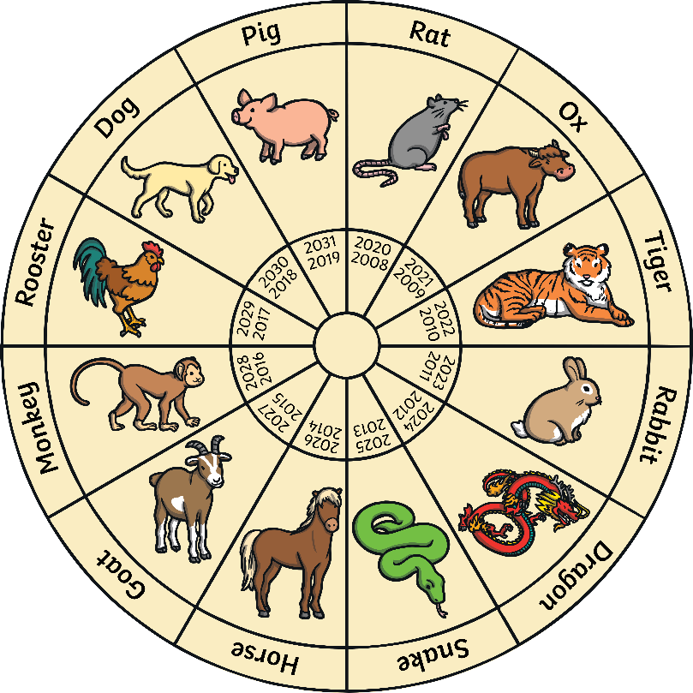
The authentic English structure of the Chinese Zodiac
the Year of the + Animals Zodiac
the Year of the Pig
the Year of the Rat
the Year of the Dog
the Year of the Ox
the Year of the Rooster
the Year of the Tiger
the Year of the Monkey
the Year of the Rabbit
the Year of the Goat
the Year of the Dragon
the Year of the Horse
the Year of the Snake

Slide 10
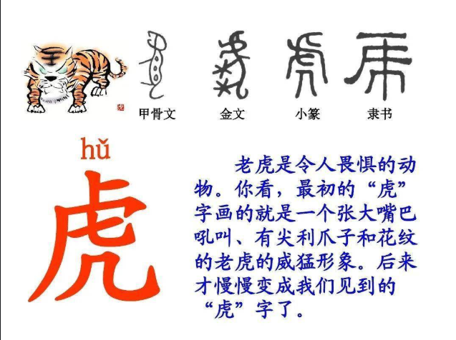
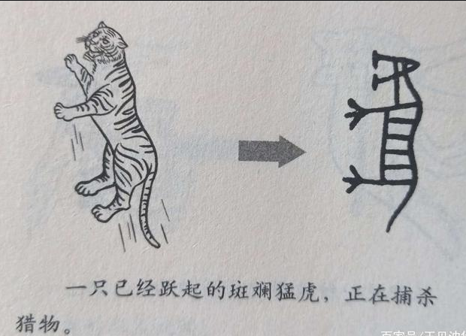
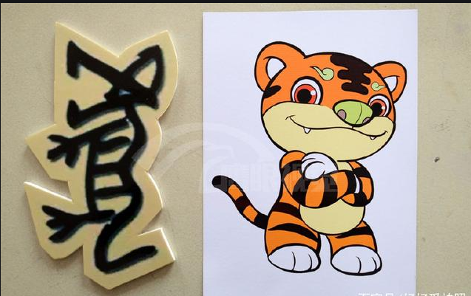
Encyclopedia about the tiger
The tiger’s etymology (词源)

Slide 11
Encyclopedia about the tiger
Felidae
（猫科）
South China Tiger
1. What kind of animal does a tiger belong to？
20-25 years
To help the tiger hide away
2. How long do tigers normally live？
3. What is unique to China in the tiger species？
4. What is the role of Tiger Stripes？
5. Everyone is afraid of the beast, but the beast
also has a fatal weakness. What is the tiger
most afraid of ？
Brown bears, rhinos, elephants

Slide 12
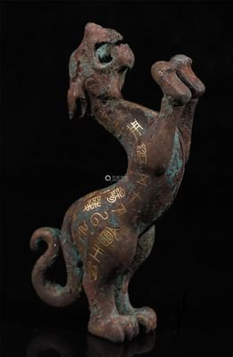
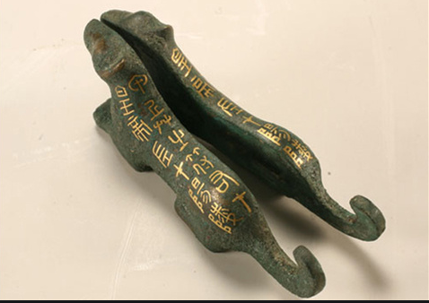
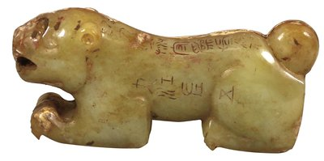
Historical tiger
Tiger Tally (虎符)
What is tiger tally？
The tiger tally first appeared in the Spring and Autumn Period and the Warring States Period. At that time, the copper tiger shape was used as the transfer certificate issued by the central government to local officials or garrison leaders, which was called the tiger tally. Inscriptions(铭文) are engraved on the back of the tiger tally. It is divided into two halves. The right half is stored in the imperial court, and the left half is sent to the generals or local governors of the unified troops. It is always dedicated(专门的，专用的) to one tally: one tally for one place. It is impossible to mobilize(调动) the troops of two places at the same time with one symbol.
战
国
立
式
虎
符
汉代玉虎符
秦
朝
虎
符

Slide 13
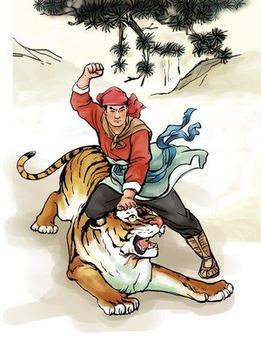
The Tiger of literature
Tell stories according to the pictures
On his way to visit his brother，Wusong passed Jingyanggang. 1 (drink) eighteen bowls of wine, he staggered to climb the hill. Then, he saw a sign 2 (post) on a tree, reading, “Travelers are advised not to climb over the mountain since tigers have killed some travelers. Don’t risk your life.” Wu Song reckoned that it must 3 (write) by the inn keeper at the foot of the mountain to scare travelers into his inn. Therefore, he ignored 4 .
Having drunk
posted
have been written
it

Slide 14
The Tiger of literature
Tell stories according to the pictures
He felt too drunk 5 (walk) on, so he decided to lie down on a stone. He was about to fall asleep 6 he felt a gust of wind whistling around him: A mammoth tiger was throwing itself at him. Wusong quickly dodged, hiding behind the tiger.The tiger roared 7 (loud), hitting Wusong with his tail. Wu Song jumped to dodge the attack. He lifted his cudgel to hit the tiger, but 8 (he) cudgel caught the branches of a tree and broke in two. The tiger launched another assault. Wu Song threw
9 his cudgel and jumped onto the back of the tiger. With his left hand, he grabbed the the head of the tiger, and used his other fist to hit the eyes, mouth, nose and ears of the tiger. Before long, the tiger bled all over and 10 (lie) on the ground, motionless.
The incident on Mount Jingyang made Wu Song famous far and wide.
to walk
when
loudly
his
away
lay

Slide 15
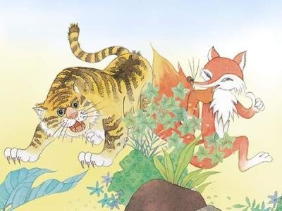
One day, a fox ran into a tiger, 1 was hunting in the forest. The tiger would like to eat it. 2 (face) the tiger’s big hungry mouth, the fox pretended to 3 (surprise), saying, “How dare you eat me? I’m much 4 (fierce) than you thought. I 5 (sent) by Heaven to rule 6 animals. Eating me, you will violate the command of Heaven. If you don’t believe me, just follow me 7 (see) whether the animals are afraid of me." The tiger only half believed what the fox said, and 8 (follow)it as it walked around the forest. Sure enough, the animals all ran away ___9___ seeing them. The tiger thought they were afraid of the fox, so he let it go. He didn’t realize that it was 10 (he) that the beasts were really afraid of.
This idiom means relying on another 's power to bully or frighten others.
中国民间主要供奉的五大财神，文财神：比干(东)、范蠡(南)；武财神:关公(西)、赵公明(北)；中斌财神：王亥(中)。
which
Facing
to brag and bully by assuming other people’s authority
be surprised
fiercer
was sent
the
to see
followed
on
him

Slide 16
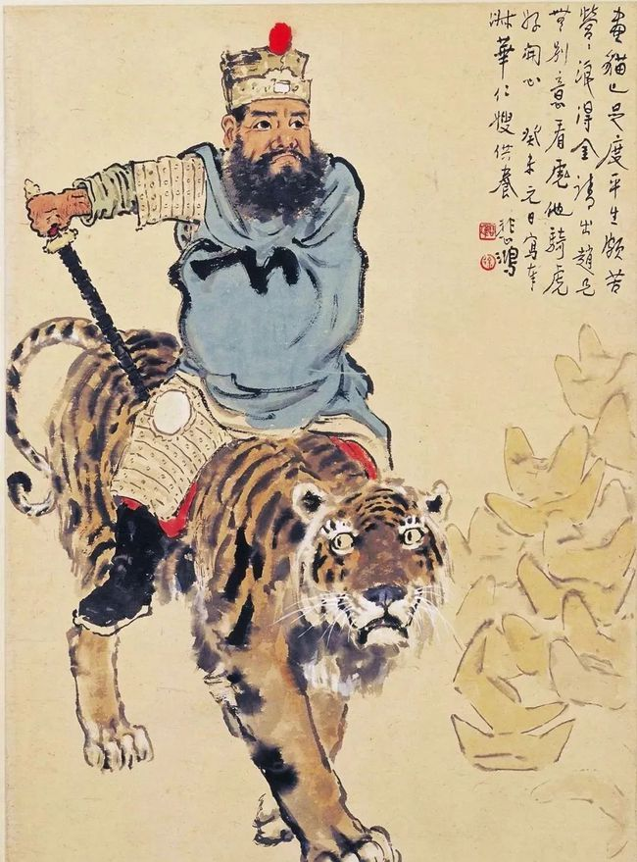
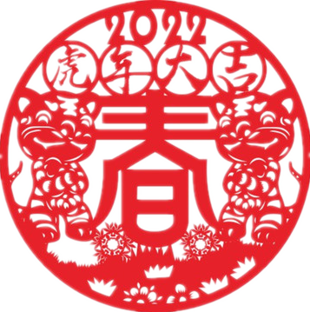
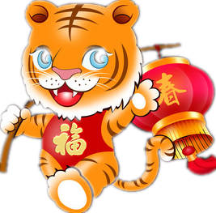
中国民间主要供奉的五大财神，文财神：比干(东)、范蠡(南)；武财神:关公(西)、赵公明(北)；中斌财神：王亥(中)。
The tiger in the folk art
The picture was drawn in 1943 by Xu Beihong when he was in 48. The painting is now in the The Palace Museum collection.
The “赵工”in the inscription（题词） refers to Zhao Gongming, who can attract wealth and treasure in folklore. This picture serves as a propitious(吉利的) painting.
徐悲鸿《骑虎财神像》

Slide 17
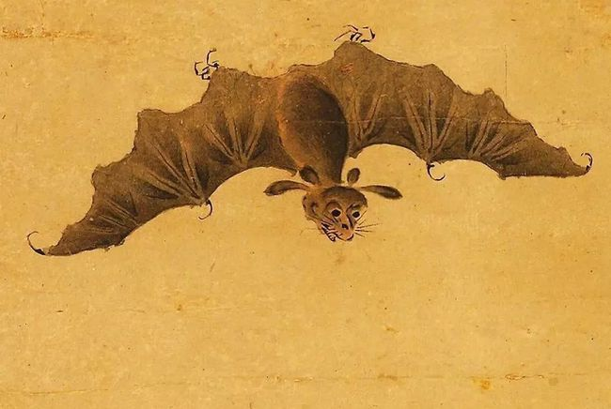
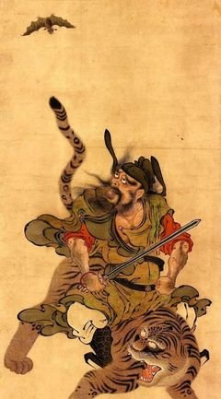
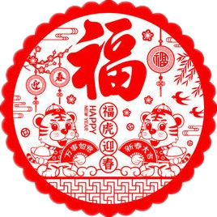
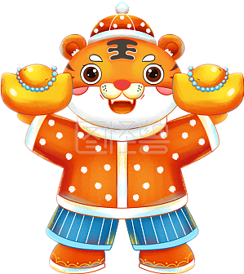
The tiger in the folk art
Zhong Kui is believed to be the god of everything, to be blessed, to be rich, so he is regarded as the "God of Wealth". His most basic duty is to "catch ghosts", so he is also called Wu Caishen.
This picture depicts Zhong Kui riding a tiger with a sword and looking back at bats. “蝠” and “福” have the same pronunciation. Therefore, bats are the same as blessings, which means auspicious and blessed.
明 佚名 钟馗骑虎图

Slide 18
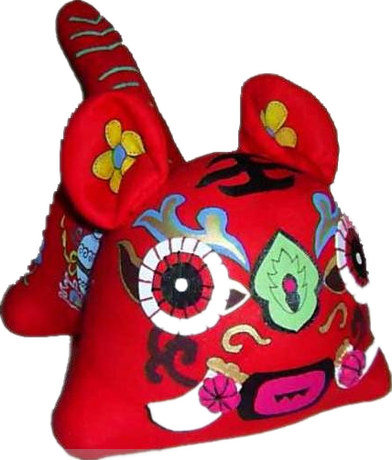
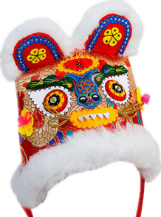
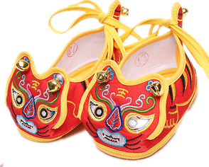
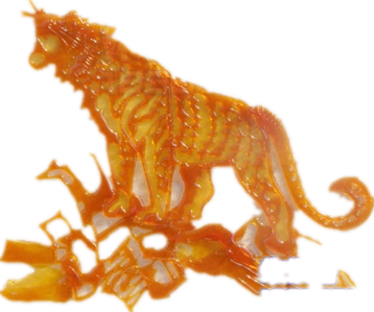
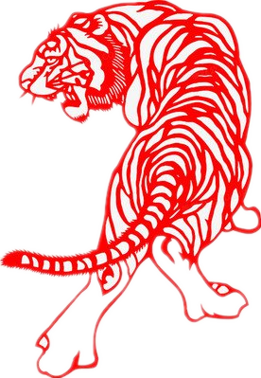
The tiger in the folkore

Slide 19
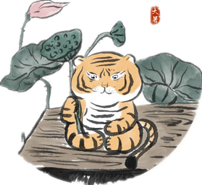
Auspicious idioms related to the tiger
Easy, tiger！
放轻松，慢慢来
放松点，你是在往墙上挂钟，不是把它推倒。
Easy, tiger！You are hanging the picture on the wall, not knocking it down.
have a tiger by the tail
骑虎难下；处境比预料的困难
当初，我不假思索地接下了这个任务，现在真是骑虎难下。
I accepted the task without much thought. Now I have a tiger by the tail.

Slide 20
Auspicious idioms related to the tiger
a tiger can’t change its stripes
本性难移
他说他再也不会迟到了，可他还是迟到了。真是本性难移。
He said he’d never come late again, but he did. I bet a tiger can’t change its stripes.
tiger father/mother
虎爸/虎妈
汤姆有个虎妈，每天逼他弹钢琴。他一点放松的时间都没有。
Tom has a tiger mother. He was forced to play piano every day. He never has any time to relax.

Slide 21
Auspicious idioms related to the tiger
虎年大吉
Best wishes for the Year of the Tiger.
talents in obscurity或a place where people with unusual abilities are to be found
卧虎藏龙
gobble up，gorge/ garbage something downwolf down/ to eat something very quickly or ravenously
狼吞虎咽
there will be no laggard among the children of a brave or talented man
虎父无犬子

Slide 22
Auspicious idioms related to the tiger
生龙活虎
work like a tiger
to be passionate about something at the beginning but soon lose their interest
虎头蛇尾
不入虎穴, 焉得虎子
How can you catch tiger cubs without entering the tiger's lair?
初生牛犊
不怕虎
A new-born calf has no fear of the tiger.

Slide 23
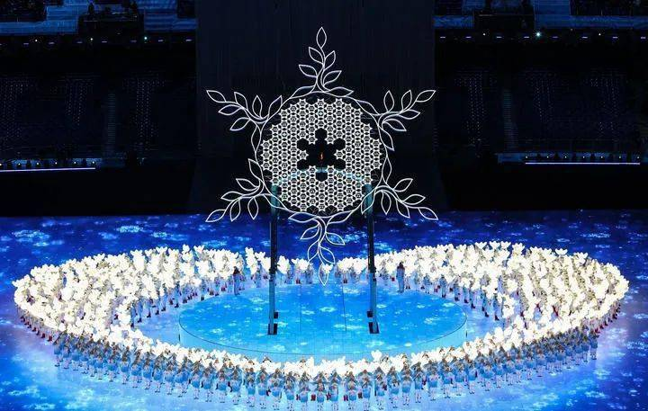
2
Beijing Winter Olympics

Slide 24
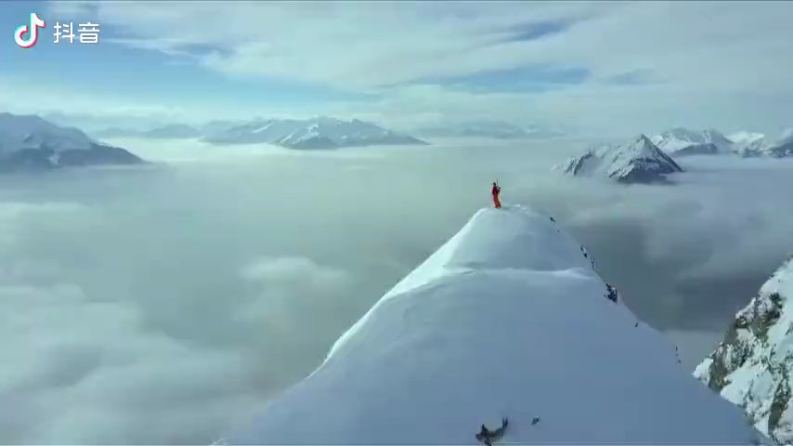
Enjoy a song： Together for a Shared Future

Slide 25

Encyclopedia of knowledge
1. The theme slogan of the Olympic Winter Games
Together for a Shared Future
2. The concept of China hosting the 2022 Beijing Winter Olympics
deliver an Olympics in 2022 with a "green, inclusive, open and clean" approach
3. The competition areas of Beijing 2022 Olympic Winter Games
Beijing Zhangjiakou Yanqing.

Slide 26

Blue: Europe
Black: Africa
Red: America
Yellow: Asia
Green: Australia
Five interlocking rings of the Olympic Winter Games
The designer?
Blue:
Black:
Red:
Yellow:
Green:
皮埃尔·德·顾拜旦
(Pierre de Coubertin)
Europe
Africa
The symbolism of the Olympic rings?
America
The Olympics five wreaths button up mutually, which not only represents the of the athletes of the five continents and the world under the Olympic Games, but also emphasizes that all athletes should meet in the stadium in a ________ sporting spirit.
reunion and friendship
Asia
Australia
fair and frank

Slide 27

The 2022 Olympic torch
Flying(飞扬)
What is the name of the Beijing 2022 Olympic torch?
Translate the following passage and keep them in mind.
As the torch turns, the whirling red line hidden in the crack seems to stretch endlessly, representing mankind's relentless pursuit of brightness, peace, excellence and the values promoted by the Olympic Movement.
双色火炬外形极具动感和活力，象征冰火相约，照亮冰雪，温暖世界。
红色线条随火炬转动，似无限延伸，表达了人类生生不息、向往光明与和平、追求卓越的期望和奥林匹克运动的力量。
Beaming with dynamism and vitality, the two-tone torch presents a metaphor of ice and fire, symbolizing how it will bring light and warmth to the winter sports gala.

Slide 28
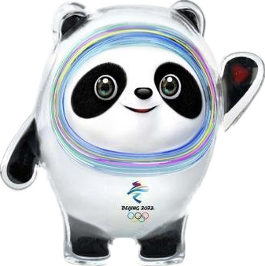
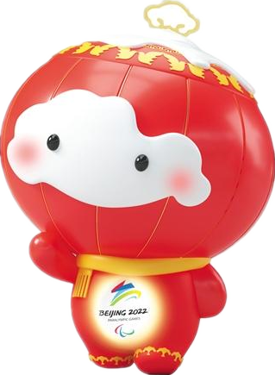
The mascot of the Beijing 2022 Olympic Winter Games
Why is the ice-glazed panda so popular?
Bing Dwen Dwen, based on a panda, 1 (select) from nearly 6,000 entries. It captures attention with its full-body "shell"
2 (make) out of ice. Cao Xue, 3 is the designer, said the inspiration came from 4 (tradition) Chinese snack "ice-sugar gourd," also known 5 tanghulu, while the shell also resembles a space suit – a nod to 6 (embrace) new technologies for a future of infinite possibilities. The team tried
7 (change) the image in the ice shell into various animals.
8 (eventual), China's national treasure panda is __9__
most beloved. Cao said, "Its ice shell is cold, but the image looks warm and 10 （love), I believe this kind of warmth can be something everybody feels."
was selected
made
who
traditional
Bing
Dwen Dwen
as
embracing
changing
Eventually
the
Xue
Rhon Rhon
lovely

Slide 29

Emblem of the Olympic Winter Games
The inspiration of the emblem design comes from the Chinese character for winter -- “冬”. A stylised, __1__ (calligraphy) rendition(描绘) of the Chinese character,
2 infuses Chinese culture with contemporary artistic elements, 3 (project) a new image of China in a new era, 4 (demonstrate) the country's commitment 5 a successful Winter 6 (Game). It also heralds 7 realisation of China's Winter Olympic Dream, 8 (name), to encourage more Chinese people 9 (take) part in winter sports, to build China into a sporting power, 10 to promote winter sports and the Olympic Movement around the world.
calligraphic
which
projects
demonstrating
to
Games
the
namely
to take
and
Winter Dream
冬梦

Slide 30
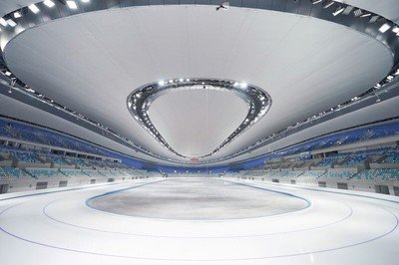
Green Olympic Games
To host a green Olympic Games, Beijing 2022 has not only made quality ice rinks 1 (suit) for respective sports in the competition venues, 2 has also stayed eco-friendly in ice-making.
Experts spent 18 months studying documents 3 ice-making from previous Olympic Winter Games and 4 (analyze) the pros and cons of every type of refrigerants. 5 (eventual), they were able to come up with 6 (good) solutions: Using carbon dioxide as 7 refrigerant can increase ice-making 8 (efficient) by 30 percent and save around two million kilowatts of electricity per year.
The choice 9 (applaud) by International Olympic Committee. They said the technology 10 (put) the importance of low Global Warming Potential refrigerants on the world stage.
suitable
but
on
analyzing
Eventually
better
a
efficiency
was applauded
has put

Slide 31
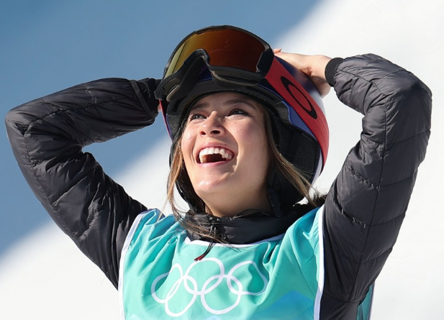
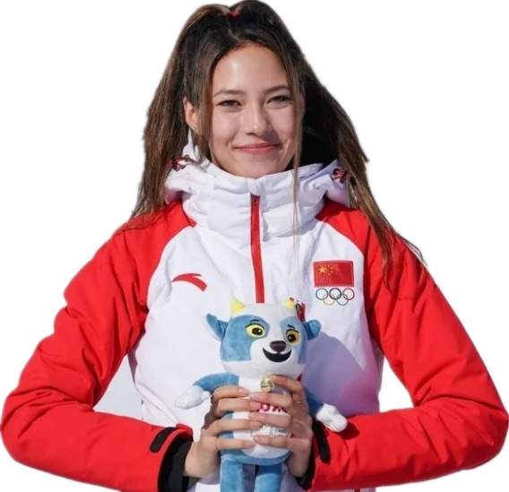
The icon---Eileen Gu
Readers: Gu Ailing an inspiration for us
She is a pretty multitalented girl in all aspects. Apart from the Olympic gold and medals in tournaments, she is also a fashion icon for top brands, speaks mandarin and English fluently, plays piano and is going to attend Stanford this fall with 1580/1600 SAT scores. She is truly inspiring as a talented teenager. (----Lisa)
Congratulations for the gold medal. Winter sports are not as popular in China as summer sports and few people are interested in them. But Ailing's flawless performance in the Winter Olympics has won the hearts of all the audience and will inspire young girls to participate in winter sports and achieve excellence. Well done!
(--Tony)

Slide 32
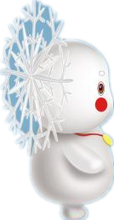
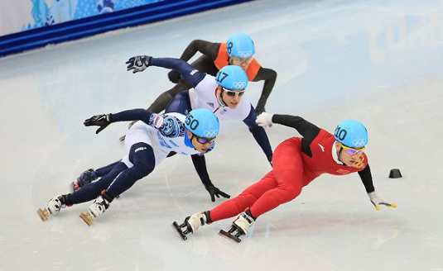
There are seven major events in the Games
Sports events
15 branches
高山滑雪 Alpine Skiing
自由式滑雪 Freestyle Skiing
单板滑雪 Snowboarding
跳台滑雪 Ski Jumping
越野滑雪 Cross-country Skiing
北欧两项（越野滑雪和跳台滑雪）Nordic Combined
短道速滑 Short Track Speed Skating
速度滑冰 Speed Skating
花样滑冰 Figure Skating
冰球 Ice Hockey
冰壶 Curling
雪车 Bobsleigh
钢架雪车 Skeleton
雪撬Luge
冬季两项（越野滑雪和步枪射击)Biathlon
Seven major events
滑雪:Skiing
滑冰：Skating
冰球：Ice Hockey
冰壶：Curling
雪车：Bobsleigh
雪橇：Luge
冬季两项：Biathlon

Slide 33
Hot words
绿色办奥、共享办奥、开放办奥、廉洁办奥
deliver an Olympics in 2022 with a "green, inclusive, open and clean" approach
冰雪运动 winter sports
奥林匹克精神 the Olympic spirit
全民健身运动 national fitness campaign
北京冬奥会中国首金China's first gold medal at Beijing 2022
单板滑雪坡面障碍技巧 Snowboard Slopestyle
大跳台 Big Air
奥运会吉祥物 Olympic mascots
奥运会会歌《奥林匹克圣歌》OlympicHymn/Anthem
主办城市host city
国际奥林匹克委员会 International Olympic Committee

Slide 34
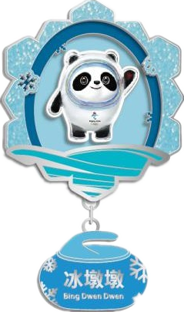
吉祥物 Mascot
冰墩墩 Bing Dwen Dwen
雪容融 Shuey Rhon Rhon
火炬传递 Torch Relay
奥林匹克圣火 Olympic flame
冰丝带 The Ice Ribbon
一起向未来 Together for a Shared Future
体育精神 Sportsmanship
业余爱好者 Amateur
运动员 Athlete
奥运场馆 Olympic venue
金牌 Gold medal
冰场 Ice rink
冰刀 Blades

Slide 35
Translate and recite
By preparing for and organizing the Winter Games, we have successfully engaged 300 million Chinese in sport on snow and ice. We have also promoted regional development, ecological conservation, green and innovative solutions and the betterment of people's lives in China, and created greater space for the development of winter sport worldwide.
——2月3日，习近平向国际奥委会第139次全会开幕式发表视频致辞
中国通过筹办冬奥会，成功带动3亿人参与冰雪运动，推动了区域发展、生态建设、绿色创新、人民生活改善，为全球冰雪运动发展开辟了更为广阔的空间。

Slide 36
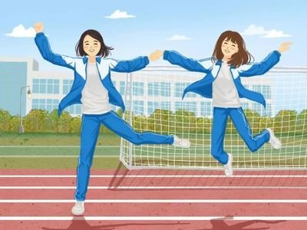
3
About students

Slide 37

Discuss
Stick to your guns and don’t stop until you get what you want
咬定青山不放松、不达目的不罢休
This Year of the Tiger is also an Olympic Year. Both the Year of the Tiger and the Olympic Year stand for ambition, courage and strength.
The tiger’s spirit
to be tenacious , hard-working, enterprising
顽强、拼搏、进取
The athletes’ spirit
Take the bull by the horns！
Overstep the Dream！
不畏艰难 超越梦想
Your spirit

Slide 38

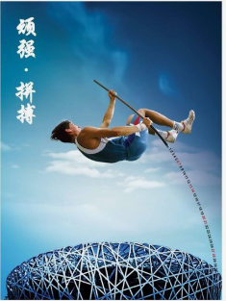
let’s end up with a song “Dream it Possible”

Slide 39

Best wishes for the Year of the Tiger!

