Slide 1

感恩遇见，相互成就，本课件资料仅供您个人参考、教学使用，严禁自行在网络传播，违者依知识产权法追究法律责任。
更多教学资源请关注
公众号：溯恩高中英语
知识产权声明

Slide 2
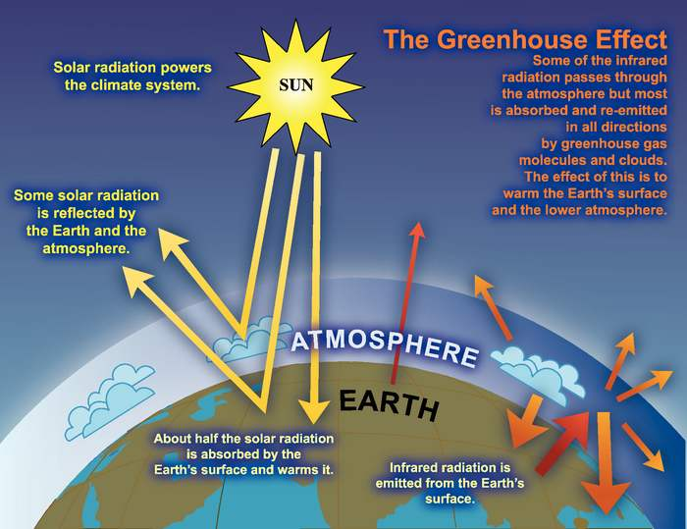
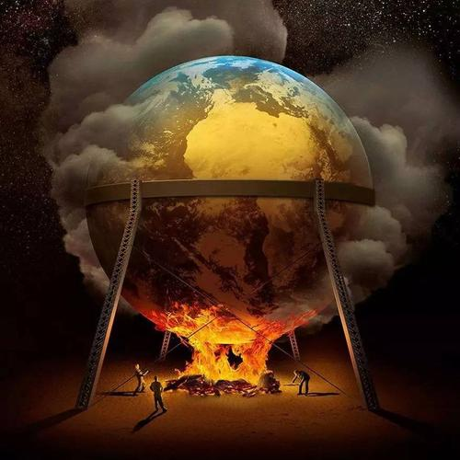
人教版 选择性必修三
Unit 3 Environmental Protection
—Reading and Thinking
Discuss climate change
杭州二中许丽君

Slide 3

To discuss climate change
To learn to identify the style of this text and infer the writer’s purpose
To learn to draw a diagram
To think about how we can do to deal with climate change

Slide 4
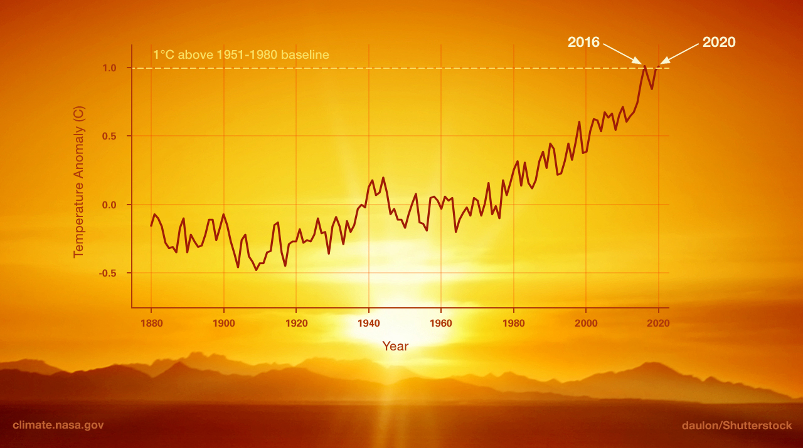
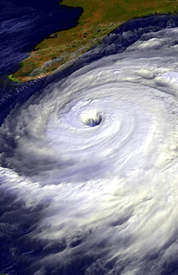
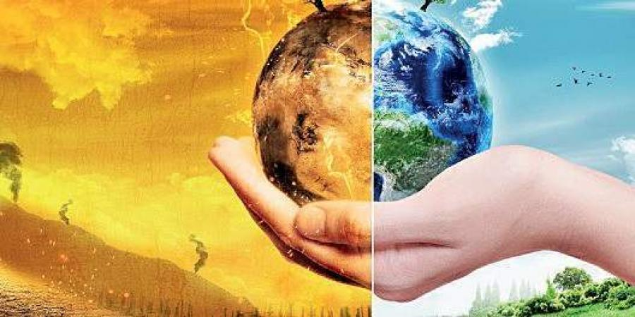
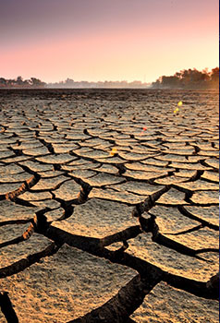
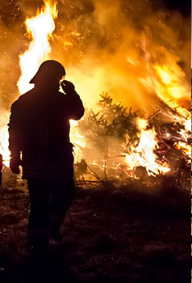
Lead in
Climate Change Requires the World’s Attention
？
What phenomena can you identify from these images?
What is the cause of these phenomena?

Slide 5
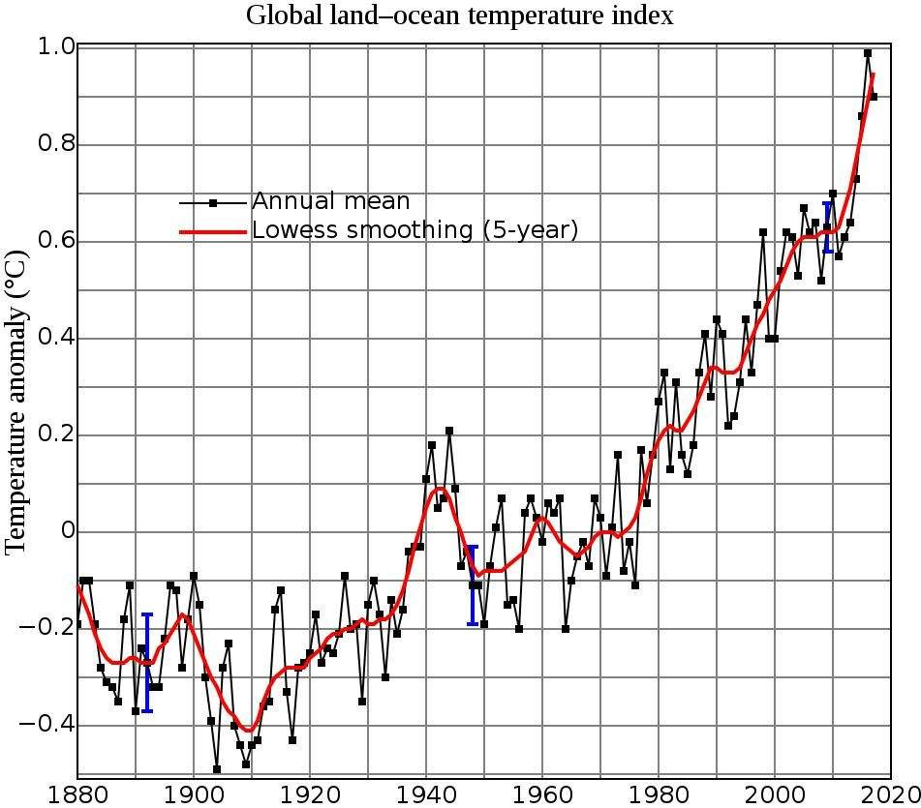
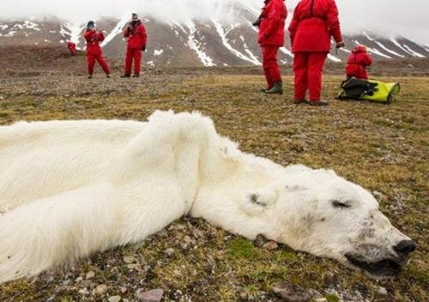
Lead in
1 Before you read, look at the graph and the picture below and discuss these questions in groups.
1 What is the graph about? What information you’ll get from it?
2 Have you ever seen the photo before? What might be the story behind it?
We can see the global surface temperature.
Yes, it may be about environment.

Slide 6
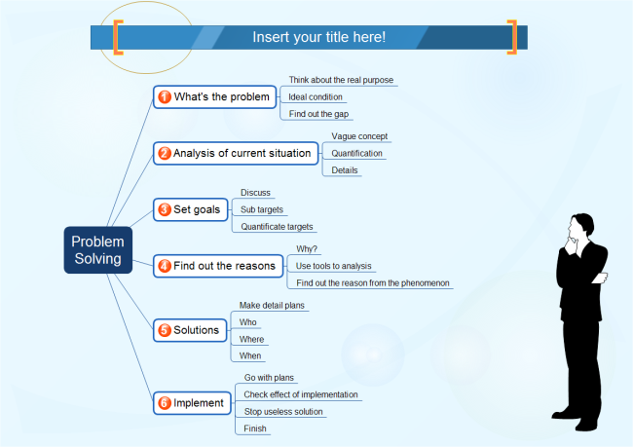
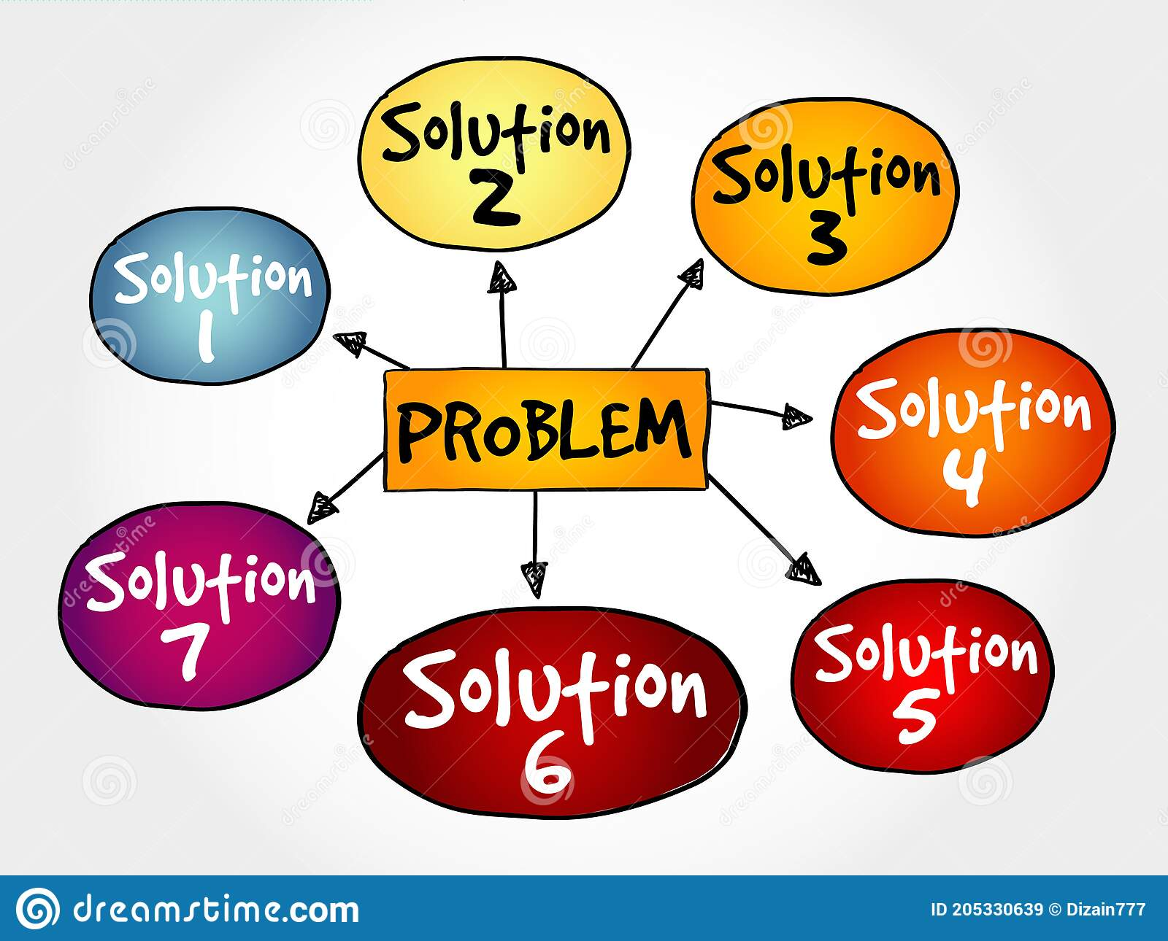
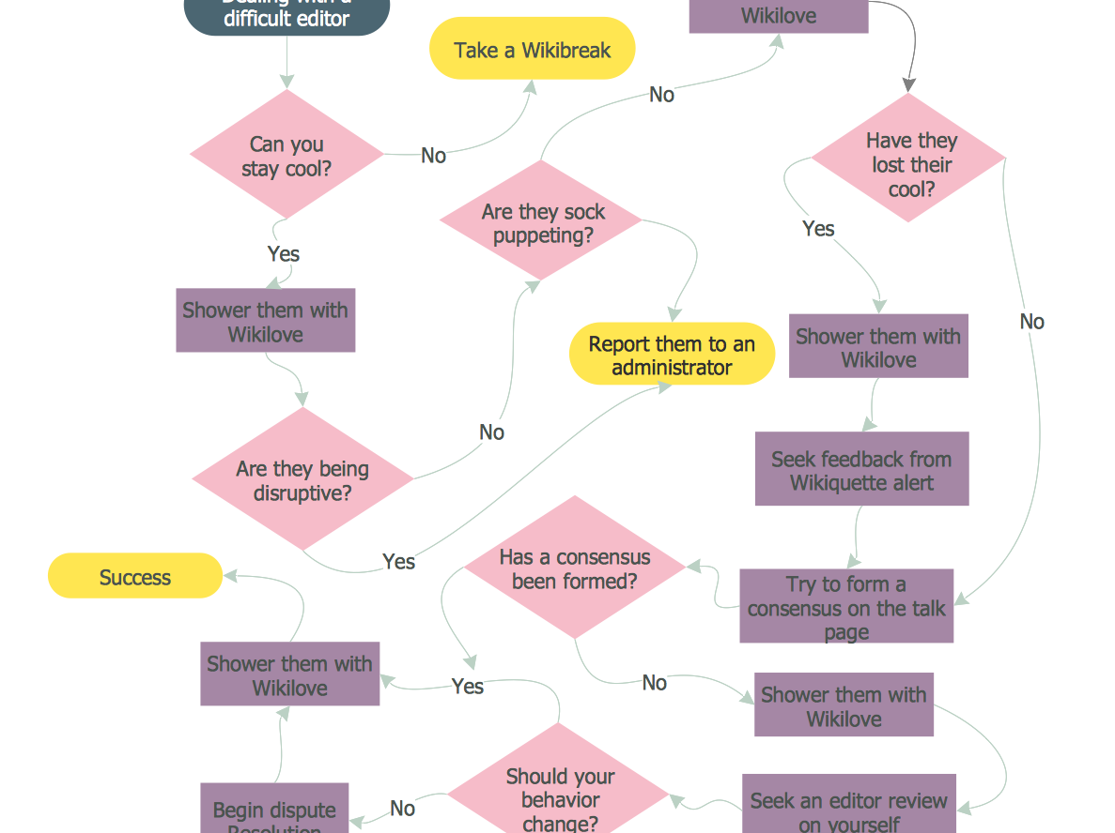
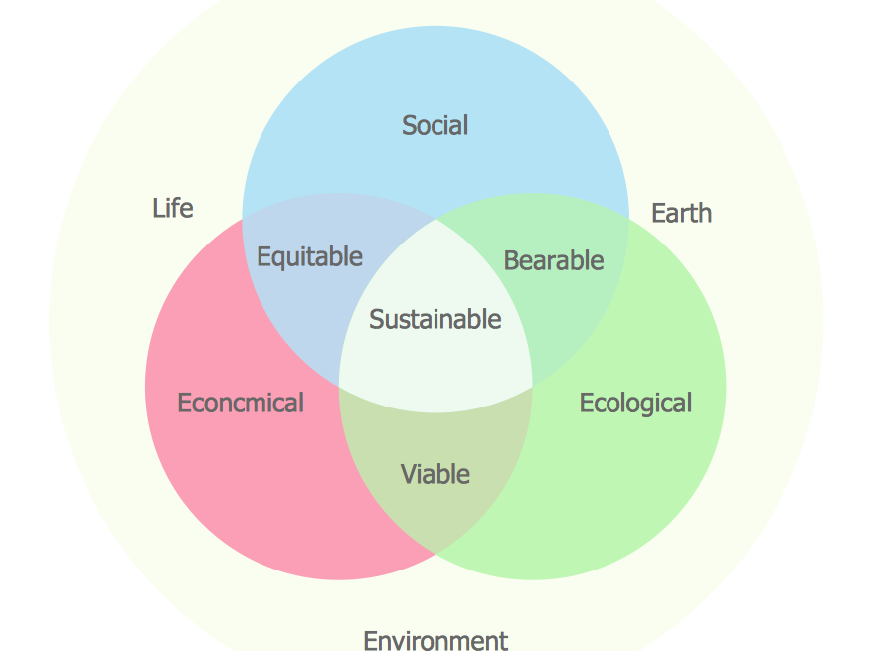
How to describe a process in a clearer way?
Preparation
You may use a diagram to show it!

Slide 7
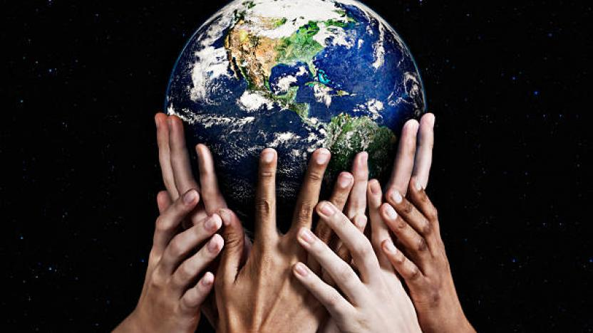
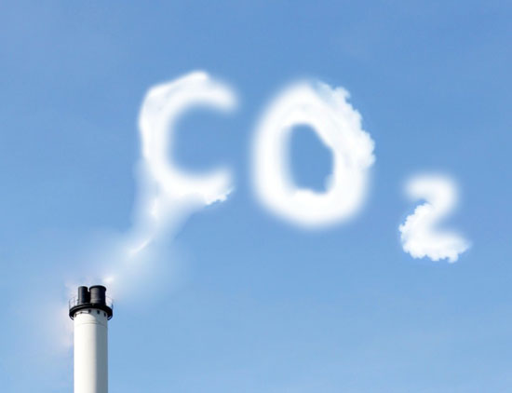
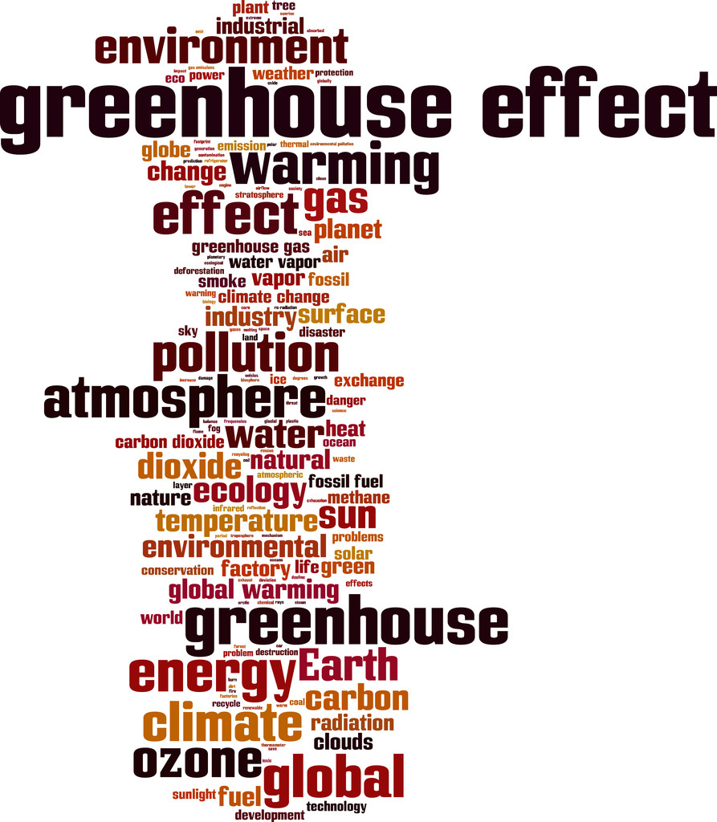
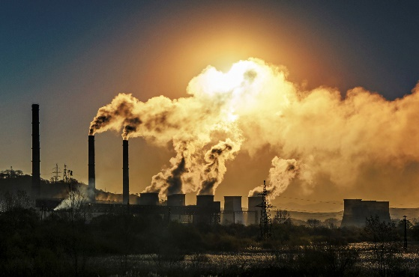
Reading
Climate change requires
the world’s attention

Slide 8
Reading
1.Read the passage and match the main idea with each paragraph.
Para.1 A. We need to do something to reduce greenhouse gas emissions.
Para.2 B. The rise in temperature has caused natural disasters.
Para.3 C. Earth is getting warmer and warmer.
Para.4 D. A dead polar bear was found，which alarmed some experts.
Para.5 E. Why is Earth getting warmer and warmer?

Slide 9
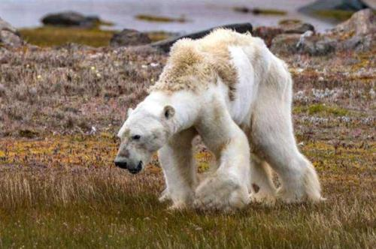
Reading
2. Read the text and answer the questions.
1. What happened to the polar bear in the photo? Why did the Writer write about it?
2. Why is the “natural” , greenhouse effect important and necessary?
3. What are the consequences of high greenhouse gas emissions?
4. Why did the author mention the climate scientists' warning?
5. What is the author’s purpose of writing this text?
They appear to starve and die. He wants us to protect our environment.
Without it, the earth can not sustain life.
It can lead to extreme weather and natural disasters
To prevent us from paying a higher price.
He wants us to protect our environment

Slide 10
Reading
the 1st and 2nd paragraph
Evidence of climate change
A graph showing rising global temperature
1
2
A warming ocean and atmosphere
along with melting ice and rising sea levels
3
Dead polar bear in Norway’s
Arctic island of Svalbard
Evidence

Slide 11
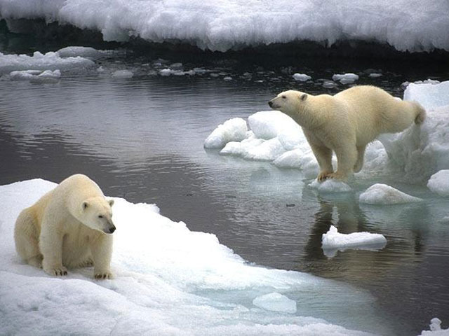
Reading
Read paragraph one, and fill in the blanks.
The ________ is getting warmer and warmer.
Evidence one:
_________________________________
Evidence two:
_________________________________
Evidence three:
_________________________________
Earth
a warming ocean and atmosphere
melting ice
rising sea levels

Slide 12
Reading
Paragraph 2 introduces an example of the increase in temperature that had an impact on Earth’s ecology. Read it and fill in the blanks.
Time | Where | What happened | How did it happen
2013
Norway’s Arctic island of Svalbard
A polar bear died of starvation.
The bear cannot hunt food because of low sea-ice levels.

Slide 13
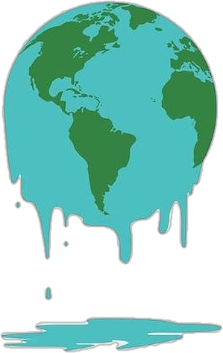


Reading
the 3rd paragraph
A key climate process called the "greenhouse effect"
natural
man-made
Definition
Definition
People produce huge amounts of extra greenhouse gases by burning fossil fuels.
Heat from the sun enters the atmosphere and warms Earth’s surface as short-wave radiation.
Greenhouse Effect
Function
A big problem
keeping Earth's climate warm and habitable
More heat energy is trapped in the atmosphere and causes Earth's surface temperature to rise quickly.

Slide 14
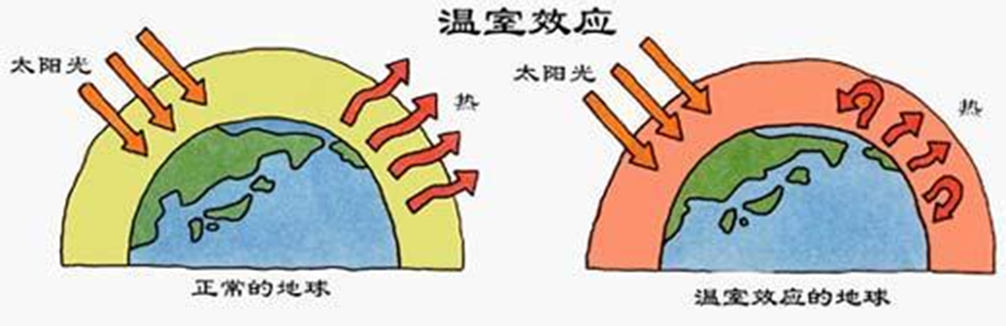
Reading
Read Paragraph 3, and figure out the reason why earth’s temperature rising.
“Natural” greenhouse effect
Trap heat from the sun to keep the Earth’s sustainable life.
Green-house effect
By burning fossil fuels, extra greenhouse gases cause Earth’s temperature to rise.
“man-made” greenhouse effect

Slide 15
Reading
the 4th paragraph
Negative effects of rise in global temperature
an increase in extreme weather and natural disasters worldwide,
causing serious damage and costing of human lives
1
2
This warming trend will probably continue.
3
Examples: News reports are frequently broadcast
about extreme rainstorms and heatwaves
causing deaths and economic losses.
Consequences

Slide 16
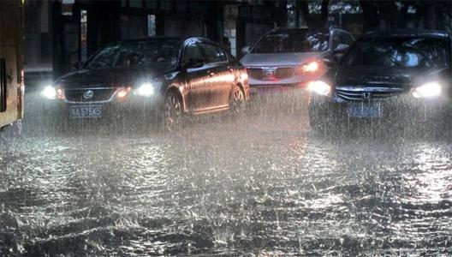
Reading
Summarize the main idea of paragraph 4, according to the diagram.
Temperature rising
Extreme weather & natural disaster
Serious damage & human lives
We should take appropriate actions at once.

Slide 17


Reading
the 5th paragraph
Solutions to the environmental problems
“Things sound pretty bad – what can we do to stop climate change?”
The attention and awareness of everyone
1
2
The government: making policies and
taking appropriate actions and measures
3
Individuals:
reduce our “carbon footprint”
Solutions

Slide 18
Discussion:
A: We shall do something about global warming.
suggestions
Turn electrical appliances off when not using them.
Put on more clothes, don’t turn up the heat.
Walk or ride a bike, don’t drive.
Recycle cans, bottles, plastic bags and newspapers.
Buy things made from recycled materials.
Buy products that use less energy.
Plant trees.
Talk with family and friends about global warming.

Slide 19
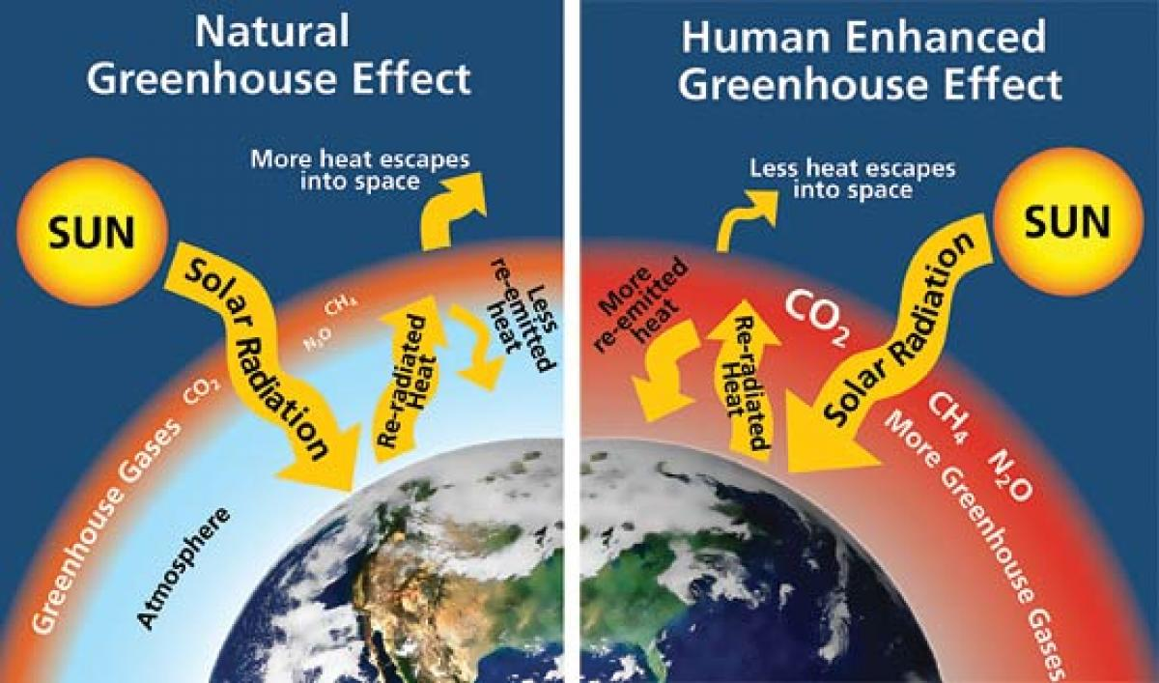
Exercise
Draw a diagram to show how the greenhouse effect works

Slide 20
Summary
Climate change: greenhouse effect
③
Individuals
Possible solutions
②
Government
Negative consequences
Extreme weather
Natural disasters
①
Evidence and definition
Natural /
Man-made

Slide 21
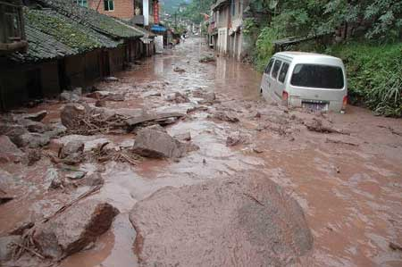
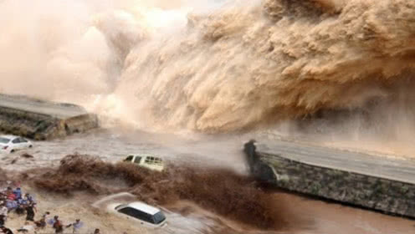
Discussion:
4. Discuss these questions in groups
1 What examples of extreme weather and disasters do you know? Can you make a list?
2 Do you think climate change is the result of human activity? Give your reasons.
3 Who do you think should take responsibility for dealing With climate change? What can we do?

Slide 22

1. Write a composition with the title : Global warming in my eyes
What is global warming
How does it come about
What harmful effects dose it cause
How to stop it
2.Read more information about environmental protection online, and then exchange information with their friends.

Slide 23
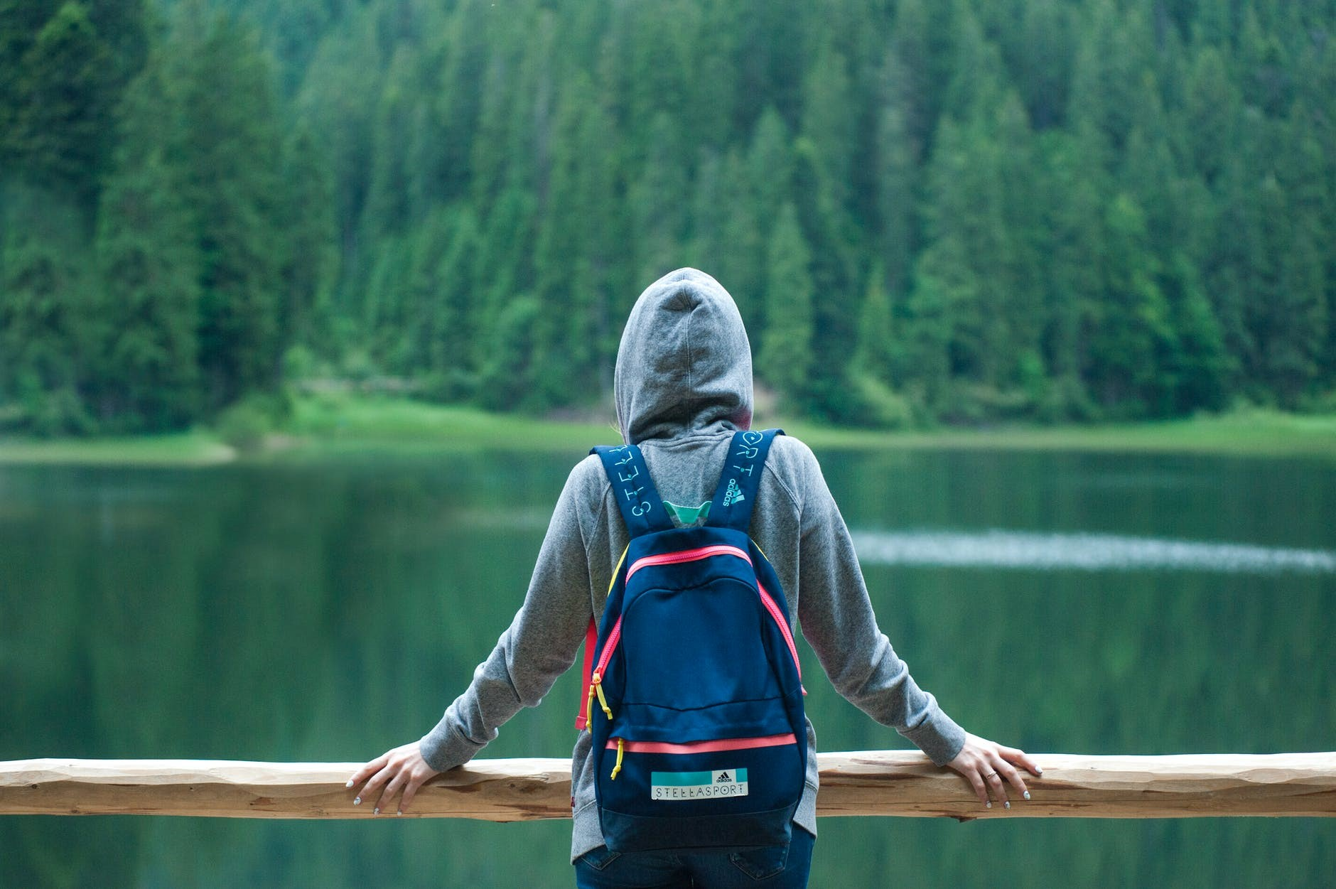
Thanks for your attention ！

