Slide 1

感恩遇见，相互成就，本课件资料仅供您个人参考、教学使用，严禁自行在网络传播，违者依知识产权法追究法律责任。
更多教学资源请关注
公众号：溯恩高中英语
知识产权声明

Slide 2
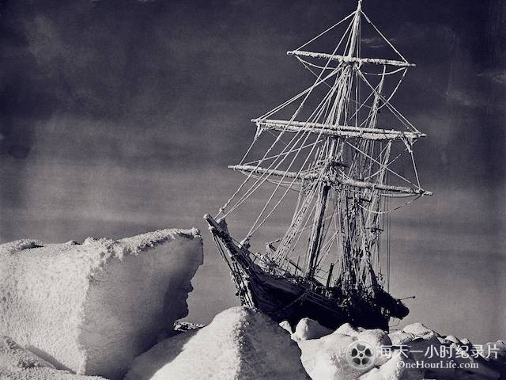
UNIT 4
ADVERSITY AND COURAGE
a difficult or unpleasant situation
Great works are performed not by strength, but perseverance. —— Samuel Johnson
continued effort and determination
锲而不舍，金石可镂

Slide 3

Lead in
What does the video talk about?

Slide 4
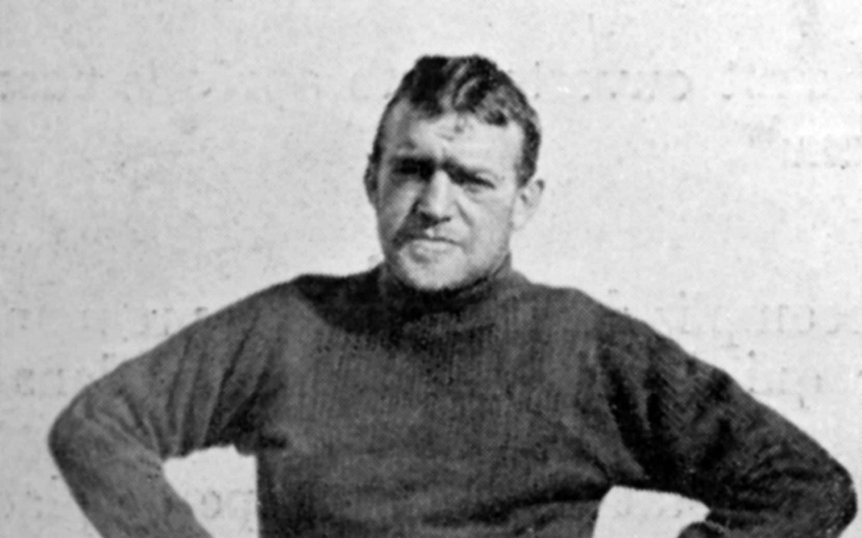
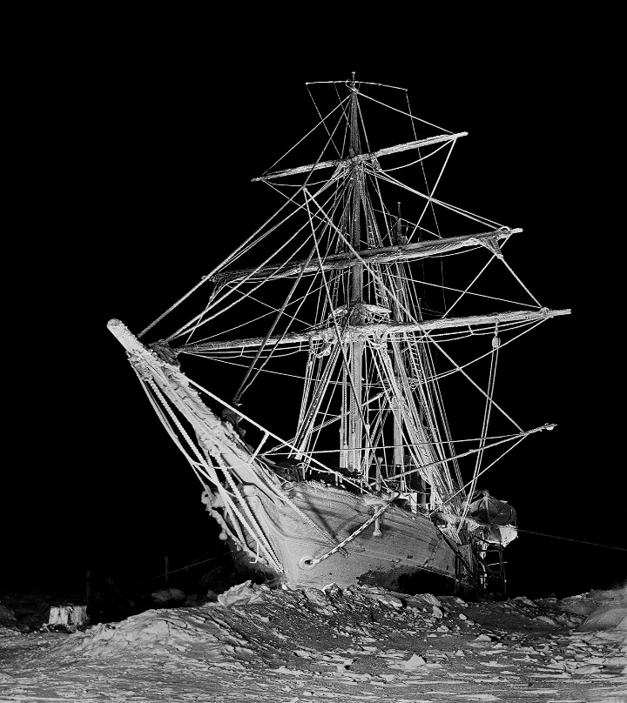
Lead in
was an Irish-born British explorer who was one of the giants of Antarctic exploration in the Heroic Age in the early years of the 20th Century.
Sir Ernest Henry Shackleton
the Endurance 坚忍号

Slide 5
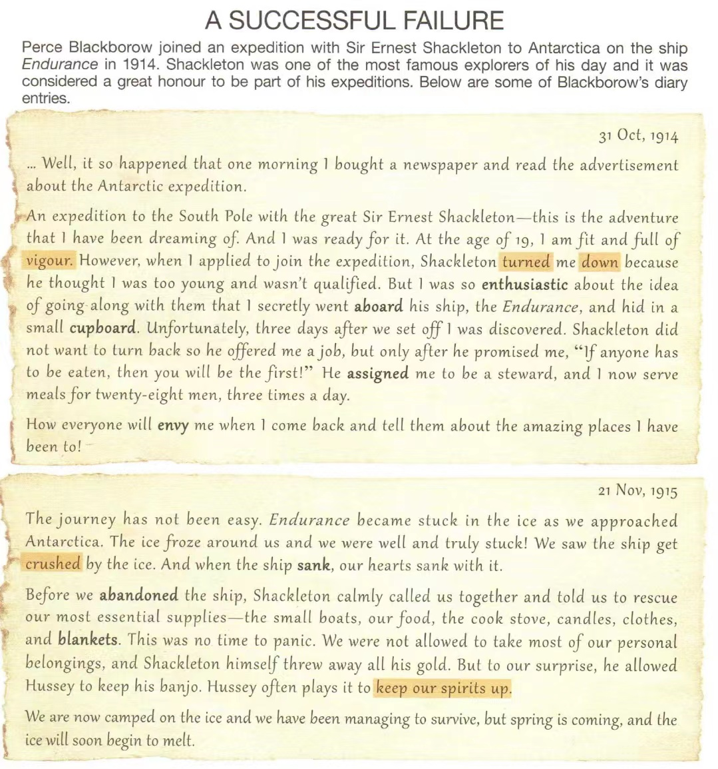
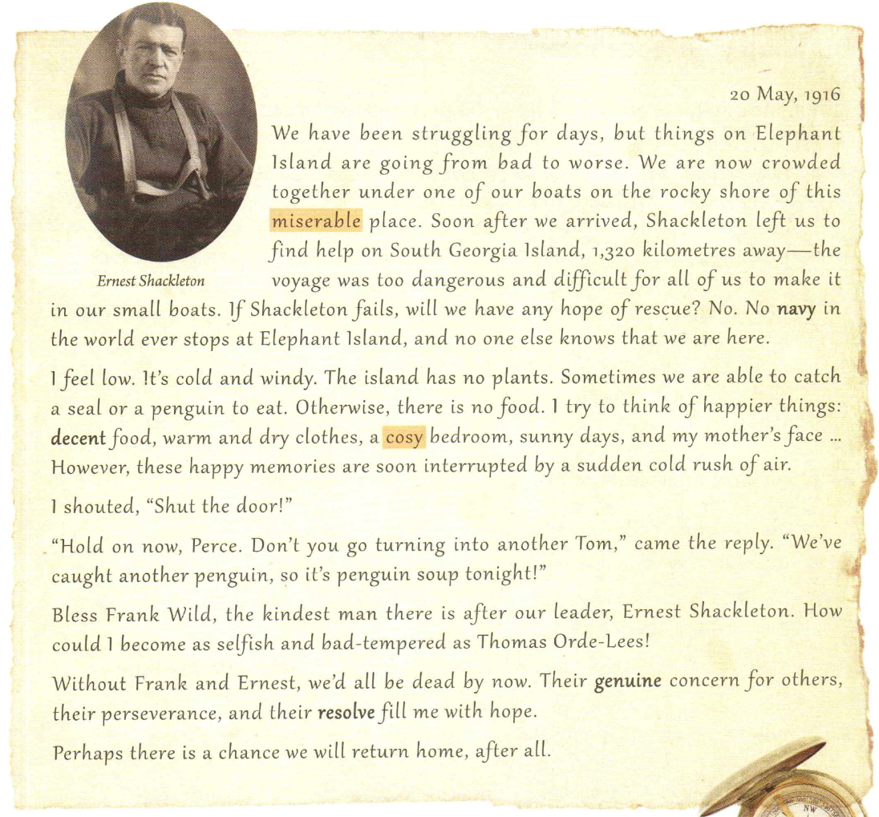
Prediction
What do you expect to read from the text?
What the content of the text is?
What is the text type of the passage?
1
2
3
4
What is the language features of diary entries?
Person:
Tense:
the first
past
Notes:
此处可以总结下日记这种语篇的写作特点和语言特点

Slide 6
Skimming
Match the main idea of each part.
Part 1
A brief introduction of the expedition’s background
Part 2
Three diaries of Perce Blackborow

Slide 7
Scanning
Find the basic information about the expedition
Time
Destination
Leader
The author’s name
The ship
1914.10.31- 1915.11.21-1916.5.20
To Antarctica
Sir Ernest Shackleton
Perce Blackborow
Endurance

Slide 8
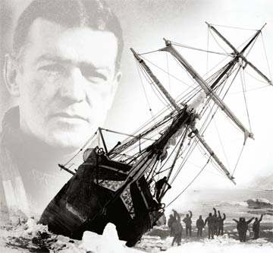
Scanning
What is the main idea of this passage ?
It is some of the diary entries of Perce Blackborow, in which he wrote that he joined an expedition of Antarctica on the ship Endurance with Sir Ernest Shackleton and how they managed to survive after Edurance was stuck in the ice.

Slide 9
Detailed reading
Diary 1
energy
reject or refuse something or someone

Slide 10
Detailed reading
Diary 1
Blackborow joined the Endurance
The first diary is about how _____________________________
_____________________________________________________
expedition/ became a crew member on Endurance.
How did Blackborow come to join the expedition?
1. At the very beginning, Perce Blackborow _________________________
_______________________________
2. Then, he ________________________. However, he ________________
______________________________________________
3. Later he ______________________, but _________________________
4. Finally he __________________________________________________
bought a newspaper and read
the advertisement about the expedition.
applied to join the expedition was turned down by Shackleton because he was too young and not qualified.
secretly went aboard he was discovered.
was assigned to be a steward and serve meals for the crew.

Slide 11
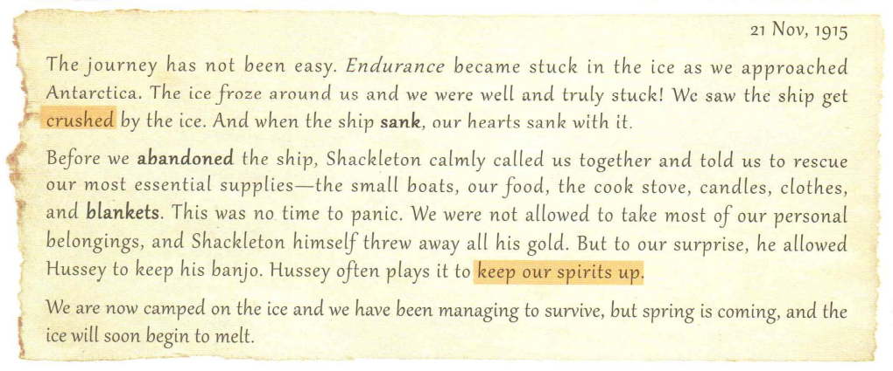
Detailed reading
Diary 2
to stay positive usually in a bad situation
destroyed and broken into pieces

Slide 12
Detailed reading
Diary 2
The second diary is about how _______________________
________________________
Shackleton and his crew
abandoned the ship Endurance.
Why did Shackleton throw away all his gold?
2. Why did he allow Hussey to keep his banjo?
Because gold was not the most essential supply when the ship was crushed.
Because he wanted to keep their spirits up.

Slide 13
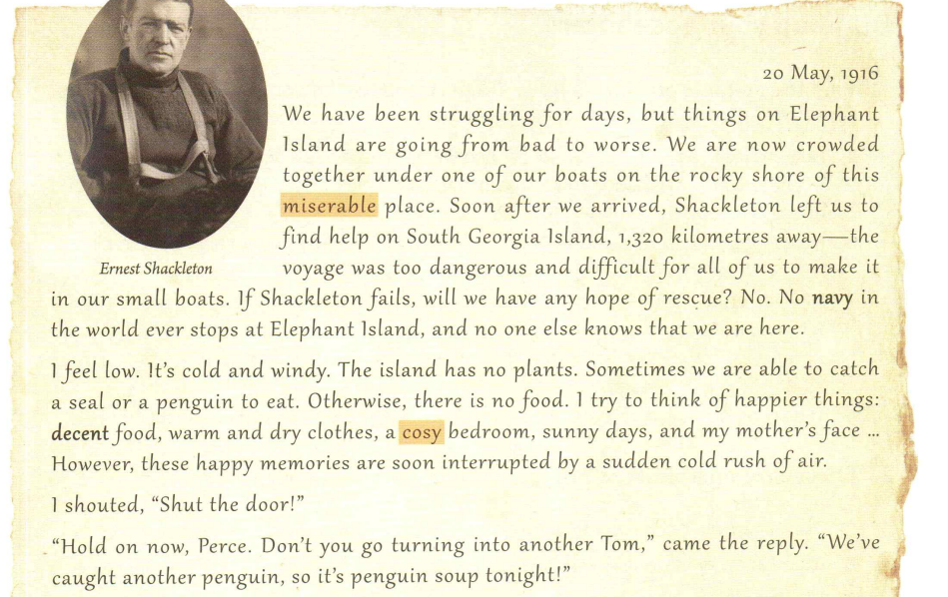
Detailed reading
Diary 3
rough and difficult
comfortable

Slide 14
Detailed reading
Diary 3
Shackleton and his crew abandoned the ship Endurance.
The third diary is about how _______________________
___________________________
What did Shackleton do to make sure all crew members could survive?
2. What did the crew members have to do to make sure they could survive?
Shackleton made sure they survived by leaving with a few men to find help. It was too dangerous for all the men to go.
They had to collect essential supplies and camp on the ice.

Slide 15
Summary
A Successful Failure
applied for the ad but failed
secretly got aboard
hard time waiting for the rescue
on the ice.
the ship got stuck and sank.

Slide 16






Detailed reading
1. How did Blackborow’s feelings change during the expedition?
feelings
excited, happy, full of expectations
enthusiastic, determined
satisfied, excited, hopeful
1. After he read the advertisement about the expedition.
2. After his application was turned down
3. After he became a steward on board
Occasions
Notes:
Detail reading部分老师可以设计一些小组合作学习活动，和前面的基本信息考察比较起来，难度在加大，学习方式也可由自主学习转向合作式学习

Slide 17
Detailed reading
feelings
a little calm, no time to panic
worried, uncertain
worried, terrified, panic
5. Before the crew settled on Elephant Island
4. When Endurance sank
6. After Shackleton left to find help
Occasions

Slide 18
Detailed reading
feelings
grateful
angry, impatient
low, despaired
7. When he thought about the living conditions on the island
8. When his happy memories were interrupted by cold air
9. After Frank Wild replied to him

Slide 19

Detailed reading
1. How did Blackborow’s feelings about being on the expedition change as the day passed?
feelings
excited
enthusiastic
satisfied
grateful
a little calm
angry
worried
despaired
panic
1 2 3 4 5 6 7 8 9
Occasions

Slide 20

Detailed reading
1. How did Blackborow’s feelings about being on the expedition change as the day passed?
Blackborow’s feeling about being on the expedition changed from enthusiasm at the start to fear and extreme discomfort after Endurance got stuck. After the captain went for help, he gradually became hopeful again.

Slide 21
Group discussion
What do we look for as evidence to infer traits and emotions?
Infer character traits and emotions
To infer means to guess something based on the evidence. when inferring character traits and emotions in a story, you need to look at the characters’ words and actions. What do these tell us about their personal qualities and feelings.

Slide 22
Group discussion
2.What personal qualities did Shackleton, Wild, and Blackborow, Thomas Orde-Lees exhibit? Find examples from the text to support your answers.
Shackleton:
example: he calmly called us together and told us to rescue our most essential supplies…
Soon after we arrived, Shackleton left us to find help…
great kindness, leadership, calmness, selfish,
courage and perseverance.

Slide 23
Group discussion
2.What personal qualities did Shackleton, Wild, and Blackborow, Thomas Orde-Lees exhibit? Find examples from the text to support your answers.
Shackleton showed kindness when he allowed Blackborow to stay on the ship and gave him a job.
He showed calmness when he asked the crew to collect essentials.
He showed he was not selfish when he left his gold behind, but showed he was thinking of others’ feelings by allowing Hussey to keep his banjo.
He showed great bravery by setting off to find help for the rest of the crew.

Slide 24
Group discussion
kind, considerate.
Wild:
example: Bless Frank Wild, the kindest man there is after our leader, …
Wild was shown to be kind when he tried to lift Blackborow’s spirits.

Slide 25
Group discussion
Blackborow:
example: I shouted, “ shut the door!”
Thomas Orde-Lees: selfish.
How could I become as selfish and bad-tempered as Thomas Orde-Lees!
risky, adventurous, energetic, emotional, a bit selfish, and bad-tempered.
Blackborow was enthusiastic at first, making sure he got on the expedition. Although he felt low later, he tried to think about better things, showing again his positive character.

Slide 26
Further thinking
1
What does A Successful Failure mean? Or what does the success/ failure mean in the title?
The success means it is considered a great honour to be part of Shackleton’s expeditions. The failure means Blackborow and other explorers got stuck.
It is a special figure of speech, called Oxymoron 矛盾修辞法. An oxymoron is a term in which two contradictory terms are combined.
2
Do you think it is a good title? Why (not)?
3
What do you think would happen next?
Notes:
题2对学生来讲，理解标题既是对文本的回顾，也是对下文的预测，不妨先讨论其意义，再指出所用的文学修辞手法，甚至可以结合本单元主题，探究如何体现作者和其同伴们的冒险精神。 另外，两个问题可以换个位置。

Slide 27
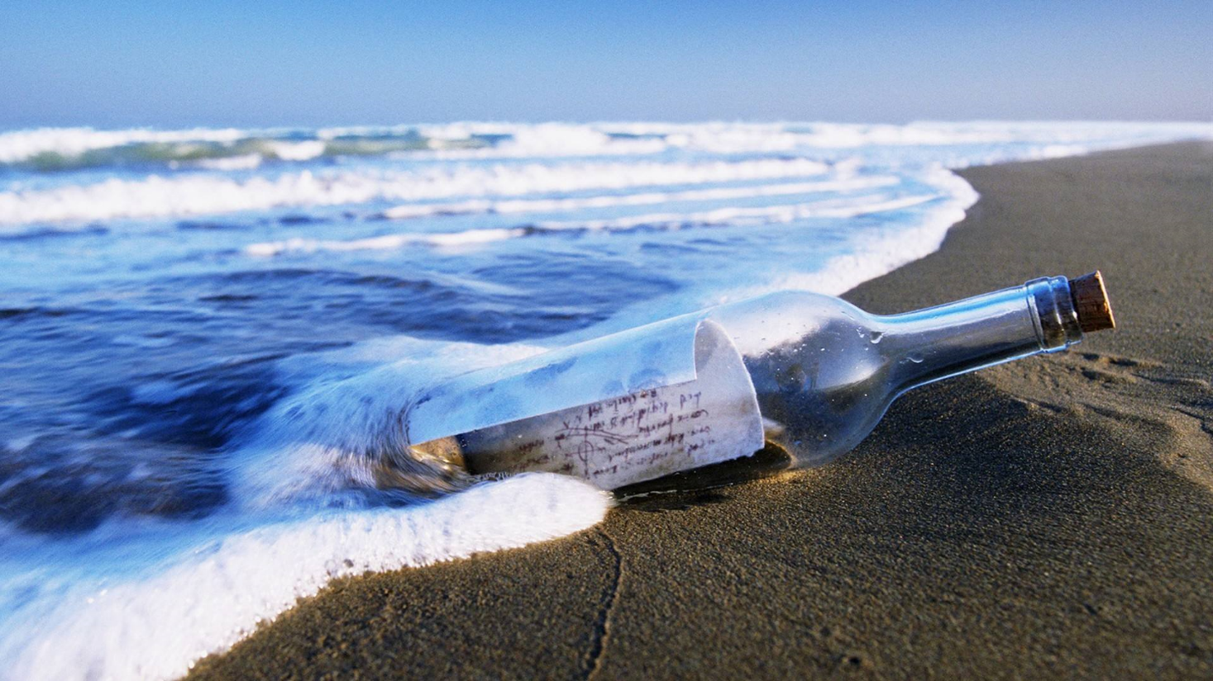
Homework
Suppose you are Perce Blackborow. Please write Diary 4 after you were rescued and survived.
Notes:
写作任务不妨改为获救后的dairy 4?语言风格和主题意义可以延续前文。

Slide 28
THANK YOU

