Slide 1

感恩遇见，相互成就，本课件资料仅供您个人参考、教学使用，严禁自行在网络传播，违者依知识产权法追究法律责任。
更多教学资源请关注
公众号：溯恩高中英语
知识产权声明

Slide 2





选择性必修Book3 Unit 5 Poems
Period 3 : Using Language
---Listening and speaking
杭州市临平区杭州二中树兰高级中学 郭合英

Slide 3
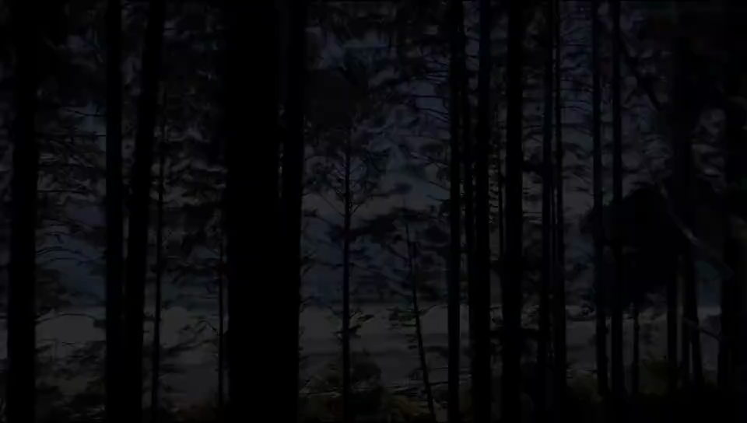
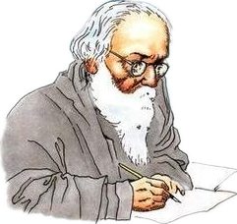



Enjoy an English poem written by Tagore
The most distant way in the world
经典
名言
世界上最远的距离
不是生与死的距离
而是我站在你面前
你却不知道我爱你

Slide 4
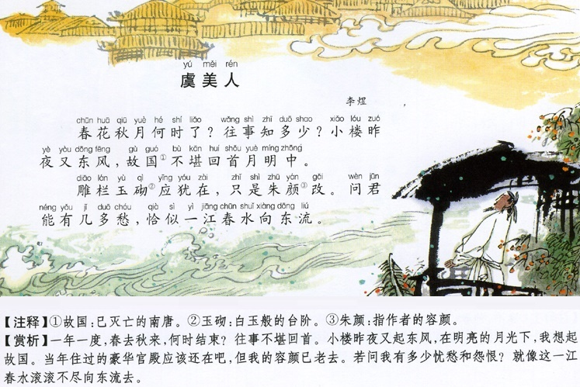


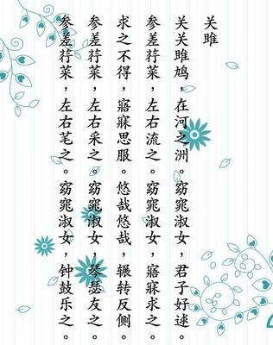
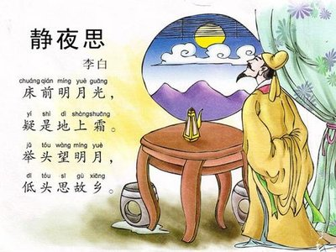
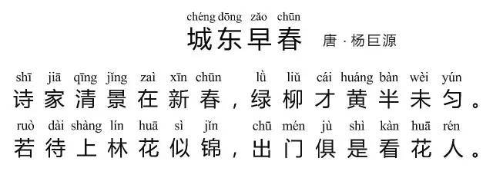
Activity 1 Pre-listening: Discussion
1. Have you ever written a poem before? If so, what did you write about?
2. What might inspire you to write poems?
experience something when at work/study, such as success, failure,
promotion, competition ……
experience different feelings in life,such as joy, sadness, exitement, fear ……
The reasons for writing poems
experience something in love: fall in love with, be broken-hearted in love or carry a torch for sb. ……
convey some feelings through poems
such as miss, homesickness……
experience something unusual in life, such as travelling, working, friendship……

Slide 5

Activity 2 While-listening: part 1
You are going to listen to a conversation between a teacher and her students about a poetry contest. Listen to part 1 and answer the questions.
Listening instruction:
Based on the following questions, guess what the topic is about?
Questions | Keys
1. When is the deadline for the poetry contest?
2. What does Nora mean by saying that she needs time to polish her writing?
3. Why doesn’t Pitt want to enter a poem?
4. What does George plan to do?
The deadline for the poetry contest is 24 June.
Nora means it's not finished, and she needs some time to change it and make it better.
Pitt doesn't want to enter a poem contest because he can't think of anything to write about.
George plans to write his poem on the weekend but only if he feels inspired.

Slide 6
Activity 3 While-listening: part 2
Listening instruction:
You should focus your attention on the verbs.
how
inspire
Listen to part 2 and find out the students will themselves to write poetry.
Questions | Keys
George
Nora
Pitt
George plans to go for a hike in the countryside and sit quietly somewhere so he will notice a lot more to inspire interesting thoughts and words
Nora writes best when surrounded by familiar things and will try George's method too.
Pitt listens to music while working and writing poetry.

Slide 7


Activity 4 While-listening: Praising and encouraging
To finish Exercise 4 on Page 54 : Listen and tick the expressions you hear
Teamwork: Now I will give you several minutes to make up short stories with the phrases that are not used in the dialogue.
Praising and encouraging
A possible answer
That's a good idea. | I like that idea.
That's a good effort. | You are doing well.
What a great idea! | Your ideas sound very encouraging to me.
Keep up the good work. | Do your best.
I think that's a fantastic idea. | You know what? That's a good idea.
Come on, you can do it. | Give it your best shot.
A: The weather reporter says that it will be fine tommorrow. Shall
we go climbing together?
B: I like that idea. But I will compete in an English poetry in several
days, and I would like to stay at home, practising it.
A: If so, I will keep you company.
B: Your ideas sound very encouraging to me.

Slide 8
Generalize listening skills
Two elements of hearing
1. Build up vocabulary. Increase your vocabulary to avoid
confusing yourself with some words you don’t know. For
example “Don't have a cow, it's no big deal.”
Don't have a cow = Don't make a fuss.
2. Master pronounce correctly. Listening can not be heard
word by word, but to master the correct pronunciation skills,
such as linking, weak reading and so on. For example: Check
it out!
[tʃekɪ daʊt] not [tʃek] [it] [aut]

Slide 9
Generalize listening skills
Two ways of hearing
1. Extensive listening. Listen to your favorite or interesting
materials, such as songs, movies, news and podcast, which
makes your ears soak in it for a long time, helping to create
linguistic environment.
Extensive listening is amied to develop language intuition.
2. Intensive listening. It means choosing a material to listen
from A to Z carefully and seriously and write some key details.
If necessary, each word. You can listen over and over again
until you fully understand its meaning.
Practise listening over again until you fully understood.

Slide 10
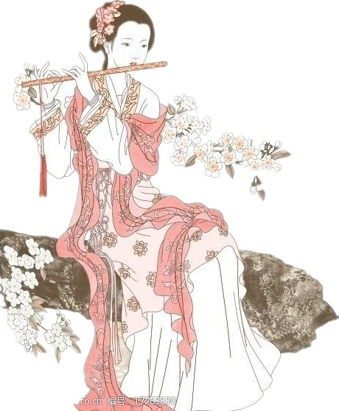
Activity 5 Post-listening : Discussion
Discuss the following questions.
1. What kind of poem are you going to write?
2. What are the topics you would love to write about?
A. Haiku B. List poem C. Nursery rhymes
D. Cinquain E.Sonnet F. Tang poem
A. Nostalgia poetry(怀旧诗)
B. Object-chanting poetry（咏物诗）
C. Landscape and pastoral poetry(山水田园诗)
D. War poetry
E. Travel poetry
F. Boudoir poetry (闺怨诗)
G. Farewell poetry

Slide 11
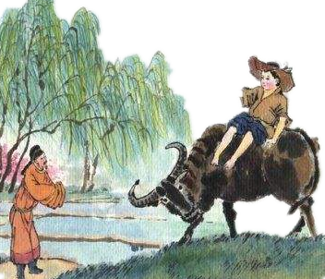

Activity 5 Post-listening : Discussion
3. How will you inspire yourself to write the poem?
Go back to listening-2, and let’s see it was what that inspired them to create poetry.
come across some beautiful things
listen to music
enjoy the sun in the morning
go for a hike in the countryside
George plans to and
somewhere so he will to inspire interesting thoughts and words
sit quietly
notice a lot more
hike in the countryside
inspiration
sit quietly on the bench
Nora writes best when and will
too.
surrounded by familiar things
try George's method
climb to the top of the mountain
watch a film
come across some old friends/lovers
listens to music
Pitt while working and writing poetry.

Slide 12

Activity 5 Post-listening : Discussion
4. Will you use rhyming words in your poem? Why?
Let’s talk about the functions of rhyming words!
1. To endow a verse with Musical Beauty.
2. The position of rhyming words is regular, which
makes the verse full of Rhythm.
3.To make the verse catchy (朗朗上口的) to read.
4. Though writing poems is difficult, the rhyming words
bring it a point of entry.

Slide 13



Activity 6 Pre-reading : Pronunciation
Pay attention to the reading skills

Slide 14
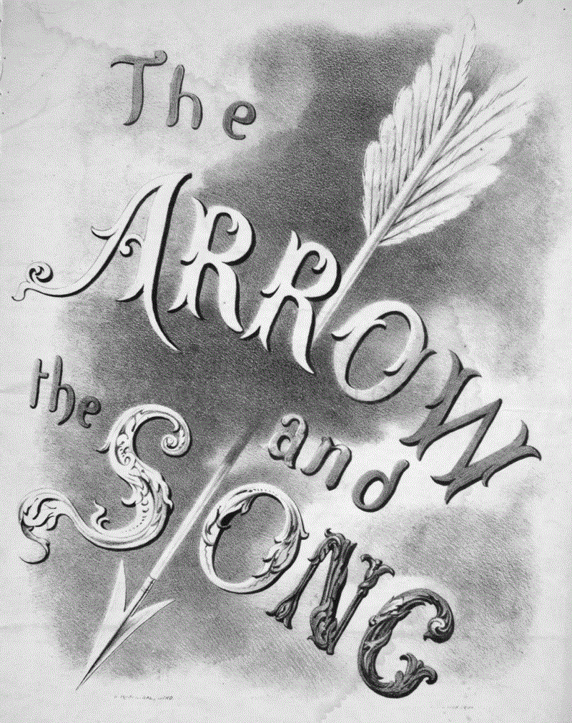


1. Read and understand the poem
The Arrow And The Song
I shot an arrow in the air,
It fell to earth, I knew not where;
For so swiftly it flew, the sight
Could not follow it in its flight.
I breathed a song into the air,
It fell to earth, I knew not where;
For who has sight so keen and strong,
That it can follow the flight of song?
Long, long afterwards, in an oak
I found the arrow still unbroke;
And the song, from beginning to end,
I found again in the heart of a friend.
Translate the poem
1. In the first verse, the poet presents the image of the arrow，which expresses a underlying feeling of
because the eyes can not catch the arrow.
A. happiness B. frustration
C. anger D. relief
1. What is the topic of the poem?
3. In the third verse, the song that the author hums at will unexpectedly still remains , making the poem remove the feeling of frustration off his heart. At the same time, the theme of the poem stand vividly revealed on the paper (跃然之上).
A. in the air
B. in an oak
C. in the flight
D. in a friend’s heart
我向空中射了一箭，
它已落到地面，我不知道其去向；
因它飞得如此地快速,
视力无法跟得上它的飞驰。
我向空中轻歌一曲，
它已落地而停，我不知其去向；
谁有这么敏锐的视力，
能跟得上歌声的飞驰？
很久，很久以后，在一棵橡树上，
我发现它依然完好无损；
而这首歌，从头到尾，
我发现又深印在一位友人的心上。
A. Love B. Friendship
C. kinship D. Leadship
2. In the poem, the author uses two
vivid images : and ,
to sing the Eternity of friendship.
A. archery and singing
B. air and earth
C. oak and song
D. arrow and heart
2. In the second verse, the poet replace the arrow with the song to present the image again, which made the underlying feeling of sadness further because, compared with the arrow, the eyes can not even seize the singing.
A. decrease B. die
C. strengthen D. disappear
3. What’s the rhetoric in this poem？
“Song” is the vehicle of “Friendship”
“Arrow”is the vehicle of “Song”
Metaphor (暗喻、隐喻)

Slide 15
2. Underline the rhyming words and the rhythm of the poems
THE ARROW AND THE SONG
I shot an arrow into the air,
It fell to earth, I knew no where;
For, so swiftly it flew, the sight
Could not follow it in its flight.
I breathed a song into the air,
It fell to earth, I knew no where;
For who has sight so keen and strong,
That it can follow the flight of song?
Long, long afterwards, in an oak
I found the arrow, still unbroke;
And the song, from beginning to end,
I found again in the heart of a friend.
H. W. Longfellow
[eə]
[əʊk]
[weə]
[ʌn'brəʊk]
[saɪ]
[end]
[flaɪt]
[frend]
[eə]
[weə]
To sum up the rhythm of poetry：
[strɒŋ]
aabb; aacc; ddee
[sɒŋ]

Slide 16


3. Listen and imitate the poem
The Arrow And The Song
I shot an arrow in the air,
It fell to earth, I knew not where;
For so swiftly it flew, the sight
Could not follow it in its flight.
I breathed a song into the air,
It fell to earth, I knew not where;
For who has sight so keen and strong,
That it can follow the flight of song?
Long, long afterwards, in an oak
I found the arrow still unbroke;
And the song, from beginning to end,
I found again in the heart of a friend.

Slide 17
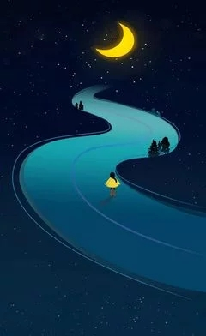
4. Read and understand the poem
Translate the poem
NIGHT
The sun descending in the west,
The evening star does shine;
The birds are silent in their nest,
And I must seek for mine.
The moon, like a flower,
In heaven's high bower,
With silent delight,
Sits and smiles on the night.
Farewell, green fields and happy groves,
Where flocks have took delight.
Where lambs have nibbled, silent moves
The feet of angels bright;
Unseen, they pour blessing,
And joy without ceasing,
On each bud and blossom,
And each sleeping bosom.
William Blake
夜
太阳沉落在西方，
晚星的光芒四射，
鸟儿在巢里无声响，
我也要寻觅我的巢，
月亮像一朵花，
在天庭中高挂；
沉默的愉快逍遥，
坐着对夜晚微笑。
再见，绿色的田野，欢腾的小树林，
在那里羊群多么开心；
在那里小羊把青草啃，
天使的脚步如此轻盈；
他们暗中洒下祝福，
不停地给予欢欣鼓舞，
给每一朵花每一颗蓓蕾，
每一颗心正在安睡。

Slide 18
5. Underline the rhyming words and the rhythm of the poems
NIGHT
The sun descending in the west,
The evening star does shine;
The birds are silent in their nest,
And I must seek for mine.
The moon, like a flower,
In heaven's high bower,
With silent delight,
Sits and smiles on the night.
Farewell, green fields and happy groves,
Where flocks have took delight.
Where lambs have nibbled, silent moves
The feet of angels bright;
Unseen, they pour blessing,
And joy without ceasing,
On each bud and blossom,
And each sleeping bosom.
William Blake
[west]
[ɡrəʊvz]
[ʃaɪn]
[dɪˈlaɪt]
[nest]
[muːvz]
[braɪt]
[maɪn]
[ˈflaʊə]
[ˈblesɪŋ]
[ˈbaʊə]
['siːsɪŋ]
[dɪˈlaɪt]
[ˈblɒsəm]
[ˈbʊzəm]
[naɪt]
To sum up the rhythm of poetry： abab; ccdd

Slide 19

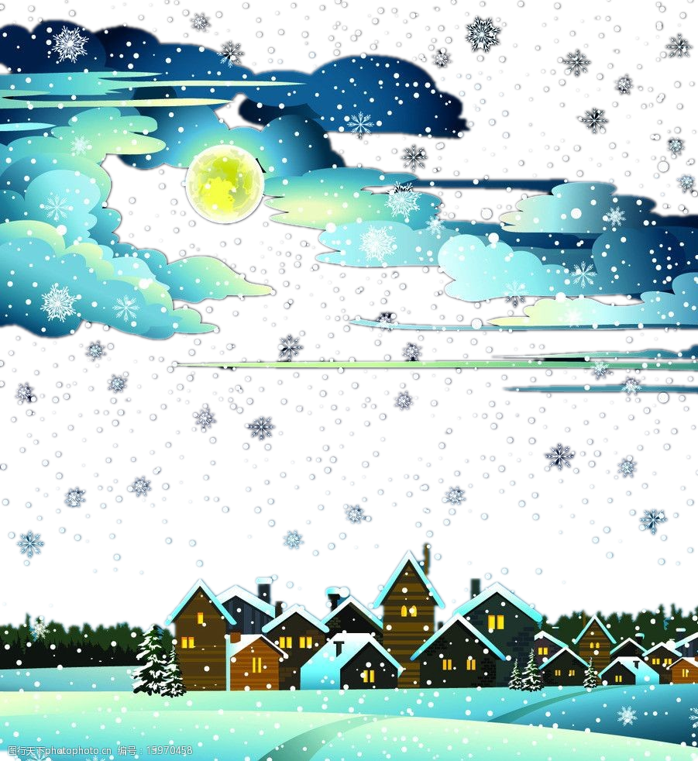
6. Listen and imitate the poem
NIGHT
The sun descending in the west,
The evening star does shine;
The birds are silent in their nest,
And I must seek for mine.
The moon, like a flower,
In heaven's high bower,
With silent delight,
Sits and smiles on the night.
Farewell, green fields and happy groves,
Where flocks have took delight.
Where lambs have nibbled, silent moves
The feet of angels bright;
Unseen, they pour blessing,
And joy without ceasing,
On each bud and blossom,
And each sleeping bosom.
William Blake
夜
太阳沉落在西方，
晚星的光芒四射，
鸟儿在巢里无声响，
我也要寻觅我的巢，
月亮像一朵花，
在天庭中高挂；
沉默的愉快逍遥，
坐着对夜晚微笑。
再见，绿色的田野，欢腾的小树林，
在那里羊群多么开心；
在那里小羊把青草啃，
天使的脚步如此轻盈；
他们暗中洒下祝福，
不停地给予欢欣鼓舞，
给每一朵花每一颗蓓蕾，
每一颗心正在安睡。

Slide 20
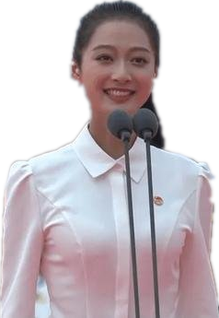

Activity 7. A reading contest
Listen and imitate the author's reading style of “ Alice in Wonderland ”.
Choose one student with the title “ The best reader”.
冯琳
董卿

Slide 21

