Slide 1

感恩遇见，相互成就，本课件资料仅供您个人参考、教学使用，严禁自行在网络传播，违者依知识产权法追究法律责任。
更多教学资源请关注
公众号：溯恩高中英语
知识产权声明

Slide 2





选择性必修Book3 Unit 5 Poems
Period 4 : Using Language
----Reading for writing
杭州市临平区杭州二中树兰高级中学 郭合英

Slide 3




1. To understand English poetry
Contents
2. To taste English poetry
3. To write English poetry

Slide 4


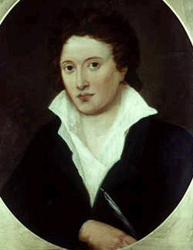


Lead in : Enjoy a poem
诗为何物
作者：埃莉诺·法杰恩（英国）
翻译：岩子（德国）
什么是诗歌?
有谁知道呢?
并不是一朵玫瑰,
但却比玫瑰更芬芳；
不是天空,
但却比天空更明亮；
不是飞鸟,
但却比飞鸟更易逝；
不是海洋,
但却比海洋更喧嚣；
不是我自己,
但却造就了我.
看一看,听一听,
去感受那散文中所没有的,
诗为何物？
有谁知道?
What Is Poetry?
by Eleanor Farjeon
What is poetry?who knows?
Not a rose,but the scent of the rose;
Not the sky,but the light in the sky;
Not the fly,but the gleam of the fly;
Not the sea,but the sound of the sea;
Not myself,but what makes me
See,hear,and feel something that prose
Cannot:and what is it,who knows?
A famous English poet Shelley said, “Poetry is the record of the best and happiest moments of the happiest and best minds.”

Slide 5
Activity1:Discuss the essence of poetry
The beauty of morning, silent bare,
Ships, towers, domes, theatres, and temples lie,
Open unto the fields, and to the sky,
All bright and glittering in the smokeless air.
交韵
Sunset and evening star,
And one clear call for me!
And may there be no moaning of the bar,
When I put out to sea.
同韵
The woods are lovely, dark and deep,
But I have promises to keep,
And miles to go before I sleep,
下面节诗中/i/及/iη/重复照应，使诗歌呈现出一派欢乐祥和的气氛。
Spring, the sweet spring, is the year’s pleasant king;
Then blooms each thing, then maids dance in a ring,
Cold doth not sting, the pretty birds do sing:
头韵
The fair breeze blew, the white foam flew;
The furrow followed free,
We were the first that ever burst into that silent sea.
--- S. T. Colerigy: The Rime of teh Ancient Mariner
I shot an arrow into the air,
It fell to earth, I knew not where;
For, so swiftly it flew, the sight
Could not follow it in its flight.
Rhyming words
联韵（随韵）
It is the most common and important form of rhyme.
Tone？
抱韵
imagery
The words are in the middle or at the end of lines that repeat the last stressed vowel sounds. Sometimes they are spelt differently, but sound the same. E.g. moon, June, cartoon.
subject
tone
Tone: a quality in a writer’s voice or writing showing his feeling or thinking.
Rhetorical devices？
Rhetorical devices: repetition, figurative language,simile, metaphor, ……
联韵（随韵）：即第一、二行同韵，第三、四行同韵。
属于aabb型。
The essence
of poetry
Imagery？
rhythm and sounds
length of lines
交韵：即第一、三行同韵，第二、四行同韵，属于abab型。
Imagery: Imagery is the language that appeals to one of the five senses. Poets try to make readers see, hear, smell, taste and feel what they are describing.
抱韵：即第一、四行同韵，第二、三行同韵，属于abba型。
Six main types
同韵：在同一诗节里，只有一种韵.
rhetorical devices
feelings and emotions
内韵：指词与词之间元音的重复形成的内部押韵。
头韵：是指一行（节）诗中几个词开头的辅音相同，形成
押韵。

Slide 6

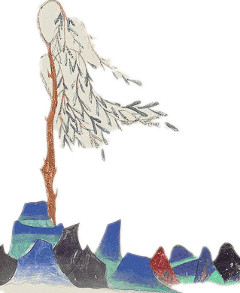
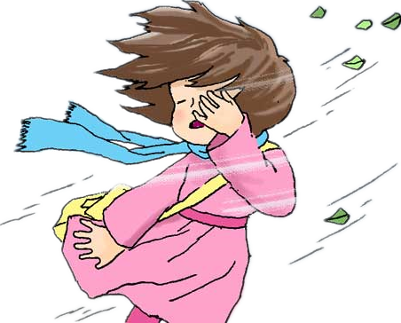
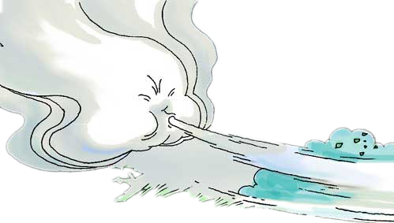
Pre-reading Guess a riddle
Let’s enjoy a poem: WIND ON THE HILL
No one can tell me,
Nobody knows,
Where the wind comes from,
Where the wind goes.
It's flying from somewhere
As fast as it can,
I couldn't keep up with it,
Not if I ran.
But if I stopped holding
The string of my kite,
It would blow with the wind
For a day and a night.
wind
And then when I found it,
Wherever it blew,
I should know that the wind
Had been going there too.
So then I could tell them
Where the wind goes…
But where the wind comes from
Nobody knows.
It has no shape.
It has no colour.
It has no smell,
And you cannot catch it.
You can hear it,
But you cannot see it.
What is it?

Slide 7




Step2 While-teaching
2. Choose the best answer.
Activity2: Read and understand
1. Translate the poem
But if I stopped holding
The string of my kite,
It would blow with the wind
For a day and a night.
And then when I found it,
Wherever it blew,
I should know that the wind
Had been going there too.
So then I could tell them
Where the wind goes…
But where the wind comes from
Nobody knows.
可要是我站着抓住
风筝的一根线，
风筝就随风飘去，
飘一天，飘一晚。
无论风筝飘哪儿，
只要我找得见，
我知道风准定
也到了那边。
我就能告诉人们，
风往哪儿跑……
可风从哪儿来，
没有人知道。
1.What is the possible way to find out where the wind goes according to
the poem?
A. To find the place where the kite drops.
B. To be told by someone nearby.
C. To hold the string of the kite and run with it.
D. To keep up with the wind all the time.
2.Which of the following is true according to the poem?
A. We can find out where the wind comes from without difficulty.
B. The writer reckons it is impossible to know where the wind goes.
C. Nobody knows where the wind comes from and goes except the writer.
D. The writer succeeds in finding a way of knowing where the wind goes.
3.What kind of person do you think the writer is?
A. Silly. B. Honest. C. Clever. D. Cold-blooded.
Wind On The Hill
------By A. A. Milne
山上的风
---A.A.米尔恩
没人告诉我，
也没人知道：
风从哪儿来，
风往哪儿跑。
风从一个地方来，
得快，飞得急，
我跟不上风的步子，
跑也来不及。
No one can tell me,
Nobody knows,
Where the wind comes from,
Where the wind goes.
It's flying from somewhere
As fast as it can,
I couldn't keep up with it,
Not if I ran.

Slide 8


3: Underline the rhyming words
But if I stopped holding
The string of my kite,
It would blow with the wind
For a day and a night.
And then when I found it,
Wherever it blew,
I should know that the wind
Had been going there too.
So then I could tell them
Where the wind goes…
But where the wind comes from
Nobody knows.
[kaɪt]
Wind On The Hill
------By A. A. Milne
Thinking ?
[naɪt]
What is the linguistic feature of this poem?
A.Bold and unrestrained language
B. Witty and humorous language
C. Descriptive and vivid language
D. An implicit and euphemistic language
No one can tell me,
Nobody knows,
Where the wind comes from,
Where the wind goes.
It's flying from somewhere
As fast as it can,
I couldn't keep up with it,
Not if I ran.
[nəʊz]
[bluː]
[gəʊz]
[tuː]
[kæn]
[gəʊz]
[ræn]
[nəʊz]
Rhyming features？
interlaced rhyming 隔行押韵

Slide 9
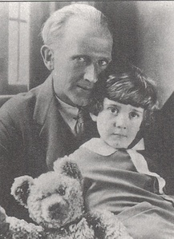
4 : About A.A.Milne
语法填空
Alan Alexander Milne (18 January 1882 – 31 January 1956) was a well-known British playwright,
1 (novel), storyteller and children’s poet, __2__
(graduate) from the University of Cambridge.
He was the best 3 (know) for his books about the teddy bear Winnie-the-Pooh and for 4__ (vary) poems. Milne was a noted writer, 5__ (primary) as a playwright, before the huge ___6___ (successful) of Pooh overshadowed all his previous work. Milne 7 (serve) in both World Wars, joining the British Army in World War I, 8 was a captain of the British Home Guard in World War II.
novelist
graduating
known
various
primarily
success
served
and

Slide 10


5 :Enjoy a poem:DREAM
Underline the rhyming words
Translate the poem
DREAM
Hold fast to dreams,
For if dreams die
Life is a broken-winged bird
That cannot fly.
Hold fast to dreams,
For when dreams go
Life is a barren field
Frozen with snow.
by Langston Hughes
梦想
紧紧抓住梦想，
梦想若是消亡，
生命就像鸟儿折了翅膀，
再也不能飞翔。
紧紧抓住梦想，
梦想若是消丧，
生命就像贫瘠的荒野，
雪覆冰封，万物不再生长。
---兰斯顿·休斯
[dai]
[flai]
[gəʊ]
[snəʊ]

Slide 11


Answer the questions
1. What rhetorical device does the poet use?
A. Hyperbole B. Metaphors and repetition
C. Similes D.Personification
2. What does the author compare the life without dreams to?
A. A flying bird and a dreamy wilderness
B. A singing bird and barren field .
C. A broken bird and frozen sonw.
D. A bird with a broken wing and frozen wilderness.
Discuss: Does a life without a dream mean anything?
Life without a dream is meaningless.
We have to hold on to our dreams to make progress tomorrow!

Slide 12



6 : Enjoy a poem: A MATCH
Complete the following questions
1. What is the poem
A MATCH about?
If love were what the rose is,
And I were like the leaf,
Our lives would grow together
In sad or singing weather,
Blown fields or flowerful closes,
Green pleasure or gray grief;
If love were what the rose is,
And I were like the leaf.
A.C. Swinburne
[ɪz]
[liːf]
[təˈɡeðə]
[ˈweðə]
2. What does this poem express?
[kləʊsiz]
In Chinese
愿得一心人，白头不相离。
This poem expresses loyalty and devotion to love
[griːf]
[ɪz]
3.Underline the rhyming words
and point out rhyming features.
[liːf]
Rhyming features？
abccabab
4. What rhetorical device does the poet use?
Metaphor
Simile
Repetition

Slide 13


7 : To finish the exercise on Page57
Read the poems below and then complete the table.
 | Wind on the hill | Dream | A Match
Subject
Images
Rhyming words
Rhetorical devices
wind
dreams
love
a broken-winged bird, a barren field frozen with snow
kite, person
rose, leaf, fields
knows/goes; can/ran;
kite/night; blew/too;
goes/ knows
die/fly;
go/snow
together/weather;
closes/is; grief/leaf
repetition,
alliteration
repetition,
metaphor
repetition,
metaphor, simile

Slide 14

Activity3: To discuss from which aspects we should enjoy English poetry
poetic imagery
poetic form
How to taste English poetry
（from which aspects）
poetic
meaning
poetic language

Slide 15

About the writing: Poetry Evaluation
The purpose of writing in this unit is to write a poem evaluation, which belongs to the category of argumentative writing.
1. Beginning---Brief introduction
The framework of
poetry evaluation
2. Body---A detailed introduction to the
understanding of the poem
3. Ending---A general evaluation, especially the
significance and influence of the poem

Slide 16
1：To taste English poetry
poetic form
poetic language
（ryhming words）
The poem Dream by Langston Hughes is very short with only 8 lines. When I read the pome aloud I can hear that the ends of the second and fourth sentences rhyme--- “die” and “fly”. The last word from the sixth and eighth sentences also rhyme--- “go” and “snow”. These rhyming words sound nice and make the poem pleasing to read.
When I close my eyes, I can see different images from the poem. For example, I can see two hands being held. I can see a bird flying in the sky. I can see a field and I can imagine what it looks like with lots of snow. I start to feel cold when I read these lines!
I learnt a new phrase, “hold fast”, which means to hold onto something. “Barren” is also a new word to me, which means empty.
I think the poet is giving us advice. He wants us to keep dreaming, because life is much better when we dream and have something to look forward to.
poetic imagery：
（有很强的画面感）
poetic language
（new words）
poetic meaning

Slide 17
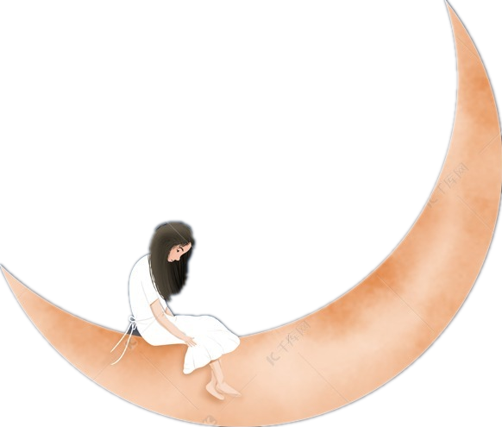

2. Choose one of the poems and write a short essay about it.
1. Students may choose one of the other two poems to write in imitation.
2. Members of the group share their works with each other, draw
inspiration from the works and comments from others, find different
perspectives, and improve students’ writing ability.
3. The teacher will show some good works to the students and
comment on it.

Slide 18
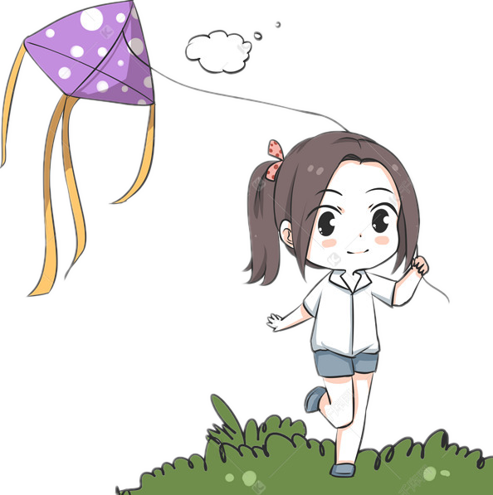


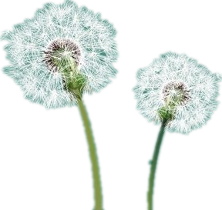
A possible answer
WIND ON THE HILL
WIND ON THE HILL by A. A. Milne is a poem with 20 lines. When I read the poem aloud I can hear that the ends of some sentences rhyme—“knows” and “goes”, “kite” and “night”. These rhyming words sound nice and make the poem vivid to read.
When I close my eyes, I can see vivid pictures from the poem. For example, I can see wind blowing across the hill and kites flying in the wind. I can even see the poet running after wind.
I think the poet is describing the beauty of wind and nature for us.

Slide 19
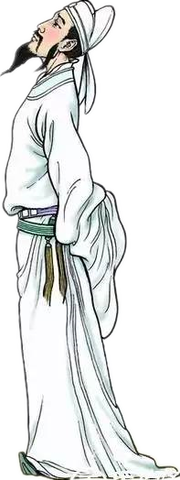
Put what you’ve learned to use
假如你是李华，你校的美国交换生Steven非常喜欢中国古诗，给你发了一封邮件，请你为他推荐一名诗人及他/她的代表作，并就诗歌内容做个简单的介绍。现请你给他回复，内容包括：
1. 推荐的诗人及其代表作；
2. 诗歌介绍（包括影响和意义）；
3. 你对诗歌的评价。
注意：
1． 词数80左右；
2． 可以适当增加细节，以使行文连贯。

Slide 20
A wonderful start
1. I am into the poems composed by Li Bai, a famous Chinese poet in the
Tang Dynasty.
1. 我喜欢唐朝诗人李白的诗歌。
2. I feel like sharing with you my feelings about Li Bai’s poetry.
2. 我想和你们分享一下我对李白诗歌的感受。
3. What do you think of Li Bai’s poems?
3.你认为李白的怎么样？
4. I’m delighted to tell you that I am a big fan of Li Bai’s poetry.
4. 我很高兴地告诉你我喜欢李白的诗歌。

Slide 21
A wonderful body
1. A Tranquil Night that was written by Li Bai’s is one of my favorite
poems, and its beauty often reminds me of my relatives far away from me
1.李白的《静夜思》是我最喜欢的诗歌之一，它优美的意境常常使我
想到我远在家乡的亲人。
2. As we all know, Li Bai was a great romantic poet in the Tang Dynasty,
who was called “The poet immortal”by later generations.
2.正如我们大家所知道的，李白是唐代伟大的浪漫主义诗人，被后人
誉为“诗仙。
3.The poems written by Li Bai enjoy a high reputation both at home and
abroad.
3. 李白的诗歌在国内外都享有很高的声誉。

Slide 22
A wonderful ending
1. It’s the most meaningful poem that I’ve ever read.
1.这是我读过的最有意义的诗歌 。
2.Therefore, I highly recommend to you the poems written by Li Bai.
2.因此，我特向你推荐李白的诗歌。
3. I’m convinced that my recommendation won’t let you down.
3.我相信我的推荐不会让你失望的。
4. On the recommendation of me, you will have a taste for Li Bai’s poems.
4.在我的推荐下，你一定会领路到李白诗歌的风采。

Slide 23
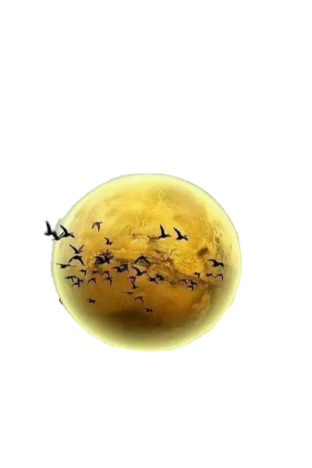
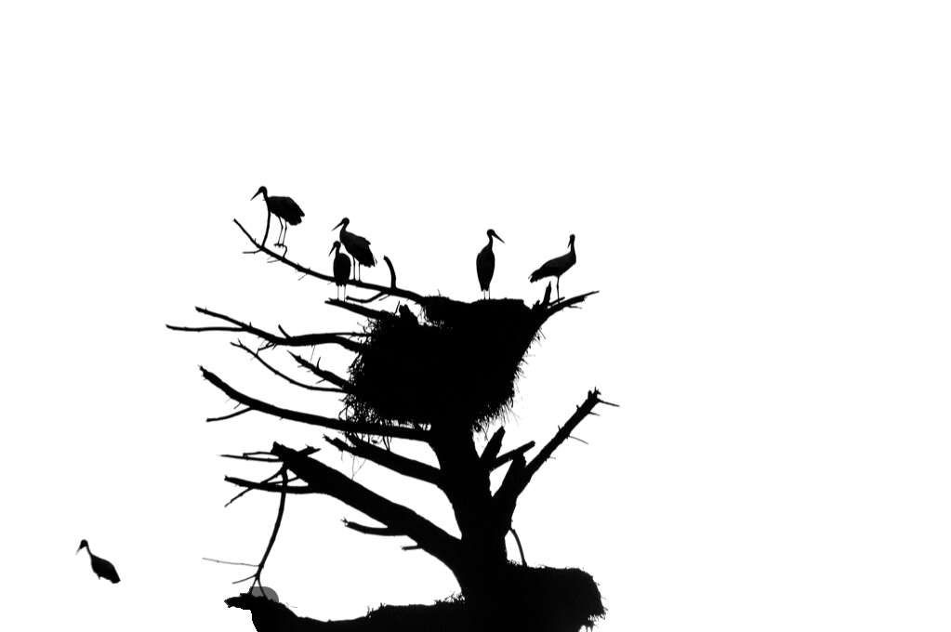
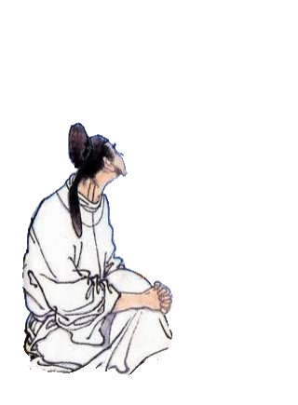
A possible answer
Dear Steven,
Delighted to know from your last e-mail that you are keen on our Chinese ancient poetry. I can hardly wait to share Li Bai’s poems with you.
As we Chinese put, Li Bai was a great romantic poet in the Tang Dynasty, who was called “The immortal poet ”by later generations. A Tranquil Night is one of his most famous poems.The poem uses metaphor, foil and other rhetoric devices to describe a picture where the poet in the house is raising his head, enjoying the moon,which actually expresses homesickness.
In my opinion, it’s the most meaningful poem that I’ve ever read. He and his poems enjoy a high reputation around the world. On my recommendation, you will have a taste for Li Bai’s poetry. If you have any questions, please call me at any time. My mobile phone is 13333333333.
Your promopt reply will be highly appreciated
Yours,
Li Hua

Slide 24
Activity4: Write your own poem.
Write an original poem based on what has been learnt in the unit.
Discuss the writing process
01
02
03
04
Determine the subject
Select the relevant words
Imagine the pictures
Determine the title
Be clear about what you want to say
Choose words related to the topic and rhyming words
Picture the poem and determine the image objects
Review, revise, and read the poem aloud

Slide 25


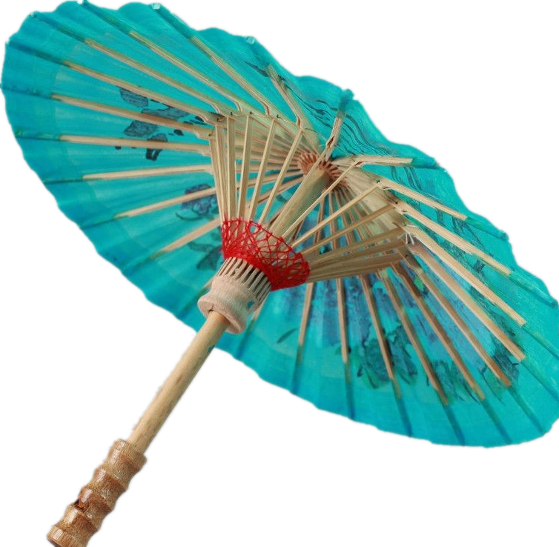
Activity 5: Work in groups.
1. After finishing it, the students share their works
with one another, which will help them draw
spiration from the works and comments from others.
2. Read aloud your poem to the class.
02

Slide 26
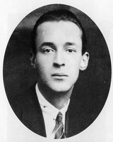
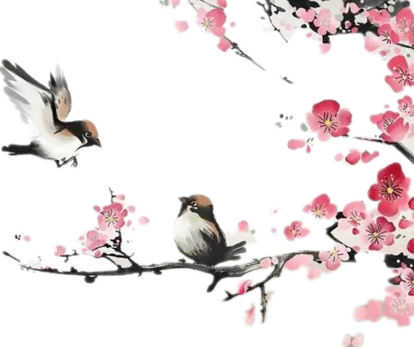
What is Poetry? （诗歌是什么？）
By: poetdreamer
Let’s end up with the lesson with a poem!
Poetry is the struggle to wake up each morning
Poetry is the struggle to sleep each night
Poetry is the image you see in the mirror
Even when you know that the image isn’t right.
Poetry is the song you sing when in love
Poetry is the tears when things fall apart
Poetry is when your fingers barely hold on
Even when you know you broke your heart.
Poetry is the breeze that cools you off
Poetry is the goal pushes you forward
Poetry is the steps to climb out of darkness
Even when you know the steps are awkward.

Slide 27



Poetry is the smile that brightens your day
Poetry is the pain that you try to hide
Poetry is the secrets that you conceal
Even with a friend to which you confide.
Poetry is not the language, nor meter
Poetry is not the form, nor the rhyme
Poetry is not the shape, nor the length
Poetry is not the education, nor even the time.
Poetry is the screams, the tears, and the laughter
Poetry is the joys, the weakness, and the vitality
Poetry is the love, the hatred, and the unfeeling
Poetry is everything in life, even your mortality.

Slide 28

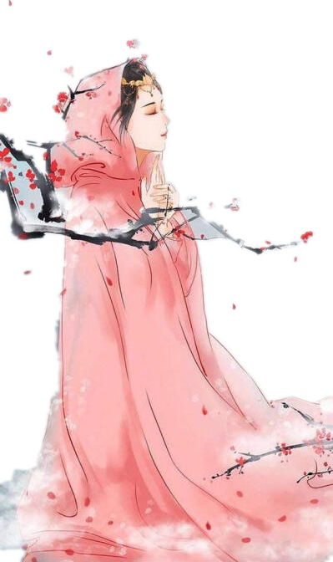
The only difference between you and writing poetry is a little feeling!
你和写诗之间的距离，差的就是一点感觉！

