Slide 1

感恩遇见，相互成就，本课件资料仅供您个人参考、教学使用，严禁自行在网络传播，违者依知识产权法追究法律责任。
更多教学资源请关注
公众号：溯恩高中英语
知识产权声明

Slide 2
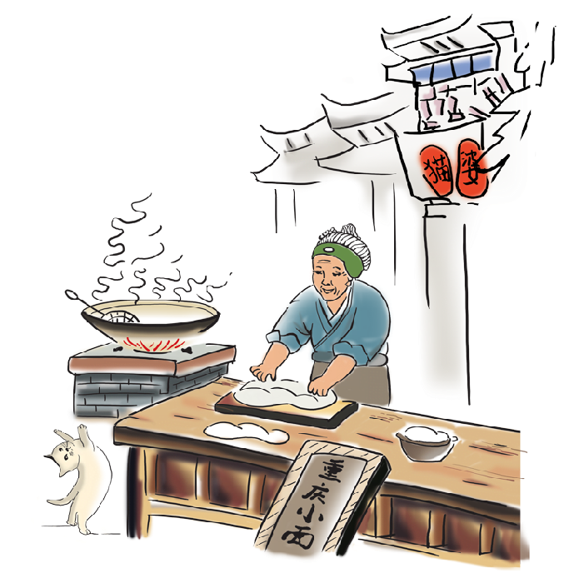
Unit 3 Food and culture
Reading and Thinking
CULTURE AND CUISINE

Slide 3
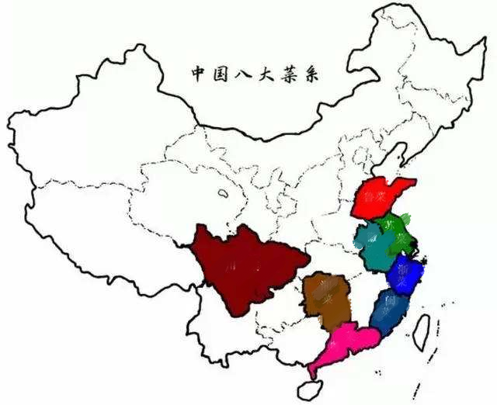
food cooked in a certain way
Lead-in
Shangdong Cuisine
How many kinds of Chinese cuisine?
Anhui Cuisine
Jiangsu Cuisine
Zhengjiang Cuisine
Sichuan Cuisine
Fujian Cuisine
Hunan Cuisine
Cantonses Cuisine

Slide 4
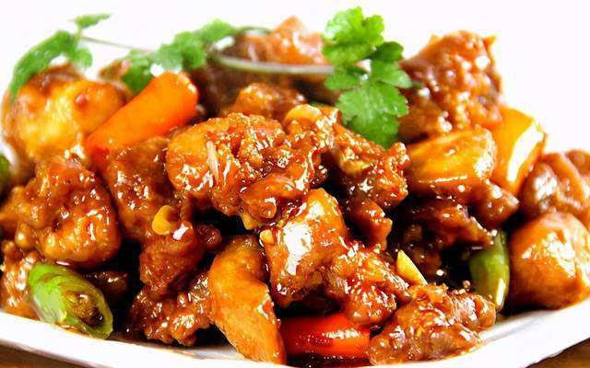
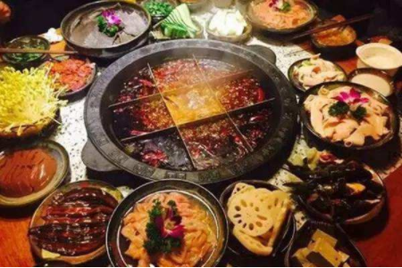
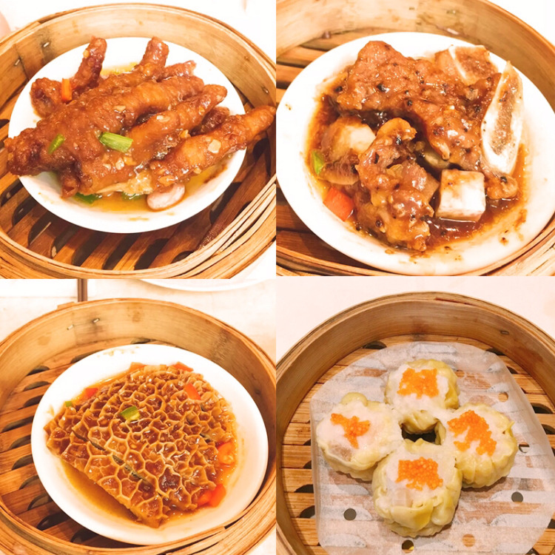
Lead-in
How can these cuisines be described?
What, if anything, do these cuisines tell you about the people who eat them?
Sichuan hot pot
General Tso’s chicken
左宗棠鸡
Dim Sum
There are numerous cooking styles that are associated with ethnic minorities.
The cuisines certainly say something about the kinds of ingredients available to the people, and a lot about the kinds of flavours the people prefer.

Slide 5
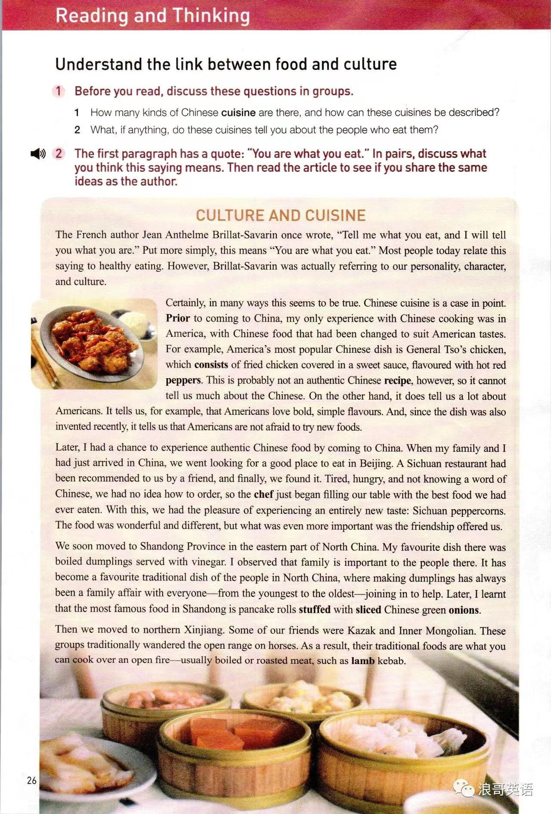
Prediction
1. What content will this passage talk about?
2. Which information would you like to get?
It is about various culture and cuisine about a place or some countries

Slide 6
While-reading
Match the main idea of each paragraph
Para1:
Para2:
Para3:
Para4:
Para5:
Para6:
Para7:
experience of Chinese cuisine in America.
experience of Sichuan cuisine in Beijing
cuisine in Shandong
cuisine in Xinjiang
cuisine in South China(Guangdong&Henan)
culture and cuisine go hand in hand.
you are what you eat.

Slide 7

While-reading
Draw the structure of the text
Para 6: Guangdong & Henan
Para 2: Chinese cuisine in America
Para 4: cuisine in Shandong
Para 7: Conclusion: culture and cuisine go hand in hand
Para1: Topic: you are what you eat
Para 5: cuisine in Xinjiang
Para 3: Sichuan cuisine in Beijing

Slide 8
While-reading
Read and find out the author’s experience of cuisine and culture in different places and complete the table below.
Place | Kind of Chinese food | Typical dish | People or culture
America
Beijing
Chinese food changed to suit American tastes
General Tso’s chicken
Americans love bold, simple flavours, and are not afraid to try new foods.
Dishes with Sichuan peppercorns
People there offered them good friendship.
Sichuan cuisine

Slide 9
While-reading
Place | Kind of Chinese food | Typical dish | People or culture
Shandon
Northwest China
boiled dumplings
served with vinegar, pancake rolls stuffed with sliced Chinese green onions
Shandong cuisine
Family is important to the people there.
People there traditionally wandered the open range on horses so their traditional foods are what you can cook over an open fire.
Xinjiang and Inner Mongolian cuisine
boiled or roasted meat, such as lamb kebab

Slide 10
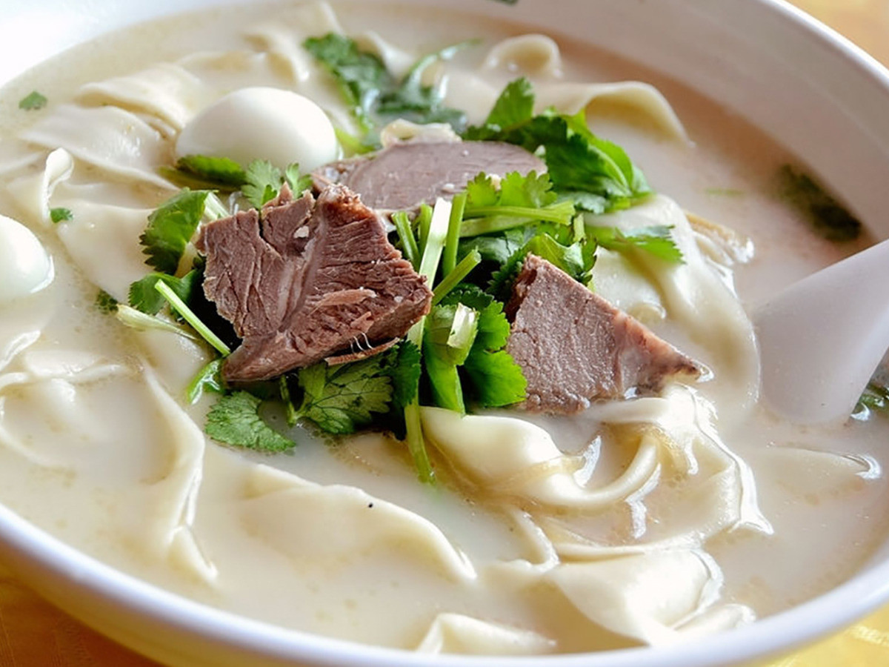
While-reading
Place | Kind of Chinese food | Typical dish | People or culture
South China
Central China
Guangdong cuisine
dim sum
Through food, Chinese people everywhere show friendship and kindness.
Henan cuisine
stewed noodles 烩面

Slide 11
While-reading
1. The first paragraph 1 has a quote: “you are what you eat.”How does the author understand it?
Key: The author thinks that the food we eat usually reflects our personality, character, and culture.

Slide 12
While-reading
2. What does the dish General Tso’s chicken tell about Americans’ personality?
Key: It tells people that Americans love bold, simple flavors and are not afraid to try new foods.
That is to say, Americans are adventurous and brave.

Slide 13
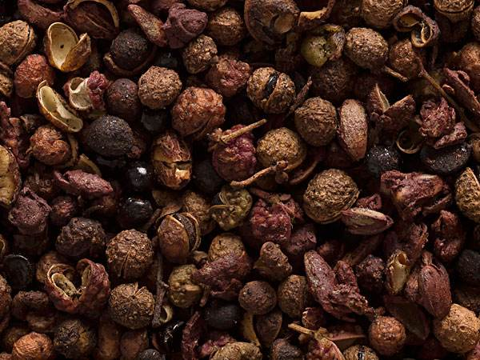
While-reading
3. What impressed the writer most while in Beijing?
4. How do you like the characters of people in Beijing from the author’s experience?
Key 3: The friendship offered by people.
Key 4: They are friendly and amicable(友善的).

Slide 14
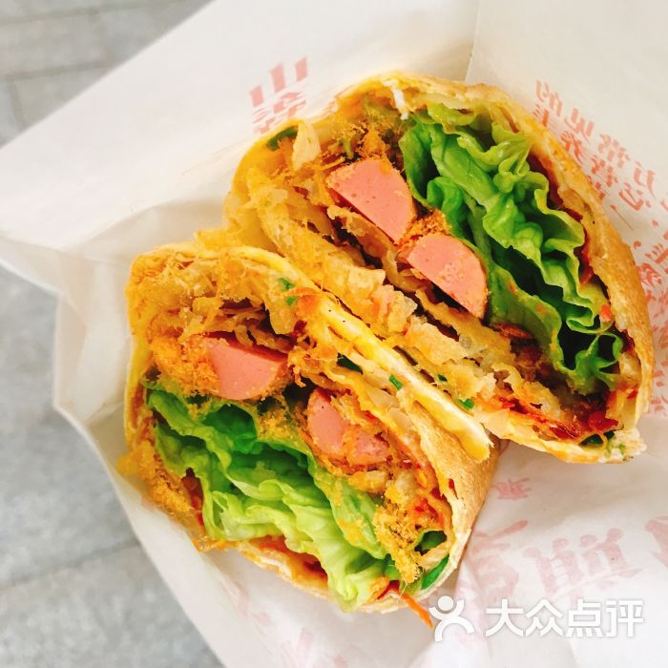
While-reading
5. What is important to people in Shandong according to the writer?
6. What do you know about the personality of people in North China?
Key 5: According to the writer, family is important to people in Shandong.
Key 6: People in North China attach importance to their family, so they are a family-centered person.

Slide 15
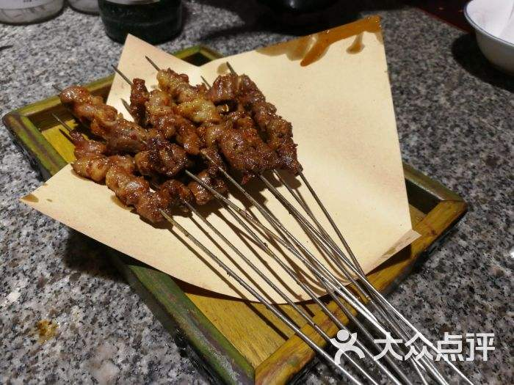
While-reading
7. Why did people in northwest China enjoy cooking over an open fire?
8. What do we know about people in northern Xinjiang according to their food?
Key 7: Because they traditionally wandered the open range on horses.
Key 8: They are bold, rash and frank.

Slide 16
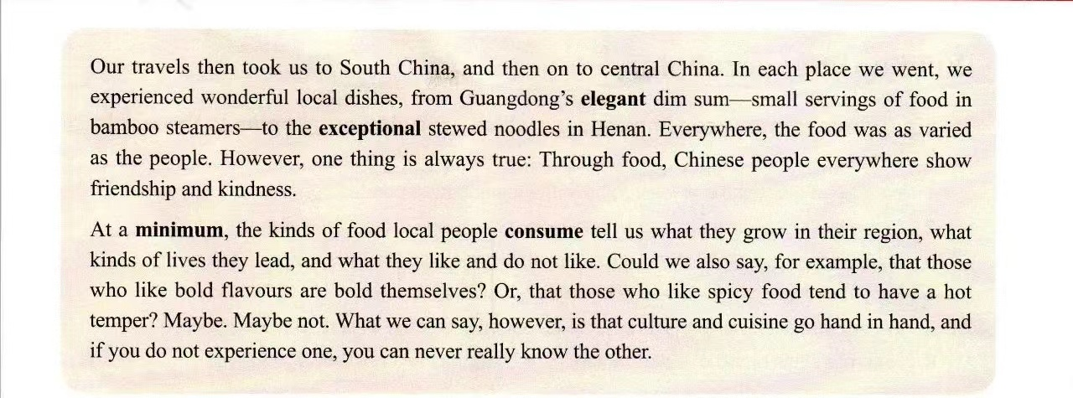
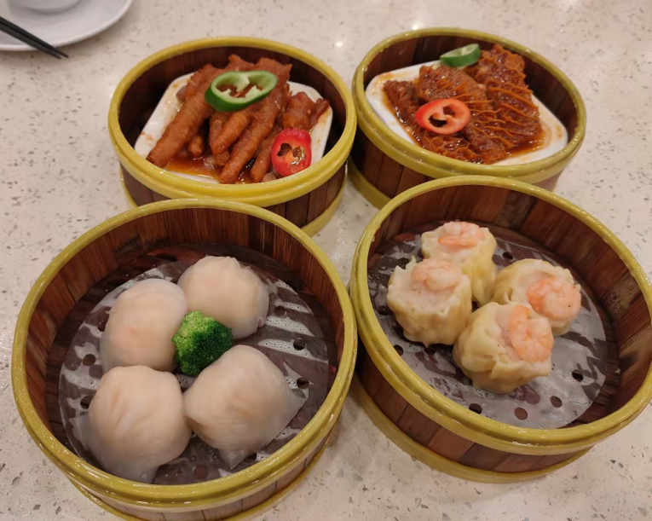
While-reading
9. What does elegant dim sum mean?
10. What is the personality of people in south China?
Key 9: Small servings of food in bamboo steamers.
Key 10: People in south China are careful, kind and considerate.

Slide 17
While-reading
11. What does the food local people consume tell the writer?
Key: It tells us what people grow in their region and what kinds of lives they lead, what they like or dislike.

Slide 18
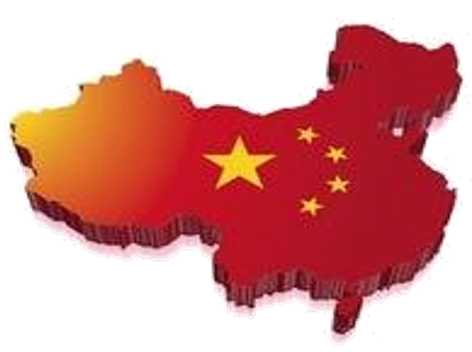
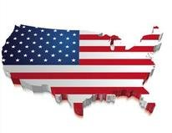
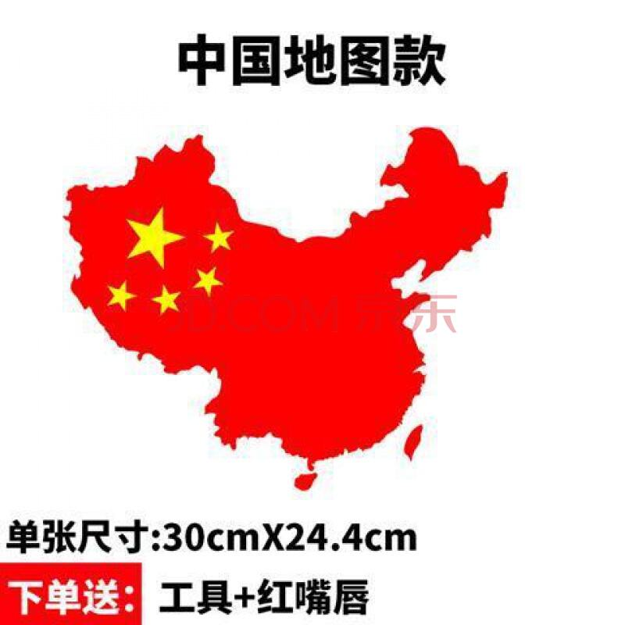
Summary
Trace the author’s travels again and understand the quote “you are what you eat”.
where: Beijing
which: Sichuan cuisine
what: friendly&
amicable
where: Northwest China
where: Shandong
which: lamb kebab
which: dumplings, pancake rolls
what: bold, rash and frank
what: family-centered
where: America
which: General Tso’s chicken
what: adventurous and brave
where: South China& central China
which: dim sum & stewed noodles
what: careful, kind and considerate

Slide 19
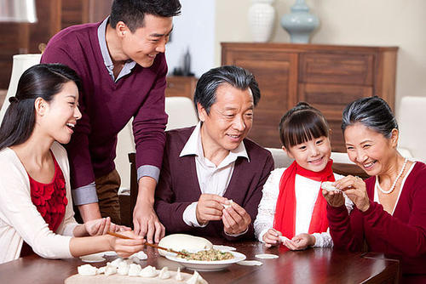
Understand cause and effect
Why do people living in different places have different cuisine?
Key: People living in different places share different cultures. As a result, they have different kinds of food. That is to say, “people living in different places consume various kinds of food because they share different local cultures.”

Slide 20


Understand cause and effect
Understand cause and effect
Sometimes two ideas are related to each other by cause and effect. That is, one thing causes something else to happen. Cause-and-effect relationships can be direct. For example, “ It was raining, so I took my umbrella. However, some cause-and-effect relationships are not direct, and some may also have more than one cause or effect.
How to identify cause and effect?
1. Look for signal words, such as therefore/ as a result/ because/ so/ due to...
2. Find them through a logical connection.

Slide 21
Understand cause and effect
cause
effect
cause
effect

Slide 22
Understand cause and effect
7. Match the causes to the effects below.
Cause
1. The flavour preferences of Americans often differ from those of the Chinese.
2. We had no idea how to
order food.
3. These groups traditionally wandered the open range on
horses.
Effect
A. The chef just began filling our table with the best food we had ever eaten.
B. Their traditional foods are what you can cook over an open fire.
C. Chinese food in America is changed to suit American tastes.

Slide 23

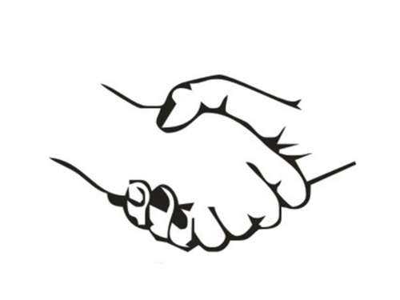
Deeper thinking
Do you think “Culture and cuisine go hand in hand? Give your reasons.
Keys: Personally, culture and cuisine go hand in hand. Reasons are as follows: Cuisine in certain place can tell us what the local people like to eat, grow or dislike. The food flavors they eat the food features they cook also well demonstrate the personality, characters or culture of the local people.
culture
cuisine

Slide 24
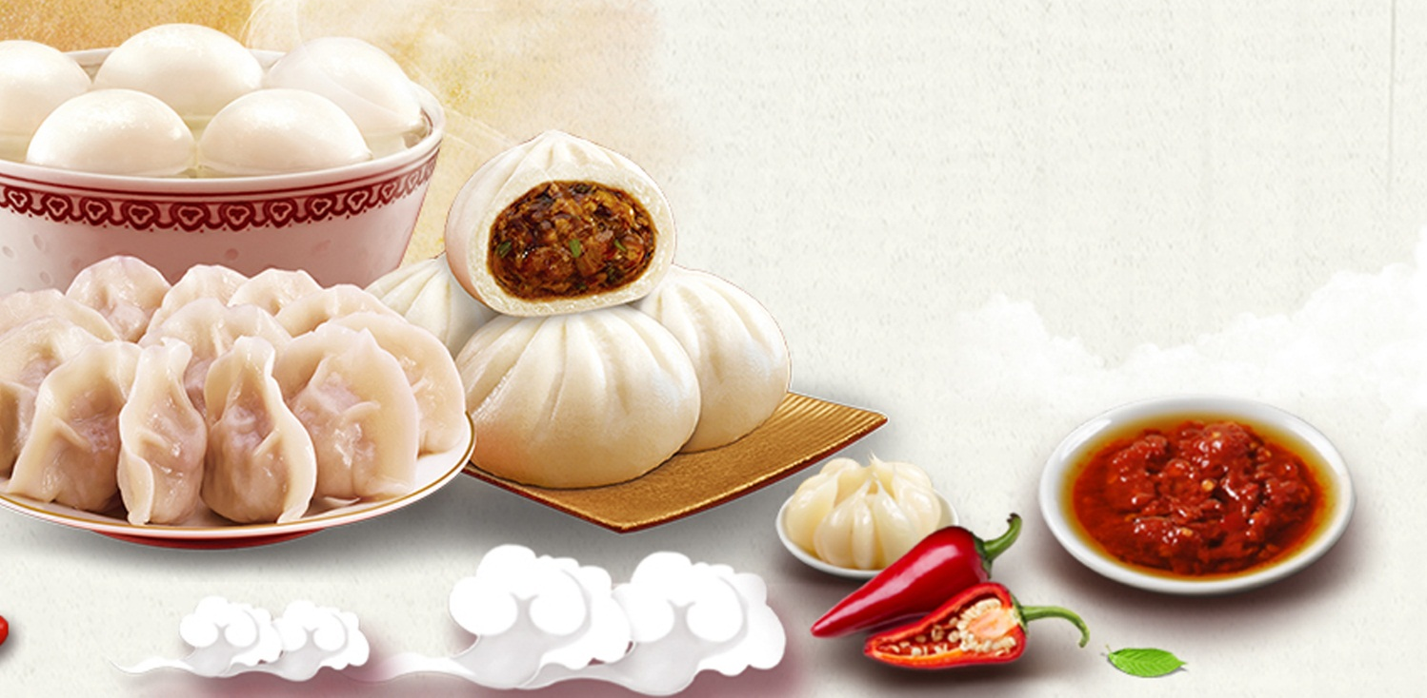
Homework
1.Write a summary about one of the author’s experiences based on the table.
2. Try to describe a food that impressed you.
Notes:
可以设置一个写作话题：让学生推荐自己家乡菜，结合原文的语言风格和写作思路。

Slide 25
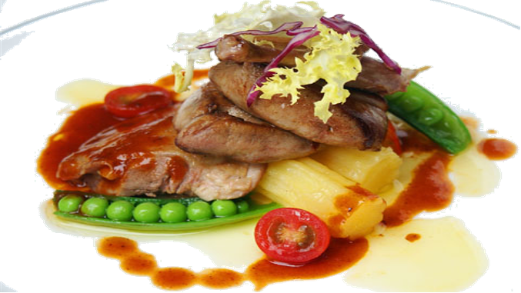
thank you

