Slide 1

感恩遇见，相互成就，本课件资料仅供您个人参考、教学使用，严禁自行在网络传播，违者依知识产权法追究法律责任。
更多教学资源请关注
公众号：溯恩高中英语
知识产权声明

Slide 2
人教版 选择性必修三
Unit 2 Healthy Lifestyle
Discover Useful Structures
The infinitive of the verb used as the subject
杭州二中许丽君

Slide 3
Teaching Goals
1.Enable the Ss to master the usage of the infinitive of the verb as the subject
2.Enable the Ss to use the relevant grammar flexibly and authentically in the real situation.

Slide 4
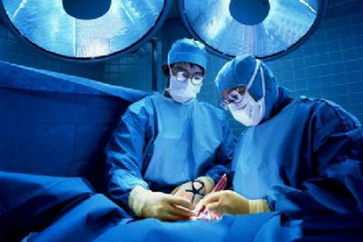
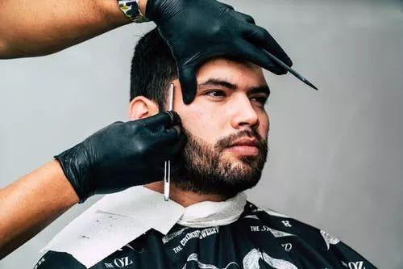
单元语法探究
Look at the following sentences and pay attention to the italicized infinitives. Find more infinitives in the reading passage, and tell their meanings and functions.
1. To change bad habits is never easy.
2. It took the surgeon three hours to finish
my mother’s ling surgery.
3.To join the people’s Liberation Army, it is
required for men to shave off their beards.
4. It was not polite to disturb your neighbors with loud music last night.

Slide 5
Grammar analysis
More infinitives in the reading passage
1….it can be easy for some of them to form bad habits.
2. After all, it is not easy to break bad habits.
Their meanings and functions
动词不定式在句中做主语，有时为了保持句子的平衡，避免头重脚轻，常用it做形式主语，而真正地主语放在句子的末尾。比如第2；3；4例句。

Slide 6
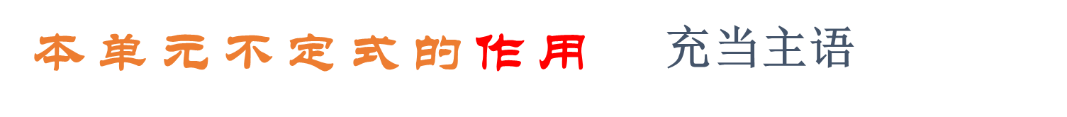
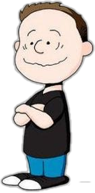

The Infinitive
What forms does infinitive have?
(to do ……)
Basic strategy: Add tense 时态 and voice 语态 into “to do” structure!

Slide 7
Grammar analysis
不定式的时态和语态：
不 定 式 主 动 被 动 一 般 to write to be written 进 行 to be writing 完 成 to have written to have been written 完成进行 to have been writing

Slide 8
Grammar analysis
不定式作主语：
1. ______( talk ) with him is a great pleasure.
2. ______( help ) others is our duty.
To talk
To help
It is our duty to help others
for the students to read.
3.It is easy____________ __________ (学生读)
4. It is important ______ Tom to get that job.
It is kind ______ you to help me with my homework.
for
of

Slide 9
Grammar analysis
Infinitive as the subject of the sentence:不定式作主语
系动词:
Be的单数形式
Example 1: To help others is our duty.
主语
表语
To do
Example 2: To get good grades requires a lot of hard work.
主语
宾语
谓语动词
To do
单数形式

Slide 10

Grammar analysis
Infinitive as the real subject of the sentence:
It (形式主语) ~ to do（真正主语）
_________( help ) others is our duty.
To help
系动词
Be 的单数形式
It is our duty to help others.
表语
真正主语
To do
形式主语
It

Slide 11
Grammar analysis
不定式作主语和动词-ing形式作主语的区别：
动词-ing形式和不定式作主语, 都是说明一个内容。
不定式通常表示一个将来的、具体的内容;
但是, 而动词-ing形式则表示一种经常性的、习惯的或抽象的概念。
To look after children is her job today.
她今天的工作是看孩子。
Looking after children is her work.
她的工作是照顾孩子。

Slide 12
Grammar analysis
不定式作主语，it 做形式主语的常见结构：
It is +adj.+(for sb) to do
It is easy for me to learn how to drive.
学开车对我来说很轻松。
It is +adj.+(of sb) to do
It is clever of you to apply for the position.
你申请这个职位真是明智的。
It is +n.+ to do sth( an honour, our duty, a pity, a shame)
It is our duty to take care of you.
照顾你是我们的责任。
It takes/took sb some time to do sth.
It took me half an hour to do my housework.
我花了半个小时做家务。

Slide 13
Grammar analysis
疑问词 + 不定式 做主语
可用于该结构的疑问词
疑问代词：who，whom，what，which
疑问副词：when，where，how
常接该结构的动词：know，see，decide，tell，ask，consider，explain，learn，wonder
How to construct the theoretical framework is very important.
怎样构建理论框架很重要。（作主语）
When to start developing such a vaccine is the question .
问题是何时开始研制这种疫苗。（作主语）
Where to find that patriotic young man is a headache for me.
到哪里去找那个爱国的年轻人令我头疼。（作主语）
练习：
1.When and where （vote） hasn’t been decided.
2. __________________（何时装修） the house hasn’t been decided
to vote
When to decorate

Slide 14
Summary
1.单个不定式作主语，谓语动词_____________
单数
2. 不定式作主语时,可以用it作_______________.
形式主语
3. 如果要说明不定式表示的动作是谁做的，
可以在不定式前加一个由 for/of 引起的短语,构成_______________。
不定式的复合结构
（修饰物的形容词）
It is+adj+for sb to do ……
5. It is+adj+ of sb to do………
(adj.: easy ,difficult, comfortable, pleasant, light , dangerous， tiresome, interesting , heavy, fit)
（修饰人品形容词）
(adj: kind, good, nice, wise, unwise, clever, silly, stupid, foolish,
careless, rude, polite, naughty)

Slide 15
Practice
单句语法填空
（1）Sometimes it’s better （remain） silent.
（2）Although is a hard task to protect our environment，we can’t help but go ahead.
（3） （control） the air pollution is necessary.
（4）It was foolish him to endanger his life in that way.
（5）Don’t you think it is rude him to ask a lady her age?
（6）It is difficult him to live on such a small salary.
to remain
it
To control/Controlling
of
of
for

Slide 16
Practice
完成句子
（7）I don’t think _____________________________ （你问……是不礼貌的） how long the interview will last.
（8） （保卫…… 是我们的职责） the country against its enemies.
（9） （ …… 花了我半个小时）to wash the clothes.
it is impolite of you to ask
It’s our duty to defend
It took me half an hour

Slide 17
Practice
Join the words to make full sentences using the infinitive.
1. important/avoid/passive cigarette smoking.
2. will take/nutrition specialist/a balanced diet menu/make /an hour/for you.
3.useful/turn to/fitness consultant/for advice
4.illegal /dangerous/take /drugs
5.harmful/skip breakfast/often

Slide 18
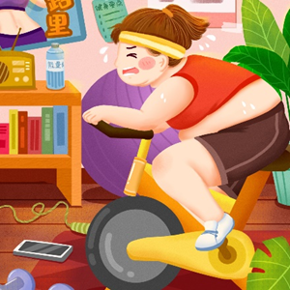
Practice
1. important/avoid/passive cigarette smoking.
It is important to avoid passive cigarette smoking.
2. will take/nutrition specialist/a balanced diet menu/make /an hour/for you.
It will take a nutrition specialist an hour for you to make a balanced diet menu.
3.useful/turn to/fitness consultant/for advice
It is useful to turn to fitness consultant for advice.
4.illegal /dangerous/take /drugs
It is illegal and dangerous to take drugs.
5.harmful/skip breakfast/often
It is harmful to often skip breakfast.

Slide 19
Practice
complete the conversations with the correct forms of the phrases in the box.
1. A: Hello, doctor. I want to lose weight, but I just can 't seem to do it. What can you do to help me?
B : Well, first, it's necessary to ______________ what you eat. Cut out all fatty food and sugary drinks, and eat more fruit and vegetables.
2.A: I really need to _____________a way to exercise more. I could use a fitness app, but my phone's full.
B: So delete a few files. I'm sure the app doesn't take up much space.
3 A: Before exercising, always do a few warm-ups to___________________.
B:I know. But then I always feel too tired to continue!
4. A: Should I go for the pizza or the fried chicken? I hate _________________ like these. You know what —I'm going to eat both!
B: Wow！l Don't eat too much junk food-you'll get fat. I've actually ________________ to go on a diet, so I'll just stick to the fruit salad.
begin with be in control of make a choice decide on make up one’s mind
be in control of
decide on
begin with
to make choices
made up my mind

Slide 20


