Slide 1

感恩遇见，相互成就，本课件资料仅供您个人参考、教学使用，严禁自行在网络传播，违者依知识产权法追究法律责任。
更多教学资源请关注
公众号：溯恩高中英语
知识产权声明

Slide 2

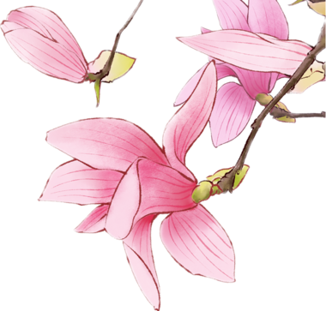
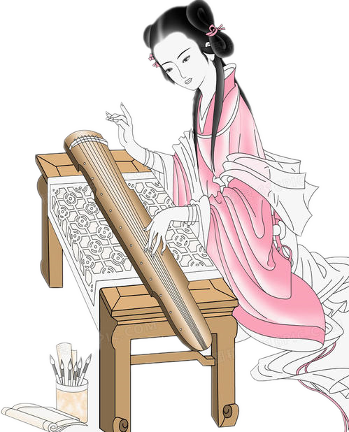
选择性必修Book3 Unit 5 Poems
Period 2 : Discover useful structures
Review of relative clauses
The girl who is playing guzheng
comes from the ancient times.
杭州市临平区杭州二中树兰高级中学 郭合英

Slide 3
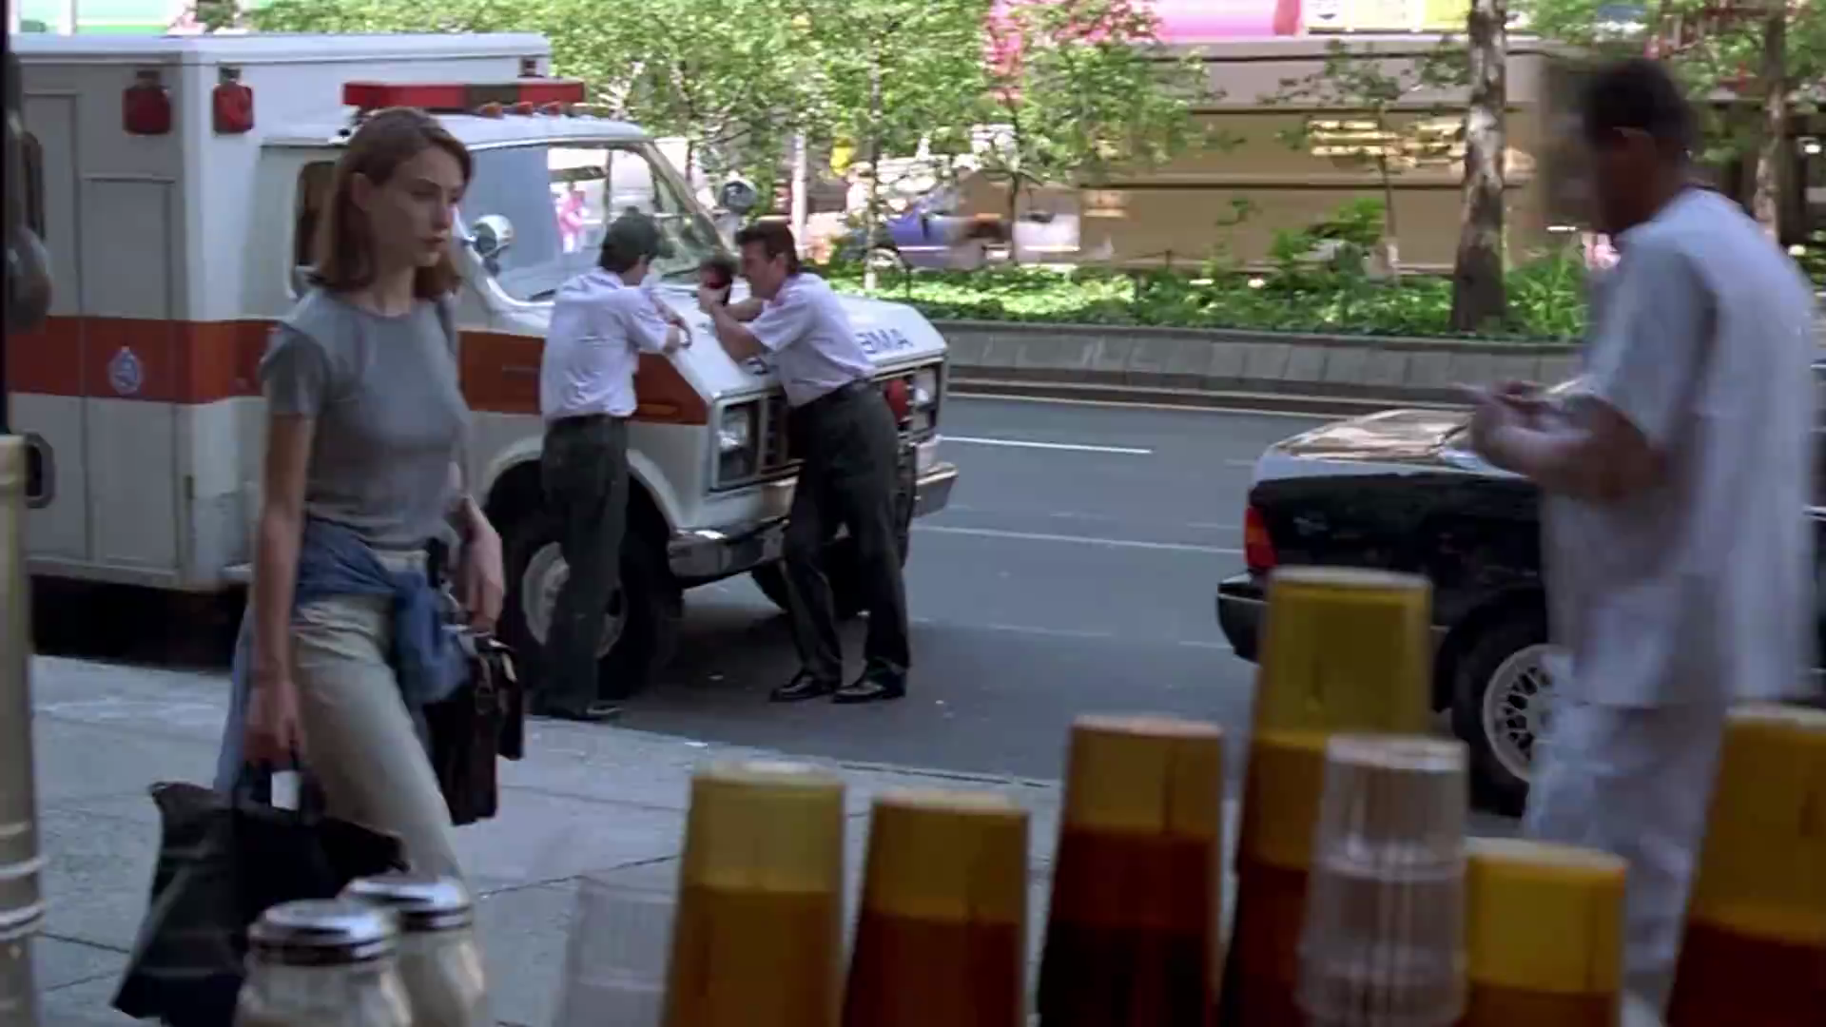
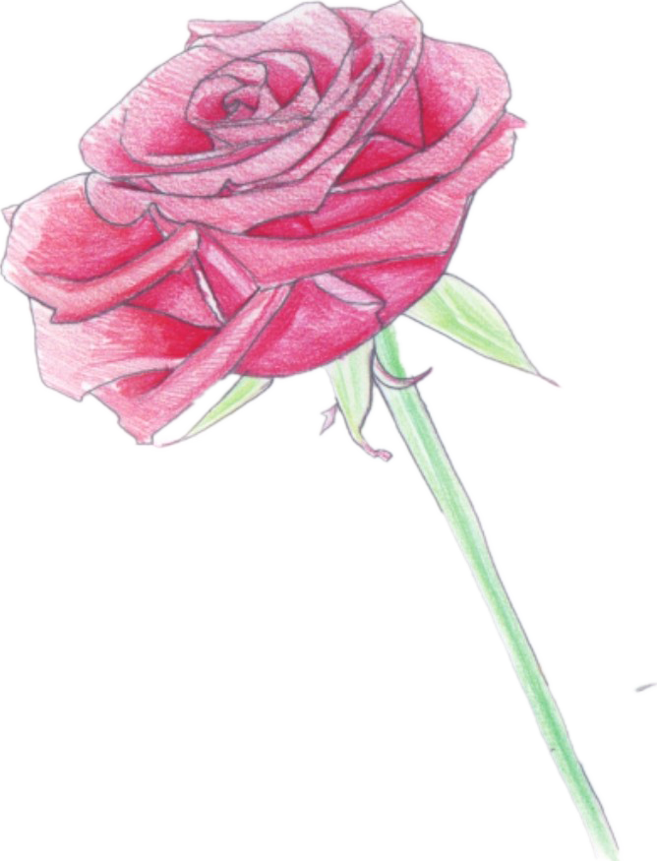
Enjoy a song with the attributive clauses.
That’s why you go away!

Slide 4


Review relative pronouns or adverbs
To review the Relative Clauses.
Teaching
Aims:
The combination of the Relative Clauses.
The application of the Relative Clauses.
The relative words that lead the attributive clauses
Antecedents refer to people：who, whom, that
Antecedents refer to objects：whic, that
Antecedents refer to ownership: whose, of which
Antecedents refer to places: where
Antecedents refer to time: when
Antecedents refer to reasons: why
relative pronoun
relative adverb

Slide 5



To review the Relative Clauses

Slide 6
Find out the Relative Clauses on Pages 50 and 51
1. There are various reasons why people compose poetry.
2. Some of the first poems a young child learns in English are nursery rhymes.
3. One of the simplest kinds of poem is the “list poem”, which contains a list
of things, people, ideas, or descriptions that develop a particular theme.
4. List poems have a flexible line length and repeated phrases which give both
a pattern and a rhythm to the poem.
5. Another simple form of poem that amateurs can easily write is the cinquain,
which is made up of five lines.
6. Haiku is a Japanese form of poetry that consists of 17 syllables.
7. The haiku poem on the right is a translation from Japanese, which shows a
moment in the life of a delicate butterfly.

Slide 7

Thinking
1. There are various reasons people compose poetry.
why
relative adverb = preposition + which
why =
for which
2. Some of the first poems a young child learns in English are nursery rhymes.
（1）Why can the relative words be omitted?
If the antecedent (先行词)is the object in the clause, the relative pronoun can be omitted；If the antecedent is the subject in the clause, the relative pronoun can not be omitted
（2） If it’s completed, which one should it be ?
that , which or both ?
Only “that” can be used in the clause, because there are the words “the first” before the antecedent.
Summarize the situations where only “that” can be used in the clause.

Slide 8
4. List poems have a flexible line length and repeated phrases which give both
a pattern and a rhythm to the poem.
6. Haiku is a Japanese form of poetry that consists of 17 syllables.
Can the two words “which” and “that” be substituted each other? Can they be omitted ?
The two words “which” and “that” can be substituted each other. They can’t be omitted beacuse the antecedent is the subject in the clause.
3. One of the simplest kinds of poem is the “list poem”, which contains a list
of things, people, ideas, or descriptions that develop a particular theme.
5. Another simple form of poem that amateurs can easily write is the cinquain,
which is made up of five lines.
7. The haiku poem on the right is a translation from Japanese, which shows a
moment in the life of a delicate butterfly.
Can the word “which” be substituted by the word “that”? Why?
The word “which” can’t be substituted by the word “that”. Because they are the non-restrictive attributive clause .
Summarize the situations where only “which” can be used in the clause.

Slide 9

The combination of the Relative Clauses
(The sentences are taken from the text.)

Slide 10




The combination of the Relative Clauses
The secret to combination
Find the same noun or pronoun in two sentences;
Remove the same noun or pronoun from one of the sentences that will be subordinate clause, and then to fill in the deleted noun or pronoun with relatives.
people：who, whom, that ; objects：whic, that ; ownership: whose, of which
places: where; time: when; reasons: why
Finally, use the relevant rules to verify! (Whether the relative word can be replaced!)
Eg.1
Today we will learn the Optional Compulsory Book 3 Unit 5 .
whose
theme is about poems.
Its
Merge
Today we will learn the Optional Compulsory Book 3 Unit 5 whose theme is about poems.

Slide 11

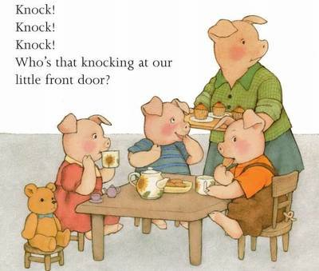

Eg.2
There are various reasons.
for which=why
People compose poetry for .
the reasons
which
Merge
There are various reasons for which people compose poetry .
When life gives you lemons, make lemonade.
There are a variety of poems .
Eg.3
Some of are nursery rhymes .
which
them
Merge
There are a variety of poems, some of which are nursery rhymes.

Slide 12
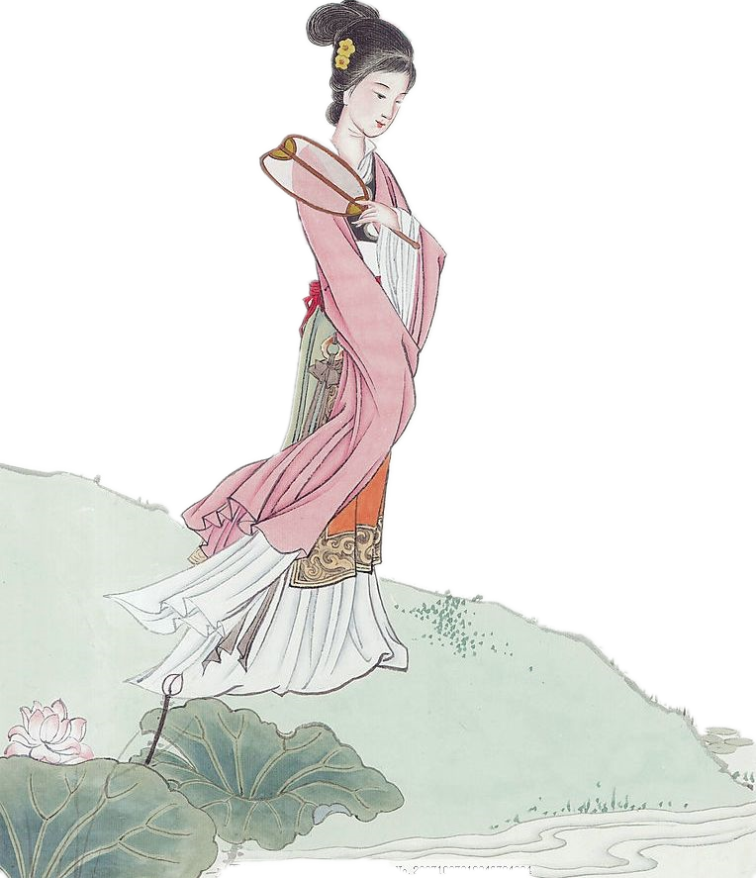


Eg.4
The woman was waiting for her husband.
who
She
was standing on the stone .
Merge
The woman who was standing on the stone was waiting for her husband.
Eg.5
English speakers also enjoy poems from China.
as
It
is konwn to us.
Merge
As is konwn to us, English speakers also enjoy poems from China.

Slide 13
Task 2: To put them in the correct order to compose a passage.
Task 1: Connect the sentences using the relative words.
Practice: To finish Exercises 1 on Page 53.
1. The Crescent Moon is perhaps the most famous collection of children’s
poems. It is known to people in China.
1
2. There are also many poems written from a child’s perspective. In these poems
the poet Tagore shows a sympathetic understanding of children’s feelings.
1. The Crescent Moon is perhaps the most famous collection of children’s
poems that is known to people in China.
5
3. The English version of the book contains nearly 50 poems. The focus of the
poems is on the parent-child relationship.
2. There are also many poems written from a child’s perspective in which the
poet Tagore shows a sympathetic understanding of children’s feelings.
3
4. The initial poems were written from the perspective of a mother. The mother
loves her baby at play and at rest, in laughter and in tears.
3.The English version of the book contains nearly 50 poems, the focus of
which is on the parent-child relationship .
4
5. Many people love to read this collection of poems. The reason is that they
can feel the warmth of love and enjoy the innocence of childhood.
4. The initial poems were written from the perspective of a mother who loves
her baby at play and at rest, in laughter and in tears.
6. It was written by the Indian poet Tagore who was the first Asian to win
the Nobel Prize in Literature.
6
6. It was written by the Indian poet Tagore. Tagore was the first Asian to win
the Nobel Prize in Literature.
5.The reason why many people love to read this collection of poems is that
they can feel the warmth of love and enjoy the innocence of childhood .
2

Slide 14

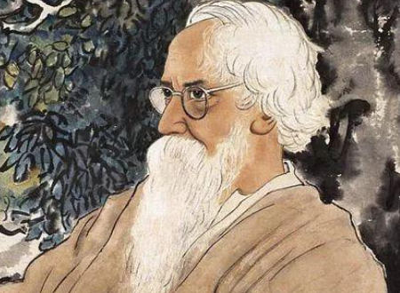
The background introduction of
The Crescent Moon

Slide 15
语法填空：The introduction of The Crescent Moon
注意：
如果一个句子带了两定语从句，从句的关系词不可重复。
that
which
Tagore was an Indian poet. The crescent moon 1 was written in 1903 is a collection of prose poems 2 describe children’s life interest and inner world. The poems create a fascinating world of children, some of
3 are representative poems, such as Babys world, the beginning and farewell. It is the first of Tagore's prose poems 4 include famous children's prose poems. It was published in 1886 5 his first daughter had just been born.The warm family and his career 6 consistently had succeeded in made the young poet happy physically and mentally. It was against the background 7 Tagore wrote many famous children's poems. This was the reason 8 he was known as "children's poet". Tagore,
9 each poem has a pure perspective, either for the mother, or for the child, or for the poet himself, was dedicated to eulogizing the most precious thing in human life - innocence. 10 is known to us, it is a great contribution to the world's children's literature!
that
which
which
that
when/in which
that/which
that
why/for which
whose
As

Slide 16
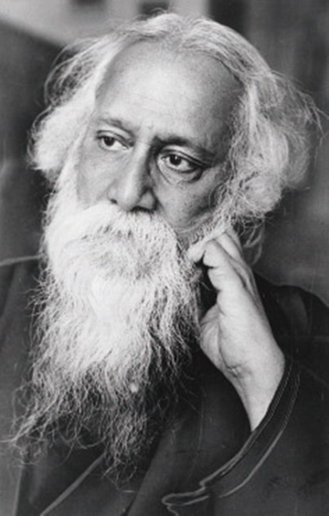
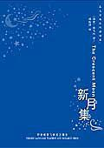
The classic lines from the Crescent Moon

Slide 17

BABY'S WORLD
I wish I could take a quiet corner in the heart of my baby's very own world.
I know it has stars that talk to him, and a sky that stoops down to his face to amuse him with its silly clouds and rainbows.
Those who make believe to be dumb, and look as if they never could move, come creeping to his window with their stories and with trays crowded with bright toys.
I wish I could travel by the road that crosses baby's mind, and out beyond all bounds;
Where messengers run errands for no cause between the kingdoms of kings of no history;
Where Reason makes kites of her laws and flies them, and Truth sets Fact free from its fetters.
孩子的世界
我愿我能在我孩子的自己的世界的中心，占一角清净地。
我知道有星星同他说话，天空也在他面前垂下，用它傻傻的云朵和彩虹来娱悦他。
那些大家以为他是哑的人，那些看去像是永不会走动的人，都带了他们的故事，捧
了满装着五颜六色的玩具的盘子，匍匐地来到他的窗前。
我愿我能在横过孩子心中的道路上游行，解脱了一切的束缚；
在那儿，使者奉了无所谓的使命奔走于无史的诸王的王国间；
在那儿，理智以她的法律造为纸鸢而飞放，真理也使事实从桎梏中自由了。

Slide 18
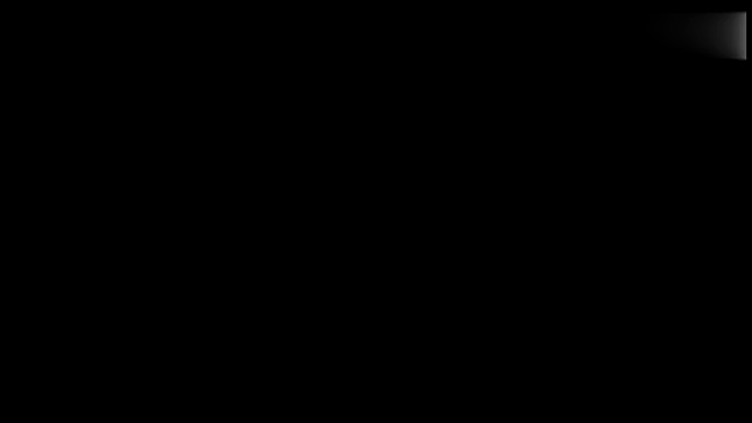
Enjoy the poem:
How Do I Love Thee?
《我是怎样地爱你？》

Slide 19
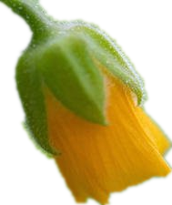
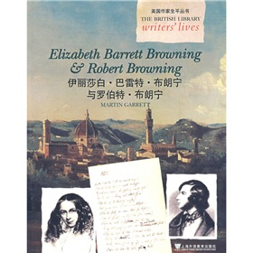
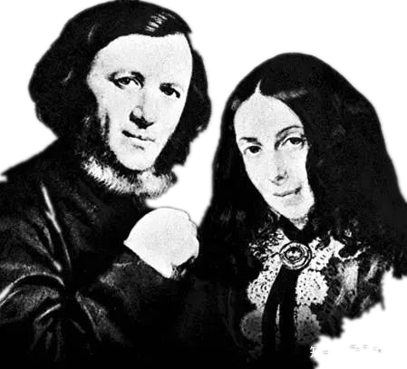
Do you know who wrote the poem?
-by Elizabeth Barrett Browning
Let’s walk into the Brownings together!

Slide 20
The secret to solving the problem ：Foucus on the same nouns and pronouns
Read the following introduction about the Brownings. Help the author edit
the passage to make it more concise, using relative clauses if necessary.
If you study the history of English literature, you will find the names of Robert and Elizabeth Barrett Browning were one of the most romantic literary couples of the Victorian era. Elizabeth Barrett started to write poetry from about the age of six. In 1844, Elizabeth’s poems brought her great success also attracted the admiration of poet Robert Browning. Browning fell in love with her poetry and then they entered into personal correspondence. The couple exchanged many letters obviously helped sow the seeds of love between the two. Elizabeth had been ill for many years. She stayed at home and almost never saw visitors. Browning was sure about his hove, so he found a way to visit her, and immediately convinced her to become his bride. However, their subsequent marriage was carried out in secret because father was a dominant and selfish man
would refuse to let his daughter go. The couple moved to Italy in1846
for the rest of her life. Browning had a great influence on Elizabeth’s writing. The best evidence that can be found is from the Portuguese were written during the time when she was in love with Robert Browning.
who
.
They
and
.
It
.
, which
These letters
her
.
It was
Barrett’s
who
.
He
where
.
Elizabeth lived
there
Sonnets
.
that
The sonnets

Slide 21



Answer the following questions
about their marriage
1. What was the bridge of their love?
Letter exchange
2. What was their marriage obstacles?
`1.Barrett herself
2.Her father’s against
3. What did they do for love?
elope

Slide 22

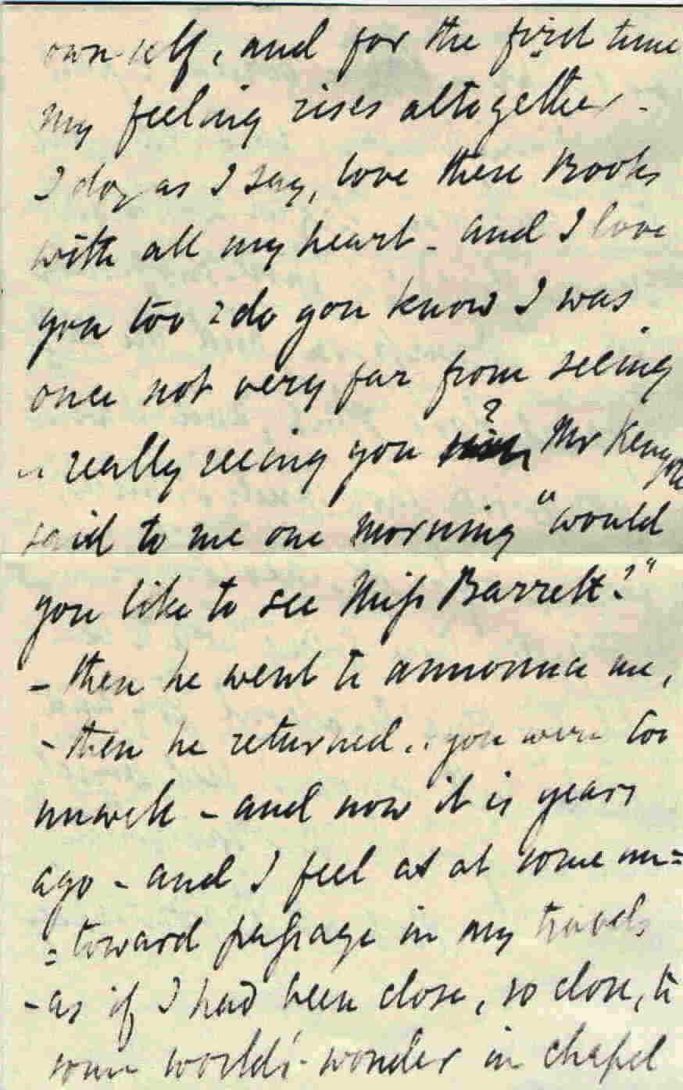
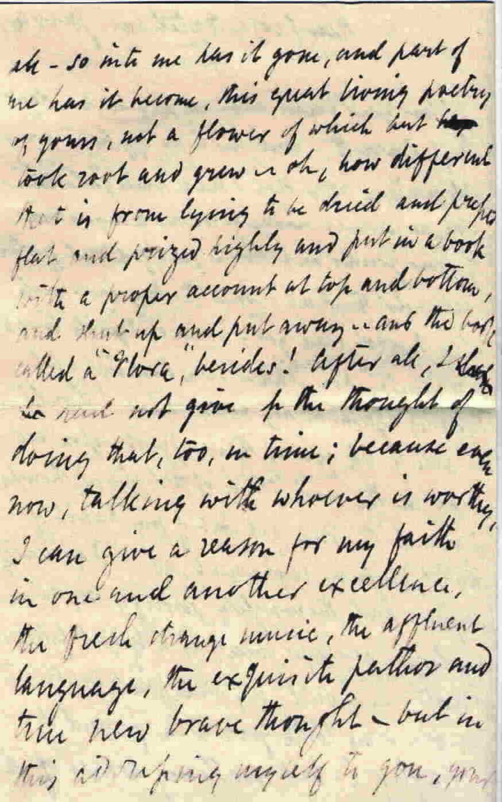
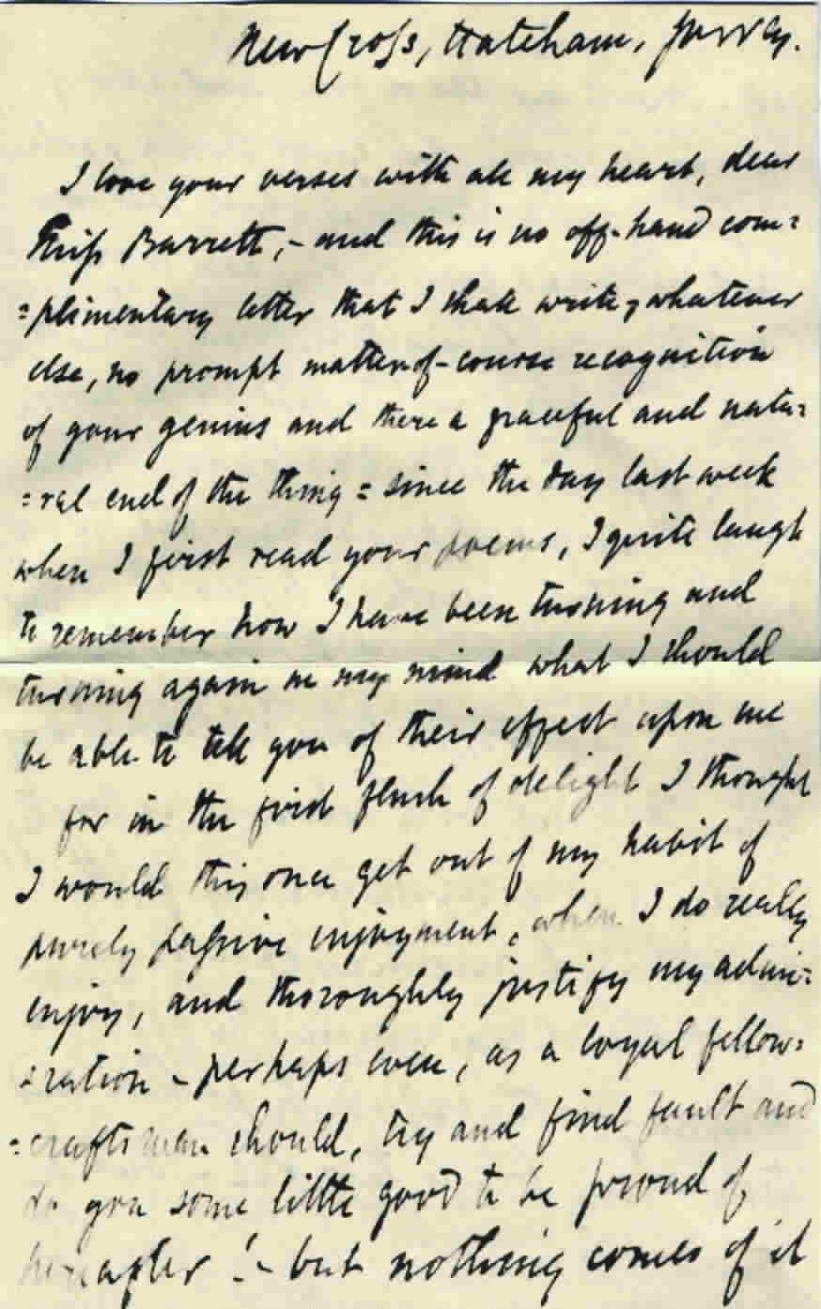
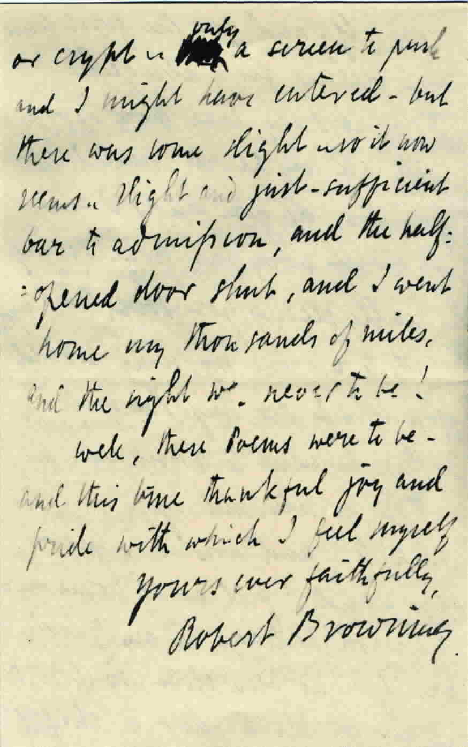
Robert’s Love Letter to E.B.B.
Meet you, meet love !

Slide 23
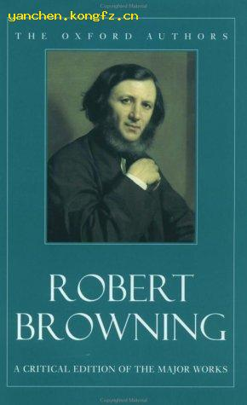
Browning’s major works
Pauline (1833) (his first poem) 《波琳》
Sordello (1834-1840)《索尔戴洛》
Paracelsus (1835)《巴拉塞尔士》
Porphyria’s Lover (1836)《波菲利雅的情人》
Pippa Passes (1841) 《皮帕走过》
My Last Duchess 《我已故的公爵夫人》
Dramatic Romances and Lyrics (1845)
《戏剧罗曼斯》
Bells and Pomegranates《铃铛和石榴》
Men and Women (1855)《男男女女》
Dramatic Personae (1864)《戏剧人物》
The Ring and the Book (1868-1869)《指环与书》

Slide 24


Enjoy a poem :
You’ll Love Me Yet 你终将爱我
You'll love me yet!—and I can tarry
Your love's protracted growing:
June rear'd that bunch of flowers you carry,
From seeds of April's sowing.
I plant a heartful now: some seed
At least is sure to strike,
And yield—what you'll not pluck indeed,
Not love, but, may be, like.
You'll look at least on love's remains,
A grave 's one violet:
Your look?—that pays a thousand pains.
What 's death? You'll love me yet!
你总有爱我的一天，
我能等着你的爱慢慢地长大。
你手里提的那把花，
不也是四月下的种子，
六月开的吗？
如今我在心里撒满爱的种子，
至少有一两粒会发芽罢。
然后开花了，你也不会去采的。
没有爱，至少，会有点喜欢罢。
你总会看一眼，
我坟头的紫罗兰。
那一眼，抵了我万千烦恼。
死又怎样？你总有爱我的一天。

Slide 25
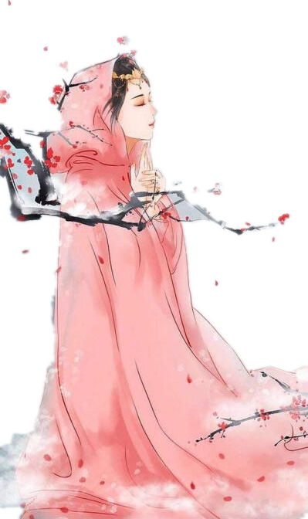
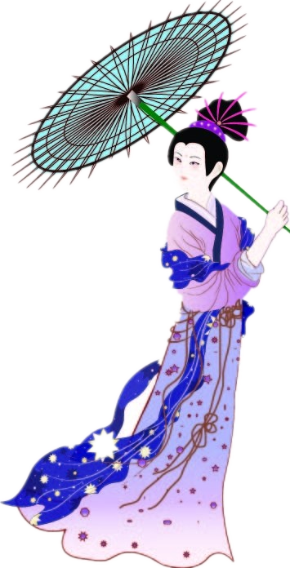
Look at the pictures and write some sentences with the attributive clauses
(看图写从句)

Slide 26
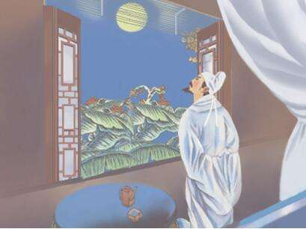
Picture 1
A possible answer
1. Li Bai was born in Tang dynasty.
2. He wrote many famous poems.
3. The Tranquil Night is one of
the famous poems.
4. People refer to him as the “诗仙” for the
reason.
A Tranquil Night
静夜思
A bed, Isee a silver light,
I wonder if it’s frost around.
Looking up, I find the moon bright,
Bowing, in homesickness I’m drowned.
Li Bai who was born in Tang dynasty wrote many famous poems, one of which is the Tranquil Night. This is the reason why people refer to him as the “诗仙”.

Slide 27
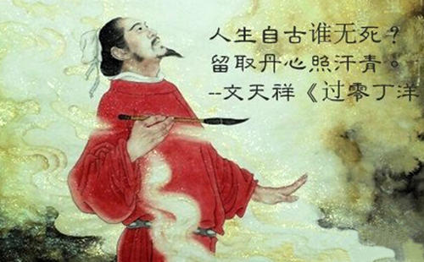
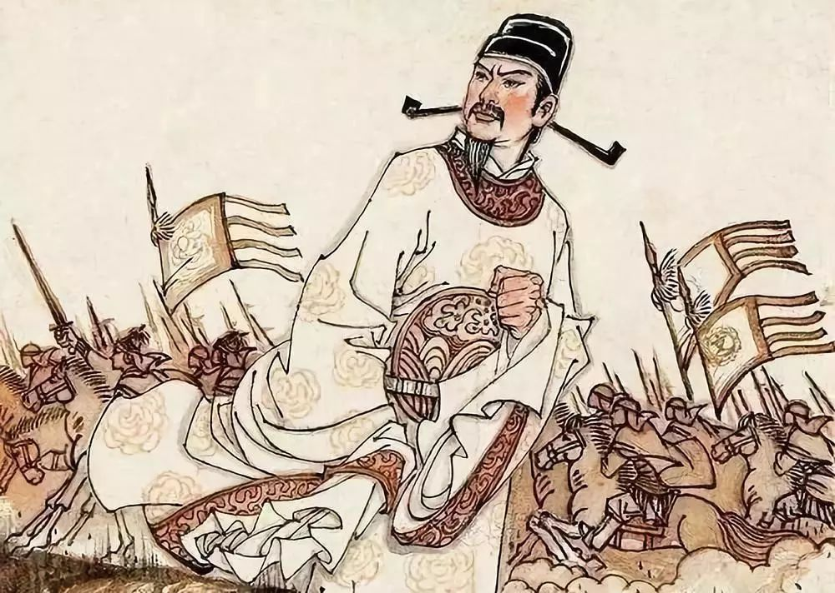
Picture 2
A possible answer
1. Wen Tianxiang was a folk hero in the
southern Song Dynasty
2. He repeatedly and sternly rejected the
enemy’s exhortation(规劝) to surrender.
3. He wrote a famous poem “A Prisoner's Lamentation
Passing by Lindingyang《过零丁洋》”.
4. This poem fully demonstrates Wen Tianxiang’s determination
to sacrifice his life for the sake of justice.
A Prisoner's Lamentation
Passing by Lindingyang
《过零丁洋》
Wen Tianxiang who repeatedly and sternly rejected the enemy’s exhortation to surrender was a folk hero in the southern Song Dynasty. He wrote a famous poem “A Prisoner's Lamentation Passing by Lindingyang”, which fully demonstrates his determination to sacrifice his life for the sake of justice.
Who can avert his death since time immemorial?
Let my heart remain true to shine in the annals.

Slide 28
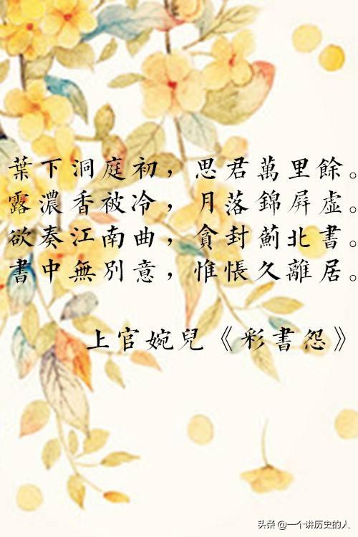
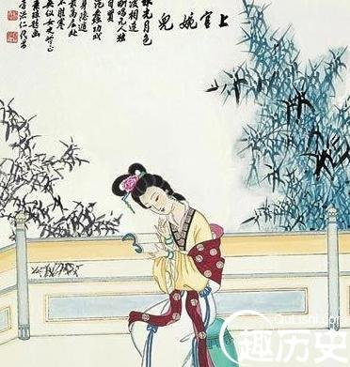
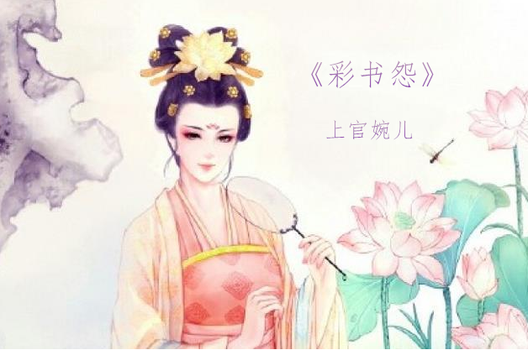
Picture 3
1. Shangguan Wan’er was a talented woman
in Tang dynasty.
A possible answer
2. She was put in an important position by Wu Zetian for
her wit and good writing.
3. Reproach in a Letter on Colored Paper
is one of her most famous works
4. The poem expresses the poet’s eagerness
to miss her husband.
Shangguan Wan’er who was a talented woman in Tang dynasty was put in an important position by Wu Zetian for
her wit and good writing. Reproach in a Letter on Colored Paper is one of her most famous works , which expresses the poet’s eagerness to miss her husband.
Reproach in a Letter
on Colored Paper
《彩书怨》

Slide 29
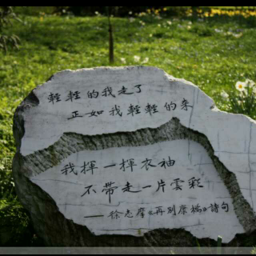
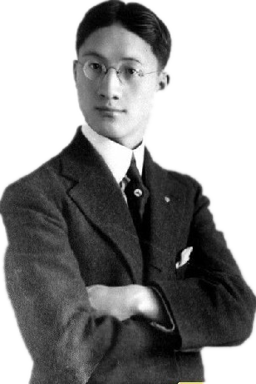
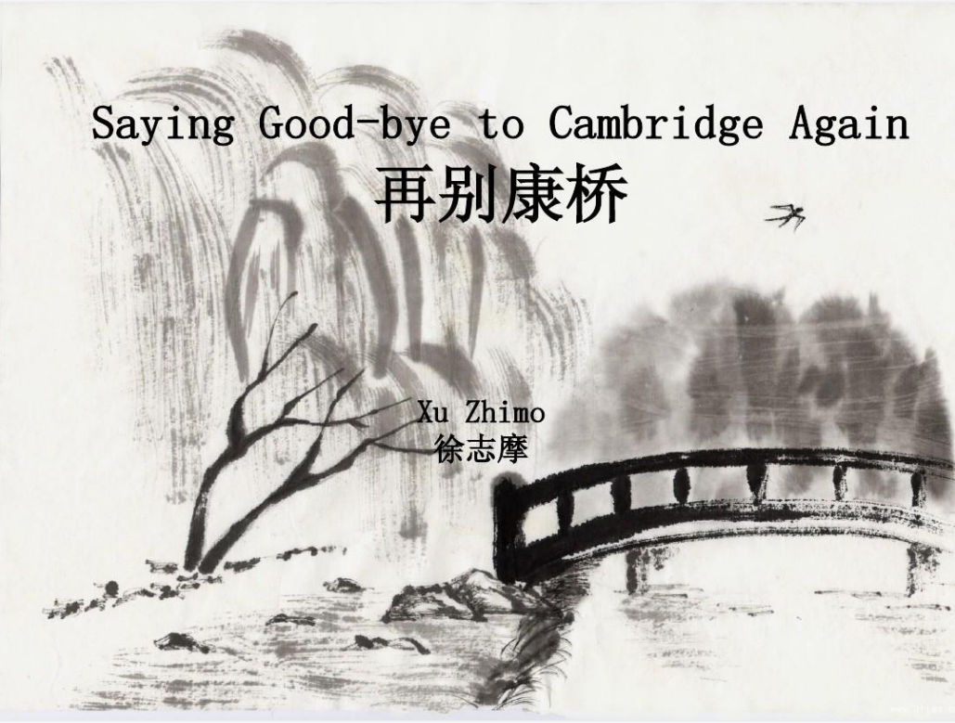
Picture 4
A possible answer
1. Xu Zhimo was well-known modern poet.
2. His original name was Zhangxu(章垿).
3. He published many poems .
4. Saying Good-bye to Cambridge Again is a famous poem.
It is known to us.
Xu Zhimo whose original name was zhangxu was well-known modern poet. He published many poems. As is known to us, Saying Good-bye to Cambridge Again is a famous poem.

Slide 30
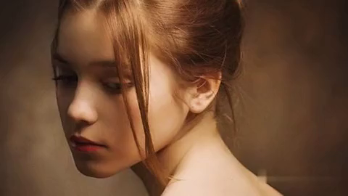
Let’s end up listening to a poem that was written
by Elizabeth Barrett Browning

Slide 31



