Slide 1

感恩遇见，相互成就，本课件资料仅供您个人参考、教学使用，严禁自行在网络传播，违者依知识产权法追究法律责任。
更多教学资源请关注
公众号：溯恩高中英语
知识产权声明

Slide 2
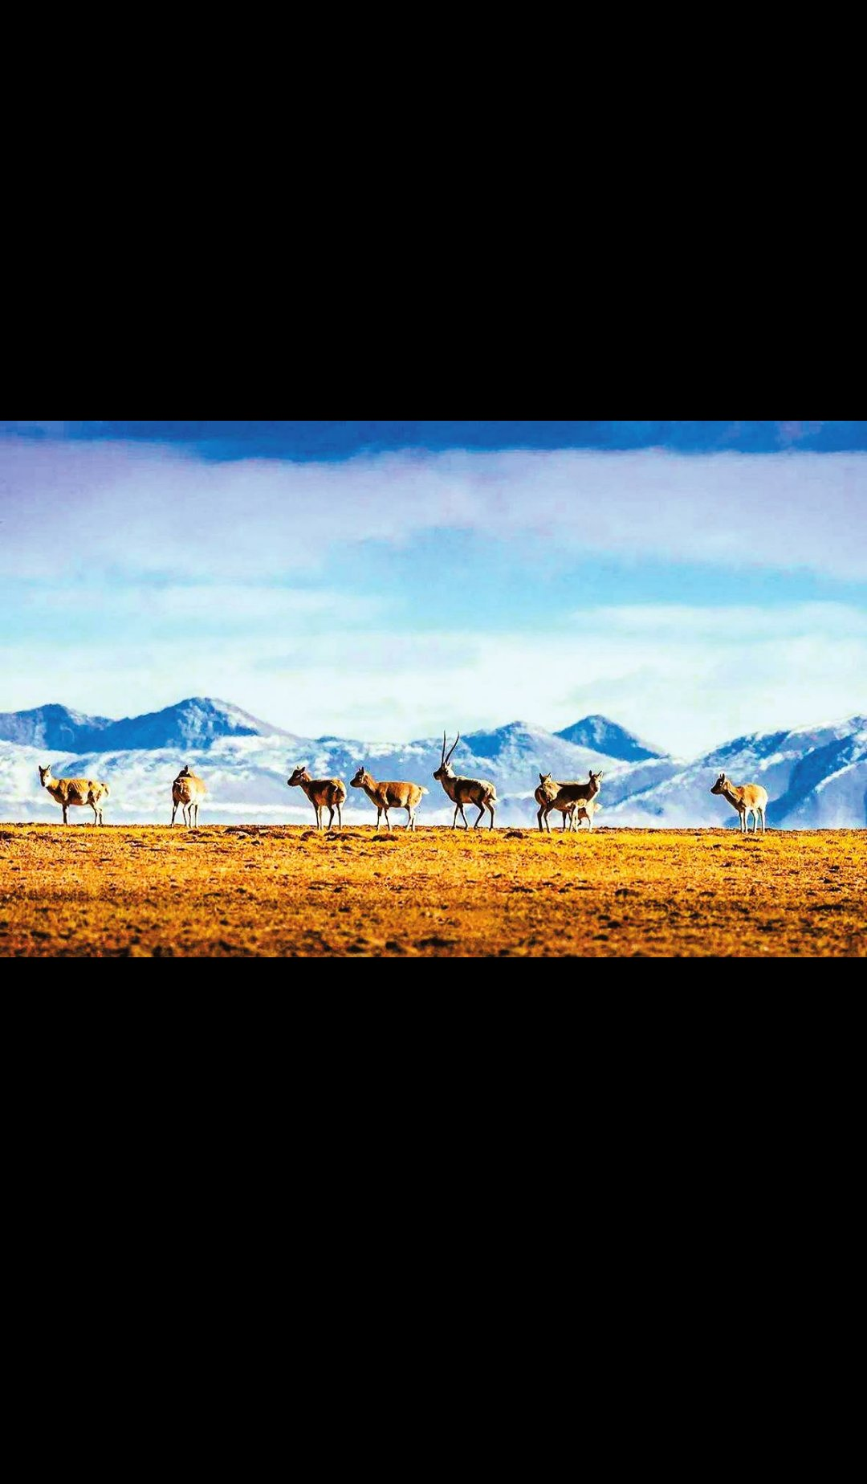
Unit2 A DAY IN THE CLOUDS
Reading and thinking
Topic: Learn about protecting endangered animals
浙江诸暨中学 何夏非

Slide 3
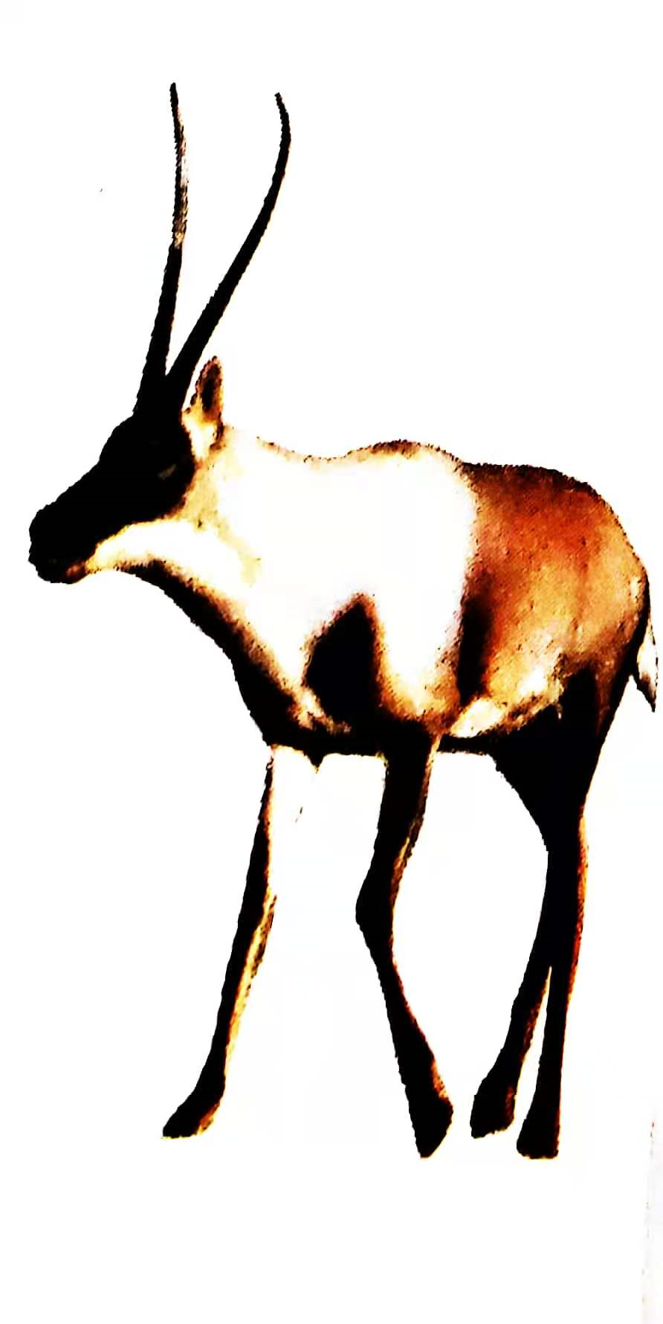
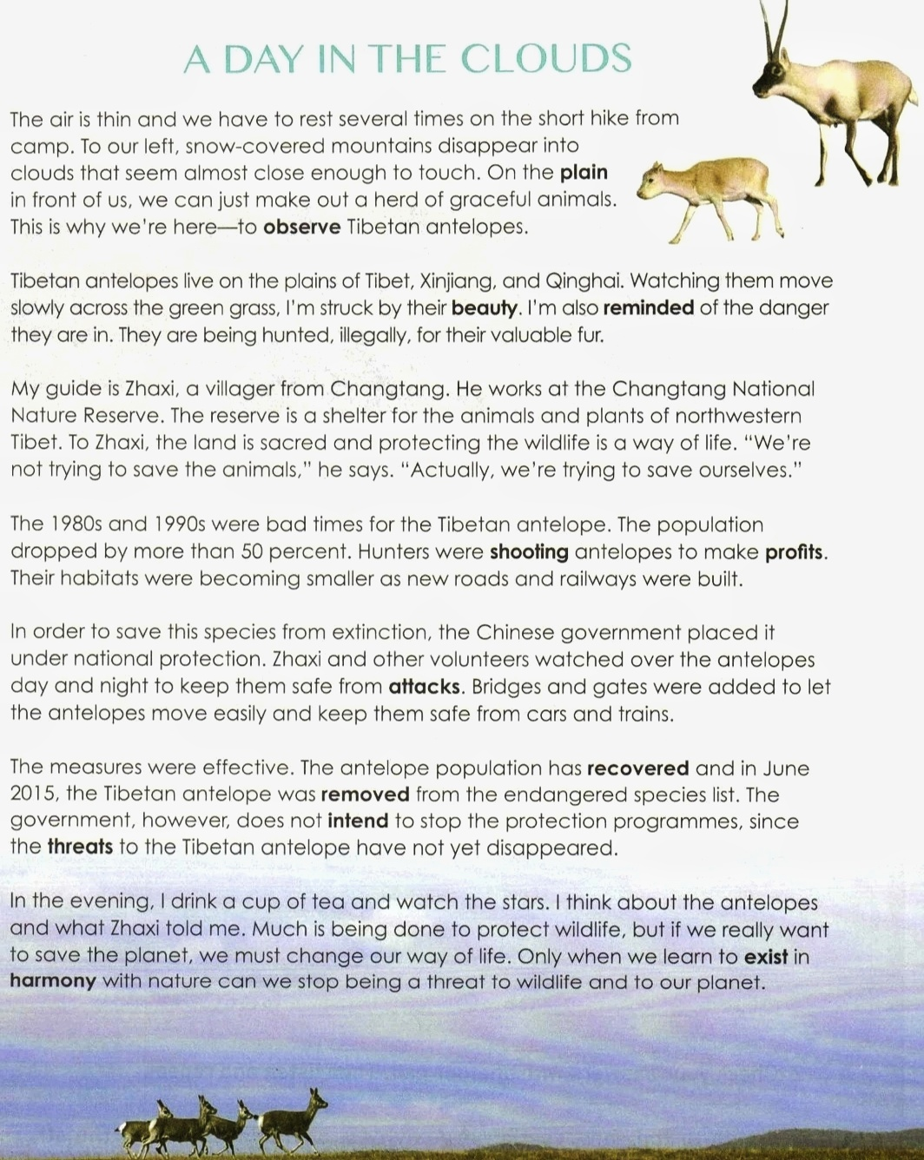
Activity 1: Predict & Skim
snow-covered mountains with a high altitude
The author's
Zhaxi's
on the plain
Tibet
Whose day is it?
Where do they go?
A Day in the Clouds
Why do they go there?
What do they see?
A herd of graceful animals
To observe Tibetan antelopes
They move slowly across...

Slide 4
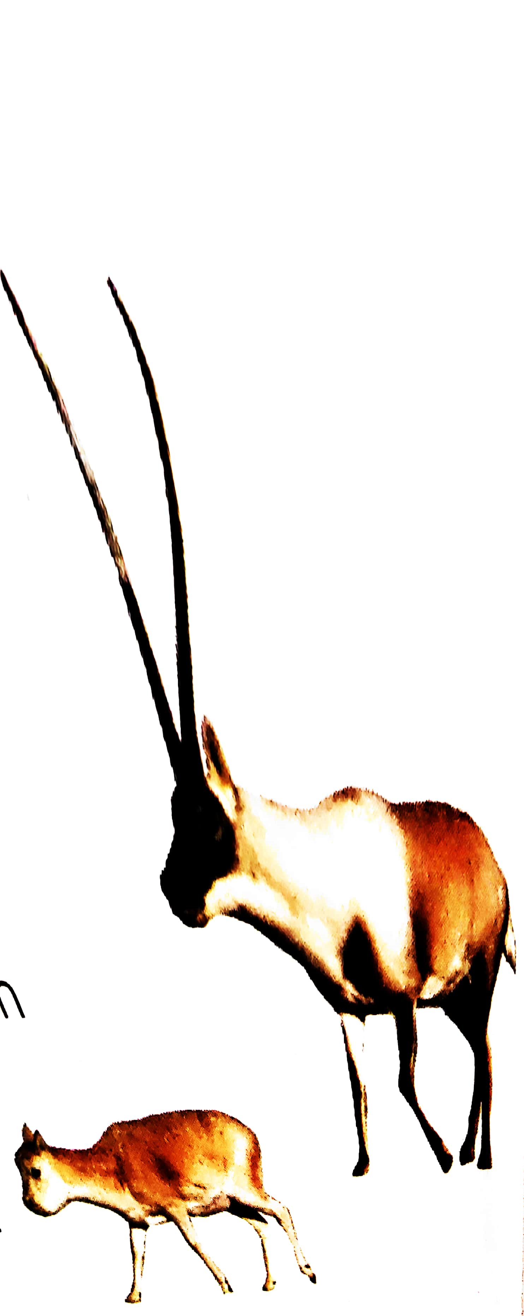
Activity 2: Read & Comprehend
Tip: Focus on the key words or topic sentences to get the main idea.
The writer visited Changtang in order to observe Tibetan antelopes.
Paragraph 1: The place and the purpose
Part One: What “I” observe
Tibetan antelopes are in danger.
Paragraph 2: The beauty & danger
His guide thinks that the land is sacred and protecting the wildlife is a way of life.
Paragraph 3: A protector
Bad times for the Tibetan antelope.
Paragraph 4: The bad times and causes
Part Two: What “I” hear
The Chinese government and volunteers took effective measures to protect the Tibetan antelope.
Paragraph 5: Protective measures
The effective measures have helped the population of Tibetan antelopes recover.
Paragraph 6: Effect / Result
Human beings must change the way of life in order to save the planet.
Paragraph 7: Reflection/Thinking
Part Three: What “I” think

Slide 5
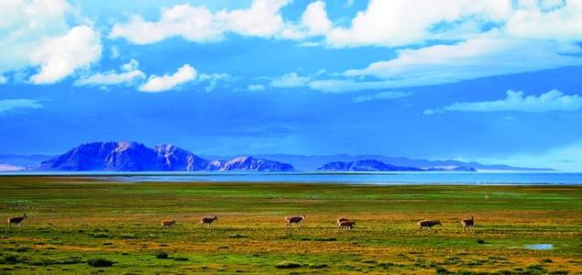
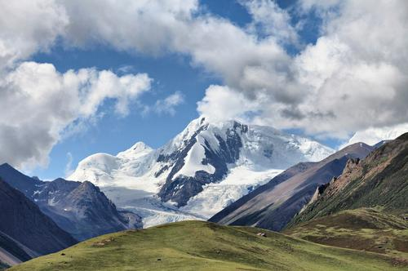
Activity 3: Read & Comprehend
What “I”observe:
What is the place where the antelope lives like?
The air is thin.
Snow-covered moutains disappear into clouds that seem
almost close enough to touch.
Tip: When the meaning is implied in the text but not directly stated, we must learn to infer.
？
peace
peace
I am also reminded of the danger they are in.
Contrast
danger

Slide 6
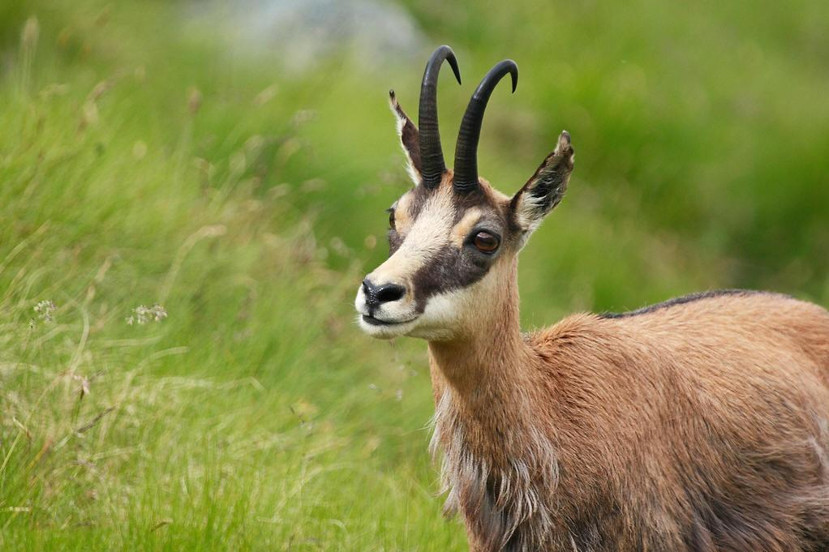
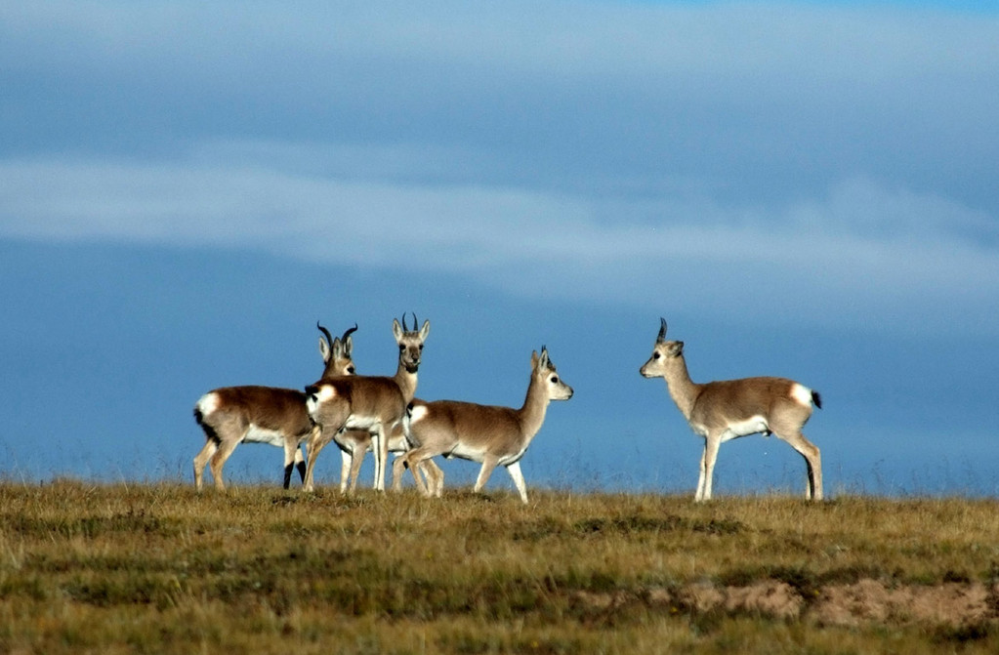
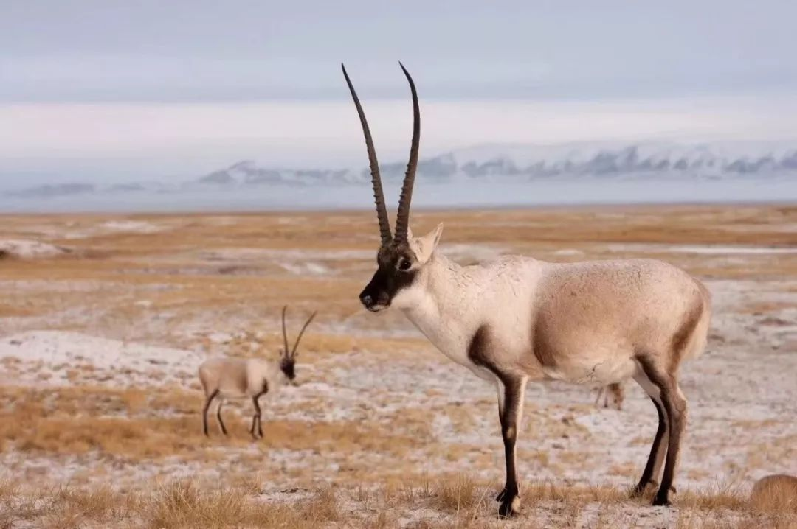
Activity 3: Read & Comprehend
What “I” hear:
The present situation:Basic information about the antelope
The Basic Information
The problem
Causes
efforts
are in danger
hunters were shooting
illegal shooting;
habitat loss
their habitats were becoming smaller
the government; volunteers

Slide 7
Activity 3: Read & Comprehend
repect for nature
What “I” hear: The volunteers' efforts
·What does Zhaxi do?
·What is Zhaxi's attitude towards protecting wildlife?
Zhaxi works at the Changtang National Nature Reserve which is a shelter for the animals and plants of northwestern Tibet.
The land is sacred and protecting the wildlife is a way of life.
？
We are not trying to save the animal. Actually, we're trying to save ourselves.
No protection, no antelopes, no humans !

Slide 8
Activity 3: Read & Comprehend
What “I” hear: The Government's efforts
The bad times:
The measures
What & How
joint efforts
result
?
Now:
Follow-up
measures
Why
threats
illegal hunting
pollution
habitat destruction
...

Slide 9
Activity 3: Read & Comprehend
Appeal for awareness
What “I” think: Our efforts
After a day's observation, what does the author think about the future?
In the evening, I drink a cup of tea and watch the stars. I think about the antelopes and what Zhaxi told me. Much is being done to protect wildlife, but if we really want to save the planet, we must change our way of life. Only when we learn to exist in harmony with nature can we stop being a threat to wildlife and to our planet.
All human beings need to make changes.

Slide 10
Activity 4: Discuss
Do you agree that we must change our way of life to save our planet? Why and how?
Note: You need refer to the text and your own experience.
What is our bad way of life | Why is it harmful | How to change
Words and expressions for reference:
In my opinion, we should/shouldn't...
The reasons are as follows:...
To save our planet, we should....

Slide 11

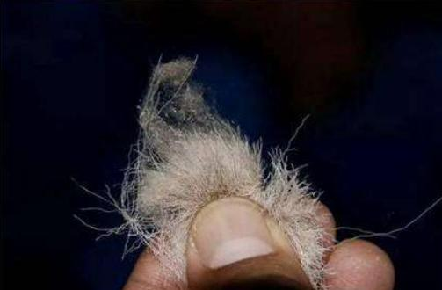
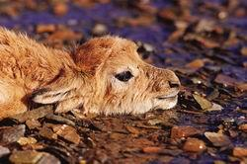
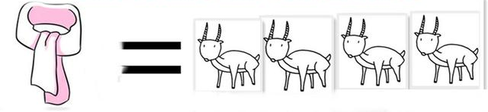
Example:
What is our bad way of life | Why is it harmful | How to change
Wearing Shahtoosh has become a fashion among the rich.
The birth of one Shahtoosh means the death of 4 antelopes.
appeal for awareness
take forceful measures
get / receive severe
punishment
bloody fashion

Slide 12

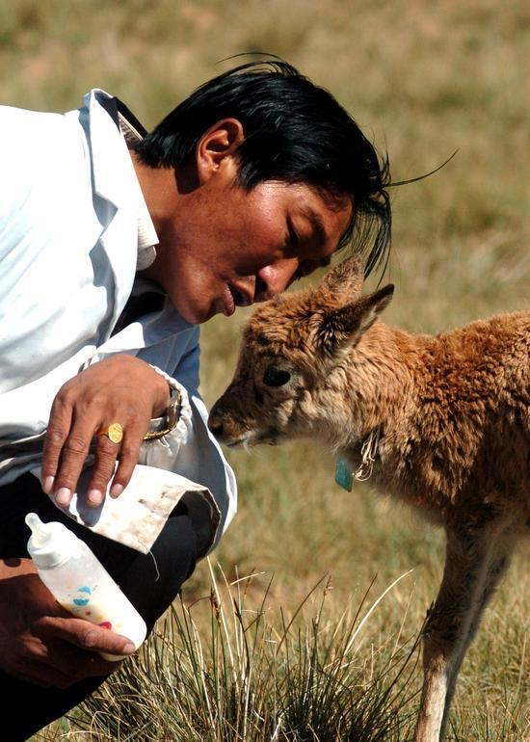
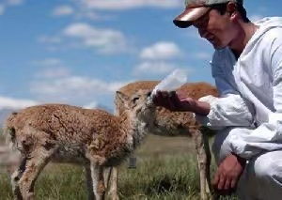
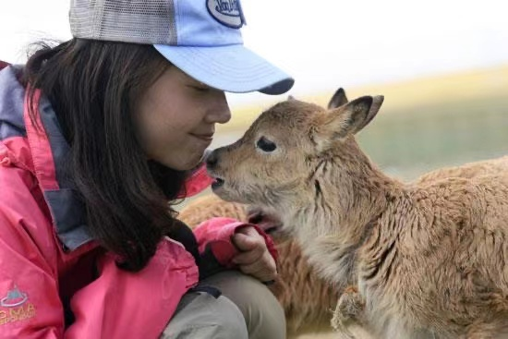
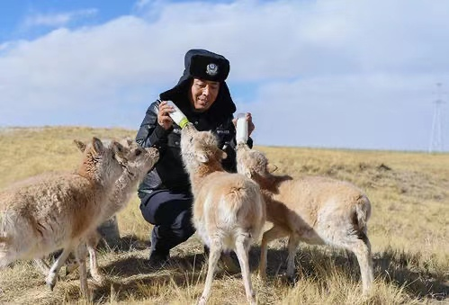
Only when all human beings change our bad ways of life
can we live in harmony with nature.
Only when all human beings ______________ can we _____________.
harmony
Humans
Wildlife
Nature
Planet

Slide 13
Activity 5: Conclusion
To save ourselves
Bad ways of life are quite common in our daily life.
Why
What
Harmony
How
It takes our efforts.
More to do
Results
Only all our bad ways of life are changed can we really live in harmony.
The situation is improving

Slide 14
Activity 6: Homework-deliver a speech
Suppose you are the writer and you have just returned from the journey. Your headmaster asked you to deliver a speech about the Tibetan antelopes. It may include the following parts:
1. The antelopes' life in the past (problems and causes);
2. Their present situation (improvements and reasons);
3. What we should do to protect the antelopes (reasons and measures).
Dear students,
I have just returned from the plain. I was really
struck by the graceful antelopes and snow-covered mountains there. But if you go there during 1980s and 1990s, things could turn out quite different.
At that time, ... Fortunately, ...
Only when we change our way of life, can we live ...

Slide 15
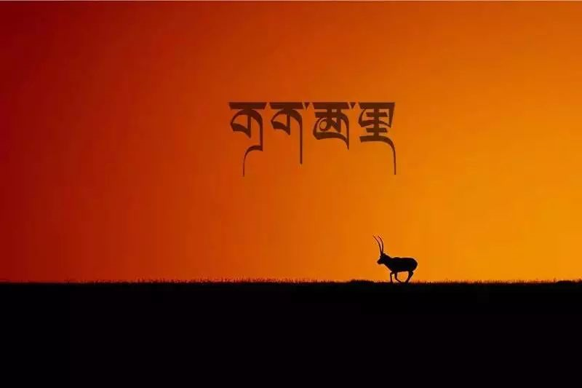
Thank you!

