Slide 1

感恩遇见，相互成就，本课件资料仅供您个人参考、教学使用，严禁自行在网络传播，违者依知识产权法追究法律责任。
更多教学资源请关注
公众号：溯恩高中英语
知识产权声明

Slide 2

Unit 4 Using language
How do I know my students?
浙江省临安中学 余智良

Slide 3

Part 1
Pre-reading：the function of description of body language
Read the passage and figure out the meanings of body language
As Lonnie yelled, we found a turkey leg was missing. We searched around the room, under the table, but in vain. We looked at Fido, who was standing at the gate licking his lips. Surprisingly, little Lonnie still yelled and kicked in his seat, with his eyes staring at something upward. We followed his eyes' direction.There, lying on the top of chandelier was the missing turkey leg.We all jumped to our feet, dancing and screaming with joy. The room echoed with our happy laughter and our gratitude for the returning turkey leg.
satisfied
impatient\anxious
curious about sth upward
thrilled/
overjoyed
Tip1：Description of body language plays an important role in showing the characters’ feelings.

Slide 4
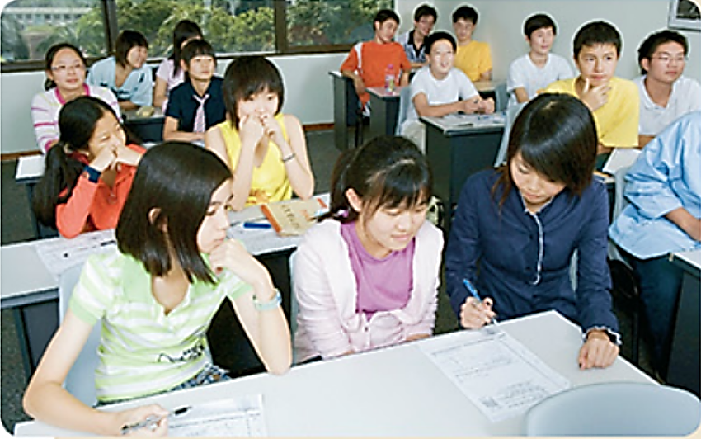
Part 1
Pre-reading ：Prediction
How do teachers tell their students’ performance in class?
By reading students’ classroom body language.

Slide 5
Part 2
Read the text and divide it into three parts.
Part | Paragraph | Main idea
1
2
3
Para 1-2
Introduction
Recognise when students are interested or bored (Para 3)
Para 3-5
Recognise when students are distracted (Para 4)
Distinguish when students are troubled (Para 5)
Para 6
Conclusion (Para 6)

Slide 6

Part 2
Read for the writing style.
Q: Where is the text likely to be taken from?
A．A social magazine. B．A science book.
C．A research report. D．A health magazine.

Slide 7
Match the body language with the meanings. Write the letters A-J on the lines.
___ 1. Looking up and making eye contact
___ 2. Leaning over to look at one's watch
___ 3. Two friends leaning heads together
___ 4. Leaning forward and looking at the
teacher
___ 5. Looking up, but no eye contact, no
expression
___ 6. Looking away
___ 7. Chin on hand, looking out the
window
___ 8. Looking down, arms or legs crossed
___ 9. Frowning
___ 10. Hair not brushed, red eyes
C
A. very interested
B. bored
C. interested
D. sad or worried
E. distracted
F. writing notes
G. serious
problems
H. like they are
asleep
I. daydreaming
J. angry, afraid, or
experiencing anxiety
B
F
A
H
E
I
Tip2：Description of body language is based on the use of various verbs.
D
J
G

Slide 8
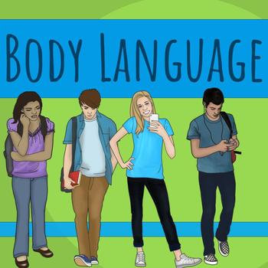
Read for specific details.
Part 2
Q: Why do the teachers think students’ classroom body language is important?
Students’body language lets the teacher know when to adjust class activities, when to intervene, and when to talk to students individually, so they can all get the most out of school.

Slide 9
Part 3
Post-reading: Learn to describe body language
Apply what you have learnt to the description of the following classroom behaviours.
Tell the meaning of each body language

Slide 10

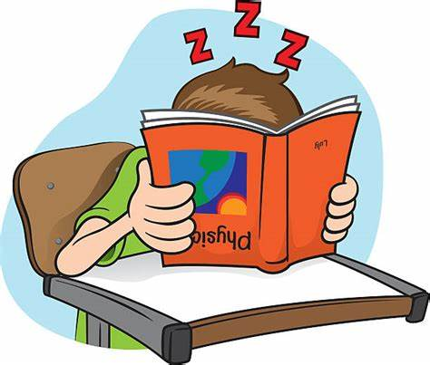
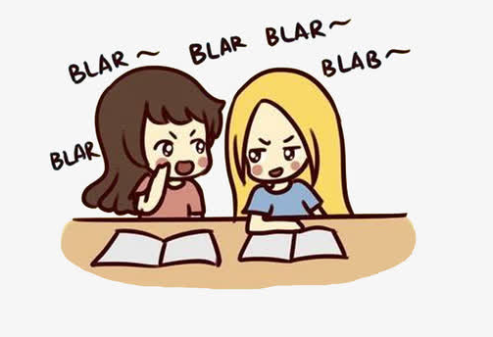
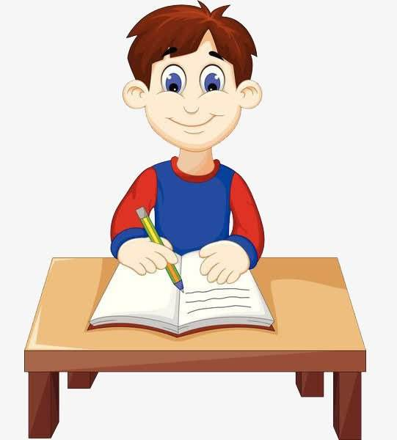
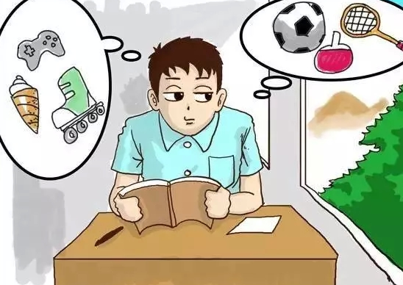
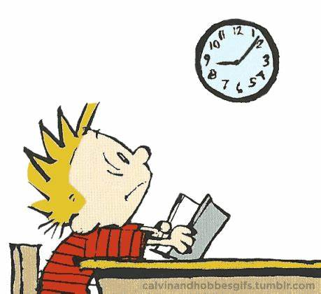
Tip3: When describing body language, pay attention to the person’s facial expressions, gestures and postures.
droop/lower his head
bury his head in the book
sleepy
lean towards...
gossip
distracted
sit straight up
take notes
with eyes fixed on
absorbed/attentive
keep his head up high
wear a bored expression
bored/waiting for---to end
hold his book up
daydreaming

Slide 11
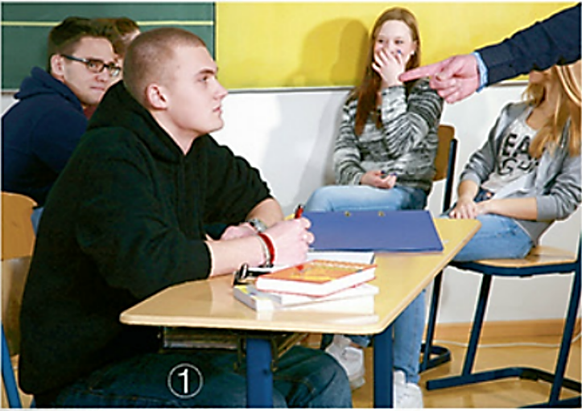
Part 4
Writing: design a story
Step 1: Discussion:
Q: Why are the students sitting in a circle?
Q: What may be the reasons why the boy student is scolded by his teacher?

Slide 12
Step2: design a story
Requirements:
You are the teacher who is scolding;
Make full use of the information you get from the discussion;
Make up a logical story;
Show characters’ feelings by describing their body language;
Work with your partner and finish the story of 80 words in 5 mins.

Slide 13
Sample:
One day in my English class, I assigned students a task for discussion. Several groups were formed instantly and one group drew my attention. In this group, a handsome boy was enthusiastically involved in the discussion, making others giggle a lot. Sometimes he bounced up and down, sometimes he made funny faces and in the other times, he leaned towards a girl talking something to her in secret. His behaviour really annoyed me, forcing me to take action. When I approached him, he pretended to work on the task with others. I scolded him for his misbehaviour. However, the serious look he wore on his face amused the girls in the corner, one covering her mouth with her hand. What a naughty boy!
active/
enthusiastic
naughty
pretend to be innocent

Slide 14


