Slide 1

感恩遇见，相互成就，本课件资料仅供您个人参考、教学使用，严禁自行在网络传播，违者依知识产权法追究法律责任。
更多教学资源请关注
公众号：溯恩高中英语
知识产权声明

Slide 2

The Week
Feb 19th-25th, 2022

Slide 3
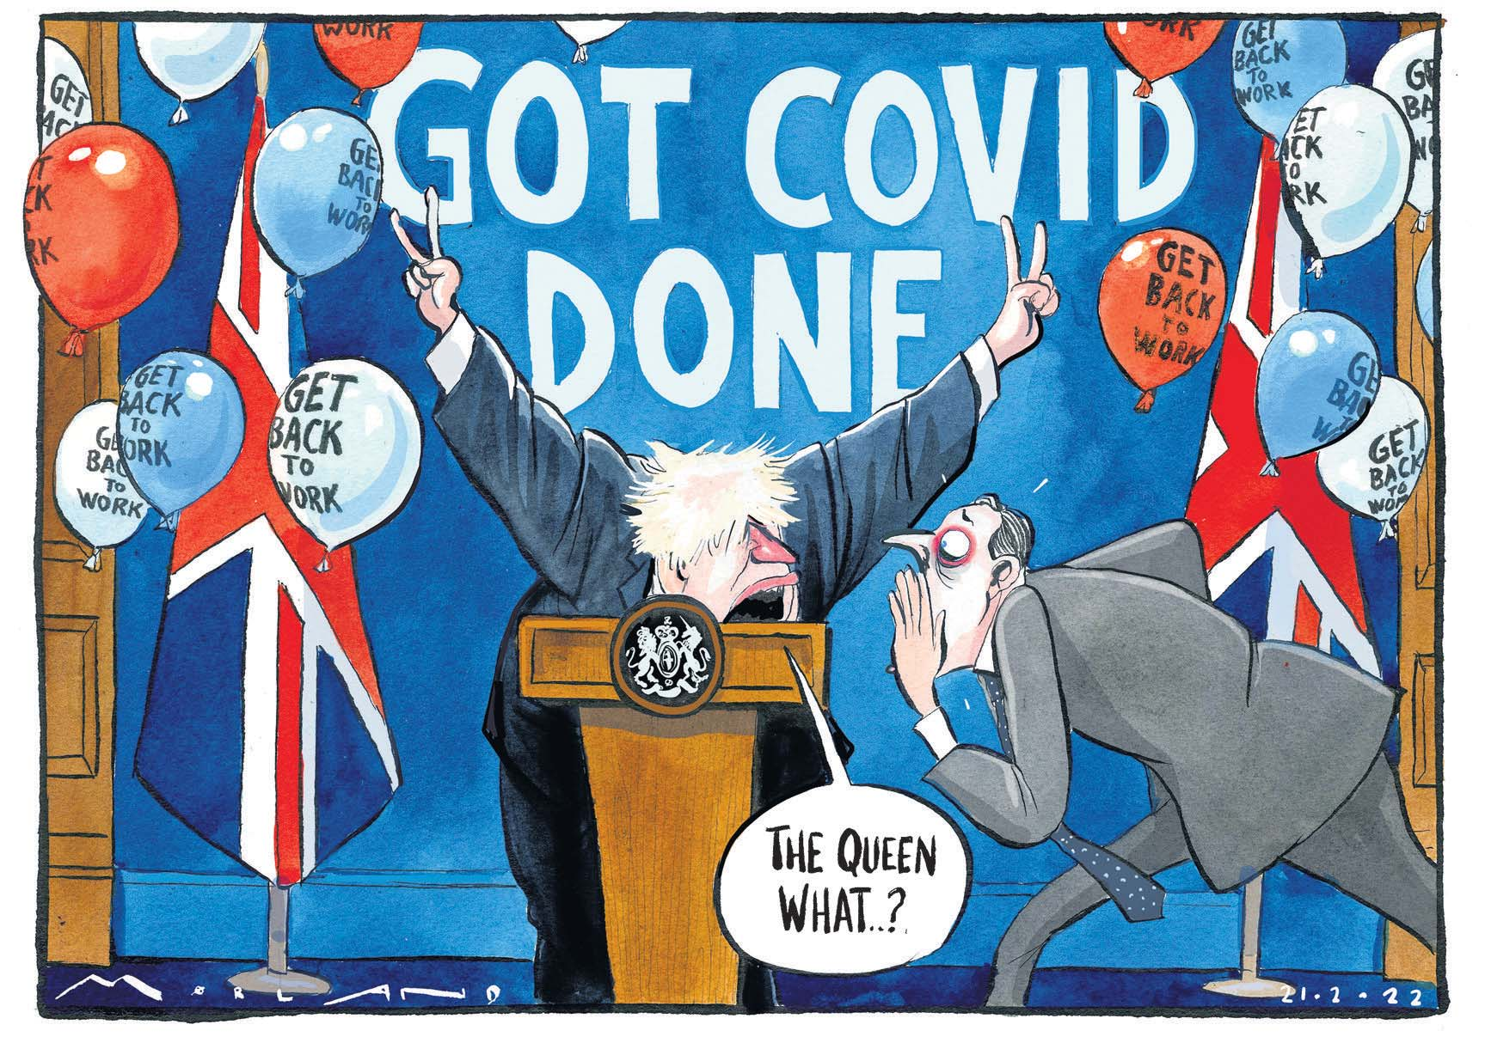
1. Queen Tests Positive for Covid-19 but Symptoms Mild
英国女王新冠检测阳性！

Slide 4
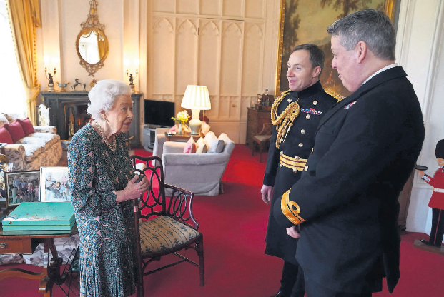
The Queen meets R Adm James Macleod, right, and Maj Gen Eldon Millar at Windsor last week.

Slide 5
语篇填空
（《卫报》2022年2月21号 1&4页）
The Queen has tested positive for Covid-19, ahead of the ________ (expect) ending of all coronavirus restrictions in England in the coming days. Buckingham Palace said the monarch, 95, was experiencing “mild cold-like symptoms” but expected __________ (continue) carrying out light duties this week.
It _____________ (confirm) that she had been in direct contact ____ her eldest son and heir, the Prince of Wales, the week he had the virus, while a number of _____ (case) have also been reported at her Windsor Castle home.The ____________ (announce) yesterday was made only a few weeks after the Queen, ____ will be 96 in April, reached her platinum jubilee of 70 years on the throne on 6 February.
The prime minister, Boris Johnson, had been speaking ______ (early) in the day about moves to lift Covid-19 restrictions, ______ (say): “Now is the moment for everybody to get their confidence back.” He later tweeted: “I’m sure I speak for everyone in wishing Her Majesty the Queen a swift recovery _____ Covid and a rapid return to vibrant good health.”
expected
to continue
was confirmed
with
cases
announcement
who
earlier
saying
from

Slide 6
词汇讲解
1. restriction: a rule or law that limits or controls what people can do 限制规定
The government has agreed to lift restrictions on press freedom.
政府已经同意撤销对新闻自由的限制。
2. vibrant: full of life and energy 充满生机的；生气勃勃的；精力充沛的
Tom felt himself being drawn toward her vibrant personality.
汤姆感到自己正被她充满活力的个性所吸引。
翻译句子
该法律对私营公司施加了新的金融限制。
The law imposed new financial restrictions on private companies.
翻译句子
她十六岁，年轻而充满活力。
She was sixteen, young and vibrant.

Slide 7
句子翻译
It was confirmed that she had been in direct contact with her eldest son and heir, the Prince of Wales, the week he had the virus, while a number of cases have also been reported at her Windsor Castle home.
据证实，在她的长子、继承人威尔士亲王感染新冠病毒的那一周，她曾与他有过直接接触，而她在温莎城堡的家中也出现了一些病例。
翻译
The prime minister, Boris Johnson, had been speaking earlier in the day about moves to lift Covid-19 restrictions, saying: “Now is the moment for everybody to get their confidence back.”
英国首相鲍里斯·约翰逊当天早些时候曾谈到取消对新冠疫情限制的举措，他说:“现在是每个人恢复信心的时候了。”
翻译

Slide 8

2. Pupils who fail English and maths
will be barred from student loans
英语和数学挂科，将无缘学生贷款！

Slide 9
语篇填空
（《泰晤士报》2022年2月23日 4页 )
will be banned
Pupils who fail GCSE English and math ______________ (ban) from taking student loans under government plans to be announced this week.
The new entry thresholds(门槛) for university are widely seen as ___ means of reining in student loan debt, with outstanding loans _________ (reach) £140 billion in 2020. The government plans come after the Office for Students regulator threatened universities and colleges in England with fines and ___________ (restrict) on their access to student loan funding in a move to eliminate “low-quality” courses.
Under the proposals, _________ (report) by The Daily Telegraph, students _____ fail to achieve a Grade 4 in math and English GCSEs will be barred from accessing student loans.
According to the DfE, less than half of students at 25 British universities who begin a degree can expect to finish ___ and find professional employment or further study _____ 15 months of graduation. A spokesman said: “Higher education is an investment and we need _________ (ensure) that graduates are being rewarded . . . with an ____________ (educate) experience and jobs that match their skills and help contribute to the economy.”
a
reaching
restrictions
reported
who
it
within
to ensure
educational

Slide 10
词汇讲解
1. rein: to control or stop sth. 控制或停止
She kept her emotions tightly reined in.
她尽量克制着自己的感情。
2. eliminate: to remove or get rid of sth/sb 排除；清除；消除
This diet claims to eliminate toxins from the body.
这种饮食据称具有排除体内毒素的作用。
翻译句子
我们需要严格控制公共开销。
We need to rein back public spending.
翻译句子
他为了消灭他们的对手而向政府宣战。
He declared war on the government to eliminate their opponents.

Slide 11
选词(组)填空
用以下词或词组的适当形式完成句子。
1. The three sons also _____________ the family business.
2. He had a terrible temper, and once ___________ to kill another child.
3. Statistical analysis is ___________ arriving at a fairly reliable forecast.
4. Stores should ______________ selling alcoholic drinks to teenagers.
5. Are you for or against the _________?
6. You've illegally __________ and misused confidential security files.
be banned from threaten access contribute to a means of proposal
contribute to
threatened
a means of
be banned from
proposal
accessed

Slide 12
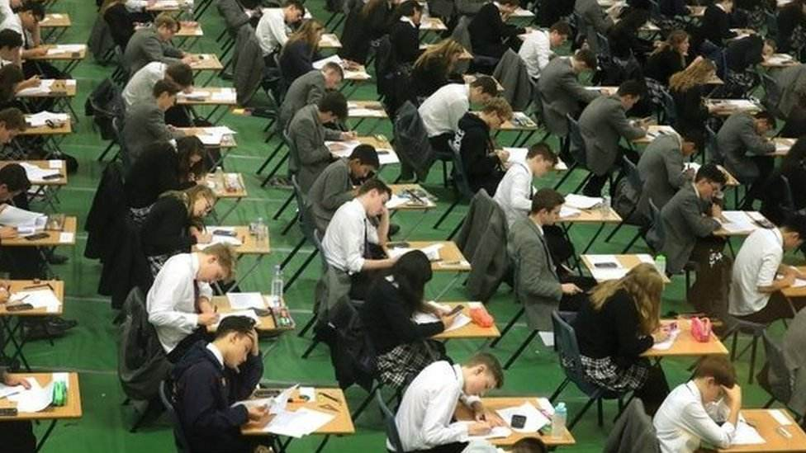
GCSE: General Certificate of Secondary Education（英国）普通中等教育证书
DfE:
Department for Education（英）教育部
普通中等教育证书 (GCSE) GCSE是英国学生完成第一阶段中等或中学教育后重要的考试证书。 完成该课程后，学生可以继续升读A Level课程、大学预科课程或其他同等课程。

Slide 13
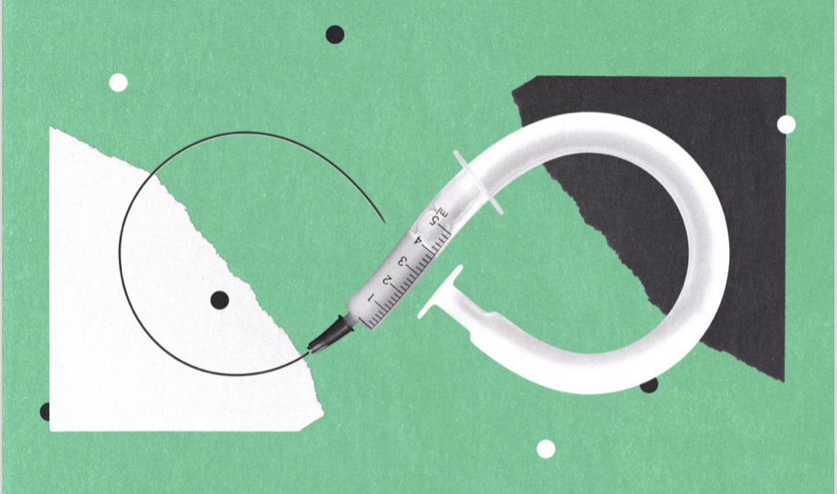
3. The Race for a Universal Coronavirus Vaccine
通用冠状病毒疫苗的前景

Slide 14
语篇填空
（《连线》2022年2月刊 20-21页）
Over the past eight months, a few international research teams ____________ (propose) approaches to protect people against not just SARS-CoV-2, but its entire viral family.
____ here’s the challenge: To make a vaccine that protects against multiple types, strains, or variants of a virus, researchers have to find a feature that they all have __ common and that our immune system reacts to.
Researchers _______ (chase) an all-in-one vaccine have to make a strategy choice. They can base their formula on the most immunogenic (产生免疫性的) elements of a virus and accept that the vaccine they make might work for that one only. Or they can use as their foundation the things __________ are most similar between viruses—and concede that their vaccine might not stimulate the ________ (strong) response.
On the path to ___ universal vaccine, researchers will also want to ask, for instance, _______ the goal of vaccination is to prevent all infection and transmission or only severe ______ (ill) and death.
And they will have to maintain support from policymakers and funders _________ (continue) research that might not deliver a product for years.
have proposed
But
in
chasing
that / which
strongest
a
whether
illness
to continue

Slide 15
词汇讲解
1. concede: to admit that sth is true, logical, etc. (勉强)承认，承认…属实
Bess finally conceded that Nancy was right.
贝丝最终承认了南希是对的。
2. maintain: to make sth continue at the same level, standard, etc. 维持；保持
Push yourself to make friends and to maintain the friendships.
要求自己与人交友并保持友谊。
翻译句子
他被迫承认可能有困难。
He was forced to concede that there might be difficulties.
翻译句子
这两个国家一直保持着密切关系。
The two countries have always maintained close relations.

Slide 16
长难句分析
To make a vaccine that protects against multiple types, strains, or variants of a virus, researchers have to find a feature that they all have in common and that our immune system reacts to.
主句
分析：本句是一个复合句,“researchers have to find a feature”是______；“To make…a virus”是不定式作_________；“they all have in common…reacts to”是_________修饰先行词_______。
目的状语
定语从句
feature
为了制造一种可以预防某种病毒不同类型、毒株或变种的疫苗，研究人员必须找到它们都具有的,并且我们的免疫系统会对其做出反应的共同特征。
翻译
They can use as their foundation the things that are most similar between viruses—and concede that their vaccine might not stimulate the strongest response.
定语从句
things
分析：本句是一个并列句,“that are… viruses”是_________修饰先行词______；“that their vaccine… response”是_________。
宾语从句
他们可以使用病毒之间最相似的东西作为他们的基础——但要承认他们的疫苗可能不会引发最强的免疫反应。
翻译

Slide 17
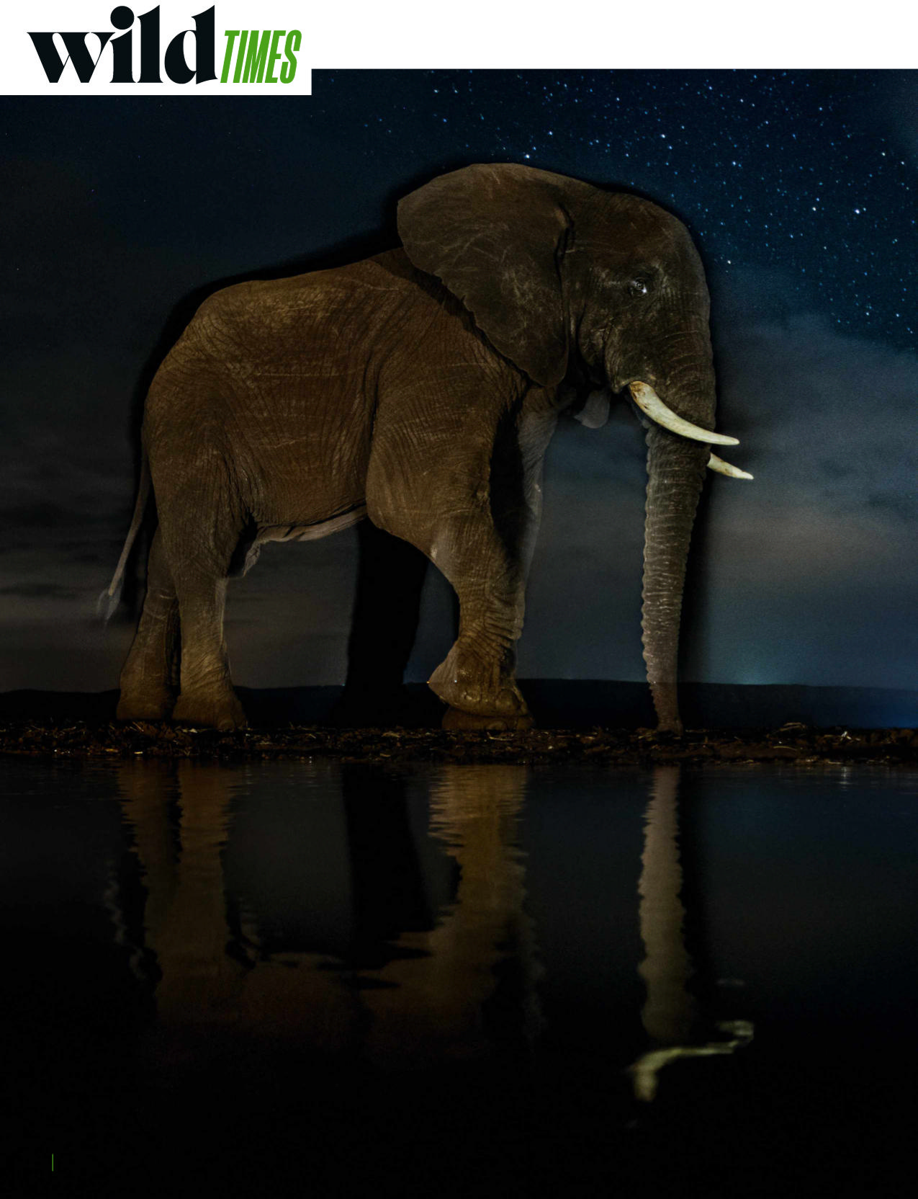
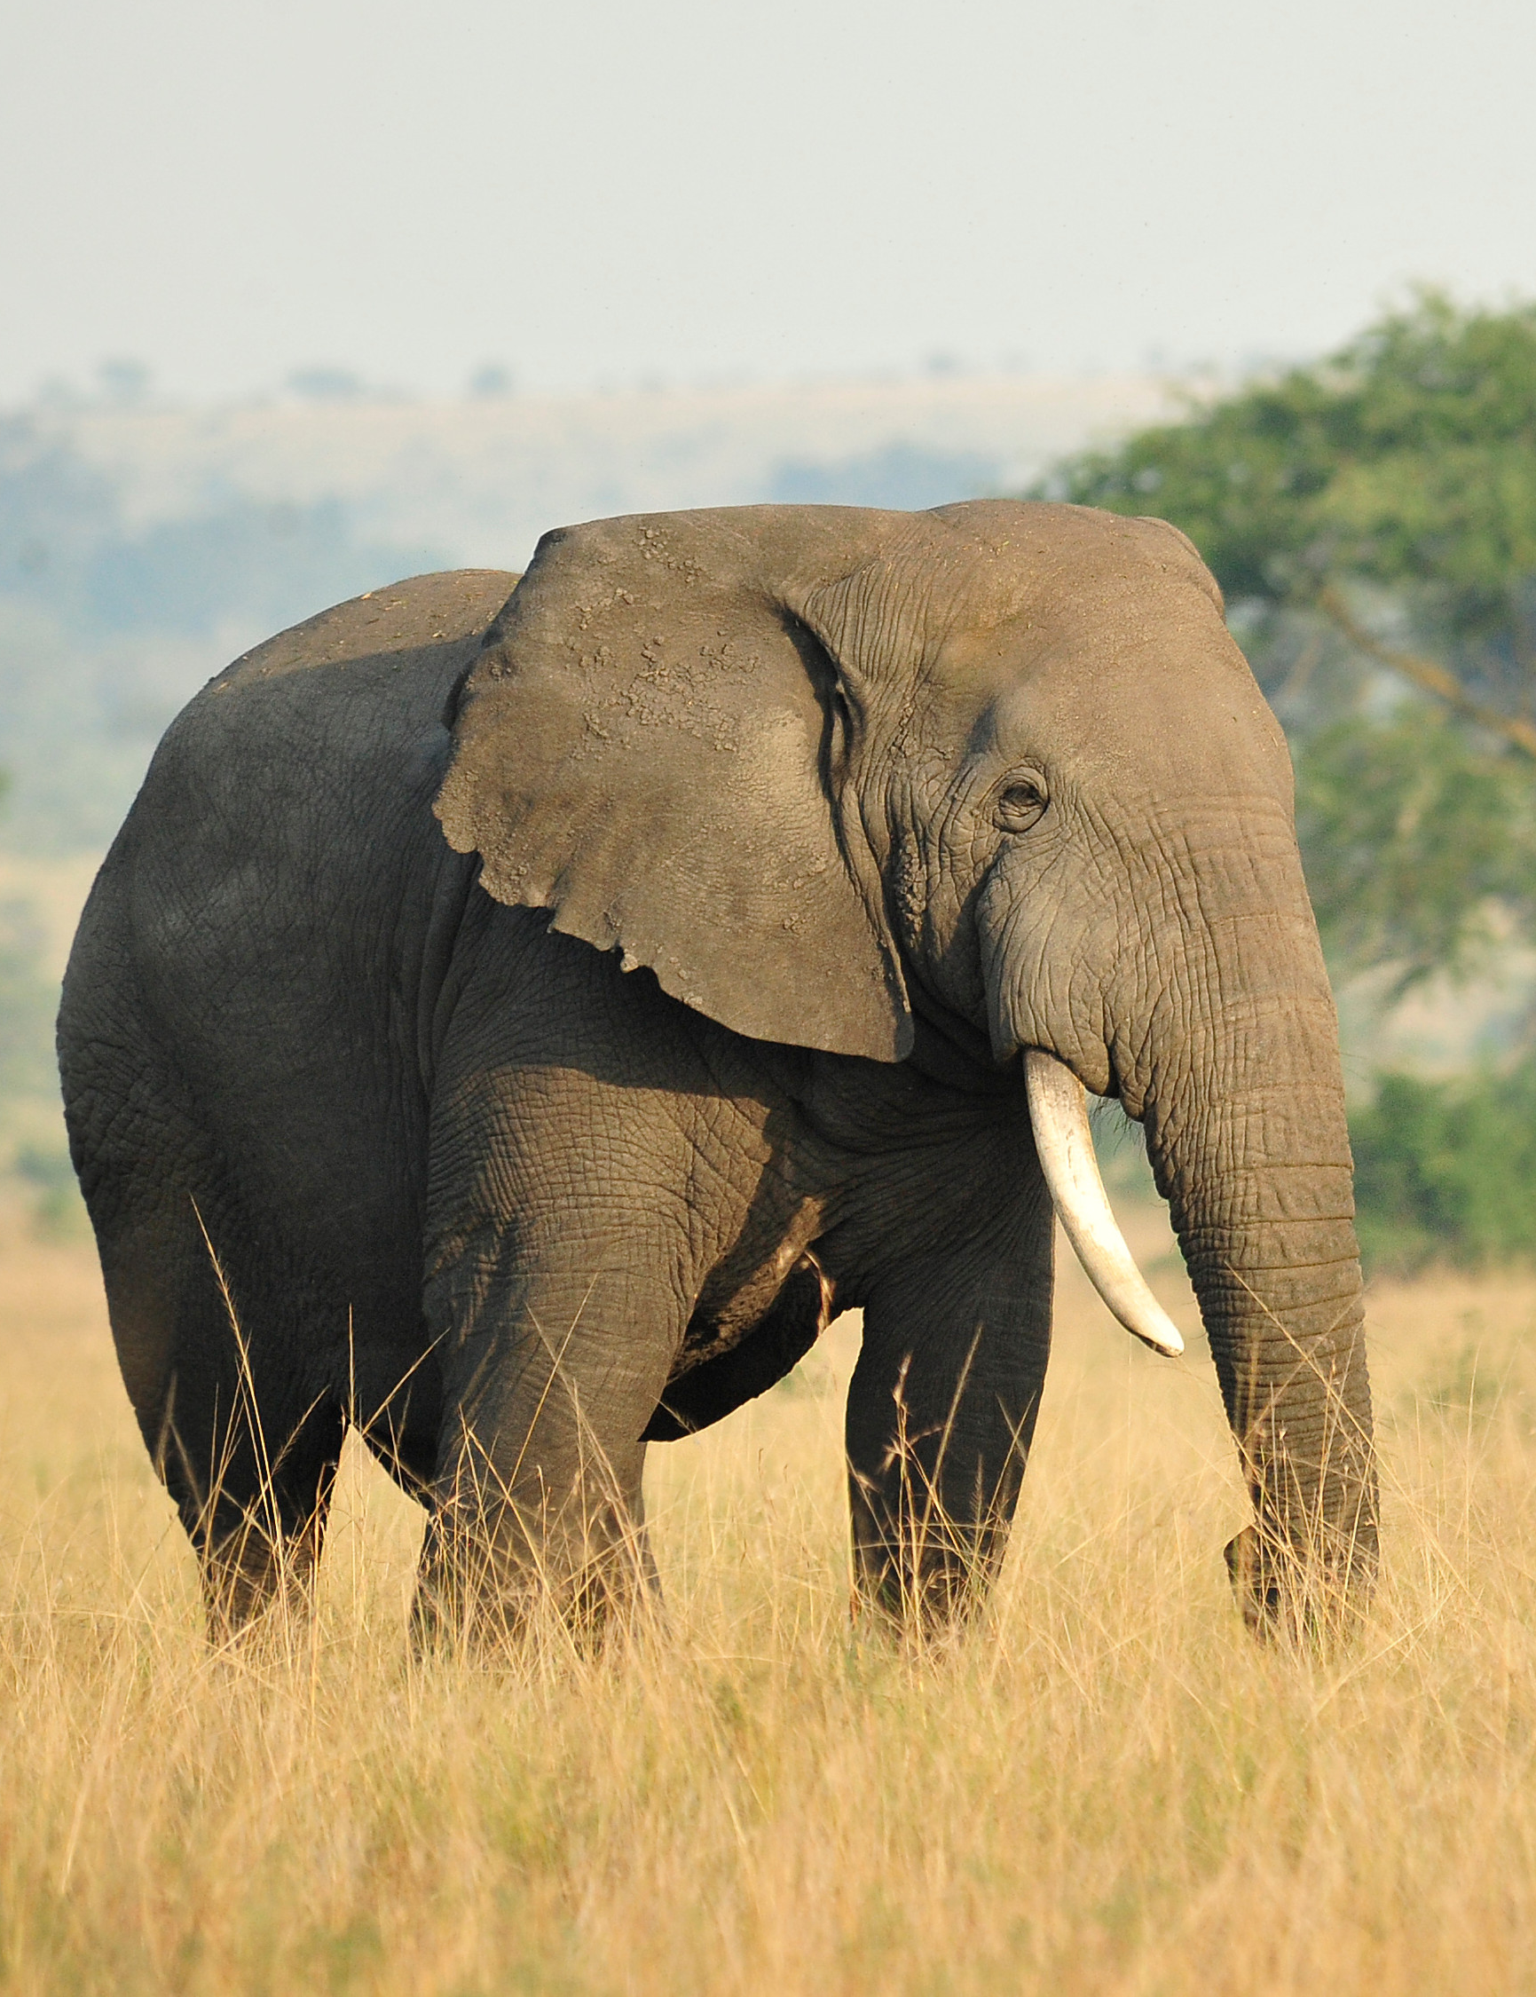
4. Elephant poaching drops to 20-year low
非洲大象偷猎率降至20年来的最低水平
An African savannah elephant visits a waterhole at night.

Slide 18

语篇填空
（《BBC野生生物》2022年1-2月刊 12-13页）
lowest
Rates of elephant poaching in Africa have fallen to their ______ (low) rate in two decades and have decreased to almost one fifth of _____ they were in 2012, according to data _______ (release) by the world’s wildlife trade body.
The figures don’t represent absolute poaching levels, but they do show trends. In 2003, CITES received reports of 287 carcasses (动物尸体) ________ (legal) killed at 69 sites across Africa. By 2012, this ________ (rise) nearly four-fold to 1048, and last year it dropped back down to 228.
Mark Jones, head of policy at animal charity the Born Free Foundation says the news of the decline was welcome and reflected increased ______ (effort) to protect elephants. “But elephants continue _______ (suffer) and die in large numbers at the hands of poachers, which puts ________ (press) on populations,” he warns. “There is no room for complacency.”
In particular, Jones points out that there has been much less of a reduction in poaching of elephants in Central and West Africa, many of ______ are forest elephants, now officially recognised as separate to the savannah (稀树草原) species. Elephants are also __ risk from human-wildlife conflict and loss of habitat, he adds.
what
released
illegally
had risen
efforts
to suffer
pressure
which
at

Slide 19
词汇讲解
1. poach: to illegally hunt birds, animals or fish on sb else’s property or without permission （在他人地界）偷猎，偷捕
→ 派生词：poacher n.偷猎者
The elephants are poached for their tusks. 为获取象牙而偷猎大象。
2.complacency: a feeling of satisfaction with yourself or with a situation 自满
Despite improvement in the economy, there is no room for complacency.
尽管经济有所改善，但仍不能自满。
翻译句子
那个农民射杀了那些人，因为他们在他的土地上偷猎。
The farmer shot the men because they were poaching on his land.
翻译句子
自满容易导致悲剧。
Complacency could easily result in tragedy.

Slide 20
长难句分析
In particular, Jones points out that there has been much less of a reduction in poaching of elephants in Central and West Africa, many of which are forest elephants, now officially recognised as separate to the savannah species.
分析：本句是一个复合句，Jones points out后that引导的是一个_____ 从句；该宾语从句中又包含一个_____从句，先行词 ________，从句部分为many of which ... savannah species，其中now officially recognised as ... savannah species为过去分词作_________。
宾语
定语
elephants
后置定语
琼斯特别指出，在中非和西非偷猎大象的减少幅度要小得多，其中许多是森林象，现在被官方认定为与草原象不同的物种。
翻译

Slide 21
5. 60-Second Science 全球气候变暖导致虎鲨改变活动范围

Slide 22

听写 Part I
Christopher Intagliata: This is Scientific American’s 60-Second Science. I’m Christopher Intagliata. As it happens, tiger sharks _______________________ with certain East Coasters.
Neil Hammerschlag: During the winter, when it’s cold, they kinda snowbird down near the Bahamas and off of Florida. And then, during the summer, ________________.
Intagliata: Neil Hammerschlag is director of the Shark Research & Conservation Program at the University of Miami. He and his colleagues ________ 40 years of fishing catch data and they found that as ocean waters have warmed, the sharks’ range has shifted some ___________________. The sharks, it seems, are _______ their preferred water temperatures towards the pole. They also tracked dozens of tiger sharks with satellite tags for nine years and _____________________.
Hammerschlag: So ____________, we have several lines of ________ that tiger shark distributions and migrations are changing from ocean warming, causing their distributions and migrations to ________________ further north. And in these northern areas, they actually ___________ in the year from ocean warming.
have something in common
they migrate north
analyzed
250 miles to the north
chasing
they found similar results
taken together
evidence
extend and expand
occur earlier

Slide 23
听写 Part II
Intagliata: Their findings appear in the journal Global Change Biology.
This shift _______, Hammerschlag says, because tiger sharks are apex predators, and where they go _________ the food web beneath them. The sharks are also moving outside marine protected areas and into places where they could be ______________ to commercial fishing.
Hammerschlag: What this points to is that: these marine protected areas need to consider current but also ____________ in species distributions from ocean warming. And they certainly have to be ________ and maybe, you know, work with not only having marine protected areas but also other types of protections, like __________ and other types of more traditional species conservation and management tools, in addition to ______________.
Intagliata: Now, if you don’t find the ecological argument __________, Hammerschlag pointed out one more implication. Although shark bites are ____________, he says, if tiger sharks shift their range—and warm waters draw more bathers to the ocean—that could up the odds of an __________________ beneath the waves.
matters
influences
more vulnerable
future changes
adaptive
catch limits
protecting places
convincing
relatively rare
unfortunate encounter

Slide 24
熟词生义讲解
1. catch: the total amount of things that are caught 总捕获量
The catch amounted to 50 fish. 渔获量达50条鱼。
2. up: to increase the price or amount of sth 提高；提升；增加
He upped his offer for the company. 他提高了给该公司的报价。
翻译句子
捕获的鱼里有一条重逾18磅。
The catch included one fish over 18 pounds.
翻译句子
许多生活方式因素会增加心脏病发作的几率。
Many lifestyle factors up the odds of having heart attacks.

