Slide 1

感恩遇见，相互成就，本课件资料仅供您个人参考、教学使用，严禁自行在网络传播，违者依知识产权法追究法律责任。
更多教学资源请关注
公众号：溯恩高中英语
知识产权声明

Slide 2
选修 1
Unit 5 Working The Land
-Using Language1
Explore the world hunger problem
-By Lily

Slide 3


nowadays
People suffered extreme hunger/ massive starvation.
a big contrast
seven decades ago

Slide 4
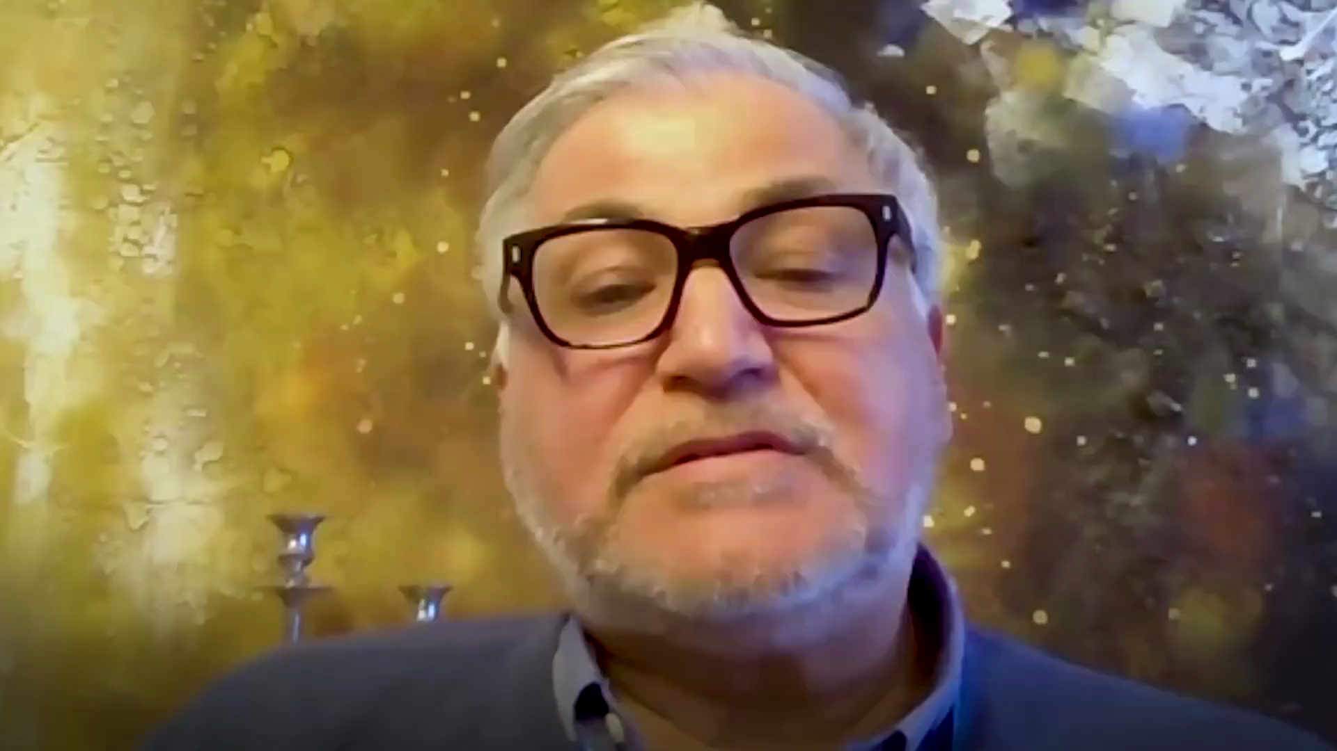
the hunger problem under the outbreak of Covid-19
How about people in other areas of the world?

Slide 5

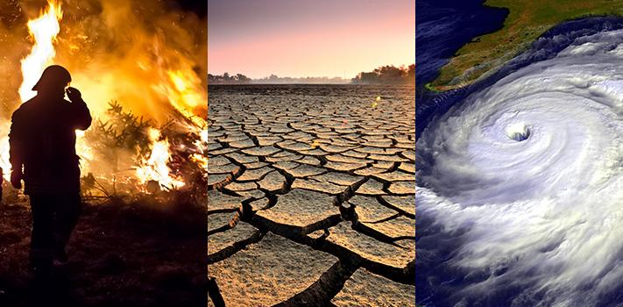
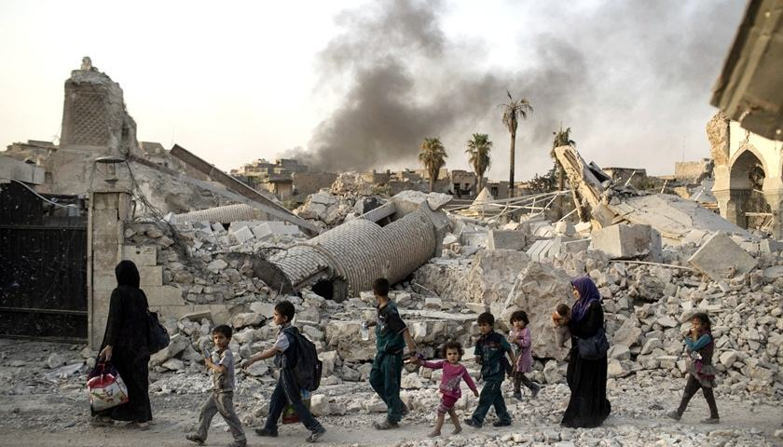


What are the possible factors causing the world hunger problem?
单击此处添加标题
extreme drought
wars
poverty
A
B
C

Slide 6


Listen for the main setting.
A host of a radio show
(Who)___________________is interview __________________about
_______________________________________________(talking topics.)
David from FAO
the FAO, the causes of world hunger and the
ways to solve the problem of world hunger.
If you were the host, what questions would you raise about the topics:
e.g: What is FAO?
...

Slide 7
FAO’s purposes
Listen for details.
1. What is the FAO? What is its mission?
FAO’s ideas
2. What can seriously affect crop production?
3. What does the FAO think about nutritious food ?
4. What is the FAO doing to alleviate world hunger?
FAO’s interventions
5. What does the FAO suggest countries do?
FAO’s suggestions

Slide 8
Listen for details.
1. What is the FAO? What is its mission?
to completely get rid of sth
FAO stands for Food Agriculture Organization to eliminate world hunger.
[ɪˈlɪmɪneɪt]
2. What can seriously affect crop production?
Things like droughts, floods and climate change can seriously affect crop production.
3. What does the FAO think about nutritious food ?
People need to eat enough nutritious food which many people can't afford or don't have access to. The FAO believes everyone should have the right to healthy food.
to have the right or chance to use or reach sth

Slide 9
4. What is the FAO doing to alleviate world hunger?
to operate
The UN is making efforts to reduce climate change and the FAO runs a project called Climate Smart Agriculture which helps countries to develop sustainable agriculture.
able to continue without causing damage to the environment
5. What does the FAO suggest countries do?
The FAO suggests that every country focus on making new achievements in agriculture which can benefit the whole world. Global conflict must be eliminated.

Slide 10
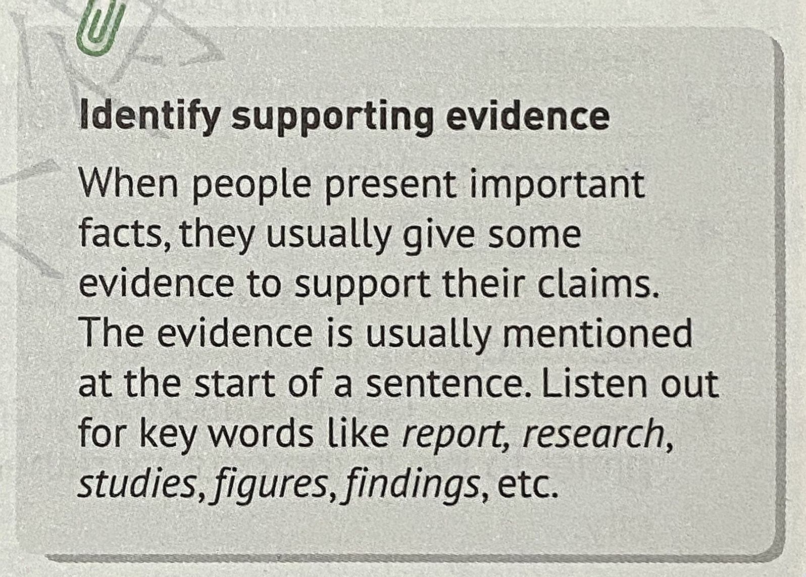
Listening for identifying supporting evidence
the Listening Tip:

Slide 11
Listen for opinions and supporting evidence.
Supporting Evidence | Opinions
According to
1. Our aim is simple, to eliminate world hunger.
1. According to our latest figures, ...
2. There is strong evidence to suggest that...
suggest that
2. And another factor is poverty
indicates that
3.War directly leads to mass hunger
3. Our research indicates that...
A. wars can heavily affect food production and transportation.
B. (world hunger) stands at around 11% of the world's population.
C. many people just can't afford to eat well.

Slide 12
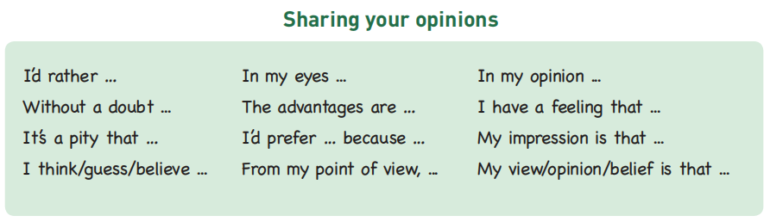
What are your ideas about this hunger issue?
Listen for thinking.
Possible Causes | Possible Solutions

Slide 13
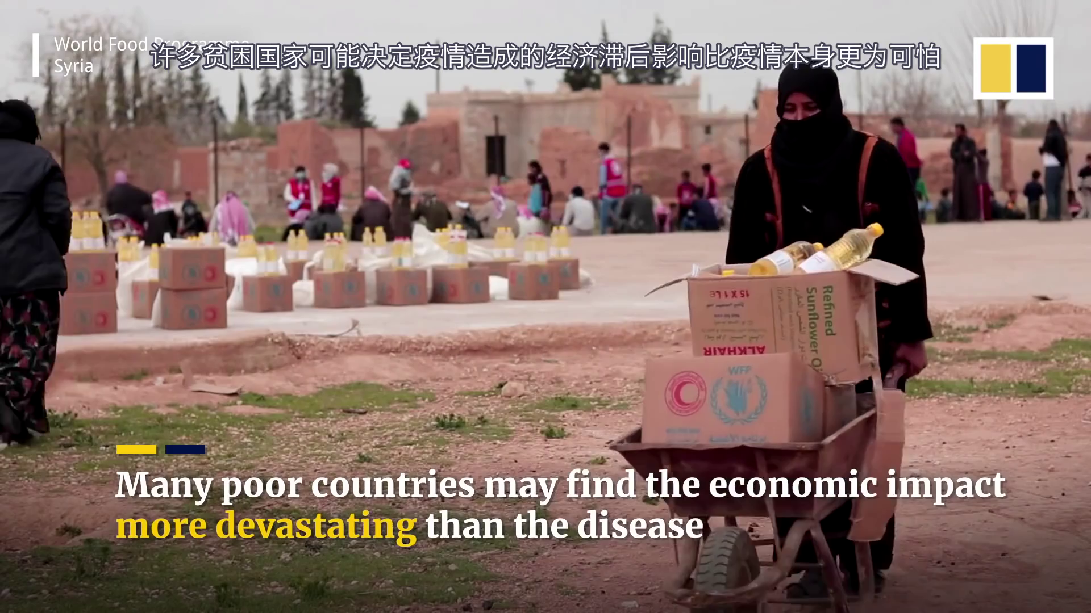
What do we need to do to alleviate the world hunger?

Slide 14

To eliminate the world hunger takes global efforts.

Slide 15
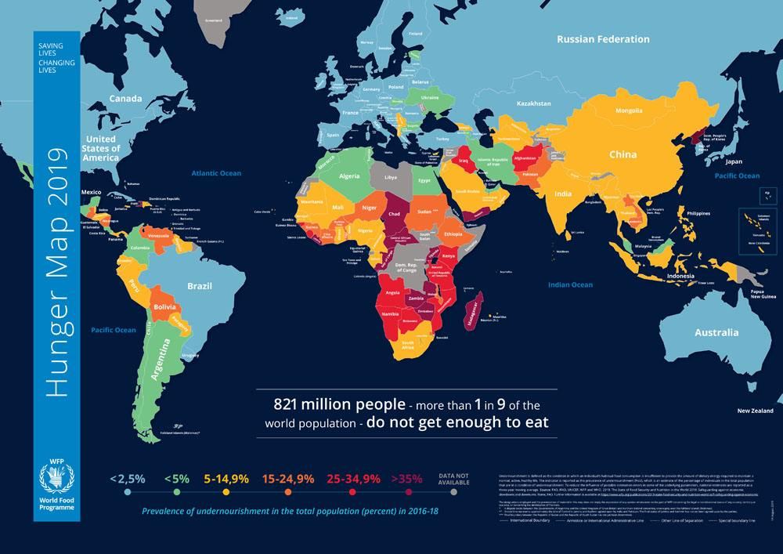
What can we do?
The Hunger Map 2019

Slide 16


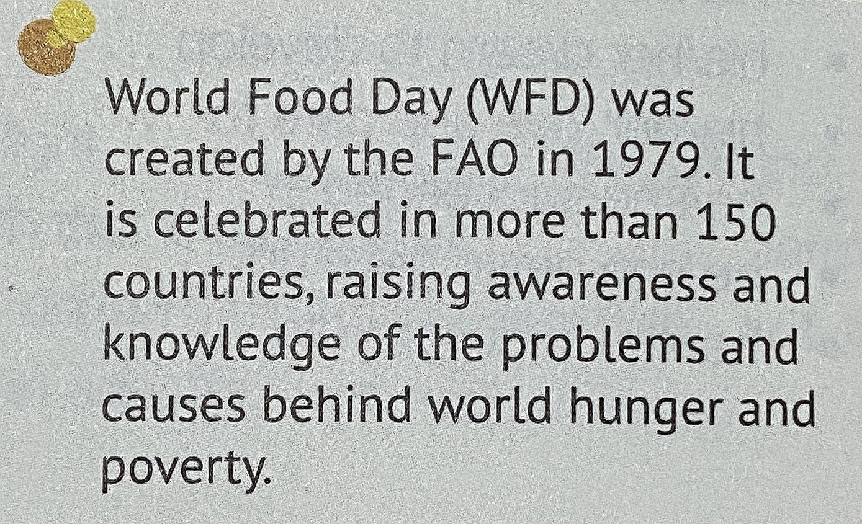

Extensive Activities
WFD’s purposes

Slide 17


Design a slogan for the WFD
Brainstorm some school activities to celebrate World Food Day.
Draw a poster for the WFD
Dishes Clean Activities
...

Slide 18

Make a speech as representative of FAO in school to appeal students to pay attention to the hunger problem and make contributions.
Homework
to know more about FAO by visiting the official site: https://www.fao.org/home/en/

Slide 19

Thank You!
-By Lily

