Slide 1

感恩遇见，相互成就，本课件资料仅供您个人参考、教学使用，严禁自行在网络传播，违者依知识产权法追究法律责任。
更多教学资源请关注
公众号：溯恩高中英语
知识产权声明

Slide 2
选择性必修二
Unit 2
Unit 4 Journey across a vast land
Using Language（1）
Talk about scenery and culture along a journey
杭州二中许丽君

Slide 3

In this class, students will
obtain information about Canada from the conversation;
continue the conversation about Canada and China based on your own travel experiences or the information from this unit.
learn to talk about scenery and culture along a journey.
learn some important words and sentence patterns.

Slide 4




A quick review
crossing the whole country by rail
.
What are the two key words in the title?
the natural features, such as mountains, valleys, rivers and forests …
the customs and beliefs, art, way of life and social organization …

Slide 5
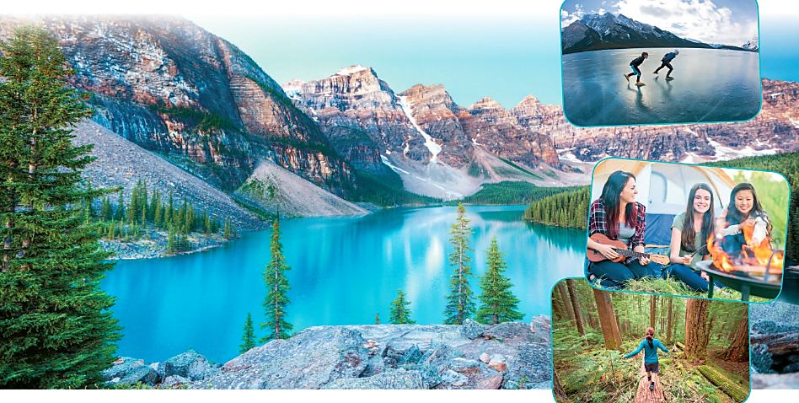
Cultural notes
What do you see in these pictures?
The large photo is of Lake Moraine in Banff National Park, Alberta, Canada, about fourteen kilometres from Lake Louise. The mountains behind the lake are in the Valley of Ten Peaks, and they are famous throughout Canada because for many years they were on the Canadian $20 bill. Though the lake can only be reached by hiking trail, it is one of the most photographed places in Canada.

Slide 6
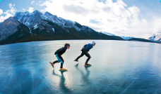


people skating on a frozen lake
young ladies camping
a woman hiking in a forest

Slide 7
They will probably be talking about a beautiful alpine lake, going skating on a frozen lake, going camping, and going hiking in a forest.

Slide 8
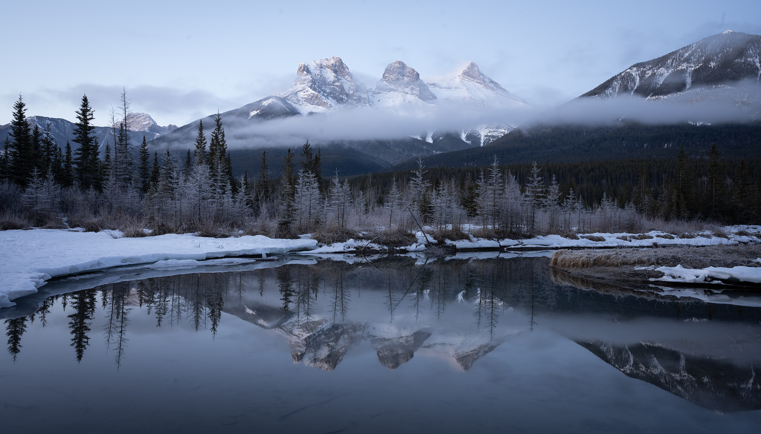
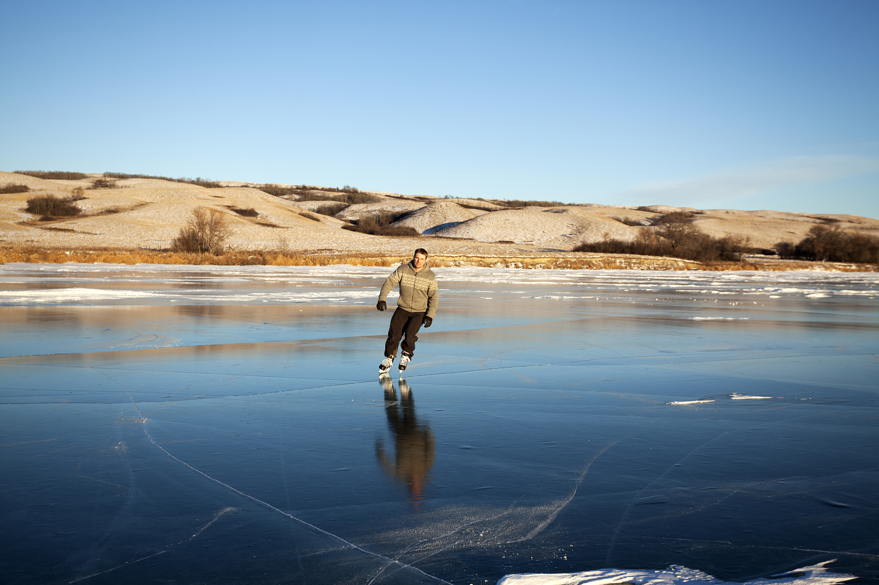
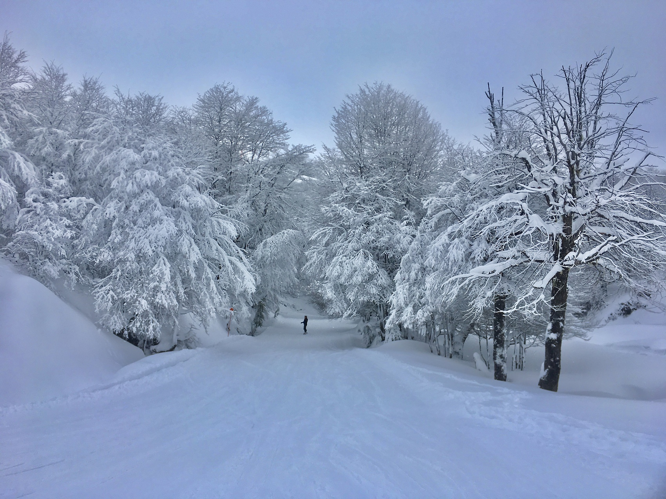
While-listening
What is mentioned in the conversation?
Can you list some key words?
Lake Louise, climate, activities;
mountains, the Prairie, lakes, forests;
their first long train journey…
the geography of Canada

Slide 9
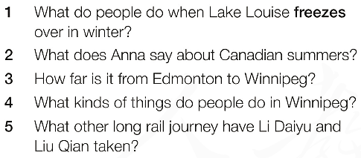
While-listening
Listening
becomes solid because of extreme cold

Slide 10
While-listening
Listen to the conversation and answer the following questions.
vi.& vt.结冰；（使）冻住
1. What do people do when the Lake Louise freezes over in winter?
2. What does Anna say about Canadian summers?
People like to go skating on the ice.
Many areas of south Canada have very hot summers.

Slide 11
While-listening
3. How far is it from Edmonton to Winnipeg?
4. What kinds of things do people do in Winnipeg?
5. What other long rail journey have Li Daiyu
and Liu Qian taken?
More than 1300kilometres.
Skiing, hiking, camping, and city things like movies or restaurants on the weekends.
They travelled from Beijing to Moscow on the Trans-Siberian Railway through Mongolia.

Slide 12
While-listening
Listen carefully again and answer the questions.
6. What kind of climate do many areas of south Canada have?
a continental climate
7. What is the mark of this kind of climate?
very hot summers and very cold winters
8. After they leave Edmonton, what kind of land will they be in?
the Prairie-as flat as a pancake and stretches for as far as the eye can see.

Slide 13
While-listening
Listen carefully again and answer the questions.
9. After they leave Winnipeg, what kind of land will they be in?
10. What kind of place is Winnipeg?
There will be lakes and forests.
It’s a small city almost in the dead centre of North America, from east to west.

Slide 14
While-listening
Listen carefully again and answer the questions.
11. What is the name of the train line between Beijing and Moscow?
12. What can you see while riding on the train in Mongolia?
the Trans-Siberian Railway
We can see the grasslands with rolling hills; a few small towns; a few horses or sheep

Slide 15
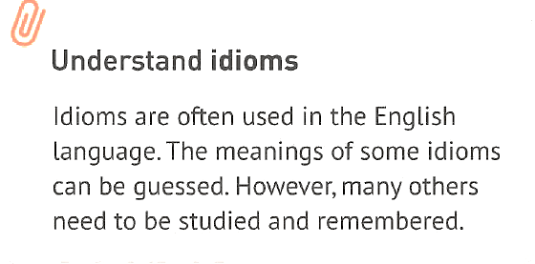
Listening Strategy:
Listening
EXAMPLE
feel at home
feel relaxed and comfortable
cost an arm and a leg
cost a lot of money

Slide 16
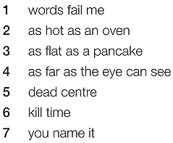
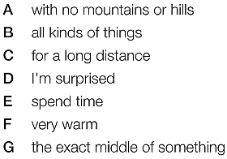
While-listening
Listening

Slide 17
While-listening
Match the idioms and meaning
words fail me
D. I’m surprised
Oh, my goodness! That must be Lake Louise! It’s so beautiful! Words fail me.
I’m so surprised at how beautiful it is that I can’t describe it.

Slide 18
While-listening
Listen again. Match the following idioms and similes with their meanings.
n.习语；成语
1. words fail me A. with no mountains or hills
2. as hot as an oven B. all kinds of things
3. as flat as a pancake C. for a long distance
4. as far as the eye can see D. I'm surprised.
5. dead centre E. spend time
6. kill time F. very warm
7. you name it G. the exact middle of something

Slide 19
Post listening
Speaking
In groups of three, continue the conversation about Canada and China based on your own travel experiences or the information you heard or read in this unit. End the conversation naturally.
What did they talk about in the conversation?
Where have you travelled in China? What places impressed you most?
How would you continue and end the conversation?

Slide 20
Post listening
Speaking
What did they talk about in the conversation?
  They talked about the climate and the geography of Canada, certain places in Canada and activities there. Also Li Daiyu and Liu Qian talked about their own travel experiences.
Where have you travelled in China? What places impressed you most?
  My favorite trip was by train to Tibet last summer. The scenery along the railway was fantastic, with green grass as far as the eye could see.
How would you continue and end the conversation?
  Showing interest is an effective way to continue the conversation. And surely you should end the conversation politely.

Slide 21
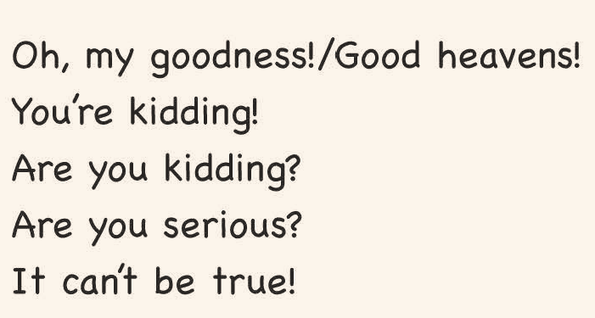
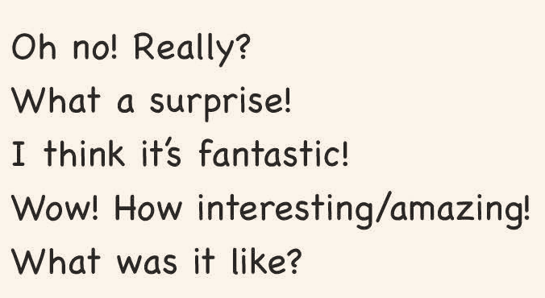
Post listening
Speaking
Expressing surprise and curiosity

Slide 22
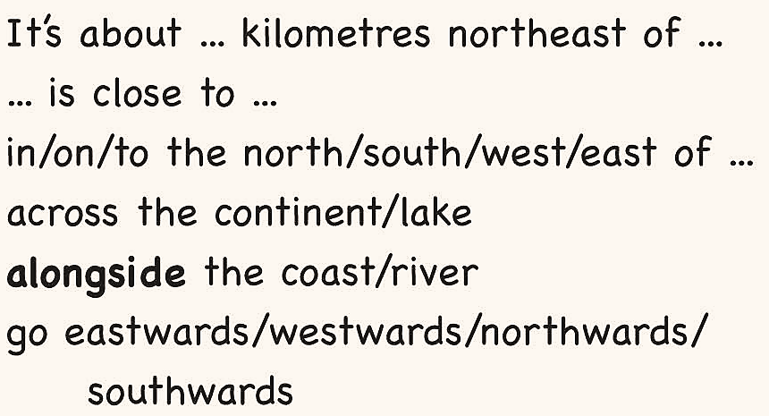
Post listening
Speaking
Talking about space and position
prep. 在……旁边；与……一起
adv.在旁边

Slide 23
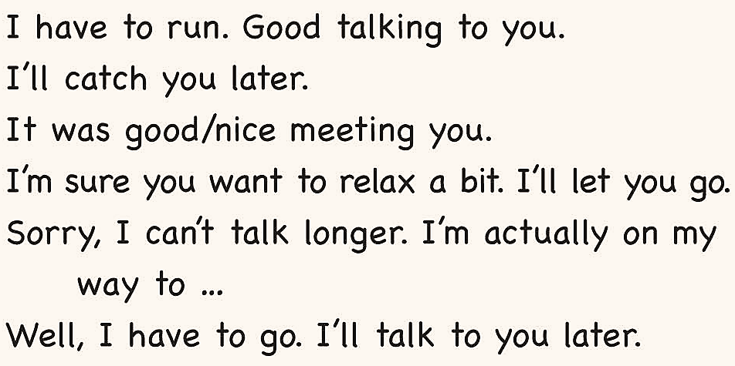
Post listening
Speaking
Ending a conversation naturally

Slide 24
Post listening
Speaking
Pay attention to what they talk about.
Anna: I thought China would be very crowded, given its large population.
Daiyu: Well, contrary to what many people believe, there are a lot of vast and empty spaces in China, actually.
Anna: That’s great! There must be amazing scenery to see in China then! ...
different from sth

Slide 25
Post listening
LiuQian: There is. My favourite trip was by train to Tibet. First, we travelled south across the Kunlun Mountains.
Daiyu : Even though it was summer, they were still
covered in snow. It was so beautiful.
LiuQian: Then we entered the Tibetan Plateau.
Daiyu: The scenery there was simply fantastic.
Green grass as far as the eye could see.
And there were so many wild animals.

Slide 26
Post listening
LiuQian: Yes! We saw a lot of antelopes, yaks, deer… and I think I even saw a snow leopard.
Anna: Good heavens! That’s one of the rarest animals on earth.
LiuQian: But you know what was really extraordinary about our trip?
Anna: No, what?
LiuQian: The railway is so high that the trains have a special oxygen supply for the passengers, kind of like you would find on an airplane, so that no one will become ill.

Slide 27
Post listening
Speaking
Learn how to end a conversation naturally.
Anna: You’re kidding! Anyhow, the next station is my stop! Take care and enjoy the rest of your trip!
Daiyu: Thanks, Anna!
Liu Qian: It was really great to meet you!
Anna: And it was nice talking to you!
Anyhow/anyway is used when changing the subject of a conversation or ending the conversation.

Slide 28

Listen again and read the conversation aloud.
Make up a dialogue about scenery and culture along a journey with your partner. using the surprise and curiosity expressions.
Practice the conversation about Canada and China based on your own travel experiences or the information you heard or read in this unit.

Slide 29
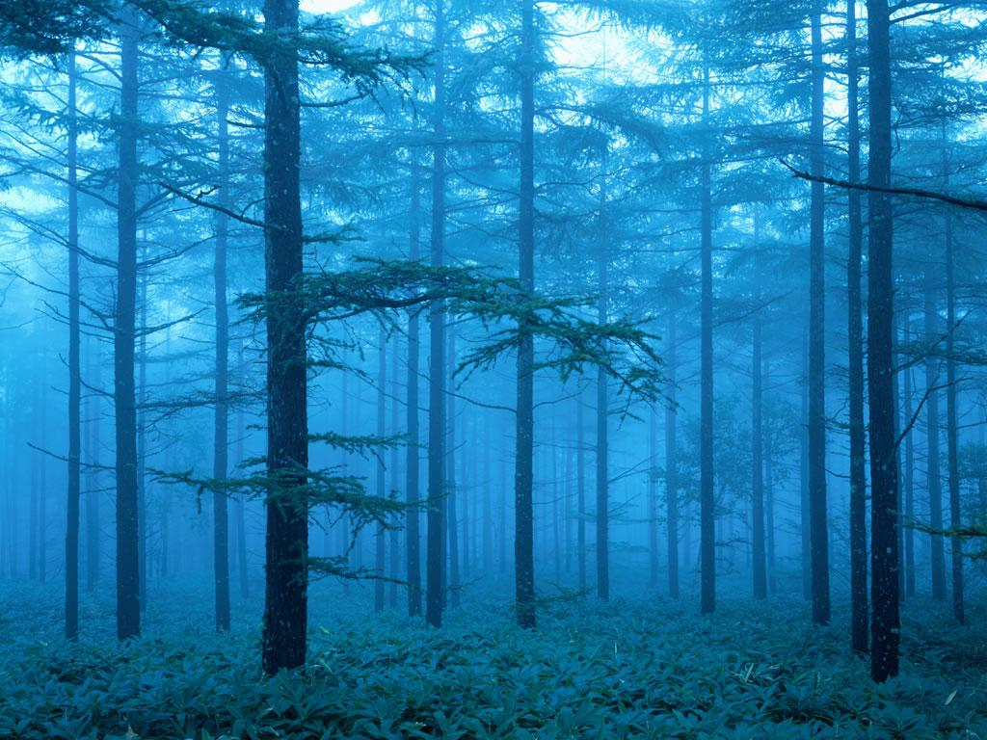
Thank you for attending!
Goodbye

