Slide 1

感恩遇见，相互成就，本课件资料仅供您个人参考、教学使用，严禁自行在网络传播，违者依知识产权法追究法律责任。
更多教学资源请关注
公众号：溯恩高中英语
知识产权声明

Slide 2

UNIT 2
BRIDGING CULTURES
Express your opinions on studying abroad
STUDYING ABROAD:
IS IT A GOOD OR A BAD IDEA?
杭州二中许丽君

Slide 3



To understand the two letters.
To learn some words and expressions.
To show your opinions about studying abroad.
To learn the structure of an argumentative letter.
To read two letters about studying abroad to find the main points and supporting reasons;
To write a letter to express your opinions on studying abroad.

Slide 4



Pre-Reading: Thinking
These years some students are choosing to study abroad.
Do you think it is necessary to study abroad? Why or why not?
Pay attention to the title and try to guess what the passage talks about.

Slide 5

Fast Reading:
Main points about two letters by Wang Li and Zhang Yi
Wang Li (mother of twin girls):
The disadvantages of studying abroad are greater.
Give reasons and evidence to support her opinion.
Zhang Yi (father of one boy):
The advantages of studying abroad are much greater.
Give reasons and evidence to support his opinion.

Slide 6
Fast Reading:
【语篇理解】
Ⅰ. Read the passage quickly and get the general idea of the passage.
1．What’s the main idea of the passage on P20?
_________________________________________________________
2．Read Wang Li’s letter and match the main idea of each paragraph.
Para. 1 A．Suffering from culture shock.
Para. 2 B．Thinking carefully about studying abroad.
Para. 3 C．More disadvantages than advantages.
Para. 4 D．Great economic pressure.
Para. 5 E．Benefits of studying at home.
The advantages and disadvantages of studying abroad.

Slide 7
Fast Reading:
3．Read Zhang Yi’s letter and match the main idea of each paragraph.
Para. 1 A．To develop our country.
Para. 2 B．More cultural exchange.
Para. 3 C．Studying abroad is worthwhile.
Para. 4 D．Studying abroad has greater advantages.
Para. 5 E．Studying abroad is personal growth.

Slide 8

Detailed Reading:
Answer the questions.
1. What is Wang Li’s attitude to studying abroad in the first letter?
A. Supportive B. Doubtful
C. Disapproval D. Objective
2. In Wang Li’s opinion, the advantage of studying abroad is _______.
A. bearing great economic pressure
B. facing unfamiliar environment
C. having great potential benefits
D. experiencing the culture shock

Slide 9
Detailed Reading:
3. Zhang Yi thinks that students studying abroad can _______.
A. become more dependent
B. get less chance for cultural exchange
C. lose a global perspective
D. develop organizational skill
4. What can we learn from the two letters?
A. Students studying abroad don’t need to learn how to live in a new environment.
B. Studying abroad helps to increase people’s understanding of cultural diversity.
C. Students studying abroad cant encounter problems with personal safety.
D. Studying abroad helps students to speak excellent English in a few years.

Slide 10
Detailed Reading: 1st letter
A local newspaper has invited parents to share their opinions about studying abroad. Listen and read two letters, underline each writer’s main points. Then mark the reasons for their opinions.
Wang Li (mother of twin girls)
Although studying abroad can bring great benefits, I think the disadvantages for young people are greater.
Main point
Great economic pressure.
adj.巨大的,极大的
The tremendous pressure that comes with studying abroad.
Reasons for her opinions
Studying abroad does have potential benefits, young people who study in China also have a great future to look forward to!

Slide 11
Detailed Reading: 2nd letter
Zhang Yi (father of one boy)
Main point
There are certainly disadvantages, but in my opinion, the advantages are much greater.
Personal growth.
Reasons for his opinions
The increased chance for cultural exchange.
It provides a great opportunity to contribute to the development of our motherland.

Slide 12
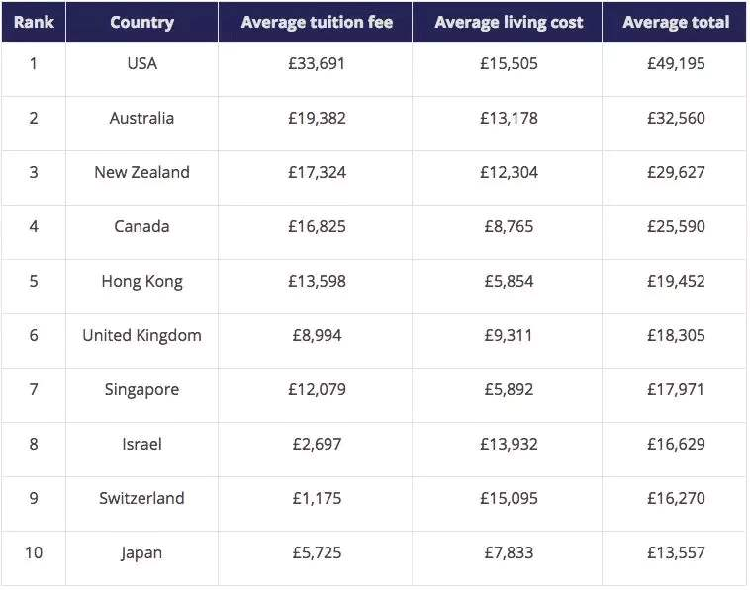
Detailed Reading: para 2
Read the first letter and find some details to support the writer’s opinion.
Economic pressure
Tuition fees
Living expenses
n.费用;花销

Slide 13


Detailed Reading: Para 3
The tremendous pressure that comes with studying abroad
An unfamiliar environment
Limited language skills
Culture shock
adj.成熟的
Not mature enough to handle the challenges by themselves
Personal safety
Different approaches to teaching and learning

Slide 14


Detailed Reading: para 4
Young people who study in China also have a great future to look forward to
vi.&n.迅速发展;繁荣
As China has boomed, the educational environment has improved significantly, with many great universities now available.

Slide 15
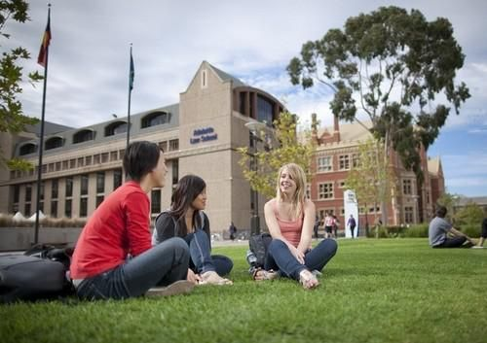

Detailed Reading: para 2
Read the second letter and find some details to support the writer’s opinion.
Personal growth
Become more independent
n.角度;观点
Gain a global perspective and improve your general competence
n.能力;本领

Slide 16


Detailed Reading: para 3
Cultural exchange
Promote friendship between nations
n.角;立场
View the world from different angles and gives us more insight into our own culture

Slide 17
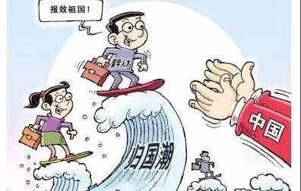

Detailed Reading: para 4
Provide a great opportunity to contribute to the development of our motherland
China needs talented young people with a global perspective
adj.有能力的;称职的
Competent with skills and abilities
Better career opportunities

Slide 18

Detailed Reading: 1st and 2nd letter
Paragraph | Argument chain | Letter 1 (body part) | Letter 2 (body part)
1 | Introducing the topic | Fact: dramatic increase in the number of people studying abroad | Question: Is studying abroad a good idea or not?
 | Main point | The disadvantages are greater. | The advantages are much greater.
2 | Reason 1 | great economic pressure | personal growth
3 | Reason 2 | tremendous pressure: unfamiliar environment, limited language skills, not mature, safety problems, different approaches to teaching and learning | chance for cultural exchange
4 | Reason 3 | great future for young people | great opportunity to contribute to the development of our motherland
5 | Conclusion | studying in China should consider the disadvantages | This life-changing experience is worthwhile.

Slide 19

Post Reading:
Read the letters from the two parents again and then use the connectors in the box to rewrite the sentences below.
as a result, besides, for instance, that is to say
1 Students who want to study abroad must consider their parents’ budget. They should think about whether they can afford the costs of studying overseas.
2 Studying abroad can put great pressure on young people. They may feel lonely and miss their families.
Students who want to study abroad must consider their parents’ budget. That is to say, they should think about whether they can afford the costs of studying overseas.
n.预算
Studying abroad can put great pressure on young people. For instance, they may feel lonely and miss their families.

Slide 20
Post Reading:
as a result, besides, for instance, that is to say
3 Studying abroad will give students a good education. It also helps them to gain a global perspective.
4 Global development strategies help to make connections between China and the rest of the world. Young people with language skills and strong cultural awareness are needed.
Studying abroad will give students a good education. Besides, It also helps them to gain a global perspective.
Global development strategies help to make connections between China and the rest of the world. As a result, young people with language skills and strong cultural awareness are needed.

Slide 21


Discussion
Discuss the following questions with your partner.
1. What are some other advantages or disadvantage of studying abroad that were not mentioned in the letters?
2. Which parent would you probably side with? Why?
One disadvantage of studying abroad is that not all students are suited to it. Some students will never gain the needed language ability or may not get the most from an unfamiliar teaching approach.
One advantage of studying abroad is the chance to meet new lifelong friends from different cultural backgrounds.
支持
I would probably side with Zhang Yi because I think Wang Li’s perspective is too narrow.

Slide 22


Writing skills
By Analyzing the argumentative letters, the structure of the passage can be arranged as follows:
Mark the parts of the argument in the letters.
Start with a question or a fact.
State an opinion.
Give reasons and evidence to support an opinion
State a conclusion.

Slide 23
Post Reading:
Underline the connectors in the letters. Then study the words below.
Connectors expressing opinion
Point of view:
in my opinion, as far as I know,
as far as I am concerned, personally (speaking)
Summary:
in short, to sum up, all in all
in conclusion/summary, generally speaking
Restating:
in other words, that is to say, that means

Slide 24
Post Reading:
Underline the connectors in the letters. Then study the words below.
Connectors expressing reasons or evidence
Listing:
to begin with, what is more, besides, moreover, in addition
Cause & effect:
because, as, so, thus, therefore, as a result
Giving examples:
for example, for instance, such as

Slide 25


Post Reading:
Work in groups and talk about the question:
What would be the most difficult challenge and the most interesting thing if you study abroad?

Slide 26

What’s your opinions about studying abroad?
最近你看到某报纸在征集主题为“出国学习的利与弊”的征文，请根据以下要点写一篇英文征文。
利 | 1 良好的语言环境，更有利于语言学习； 2 拓宽视野，学习国外先进的科学技术； 3 把中国文化传播出去。
弊 你的观点 | 1 费用较高，家庭负担重； 2 情感孤独，思乡。 1 出国学习使学生更独立，学会与人合作； 2 交不同国家的朋友。

Slide 27

Advantages of studying abroad | Disadvantages of studying abroad
your own opinions about studying abroad.
Question or fact/ main idea
Use some connectors to make your letter logical.
Reason 1 / Evidence
Reason 2/ Evidence
Reason3/ Evidence
Conclusion

Slide 28

Use connectors
When you write an argumentative piece, use connecting phrases to lead readers through your process of reasoning. Good logical connectors will help your audience understand your point of view, whether they agree with you or not!
adj.合乎逻辑的;合情合理的

Slide 29
【常用连接词汇】
递进及并列：besides, in addition, what’s more
比较：just like, just as, in the same way, on the other hand, on the contrary, while ...
顺序：first of all, second(ly), third(ly), then ...
因果：therefore, as a result, for this reason ...
目的：so that, for this purpose, in order to...
总结：in a word, in short, all in all, in all ...
个人看法：in one’s opinion, in one’s eyes, personally, as far as I know…

Slide 30


Write a letter to the editor expressing your own opinions about studying abroad.

Slide 31


Thanks for your attention !

