Slide 1

感恩遇见，相互成就，本课件资料仅供您个人参考、教学使用，严禁自行在网络传播，违者依知识产权法追究法律责任。
更多教学资源请关注
公众号：溯恩高中英语
知识产权声明

Slide 2
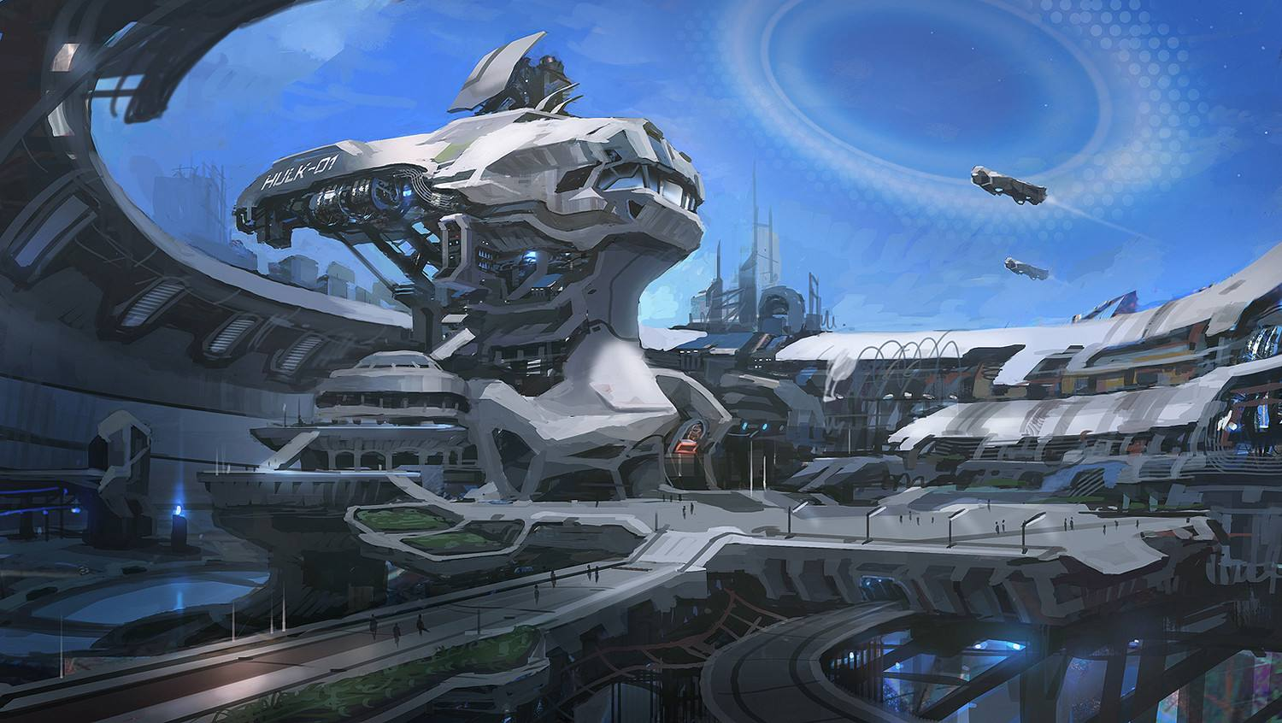
UNIT 1
SCIENCE FICTION
Today’s science fiction is tomorrow’s science fact.
— Isaac Asimov
今天的科幻小说即明天的科学现实
— 阿西莫夫

Slide 3
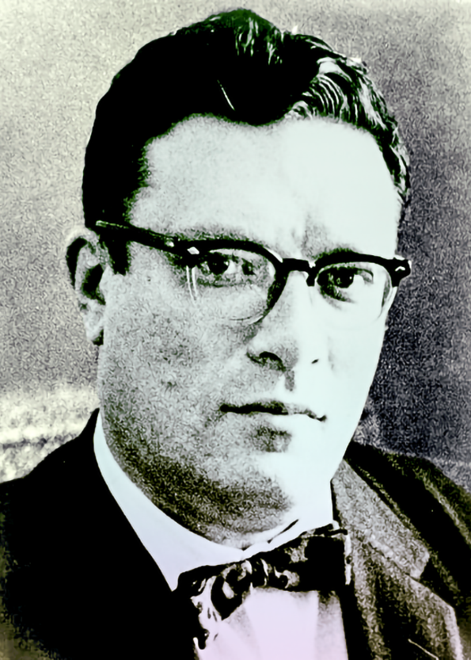
Lead in
Isaac Asimov is an American scientist and author, who wrote science fiction, proposed three Laws of Robotics (in the 1940's):
Law 1: A robot may not injure a human being or, through inaction, allow a human being to come to harm.
Law 2: A robot must obey the orders given it by human beings except where such orders would conflict with the First Law.
Law 3: A robot must protect its own existence as long as such protection does not conflict with the First or Second Laws.
Isaac Asimov

Slide 4
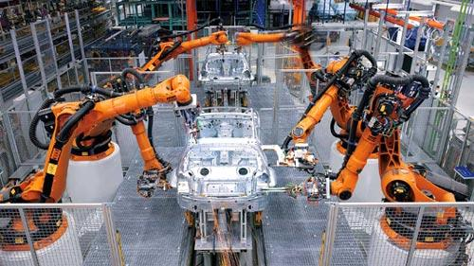
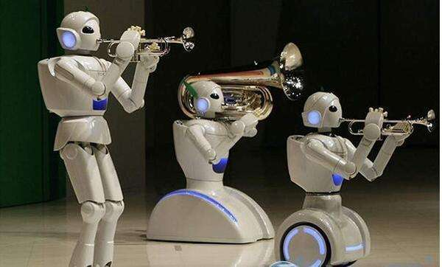
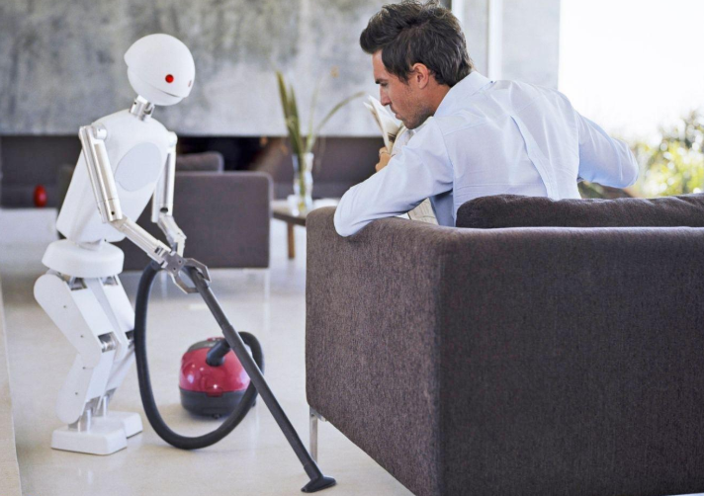
Lead in
What types of robots are the following robots?
industrial robots
entertainment
robots
household robots

Slide 5
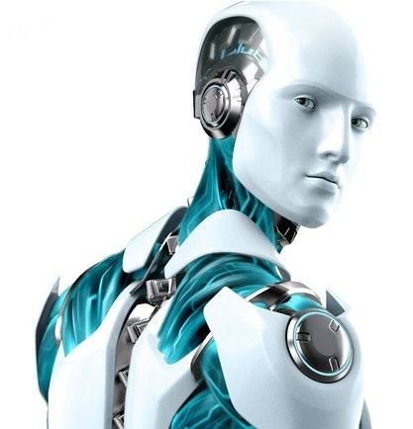
Lead in
How do robots already help humans today?
Do you think it is possible for a robot to
think for itself ?
have feelings?
have its own needs and desires?
look and feel like a human being?

Slide 6
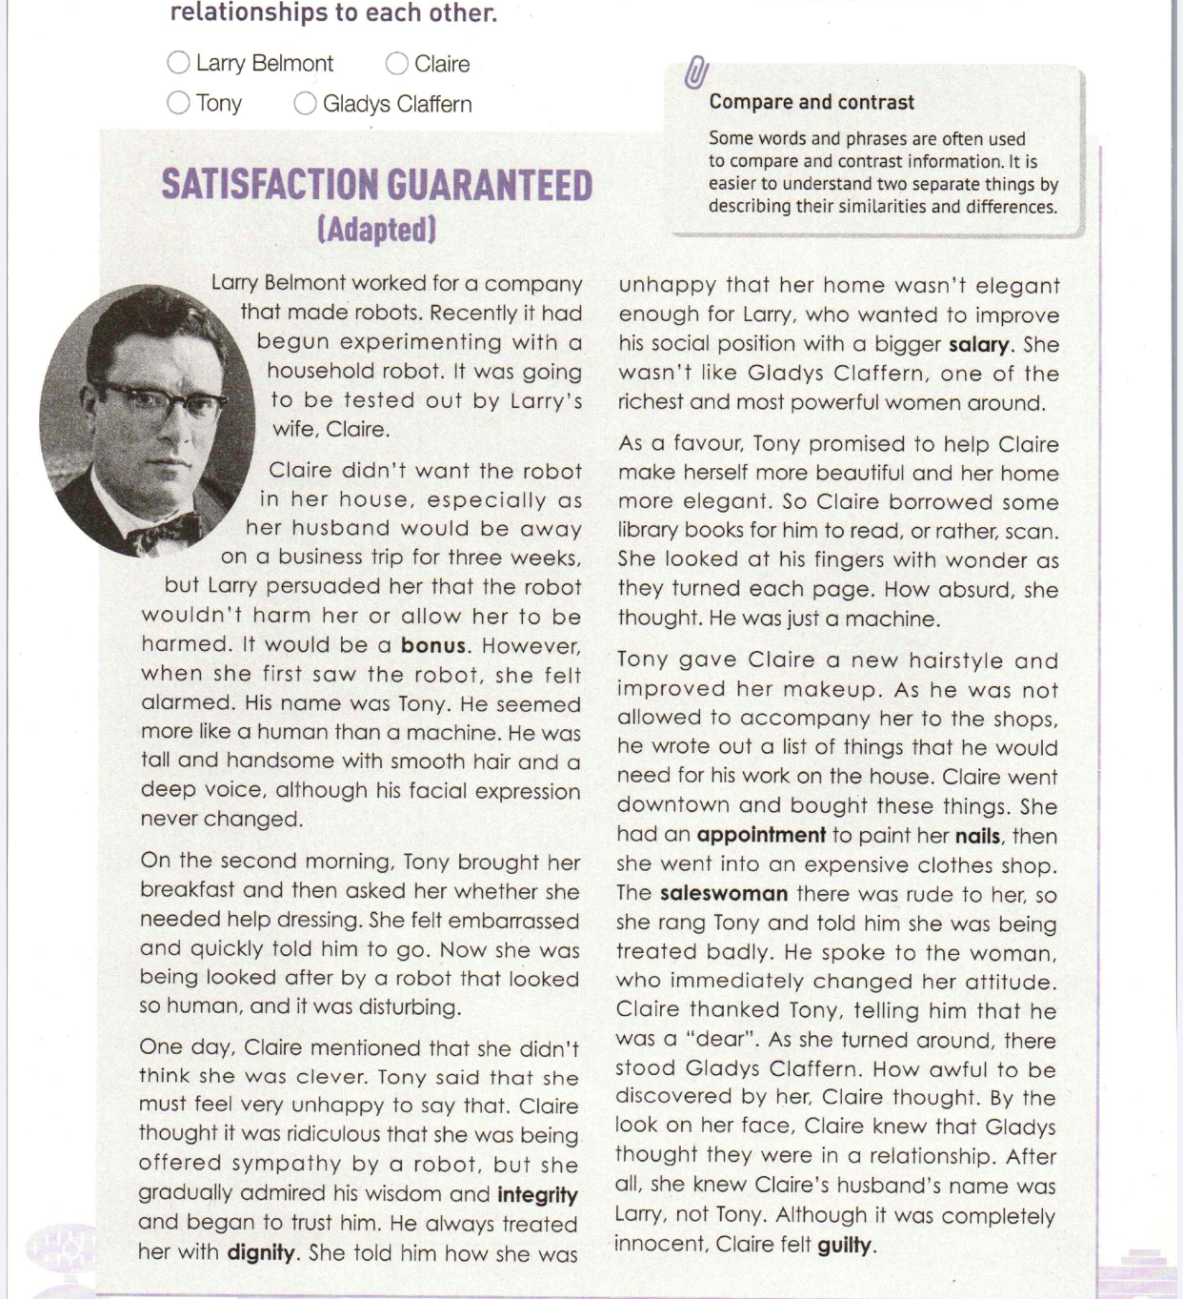
Prediction
Focus on the title and the picture to predict:
1. What do you expect to read from the text?
2. Whose satisfaction do you think will be guaranteed?
3. What does the word “adapted” mean?
4. Will there be a robot in this novel? What type of robot will it be?

Slide 7
Fast reading
Read the story, which was originally written by famous science fiction writer Isaac Asimov. Take notes on who these people are and their relationships to each other.
Larry Belmont
Gladys Claffern
Claire
Tony
made
be tested out
couple
a woman that Claire envies

Slide 8
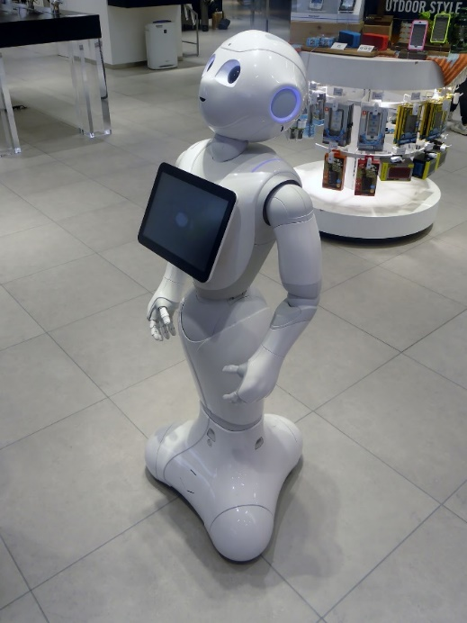
Fast reading
The main idea of the text:
robot
It is mainly about how a household _________ was _________ ________ in a family.
tested
out

Slide 9
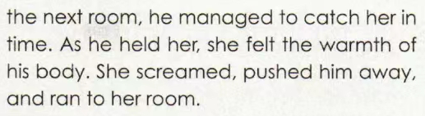
Detailed reading
How did the story develop? Read the story carefully and pay attention to the changes of Claire’s feelings towards Tony as the story developed.
shy & nervous
6.when Claire fell and Tony caught and held her
thankful
5.when Tony helped her talk to the saleswoman
admiring & trusting
embarrassed
4.when Tony offered sympathy
alarmed
3.when Tony asked if he should help her get dressed
Claire
dislike
2.when she first saw him
1.Before Tony arrived
Tony

Slide 10
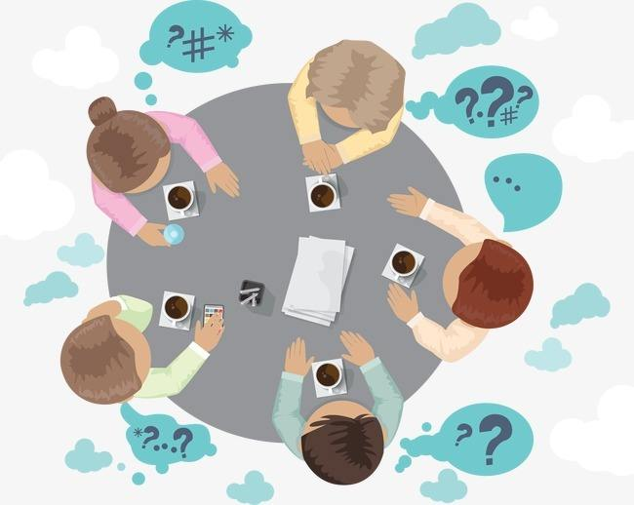
Group discussion
1. How do you think this story will end?
2. What would happen next in the party? Was it successful?
3. What would happen to Claire? Was she eventually satisfied?
4. What would happen to Tony? Did he pass the test in the experiment?
Work in groups and come up with an (happy/ surprising/ sad)ending.

Slide 11

Group discussion
The door bell rang just as Claire’s husband entered from the garage door. Larry had come home early.
Tony declared that he loved Claire. Larry, hearing this, raced to take her from Tony’s arms.
“What are you doing, Tony?” yelled Larry.
“I am doing as I am programmed!” answered Tony.
Just then the ladies who had rang the door bell appeared.
“You didn’t answer the doors, so we just decided to come in,” Gladys said. “See! I told you! That’s the man she was talking sweetly to!”
“Good heavens!” shouted all the ladies.

Slide 12
Group discussion
“He isn’t a human!” answered Larry. “He’s a robot I designed to take care of Claire. I just never imagined…”
“What a handsome robot with decorating skills!” exclaimed one of the ladies.
“I need him!” demanded Gladys.
“I want one too,” shouted all the others.
From that day on, the orders for more Tony’s went on and on. Claire remained stylish, kept a beautiful home, and her husband.

Slide 13

Group discussion
Listen to the rest of the story.
How different is it from your ending?
Do you like the ending? Why and why not?
What is your ending? Which one do you think is better? Why?

Slide 14
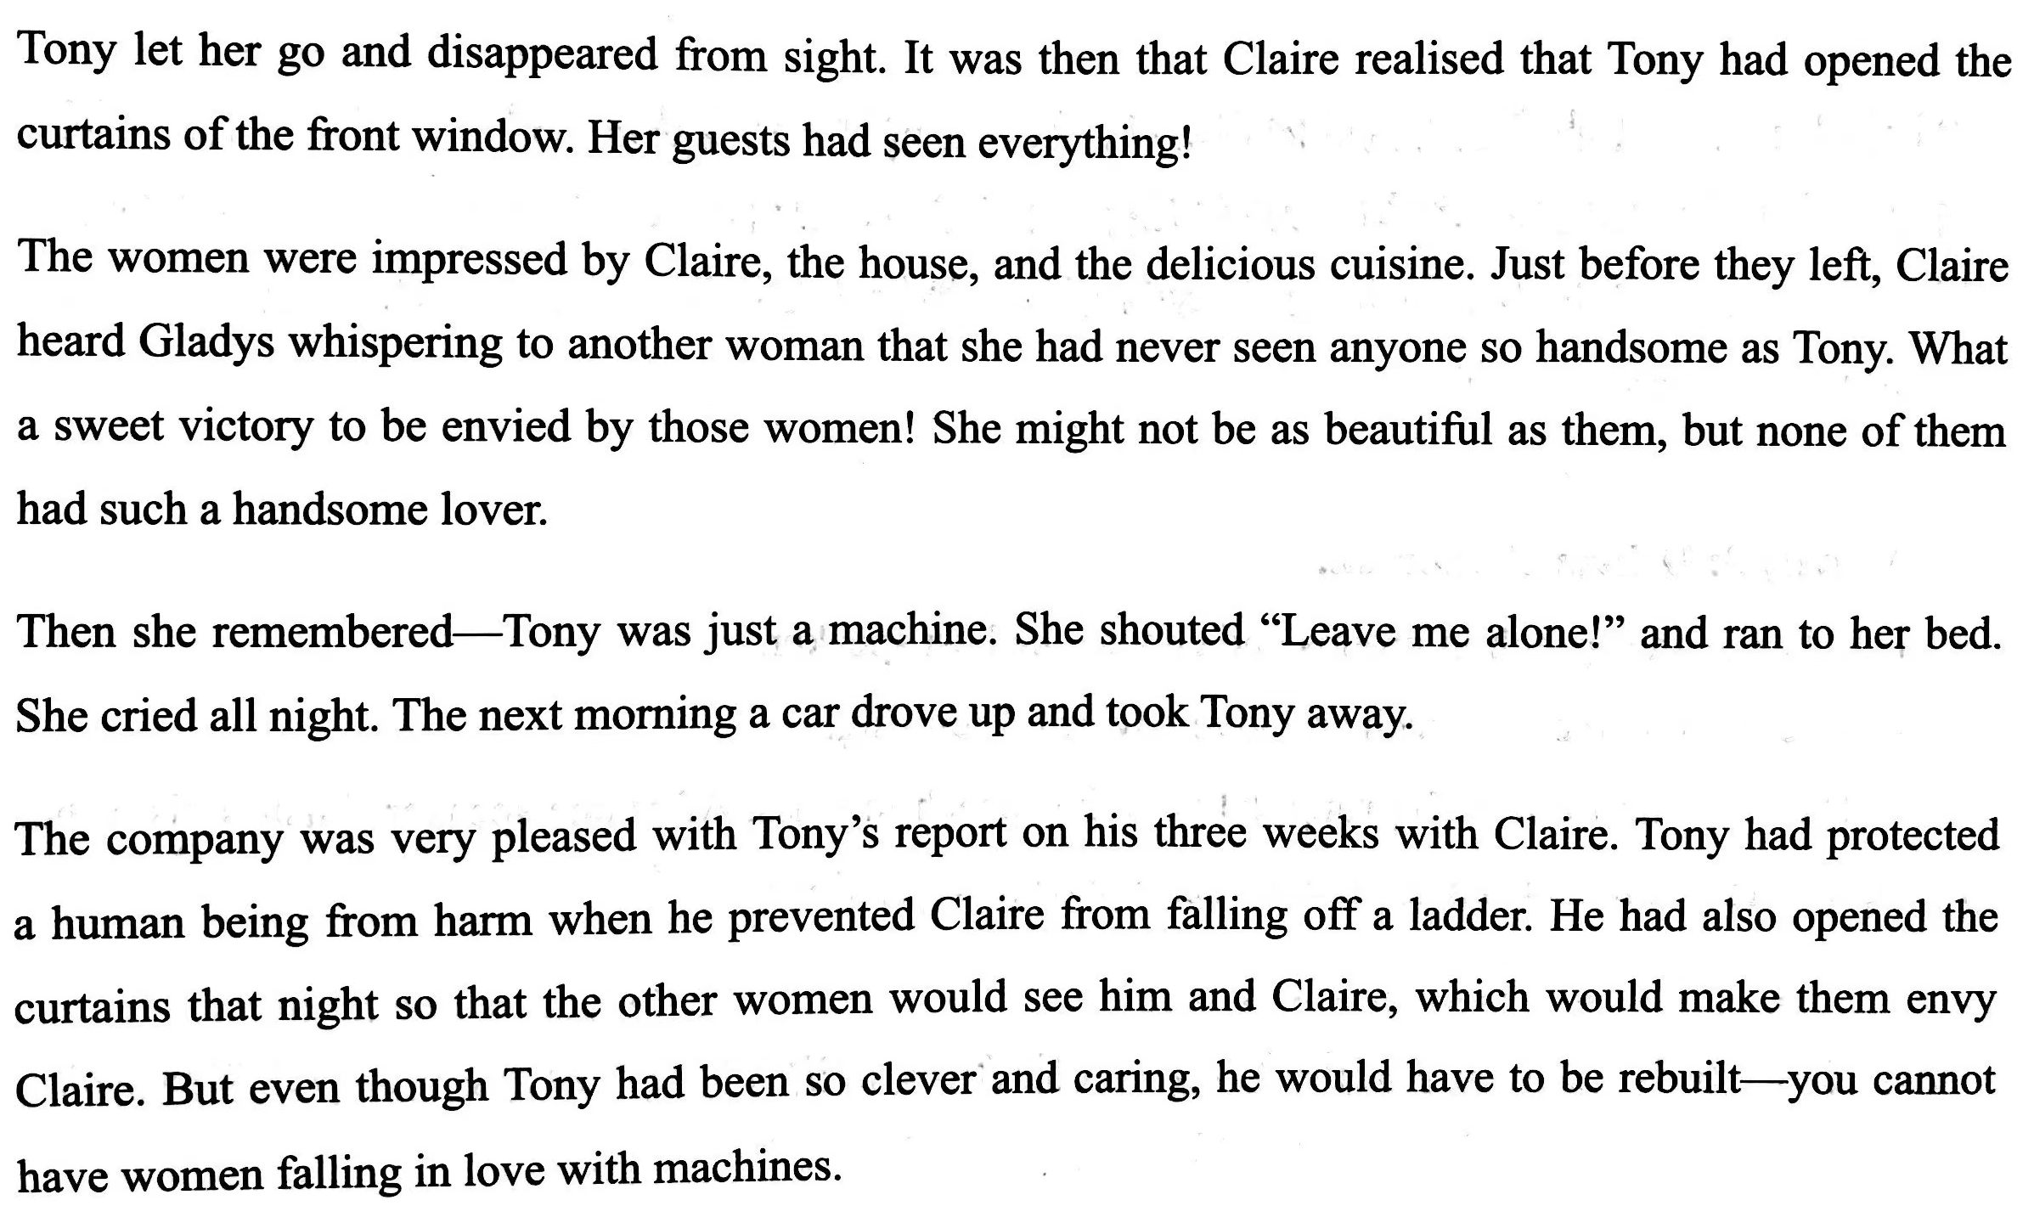
Detailed reading
Read the rest of the story, and then complete the chart.

Slide 15
Detailed reading
Occasion | Claire…
1
Before he arrived
disliked him
2
When she first saw him
was alarmed
3
When Tony asked if he should help her get dressed
felt embarrassed
4
When Tony offered sympathy to her
admired him

Slide 16
Detailed reading
Occasion | Claire…
5
when he helped her talk to the saleswoman
called him a dear
6
when she fell and Tony caught and held her
felt his warmth
after the ladies saw Tony holding her and speaking to her lovingly through the window
7
felt being envied
after she remembered he was just a machine and shouted, “Leave me alone!”
8
cried all night

Slide 17
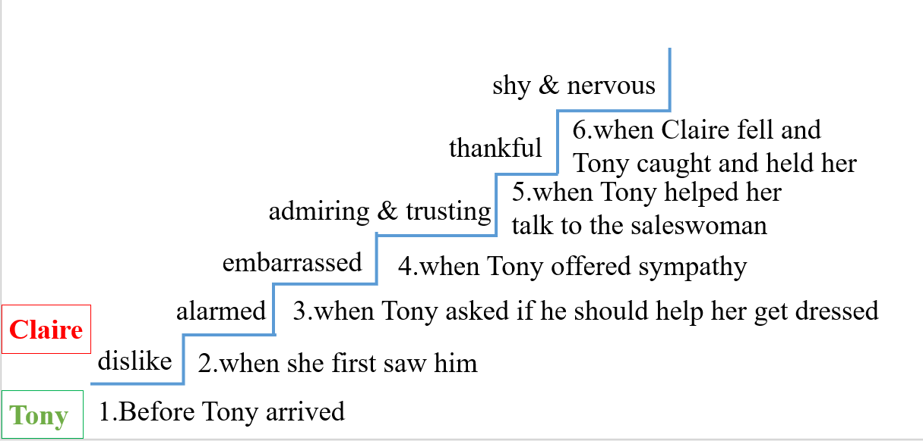
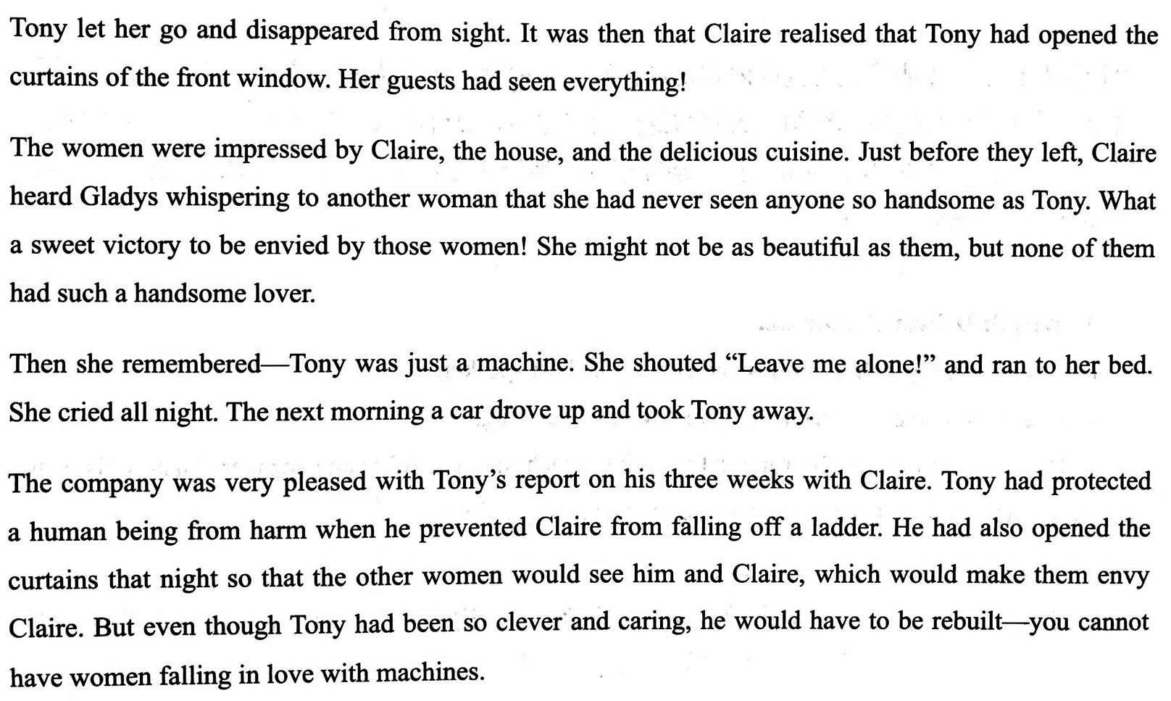
Detailed reading
Continue to write the changes of Claire’s feelings towards Tony as the story developed.
sad
8. after Claire remembered Tony was just a machine
envied
7.when guests saw Tony holding Claire

Slide 18
Detailed reading
Read the story again and find the similarities and differences between Tony and a human being.
Human being
Tony
facial expression never changes;
facial expression changes often;
smooth hair;
programmed to appear sensitive and earing;
offers sympathy;
can show true sensitivity and care;
treats people kindly;
warm body
emotions can change
always the same

Slide 19
Detailed reading
Use the words in the boxes to describe the similarities and differences.
Comparison | Contrast
the same as similar to similarly more like just as in comparison in the same way | different from but while whereas although however on the other hand in contrast
EXAMPLE
A human being’s facial expression changes often, whereas Tony’s never changes.
In contrast to Tony, who never changed from his programming, a human’s emotions can change.

Slide 20

Critical thinking
1. Whose satisfaction do you think will be guaranteed?
2. What does the word “adapted” mean?
3. What type of robot will it be?
4. Do you think it is possible for a person to love a robot? Why?
5. What relationship do you think will develop between humans and robots in the future?
Claire
modify/ adjust
Household robots

Slide 21
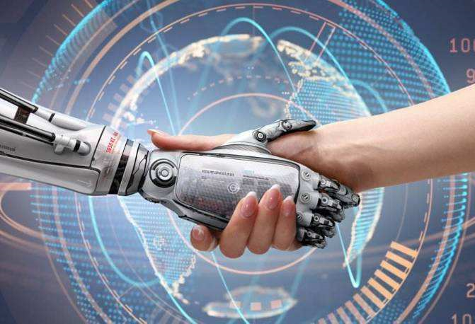
Homework
Please write a summary of the article in about 60 words based on the changes of Claire’s feelings towards Tony.
Who
What (the beginning, the development, the ending)
How
Where
When
Linking words: although, however, so, then…

Slide 22
Samples
Larry invented a robot named Tony. Although Larry’s wife refused to test it out, she compromised finally. At first, she was alarmed and embarrassed when she first saw the robot. However, she gradually admired Tony and felt thankful when Tony helped her get dressed, offered sympathy and protected her from injuries. Therefore, Claire was sad after Tony was taken away, but she still remembered Tony was just a robot.

Slide 23
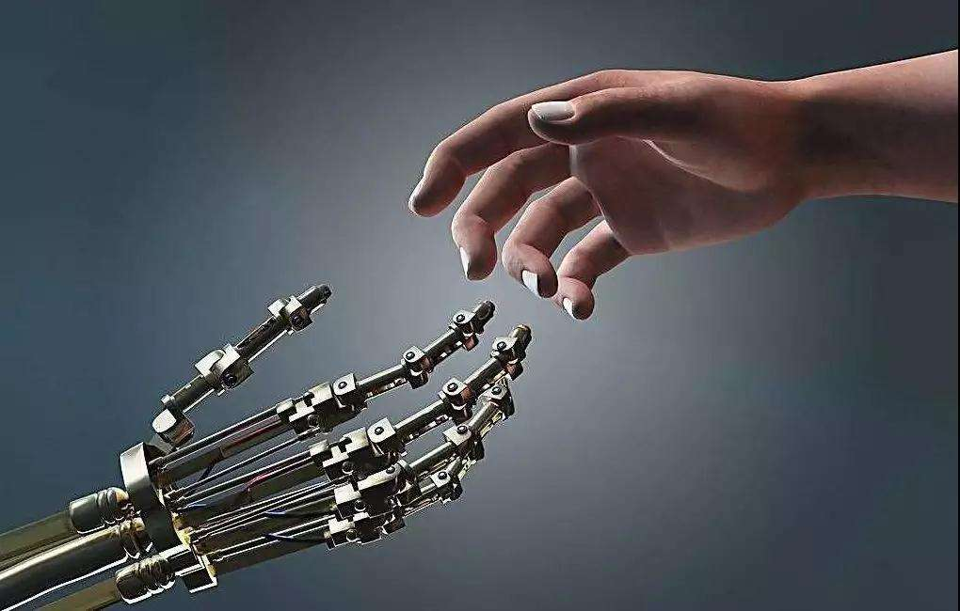
THANK YOU

