Slide 1

感恩遇见，相互成就，本课件资料仅供您个人参考、教学使用，严禁自行在网络传播，违者依知识产权法追究法律责任。
更多教学资源请关注
公众号：溯恩高中英语
知识产权声明

Slide 2
感动中国
2021年度人物颁奖盛典
2021 ANNUAL PEOPLE AWARD CEREMONY

Slide 3

Lead - in
2021 Annual People Award Ceremony was held on the evening of March 3, 2022. And Ten people were awarded for their moving stories and significant contribution to the society.

Slide 4

Look back on the old days

Slide 5
A brief Introduction to Touching China
生词讲解：
1. live /laɪv/
现场直播的
2. audience
观众；听众
（单复数同形）
3. prominent
重要的，著名的
4. senior party officials
党员高级官员
5. epic
史诗
"Touching China" is a mental brand column ________ (create) by CCTV1, ______ is hosted by the live broadcasting group of the social special department of the news center. It is launched every year around the Lantern Festival. It _____________ (hold) for many years .
"Touching China" has brought many ___________ (character) to the national audience, _________ (include) Xu Benyu, Gao Yaojie, Tian Shiguo，Congfei, Wang Shunyou and other prominent people from the civil society. There are famous stars like Jackie Chan, Pu Cunxin, Liu Xiang and Yao Ming, as well as wise scholars like Ji Xianlin, Zhong Nanshan, Yuan Longping, Gui Xiehan and Huang Boyun. There are also ordinary people like Zhang Rong, Wei Qinggang, Hong Zhanghui, Huang Jiusheng and Wang Feng, as well as the senior party officials such ___ Zheng Peimin, Niu Yuru, Liu jin and Liu yuejin. Each character has ___ spiritual power that _______ (make) the audience feel ________ (power). "Touching China" has been praised by the media as "the annual spiritual epic ___ the Chinese people".
created
which
has been held
characters
including
as
a
makes
powerful
of

Slide 6
10 inspirational role models honored in annual Touching China awards
生词讲解：
1. high-profile
高调的；备受瞩目的
2. figure 人物(形象)
3. wisdom 智慧
4. tenacity 顽强
5. physicist 物理学家
6. legendary sprinter
鼎鼎有名的短跑选手
7. inspirational
鼓舞人心的
___ group of 10 high-profile ______ (figure) and common citizens _______ (gift) with wisdom, ______ (brave) and tenacity, including Nobel Prize-winning ______ (physic) Yang Zhenning, China's legendary sprinter Su Bingtian, as well as China's space community, ___________ (honor) as inspirational role models in this year's Touching China awards __________ (announce) by China Central Television __ Thursday.
A
figures
gifted
bravery
phisicist
were honored
announced
on

Slide 7
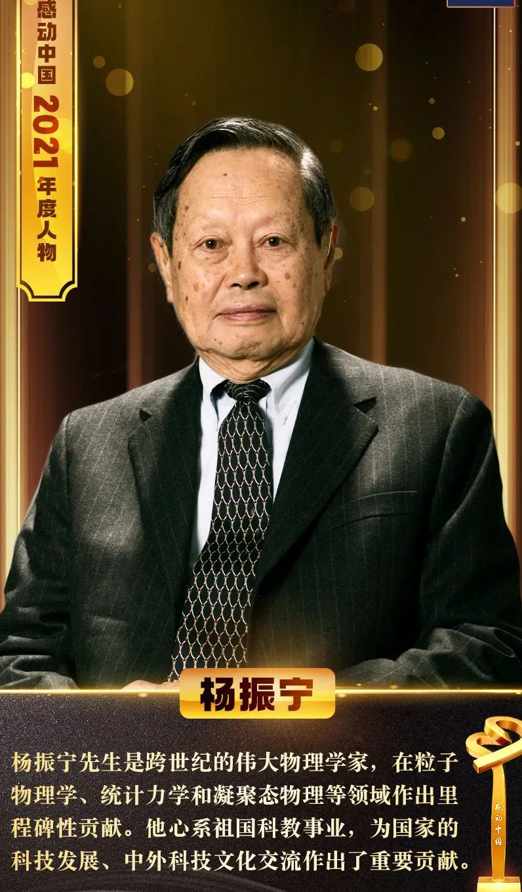
Yang Zhenning
生词讲解：
1. renowned
有名望的，著名的
2. lift
解除；撤销
3. ban
禁止；禁令
4. sponsor
赞助
5. further study
深造
6. talent
人才
7. backbone
骨干，支柱
Renowned Nobel Prize-winning physicist, Yang Zhenning, ______ (become) the first Chinese-American scientist ___ applied to return to China ____ the US just lifted the ban ___ visits to China in 1971. Yang also sponsored ________ (hundred) of Chinese _______ (scholar) to further ____ (they) studies in the US through _ committee for education exchanges he _________ (establish) in New York. These talents later became the backbone of the __________ (construct) of China.
became
who
after
on
hundreds
scholars
their
a
established
construction

Slide 8
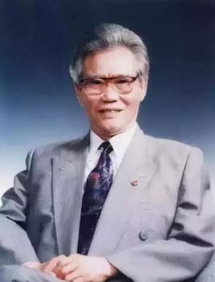
Peng Shilu
生词讲解：
1. submarine
潜水艇
2. nuclear
核武器
3. indispensable
不可或缺的
4. dedicate
致力于，献身于
5. cause
事业
Peng Shilu, _________ (honour) as "the father of nuclear submarines", played ___ indispensable role in developing and _______ (build) China's first nuclear submarines. He dedicated his life ___ the cause of nuclear power. ________, he once said: "as long as ____ motherland _____ (need), I am willing ___________ (contribute) everything."
honoured
an
building
to
Moreover
the
needs
to contribute

Slide 9
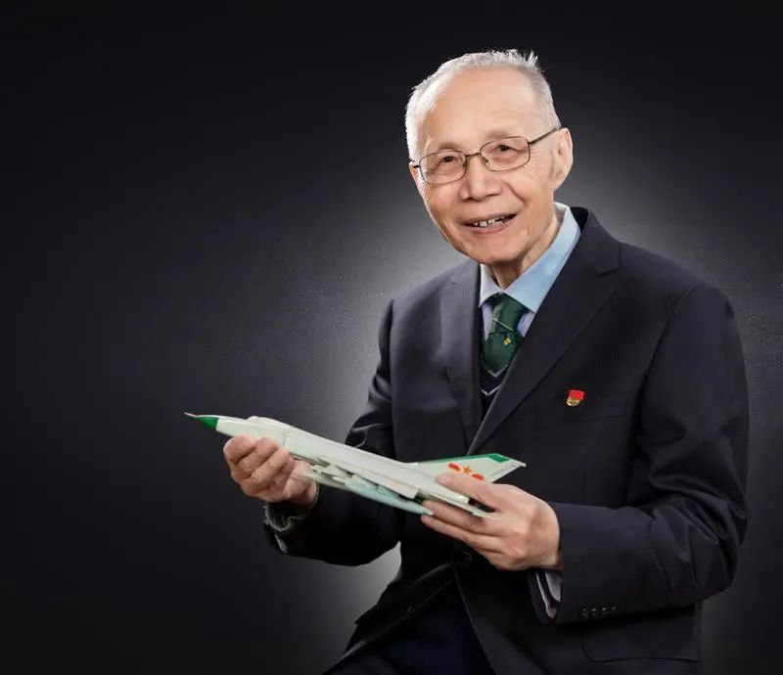
Gu Songfen
生词讲解：
1. aircraft 飞机
2. aviation 航空
3. pioneer
先锋；做先驱
4. aerodynamic
航空动力学的
5. advance (使)前进
6. interceptor 截击机
7. defense capabilities
防御能力
8. cornerstone 基石,支柱
The renowned aircraft designer, ____ won the State Preeminent Science and Technology Award, is ___ only person in the country's aviation industry ________ (hold) membership of both the Chinese Academy of Sciences and the Chinese Academy of Engineering. He ________ (pioneer) the aerodynamic design __ aircraft, which ________ (advance) the __________ (develop) of a number of major jet ______ (fighter), including the Nanchang CJ-6, a basic training plane, and the Shenyang J-8, a high-speed, high-altitude single-seat interceptor. Those aircraft not only _____ (great) improved China's air defense capabilities ____ laid the cornerstone of its aviation industry.
who
the
to hold
pioneered
of
advanced
development
fighters
greatly
and

Slide 10
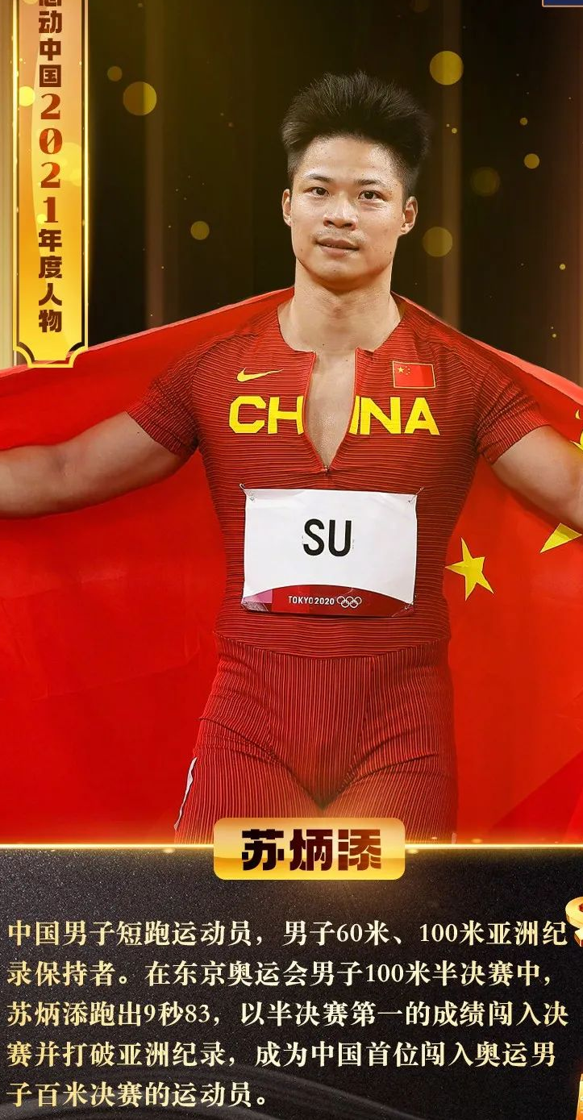
Su Bingtian
生词讲解：
1. nominee
被提名者
2. final
决赛
3. semi-final
半决赛
4. second
秒
Another nominee was Su Bingtian, ___ first Chinese sprinter _________ (compete) in the men's 100-meter sprint final ___ the Tokyo 2020 Olympic Games.
At the age of 32, he ______ (shock) the world ___ finishing first in his group with a time of 9.83 ______ (second) on the semi-final, 0.08 seconds ______ (fast) than his Asian record of 9.91 seconds in 2018.
the
to compete
at
shocked
by
seconds
faster

Slide 11
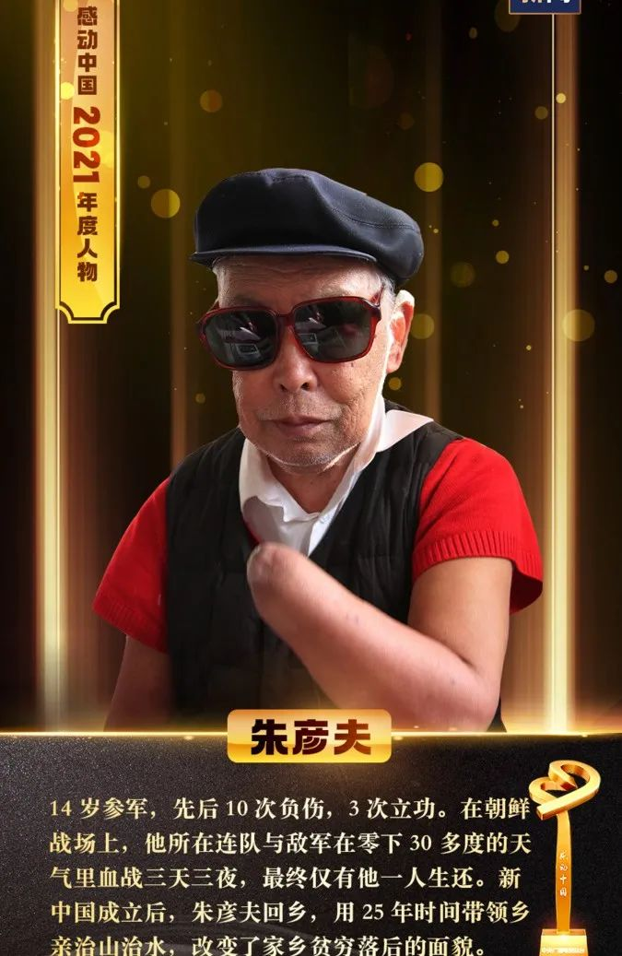
Zhu Yanfu
Zhu Yanfu ___ (lose) his hands, his left eye and both legs below the knee ___ a battle ______ the Korean War in the 1950s. He was just 17. After he went back to his hometown and opened ___ school, He gave ______ (lesson) to local illiterate villagers ___ five years and helped develop the villages.
1. the War to Resist the US Aggression and Aid Korea (1950-53).抗美援朝战争
2. literate 文盲的，不识字的
lost
in
during
a
lessons
for

Slide 12
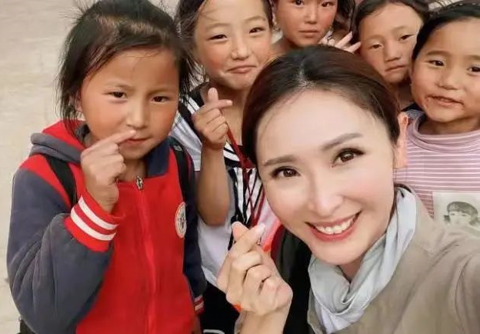
Chen Beier/Janis Chan
Janis Chan, the Hong Kong Television Broadcasts Limited (TVB) host ___ acts as ___ guide for audience in the documentary No Poverty Land. It is the wish ___ the team to allow the people ____________ (understand) more about the Chinese mainland. They want to show real life, the remote ______ (village), and the journey out of poverty. The team described the poverty alleviation
who
a
of
to understand
villages
they saw in China ___ "a miracle", a success _________ (achieve) by grassroots governments and local residents through years of hard work. Now they want ______ (show) this miracle to the world.
as
生词讲解：
1. mainland 大陆
2. alleviation 减轻
3. grassroot 草根
4. resident 居民
achieved
to show

Slide 13
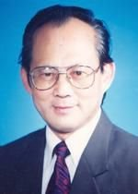
Wu Tianyi
Wu Tianyi is ___ only member of the Chinese Academy of Engineering _____ (live) in Northwest China's Qinghai province. During the ___________ (construct) of the Qinghai-Tibet Railway, Wu Tianyi made careful ______ (plan) to ensure ______ 140,000 road ______ (build) did not die ___ altitude ________ (sick). His life motto is “No pains, no gains.”
the
living
construction
plans
that
builders
of
sickness

Slide 14
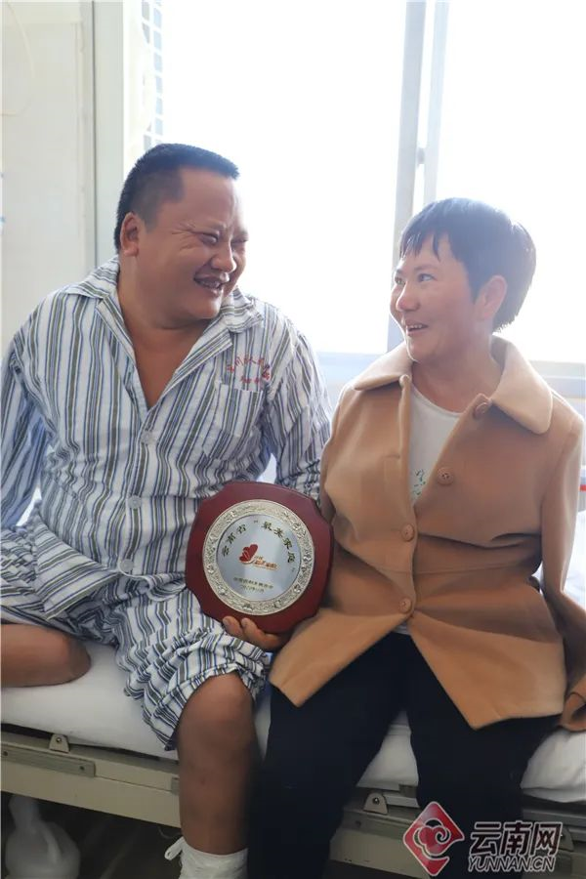
The couple Zhang Shundong and Li Guoxiu
生词讲解：
1. odd
机会
2. poverty
贫穷
3. trophy
奖杯，奖品
4. endear
使受欢迎(喜爱、爱慕)
The couple Zhang Shundong and Li Guoxiu _________ (overcome) their physical _________ (difficult), ______ (beat) all the odds to build a family, and lift _________ (they) out of poverty. ______ they lifted the Touching China trophy they endeared themselves to ______ (million) of people!
overcame
difficulties
beating
themselves
When
millions

Slide 15
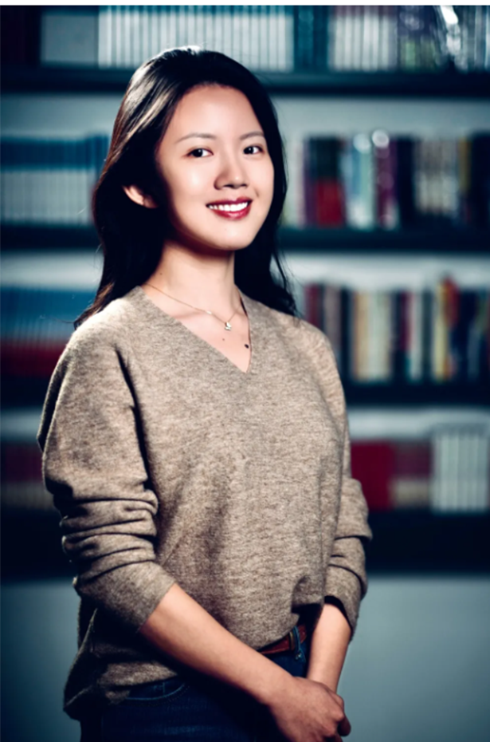
Jiang Mengnan
生词讲解：
1. doctorate
博士学位
2. fate
命运
3. triumph
巨大的成功
4. adversity
逆境
5. myriad 、
无数的
6. obstacle
挫折
7. prestigious
有名望的
Jiang Mengnan, ___ deaf Chinese girl _______ (accept) to study doctorate at Tsinghua University ___ 2018. Though life kept ______ (throw) Jiang more challenges, the positive woman regarded them ___ "gifts of fate." Jiang Mengnan's story is one of triumphs over adversity. Deaf almost since birth, she ___________ (overcome) myriad obstacles to achieve her dream of studying for a PhD ___ one of China's most prestigious _______ (school).
a
accepted
in
throwing
as
has overcome
at
schools

Slide 16
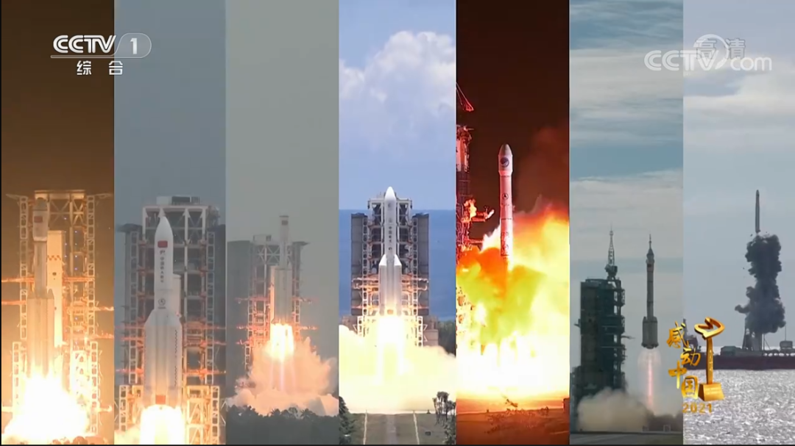
Chinese Aviation
生词讲解：
1. starry
布满星星的
2. horizon
地平线；眼界
3. cosmos
宇宙
4. interplanetary
太阳系的；行星间的
5. probe
航空探测器
6. explore
探索
This ______ (year) Touching China awards also ______ (focus) on China's space community ___ opening new ______ (horizon) in the starry ocean ___ the cosmos, including building China's own space station, ___ smooth interplanetary travel and ______ (land) beyond the Earth-Moon system with the Mars probe, Tianwen-1, and the _________ (explore) of Mars.
year’s
focused
for
horizons
of
a
landing
exploration

Slide 17
应用文句子翻译
1. 杨振宁，一个著名的物理学家，为祖国奉献了他的一生。
Yang Zhenning, a renowned physicist, contributed all his life to his motherland.
2. 虽然天生聋哑，但是江南梦通过自己的努力实现了自己的梦想。
Although born deaf and blind, Jiang Nanmeng achieved her dream through her persistent effort.
3. 朱彦夫不仅教会了孩子们识字，而且教会了孩子们做人的道理。
Not only did Zhu Yanfu teach kids how to read, but also he taught them how to be a man.
4. 面对生活的挫折，张顺德李国秀夫妇没有放弃，而是用更积极的态度去回馈社会。
Facing all the obstacles, The couple Zhang Shundong and Li Guoxiu never give up, but try to give back to the society with a more positive attitude.

Slide 18
用本课中的新词替换划线词
1. The visitors in the theater all cheered up.
2. Vocabulary is important in English-learning.
3. The family die from being poor.
4. Your loyalty will make them admire you.
5. His work is a great success.
6. The villagers here is friendly.
7. He contributed himself to teaching cause.
8. The Four Great Inventions is neccesary in Chinese history.
9. It’s important to relieve our pressure.
10. Zhong Nanshan is a famous physicist.
audience
prominent
poverty
endear yourself
a triumph
resident
dedicate
indispensable
alleviate
prestigious/renowned

Slide 19
模拟高考题：
感动中国2021年度人物已经揭晓，他们或护卫祖国，或造福民生，或推广传统文化，或传递市井温暖，都让人忍不住热泪盈眶。在你心中，年度人物有什么样的特征？请以“2021 Person of the Year in my heart”为题写一篇英语演讲稿。
内容包括： 1. 你心中年度人物的标准是什么？ 2. 你心中的2021年度人物是谁？ 3. 你为什么选择他或她？

Slide 20
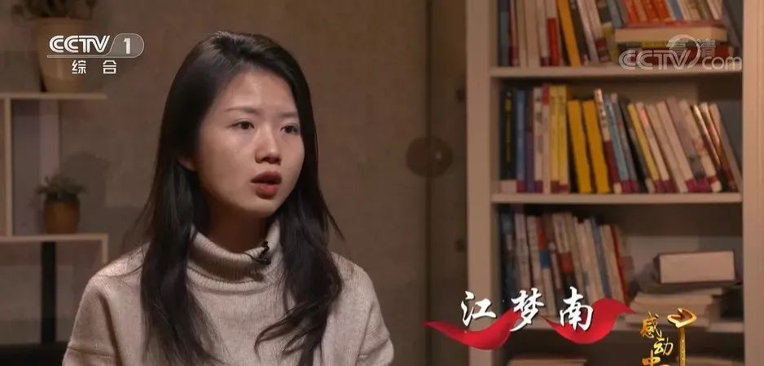
2021 Person of the Year in my heart In my heart, the Person of the Year is someone who makes great contributions to society. Ten inspirational role models was honored in 2021 annual Touching China awards. What impresses me most is the deaf Chinese girl, Jiang Mengnan, who achieved her dream through her persistent effort despite the fact that she was born deaf and blind.
Jiang Mengnan was accepted to study doctorate at Tsinghua University in 2018. Though life kept throwing her more challenges, the positive girl regarded them as "gifts of fate." Jiang Mengnan's story is one of triumphs over adversity. Deaf almost since birth, she has overcome myriad obstacles to achieve her dream of studying for a PhD at one of China's most prestigious schools.
As a student in Senior school, we are supposed not to give up but try to try our best with a more positive attitude.

Slide 21


