Slide 1

感恩遇见，相互成就，本课件资料仅供您个人参考、教学使用，严禁自行在网络传播，违者依知识产权法追究法律责任。
更多教学资源请关注
公众号：溯恩高中英语
知识产权声明

Slide 2
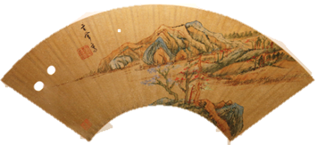
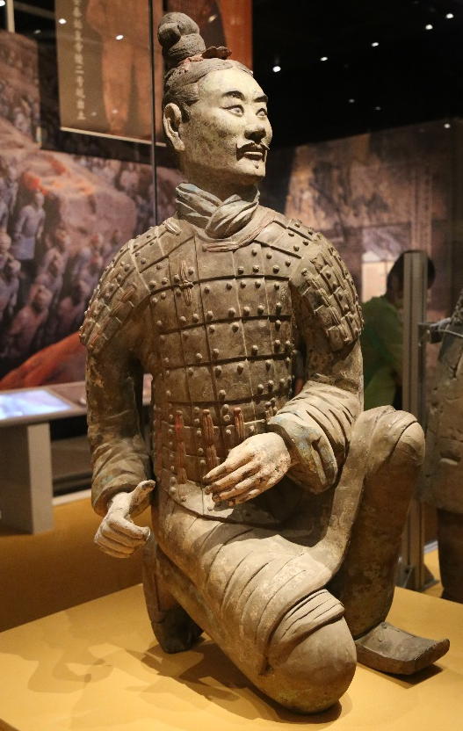
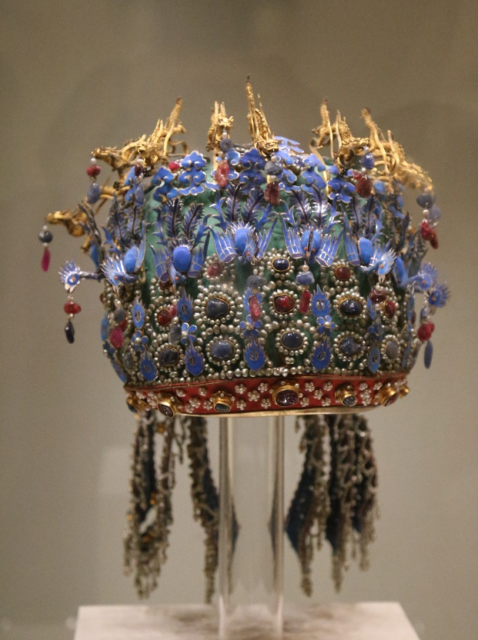
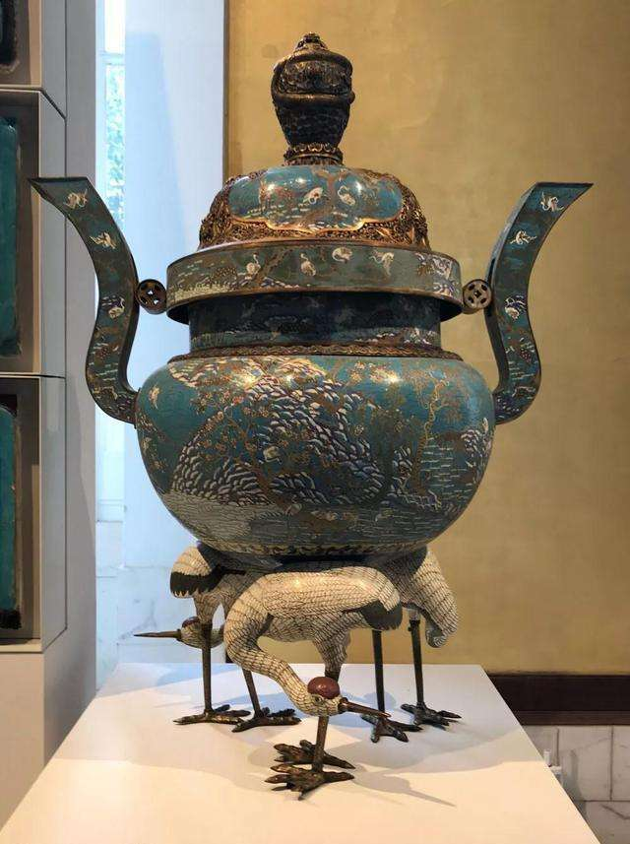
UNIT 1 Using Language
Ancient Chinese Art on Show

Slide 3
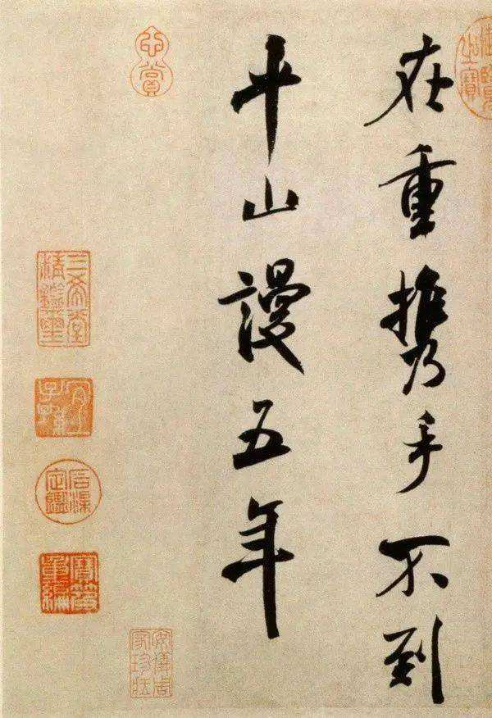
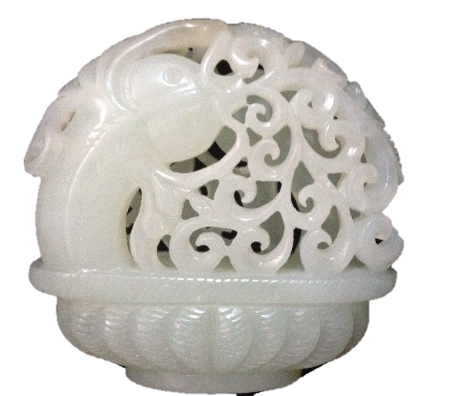
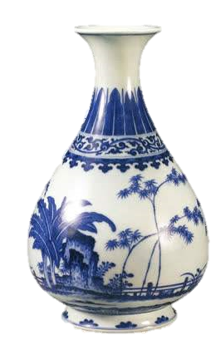
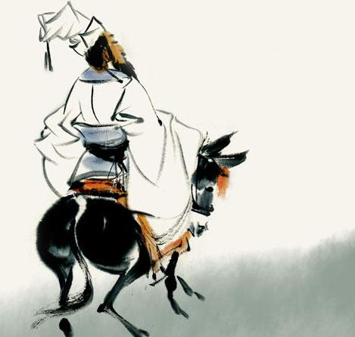
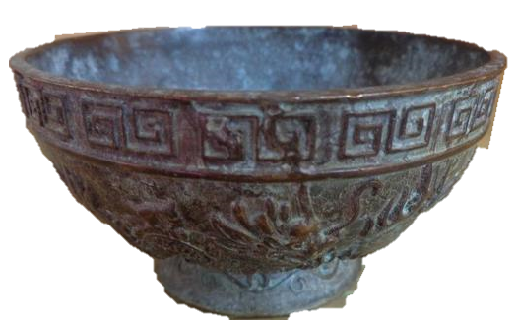
Brainstorming
What Chinese art have you ever seen in the museum?
Jade sculptures
calligraphy
…
Chinese Art
Aceramic vases
ink wash paintings
Bronze
bowls

Slide 4
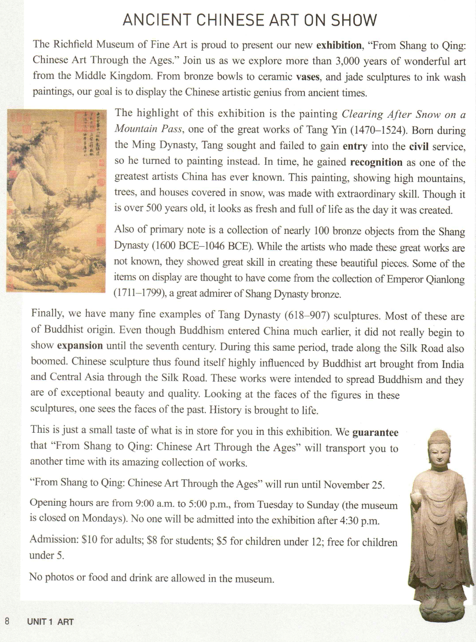
Prediction
1. What do you expect to read from the text?
2. Where can you read the text?
3. What is the text type of the passage?
?

Slide 5
Skimming
Skim the text quickly to see if you are right.
Where can you read the text?
What is the text type of the passage?
Advertising leaflets(宣传册) or newspaper
?
A. Narration(记叙文).
B. Argumentative Essay(议论文).
C. Expository Writing(说明文).
D. Practical Writing(应用文).
√
3. What the content of the text is? Or what is the main idea of this text
This text is a short introduction about the ancient Chinese art exhibition.

Slide 6
Skimming
Skim the text and match the main idea of each part.
Part 1(para 1)
Matters needing attention about the exhibition
?
Part 2(para 2-4)
Highlights of the exhibition
An introduction of the exhibition
Part3(para5)
A brief summary of the exhibition
Part 4(Para6—9)

Slide 7
Detailed reading
Read the text carefully and find the basic information.
?
Theme
Items on display
Purpose
Highlights
Possible emotions
Date
Details
Opening hours
Ticket price
Rules

Slide 8
Detailed reading
Theme
From Shang to Qing: Chinese Art Through the Ages
Items on display
Bronze bowls, ceramic vases, jade sculptures and ink wash paintings
Purpose
To display the Chinese artistic genius from ancient times
?
Ancient Chinese Art on Show
The painting called Clearing After Snow on a Mountain Pass.
Highlights
A collection of nearly 100 bronze objects.
Many fine examples of Tang Dynasty sculptures
Possible emotions
amazed, thrilled and fascinated
It runs until November 25
Date
Opening hours
9:00 a.m. - 5:00 p.m. (Tuesday to Sunday)
Details
Ticket price
Adults: $10, students: $8, children uder12: $5,
Rules
Photos or food and drink are prohibited.

Slide 9
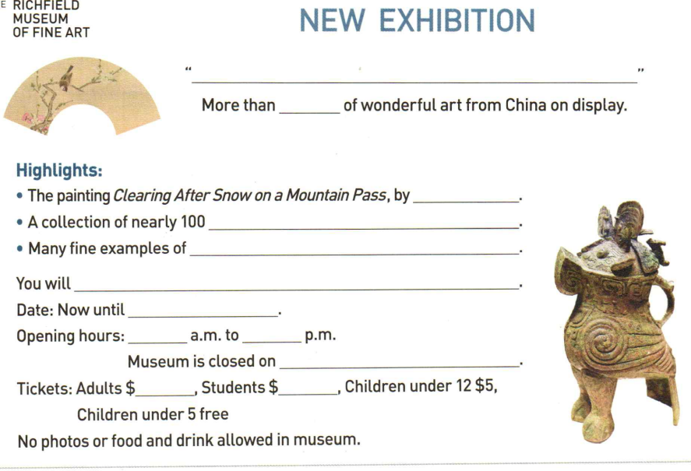
Complete the advertising leaflet below.
From Shang to Qing: Chinese Art Through the Ages.
Introduction
3000 years
?
Tang Yin
bronze objects
Tang Dynasty sculptures
Summary: emotions
be transported to another time with its amazing
November 25
Matters needing attention: details
9:00
5:00
Mondays
10
8

Slide 10
Critical thinking
1. Who are the target readers?
Tourists
This text was written for people who are interested in art and art history, and who enjoy visiting museums.
?
2. What’s the author’s purpose of writing this passage?
In order to attract people to the exhibiton and spread the Chinese traditional culture to the world.
3. How to spread the Chinese traditional culture to the world?

Slide 11
Language Features
What are the language features of the announcement?
Voice:
passive
1. This painting, showing high mountains, trees, and houses covered in snow, was made with extraordinary skill.
2. Some of the items on display are thought to have come from the collection of Emoeror Qianlong...
3. No one will be admitted into the exhibition after 4:30 p.m.
4. No photos or food and drink are allowed in museum.

Slide 12
Language Features
What are the language features of the announcement?
Voice:
Sentence type:
Words & phrases:
Person:
Tense:
passive
?
simple sentences and imperative sentences
formal
the first
simple present and future

Slide 13
Language Features
What should be included in an announcement?
How should the information be arranged?
Theme
Items on display
Purpose
Highlights
Possible emotions
Exhibition period
Opening hours
Ticket price
Visiting rules
?
→1. Theme
→2. Highlights
→3. Details

Slide 14
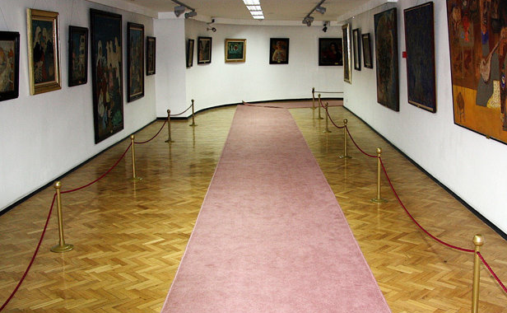
Discussion
You are now going to write an announcement for art club members about a trip to see an exhibition.
Work in groups. Brainstorm the details about the exhibition and take notes.
?
What is the exhibition about? (name, items & purpose )
What are the highlights?
How will you feel?
When are you going?
Where shall you meet?
How are you going to get there?
What’s the ticket price?
What should you bring?
What rules should you obey?
….

Slide 15

Writing
You are now going to write an announcement for art club members about a trip to see an exhibition.
To: Art Club members
From: J. Turner
Subject: On March 15, we will go to see “Making an Impression: the Birth of Impressionism”
This exhibition is about the beginning of the Impressionist movement. Its highlights are paintings by Monet, Manet, and Renoir. We will meet at school at 10 a.m. and take the metro to the museum. Bring your mobilephone to take pictures and a notebook for notes and sketches. Bring some money for lunch, too.
?

Slide 16
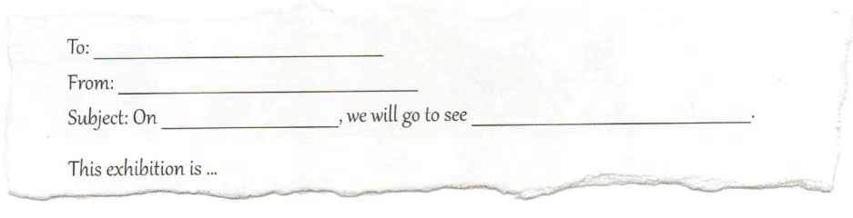
Writing
Write your announcement based on your notes.
?

Slide 17
Show time
Exchange drafts with a partner. Use this checklist to give feedback on your partner’s draft.
1. Is the announcement clear and to the point?
2. Is all the necessary information about the exhibition and the trip included?
3. Does the writer use correct grammar, punctuation, and spelling?
?
Get your draft back and revise it. Then put up your announcement in the classroom.

Slide 18


Write an announcement.
Useful information:
1. Beyond the Bounds of History: A Collaborative Exhibition Between the Palace Museum and Dunhuang
2. Location: Wu men, the Palace Museum
3. Dates: 2021-09-17 through 2021-11-18
You can search on the Internet for more details.

Slide 19

Thank You
?

