Slide 1

感恩遇见，相互成就，本课件资料仅供您个人参考、教学使用，严禁自行在网络传播，违者依知识产权法追究法律责任。
更多教学资源请关注
公众号：溯恩高中英语
知识产权声明

Slide 2

空白演示
B2U3 The Internet
[workbook]-Reading and Writing
单击输入您的封面副标题
-by Iris Yan

Slide 3

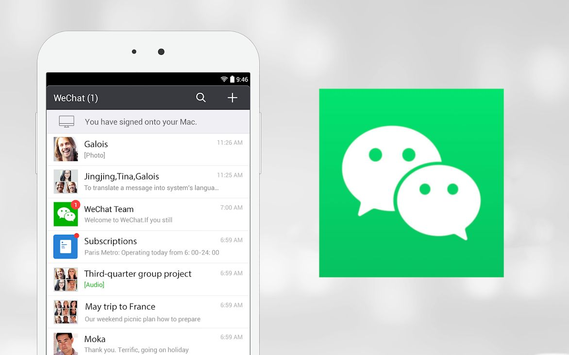
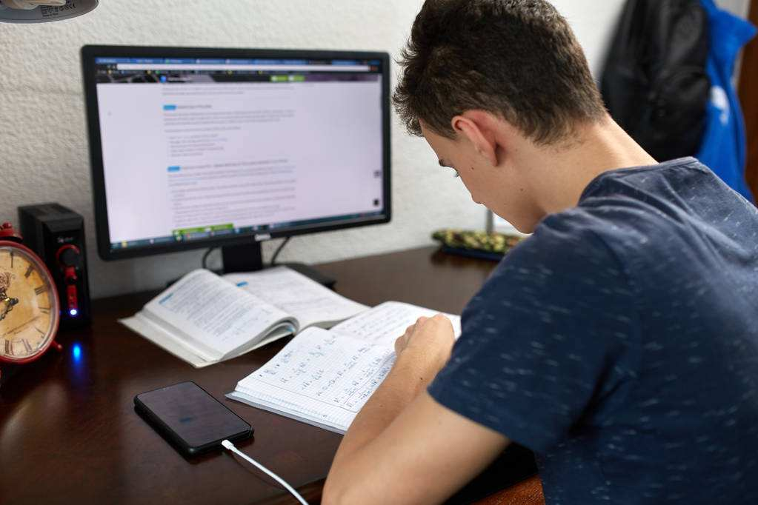
Lead-in: Types of online activities.
Entertainment
Social use
Learning

Slide 4
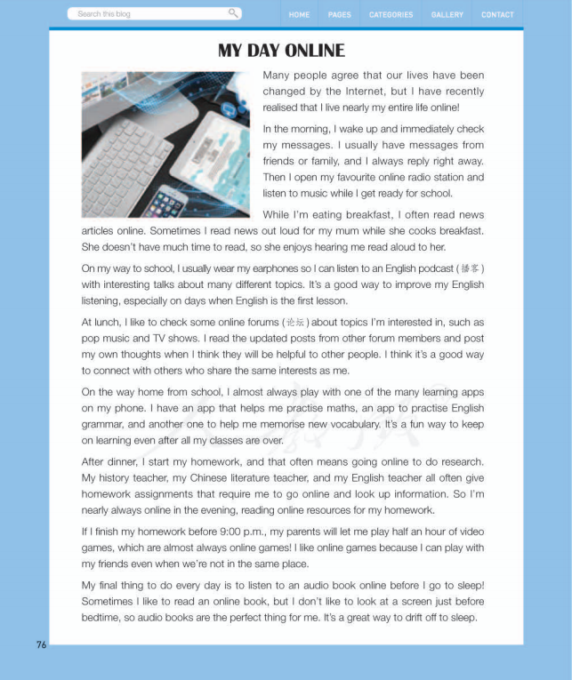

Reading
introduction
Draw a mind map to show the outline.
In what order does the author organise the details?
1
Introduction
Morning
Evening
2
3
4
5
6
7
8
9
Details
Details
Noon
Time
Afternoon

Slide 5
自主探究
introduction
Morning
What online activities does the student do throughout the day?
Noon
Details
Afternoon
Evening
Time

Slide 6
自主探究
Time of day | Online activity | Activity type | I do or not | Good or bad | Why | Recommen-dation
Morning
Noon
Afternoon
Evening
check for messages and reply
S
listen to music
E
read news articles online
E
What online activities does the student do throughout the day?
listen to an English podcast
L
check online forums
S
At lunch, I like to check some online forums about.... I read the updated posts from other forum members and post my own thoughts...I think it’s a good way to connect with others...
read posts and post my own
S
play with a learning app
L
look up for information online
L
play video games
E
listen to an audio book online
E
It’s a great way to drift off to sleep.

Slide 7
Time of day | Online activity | Activity type | I do or not | Good or bad | Why | Recommen-dation
Morning
Noon
Afternoon
Evening
S
a waste of time
put smartphone away from me
check for messages and reply
√
not so good
listen to music
E
read news articles online
E
Thinking and Sharing
1)Do I do it, too?
2)Is it a good or bad activity, why?
3)Is there anything better or just as good to recommend?
listen to an English podcast
L
check online forums
S
read posts and post my own
S
play with a learning app
L
look up for information online
L
play video games
E
listen to an audio book online
E

Slide 8
Time of day | Online activity | Activity type | I do or not | Good or bad | Why | Recommen-dation
Morning
Noon
Afternoon
Evening
S
a waste of time
don’t check too often
check for messages and reply
√
not so good
listen to music
E
read news articles online
E
listen to an English podcast
L
check online forums
S
read posts and post my own
S
play with a learning app
L
look up for information online
L
play video games
E
listen to an audio book online
E

Slide 9
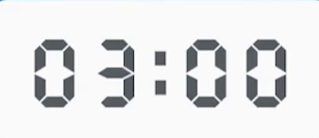

Group work-Discussion
Time of day | Online activity | Activity type | I do or not | Good or bad | Why | Recommen-dation
Morning
Noon
Afternoon
Evening
check for messages and reply
S
4E-3S-3L
listen to music
E
read news article online
E
Do you think it is a good idea to spend so much time online every day? Why or why not?
listen to an English podcast
L
check online forums
S
read posts and post my own
S
play with a learning app
L
look up for information online
L
play video games
E
listen to an audio book online
E

Slide 10
Writing task
Write a comment about the blog post.
Tip1 about the way to organise your ideas.
A.by the time of day when the activities happen.
B.by the type of activity (E,S,L)
C.by opinion: good VS bad
D.by the ones I do VS the ones I don’t do.

Slide 11
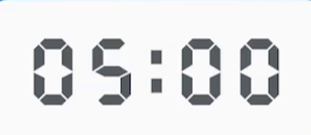
Writing task
Write a comment about the blog post.
Tip2 about the outline.
Be sure to start with an introduction and end with a conclusion.
I think your daily online activities are very ...________.
...____________________________________________
__________________________________________________
To sum up, I think that your online activities are ...______
__________________________________________________.

Slide 12
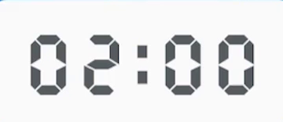
Evaluation评价
Pair work: use the checklist to revise your partner’s draft.
Checklist
Does the comment start with an introduction and end with a conclusion?
Does the writer show the idea clearly in the introduction?
Are the ideas well organised?
Does the writer include examples, explanations, or comparisons?
Can you find any grammar, spelling or punctuation mistakes?

Slide 13

Assignment
Revise your draft and help yourselves use the Internet wisely.

Slide 14
Writing task
Possible version
I think your daily online activities are very interesting.
I also like to stream music and audio books for entertainment. I also like to watch videos too. It is good that you use an app and podcast to learn English everyday. You can also stream English songs and films to help practise and hear natural English being spoken.
To sum up, I think that your online activities are well balanced among entertainment. social use, and learning.

