Slide 1

感恩遇见，相互成就，本课件资料仅供您个人参考、教学使用，严禁自行在网络传播，违者依知识产权法追究法律责任。
更多教学资源请关注
公众号：溯恩高中英语
知识产权声明

Slide 2

After this class, you'll be able to
Understand the basic features of some English poems.
1
objectives
2
Appreciate the similarities and differences between different forms.
3
Create a short English poem.

Slide 3



选择性必修三 Unit 5
p
o
m
s
e

Slide 4


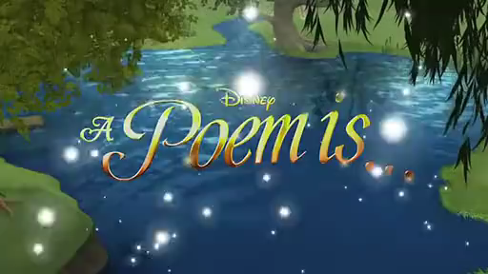
What is a poem?
Lead-in Watch the video and fill the blanks
In children's eyes:
for everyone
A poem is ____________.
A poem is lovely ________.
A poem is ________.
A poem can be __________ and can be ____________.
A poem makes you ______________________.
to share
colourful
really loud
quiet
feel like singing laaaa…

Slide 5

A Few Simple Forms of English Poems
How many
What
Why

Slide 6
Activity 1 Skimming and scanning
1. What is the main topic of the reading
passage?
2. How many forms of poems does the passage talk about? What are they?
forms
English poems
It is about a few simple _____ of ___________.
5

Slide 7
Five forms of poems
4
5
Haiku
1
Forms
Tang poems
Nursery rhymes
3
2
Cinquain
List poems

Slide 8
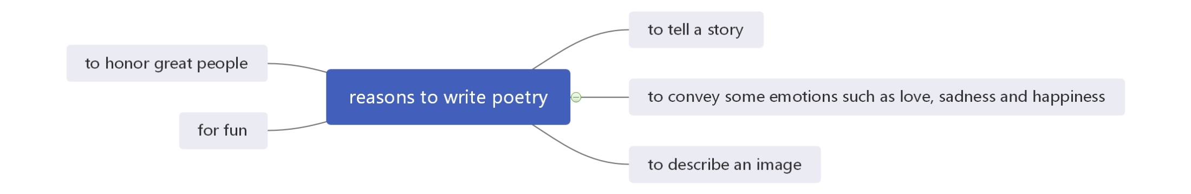
Why do you think people write poems?

Slide 9

Understanding: Focus on language style,
rhyme, feelings of poems
A Nursery rhyme
Hush, little baby, don’t say a word,
Papa’s going to buy you a mockingbird.
If that mockingbird won’t sing,
Papa’s going to buy you a diamond ring.
If that diamond ring turns to brass,
Papa’s going to buy you a looking glass.
If that looking-glass gets broke,
Papa’s going to buy you a billy-goat.
If that billy-goat runs away,
Papa is going to buy you another today.

Slide 10
Nursery rhyme
Read Poems A and find out the rhyming word for the following words:
word ____________ sing ________
brass ____________ broke _________
away ________
mockingbird
ring
looking-glass
billy-goat
today

Slide 11
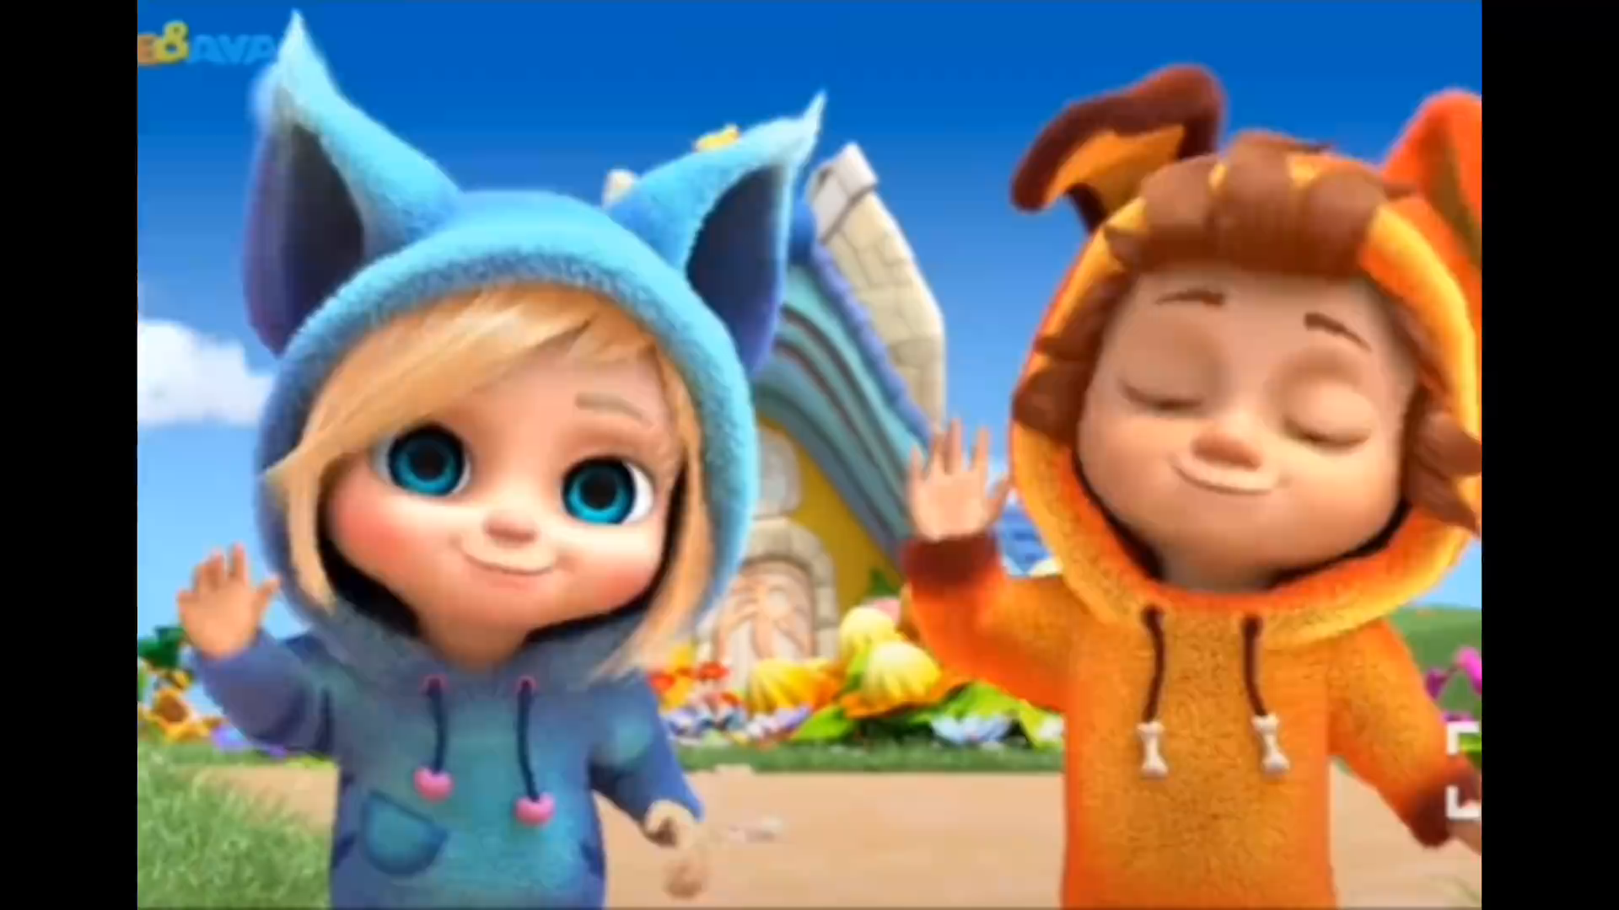
Activity 2 Sing the poems along the video clips

Slide 12

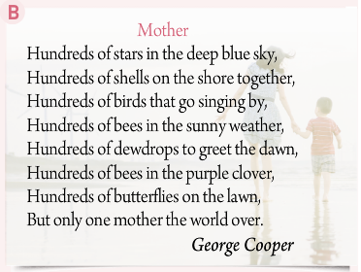

Read para. 3 and then answer the questions.
1. What's the pattern of poem B and C?
B C List poem

Slide 13
2. What are the rhymes of poem B and C?
[aɪ]
[eðə(r)]
[ɔːn]
[əʊvə(r)]
[æd]
[ɔːt]

Slide 14
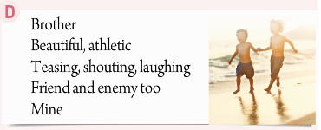
D Cinquain
one noun
two
_____adjectives
____v-ing
three
four
____words
one word
Line 1: a noun (name the subject of the poem)
Line 2: two adjectives (describe the subject)
Line 3: three -ing verbs (describe the subject's actions)
Line 4: four words (give the writer's opinions or feelings)
Line 5: a word (give another name for the subject)

Slide 15
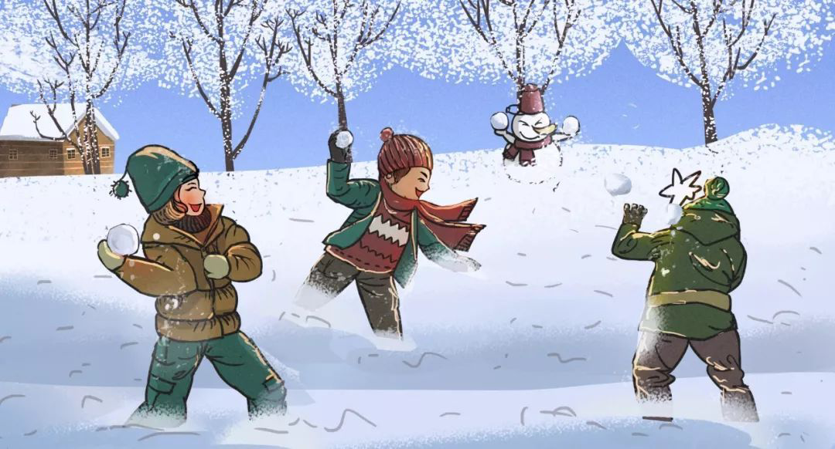

Snow having melted,
the whole village is brimful of happy children.
(by Issa)
5 syllables
A fallen blossom
is coming back to the branch.
look, a butterfly!
(by Moritake)
7 syllables
5 syllables
E Haiku
17 syllables

Slide 16

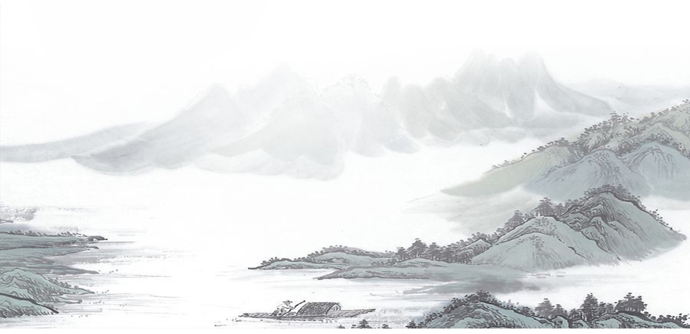
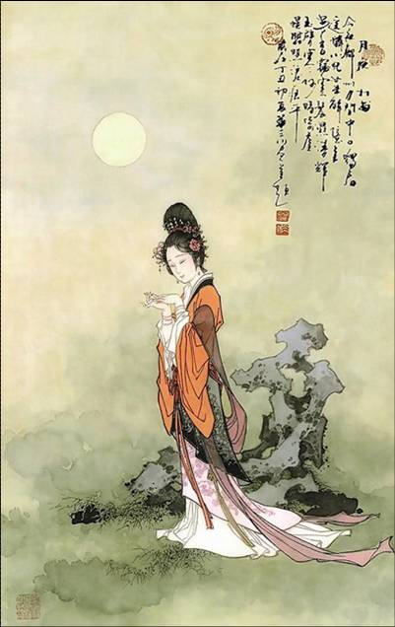


Tang poems
F Tang poem
Where she awaits her husband,
On and on the river flows
Never looking back,
Transformed into stone.
Day by day upon the mountain top,
wind and rain revolve.
Should the traveller return,
this stone would utter speech.
(by Wang Jian)

Slide 17
summary1
emotions
Concrete and imaginative language; strong___________; repetition; easy.
Nursery
rhymes
rhythm
01
List
poems
flexible line length; ___________phrases.
02
repeated
5
____lines; convey a strong picture in just a few words.
Cinquain
03
Japanese form; ____syllables; give a clear picture & a special feeling using few words
04
Haiku
17
From China particularly.
Tang
poems
05
China
China
China

Slide 18
summary2
Form
Emotions
Nursery Rhymes A
love between father and baby
List Poems B/C
love for a mother
Cinquain D
the affection for his/her brother
Haiku E
love for the beautiful spring
Tang Poems F
sad love for her husband

Slide 19




Can you tell which form
the following poems belong to?
Rain, rain, go away, Come again another day; Little Johnny wants to play.
Comment: Johnny can be substituted
for any boy or girl name.

Slide 20

Life is beauty, admire it. Life is bliss, taste it. Life is a dream, realize it. Life is a challenge, meet it. Life is a duty, complete it. Life is a game, play it. Life is a promise, fulfill it. Life is sorrow, overcome it.

Slide 21
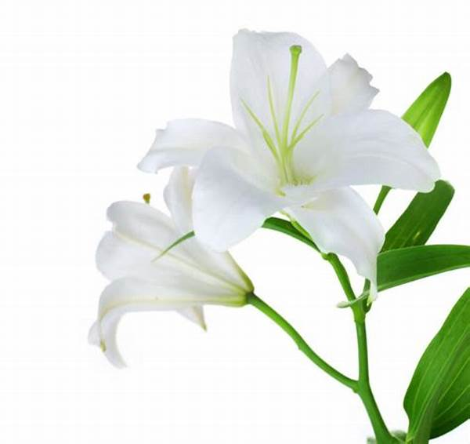

Lily
out of the water
out of itself

Slide 22

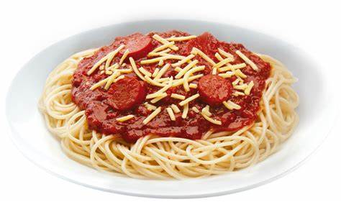
Spaghetti
Messy, spicy
Slurping, sliding, falling
Between my plate and mouth
Delicious

Slide 23
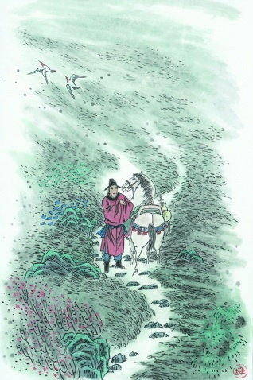

A Farewell Poem to the Old Meadow
Grass is spreading over the meadow
Life or death will yearly come, yearly go.
The bale-fire can burn away the green
Spring breeze will help it survive again.
赋得古原草送别 — 白居易
离离原上草，一岁一枯荣。
野火烧不尽，春风吹又生。

Slide 24
Imitation and creation
Write a poem to convey your feelings,eg: love, sorrow, sadness...Choose a form from the text or create your
own style.
forms
Focus
rhythm & rhymes
emotions

Slide 25

Life is not just about survival,
but
poetry and distance!

Slide 26

Homework
Polish your poems and prepare for a poem exhibition!
An exhibition of poems
----------------------------------------------------------------------------
----------------------------------------------------------------------------
----------------------------------------------------------------------------
------------------------------------------------------------
---------------------------------------------------------------------------
------------------------------------------------------------
------------------------------------------------------------
-----------------------------------------------------------

