Slide 1

感恩遇见，相互成就，本课件资料仅供您个人参考、教学使用，严禁自行在网络传播，违者依知识产权法追究法律责任。
更多教学资源请关注
公众号：溯恩高中英语
知识产权声明

Slide 2


A letter of appeal
浙江省春晖中学
宣晔霏

Slide 3
2022.2名校协作体 应用文：倡议书
第四部分 写作（共两节，满分 40 分） 应用文写作（满分 15 分）
假定你是国际学校学生李华，4月22日“世界地球日”(Earth Day)即将来临，请你代表学生会写一封倡议书，呼吁大家关爱地球。内容包括：
现状说明；
具体措施；
发出倡议。
注意：
1. 词数80左右；
2. 可以适当增加细节，以使行文连贯。
______________________________________________________________________________________________________________________________

Slide 4
审题
倡议书
体裁：
格式：
语言：
人称：
要点：
假定你是国际学校学生李华，4月22日“世界地球日”(Earth Day)即将来临，请你代表学生会写一封倡议书，呼吁大家关爱地球。内容包括：
现状说明；
具体措施；
发出倡议。
注意：
1. 词数80左右；
2. 可以适当增加细节，以使行文连贯。
Dear fellow students,
Students’ Union
（Apr.27th,2020）
Formal or informal?
第三人称为主
现状说明；
具体措施；
发出倡议。

Slide 5
Main parts of the letter of appeal
Dear fellow students,
Students’ Union /Li Hua
Para 1： 发出倡议的背景、原因或某一个倡议的表述
Para 2： 所倡议的具体内容和要求
Para3：结尾要表示倡议者的决心和希望或建议

Slide 6
Para 1: how to express “appeal”
开头常用语：
1. In order to…, I sincerely appeal to/call on/urge sb. to do …
2. I strongly advocate that sb. (should) do/ advocate sb to do…
3. With/For the purpose of…, I’d like to call your attention to the importance of…
4. Recently, there exists a problem/ phenomenon that…, which leads to many bad effects. So it’s(high) time that we did…
5. It is required that we…
6. In my opinion, we had better…

Slide 7
Para 2: detailed advice
To solve the problem, we should do as follows.
In order to ease the present serious situation, all students had better do as follows
It develops rapidly and now has become one of the hottest topics. But still, problems can’t be overlooked.
No one can deny the fact that/It can be said with certainty that/There’s no denying that/There’s no doubt that/Undoubtedly,/Without doubt, the environment is getting polluted more and more seriously
Everyone ought to have a positive attitude toward/to the campaign against the disease
常用句型：We are supposed/required/expected to do…
We had better do/ ought to do …
It is suggested/advised that …
It’s a good choice to do… It is advisable to do…
It would be wise if…
It’s of great importance/significance to do…
Immediate measures should be taken to do…

Slide 8
Para 3: appeal again
Such measures/action can surely improve ……, so let’s start from now on.
Hopefully, you can join in the action and ...
It’s high time that we took measures to change the situation.
Every effort counts/matters/makes a difference. Let’s work together to make the planet a better place.
Please keep in mind that a small action can make a huge difference.
Let’s take action right now! I’m convinced our efforts will eventually pay off.
Hoping to see you participate in the activity! Take action now and you won’t regret it!
常用句型：1. Let’s join together to fight …
2. Let’s take responsibility for…
3. Let’s make every effort/ spare no effort to ...
4. Only if we take effective steps to deal with this problem now can we…
5. Only in this way can we …

Slide 9
第四部分 写作（共两节，满分 40 分） 应用文写作（满分 15 分）
假定你是国际学校学生李华，4月22日“世界地球日”(Earth Day)即将来临，请你代表学生会写一封倡议书，呼吁大家关爱地球。内容包括：
现状说明；
具体措施；
发出倡议。
注意：
1. 词数80左右；
2. 可以适当增加细节，以使行文连贯。
______________________________________________________________________________________________________________________________

Slide 10
Para 1： 发出倡议的背景、原因或某一个倡议的表述
background
背景： 4月22日“世界地球日”(Earth Day)即将来临/ 地球目前面临的一些问题
倡议：呼吁大家关爱地球
1. There is a wide concern over the issue that the earth is confronted with such damages. Species disappearing, global warming and water being polluted, the earth is in desperate need of help. Therefore, I feel it an obligation to take some measures.
2. With the earth day upcoming, I, on behalf of Students Union, is cordially appealing to everyone to shoulder the responsibility to protecting our mother earth.
3.With the earth day around the corner,
I am writing with desperate need to appeal to you to cherish and protect our valuable earth.
假定你是国际学校学生李华，4月22日“世界地球日”(Earth Day)即将来临，请你代表学生会写一封倡议书，呼吁大家关爱地球。内容包括：
现状说明；
具体措施；
发出倡议。
appeal
I am appealing to you with desperate need to cherish and protect our earth.

Slide 11
Para 2： 现状说明+具体措施
影响类的词：
have an effect on…
be harmful for\ do harm to..
suffer from
impair损害
loss of…
cause great damage to
catastrophic 灾难性的
disastrous 灾难性的
Fall; decline; drop (quickly/dramatically/sharply)
problems
water\air pollution
global warming \climate change
(ice melting ) natural disasters
water shortage
loss of biodiversity生物多样性
lack of resources
deforestation 滥砍森林
Desertification 荒漠化
endangered animals
loss of habitat
Overuse of… excessive use of…
overpopulation 人口过多
due to
account for
result in
on account of
Seeing that…
Since/for
Thus
therefore……

Slide 12
Horribly, our earth is suffering from a wide variety of catastrophes, ranging from global warming, the rising of sea level and deforestation.
Climate change and loss of biological diversity caused by human activities pose a fatal threat to our ecosystem
problems
take public transportations
do rubbish classification
use recyclable bags
arouse people’s environment awareness
turn off lights save water…
solutions
It’s highly recommended that we walked or took public transportation to school.
You’d better spare no effort to do rubbish classification
It’s significant that we should promote low-carbon, environmentally-friendly lifestyle
It is suggested that we … which is bound to infinite hope into our earth.
solutions

Slide 13
Para 3： 再次发出倡议
●let’s make joint effort to make a difference to the world!
● It’s my genuine hope that we’ll share a bluer sky in the future. Spring into action from now on. For the earth and for yourself.
● Every small action counts in beautifying our earth.
● Let’s take action from now on and spare no effort to build a harmonious relationship with our planet.
● Hopefully, our joint effort will be bound to create a better earth for us and for the coming generations.
● Don’t hesitate to care about your mother earth! Let’s take action now.
● Once again, I appeal to all of you to take care of our earth and create a harmonious and everlasting relationship with our earth.
What about your ending?

Slide 14
Dear fellow students,
With the earth day approaching, I, on behalf of the Student Union, firmly advocate everyone to care about the planet we live on.
Problems ranging from large amounts of food waste, loss of trees, excessive use of water as well as plenty of rubbish, arise almost every corner of our school. Thus, we are obliged to turn off the lights and water tap. Besides, your firm “no” to food waste will definitely contributes to what is advocated as "Empty Plates Movement". What’s more, recycling textbooks and reusing them will also make a big difference.
Hopefully, our joint efforts are bound to beautify our campus. It’s high time that we took action now!
Students’ Union
Para1:根据审题，“李华作为学生，代表学生会发出倡议”，所呼吁的对象应该是学生，而非全社会或者全人类！
Para2:常见错误是没有结合学生学习生活和校园实际，可结合校园实际提一些建议如：光盘行动，垃圾分类，节约用电，教材循环利用等
Para3: 切忌假大空的倡议，需贴合学生实际发出倡议。

Slide 15
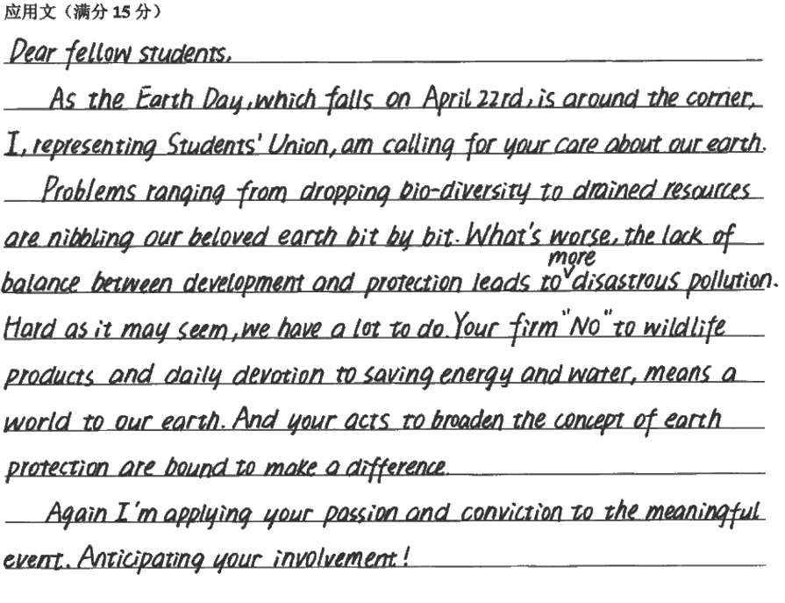
高分作文赏析：
rang from…
biodiversity
生物多样性
drained resources
nibble our beloved earth
disastrous
hard as it may seem
say firm “no” to wildlife products
be bound to
make a difference to

Slide 16
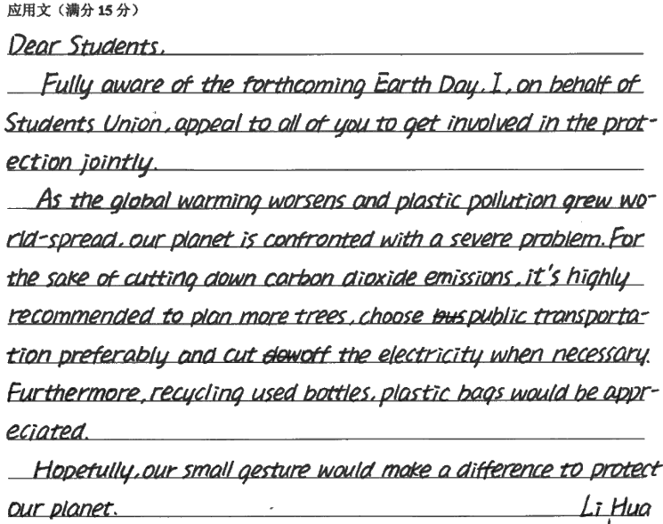
be fully aware of
be confronted with
for sake of
make a difference to

Slide 17
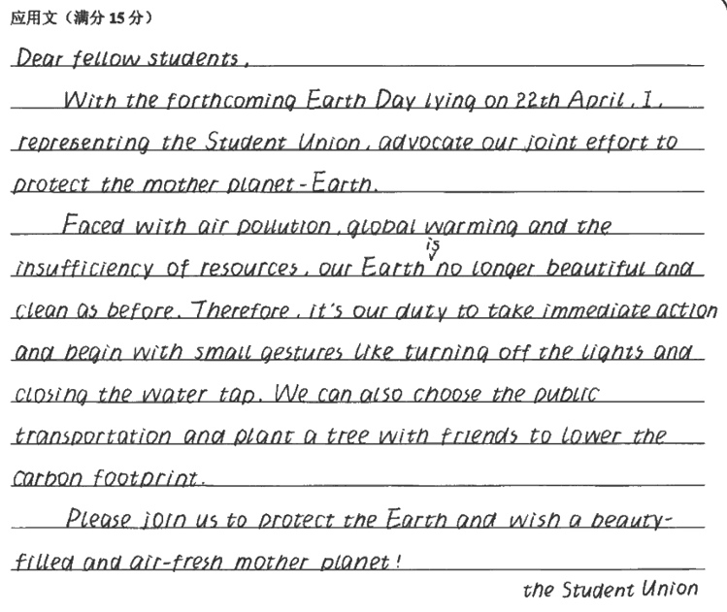

Slide 18
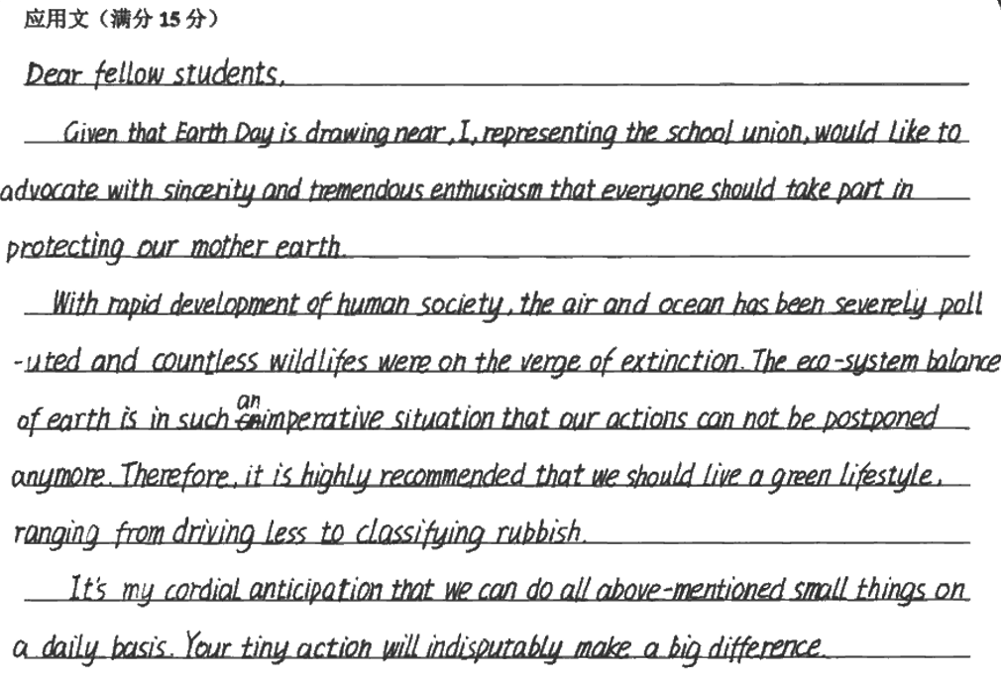
高分作文赏析：

Slide 20
Thank you!

