Slide 1

感恩遇见，相互成就，本课件资料仅供您个人参考、教学使用，严禁自行在网络传播，违者依知识产权法追究法律责任。
更多教学资源请关注
公众号：溯恩高中英语
知识产权声明

Slide 2
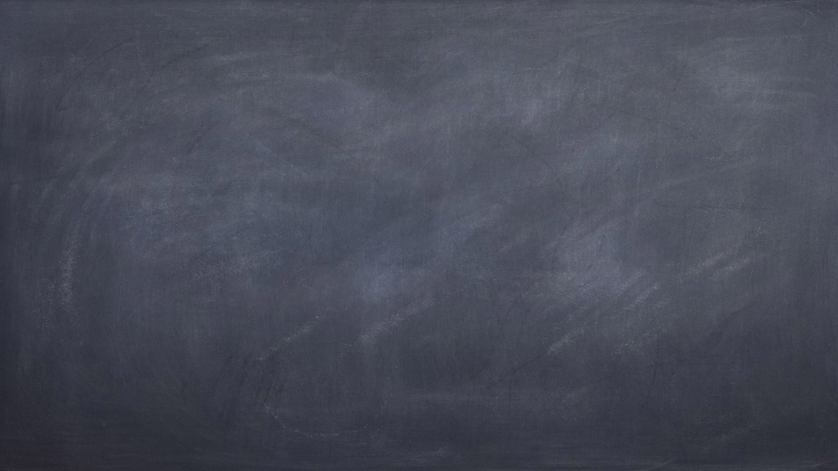
Book5 Unit5 Using language 2
Teacher: 陈佳莉

Slide 3
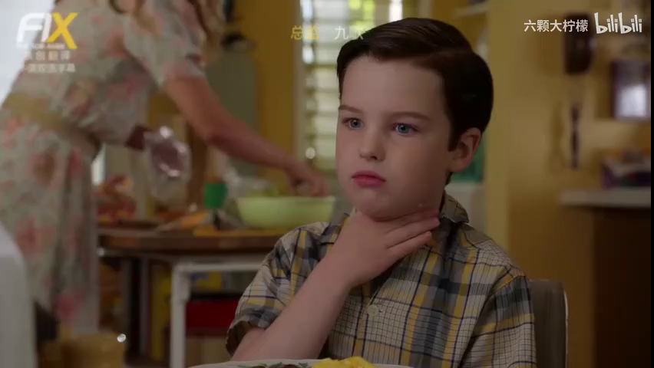
Video Time
What is young Sheldon suffering?

Slide 4

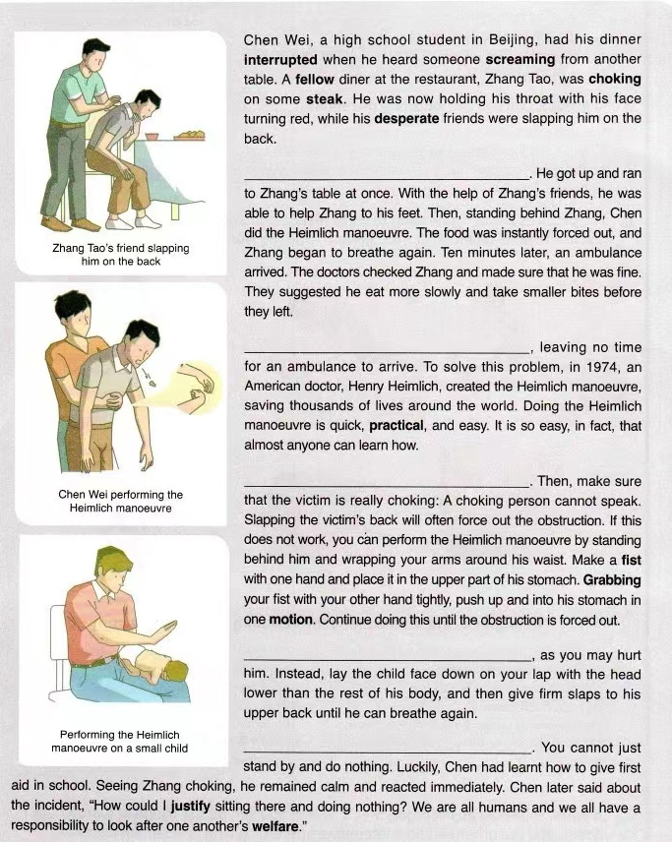
Read and complete
A Choking victims usually have only about four minutes before they collapse and sometimes die
B If you see someone choking, first call the emergency services
C Chen wasted no time
D With choking victims, every minute counts
E Doing the Heimlich manoeuvre on a small child is not recommended
only
sometimes
die
C Chen wasted no time
first
no
A Choking victims...
counts
B If you see ...
not
E Doing the ...
functions:
 give the main idea of the paragraph
 link up ideas between paragraphs
D With choking ...
√

Slide 5
Read for the structure
the story of a choking incident
Part 1: ___________________________
Part 2: ___________________________
________________
Part 3: ___________________________
the introduction of the Heimlich manoeuvre
comments on the choking incident

Slide 6
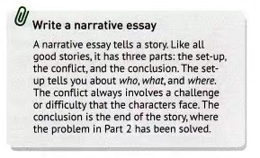
Read for details
Part 1
◾the set-up
◾the conflict
◾the conclusion
√ who
√ what
√ where
√ a challenge or difficulty
√ the end of the story

Slide 7
Read for details
Part 1
A narrative essay should include:
What did Chen Wei do?
01
▪ ...
conflict
02
▪ ...
who
...
03
▪ ...
what
...
where
...
conclusion
set-up
What’s the end of the story?
...

Slide 8
Read for details
conflict
who
Chen Wei, Zhang Tao
Zhang Tao was choking on some steak while eating.
what
where
a restaurant in Beijing
set-up

Slide 9
Read for details
What did Chen Wei do?
01
▪ He got up and ran to the table at once.
▪ With the help of Zhang’s friends, he was able to help Zhang to his feet.
conflict
02
▪ Standing behind Zhang, Chen did the Heimlich manoeuvre.
03
conclusion
What’s the end of the story?
Zhang began to breathe again.
Notes:
what did Chen Wei say about the incident?

Slide 10
Read for details
Part 2
______ Make a fist with one hand ______ Stand behind him ______ Place the fist in the upper part of his stomach ______ Push up and into his stomach in one motion ______ Grab your fist with the other hand tightly ______ Wrap your arms around his waist(腰)
Process of the Heimlich manoeuvre
③
①
④
⑥
⑤
②

Slide 11
Read for details
Part 3
What purpose does the quote serve?
“How could I justify sitting there and doing nothing? We are all humans and we all have a responsibility to look after one another’s welfare.”
▪ Provide a good way to wrap up the essay
▪ Tell the reader about Chen Wei’s emotions and opinions
▪ Give unique insight into his character

Slide 12
Read for language
How can we describe an urgent situation vividly?
forms | expressions
adj.
adv.
v.
sentence structures
desperate friends
vivid
was instantly forced out
heard someone screaming
was choking on steak, was now holding his throat
were slapping him on the back
wasted no time, ran to... at once, help Zhang to his feet
be doing
Chen Wei had his dinner interrupted when he heard ...
Standing behind Zhang, Chen did the Heimlich manoeuvre.

Slide 13
Brainstorm
first aid for burns by hot water
假设你和你班同学Mike正在教室做作业，突然Mike的杯子摔倒在地上，开水烫伤了他的脚，于是你对此实施了必要的急救。
01
02
03
characteristics
descriptions of feelings
first-aid treatment
pain: be numb with pain;
be extremely painful;
clench one’s fist (握紧拳头);
grit the teeth(咬紧牙关);
His face turned pale, with....
red and swollen;
blisters;
watery surface
worries: be worried about; wear a concerned look;
Not knowing what to do, ...
place burns under...;
dry the burnt area with...;
cover it with...

Slide 14

Writing task
假如你是李华，给校英文报专栏投稿，记述上周你对班级同学Mike实施烫伤急救的经历，并简单谈谈你的感受。
注意：1.词数80字左右（开头已给出，不计入总词数）；
2. 合理增加细节，使行文连贯；
Use adj., adv. ,v., and flexible sentence structures to make the narrative essay vivid
Accidents always happen suddenly. The other day, Mike had his glass knocked over, thus spilling the hot water on his right leg. Immediately, I arose from my seat and ran to his table at once.______________________________________

Slide 15
Thank you！

Slide 16
A possible version
Concerned about his injury, some classmates were gathering around him, not knowing what to do. It seemed that Mike was suffering extreme pain and he let out a yell of pain. I checked his injury without delay and found his foot had become red and swollen, followed by some blisters. With the help of his deskmate, we instantly carried him to the restroom and placed burns under cool running water, which lasted about ten minutes. To our relief, the sharp pain seemed to be greatly eased. After drying the burnt area gently, I covered it with a loose clean cloth.
Only then was I aware of what a difference a basic knowledge of first aid could make, especially in such a case.

