Slide 1

感恩遇见，相互成就，本课件资料仅供您个人参考、教学使用，严禁自行在网络传播，违者依知识产权法追究法律责任。
更多教学资源请关注
公众号：溯恩高中英语
知识产权声明

Slide 2
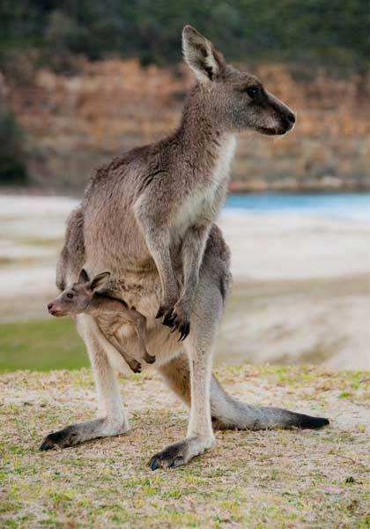
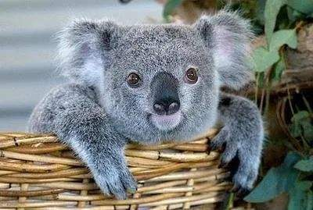
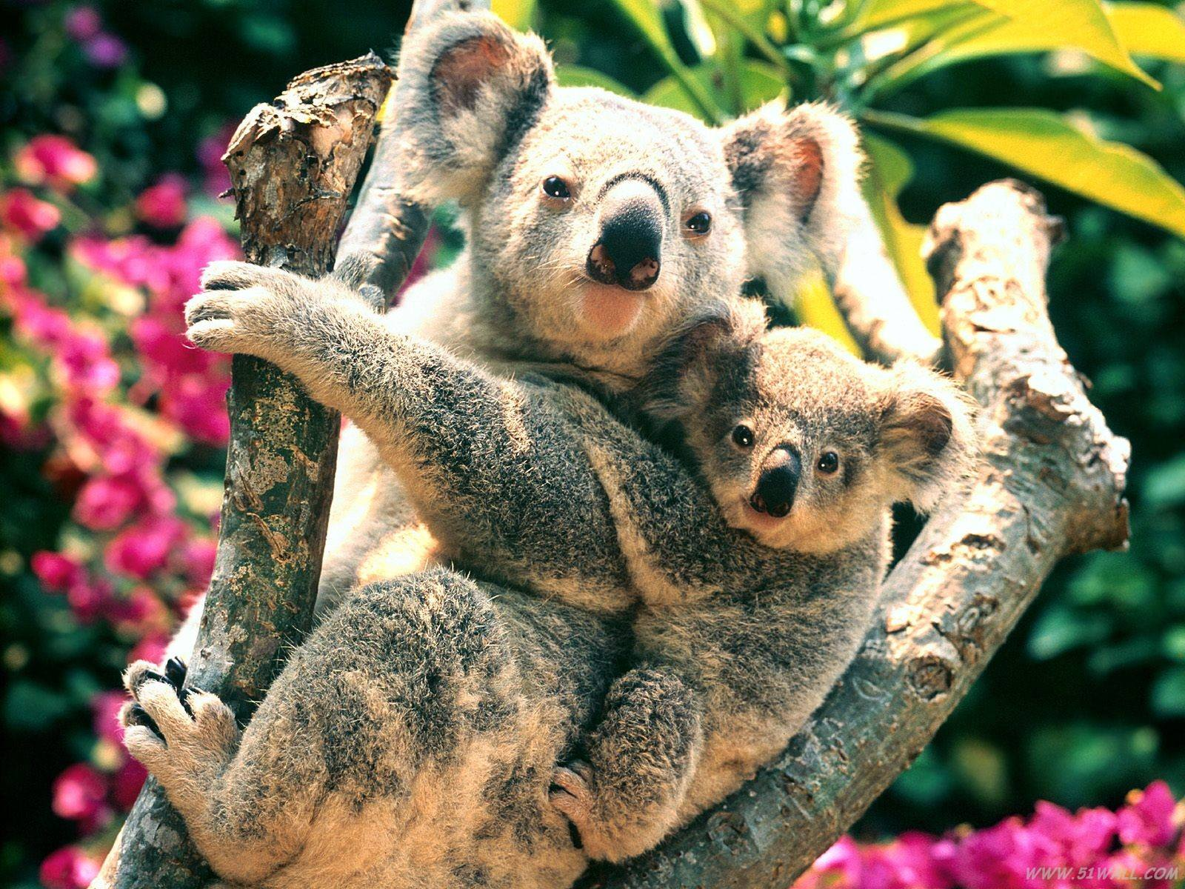
Unit 2 Using Language
Describe an iconic animal

Slide 3
Revision: Experience the iconic features of Australia
Experience the iconic features of Australia
Australian people
Location
Aborigines
To the south of the equator
straightforward,
free-and-easy attitude, friendliness, warmth
Premier food experiences
music and instrument
BBQ, bakeries, fast-food joints, butcher shops, cafes

Slide 4
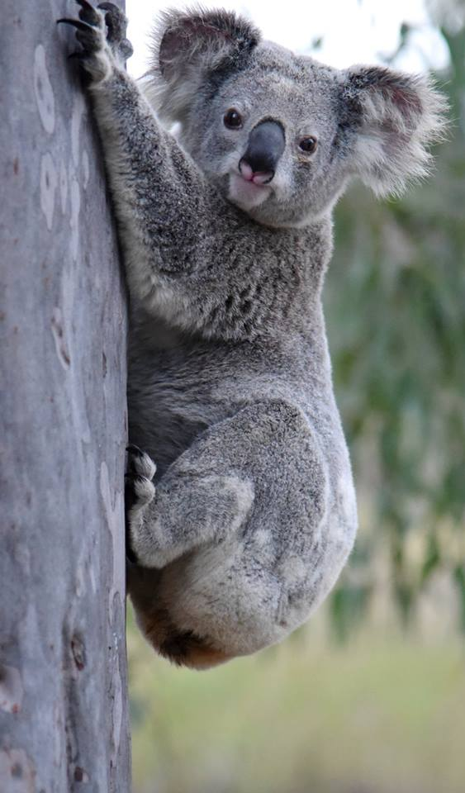
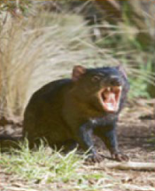
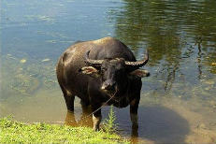
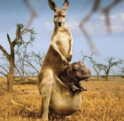
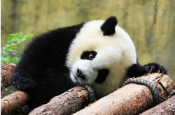
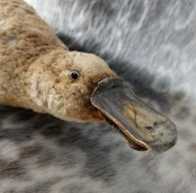
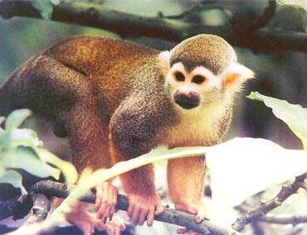
Describe an iconic animal
Look at the pictures below.
What are the amazing animals of Australia?
Tasmanian devil
kangaroo
koala
duck–billed platypus

Slide 5
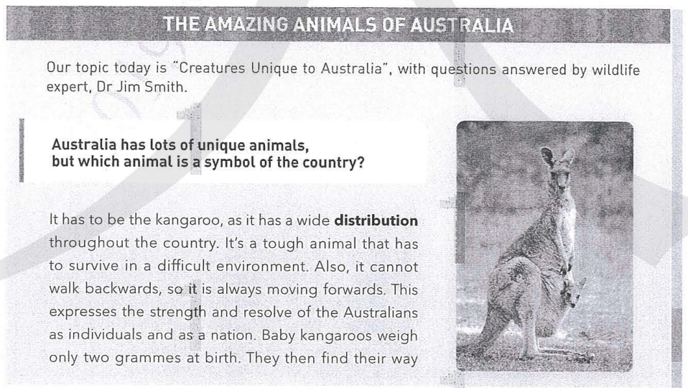
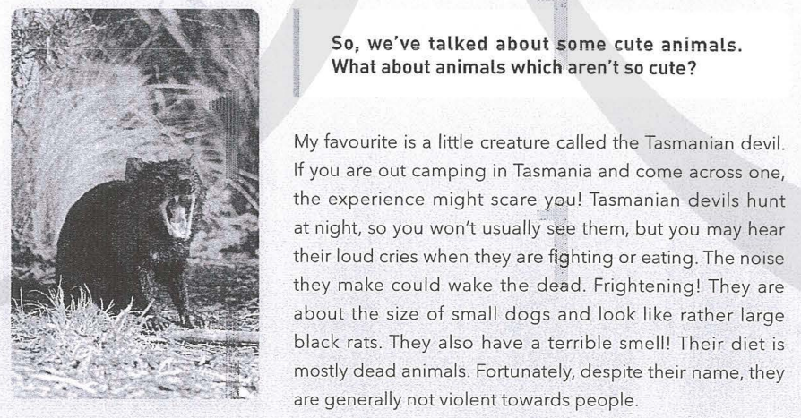
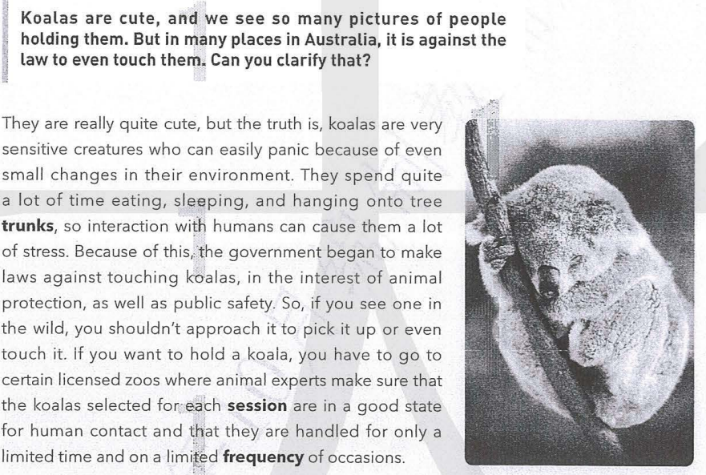
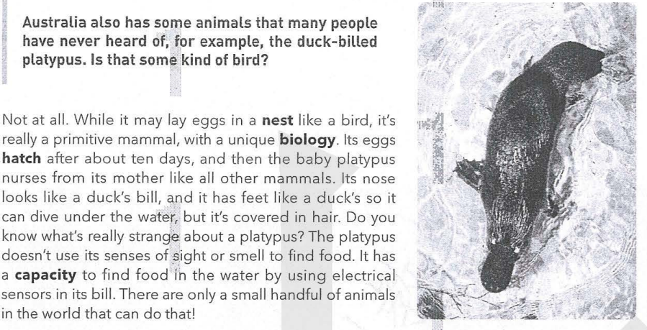
Q
Expository essay
A
Question and answer column
What is the type of the text?

Slide 6
While-reading: read for the structure
1. Australia has lots of unique animals, but which animal is a symbol of the country?
2. Koalas are cute, and we see so many pictures of people holding them. But in many places in Australia, it is against the law to enen touch them. Can you clarify that?
3. So, we’ve talked about some cute animals. What about animals which aren’t so cute?
4. Australia also has some animals that many people have never heard of, for example, the duck-billed platypus. Is that some kind of bird?
To read the first sentence of each part
kangaroos:
a wide ________ throughout the country
koala:
cute but _______
Tasmanian devil
____________:
author’s favourite
duck-billed platypus:
_______ eggs and a _______ _______
distribution
sensitive
lay
primitive mammal
well-known
few people know

Slide 7
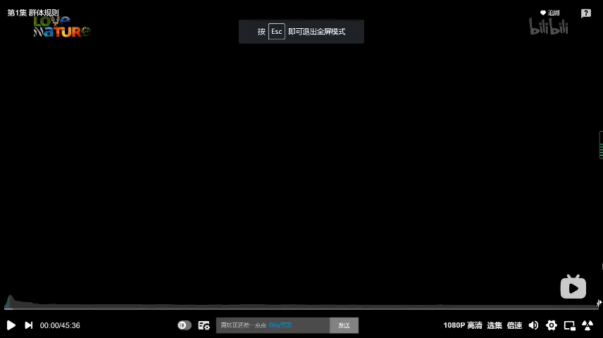
While-reading: read for the details
mother kangaroo’ pouch
Features: look cute, ________________________________
find their way into mother’s pouch, sleep and drink milk
Babies: weigh 2g at birth,______________________________________
Kangaroo
Uniqueness:________________________________________________________________
it cannot walk backwards, always moving forwards.
Relationship with humans:_______________________________________________________________
they can hit and kick very hard, they are not for petting.

Slide 8
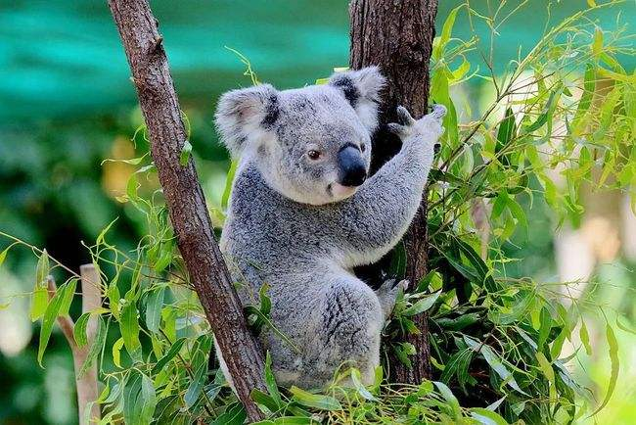
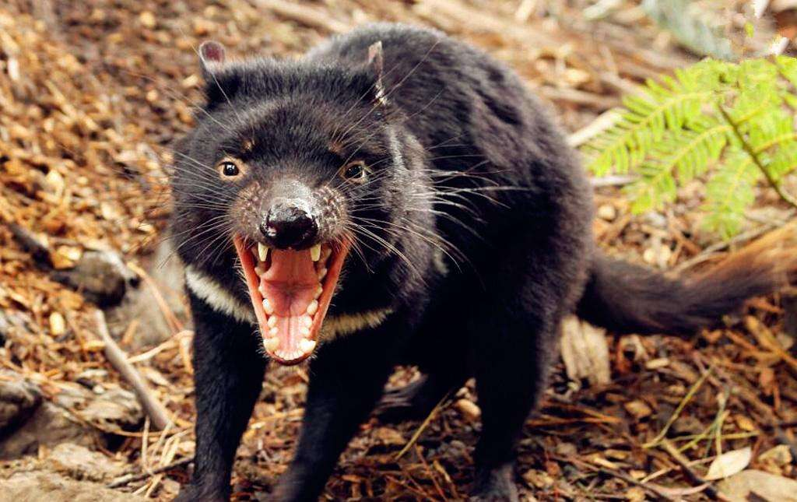
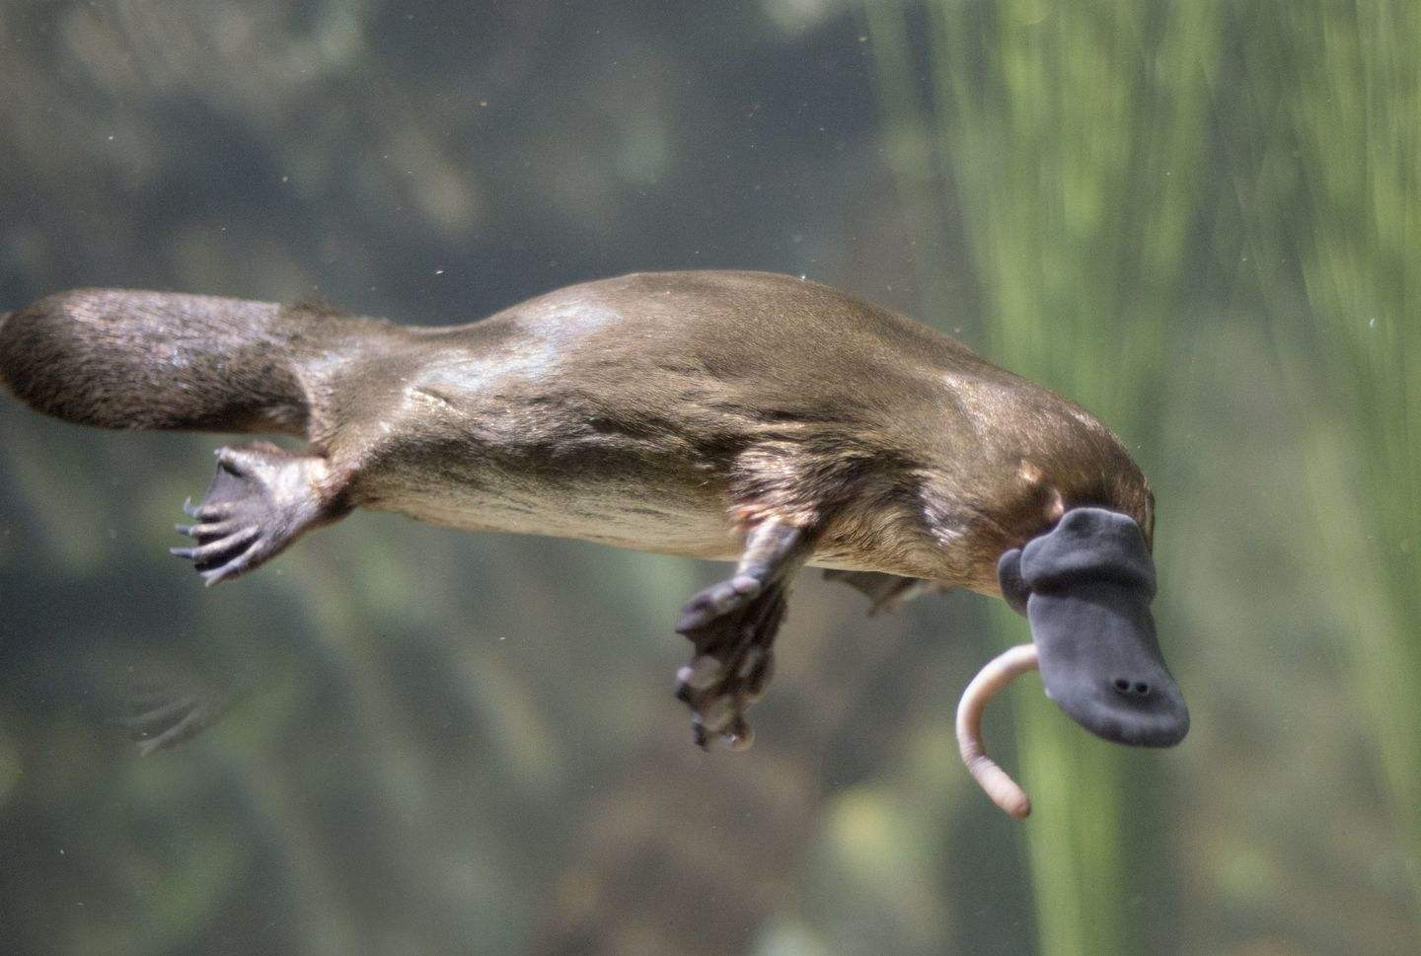
While-reading: read for the details
Koalas
Features
Living habits
Uniqueness
Relationship with humans
Tasmanian devil
Features
Food
Uniqueness
Relationship with humans
Duck-billed platypus
Features
Babies
Uniqueness

Slide 9
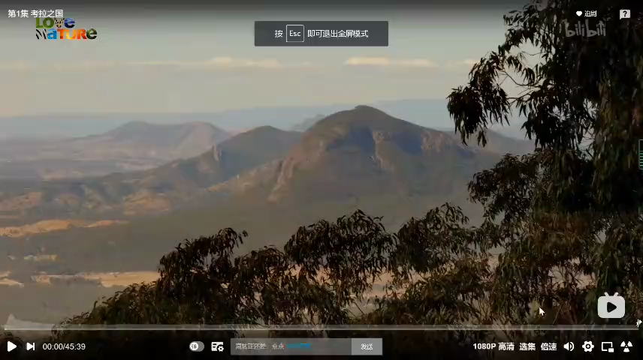
While-reading: read for the details
Koalas
Features
Living habits
Uniqueness
Relationship with humans
Cute
They spend quite a lot of time eating, sleeping, and hanging onto tree trunks.
They are very sensitive creatures who can easily panic because of small changes.
People shouldn’t approach it to pick it up or even touch it.

Slide 10
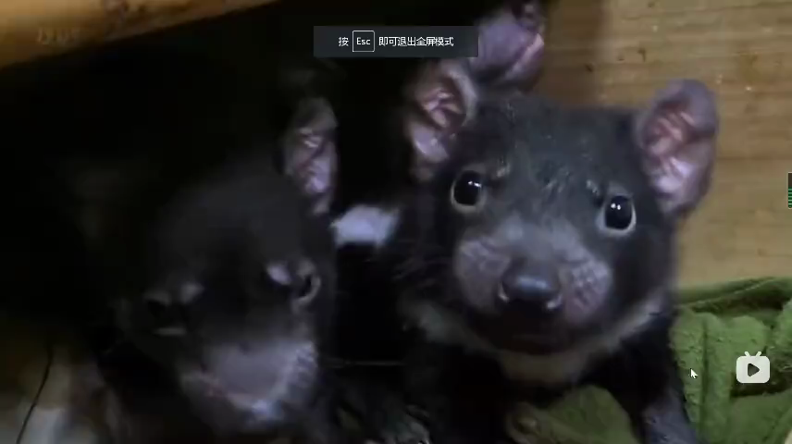
While-reading: read for the details
Tasmanian devil
Features
Food
Uniqueness
Relationship with humans
They are about the size of small dogs and look like rather large black rats.
Their diet is mostly dead animals, so they have a terrible smell.
They make frightening loud cries.
They are generally not violent towards people.

Slide 11
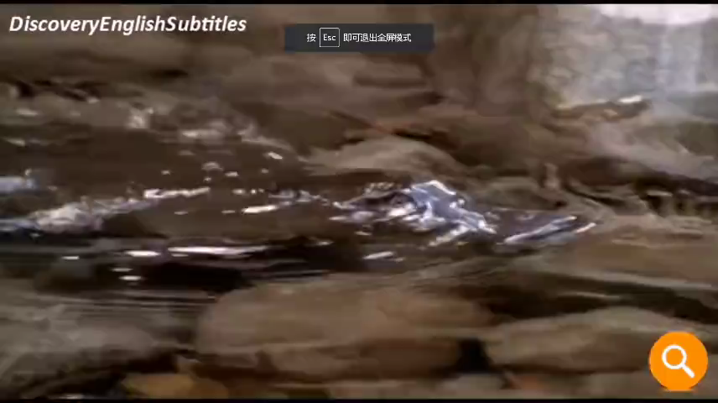
While-reading: read for the details
Duck-billed platypus
Features
Babies
Uniqueness
Its nose looks like a duck’s bill, and it has feet like duck.
They lay eggs and the baby platypus nurses from its mother like all other mammals.
They find food in the water by using electrical sensors in its bill.

Slide 12
While-reading: read for writing techniques
Examples | Rhetorical devices | Purpose
What rhetorical devices does the writer use to arouse the readers’ interest?
This experesses the strength and resolve of the Australians as individuals and as a nation.
To emphasize the reason why kangaroos is the symbol of Australia
analogy 隐喻
... and that they are handled for only a limited time and on a limited frequency of occasions.
To emphasize the condition to touch koalas
repetition
They are about the size of small dogs and look like rather large black rats.
To tell us the size in a more precise way
simile明喻
The noise they make could wake the dead.
To highlight its frightening sound
hyperbole 夸张
While it may lay eggs in a nest like a bird, it’s really a primitive mammal, with a unique biology.
To vividly tell us the way they give birth
simile

Slide 13
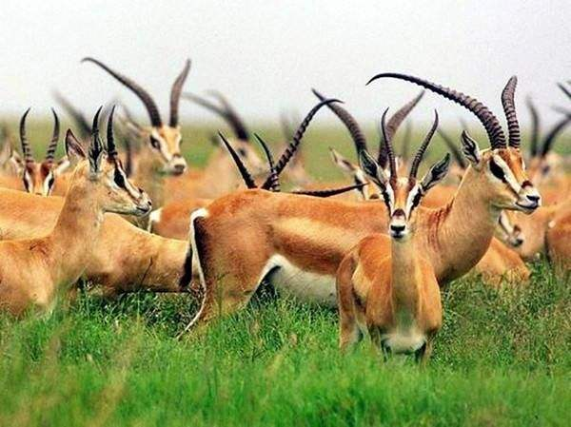
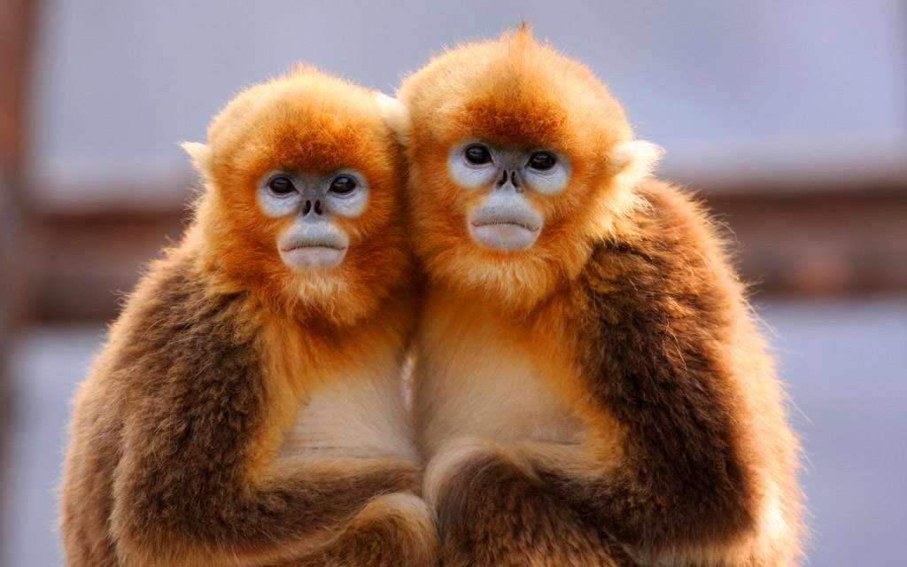
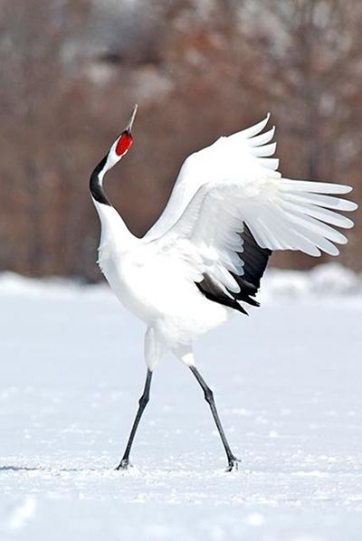
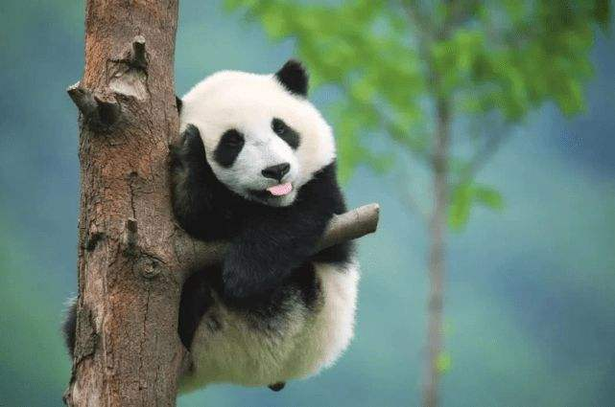
Reading for writing
Write a description of an iconic animal in China
Tibetan antelopes
golden Monkey
red-crowned cranes

Slide 14
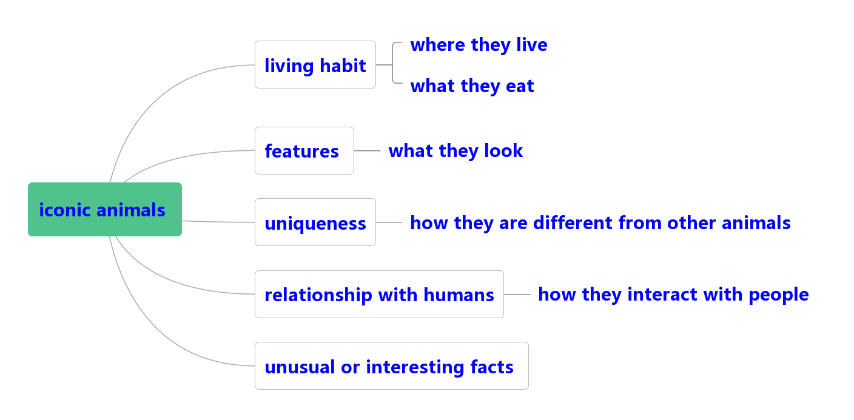
Pre- writing: Brainstorm
1. In groups, brainstorm some Chinese iconic animals.
2. What aspects or details would you like to introduce?

Slide 15
Pre- writing: To write an exposity passage
1. What is the key sentence for this expository writing?
2. How do you make it attractive, such as asking a question, giving an interesting fact about this animal?
3. What is the logical order of each aspect?
4. How do you make the ending more attractive?

Slide 16
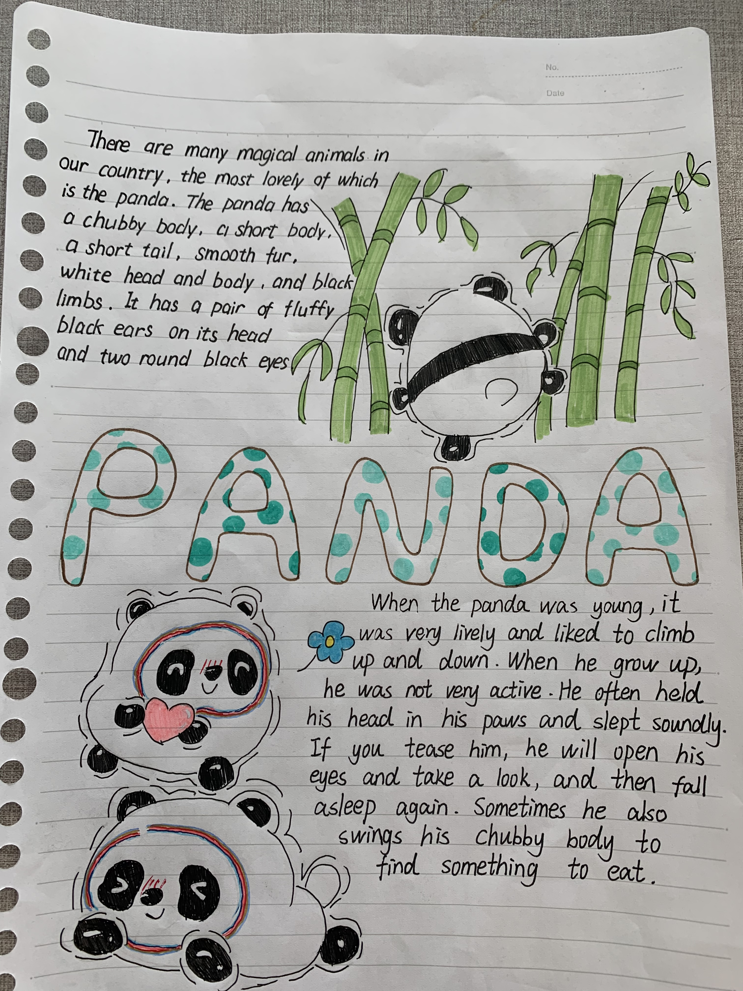
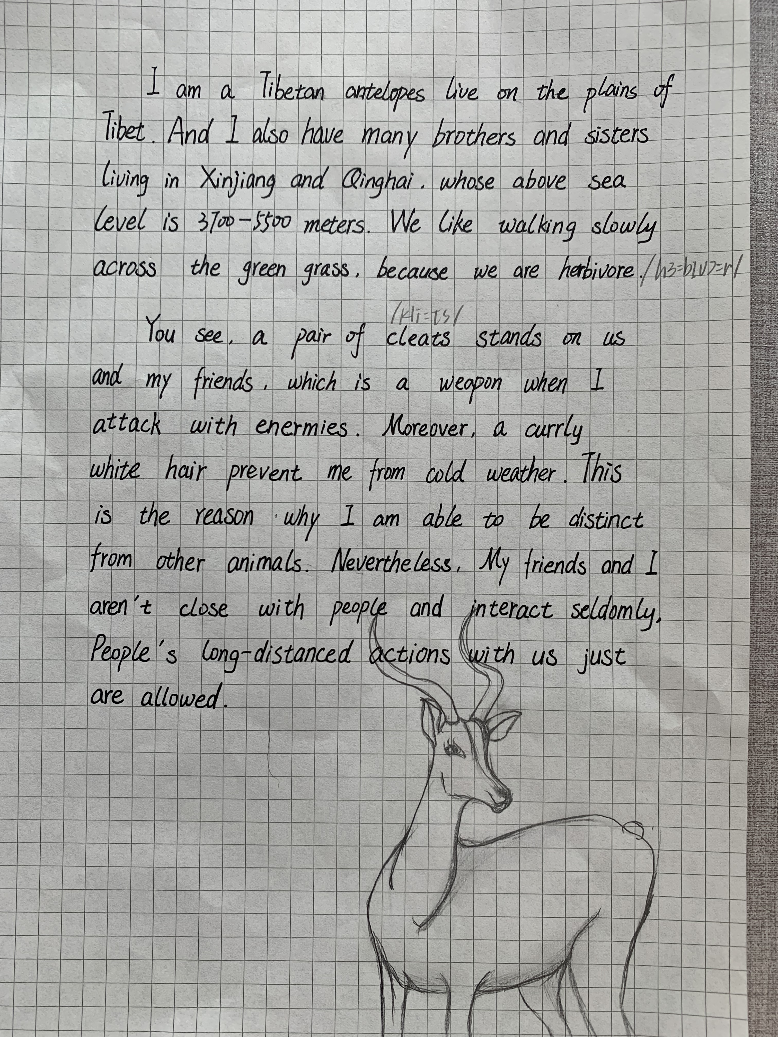
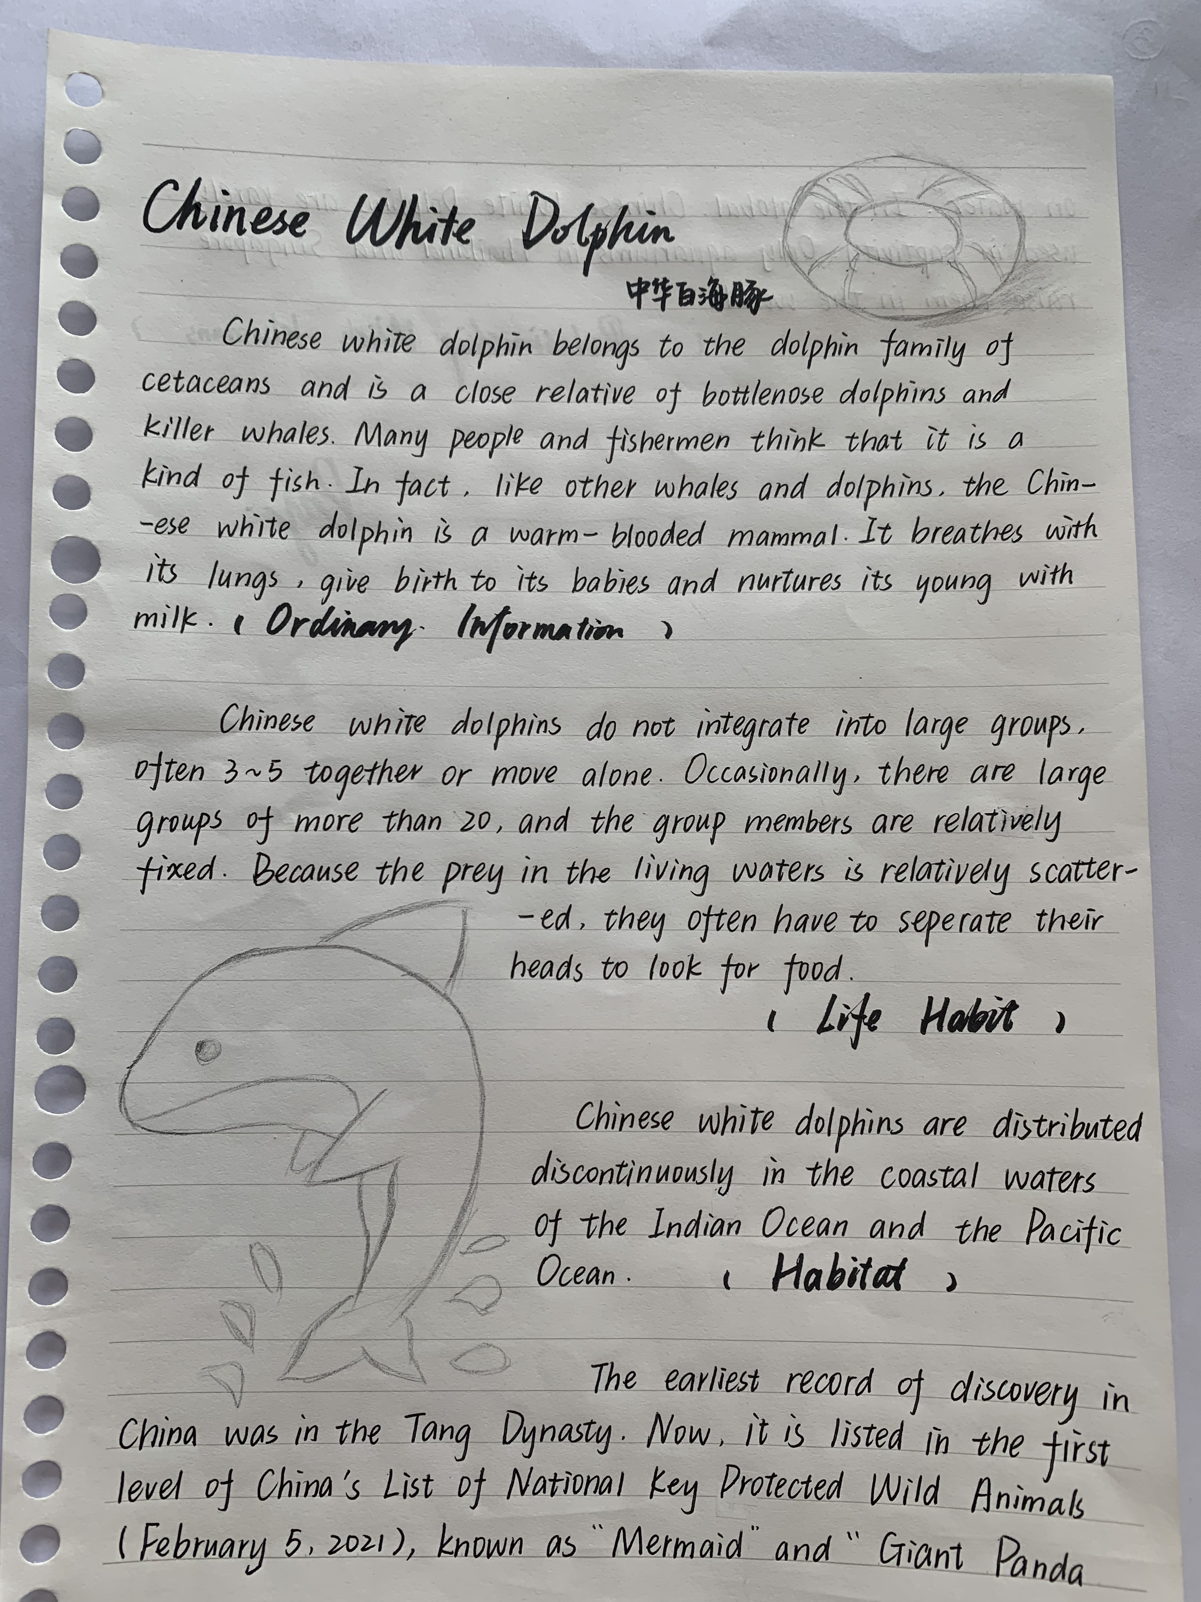
Post- writing: Students’ works

Slide 17
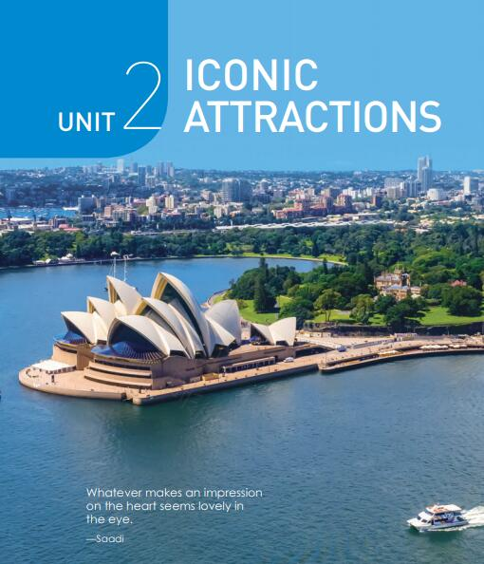
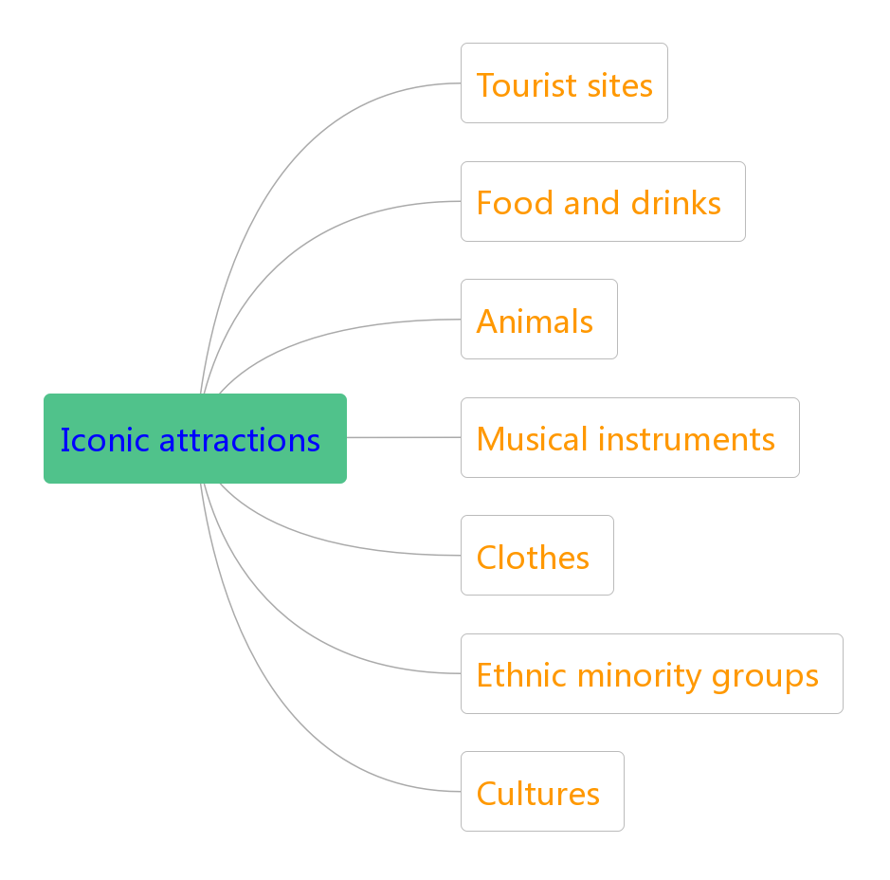
Summary: How to introduce a place’s icoic attractions

