Slide 1

感恩遇见，相互成就，本课件资料仅供您个人参考、教学使用，严禁自行在网络传播，违者依知识产权法追究法律责任。
更多教学资源请关注
公众号：溯恩高中英语
知识产权声明

Slide 2

The Week
Mar 12th-18th, 2022

Slide 3

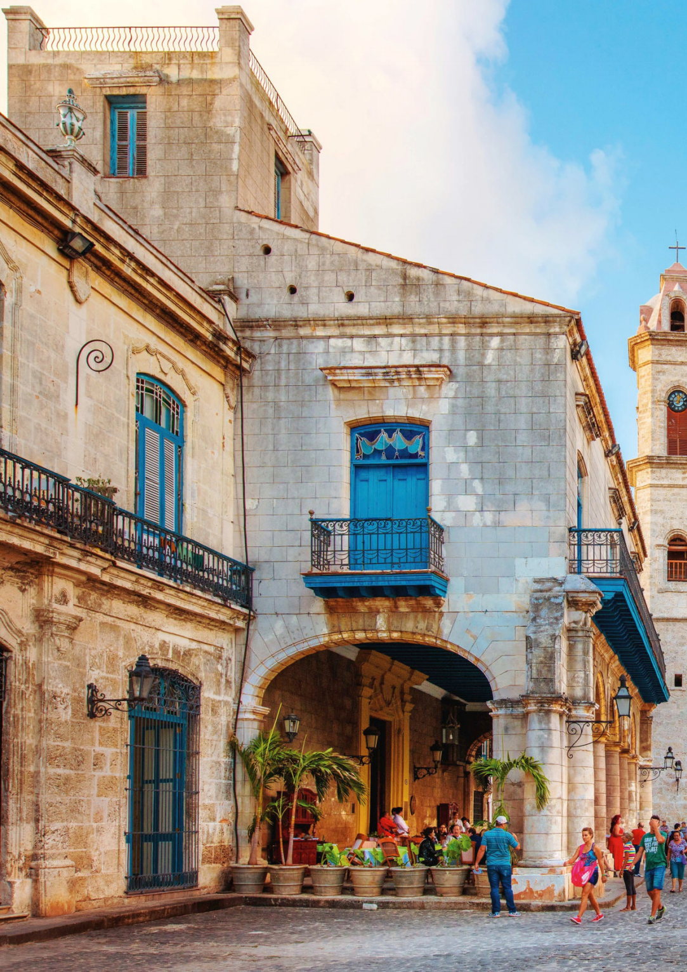
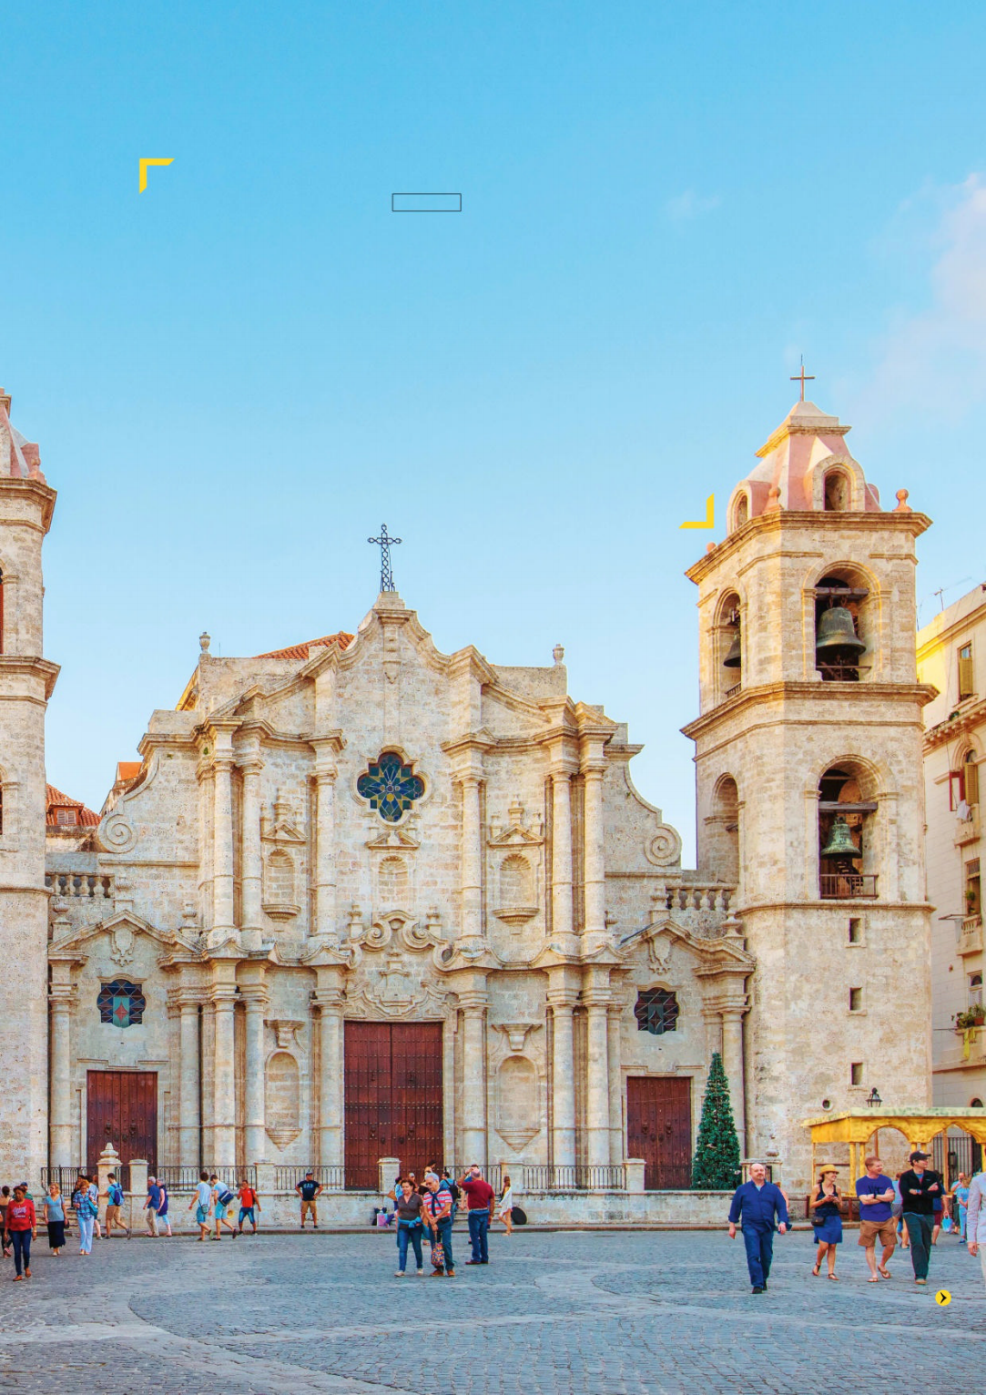
1. Havana, ooh na-na!
异域风情之古巴首都哈瓦那
Famous for its live music, performed in tattered theatres and spilling from once-grand rum bars onto cobbled streets, the Cuban capital is striking up the band again after two years of restrictions.

Slide 4

语篇填空
（《国家地理旅行者》2022年3月刊 120-122页）
but
“It’s not so easy to find music right now, ___ we might get lucky, “says my guide, Mirvel Bravo, explaining that tight Covid-19 __________ (restrict) have hushed Havana, a city with a long and rich musical tradition. I’d come chasing its sounds — the Cuban capital is famous ___ the pedigree of its singers, institutions like the Buena Vista Social Club and a feeling ____ someone with a guitar or trumpet might appear at any moment. The pandemic had halted all of that, but while most venues are still closed when I visit, the situation seems __________ (improve) and grow noisier by the hour. From day to day, more bars and restaurants are reopening, and others, seeing their neighbours take a risk, are following suit. Bands are then ______ (hasty) assembled and installed inside.
Sitting on the edge of the busy Plaza Vieja, La Vitrola — ________ (mean) “The Jukebox” — was one of the first to reopen its doors and strike up the band. Mirvel and I take a seat at the back, but we can hardly hear each other talk as the noise of the bongo (小手鼓) ricochets (反弹) off the _____ (wall) and the high trill (颤音) of a cornet (短号) competes with a whirring ceiling fan. For the players, some performing with their eyes ______ (close) in an energetic rapture, the music _____ (look) as much an exorcism (驱魔) as it does a concert.
restrictions
for
that
to improve
hastily
meaning
walls
closed
looks

Slide 5
词汇讲解
1. halt: to stop; to make sb/sth stop （使）停止，停下
The police were halting traffic on the parade route.
警察正阻止车辆在游行路线上行驶。
2. rapture: a feeling of extreme pleasure and happiness 狂喜
His speech was received with rapture by his supporters.
他的演说受到了其支持者的热烈欢呼。
翻译句子
他们停在离房子不远处。
They halted at a short distance from the house.
翻译句子
孩子们欣喜若狂地看着她。
The children gazed at her in/with rapture.

Slide 6
句子翻译
I’d come chasing its sounds — the Cuban capital is famous for the pedigree of its singers, institutions like the Buena Vista Social Club and a feeling that someone with a guitar or trumpet might appear at any moment.
我是为了追寻它的声音而来的——古巴首都以其歌手的天生音乐细胞、布埃纳维斯塔社交俱乐部之类的机构以及那种随时可能出现拿着吉他或小号的人的感觉而闻名。
翻译
Mirvel and I take a seat at the back, but we can hardly hear each other talk as the noise of the bongo ricochets off the walls and the high trill of a cornet competes with a whirring ceiling fan.
米维尔和我坐在后面，但我们几乎听不到对方的谈话，因为四周回荡着的手鼓声音，短号的高音颤音，在与天花板上呼呼作响的电扇一较高低。
翻译

Slide 7
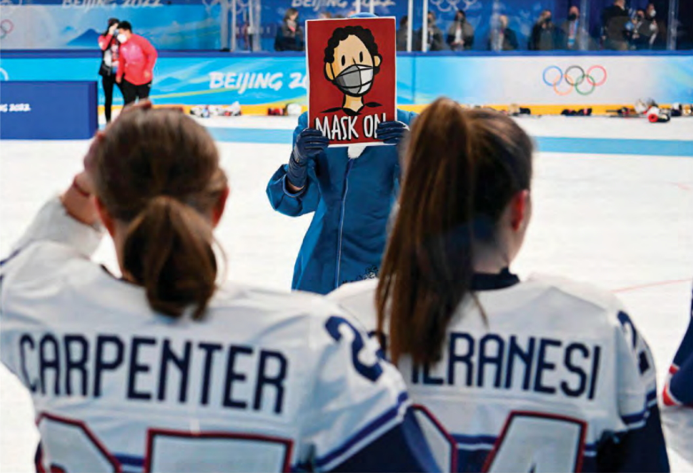
2. What other nations can learn from China’s COVID-19 rules at the Beijing Games
北京冬奥会的防疫措施可供各国借鉴
An Olympic volunteer at work during a women’s ice-hockey match on Feb. 17

Slide 8
语篇填空 1
（《时代周刊》2022年3月14日&21日合刊 16页）
China promised a “simple, safe, and splendid” Olympics. While the COVID-19 containment ________ (measure) in place at the 2022 Winter Games were far from simple, _________ (organize) still managed to put on an elaborate show, even amid a global health crisis.
There’s also little doubt that the Games were safe. Organizers ___________ (record) just 437 infections by the time ____ Olympic flame was extinguished at Beijing National Stadium on Feb. 20. ________________ more than 180 athletes and team officials tested positive after arriving in China, there were no major disruptions ______ (cause) by outbreaks.
_________ (protect) its citizens, China ran the Beijing Olympics on a strict closed-loop system; participants and venues were confined to epidemiological bubbles, ______ (strict) segregated from the city at large. That system worked. The Winter Games demonstrated China’s capability to keep Omicron at bay—something no other nation has done effectively.
Around 19,000 volunteers agreed to spend up to 2 months away ____ their families to help out at the Games. To prevent any chance of a post-Olympics outbreak, they also consented to undergo a 21-day quarantine after the Games before ____________ (allow) home.
measures
organizers
had recorded
the
Though / Although
caused
To protect
strictly
from
being allowed

Slide 9
语篇填空 2
（《时代周刊》2022年3月14日&21日合刊 16页）
From the time Beijing’s closed-loop system took effect on Jan. 23, organizers ___________ (administer) more than 1.8 million COVID-19 tests—at least one per day for everyone involved. Masks and contact- tracing _____ (app) were mandatory; athletes had to _______ (most) stay in their rooms when not training or competing. On-site spectators were also kept at a minimum. As a _________ (televise) and online spectacle, the 2022 Olympics were the most watched Winter Games ever. But over its 19 days, only 150,000 people saw the sporting events in Beijing and neighboring Zhangjiakou ___ person.
Bringing together tens of thousands of people, many flying in from countries being ravaged by Omicron, and still managing _______ (keep) a highly contagious disease at bay is a feat that _____________ (deny).
“This is a great achievement,” Bach told reporters. “___ everybody is respecting the rules in solidarity, and if everybody _____________ (contribute), then you can even have such a great event like Olympic Winter Games under _____ terms of such a pandemic.”
administered
apps
mostly
televised
in
to keep
can’t be denied
If
is contributing
the

Slide 10
词汇讲解 1
1. elaborate: very complicated and detailed; carefully prepared and organized
复杂的；详尽的；精心制作的
He is known for his elaborate costumes.
他以着装精致而闻名。
2. undergo: to experience sth, especially a change or sth unpleasant
经历，经受（变化、不快的事情等）
New recruits have been undergoing training in recent weeks.
最近几周，新兵正在接受训练。
翻译句子
她做了一顿精美的饭菜。
She prepared a very elaborate meal.
翻译句子
一些孩子进入少年期会变成另一个人。
Some kids undergo a complete transfomation when they become teengers.

Slide 11
词汇讲解 2
1. at large:
(used after a noun) as a whole; in general 整个；全部；总地；一般的
the opinion of the public at large 普通大众的意见
(of a dangerous person or animal) not captured; free 未被捕获的；自由的
Her killer is still at large. 杀害她的凶手仍然逍遥法外。
2. keep sb/sth at bay: to prevent an enemy from coming closer or a problem from having a bad effect. 不让（敌人）接近；防止（问题恶化）
I’m trying to keep my creditors at bay. 我在竭力避开债主。
翻译句子
整个社会都丧失了社区价值观。
There has been a loss of community values in society at large.
翻译句子
Charlotte咬住嘴唇不让眼泪流出来。
Charlotte bit her lips to hold the tears at bay.

Slide 12
词汇讲解 3
1. mandatory: required by law 强制的；法定的；义务的
It is mandatory for blood banks to test all donated blood for the virus.
血库必须检查所有捐献的血是否含有这种病毒。
2. spectacle: a performance or an event that’s impressive and exciting to look at
精彩的表演；壮观的场面
Ninety-four thousand people turned up for the spectacle.
9.4万人参加了这个盛大的活动。
翻译句子
这种罪行依照法律要判无期徒刑。
The offence carries a mandatory life sentence.
翻译句子
狂欢节游行场面热烈，蔚为大观。
The carnival parade was a magnificent spectacle.

Slide 13
词汇讲解 4
1. contagious: a contagious disease spreads by people touching each other
（疾病）接触传染的
The cute but clumsy pink piglet might be the most contagious thing this summer.
可爱却又笨拙的粉红小猪大概是今夏最具感染力的角色了。
2. solidarity: support by one person or group of people for another because they share feelings, opinions, aims, etc. 团结；齐心协力；同心同德；相互支持
There was a degree of solidarity and sisterhood among the women.
这些女人之间具有一定程度的团结精神和姐妹情谊。
翻译句子
他的热情富有感染力。
His enthusiasm was contagious.
翻译句子
中国各族人民之间的团结坚如磐石。
The solidarity among China’s various nationalities is as firm as a rock.

Slide 14
句子翻译
While the COVID-19 containment measures in place at the 2022 Winter Games were far from simple, organizers still managed to put on an elaborate show, even amid a global health crisis.
在2022年冬季奥运会上采取的新冠疫情防控措施远非简单，但即使在全球健康危机中，组织者仍然设法呈现了一场盛会。
翻译
To protect its citizens, China ran the Beijing Olympics on a strict closed-loop system; participants and venues were confined to epidemiological bubbles, strictly segregated from the city at large.
翻译
为了保护本国公民，中国在严格的闭环系统中举办北京奥运会；参与者和场地都被限制在“流行病气泡”中，与整个城市严格隔离。

Slide 15
选词(组)填空
用以下词或词组的适当形式完成句子。
1. The teacher has the authority _____________ punishment.
2. For this purpose, each member had to ___________ a tenth of his income.
3. The traffic laws don’t ____________ until the end of the year.
4. Survivors may ______________ sores physically and mentally.
5. Man’s first landing on the moon was a ______ of great daring.
6. ______________, you should spend two hours in the evening studying in order to catch up with your classmates.
take effect administer at a minimum
feat be ravaged by contribute
to administer
contribute
take effect
be ravaged by
feat
At a minimum

Slide 16
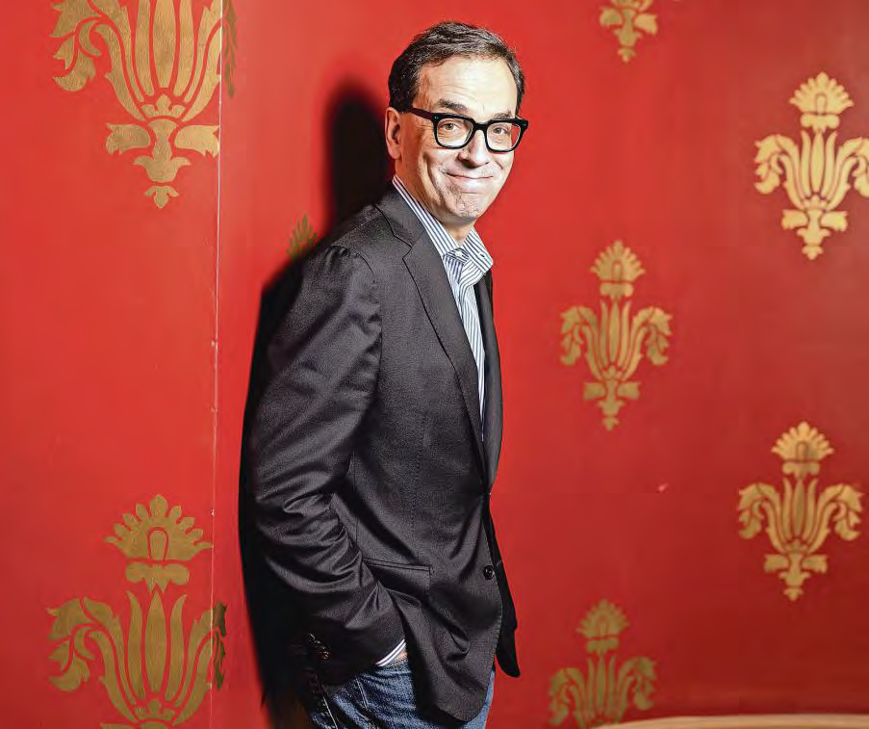
3. When regret can be a rich source of inspiration
遗憾或许是灵感之源
Daniel Pink’s new book looks at how we can turn our most “misunderstood emotion” into positive action, writes Andrew Hill.

Slide 17
语篇填空
（《金融时报 》2022年3月14日 14页）
If you are picking your way through the late phases of the pandemic, reexamining your ____________ (motivate) and purpose, or considering career paths not taken, then Daniel Pink has ___ book to sell you. His latest, The Power of Regret, ______ (turn) what Pink calls “our most misunderstood emotion” into a source of inspiration for future action.
“We _______________ (sell) this bill of goods that you have to be positive all the time. You have to look forward all the time,” says Pink. “That’s nonsense. That’s not ______ our brains work. Our brains are programmed for regret. On the other hand, you don’t want to spend all your time _________ (spin) in regret and ruminating over it.”
One exception to the consistency of Pink’s findings ____ regret was age-related. The older the respondents, the more likely they were to regret not having tried something. Career regrets were a subset of this core regret.
For every person in his database __________ said they regretted setting out on their own in business, Pink says there were 40 or 50 who kicked themselves for not ____________ (act). “The lesson from career regrets,” he says, “is that we should have a slight bias for action. We should just try stuff and be less _______ (worry) about the risk.”
motivation
a
turns
have been sold
how
spinning
on
who / that
having acted
worried

Slide 18
熟词生义讲解
1. spin: to feel unsteady or confused 眩晕
In addition, being drunk in the hot sun makes you spin.
另外，在大太阳底下喝醉，会让你觉得眩晕。
2. kick: to be annoyed with yourself because you have done sth stupid, missed an opportunity, etc. （因干了蠢事、失去良机等）对（自己）生气
He’ll kick himself when he finds out he could have had the job.
一旦发现他本可以得到这个工作，他会感到懊恼的。
翻译句子
当时我因喝了酒而感到眩晕。
My head was spinning from the wine.
翻译句子
我气我自己那么轻易就让步了。
I kicked myself for giving in so easily.

Slide 19
词汇讲解
1. ruminate: to think deeply about sth 沉思；认真思考
He ruminated on the terrible wastefulness that typified American life.
他反复思考美国生活中典型的可怕的浪费现象。
2. consistency: the quality of always behaving in the same way or of having the same opinions, standard, etc. 一致性；连贯性
We need to ensure the consistency of service to our customers.
我们对客户要确保服务的连贯性。
翻译句子
这些结论有利于对儿童游戏进行反思。
These conclusions benefit to ruminate over the child play.
翻译句子
她整个赛季表现相当稳定。
She has played with great consistency all season.

Slide 20

4. 美联社一分钟新闻听写填空 AP News Minute 03/15/22

Slide 21
AP News Minute 03/15/22
听力填空
a military base
This is AP News Minute. Russian missiles pounded ____________ in western Ukraine Sunday, killing 35 people. More than 30 Russian cruise missiles _______ the facility, which has long been used to train Ukrainian soldiers, often with instructors from the U.S. and other countries in the Western alliance.
A U.S. journalist was killed, and another _____________ at a hospital after Russian forces opened fire on their vehicle. Ukraine’s Interior Ministry said 50-year-old documentary filmmaker Brent Renaud died Sunday in Irpin, a suburb of the Ukrainian capital Kyiv. His colleague Juan Arredondo said the men were filming refugees _____________ when they were shot at while in a car ___________ a checkpoint.
Iran has __________________ for a missile barrage that struck near a sprawling U.S. consulate complex in northern Iraq, retaliation for an Israeli strike in Syria several days ago that killed two members of its Revolutionary Guard. _____________________ from the missile barrage.
And New York City Police say a man __________ a reception desk and stabbed two employees inside the Museum of Modern Art Saturday. The man, ________ as 60-year-old Gary Cabana, was denied entrance for _______________ of disorderly conduct. Police are asking for the public’s assistance in his arrest.
targeted
is being treated
fleeing the area
approaching
claimed responsibility
No injuries were reported
leaped over
identified
previous incidents

Slide 22
熟词生义讲解
1. pound:
to attack an area with a large number of bombs over a period of time 狂轰滥炸
The area is still being pounded by rebel guns.
这个地区仍然遭受着叛军炮火的轰击。
to hit sth/sb with great force, usually loudly and repeatedly 反复击打
He pounded the table with his fist. 他用拳头猛击桌子。
2. film: to make a film of a story or a real event 拍摄电影
He had filmed her life story. 他把她一生的经历拍成了电影。
翻译句子
有人开始不停地猛敲前门。
Somebody began pounding on the front door.
翻译句子
他们正在莫斯科拍电影。
They are filming in Moscow right now.

Slide 23
长难句分析
Iran has claimed responsibility for a missile barrage that struck near a sprawling U.S. consulate complex in northern Iraq, retaliation for an Israeli strike in Syria several days ago that killed two members of its Revolutionary Guard.
分析：本句是一个复合句，整体是一个______________从句，retaliation是_______，其后又包含一个______________从句。
that引导的定语
同位语
that引导的定语
伊朗声称对伊拉克北部庞大的美国领事馆附近的导弹袭击负责，以报复以色列几天前在叙利亚发动的袭击，该袭击造成两名革命卫队成员丧生。
翻译

Slide 24
句子翻译
More than 30 Russian cruise missiles targeted the facility, which has long been used to train Ukrainian soldiers, often with instructors from the U.S. and other countries in the Western alliance.
翻译
30多枚俄罗斯巡航导弹攻击了该设施，它长期以来一直用于训练乌克兰士兵，他们通常在来自美国和其他西方联盟国家的教官下训练。
His colleague Juan Arredondo said the men were filming refugees fleeing the area when they were shot at while in a car approaching a checkpoint.
翻译
他的同事胡安·阿雷东多说，这些人在拍摄难民逃离该地区时遭枪击，当时他们在一辆接近检查站的汽车中。
The man, identified as 60-year-old Gary Cabana, was denied entrance for previous incidents of disorderly conduct.
翻译
这名男子被确认为60岁的加里·卡巴纳，因之前的几次行为不检而被禁止入内。

