Slide 1

感恩遇见，相互成就，本课件资料仅供您个人参考、教学使用，严禁自行在网络传播，违者依知识产权法追究法律责任。
更多教学资源请关注
公众号：溯恩高中英语
知识产权声明

Slide 2


Slide 3










审题立意的思维导图
Mind map to analyze and explore the topic
1
2
高考审题雷区及对策
Mistakes and countermeasures in Gaokao
审题训练和思维拓展
Further thinking expansion to recent tests
目录
3
4
学生习作的审题偏差
The deviation in the students' compositions

Slide 4

Mind map to analyze and explore the topic
认识寿春，从此我是寿春人
1
审题立意的思维导图

Slide 5
Mind map
试题呈现Presentation | 信息分层 Level | 要点齐全 Completeness | 合理建构 Logic | 真实交际 Authenticity
 | Level-1. |  |  | Para-1: 写作者+ +写作对象
 | Level-2. |  |  | Para-2: 写作者+ +写作对象
 |  |  |  | Para-3: 写作者+ +写作对象
 | Level-3.

Slide 6
Mind map
试题呈现Presentation | 信息分层 Level | 要点齐全 Completeness | 合理建构 Logic | 真实交际 Authenticity
1.交际双方 （树立读者意识） 2.交际背景 （设立主题语境） 3.交际要点 （建立语篇意识） | Level-1. 交际双方对象明确 | 第五档（13—15）要求： 覆盖所有内容要点。 第四档（10—12）要求： 虽漏掉1、2个次重点，但覆盖所有主要内容。 第三档（7—9）要求： 虽漏掉一些内容，但覆盖所有主要内容。 第二档（4—6）要求： 漏掉或未描述清楚一些主要内容，写了一些无关内容。 第一档（1—3）要求： 明显遗漏主要内容，写了一些无关内容，原因可能是未理解试题要求。 | 交际双方统一语境 交际背景方向明确 要点展开紧扣主题 要点之间逻辑关联 | Para-1: 写作者+写作背景导入下的情感交流+写作对象
 | Level-2. 交际背景交代清晰 （交际背景=主题语境） |  |  | Para-2: 写作者+主题语境下的要点呈现，实现交际目的+写作对象
 |  |  |  | Para-3: 写作者+写作体裁框架下的期盼、祝愿、鼓励等情感+写作对象
 | Level-3. 内容要点详略得当
Unique presentation：以极简的语言概要，突显重心和特色

Slide 7
Analyze and explore based on Mind map
试题呈现 Unique presentation | 信息分层 Clear levels | 要点齐全 Complete points | 合理建构 Logic bridges | 真实交际 Authentic emotions
假定你是李华，在“中国—爱尔兰文化节”活动中结识了爱尔兰朋友Chris，现在他已回国。请你给他写一封邮件，内容包括: 1.回忆活动经历； 2.分享个人收获； 3.希望保持联系。 | Dear Chris, ... Yours, Li Hua | 在“中—爱文化节”活动中结识的爱尔兰朋友Chris已回国 | 结识的朋友回国 希望保持联系 回忆活动经历 分享个人收获 | Para-1: 朋友回国 ↓ Para-2: 回忆活动经历 ↓ 分享个人收获 ↓ ↓ Para-3: 希望保持联系 ↓ ↓
 | 背景信息：“中国—爱尔兰文化节” | 1.回忆活动经历； 2.分享个人收获； 3.希望保持联系。
 | 三个内容要点
（因）
↑↓
（果）
思念
开心
文化理解
（自我文化与跨文化 ）
（因）
↑↓
（果）
国际友谊
Unique presentation：“中爱文化节”活动的回忆和收获
加深友谊
增强交流

Slide 8

Appreciation
试题呈现 Unique presentation | 信息分层 Clear levels | 要点齐全 Complete points | 合理建构 Logic bridges | 真实交际 Authentic emotions
假定你是李华，在“中国—爱尔兰文化节”活动中结识了爱尔兰朋友Chris，现在他已回国。请你给他写一封邮件，内容包括: 1.回忆活动经历； 2.分享个人收获； 3.希望保持联系。
Dear Chris,
How was your journey home?
I’m still excited about what we experienced together during the China-Ireland Cultural Festival. The lectures we attended, the movies we watched, and the exhibitions we visited were really impressive. I certainly learned a lot about the Irish culture. What is amazing is that I gained a deeper understanding of my own culture as well.
I hope I can visit Ireland some day and gain first-hand experience of your culture. I also hope you will come to China again sometime. Let’s keep in touch.
Yours,
Li Hua

Slide 9
Appreciation
试题呈现 Unique presentation | 信息分层 Clear levels | 要点齐全 Complete points | 合理建构 Logic bridges | 真实交际 Authentic emotions
假定你是李华，在“中国—爱尔兰文化节”活动中结识了爱尔兰朋友Chris，现在他已回国。请你给他写一封邮件，内容包括: 1.回忆活动经历； 2.分享个人收获； 3.希望保持联系。
Dear Chris,
How was your journey home?
I’m still excited about what we experienced together during the China-Ireland Cultural Festival. The lectures we attended, the movies we watched, and the exhibitions we visited were really impressive_{（因）}. I certainly learned a lot_{（果）} about the Irish culture. What is amazing is that I gained a deeper understanding of my own culture as well_{（并列和递进）}.
I hope I can visit Ireland some day and gain first-hand experience of your culture. I also hope you will come to China again sometime_{（因）}. Let’s keep in touch_{（果）}.
Yours,
Li Hua

Slide 10

Appreciation
试题呈现 Unique presentation | 信息分层 Clear levels | 要点齐全 Complete points | 合理建构 Logic bridges | 真实交际 Authentic emotions
假定你是李华，在“中国—爱尔兰文化节”活动中结识了爱尔兰朋友Chris，现在他已回国。请你给他写一封邮件，内容包括: 1.回忆活动经历； 2.分享个人收获； 3.希望保持联系。
Dear Chris,
How was your journey home?
I’m still excited about what we experienced together during the China-Ireland Cultural Festival. The lectures we attended, the movies we watched, and the exhibitions we visited were really impressive. I certainly learned a lot about the Irish culture. What is amazing is that I gained a deeper understanding of my own culture as well.
I hope I can visit Ireland some day and gain first-hand experience of your culture. I also hope you will come to China again sometime. Let’s keep in touch.
Yours,
Li Hua
摒弃生僻词，合理运用小词，如“ still excited，really impressive”形象表示经历难忘，历历在目；用 “certainly_{因果}，as well_{递进}，also_{并列}”清晰表明语义逻辑和上下文的衔接。这些小词的运用，文风朴实，娓娓道来，体现了朋友之间亲和自然的真实交际。

Slide 11
Mistakes and countermeasures in Gaokao
认识寿春，从此我是寿春人
2
高考审题雷区及对策

Slide 12

”信息分层“的审题误区（以 2020年1月浙江卷 为例）
试题呈现 Unique presentation | 信息分层 Clear levels | 要点齐全 Complete points | 合理建构 Logic bridges | 真实交际 Authentic emotions
假定你是李华，你校将举办外国学生中文演讲比赛，请给你的英国朋友George 写封邮件邀请他参加。内容包括： 1.比赛时间； 2.演讲话题； 3.报名方式。 | Dear George, As the Chinese competition in my school is around the corner, I’m writing to invite you to participate in. As scheduled, the competition only designed for foreign students is to be held in School Hall next Thursday morning. And the lecture is going ot be centered on the traditional Chinese festivals. If interested, please call 12345 or email 223@163.com to sign up. I promise that it would be a great platform where you can enjoy yourself and benefit a lot. Looking forward to your reply. Yours, Li Hua
本篇写作特别注意第一层级信息的表达“Chinese speech competition/ contest”，这三个意思缺一不可，共同构成一个完整的方向标的关键信息，直接影响交际的有效性，因此缺失任何一个都判为要点缺失，要掉到2档，再看语言面貌适当调档。如果后面有相关信息的补充，亦视为有效信息。

Slide 13


”信息分层“的审题误区（以 2021年6月浙江卷 为例）
试题呈现 Unique presentation | 信息分层 Clear levels | 要点齐全 Complete points | 合理建构 Logic bridges | 真实交际 Authentic emotions
昨天你参观了学校举办的学生国画作 品展。请给校英文报写一篇宣传稿，内容包括： 1. 展览时间、地点；2. 观展感受； 3. 推荐观展。 | An extrodinary Chinese Painting Exhibition Yesterday, I visited the show of students’ Chinese pictures, this show was in our school. When I saw these pictures, I was shocked. Many different kinds of pictures are in this show. These pictures are so beautiful that I couldn’t speak anything to show my feeling. This show is in our school so it is near by our home, we can spend less time to arrive this show. So, I hope students could visit this show if you have some free time.
作者参观时间≠展览时间
漏掉了“展览时间、地点”要点
tips1
对第一和第二层级隐藏信息解读透彻，根据背景信息确定和代入角色，产生共情，并以此为交际方向，拓展真实有效的交际内容。

Slide 14


”要点齐全“的审题误区（以 2018年06月浙江卷 为例）
试题呈现 Unique presentation | 信息分层 Clear levels | 要点齐全 Complete points | 合理建构 Logic bridges | 真实交际 Authentic emotions
假如你是李华，你校英语协会招聘志愿者，接待来访的外国中学生。请你写信应聘，内容包括： 1.口语能力； 2.相关经验； 3.应聘目的。 | Dear Sir/Madam, On hearing that volunteers are in desperate need for receiving the foreign students, I can't wait to be part of you. Equipped with a briliant spoken-English, I can surely meet with the requestments. Besides, my great sense of humor also adds to my strength. Overwhelming with abundant relevant experience, I am bound to be qualified for the job. Additionally, I can't let the golden opportunity to practice my spolken-English slip through my fingers. I would appreciate it if you could take my application into favorable consideration.Looking forward to your reply. Sincerely yours, Li Hua
tips2
要点不明：“口语能力”和“相关经验”都不具体；“幽默感”与要点无关；“不想错失机会”不是“应聘目的。
不能完全依赖不是平时背下的高分范文和句子，死搬硬套，缺乏应用能力。要结合主题语境，合理分析、拓展和整合要点。

Slide 15


”合理建构“的审题误区（以 2022年1月浙江卷 为例）
试题呈现 Unique presentation | 信息分层 Clear levels | 要点齐全 Complete points | 合理建构 Logic bridges | 真实交际 Authentic emotions
假定你是李华，在“中国—爱尔兰文化节”活动中结识了爱尔兰朋友Chris，现在他已回国。请你给他写一封邮件，内容包括: 1.回忆活动经历； 2.分享个人收获； 3.希望保持联系。 | Dear Chris, Hearing that you have returned to your country. I’m writing this email to share my experience during the Culture Festival with you. Themed on colorful culture of different country, the festival contained many activities including speech competition, exhibitions and so on, in which I all took part. This experience really broadened my horizon. It sparked my enthusiasm of foreign culture and I learned a lot. I hope we can stay in touch. I’m looking forward to your early reply. Yours, Li Hua
介绍了文化节活动，而不是回忆活动经历。一旦介绍活动，马上9分或以下。其实只要在此基础上加I vividly remember; I never forget等字眼就行。
tips3
打破体裁模板的限制，注重交际内容之间的关系，以意义传达为主。
简化语言提示，找到写作题开放性与限制性之间的结合点。

Slide 16


”真实交际“的审题误区（以 2018年11月浙江卷 为例）
试题呈现 Unique presentation | 信息分层 Clear levels | 要点齐全 Complete points | 合理建构 Logic bridges | 真实交际 Authentic emotions
假定你是李华，乘坐FL753航班抵达伦敦后发现钱包遗失。请给航空公司写一封邮件说明情况并寻求帮助。内容包括： 1. 行程信息； 2. 钱包特征； 3. 联系方式。 | Dear Sir / Madam, I’m Li Hua, a passenger in the FL753 flight. I hope you can help me find my wallet which was lost when I arrived in London. Yesterday, I just took FL753 flight from Shanghai to London. I realized my wallet was lost when I got to my destination. My wallet was black and small. There was some books, money and my ID card. Please call my phone if you find it. Thanks for your assistance. Sincerely yours, Li Hua
钱包里有“books”不合情理。 “Please call my phone if you find it”没有具体方式，不能体现实际交际功能。
tips4
挖掘试题中隐含的情感态度及文化意识。强化读者意识，行文注重逻辑性，思想性和真实性。

Slide 17
Further thinking expansion to recent tests
认识寿春，从此我是寿春人
3
审题训练和思维拓展

Slide 18
Analyze and explore based on Mind map（以 20220317金丽衢12校联考 为例）
试题呈现 Unique presentation | 信息分层 Clear levels | 要点齐全 Complete points | 合理建构 Logic bridges | 真实交际 Authentic emotions
假定你是李华，你的朋友交换生 Jonny 发来邮件，询问你暑期社会实践活动安排。请你给他回一封邮件，内容包括： 1. 表明写信目的； 2. 介绍活动安排； 3. 询问对方计划。 | Dear Jonny, ... Yours, Li Hua | 交换生 Jonny 发来邮件，询问你暑期社会实践活动安排。 | 朋友询问 写信目的答复 介绍暑期安排 社会实践活动 | Para-1: 朋友询问 ↓ 表明写信目的 ↓ Para-2: 介绍暑假安排 ↓ 社会实践活动 ↓ Para-3: 询问对方计划 ↓
 | 背景信息：交换生 Jonny 发来邮件，询问你暑期社会实践活动安排。 | 1. 表明写信目的； 2. 介绍活动安排； 3. 询问对方计划。
 | 三个内容要点
（因）
↑↓
（果）
乐意分享
快乐
（一般）
↑↓
（特殊）
成长，奉献
Unique presentation：介绍暑期社会实践活动安排
期待精彩

Slide 19

Appreciation （以 20220317金丽衢12校联考 为例）
试题呈现 Unique presentation | 信息分层 Clear levels | 要点齐全 Complete points | 合理建构 Logic bridges | 真实交际 Authentic emotions
假定你是李华，你的朋友交换生 Jonny 发来邮件，询问你暑期社会实践活动安排。请你给他回一封邮件，内容包括： 1. 表明写信目的； 2. 介绍活动安排； 3. 询问对方计划。 | Dear Jonny, I’m glad to receive your letter and I’d like to share my plans for social practice in the coming summer vacation with you. At present my community is recruiting student volunteers and I’m lucky enough to be admitted. So during the holiday, I’ll participate in various activities organized by the volunteer group, including cleaning the community, teaching residents how to sort out rubbish and visiting the elderly in the local nursery home. Hopefully, I’ll have a meaningful and unforgettable experience. What are your plans for the vacation? Looking forward to your reply. Yours, Li Hua
本文情感饱满，如“ I’m glad，I’d like to share”体现作者真诚待人，语气得体；“I’m lucky enough，Hopefully”表明作者对暑假活动的兴奋和期待，容易引起共鸣，读者会更容易接受。本篇范文内容完整、以“暑期社会实践活动安排”为中心，层层推进，逻辑连贯，段落清晰。

Slide 20
Critical thinking （以 20220317金丽衢12校联考 为例）
试题呈现 Unique presentation | 信息分层 Clear levels | 要点齐全 Complete points | 合理建构 Logic bridges | 真实交际 Authentic emotions
假定你是李华，你的朋友交换生 Jonny 发来邮件，询问你暑期社会实践活动安排。请你给他回一封邮件，内容包括： 1. 表明写信目的； 2. 介绍活动安排； 3. 询问对方计划。 | Dear Jonny, I’m glad to receive your letter and I’d like to share my plans for social practice in the coming summer vacation with you. At present my community is recruiting student volunteers and I’m lucky enough to be admitted. So during the holiday, I’ll participate in various activities organized by the volunteer group, including cleaning the community, teaching residents how to sort out rubbish and visiting the elderly in the local nursery home. Hopefully, I’ll have a meaningful and unforgettable experience. What are your plans for the vacation? Looking forward to your reply. Yours, Li Hua
Looking forward to your reply通常用于咨询或邀请。此处改为 “Wish you an enjoyable and fulfilling holiday”, 既增强感情，又与第二段“Hopefully...”语义连贯，一气呵成。

Slide 21
Analyze and explore based on Mind map（以 20220322三钉冲刺卷-1 为例）
试题呈现 Unique presentation | 信息分层 Clear levels | 要点齐全 Complete points | 合理建构 Logic bridges | 真实交际 Authentic emotions
假定你是李华，你的英国朋友 Jason 上周五邀请你观看了他参加的留学生中文辩论赛，并在获奖后向你征求改进建议。请你用英文给他写一封邮件，内容包括: 1.祝贺获奖; 2.提出建议; 3.表达祝愿。 | Dear Jason, ... Yours, Li Hua | 留学生中文辩论赛获奖后征求改进建议 | 辩论赛上乘表现 祝贺获奖 中文辩论 老外改进建议 祝愿 | Para-1: 观看辩论赛 ↓ 祝贺获奖 Para-2: 中文辩论赛不足 ↓ 提出改进建议 ↓ Para-3: 表达祝愿 ↓ ↓
 | 背景信息：英国朋友 Jason 上周五邀请你观看了他参加的留学生中文辩论赛，并在获奖后向你征求改进建议 | 1.祝贺获奖; 2.提出建议; 3.表达祝愿。
 | 三个内容要点
（因）
↑↓
（果）
惊喜
中文表达
（因）
↑↓
（果）
内涵发展
（因）
↑↓
（果）
享受中文辩论
Unique presentation：留学生中文辩论赛的建议
更精彩表现
更长足进步

Slide 22

Appreciation（以 20220322三钉冲刺卷-1 为例）
试题呈现 Unique presentation | 信息分层 Clear levels | 要点齐全 Complete points | 合理建构 Logic bridges | 真实交际 Authentic emotions
假定你是李华，你的英国朋友 Jason 上周五邀请你观看了他参加的留学生中文辩论赛，并在获奖后向你征求改进建议。请你用英文给他写一封邮件，内容包括: 1.祝贺获奖; 2.提出建议; 3.表达祝愿。 | Dear Jason, Congratulations! It came as no surprise that your team won the debate competition. I'm deeply impressed by your excellent debating skills and quick wit! As for your performance, you were doing amazingly well during the debate except for some stumbles. Otherwise, you would have got your ideas across better. I understand it's really challenging for foreign language learners to speak Chinese with great fluency. It calls for tremendous practice with native speakers. And I am always ready if you need help. Congratulations again! Wish you continued success and progress! Yours, Li Hua
本篇范文角色代入感强，“ your team ，your excellent debating skills and quick wit”的比赛现场真实形象，特色鲜明。并针对英国朋友表现出的中文辩论“some stumbles”的不足，提出合理建议，乐意帮助。行文逻辑严谨、合情合理，难得的佳作。

Slide 23
Critical thinking（以 20220322三钉冲刺卷-1 为例）
试题呈现 Unique presentation | 信息分层 Clear levels | 要点齐全 Complete points | 合理建构 Logic bridges | 真实交际 Authentic emotions
假定你是李华，你的英国朋友 Jason 上周五邀请你观看了他参加的留学生中文辩论赛，并在获奖后向你征求改进建议。请你用英文给他写一封邮件，内容包括: 1.祝贺获奖; 2.提出建议; 3.表达祝愿。 | Dear Jason, Congratulations! It came as no surprise that your team won the debate competition. I'm deeply impressed by your excellent debating skills and quick wit! As for your performance, you were doing amazingly well during the debate except for some stumbles. Otherwise, you would have got your ideas across better. I understand it's really challenging for foreign language learners to speak Chinese with great fluency. It calls for tremendous practice with native speakers. And I am always ready if you need help. Congratulations again! Wish you continued success and progress! Yours, Li Hua
“Hope my suggestions could help you make further progress. Anticipating a brilliant performance in the future.” 既衔接上文，统领全文，又表达美好期待。

Slide 24

The deviation in the students' compositions
认识寿春，从此我是寿春人
4
学生习作的审题偏差

Slide 25
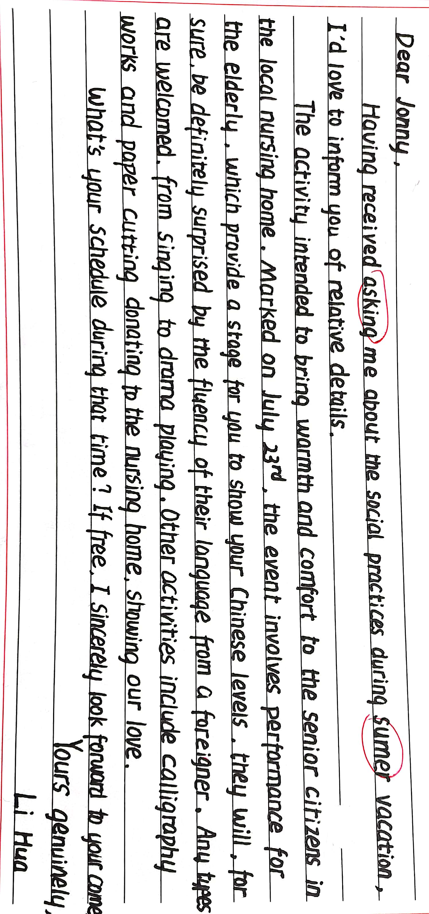
Deviation in the Ss' compositions（以 20220317金丽衢12校联考 为例）
试题呈现 Unique presentation | 信息分层 Clear levels | 要点齐全 Complete points | 合理建构 Logic bridges | 真实交际 Authentic emotions
假定你是李华，你的朋友交换生 Jonny 发来邮件，询问你暑期社会实践活动安排。请你给他回一封邮件，内容包括： 1. 表明写信目的； 2. 介绍活动安排； 3. 询问对方计划。
暑期较长，活动不应只有一个，建构不合理

Slide 26
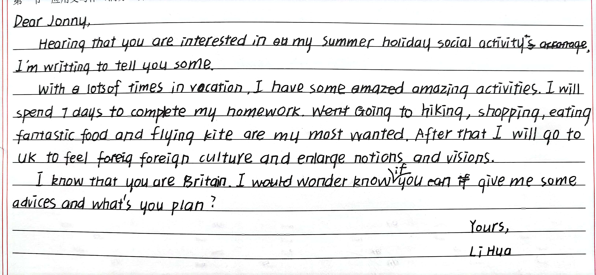
Deviation in the Ss' compositions（以 20220317金丽衢12校联考 为例）
试题呈现 Unique presentation | 信息分层 Clear levels | 要点齐全 Complete points | 合理建构 Logic bridges | 真实交际 Authentic emotions
假定你是李华，你的朋友交换生 Jonny 发来邮件，询问你暑期社会实践活动安排。请你给他回一封邮件，内容包括： 1. 表明写信目的； 2. 介绍活动安排； 3. 询问对方计划。
没有抓住主题语境“社会实践”，所计划的活动都是无关信息。要点严重缺失。

Slide 27
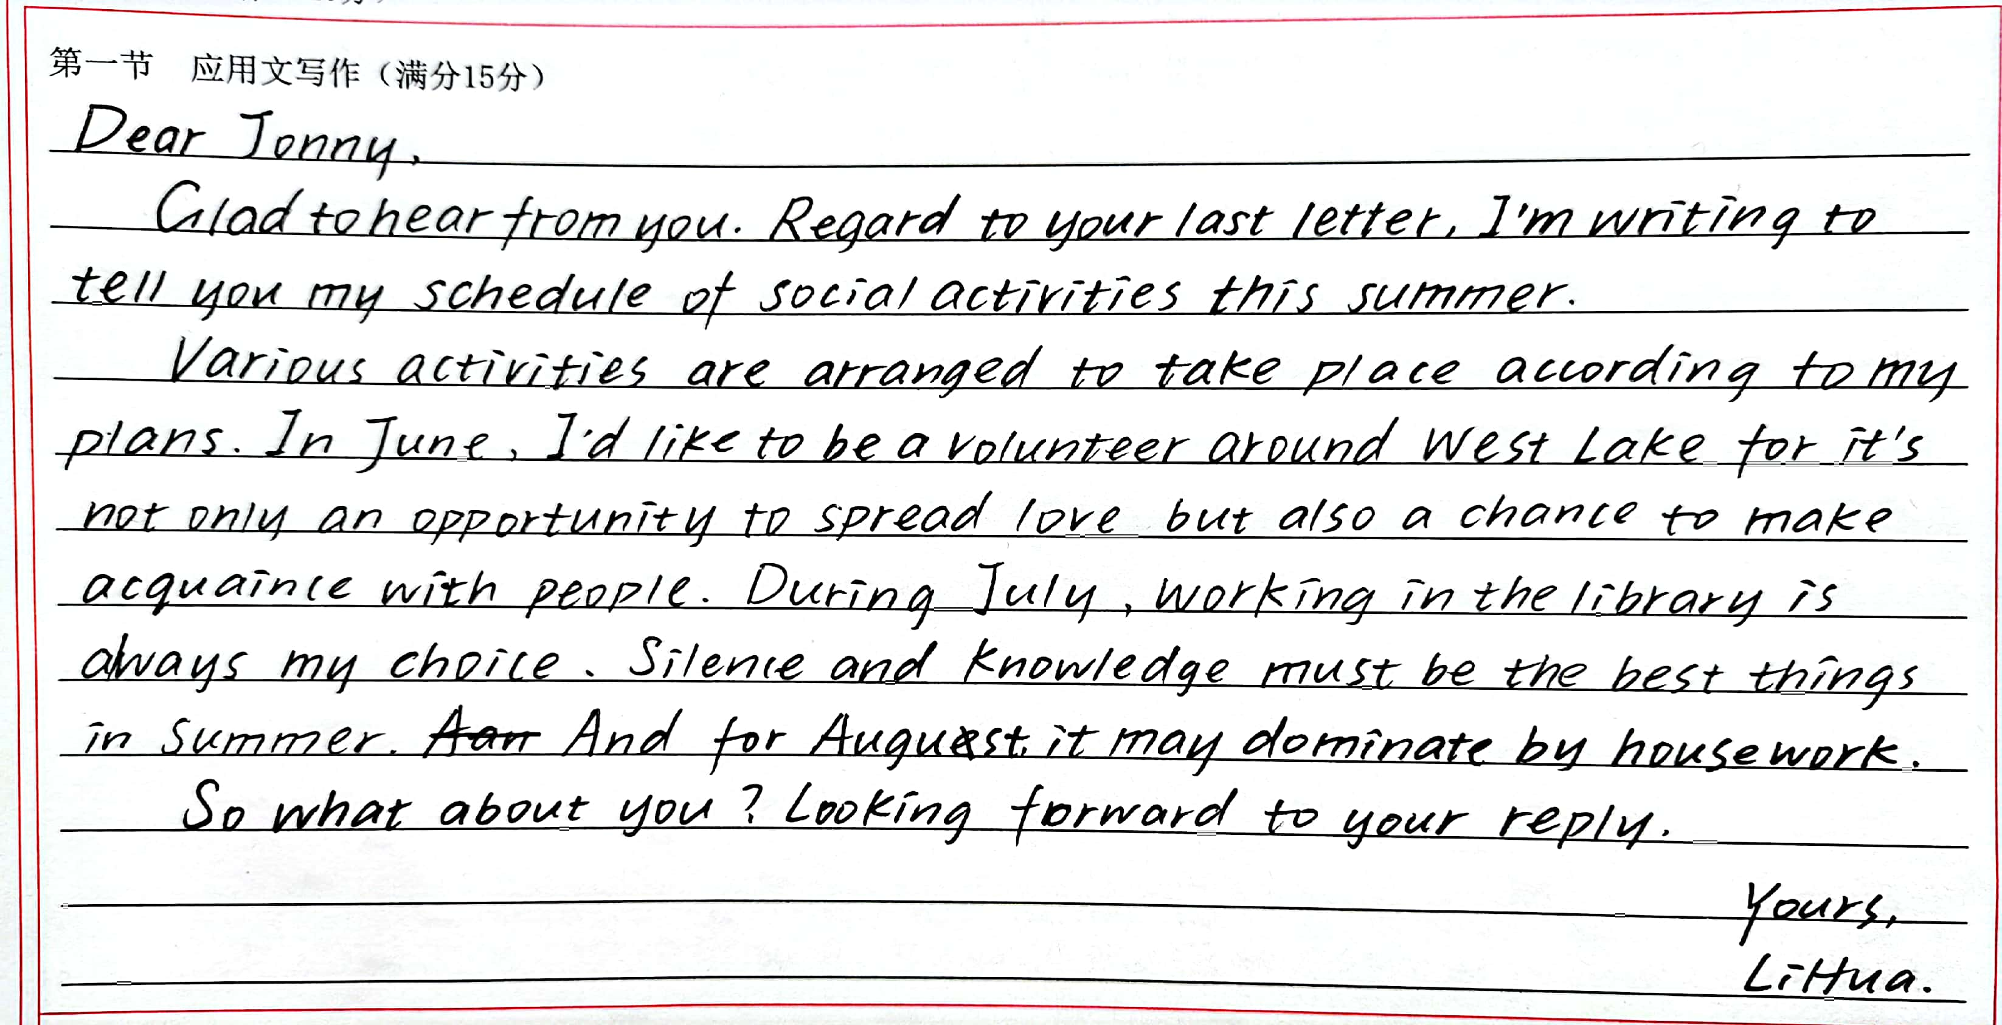

Deviation in the Ss' compositions（以 20220317金丽衢12校联考 为例）
试题呈现 Unique presentation | 信息分层 Clear levels | 要点齐全 Complete points | 合理建构 Logic bridges | 真实交际 Authentic emotions
假定你是李华，你的朋友交换生 Jonny 发来邮件，询问你暑期社会实践活动安排。请你给他回一封邮件，内容包括： 1. 表明写信目的； 2. 介绍活动安排； 3. 询问对方计划。
抓住时间主线“June-July-August”，安排的活动非常契合主题语境“暑期社会实践”，思维缜密。

Slide 28
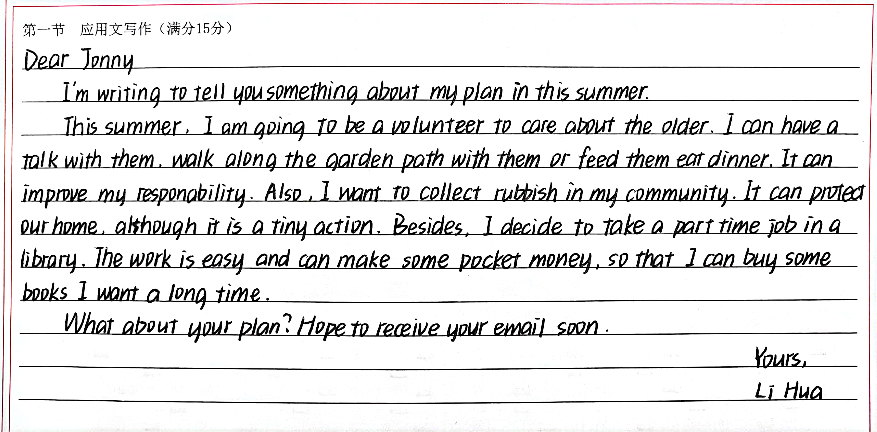
Deviation in the Ss' compositions（以 20220317金丽衢12校联考 为例）
试题呈现 Unique presentation | 信息分层 Clear levels | 要点齐全 Complete points | 合理建构 Logic bridges | 真实交际 Authentic emotions
假定你是李华，你的朋友交换生 Jonny 发来邮件，询问你暑期社会实践活动安排。请你给他回一封邮件，内容包括： 1. 表明写信目的； 2. 介绍活动安排； 3. 询问对方计划。
习作者 “I am going to be a volunteer...; Also, I want to collect rubbish...; Besides, I decide to take a part time job”语义逻辑密切的相关词的复现，连接全文，紧扣主题“社会实践活动”形成一条完整的逻辑链。

Slide 29
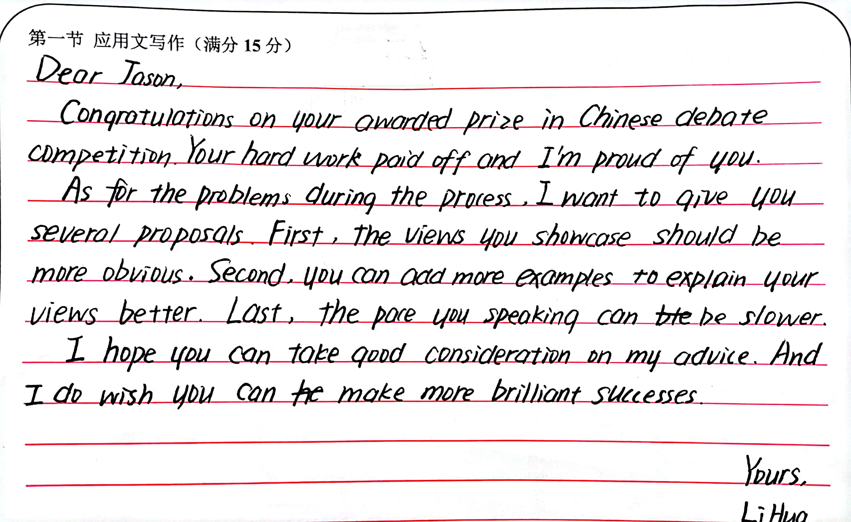
Deviation in the Ss' compositions（以 20220322三钉冲刺卷-1 为例）
试题呈现 Unique presentation | 信息分层 Clear levels | 要点齐全 Complete points | 合理建构 Logic bridges | 真实交际 Authentic emotions
假定你是李华，你的英国朋友 Jason 上周五邀请你观看了他参加的留学生中文辩论赛，并在获奖后向你征求改进建议。请你用英文给他写一封邮件，内容包括: 1.祝贺获奖; 2.提出建议; 3.表达祝愿。
没有突出英国留学生在中文辩论赛的问题和改进意见，因此所提建议没有结合“主题语境”，显得不真实，事实摆得很多，却不能切中要点。

Slide 30
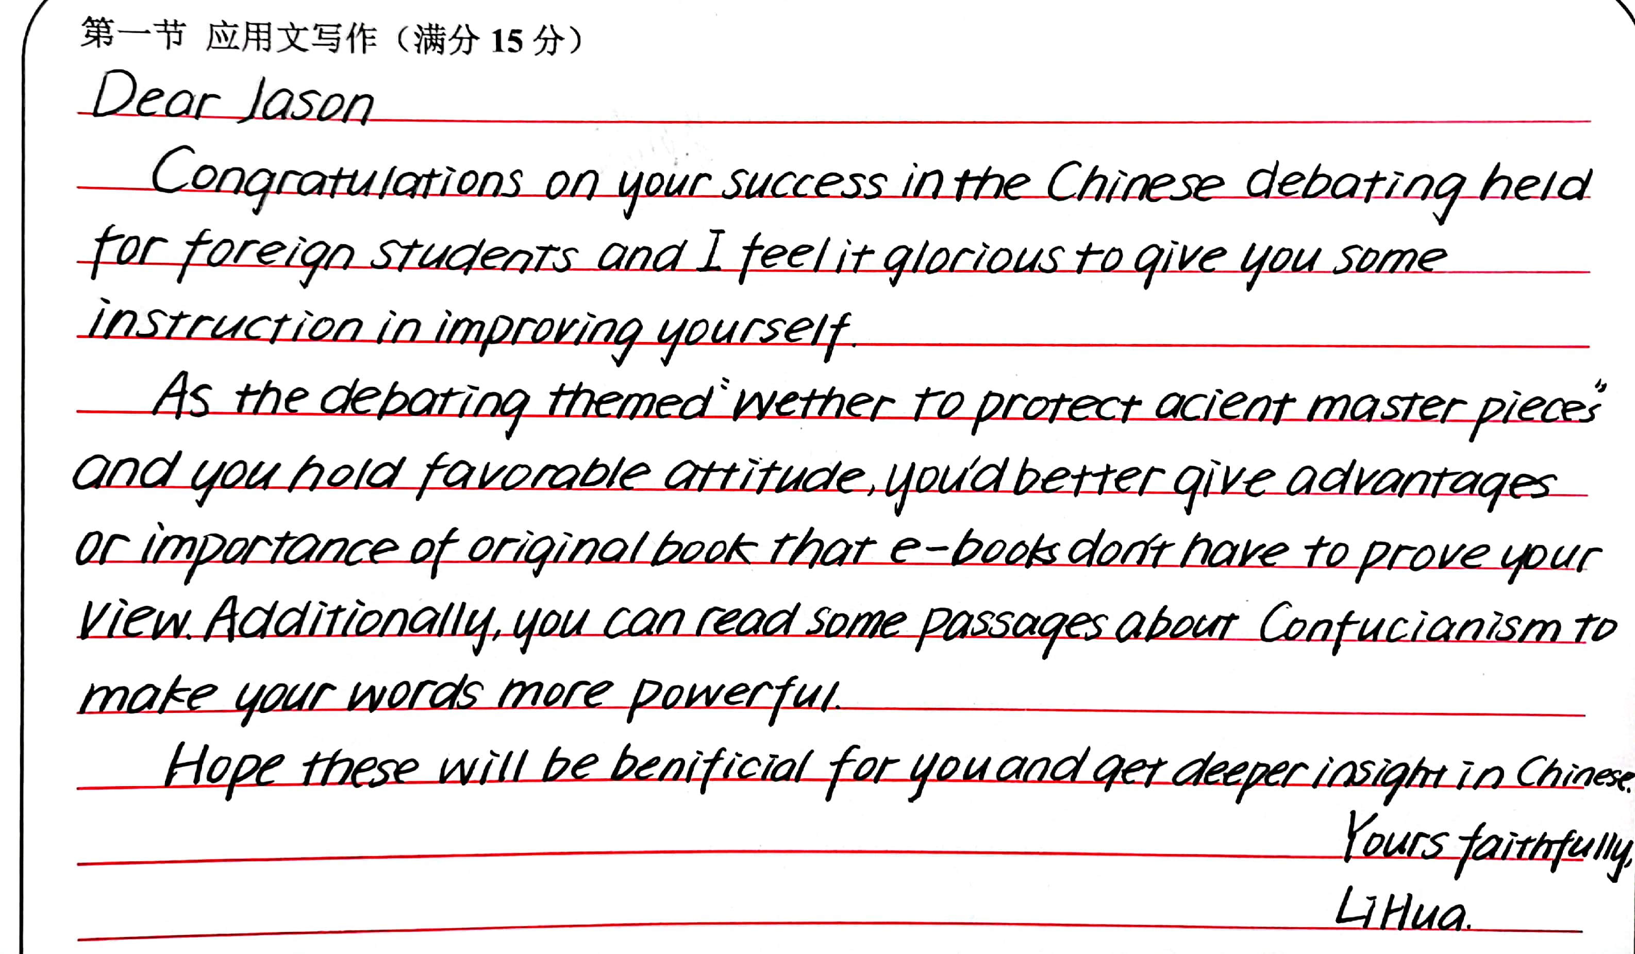
Deviation in the Ss' compositions（以 20220322三钉冲刺卷-1 为例）
试题呈现 Unique presentation | 信息分层 Clear levels | 要点齐全 Complete points | 合理建构 Logic bridges | 真实交际 Authentic emotions
假定你是李华，你的英国朋友 Jason 上周五邀请你观看了他参加的留学生中文辩论赛，并在获奖后向你征求改进建议。请你用英文给他写一封邮件，内容包括: 1.祝贺获奖; 2.提出建议; 3.表达祝愿。
提出学习“Confucianism 儒家思想”的建议，内涵发展，突显作者传播中华文化的能力。

Slide 31
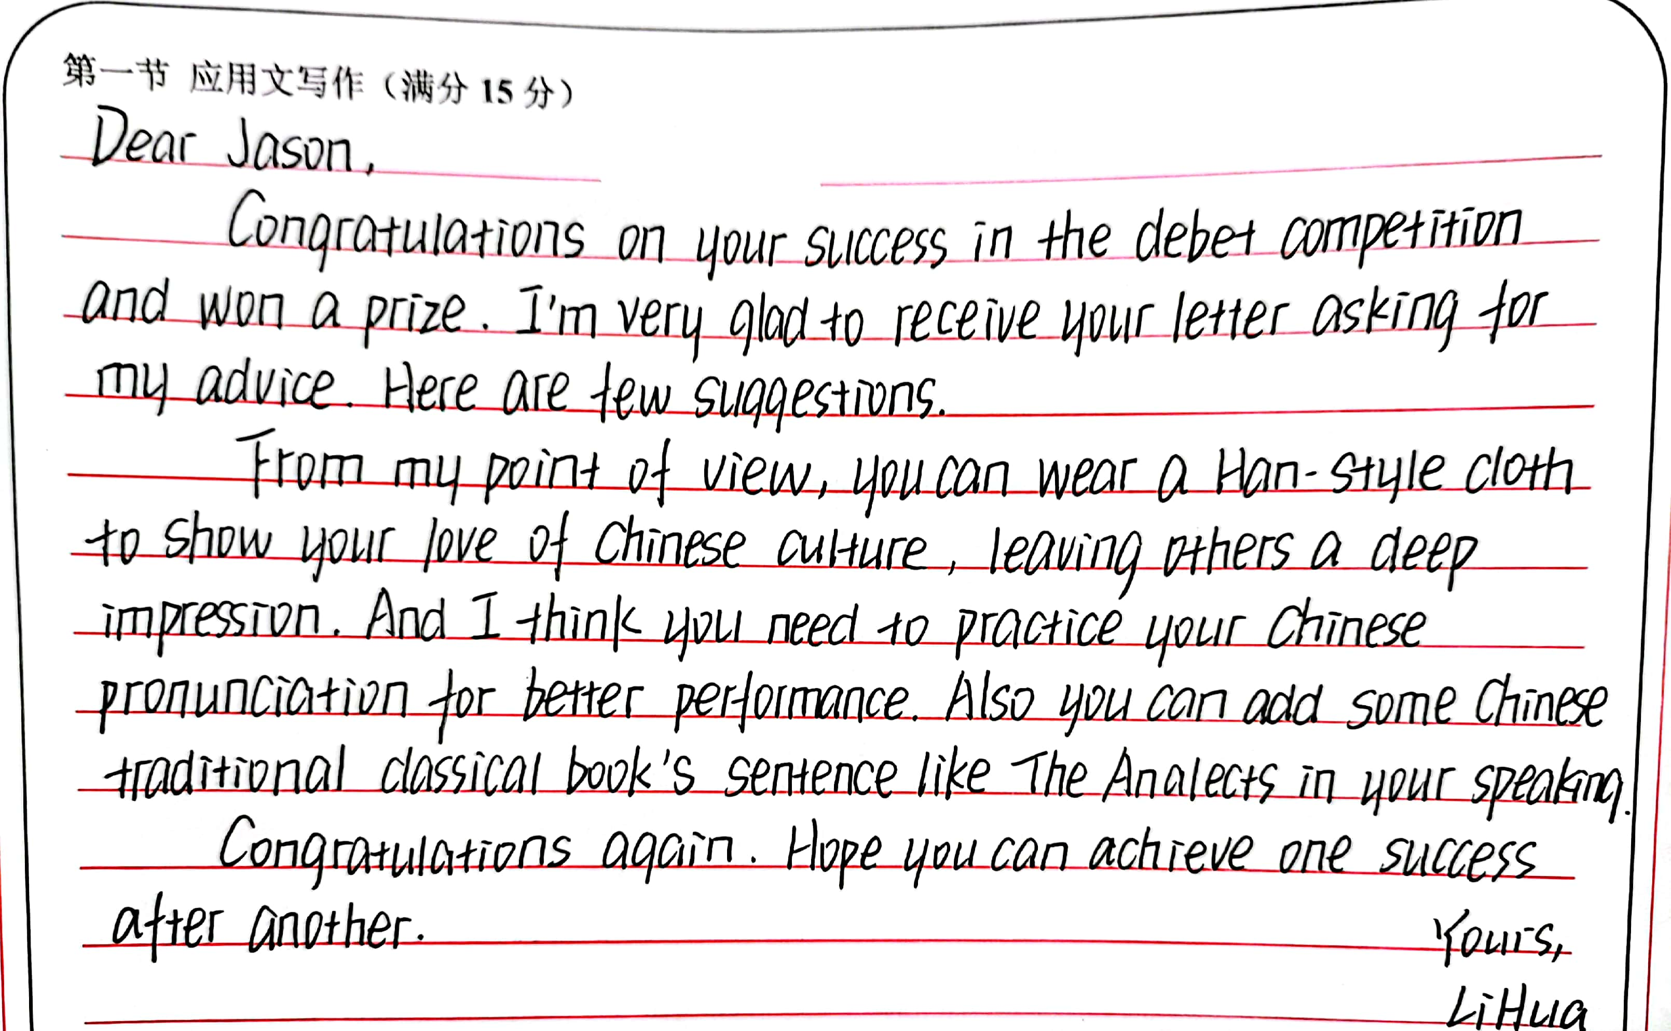
Deviation in the Ss' compositions（以 20220322三钉冲刺卷-1 为例）
试题呈现 Unique presentationquote | 信息分层 Clear levels | 要点齐全 Complete points | 合理建构 Logic bridges | 真实交际 Authentic emotions
假定你是李华，你的英国朋友 Jason 上周五邀请你观看了他参加的留学生中文辩论赛，并在获奖后向你征求改进建议。请你用英文给他写一封邮件，内容包括: 1.祝贺获奖; 2.提出建议; 3.表达祝愿。
在“中文辩论赛”中合理运用中国元素 “wear Han-style cloth, practise Chineses pronunciation, quote The Analects 论语”，审题到位，也反映作者传播中华文化能力突出。

Slide 32

博学之 Study extensively，
慎思之 Enquire accurately，
审问之 Reflect carefully，
明辨之 Discriminate clearly，
笃行之 Practice earnestly
—— 摘自《中庸》（本句也是中山大学的校训）

