Slide 1

感恩遇见，相互成就，本课件资料仅供您个人参考、教学使用，严禁自行在网络传播，违者依知识产权法追究法律责任。
更多教学资源请关注
公众号：溯恩高中英语
知识产权声明

Slide 2

The Week
Mar 19th-25th, 2022

Slide 3
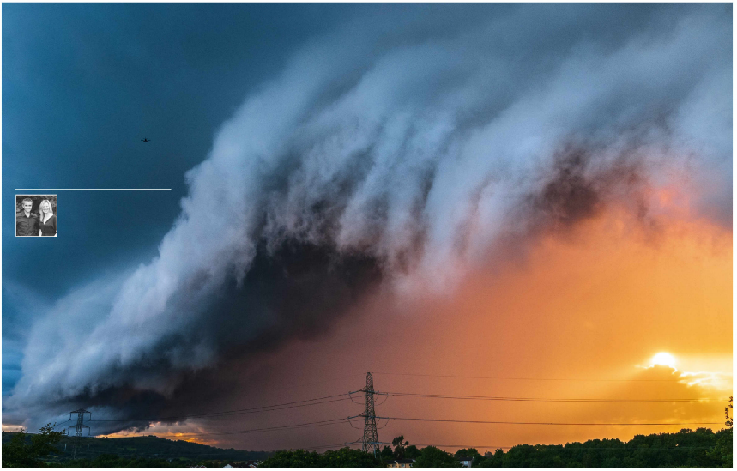
1. Weird Weather 英国的天象奇观
Meteorologists and journalists John Hammond and Sara Thornton run the digital weather service weathertrending.com and regularly write and provide commentary on the weather and climate. You can also hear John presenting on BBC Radio 4 and find Sara reporting on the weather on BBC SouthEast Today, BBC London, BBC Points West and across other parts of BBC England.

Slide 4
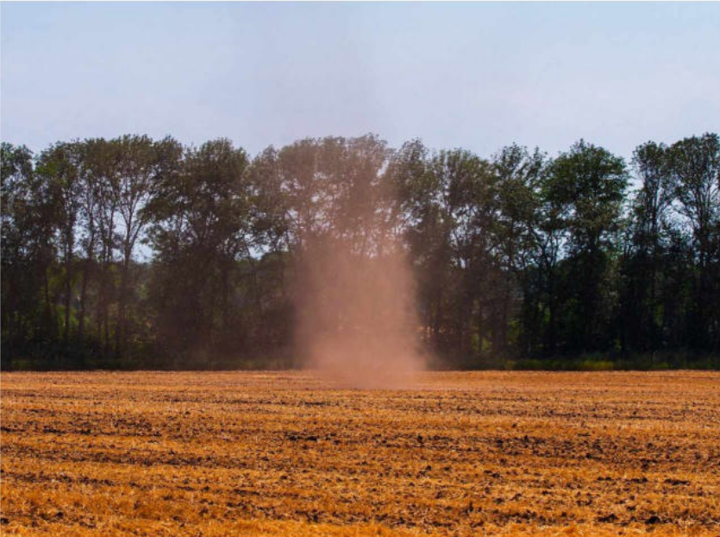

语篇填空 1
（《BBC乡村档案》2022年3月刊 64页）
Walk through the countryside on a sunny summer’s day and you might suddenly hear a gathering roar. In the _______ (distant), a rotating swirl of ______ (leaf), grass or hay is being lifted high into the clear blue sky. This whirlwind of energy is __ dust devil, barely a few metres across, but _______ (possible) hundreds of metres high. It _____ (spin) across fields and hedgerows, before disappearing.
distance
leaves
a
possibly
spins
Dust devils tend _______ (occur) when the sunshine is intense ____ the air above is relatively cool. _________ (trigger) by a particular hotspot on the ground, causing a bubble of warm air to rise, the vacuum of low pressure it produces is enough to suck in air _____ the surroundings. This then spins rapidly skywards, ______ (take) debris with it but only lasting seconds.
to occur
but
Triggered
from
taking

Slide 5
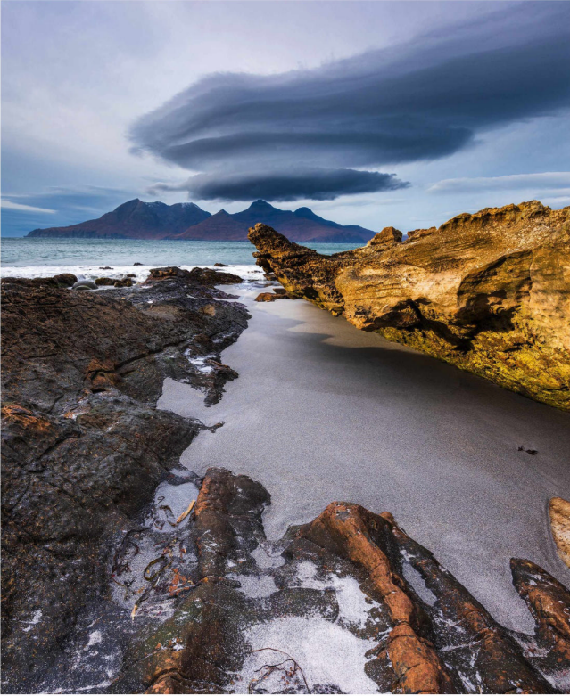
语篇填空 2
（《BBC乡村档案》2022年3月刊 65页）
We all know that flying saucers are the stuff of science fiction – don’t we? But you can see why UFO reports arise from the “out of this world” weather __________ (phenomenon) of lenticular clouds (荚状云). The ________ (form) of these giant, smooth, lens-shaped clouds is all down to waves of wind _______ (flow) over mountain ranges. The high ground sets up air ripples ___________ can propagate hundreds of miles downstream. With each ascending peak in the ripple, the air rises high enough to cool and condense, before it descends and evaporates. Because the clouds are triggered by unmoving mountains, they can last ____ hours in the same place.
phenomena
formation
flowing
that / which
for

Slide 6
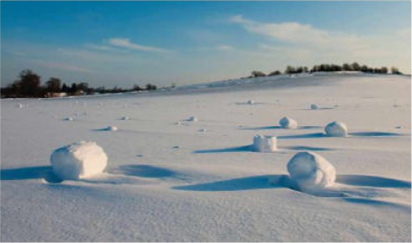
语篇填空 3
（《BBC乡村档案》2022年3月刊 67页）
On a cold winter’s day, you might encounter large rolls of snow _____ (lie) across a field. They seem to have been rolled up by a person – maybe to make the head for a snowman? But think again! These snow rollers have formed _______ any human help at all. They’re rare _______ the natural conditions have to be just right. First, they need a thin layer of
lying
without
because
slightly
snow which is _______ (slight) sticky – not too dry and powdery, not too wet and heavy. Underneath, they need a harder, smoother base of snow or ice, on ______ the snow can roll. Then, the crucial ingredient is wind at just the right speed. The wind ______ (push) a small lump of snow and starts it ______ (roll) along, preferably down a slope. The further it rolls, the more snow each cylinder picks up, with layers as high as a metre.
which
pushes
rolling

Slide 7
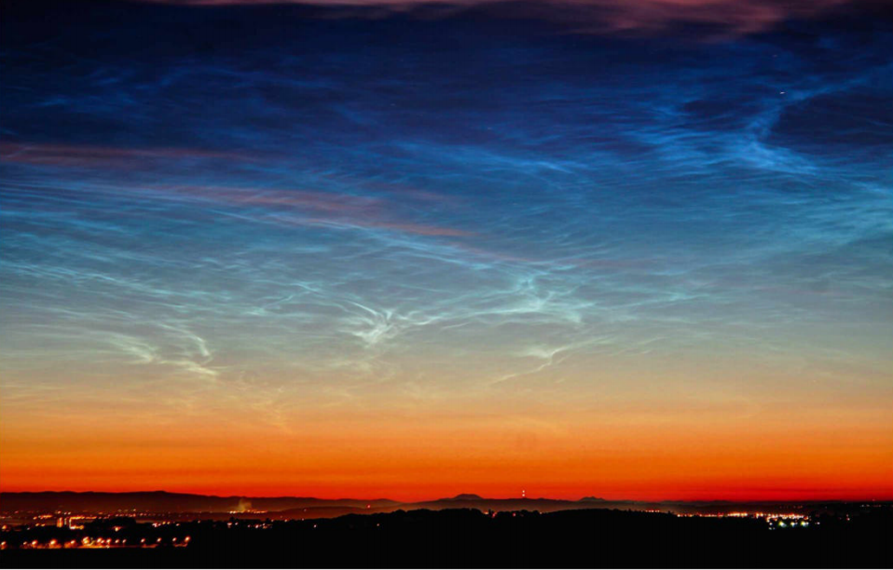

语篇填空 4
（《BBC乡村档案》2022年3月刊 68页）
On a clear summer’s evening, long after sunset, you might see a _________ (mystery) glow when you look into the northern sky. These rare noctilucent (夜光的) clouds _______ (see) at this odd time because, while the sun may have disappeared at ground level, at ___ height of around 200,000 feet, it’s still shining brightly. ________ (glow) from the outer _______ (reach) of the atmosphere,
mysterious
are seen
a
Glowing
reaches
these clouds are higher than any other. They appear ___ thin streaky clouds with a sometimes silvery luminescence and tend to only be seen at high latitudes, ______ means the UK is well placed to see them.
as
which

Slide 8
词汇讲解 1
1. debris:
pieces of wood, metal, brick, etc. that are left after sth has been destroyed
残骸；碎片；破片
Emergency teams are still clearing the debris from the plane crash.
各抢救小组仍在清理失事飞机的残骸。
pieces of material that are not wanted and rubbish that are left somewhere
残渣；垃圾；废弃物
Clear away leaves and other garden debris from the pond.
把池塘里的树叶和其他庭园垃圾清除干净。
翻译句子
有数人被飞射的碎片击中身亡。
A number of people were killed by flying debris.

Slide 9
词汇讲解 2
2. ascend: (to sth) to rise; to go up; to climb up 上升；升高；登高
A number of staircases ascend from the cobbled streets onto the ramparts.
一段石阶从鹅卵石路上一直向上直通城墙。
They set a new altitude record when they ascended 55,900 feet in their balloon.
他们乘坐热气球上升了55900英尺，创造了一项新的高度纪录。
Mrs Clayton had to hold Lizzie's hand as they ascended the steps.
拾级而上的时候克莱顿夫人不得不抓着莉齐的手。
翻译句子
小径开始陡峭而上。
The path started to ascend more steeply.
随着我们往上攀登，空气就寒冷起来。
The air became colder as we ascended.

Slide 10
词汇讲解 3
3. encounter:
If you encounter problems or difficulties, you experience them.
遇到；遭遇（问题、困难）
Environmental problems they found here are among the worst they encountered.
他们在此处发现的环境问题是他们遇到过的最严重的。
If you encounter someone, you meet them, usually unexpectedly. 偶遇；邂逅
Renata wrote him that she had encountered her long-estranged father.
雷娜塔写信告诉他说她碰到了分离多年的父亲。
翻译句子
你在大楼里遇到谁了么?
Did you encounter anyone in the building?
我们在每天的生活中会面临这样或那样的压力。
Every day of our lives we encounter stresses of one kind or another.

Slide 11
词汇讲解 4
4. glow (n.):
A glow is a dull, steady light, for example the light produced by a fire when there are no flames. 微弱稳定的光；暗淡的光
The rising sun casts a golden glow over the fields.
冉冉升起的太阳在田野中洒下金色的阳光。
A glow is a pink colour on a person’s face, usually because they are healthy or have been exercising. （脸上的）红光；红晕；红润
The moisturiser gave my face a healthy glow that lasted all day.
涂了润肤霜，我的脸一整天都红润亮泽。
翻译句子
我们可以看到窗户里灯的光芒。
We could see the glow of the lamp in the window.
当他想起他们第一次见面的那一天时，他脸上泛起红晕。
He felt a glow as he remembered the day they first met.

Slide 12
长难句分析
Triggered by a particular hotspot on the ground, causing a bubble of warm air to rise, the vacuum of low pressure it produces is enough to suck in air from the surroundings.
分析：本句是一个复合句，整体是一个___________________从句， “Triggered...ground” 是______________________，“causing...rise”是_______________________。
省略了关系词的定语
过去分词短语作原因状语
现在分词短语作结果状语
由地面上的特定热点触发，导致暖空气泡上升，它产生的低压真空足以从周围吸入空气。
翻译

Slide 13
句子翻译
The formation of these giant, smooth, lens-shaped clouds is all down to waves of wind flowing over mountain ranges.
翻译
这些巨大的、光滑的、透镜状的云层的形成，全都归功于流过山脉的风浪。
Underneath, they need a harder, smoother base of snow or ice, on which the snow can roll.
翻译
在下面，他们需要更硬、更光滑的雪或冰底，雪可以在上面滚动。
These rare noctilucent clouds are seen at this odd time because, while the sun may have disappeared at ground level, at a height of around 200,000 feet, it’s still shining brightly.
翻译
这些罕见的夜光云是在这个奇怪的时间出现的，因为虽然太阳可能已经在地面上消失了，但在大约20万英尺的高度，它仍然光芒闪耀。

Slide 14
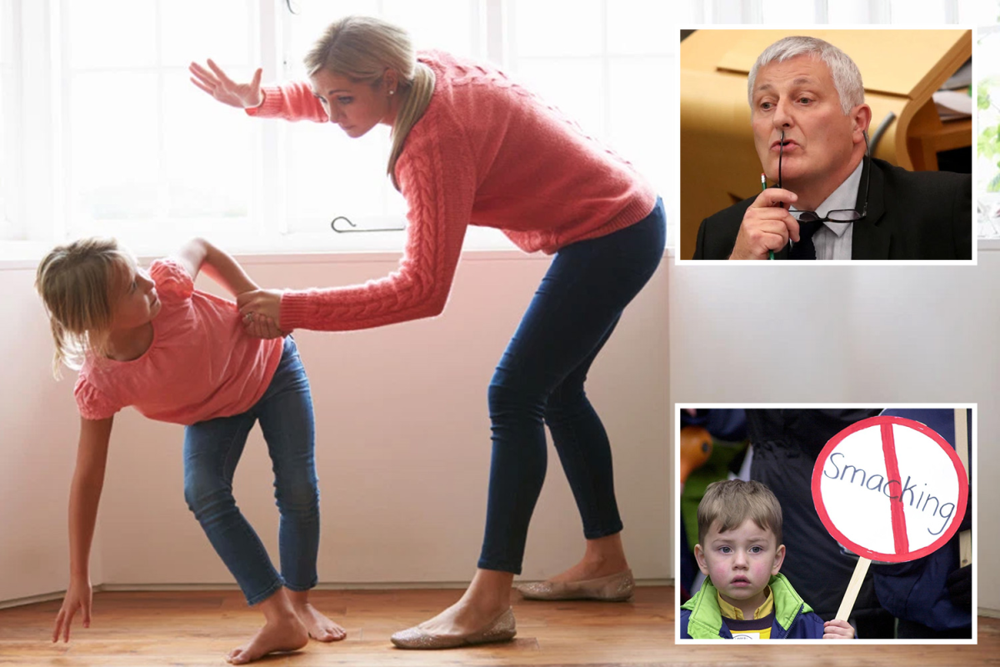
2.Ban on smacking children in Wales comes into force today
威尔士体罚儿童的禁令于今日生效

Slide 15
阅读理解
（《卫报》 2022年3月21日 19页）
Smacking and slapping children has been outlawed in Wales, with people told to contact social services or the police if they see a parent or carer meting out physical punishment. The change in the law from first thing today was hailed as “historic” by the Labour-led Welsh government and child protection champions .
Critics, including the Welsh Conservatives, said it would criminalize parents and create a “Stasi culture” with people “shopping” their neighbours. The legislation removes the Victorian-era defence of “reasonable punishment” and makes all physical punishment, such as smacking, hitting, slapping and shaking, illegal. The law will apply to everybody in Wales, including visitors.
Julie Morgan, the deputy minister for social services, who has campaigned for the change for more than two decades, said: “Today is a historic moment for children and their rights in Wales as we make physically punishing children a thing of the past.” Rejecting the notion of a “Stasi culture”, Morgan said: “We don’t want people spying.” But she added: “Looking after children is the responsibility of the whole community.” Morgan hoped England would follow the example of Wales and Scotland, which brought in a ban in November 2020.
Viv Laing, from NSPCC Cymru Wales, said England and Northern Ireland were outliers. She added: “ Until now [in Wales], children were the only group in our society who it was acceptable to strike in certain circumstances. We don’t allow the physical punishment of adults or animals, so it is absurd that we have for so long with children.”
For the Welsh Conservatives, the shadow social services minister, Gareth Davies, said the law was “unnecessary, unworkable and undesired”. “I am very worried about campaigns that encourage a Stasi culture in Wales where people – and children – are encouraged to shop parents who discipline their children in what they deem a proportionate manner to the police, ” he added.

Slide 16
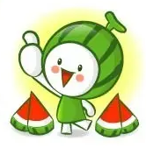
阅读理解
1.Which world can replace the underlined word “hailed” in Paragraph 1 ?
A. identified B. praised C. known D. mistaken
词义猜测
2. What can be inferred from Paragraph 3?
A. Parents in Wales always physically punished their kids in the past.
B. Morgan was quite pleased with the concept of “Stasi culture” .
C. England hasn’t brought in a ban on smacking children.
D. It is only the parents’ responsibility to take care of children.
推理判断
3. What’s the author’s attitude towards the ban?
A. Approving B. Critical C. Indifferent D. Objective
观点态度

Slide 17
熟词生义
1. shop: 常见义 → n.商店 v.购物
生义 → to tell the police about someone who has done something illegal 告发
He was shopped by his ex-wife. 他被他的前妻告发了。
2. shadow: 常见义 → n.阴影；影子；背光处
生义 → used to refer to senior politicians of the main opposition party影子内阁的
the shadow Cabinet 影子内阁
翻译句子
他没想到自己的母亲会向警方告发他。
He didn’t expect his own mother to shop him to the police.
翻译句子
影子内阁是威斯敏斯特政府体制的一个特点。
The Shadow Cabinet is a feature of the Westminster system of government.

Slide 18
词汇讲解
1. mete out: to give sb a punishment; to make sb suffer bad treatment 给予惩罚
Judges are meting out harsh sentences for car theft.
法官正在对偷车的人处以严厉的刑罚。
2. deem: to have a particular opinion about sth 认为；视为；相信
He says he would support the use of force if the UN deemed it necessary.
他说如果联合国认为有必要，他就支持动用武力。
翻译句子
他觉得他有权体罚孩子。
He felt he had a right to mete out physical punishment to the children.
翻译句子
他们被告知采取任何他们认为必要的行动。
They were told to take whatever action they deemed necessary.

Slide 19
句子翻译
Smacking and slapping children has been outlawed in Wales, with people told to contact social services or the police if they see a parent or carer meting out physical punishment.
在威尔士，打孩子是违法的，如果人们看到父母或看护者体罚孩子，就要联系社会服务机构或警方。
翻译
Critics, including the Welsh Conservatives, said it would criminalize parents and create a “Stasi culture” with people “shopping” their neighbours.
包括威尔士保守党在内的批评人士表示，该法案将把父母当罪犯对待，并创造一种“斯塔西文化”，让人们“举报”邻居。
翻译

Slide 20
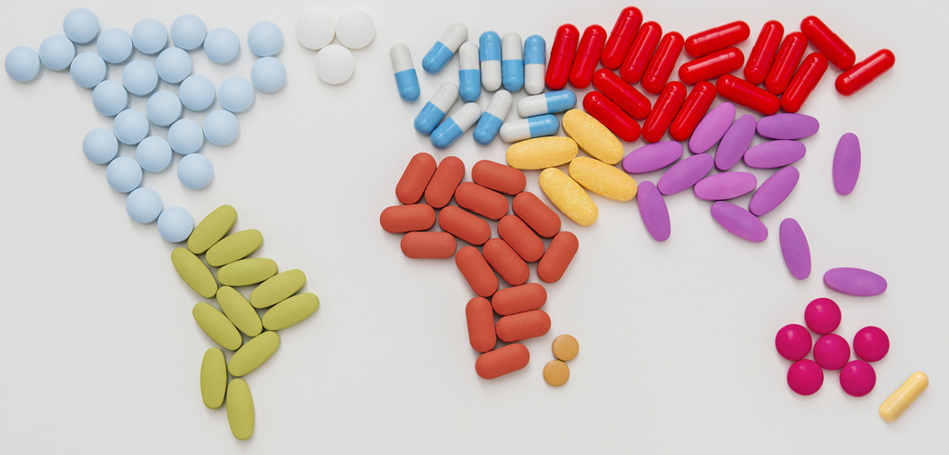
3. News From the WORLD OF MEDICINE
医学界新发现

Slide 21
语篇填空1&2
（《读者文摘》美国版 2022年3&4月合刊 52页）
Exercise Builds Bones and Protects Against Cancer
While it may seem counterintuitive (违反常理的), a British study has found that people ____ suffer from osteoporosis (骨质疏松症) – a condition that causes bones to become fragile and break _____ (easy) – could benefit _________ exercising more. Researchers found that exercising slows osteoporosis by accelerating the formation of new bone cell tissue and removal of old. Exercise may also help ward off cancer by activating a tumor suppressor gene, which leaves less room for cancer cells to invade. Many ________ (hospital) recommend that cancer patients exercise for up to 150 minutes a week, as it boosts energy and strength while ________ (reduce) pain and anxiety.
who
easily
from / by
hospitals
reducing
Berries Promote Good Blood Pressure
___ study from researchers in Germany and Ireland reveals that eating foods rich ___ flavonoids (黄酮类) – such as berries, pears, and apples — creates a virtuous cycle (良性循环) inside your body that ______ (lower) blood pressure. These plant compounds increase the abundance and ________ (diverse) of good bacteria in the gut (肠道) . This in turn helps your body better metabolize (新城代谢) the next flavonoids to come along, enhancing their ______ (nature) medicinal effects.
A
in
lowers
diversity
natural

Slide 22
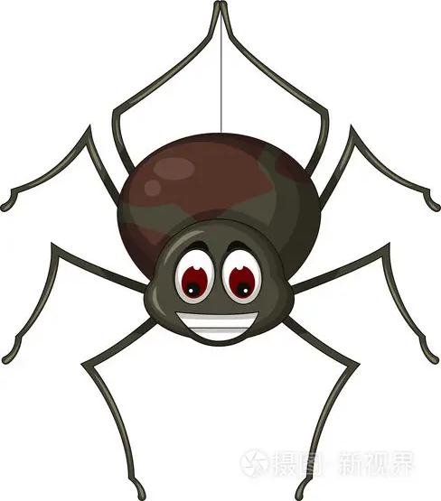
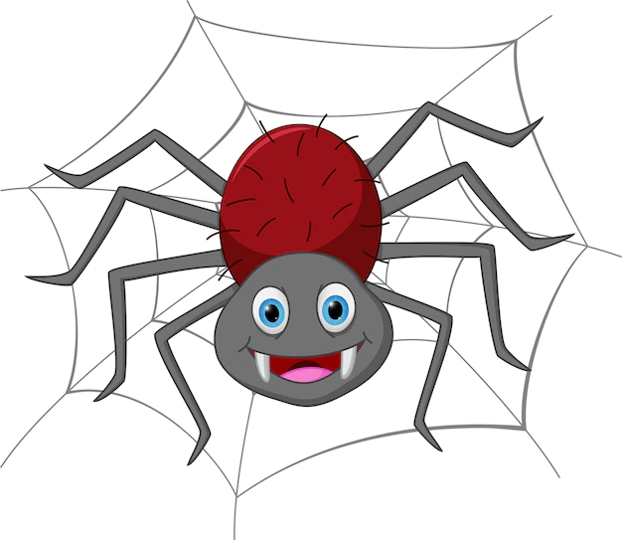
语篇填空3
（《读者文摘》美国版 2022年3&4月合刊 52页）
A Deadly Spider Venom That Can Save Lives
Australian scientists have discovered a _________ (potential) lifesaving treatment for heart attack victims. Incredibly, it comes from the venom of the world’s deadliest spider. Existing treatments reduce blood clots (血块), ___ they don’t block the “death signal” – what doctors call the body’s inability to send blood, and thereby oxygen, to the heart after an attack. Because of its effect ___ cell acidity, a protein produced by the Fraser Island (K’gari) funnel-web spider (漏斗网蜘蛛) blocks the death signal, ________ (allow) more heart cells to survive. As well as giving heart attack victims better outcomes, the drug now being developed could also extend the life of donor hearts _____ (use) for organ transplants.
potentially
but
on
allowing
used

Slide 23
词汇讲解1
1. accelerate: to happen or to make sth happen faster or earlier （使）加速，加快
Exposure to the sun can accelerate the ageing process.
暴露在日光下会加快老化过程。
2. ward off: to defend yourself against danger, illness, attack, etc. 防止，避免
Don’t forget insect repellent to ward off the mosquitoes.
别忘了用驱虫剂来驱赶蚊子。
翻译句子
他们使用特殊的化学品来加速农作物生长。
They use special chemicals to accelerate the growth of crops.
翻译句子
冬天我服用维生素C以预防感冒。
In the winter I take vitamin C to ward off colds.

Slide 24
词汇讲解2
3. enhance: to increase the good quality, value or status of sb/sth 提高；增强
This is an opportunity to enhance the reputation of the company.
这是提高公司声誉的机会。
4. extend: to make sth last longer
Careful maintenance can extend the life of your car.
精心保养可延长汽车寿命。
翻译句子
大幅画作能增加小房间的宽敞感。
Large paintings can enhance the feeling of space in small rooms.
翻译句子
他们已经将最后期限延长了24小时。
They have extended the deadline by twenty-four hours.

Slide 25
句子翻译
Exercise may also help ward off cancer by activating a tumor suppressor gene, which leaves less room for cancer cells to invade.
运动还可以通过激活肿瘤抑制基因来帮助预防癌症，从而减少癌细胞入侵的空间。
翻译
This in turn helps your body better metabolizethe next flavonoids to come along, enhancing their natural medicinal effects.
这反过来又能帮助你的身体更好地代谢即将到来的类黄酮，增强它们的天然药用效果。
翻译
As well as giving heart attack victims better outcomes, the drug now being developed could also extend the life of donor hearts used for organ transplants.
除了给心脏病患者带来更好的结果，目前正在开发的这种药物还可以延长用于器官移植的供体心脏的寿命。
翻译

Slide 26

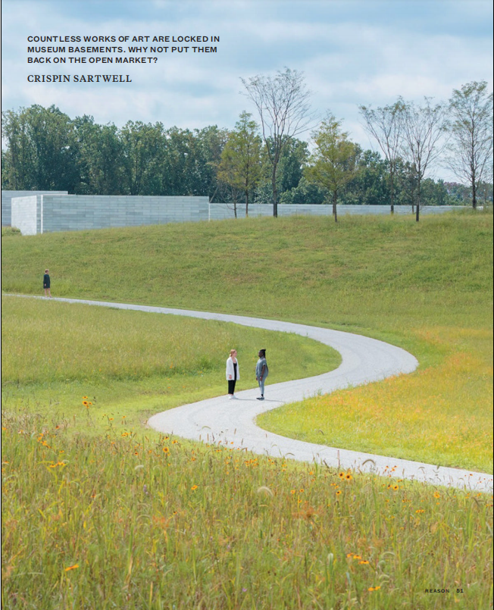
4. Free the art! Sell the art!
还给艺术自由还是出卖了艺术？

Slide 27
语篇填空
（《理性》2022年3月刊 50-54页）
acknowledged
It is widely _______________ (acknowledge) that there can be good reasons for a museum to cut its collection—for example, to repatriate looted artworks to their native lands. Even so, the __________ (propose) sale generated a lot of anger. The Los Angeles Times’ art critic, Christopher Knight, called it “____ ugly swindle,” which intended to “trash the art collection.” Knight argued that sales from a museum’s collection should never be used to fund its ___________ (operate) expenses.
Knight isn’t alone. Many commentators believe that no museum should ever disobtain any significant work of art except to repatriate it—____________ (particular) when the museum proposes to put the work back onto the private market. The idea appears to be that museums should have all the art. The underlying justification for that is the admirable notion that all the important art should be available for the public to view and for scholars _________ (study).
In any case, the argument _____ major museums should have all the important art because it then will be available for public view is detached from reality. That’s not ____ these institutions operate. At any given time, the Guggenheim _________ (display) about 2 percent of its collection. Many less familiar but important artists ________ (keep) completely in storage, virtually all of their work invisible
proposed
an
operating
particularly
to study
that
how
displays
are kept

Slide 28
词汇讲解 1
1. repatriate: to send or bring sb back to their own country 遣送回国；遣返
China could repatriate all the dollars its exporters earn by selling stuff to the U.S.
中国可以将出口商们通过将商品挣来的美元都遣返回美国。
2. generate: to produce or create sth 产生；引起
We need someone to generate new ideas.
我们需要有人出新主意。
翻译句子
难民被强制遣送回国。
The refugees were forcibly repatriated.
翻译句子
这项建议引起众多的关注。
The proposal has generated a lot of interest.

Slide 29
词汇讲解 2
1. notion: an idea, a belief or an understanding of sth 观念；信念；理解
I have to reject the notion that greed can be a good thing.
我不能接受那种认为贪欲也可以是件好事的想法。
2. detach: to remove sth from sth larger; to become separated from sth 拆卸；（使）分开，脱离
One of the panels had become detached from the main structure.
一块镶板已从主体结构上脱落。
翻译句子
对于可能发生的事她只有一个模糊的概念。
She had only a vague notion of what might happen.
翻译句子
要是你跌倒了，滑雪板就该脱离靴子。
The skis should detach from the boot if you fall.

Slide 30
句子翻译
Many commentators believe that no museum should ever disobtain any significant work of art except to repatriate it—particularly when the museum proposes to put the work back onto the private market.
翻译
许多评论家认为，任何博物馆都不应该剥夺任何重要的艺术品，除非将其归还——尤其是当博物馆提议将这些艺术品重新放到私人市场上时。
In any case, the argument that major museums should have all the important art because it then will be available for public view is detached from reality.
在任何情况下，认为大型博物馆应该拥有所有重要艺术品，因为这样它们就可以供公众观看，这样的观点是与现实脱节的。
翻译

Slide 31

5. CNN听力 03/23/22 美国航空燃油成本飙升

Slide 32

听力填空 1
If you’re planning to _____ a real jet this spring break or summer, the plain truth is it’s gonna to be more expensive. Prices are ________ like the jets themselves.
There are several reasons for this. One is _______. People want to travel. The head of Delta Airlines says he’s never seen demand ramp up so quickly as it has after the omicron wave of COVID, which ___ the U.S. late last year. Planes are ________ with some flights reportedly carrying as many passengers as they did in 2019 before the pandemic, but most airlines still aren’t operating as many flights as they were then. They’re still having trouble finding enough workers and there been some ______ in getting new planes ________.
Also, while more Americans are traveling within the United States ______, they’re not traveling as much for business. Many people are still working from _____ as they started doing in 2020, so that’s reduced a _________ number of airline bookings.
board
climbing
demand
hit
filling up
delays
delivered
for fun
home
significant

Slide 33
听力填空 2
The head of American Airlines suggests COVID rules continue to affect international ___________ but he says a huge number of people still want to do it and that if countries _______ their restrictions, international bookings could grow back to their 2019 levels by the end of this year.
A big reason why all bookings are getting more expensive though is the cost of jet fuel. _________ the cost of gas, it’s ________ over the past year. What’s interesting here is that crude oil prices which factor heavily into the cost of gasoline and jet fuel, they’ve _______ a little since last week when they hit their highest prices in 13 years.
But fuel costs didn’t reflect that _________. Experts say gas prices rise like _______ but fall like _______—meaning, they’re quick to increase when oil prices do but they take a while to ______________ after oil prices drop. For airlines, 20 to 25 percent of their ________________ come from fuel costs alone. It’s their largest expense after paying their workers.
leisure travel
remove
Mirroring
taken off
dropped
right away
rockets
feathers
settle back down
operating expenses

Slide 34
熟词生义讲解
1. plain: easy to see or understand 清楚的；明显的；浅白的
It was plain to him that I was having a nervous breakdown.
他能明显地看出我快要精神崩溃了。
2. factor sth in / factor sth into sth: to include a particular fact or situation when you are thinking about or planning sth 把……因素包括进去
Remember to factor in staffing costs when you are planning the project.
规划项目时，记住要把雇人费用这个因素考虑进去。
翻译句子
事实显而易见。
The facts were plain to see.
翻译句子
您必须将保险费计入汽车维护成本中。
You must factor insurance payments into the cost of maintaining a car.

Slide 35
词汇讲解
1. ramp sth up: to make sth increase in amount 使……的数量增加
Ever since that break-in, they’ve really ramped up security at the office.
自从那次入室抢劫以来，他们确实加强了办公室的安全性。
2. reportedly: according to what some people say 据说；据报道；据传闻
More than 200 people have reportedly been killed in the past week’s fighting.
据说在上一周的战斗中有200多人丧生。
翻译句子
如果你想在这次考试中获得A，你需要加大学习力度。
You need to ramp up your study efforts if you want to get an A on this exam.
翻译句子
据说这个乐队已经决定解散。
The band have reportedly decided to break up.

Slide 36
句子翻译
The head of Delta Airlines says he’s never seen demand ramp up so quickly as it has after the omicron wave of COVID, which hit the U.S. late last year.
翻译
达美航空公司的负责人表示，自去年底奥密克戎毒株肆虐美国以来，他还从未见过需求如此迅速增长。
Planes are filling up with some flights reportedly carrying as many passengers as they did in 2019 before the pandemic, but most airlines still aren’t operating as many flights as they were then.
翻译
据报道，一些航班载客量与大流行前的2019年一样多，但大多数航空公司的航班数量仍不及当时。
The head of American Airlines suggests COVID rules continue to affect international leisure travel, but he says a huge number of people still want to do it and that if countries remove their restrictions, international bookings could grow back to their 2019 levels by the end of this year.
美国航空公司的负责人表示，防疫规定继续影响国际休闲旅行，但他表示仍有大量人希望出行，如果各国取消出行限制，国际航班预订量可能会在今年年底前恢复到 2019年的水平。
翻译

