Slide 1

感恩遇见，相互成就，本课件资料仅供您个人参考、教学使用，严禁自行在网络传播，违者依知识产权法追究法律责任。
更多教学资源请关注
公众号：溯恩高中英语
知识产权声明

Slide 2
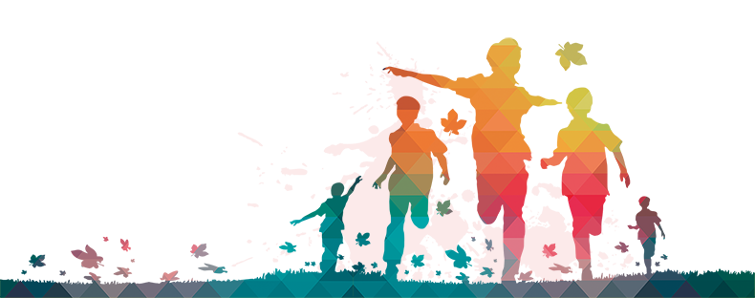
How to introduce
a festival ?

Slide 3
Time
Origin
How to introduce
a festival ?
Celebrations
Purpose

Slide 4
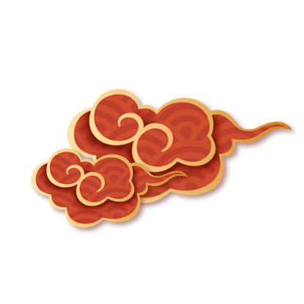
Learning from the book
Time
People celebrate the Day of the Dead in early November.
India has a national festival on October 2 …
Some Western countries have very exciting carnivals, which take place forty days before Easter, usually in February.
…is celebrated on…
…takes place on…
…falls on…
The most energetic and important festivals are the ones that look forward to the end of winter and to the coming of spring. At the Spring Festival in China, people eat dumplings, fish and meat and may give children lucky money in red paper. There are dragon dances and carnivals, and families celebrate the Lunar New Year together. Some Western countries have very exciting carnivals, which take place forty days before Easter, usually in February. These carnivals might include parades, dancing in the streets day and night, loud music and colourful clothing of all kinds. Easter is an important religious and social festival for Christians around the world. It celebrates the return of Jesus from the dead and the coming of spring and new life. Japan’s Cherry Blossom Festival happens a little later. The country, covered with cherry tree flowers, looks as though it is covered with pink snow.
Some festivals are held to honour the dead or to satisfy the ancestors, who might return either to help or to do harm. For the Japanese festival Obon, people should go to clean graves and light incense in memory of their ancestors. They also light lamps and play music because they think that this will lead the ancestors back to earth. In Mexico, people celebrate the Day of the Dead in early November. On this important feast day, people eat food in the shape of skulls and cakes with "bones" on them. They offer food, flowers and gifts to the dead. The Western holiday Halloween also had its origin in old beliefs about the return of the spirits of dead people. It is now a children’s festival, when they can dress up and go to their neighbours’ homes to ask for sweets. If the neighbours do not give any sweets, the children might play a trick on them.
Festivals can also be held to honour famous people. The Dragon Boat Festival in China honours the famous ancient poet, Qu Yuan. In the USA, Columbus Day is in memory of the arrival of Christopher Columbus in the New World. India has a national festival on October 2 to honour Mohandas Gandhi, the leader who helped gain India’s independence from Britain.

Slide 5
Learning from the book
Origin/ Purpose
Some festivals are held to honour the dead or to satisfy the ancestors.
…also had its origin in old beliefs about the return of the spirits of dead people.
Festivals can also be held to honour famous people. … honours the famous ancient poet, Qu Yuan.
Columbus Day is in memory of the arrival of Christopher Columbus in the New World.
India has a national festival on October 2 to honour Mohandas Gandhi, …
… are the ones that look forward to the end of winter and to the coming of spring.
It celebrates the return of Jesus from the dead and the coming of spring and new life.
Harvest and Thanksgiving festivals can be very happy events.
Easter is an important religious and social festival for Christians around the world.
… is held to/ is celebrated to / is meant to / aims to …
… celebrates/ looks forward to…
It is in memory/ honor of … It is to honor / to remember…
… has its origin in…
… originates from / has a root in / begins with / starts with…
… has/ enjoys a long/ splendid history, which was originally celebrated to…
The most energetic and important festivals are the ones that look forward to the end of winter and to the coming of spring. At the Spring Festival in China, people eat dumplings, fish and meat and may give children lucky money in red paper. There are dragon dances and carnivals, and families celebrate the Lunar New Year together. Some Western countries have very exciting carnivals, which take place forty days before Easter, usually in February. These carnivals might include parades, dancing in the streets day and night, loud music and colourful clothing of all kinds. Easter is an important religious and social festival for Christians around the world. It celebrates the return of Jesus from the dead and the coming of spring and new life. Japan’s Cherry Blossom Festival happens a little later. The country, covered with cherry tree flowers, looks as though it is covered with pink snow.
Some festivals are held to honour the dead or to satisfy the ancestors, who might return either to help or to do harm. For the Japanese festival Obon, people should go to clean graves and light incense in memory of their ancestors. They also light lamps and play music because they think that this will lead the ancestors back to earth. In Mexico, people celebrate the Day of the Dead in early November. On this important feast day, people eat food in the shape of skulls and cakes with "bones" on them. They offer food, flowers and gifts to the dead. The Western holiday Halloween also had its origin in old beliefs about the return of the spirits of dead people. It is now a children’s festival, when they can dress up and go to their neighbours’ homes to ask for sweets. If the neighbours do not give any sweets, the children might play a trick on them.
Festivals can also be held to honour famous people. The Dragon Boat Festival in China honours the famous ancient poet, Qu Yuan. In the USA, Columbus Day is in memory of the arrival of Christopher Columbus in the New World. India has a national festival on October 2 to honour Mohandas Gandhi, the leader who helped gain India’s independence from Britain.

Slide 6
Learning from the book
Celebrations
For…, people should go to …. They also … because …
On this important feast day, people …. They ...
It is now a children’s festival, when they can ...
In European countries, people will usually …, and will …. Some people might …
China and Japan have mid-autumn festivals, when people ...
At the Spring Festival in China, people …, … and may …. There are …, … and …
These carnivals might include …, …, … and …of all kinds.
The celebrations / activities include…
involve…
… hold a variety of activities, including ….
There are …
It is a time for … / a time to do …/ a time when people …
It is a time of excitement and joy/ for family reunion and friends gathering together.
It is a festival when family and friends get together.
Some festivals are held to honour the dead or to satisfy the ancestors, who might return either to help or to do harm. For the Japanese festival Obon, people should go to clean graves and light incense in memory of their ancestors. They also light lamps and play music because they think that this will lead the ancestors back to earth. In Mexico, people celebrate the Day of the Dead in early November. On this important feast day, people eat food in the shape of skulls and cakes with "bones" on them. They offer food, flowers and gifts to the dead. The Western holiday Halloween also had its origin in old beliefs about the return of the spirits of dead people. It is now a children’s festival, when they can dress up and go to their neighbours’ homes to ask for sweets. If the neighbours do not give any sweets, the children might play a trick on them.
Harvest and Thanksgiving festivals can be very happy events. People are grateful because their food is gathered for the winter and the agricultural work is over. In European countries, people will usually decorate churches and town halls with flowers and fruit, and will get together to have meals. Some people might win awards for their farm produce, like the biggest watermelon or the most handsome rooster. China and Japan have mid-autumn festivals, when people admire the moon and in China, enjoy mooncakes.
The most energetic and important festivals are the ones that look forward to the end of winter and to the coming of spring. At the Spring Festival in China, people eat dumplings, fish and meat and may give children lucky money in red paper. There are dragon dances and carnivals, and families celebrate the Lunar New Year together. Some Western countries have very exciting carnivals, which take place forty days before Easter, usually in February. These carnivals might include parades, dancing in the streets day and night, loud music and colourful clothing of all kinds. Easter is an important religious and social festival for Christians around the world. It celebrates the return of Jesus from the dead and the coming of spring and new life. Japan’s Cherry Blossom Festival happens a little later. The country, covered with cherry tree flowers, looks as though it is covered with pink snow.

Slide 7
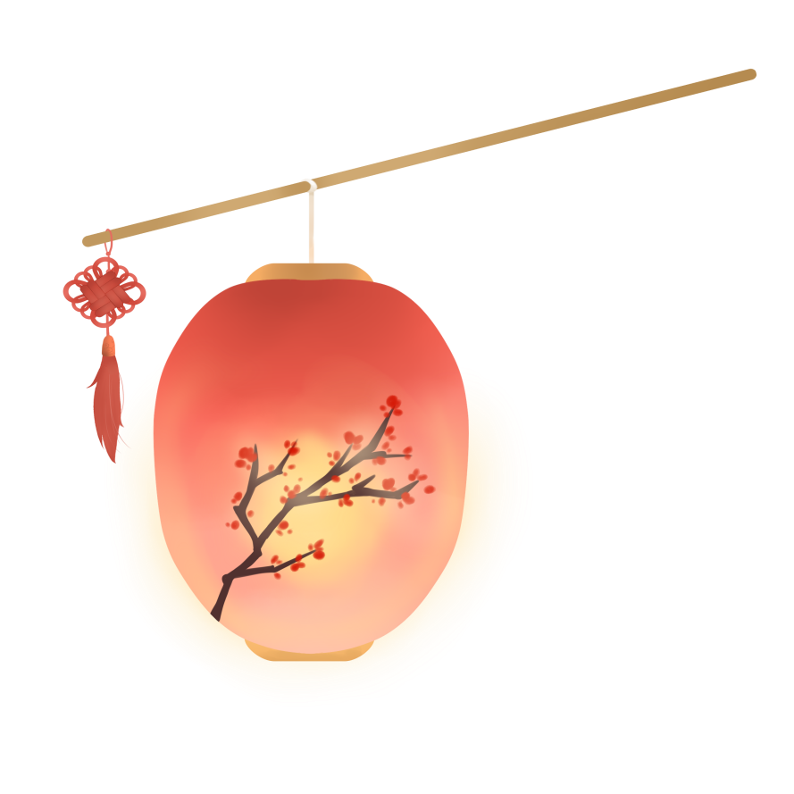
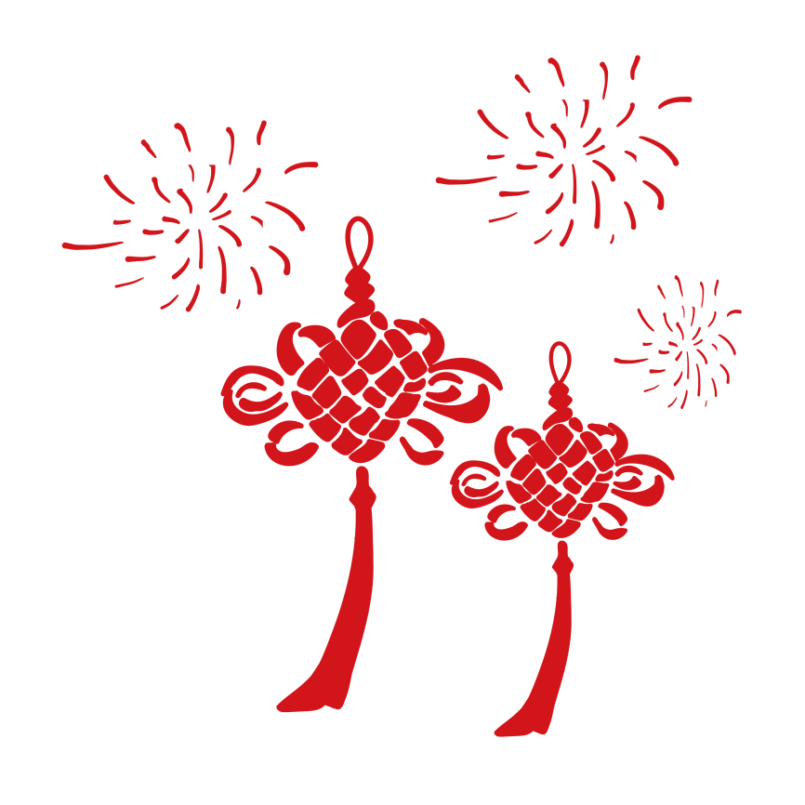
Traditional Chinese Festivals

Slide 8
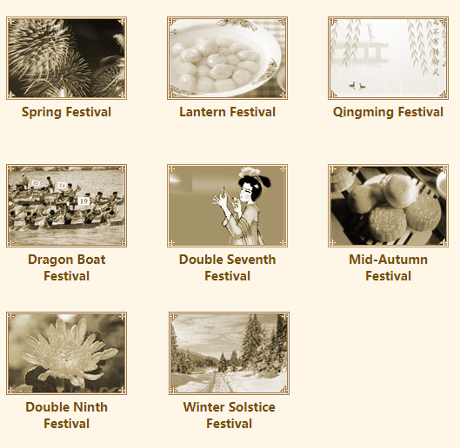
the 1st day of
the 1st lunar month
the 15th day of
the 1st lunar month
April 4-6 each year
the 5th day of
the 5th lunar month
the 7th day of
the 7th lunar month
the 15th day of
the 8th lunar month
each December 21 or 22

Slide 9
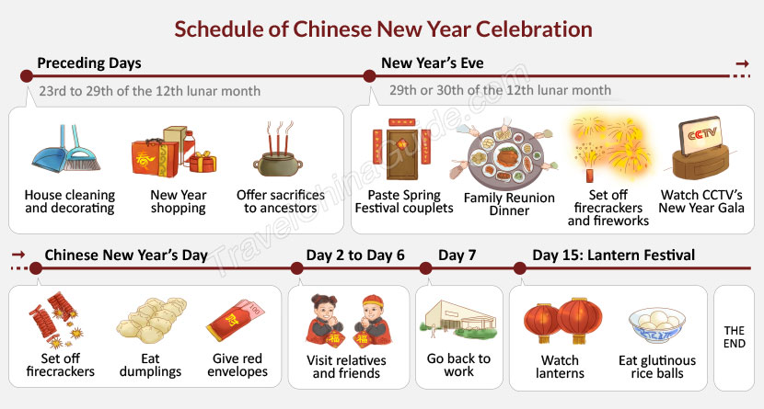
Time
Origin
Purpose
Celebrations
How would you introduce the Spring Festival to foreigners?

Slide 10
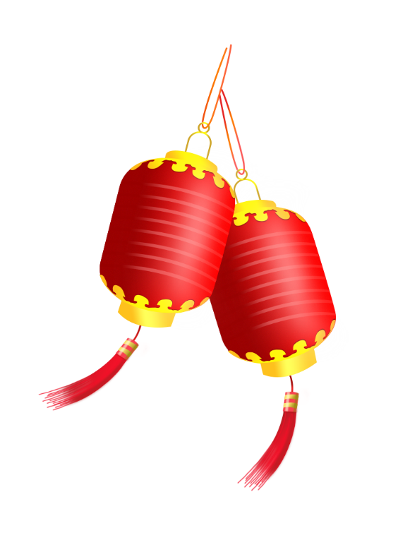
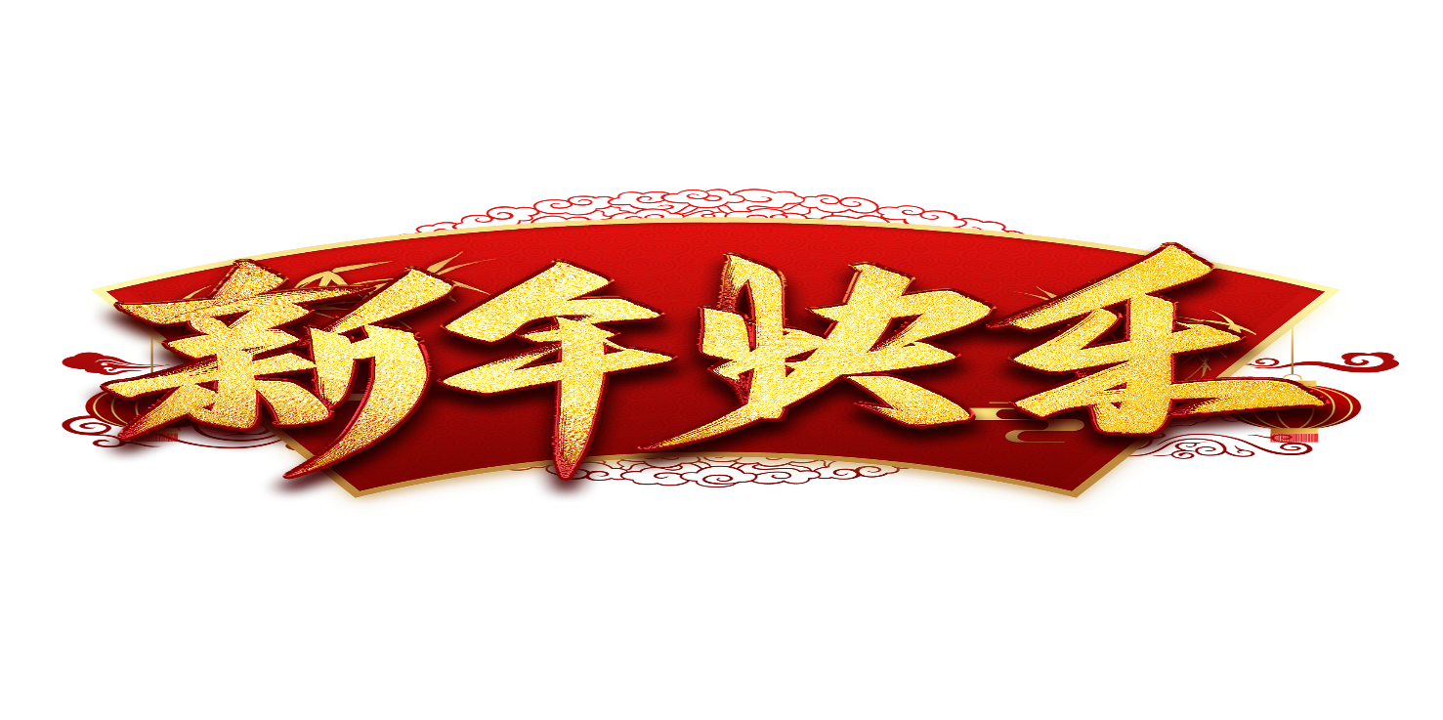
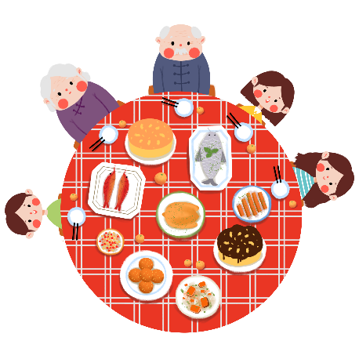
Put two or three points into one sentence
Time
the 1st day of the 1st lunar month
The Spring Festival, which falls on the 1st day of the 1st lunar month, was originally celebrated to scare away a fierce beast “Nian” and now to welcome the coming of spring and new life
/ and now regarded as a way for people to enjoy reunion
with their families however far they live or work.
was originally celebrated to scare away a fierce beast “Nian”
Origin/ Purpose
celebrates the coming of spring and new life
is now regarded as a way for people to enjoy reunion with their families however far they live or work
What to choose?
In what order?
Detailed or not?
Celebrations

Slide 11
A variety of activities involve/ include…
It is the most important time in a year when people…
, people… to get fully prepared/ make full preparations for the coming New Year
2. On New Year’s Eve
1. A few days before Chinese New Year
3 .On New Year’s Day
What to choose?
In what order?
Detailed or not?
, the children are looking forward to receiving lucky money, eating delicious dumplings, and setting off fireworks.
, people might…
4. During the Spring Festival

Slide 12
Put all the points in the right order (time, space, importance)
Delete less important information
A few days before Chinese New Year, people clean houses and go shopping to get fully prepared/ make full preparations for the coming New Year.
On New Year’s Eve, a variety of activities involve/ include pasting Spring couplets and setting off firecrackers and fireworks.
It is the most important time in a year when people enjoy family reunion dinner and watch New Year Gala on CCTV.
On New Year’s Day, the children are looking forward to receiving lucky money, eating delicious dumplings, and setting off fireworks.
During the Spring Festival, people might visit relatives and friends.

Slide 13
Time
The Spring Festival, which falls on the 1st day of the 1st lunar month, was originally celebrated to scare away a fierce beast “Nian” and now to welcome the coming of spring and new life / and now regarded as a way for people to enjoy reunion with their families however far they live or work.
Origin/ Purpose
On New Year’s Eve, a variety of activities involve/ include pasting Spring couplets and setting off firecrackers and fireworks. It is the most important time in a year when people enjoy family reunion dinner and watch New Year Gala on CCTV. On New Year’s Day, the children are looking forward to receiving lucky money, eating delicious dumplings, and setting off fireworks.
Celebrations

Slide 14

假定你是李华，你的美国朋友Mike想了解中国的春节，请你给他写封email介绍这个节日。要点如下：
1)春节的时间、由来及寓意;
2)春节的庆祝活动;
3)邀请他到来中国欢度春节。
注意：
1)词数80左右;
2)可以适当增加细节，以使行文连贯;
3)开头和结尾已为你写好。

Slide 15
Dear Mike,
In your last letter, you mentioned that you want to know something about the Spring Festival. I am writing to tell you about it.
I hope you will come here and experience this wonderful festival.
Yours,
Li Hua
The Spring Festival, which falls on the 1st day of the 1st lunar month, was originally celebrated to scare away a fierce beast “Nian” and now to welcome the coming of spring and new life. It is the most important time in a year when people enjoy family reunion dinner and watch New Year Gala on CCTV. On New Year’s Day, the children are looking forward to receiving lucky money, eating delicious dumplings, and setting off fireworks.
Notes:
文章很好，但远超80字，还要精简。

Slide 16
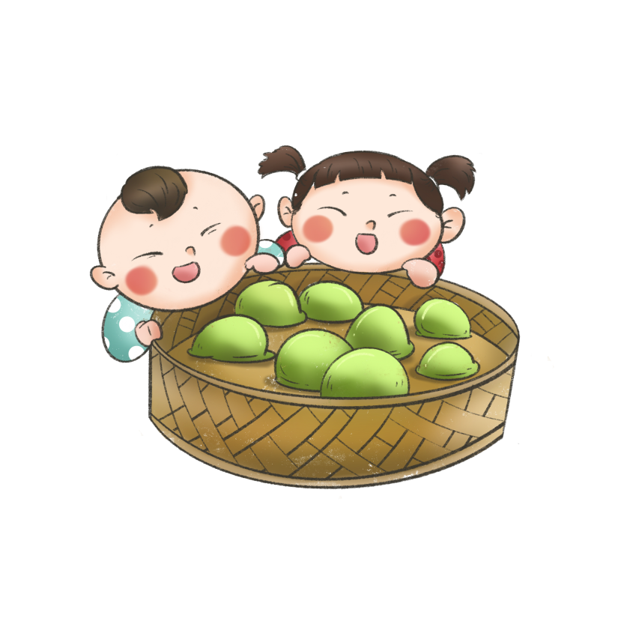
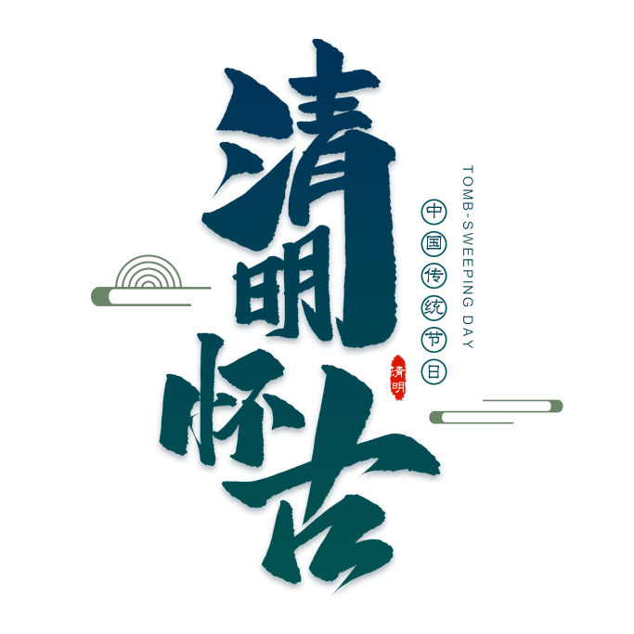
假定你是李华，你的美国朋友Linda对中国
文化和习俗很感兴趣，近日她给你写信询问清明
节的信息，请你给她写封email介绍这个节日。
要点如下：
1)清明节的时间及寓意;
2)清明节的习俗;
注意：
1)词数80左右;
2)可以适当增加细节，以使行文连贯;
3)开头和结尾已为你写好。
Notes:
请提供一篇范文。

Slide 17
Dear Linda,
In your last letter, you mentioned that you want to know something about the Qingming Festival. I am writing to tell you about it.
I hope you will come here and experience this wonderful festival.
Yours,
Li Hua
The Qingming Festival, which falls on April 4-6 each year, is celebrated to be in memory of those late ancestors and to experience the refreshing early spring. It is considered one of the 24 solar terms, a perfect combination of nature and humanity. On this day, we Chinese often sweep the tombs of ancestors, go spring outing and eat traditional green rice balls called Qingtuan.
Notes:
文章很好，但远超80字，还要精简。

