Slide 1

感恩遇见，相互成就，本课件资料仅供您个人参考、教学使用，严禁自行在网络传播，违者依知识产权法追究法律责任。
更多教学资源请关注
公众号：溯恩高中英语
知识产权声明

Slide 2

The Week
Mar 26th-Apr 1st, 2022

Slide 3
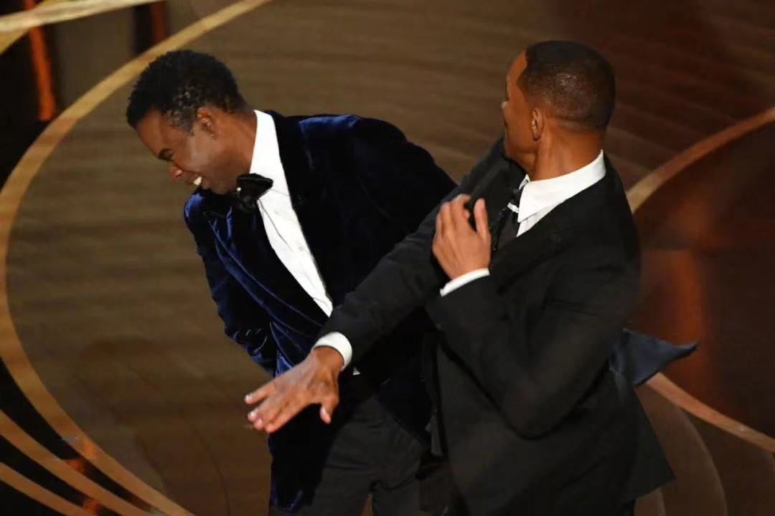
1. A slap interrupts a star-filled night
奥斯卡颁奖礼 史皇怒扇主持人巴掌
Will Smith slaps Chris Rock after a joke. Smith later won best actor.

Slide 4
阅读理解
（《华盛顿邮报》 2022年3月28日 C1版面）
The most ________ (shock) moment of the 94th Academy Awards included two _________ (celebrity). After Chris Rock made a joke comparing Jada Pinkett Smith’s looks to “GI Jane,” her husband Will Smith _______ (storm) onto stage where he appeared to slap the comedian. Smith appeared to be screaming “Keep my wife’s name out your mouth!” according to reporters on the scene. “That was ... uh ... greatest night in the history of television,” Rock quipped soon after.
Moments _____ (late), Smith finally won his first best actor award for portraying Richard Williams, father and coach of Venus and Serena. With tears _________ (stream) down his face, Smith gave ___ somewhat rambling speech in which he apologized to the academy and his fellow nominees, at one point seeming __________ (compare) himself to the man he portrayed, ____ he said was “a fierce defender of his family.” “Love will make you do crazy things,” Smith said. _______ (notable), he did not apologize to Rock.
Aside _____ spontaneous acts of violence, the show was something of a return to form.
shocking
celebrities
stormed
later
streaming
a
to compare
who
Notably
from

Slide 5
词汇讲解
1. quip: to make a quick and clever remark 讲俏皮话；讥讽；打趣
“He’ll have to go on a diet,” Ballard quipped.
“他得减肥啦，”巴拉德俏皮地说。
2. spontaneous: not planned but done because you suddenly want to do it
自发的；非筹划安排的
The comment was completely spontaneous. 评论完全是自发的。
翻译句子
他风趣地说，他宁可卖掉他的航空公司，也不愿出售他的计算机系统。
He quipped that he would rather sell his airline than his computer systems.
翻译句子
我跟着也自然而然地鼓起掌来。
I joined in the spontaneous applause.

Slide 6
长难句分析
With tears streaming down his face, Smith gave a somewhat rambling speech in which he apologized to the academy and his fellow nominees, at one point seeming to compare himself to the man he portrayed, who he said was “a fierce defender of his family.”
分析：本句是一个复合句，“With tears streaming down his face”是______________________，“seeming to... he portrayed”是_______________________；“in which he... nominees”是_________，修饰先行词______；“he portrayed”是_________，修饰先行词_______；“who he said was “a fierce defender of his family””是_________，修饰先行词_______，其中“he said”是________。
with结构短语作伴随状语
现在分词短语作伴随状语
定语从句
speech
定语从句
the man
定语从句
the man
插入语
翻译
史密斯泪流满面，发表了一段有点漫无边际的获奖感言，并向学院和其他提名者道歉，讲到某一刻时似乎将自己与他扮演的角色进行比较，他说他是“家人的坚定捍卫者。”

Slide 7

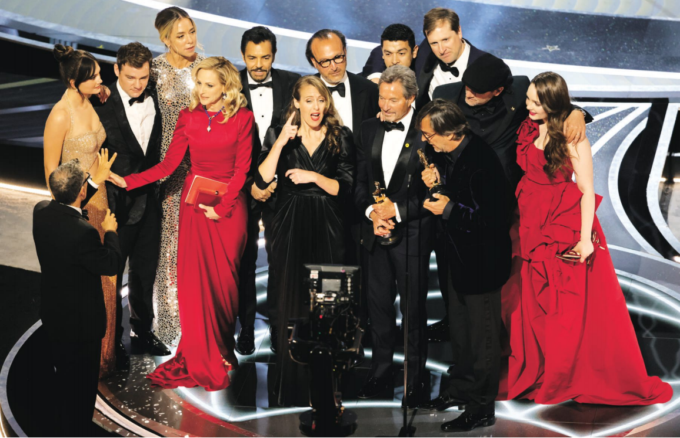
The cast of Apple TV Plus’s “CODA” accept the award for best picture at the Academy Awards.

Slide 8

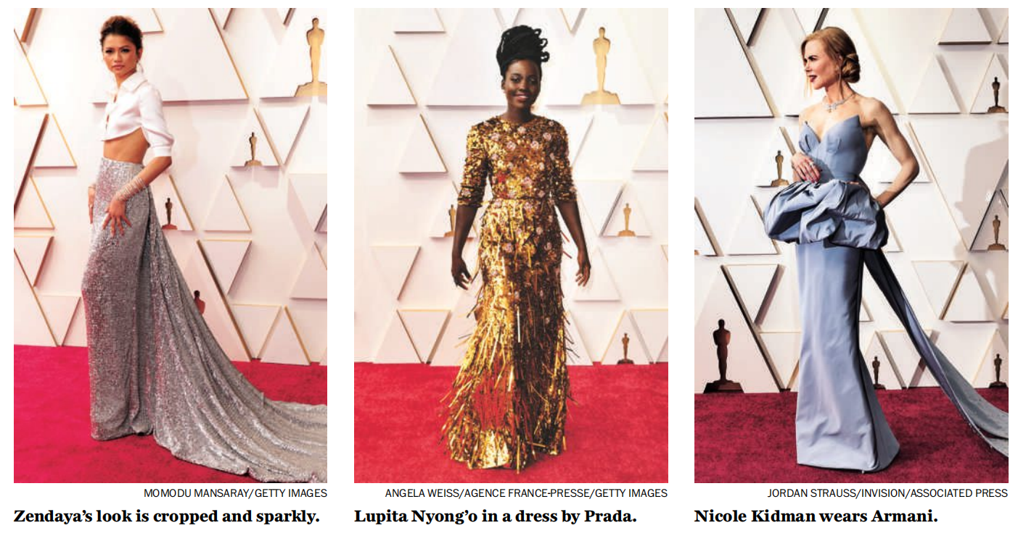

Slide 9
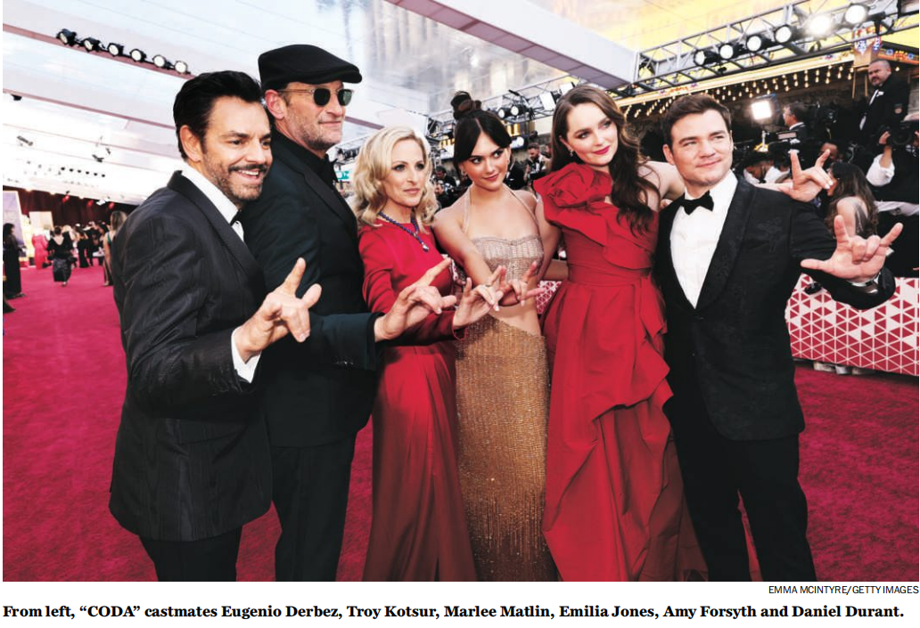

Slide 10

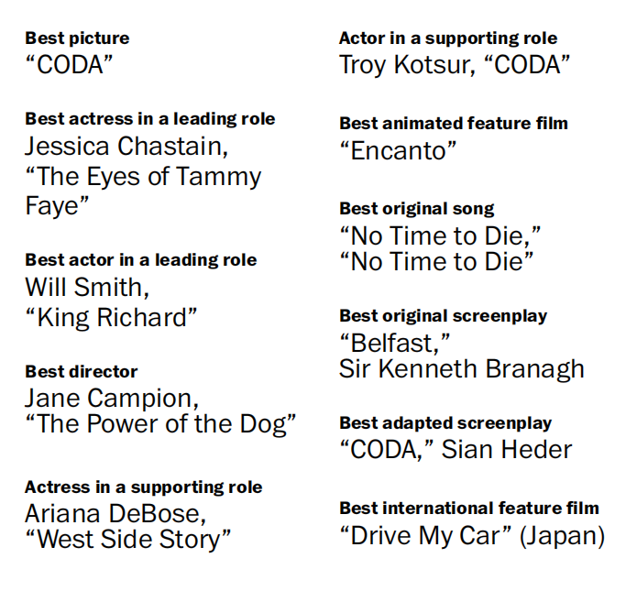
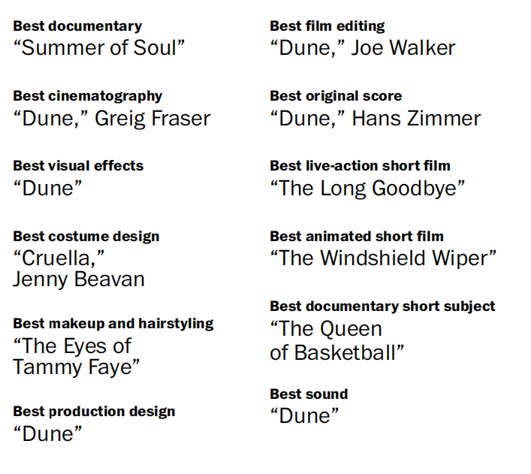

Slide 11
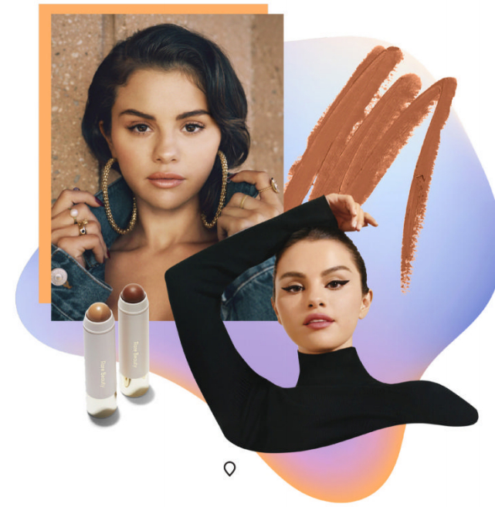
2. Cause & Effect
傻脸娜进军美妆界，致力于慈善事业
With Rare Beauty, Selena Gomez added entrepreneur to her pop-star-producer-actor résumé. She also wrote a new script for how a beauty start-up can create impact far beyond its blushes and balms.

Slide 12
阅读理解
（《诱惑力》2022年3月版 34页）
Allure
THERE ARE BEAUTY BRANDS THAT give back—and then there are brands that are created with a specific philanthropic mission at their core. There aren’t many in that second group and even fewer are driven by a global superstar. But when Selena Gomez founded Rare Beauty in 2020, she was passionate about it bringing the world more than silky lip colors and cushiony blushes (though she certainly does that well). “I have bipolar [disorder] and I’m not afraid to say that’s something I deal with. That’s something that I live with,” she told us on a recent call. “I’m gonna take [my experience] and create a space for other girls and boys—whoever they identify as—[so] they don’t go through what I’ve gone through.”
Founded alongside Gomez’s makeup brand was her nonprofit, the Rare Impact Fund. Rare Beauty donates 1 percent of all sales (yes, that’s gross, not net) to the fund, which is dedicated to breaking mental health stigmas and providing communities with resources. In its first year, the Rare Impact Fund gave $1.2 million in grants to eight mental health and education-focused organizations, including the Yale Center for Emotional Intelligence and Didi Hirsch Mental Health Services. These groups provide services such as suicide prevention training and mentoring programs. “Helping young people gain access to mental health resources is exactly why we created the [fund],” says Gomez.
A large part of Gomez’s fan base is Gen Z and over 40 percent of that population has experienced increased mental health struggles during the pandemic, according to a survey by the American Psychological Association. As difficult as this time has been, “an interesting silver lining is that [the pandemic] gave people permission to finally talk about mental health,” says Cohen. Gomez, who bravely opened up several years ago about her own mental health, is there to help lead the conversation, with equal parts conviction and compassion. In addition to monetary contributions, the Rare Impact Fund is committed to creating community events that open the door for honest discussions. “I’ve been able to join a couple [virtually] and what’s so beautiful is that people are so open, and strangers are expressing how they feel,” says Gomez.
While Gomez has become a powerful voice in the historically silenced world of mental illness, she often finds that the most meaningful support doesn’t involve uttering a word. “When I’m talking to someone who’s struggling, the first thing I do is just listen. That’s all I want—to be heard,” she says. Listening to Gomez, one thing is especially clear: She has a vision for what the future of philanthropy in the beauty industry can look like. “I don’t want to be someone that people look up to because I wear pretty dresses and I like to sing,” she says. “I want to be remembered as someone who cares. I care a lot— and that’s what I want to do with my platform.”

Slide 13

阅读理解
1. Why did Selena Gomez found the Rare Impact Fund?
A. She desired to make more money to achieve her dream.
B. She wanted to promote her makeup brand Rare Beauty.
C. She was interested in setting up nonprofit organizations.
D. She hoped to offer assistance to those with mental illness.
细节理解
2.What does the underlined word “silver lining” in Paragraph 3 mean?
A. lucky part B. important factor C. positive side D. effective measure
词义猜测
3. Which of the following words can best describe Selena Gomez?
A. Hard-working and intelligent B. Ambitious and caring
C. Creative and honest D. Independent and responsible
推理判断

Slide 14
词汇讲解
1. stigma: feelings of disapproval that people have about particular illnesses or ways of behaving 耻辱；羞耻
There is still a stigma attached to cancer. 癌症仍被人看作是见不得人的事。
2. conviction: a strong opinion or belief 坚定的看法（或信念）
She was motivated by deep religious conviction.
她的行动是出于虔诚的宗教信仰。
翻译句子
离婚不再是什么丢脸的事。
There is no longer any stigma attached to being divorced.
翻译句子
我们坚信已经向前迈进了一步。
It is our firm conviction that a step forward has been taken.

Slide 15
句子翻译
Rare Beauty donates 1 percent of all sales to the fund, which is dedicated to breaking mental health stigmas and providing communities with resources.
Rare Beauty将销售额的1% 捐赠给该基金，该基金致力于打破心理健康的污名，并为社区提供资源。
翻译
Gomez, who bravely opened up several years ago about her own mental health, is there to help lead the conversation, with equal parts conviction and compassion.
几年前，戈麦斯勇敢地公开了自己的心理健康状况，她以同样的信念和同情心帮助引导对话。
翻译

Slide 16
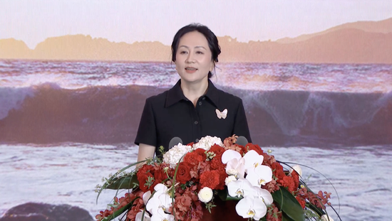
3. Huawei Finance Chief Returns to Spotlight
华为首席财务官重返聚光灯下

Slide 17
语篇填空
（《华尔街日报》2022年3月29日 B3版面）
Months after returning home to a hero’s welcome in China, Huawei Technologies Co. Chief Financial Officer Meng Wanzhou was back ____ the spotlight Monday: This time, she was in more familiar surroundings, taking the stage at Huawei’s headquarters to deliver the company’s ________ (close) watched annual results.
Speaking in Mandarin and _____________ (accompany) by an interpreter, Ms. Meng offered few details about her life back at the company helm in Shenzhen, ____ said the company’s cash flow has improved to make Huawei“____________ (capable) of dealing with uncertainty.”
With the company giving an update on finances Monday, she ______ (take) the lead at a press conference, unveiling ___ mixed slate of figures that show the tech giant is working to reboot in the face of long-running U.S. ____________ (restrict). Huawei’s global sales revenue reached 636.8 billion yuan and net profit rose 76% to a record 113.7 billion yuan.
Huawei’s enterprise business unit, ______ sells an array of software and other technology to businesses and governments, grew 2.1%. After __________ (decline) in 2020, the company’s cash and short term investments rose 17% to about $65 billion.“Huawei’s overall financial position is sound,”Ms. Meng said.
in
closely
accompanied
but
more capable
took
a
restrictions
which
declining

Slide 18
词汇讲解 1
1. unveil: to show or introduce a new plan, product, etc. 介绍；将…公之于众
They will be unveiling their new models at the Motor Show.
他们将在汽车大展上首次推出自己的新型汽车。
2. reboot: to switch sth. off and then start it again 重新启动
The install requests that you reboot.
安装程序要求您重新启动。
翻译句子
他将要公布对伊政策的新计划。
He has promised to unveil a new plan for Iraq.
翻译句子
我必须要重启大脑换种思路。
I’ve got to reboot my brain.

Slide 19
词汇讲解 2
1. revenue: the money that a government receives from taxes or that an organization, etc. receives from its business 财政收入；税收收入；收益
The Japanese market accounts for 35% of the company's revenue.
日本市场占该公司收入的35%。
2. sound: in good condition or healthy 健康的; 状况良好的
When we bought the house, it was structurally sound.
当我们买下这房子时，其结构完好无损。
翻译句子
这份合约相当于公司20%的年收入。
This contract represents 20% of the company's annual revenue.
翻译句子
他们安然无恙地出现了。
They turned up safe and sound.

Slide 20
选词填空
用以下的适当形式完成句子。
1. They pay him around $2 million _______ .
2. We _________ the number of students per class to 10.
3. Ken agreed to ___________ me on a trip to Africa.
4. Exposure to ultraviolet light is _________ linked to skin cancer.
5. The figures represent a general _________ in employment.
6. Anne was intelligent and __________ of passing her exams with ease.
closely accompany capable
restrict net decline
net
restricted
accompany
closely
decline
capable

Slide 21
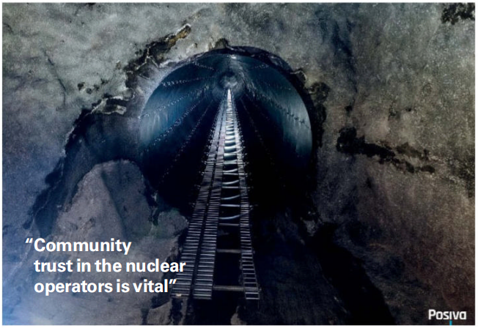
4. The UK’s nuclear waste and the geological solution 英国的核废料及其解决方案
The best way to deal with Britain’s radioactive waste is to bury it deep underground, says the government and scientific community. New Scientist asked a panel of experts to discuss the scientific, engineering and social challenges ahead.

Slide 22
语篇填空
（《新科学家》2022年3月刊 16-17页）
since
The UK has produced radioactive waste ______ the dawn of the nuclear age some 70 years ago. The waste comes from nuclear power stations, medical and industrial ________ (facility) and the defence programme. Some of the _______ (high) activity waste will take tens of thousands of years to decay and is currently stored above ground in around 20 secure facilities, _______ cost billions of pounds to maintain. Within the next 100 years, the total amount ___________ (expect) to fill a volume of almost 250,000 cubic metres.
In the early 2000s, the UK government set out to find the solution and _______ (agree) on disposing of the material in a geological disposal facility (GDF). There is international consensus here – other facilities have already been built in the US, and construction of another is underway in Finland.
The facility would be designed to _________ (secure) lock away the waste, protecting future generations against any radiation hazard and ________ (free) them from the commitment to deal with it themselves. A key part of the plan is ________ (find) a community willing to host this facility and several in Cumbria and Lincolnshire are currently discussing the possibility.
A key part of this process is building trust between nuclear operators and local people. Of course, there is always the potential _____ accidents. In 2014, a geological disposal facility in New Mexico in the US experienced a radiation leak.
facilities
higher
which
is expected
agreed
securely
freeing
to find
for

Slide 23
词汇讲解
1. decay: to be destroyed gradually by natural processes （使）腐烂，腐朽
The unoccupied house started to decay.
无人居住的房子开始衰败。
2. consensus: an opinion that all members of a group agree with 一致意见；共识
There seems to be a consensus that the plan should be rejected.
看来人们一致同意放弃这一计划。
翻译句子
埋在细灰里的尸体慢慢腐烂了。
The bodies buried in the fine ash slowly decayed.
翻译句子
对这个问题的看法日趋一致。
There is a growing consensus of opinion on this issue.

Slide 24
长难句分析 1
Some of the higher activity waste will take tens of thousands of years to decay and is currently stored above ground in around 20 secure facilities, which cost billions of pounds to maintain.
分析：本句是一个复合句，整体是一个_____________从句，主句的主语是____________________________，谓语是__________________________ 。
从句中的which指_________________。
非限定性定语
Some of the higher activity waste
will take 和 is currently stored
20 secure facilities
翻译
一些高活性废物需要数万年才能腐烂，目前储存在地面上的大约20个安全设施中，这些设施的维护成本高达数十亿英镑。

Slide 25
长难句分析 2
The facility would be designed to securely lock away the waste, protecting future generations against any radiation hazard and freeing them from the commitment to deal with it themselves.
分析：本句是一个简单句，本句的主语是____________，谓语是________________，__________________________ 和 _______________
是结果状语。
The facility
would be designed
protecting future generations...
freeing them from...
翻译
该设施将被设计成能够安全锁住核废料，保护后代免受任何辐射危害，并让他们不必承担自己处理核废料的责任。

Slide 26

5. BBC新闻听写填空 03/29/22

Slide 27

BBC News 03/29/22
听力填空
BBC News. An unprecedented day of NATO, EU, and G7 summits in Brussels, —_______ by Russia’s invasion of Ukraine, has produced __________________ among western leaders. President Biden and the European Commission President Ursula von der Leyen said they were ______ in response to what they called “Russia’s unjustified and unprovoked war”. Ukraine has _______ Russian forces of shelling checkpoints in a town which is home to staff at the Chernobyl _________________. It said the bombardment prevented _____________________ to and from the decommissioned power station. A top advisor to President Zelenskyy says his country’s troops have destroyed the Russian army’s forward command post in southern Ukraine, the scene of the ______________. Aleksey Arestovich claimed Russian offensives all over Ukraine had ground to a halt.
Ethiopia has declared an indefinite ___________ truce (停战), which it says will allow ___ to get to the Tigray region. Rebels there have not responded to the announcement. No aid trucks have reached Tigray since mid-December, and _______ have been blocked during 16 months of civil war.
sparked
a display of solidarity
united
accused
nuclear power plant
the movement of workers
fiercest fighting
humanitarian
aid
supplies

Slide 28
词汇讲解
1. unprecedented: never done or known before
前所未有的；空前的；没有先例的
In 1987 the Socialists took the unprecedented step of appointing a civilian to command the force.
1987年，社会党人史无前例地任命了一位非军队出身的人来指挥军队。
2. indefinite: lasting for an unknown or unstated length of time 无限期的
The trial was adjourned for an indefinite period. 审判被无限期推迟。
翻译句子
这种做法很罕见，但也不是没有先例的。
Such a move is rare, but not unprecedented.
翻译句子
他们可能面临无限期拘留。
They may face indefinite detention.

Slide 29
熟词生义讲解
1. shell: To shell a place means to fire explosive shells at it. 炮轰;炮击
The rebels shelled the densely-populated suburbs near the port.
叛乱者炮轰了港口附近人口密集的郊区。
2. grind: If a country’s economy or something such as a process grinds to a halt, it gradually becomes slower or less active until it stops. 逐渐停止；慢慢瘫痪
The peace process has ground to a halt while Israel struggles to form a new government.
当以色列竭力组建新政府的时候，和平进程已经陷于停顿。
翻译句子
该镇在战斗中遭到炮击。
The town was shelled during the battle.
翻译句子
公共汽车在拐角处停了下来，有人下车。
The bus ground to a halt at the corner and someone got off.

