Slide 1

感恩遇见，相互成就，本课件资料仅供您个人参考、教学使用，严禁自行在网络传播，违者依知识产权法追究法律责任。
更多教学资源请关注
公众号：溯恩高中英语
知识产权声明

Slide 2
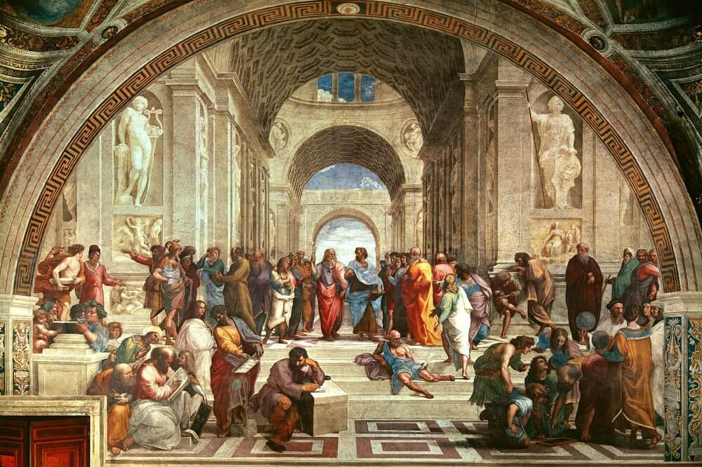
S3U1 ART
Reading and Thinking
A Short History of Western Painting
桐乡市高级中学 俞莺婕

Slide 3
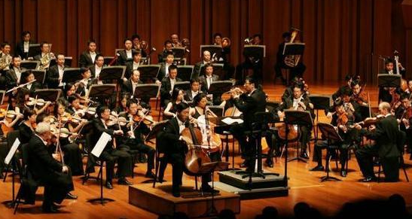
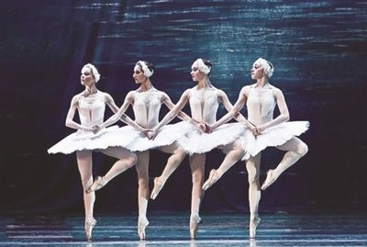
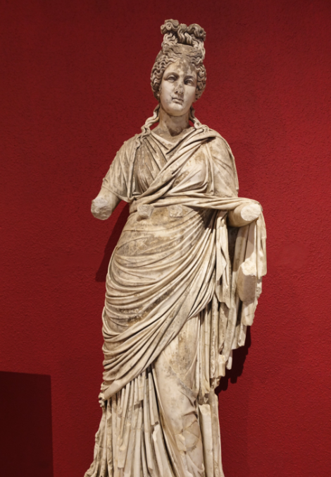
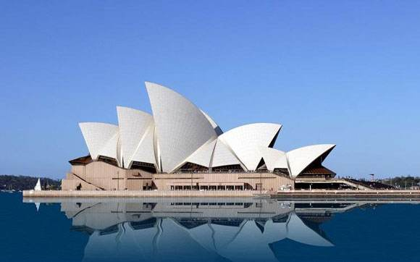
Activity 1 Get to know art and art forms
What do you think is art?
Can you list some art forms?
music
dance
sculpture
architecture

Slide 4
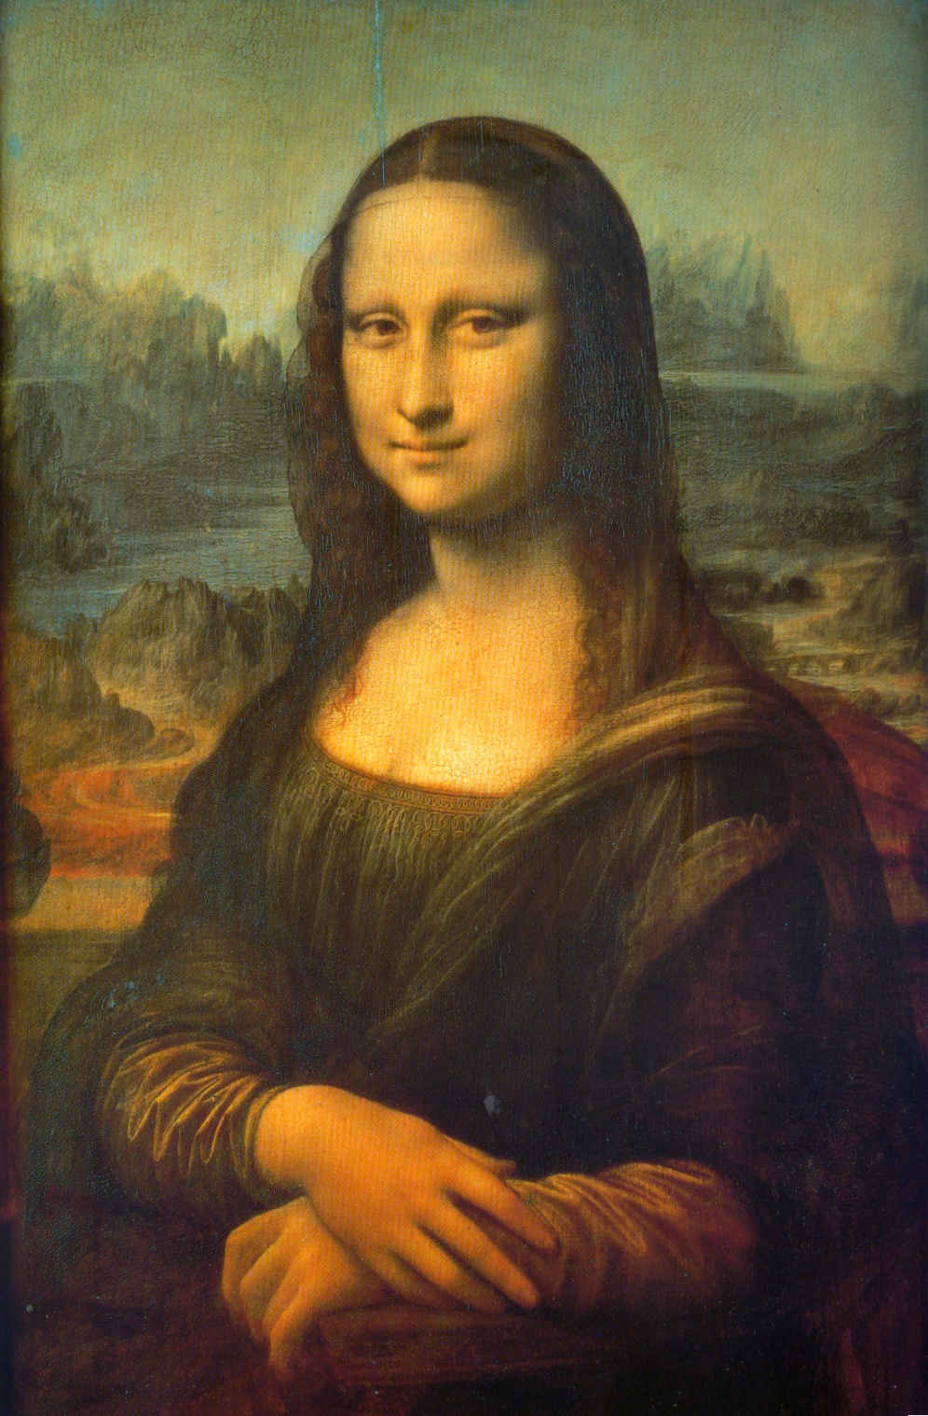
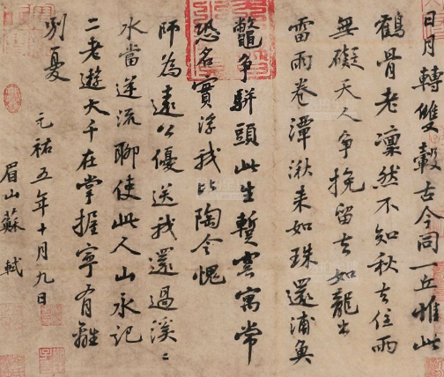
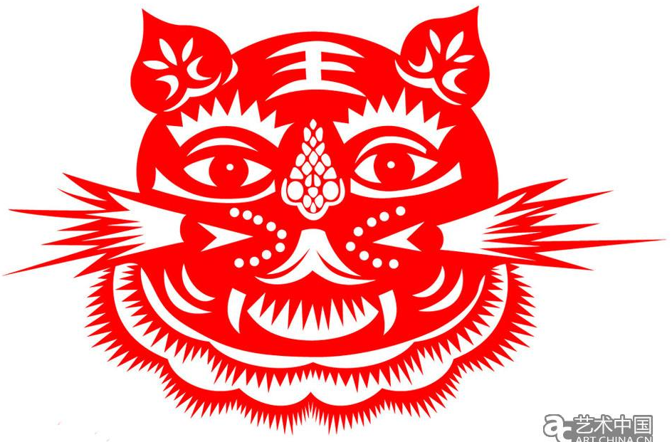


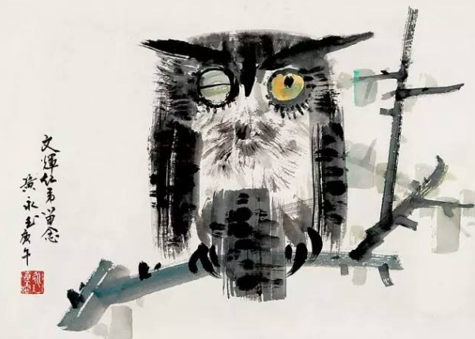
Activity 1 Lead in
painting
calligraphy
paper cutting
photography
Chinese-style Paintings
Western-style Paintings

Slide 5
Activity 2 Read the title and subtitles for main idea
The text mainly tells us _____ major styles of _______________ , showing the __________________ of it.
four
Western paintings
development/history
Part 1(Para.1) A．The Renaissance
Part 2(Para. 2) B．The Middle Ages
Part 3(Paras. 3～5) C．Introduction
Part 4(Paras. 6～7) D．Modern Art
Part 5(Para. 8) E．Impressionism
What functions do the subtitles serve?
To clearly show the structure of the text

Slide 6
Activity 3 Read for detailed information
Para1 Introduction
accurate
(1)What is western art?
(2)What is the best way to understand it?
It’s hard to give a precise definition.
There are many different styles of western art.
The best way to understand western art is to look at the development of it over the centuries.

Slide 7
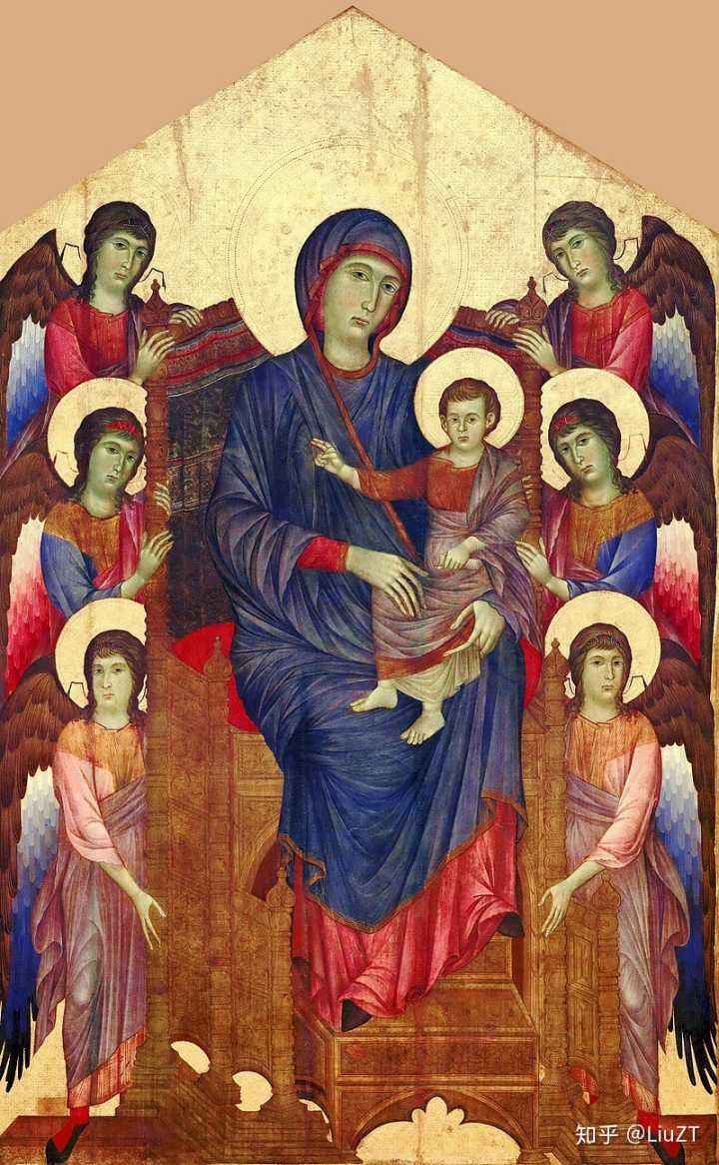
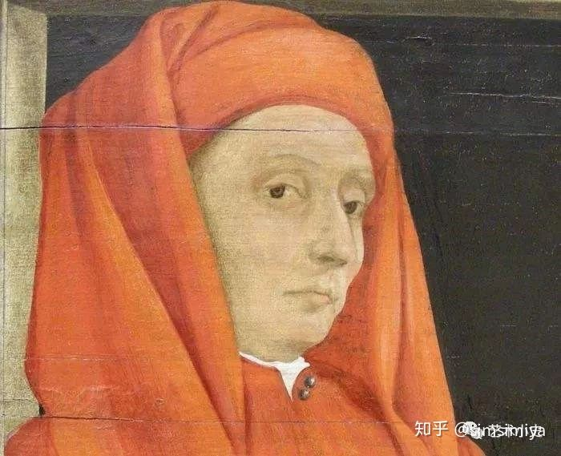
Activity 3 Read for detailed information
Para2 The Middle Ages
(1)the purpose of the western art:
(2)the features of the paintings:
(3) famous artist(s):
To teach people about Christianity
primitive and two-dimensional
Main characters were made much larger than everyone else.
In the 13th century, paintings showed real people in a real environment with realistic human faces and deep emotional impact
Giotto di Bondone(乔托迪邦多纳)

Slide 8
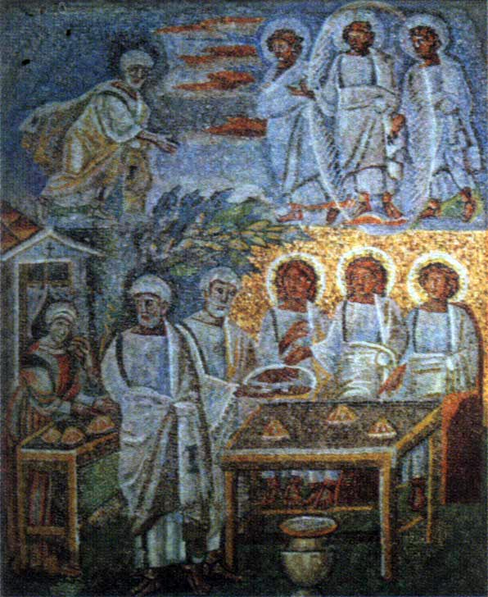
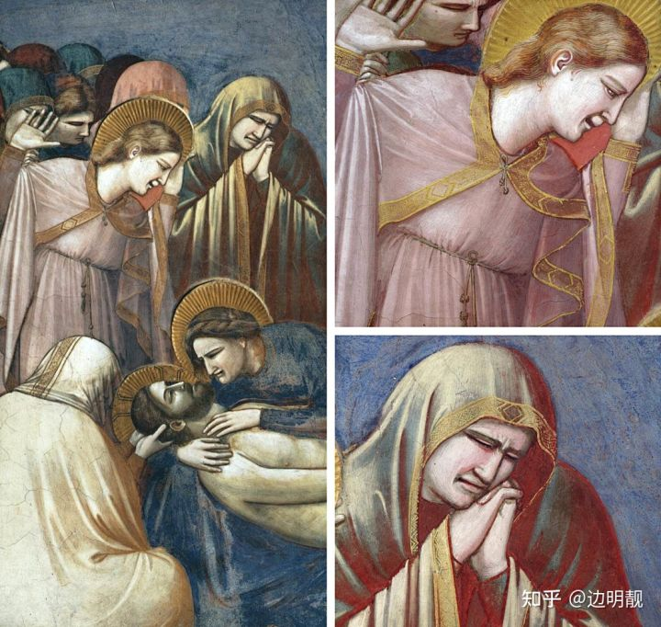
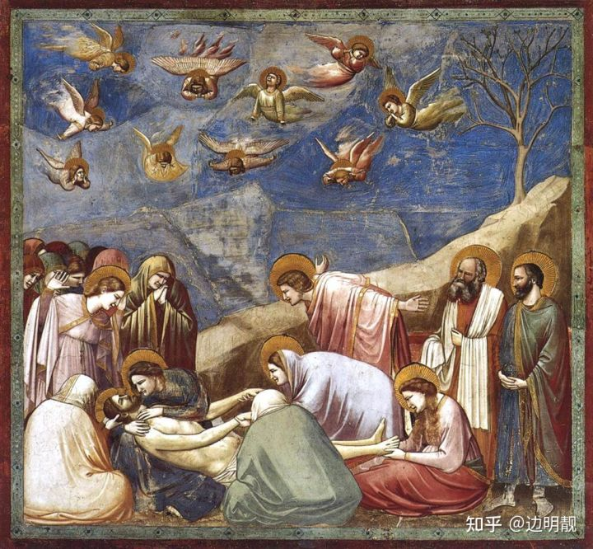

Which one is more realistic?
The Mourning of Christ (哀悼基督)

Slide 9
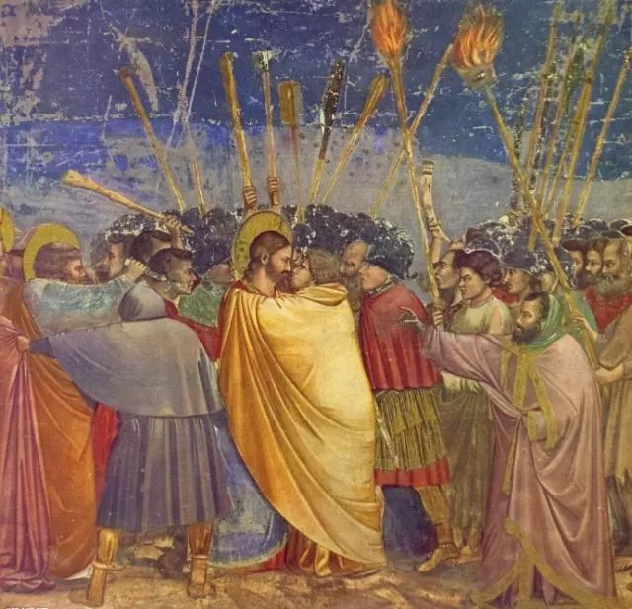
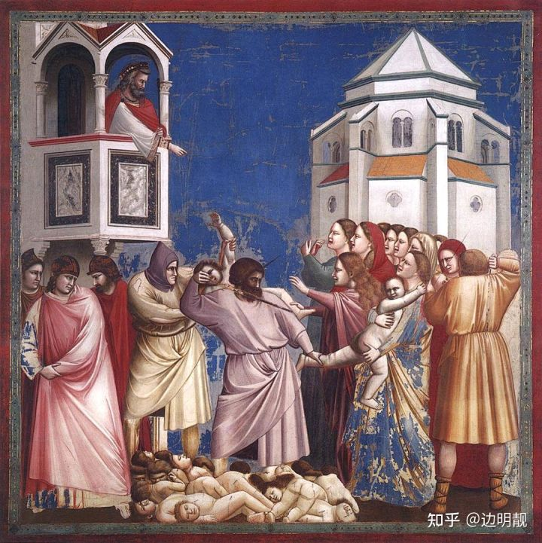
Works of Giotto di Bondone
Kiss of Judas
犹大之吻
The Massacre of the Innocents无辜者的大屠杀

Slide 10
Activity 3 Read for detailed information
Para3-5 The Renaissance
(1)Why didn’t painters focus more on religion at this period?
Because new ideas and values gradually replaced the old ones from the middle ages.
(2)What are the features of paintings ?
subject: shifted from ________________ to ________________________________
adopt __________________________________
accurate pictures of people’s portraits and important _______ events
Two breakthroughs:________________________
religious themes
people and the world around us
a more humanistic attitude to life
historical
perspective
oil paints
(3)famous artist(s):
Masaccio，Leonardo da Vinci，Michelangelo，Raphael，Rembrandt

Slide 11
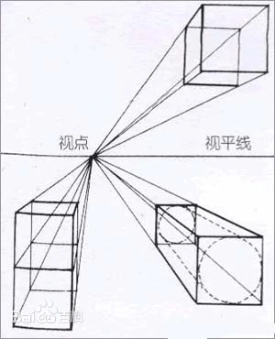
Perspective （透视法）
It is the art of creating an effect of depth and distance
in a picture by presenting people and things as being smaller than those are nearer the front.
School of Athens by Raphael

Slide 12
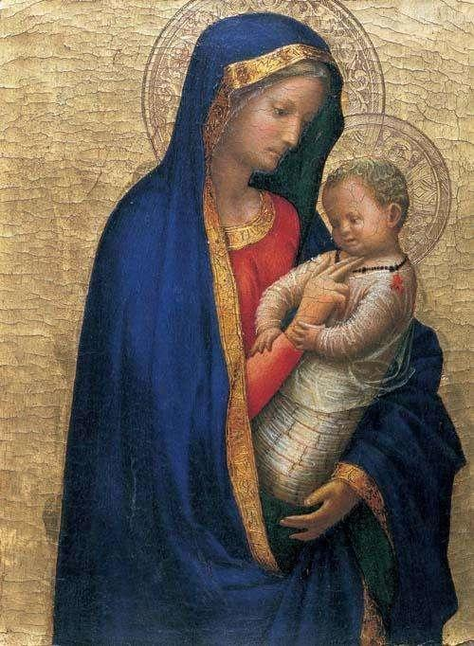
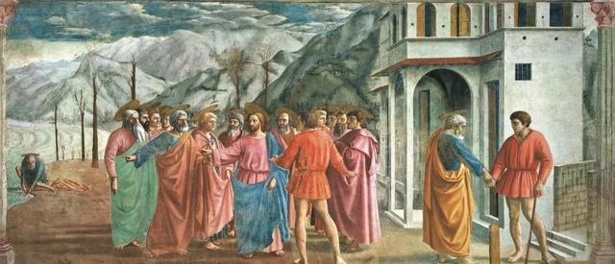
Works of Masaccio
The Tribute Money
纳税银
Madonna And Child
圣母子

Slide 13
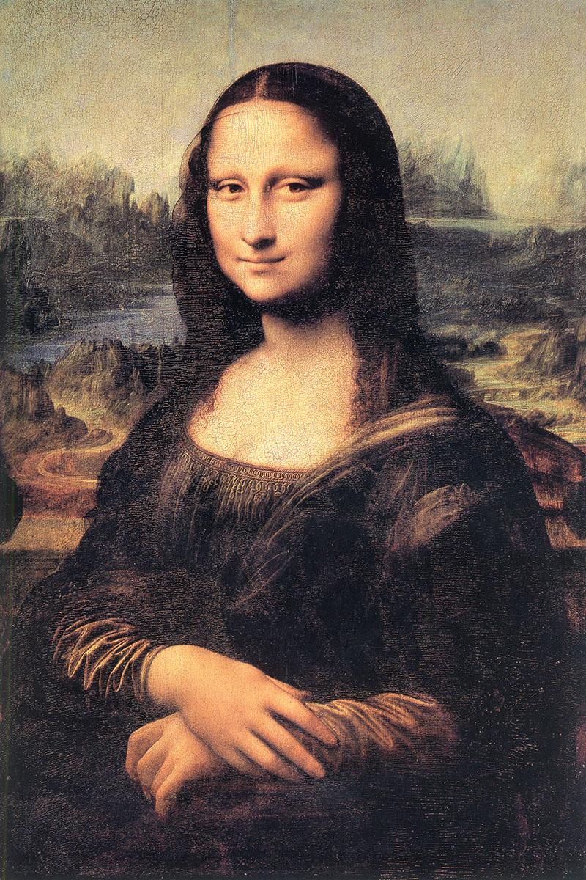
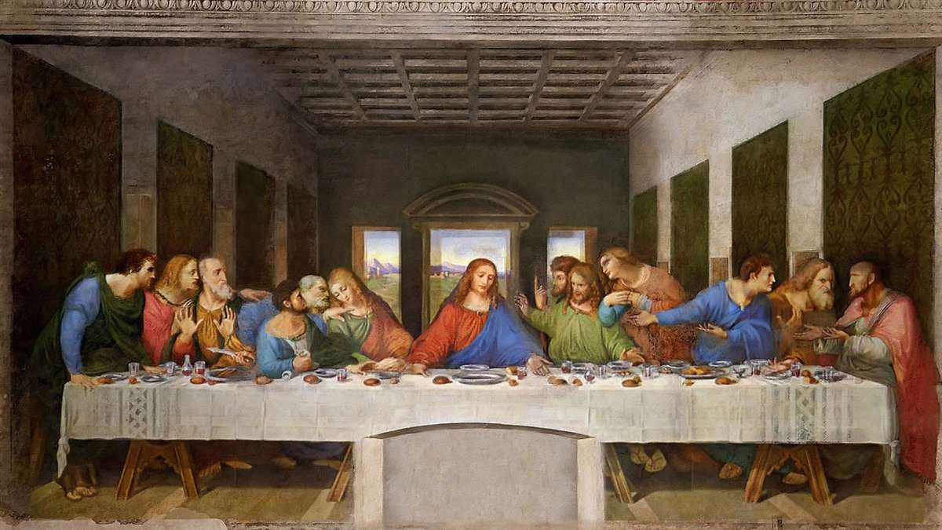
Works of Leonardo da Vinci

Slide 14
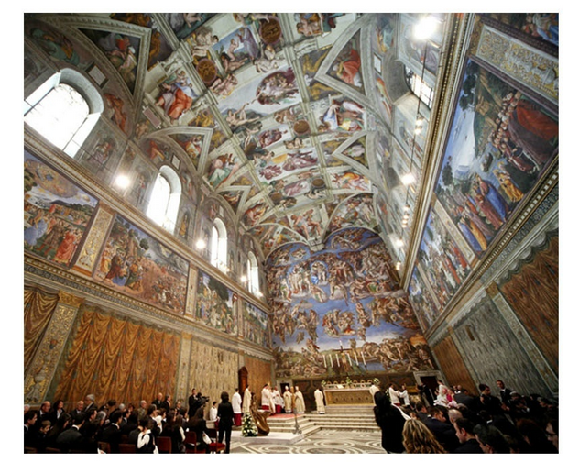
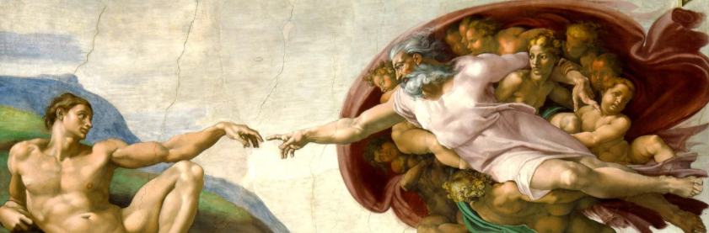
Works of Michelangelo

Slide 15
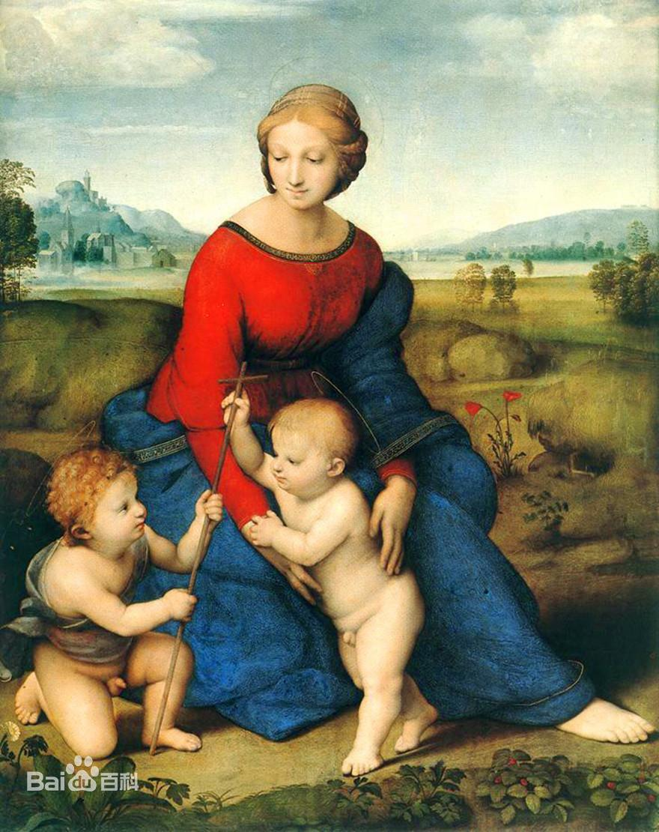
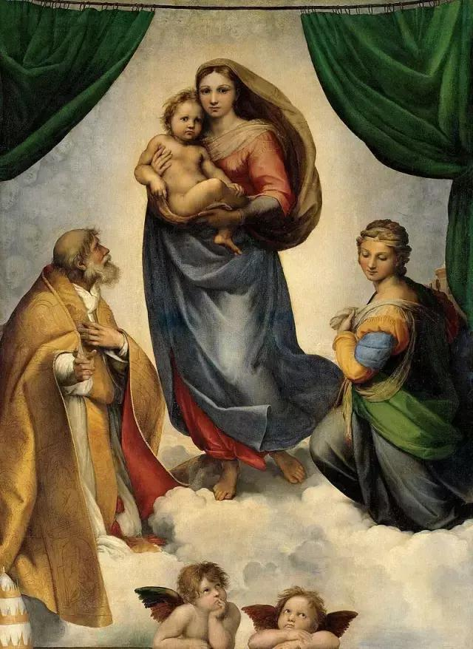
Works of Raphael
Madonna of the Meadow
草地上的圣母
Sistine Madonna
西斯廷圣母

Slide 16
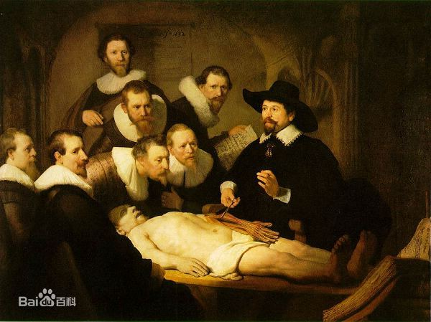
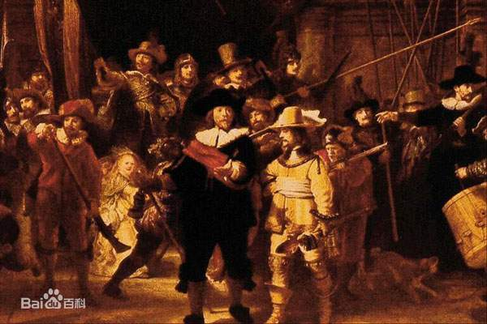
Works of Rembrandt
The Anatomy Lessonof Dr.Tulp
杜普教授的解剖学课
The Night Watch
夜巡

Slide 17
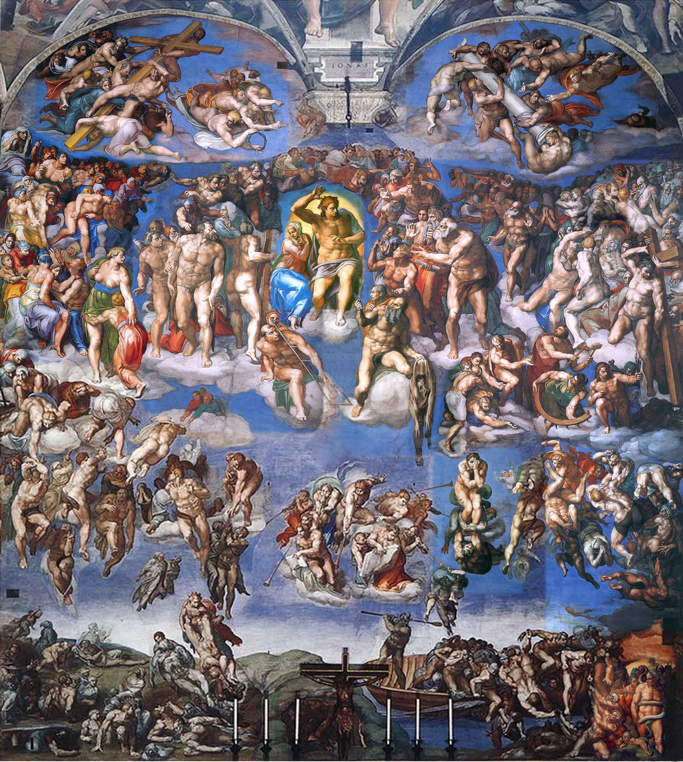
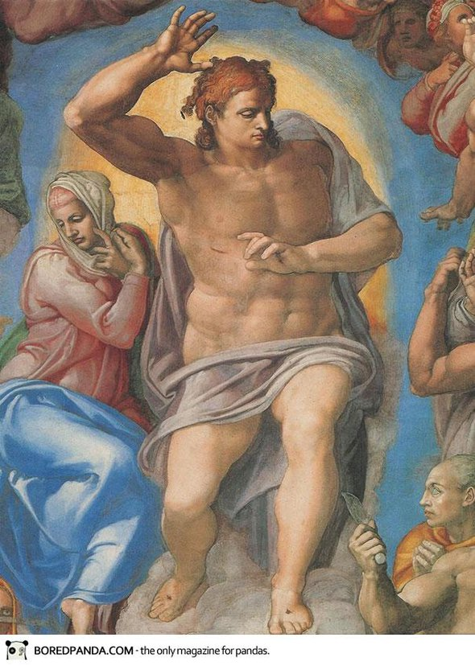
如果画面上的人全都帅哥美女，还都很健美，而且还人靠着人的话，那就是米开朗基罗。

Slide 18
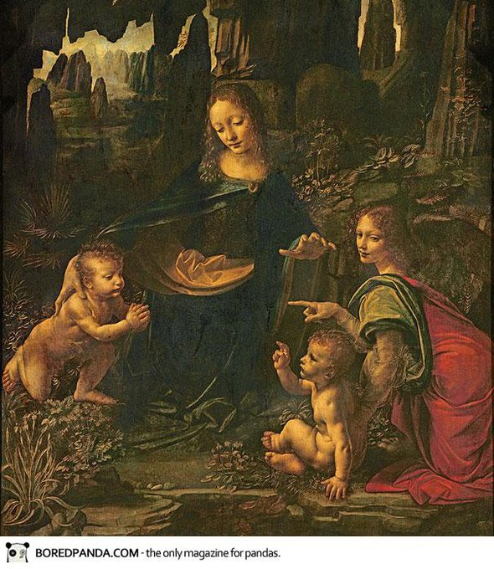
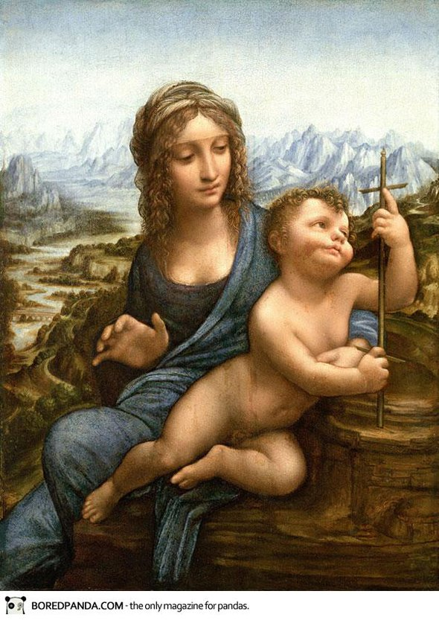
如果背景像《指环王》里一样壮阔，却笼罩着乖乖的蓝色迷雾；圣母玛利亚总有着同样的卷发与贵族式的鼻子，那是达芬奇。

Slide 19
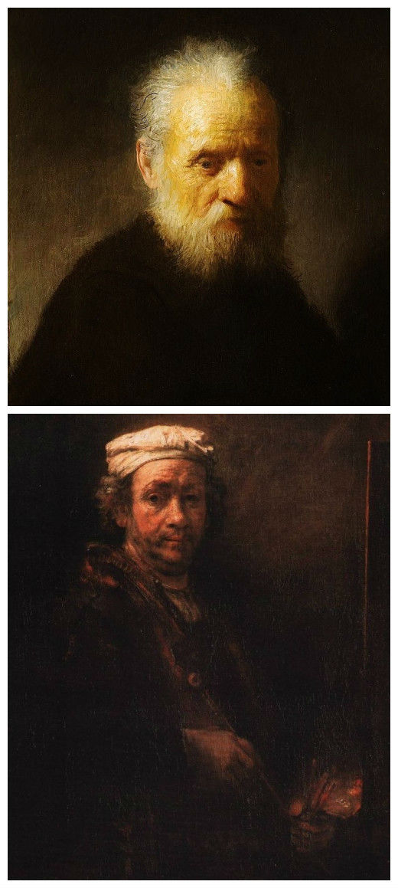
如果把什么人都画得像只有一盏小蜡烛下的流浪汉的话，那就是伦勃朗没错了。

Slide 20
Activity 3 Read for detailed information
Para 6-7 Impressionism
(1)Why did painters find a new way of looking at their art?
(2)What were the subjects of painters?
(3)What are the features of the paintings during this period：
(4) famous artist(s):
Because of the invention of photography.
Scenes of nature or daily life; People
To convey the light and movement in the scene;
To show their inner warmth and humanity
Claude Monet，Renoir

Slide 21
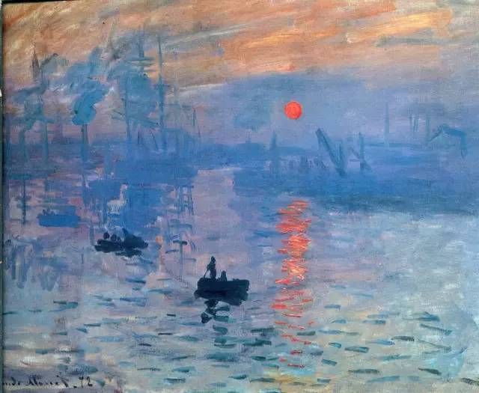
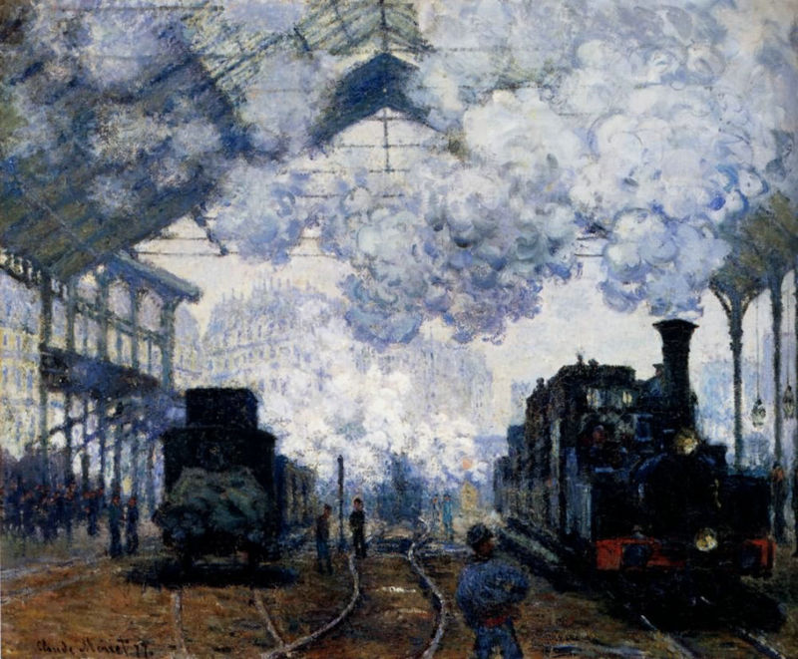
Works of Claude Monet
Impression,Sunrise
印象，日出
Arrival of the Normandy Train
圣拉扎尔火车站

Slide 22
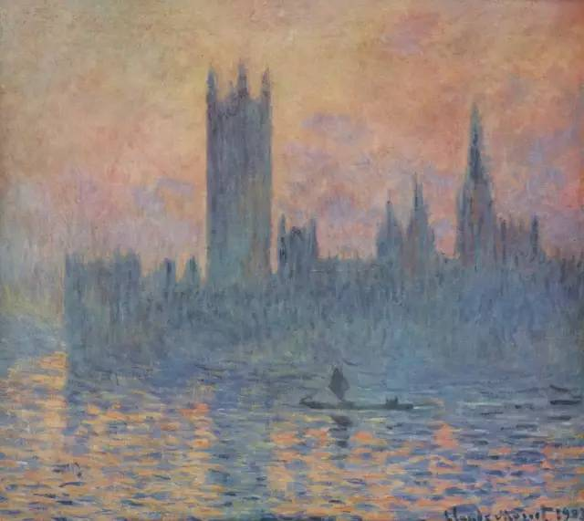
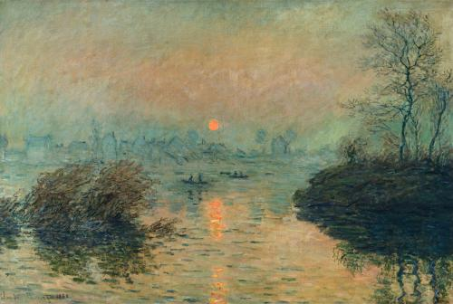
看上去永远像是眼睛起了一层雾, 什么都看不清, 那就是莫奈了。

Slide 23
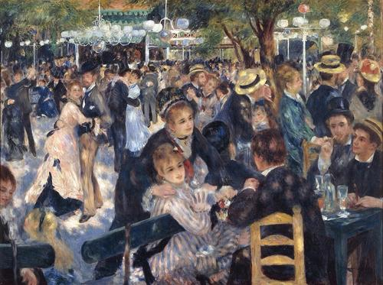
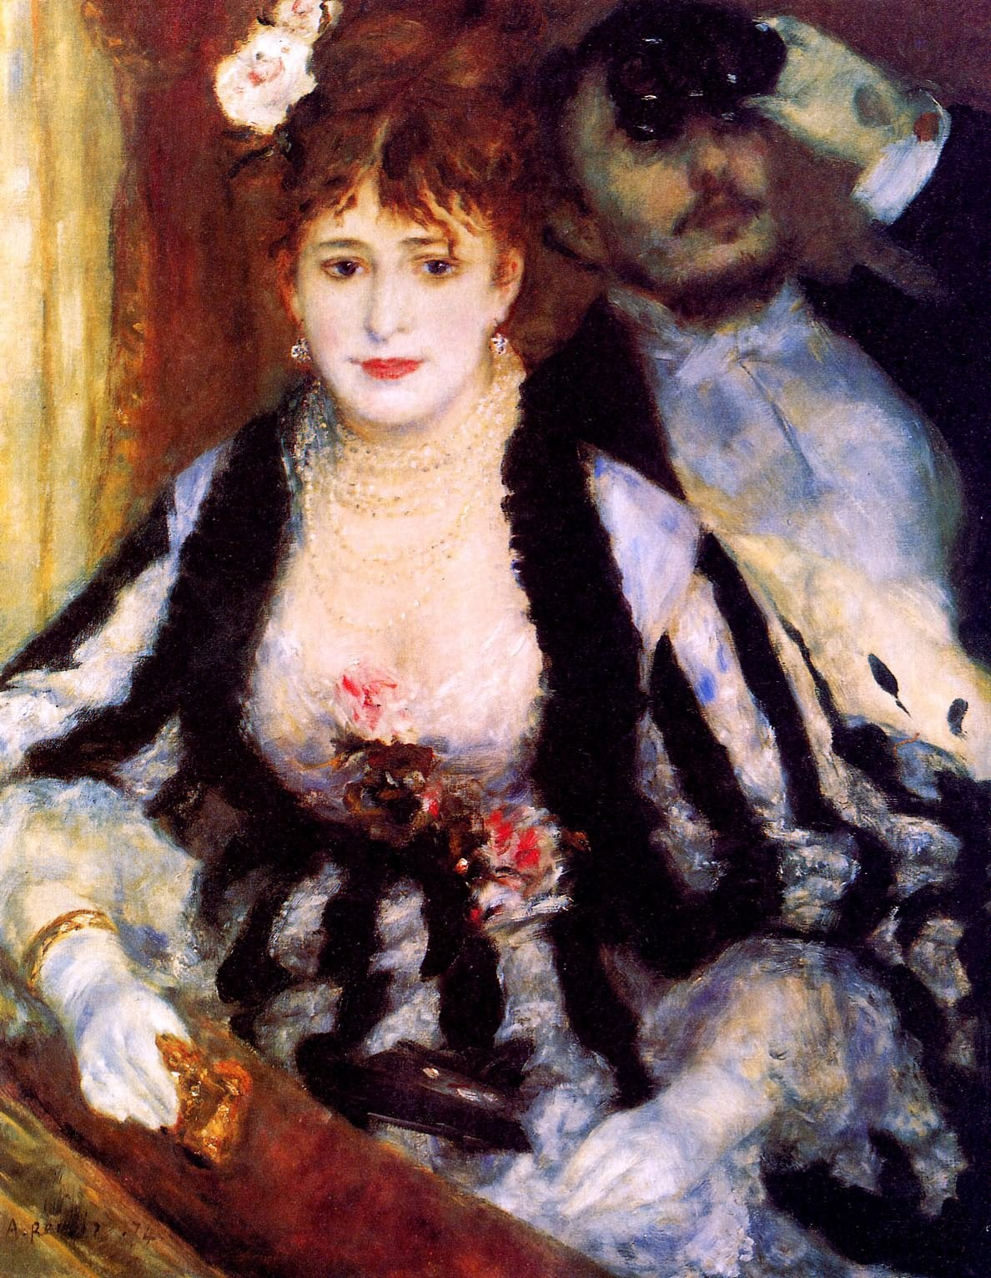
Works of Renoir
Dance at Le Moulin de la Galette
红磨坊街的露天舞会
The Loge
包厢

Slide 24
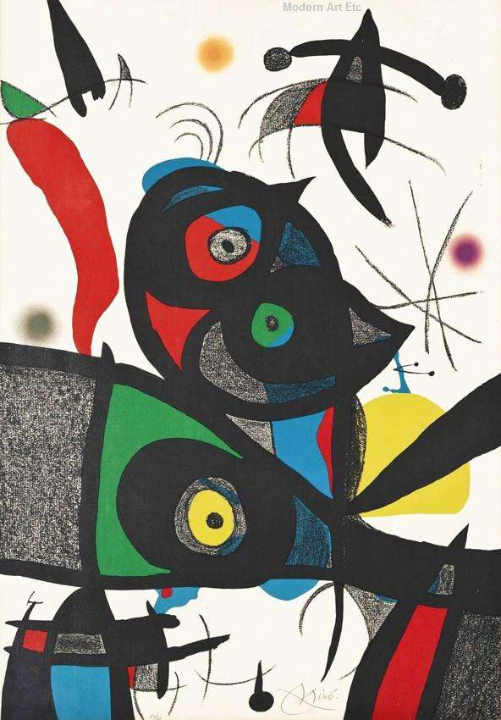
Activity 3 Read for detailed information
Modern Art Para 8
(1)What were the styles and features during this period?
(2)famous artist(s):
Cubism: analyze the shapes in a new way
give paintings a realistic but dream-like quality
Abstract art: no longer to show reality
Picasso

Slide 25
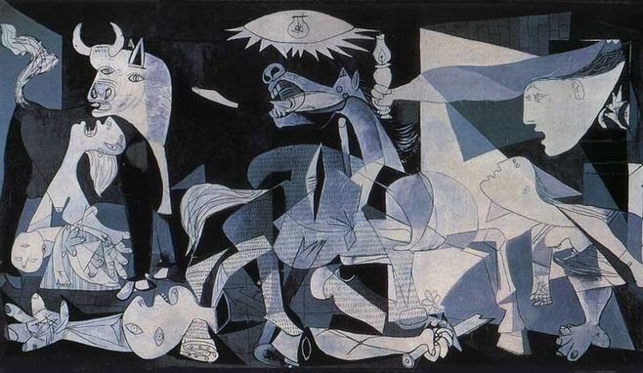
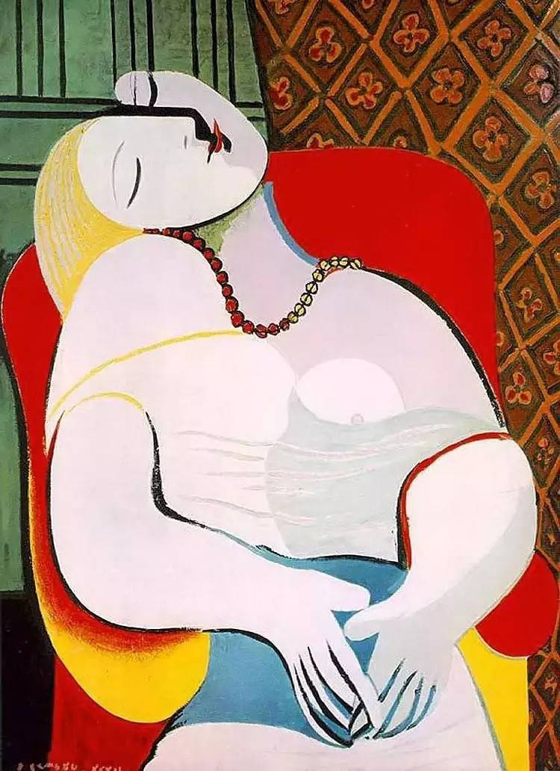
Works of Picasso
Guernica
格尔尼卡
Dream
梦
Guernica
格尔尼卡
Dream
梦

Slide 26
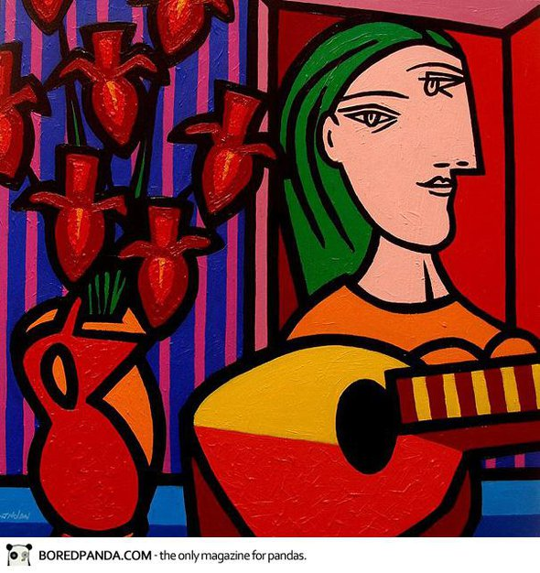
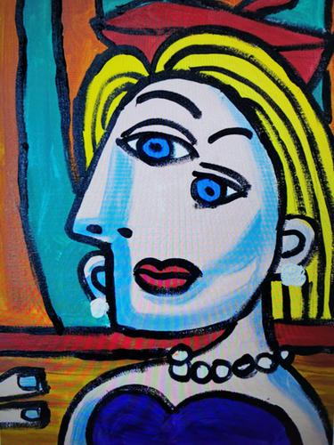
如果画里的人都有那么些残疾部位，那就是毕加索。

Slide 27
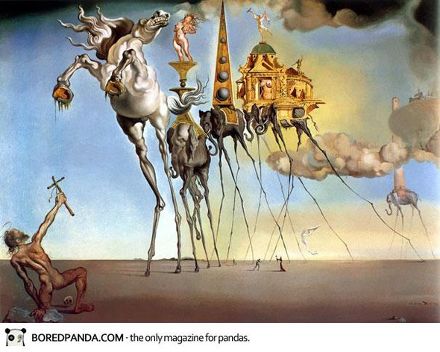
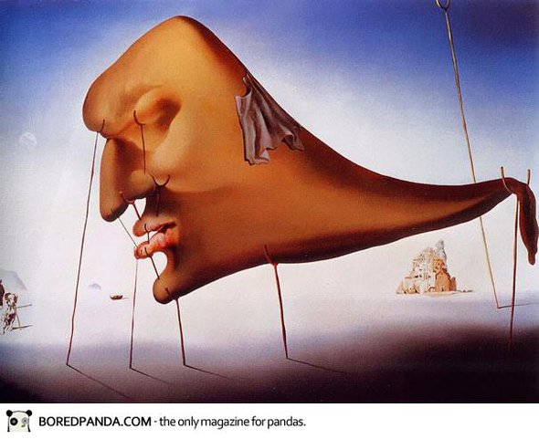
如果画的东西，像是出现幻觉后看到的东西，那是达利。

Slide 28
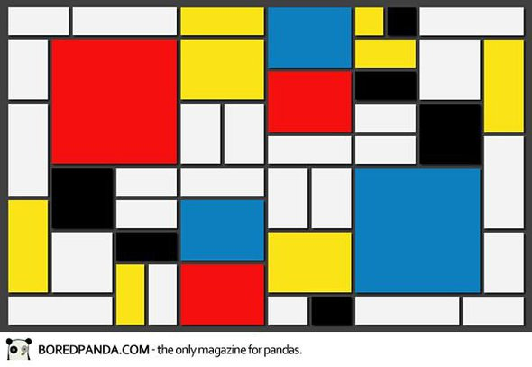
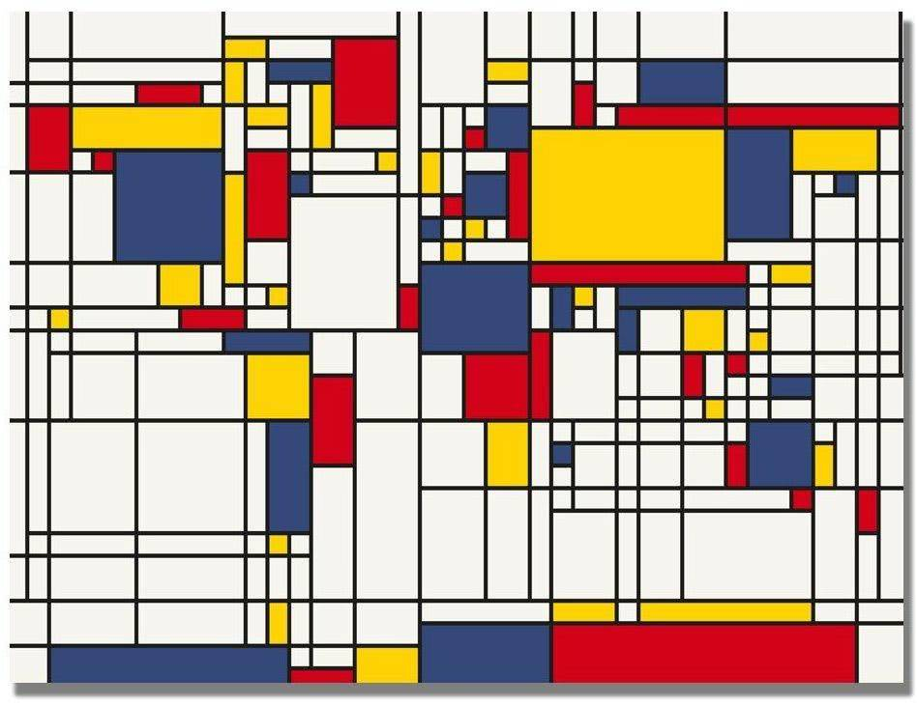
如果碰到充满填充色块的Excel表格，那就是蒙德里安。

Slide 29
Activity 4 Summarize the history of west painting
humanistic
accurate portraits
perspective
oil paints
1. Draw a mind-map of the short history of the western paintings, add the features of each time period.
realistic, dream-like quality, abstract
The Renaissance
Modern Art
5th
14th
15th
17th
The Middle Ages
Impressionism
20th
19th
religious themes
primitive and 2D
Main characters were larger than everyone else
change in 13th century
subjective impressions of the scene
inner warmth and humanity

Slide 30
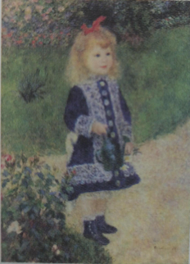
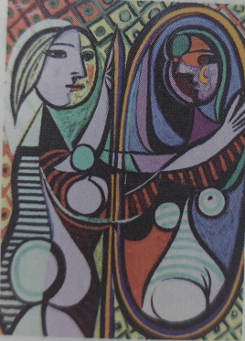
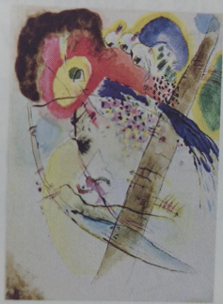

Activity 4 Summarize the history of west painting
2. In which period was each painting created?
Impressionism
Modern Art
Modern Art
The Renaissance
A Girl with a Watering Can (1876) by Renoir
Girl Before a Mirror (1932) by Picasso
Exotic Birds (1915)
by Wassily Kandinsky
The Woman with the Veil by Raphael

Slide 31



Activity 4 Summarize the history of west painting
3. Which period of Western art do you like most? Why are you fond of it?
4. What do you think promoted the change in western paintings?
5. Based on the text, what do you think is art?

