Slide 1

感恩遇见，相互成就，本课件资料仅供您个人参考、教学使用，严禁自行在网络传播，违者依知识产权法追究法律责任。
更多教学资源请关注
公众号：溯恩高中英语
知识产权声明

Slide 2
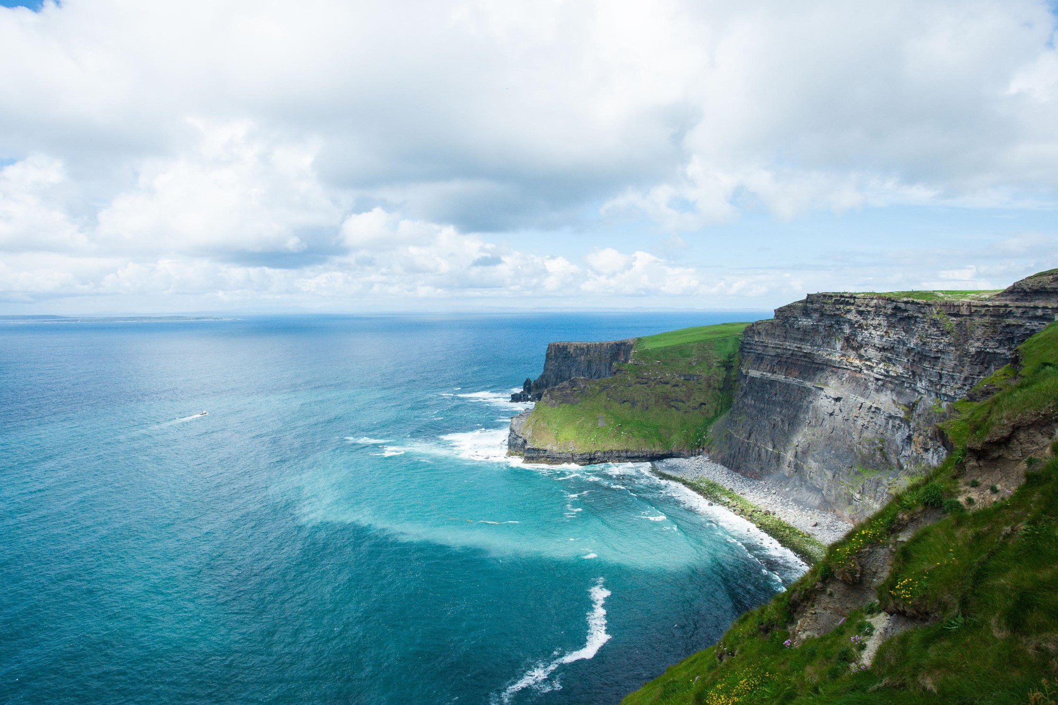

Unit 4 Reading for Writing
BEAUTIFUL IRELAND AND ITS TRADITIONS

Slide 3

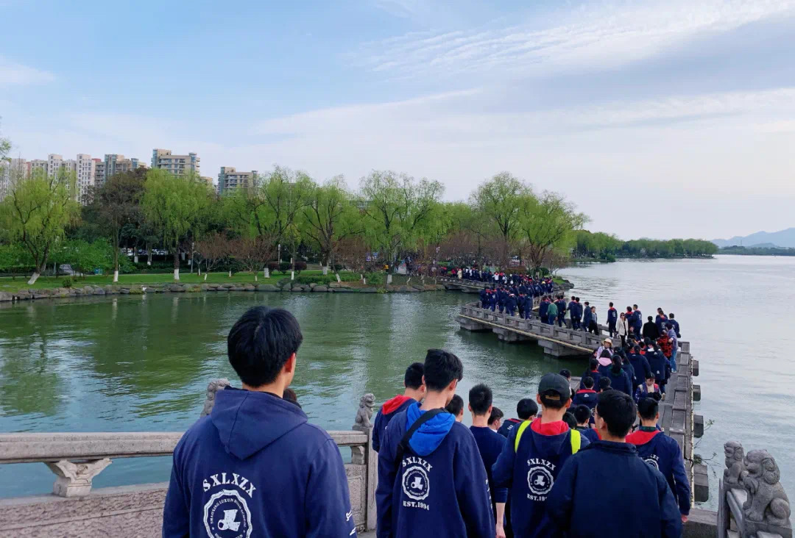
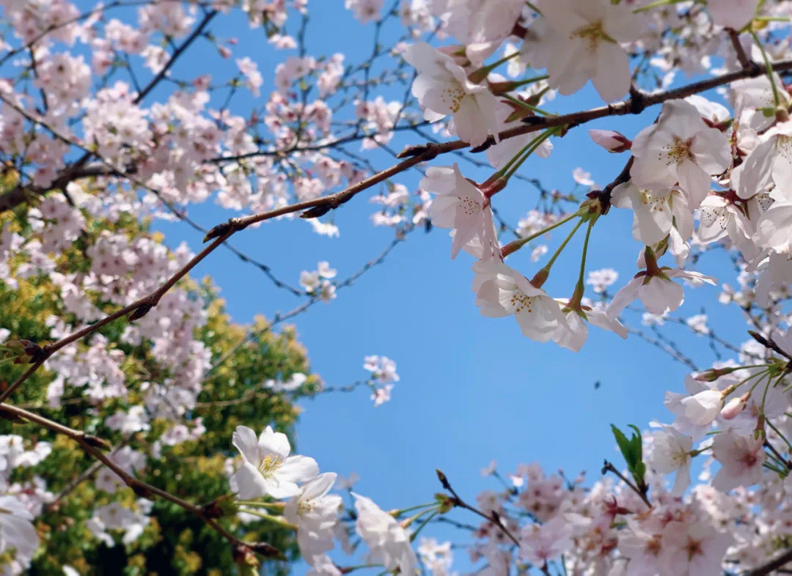





Describe a place that you like
……
What did you see/hear/feel/smell/taste in Guazhu Lake Park?

Slide 4


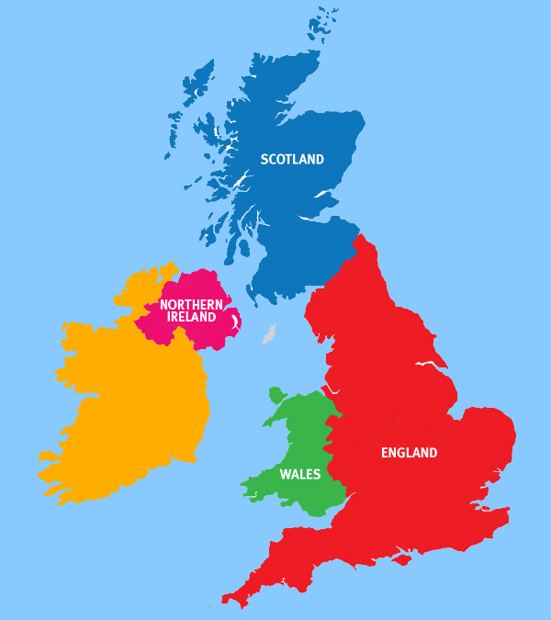
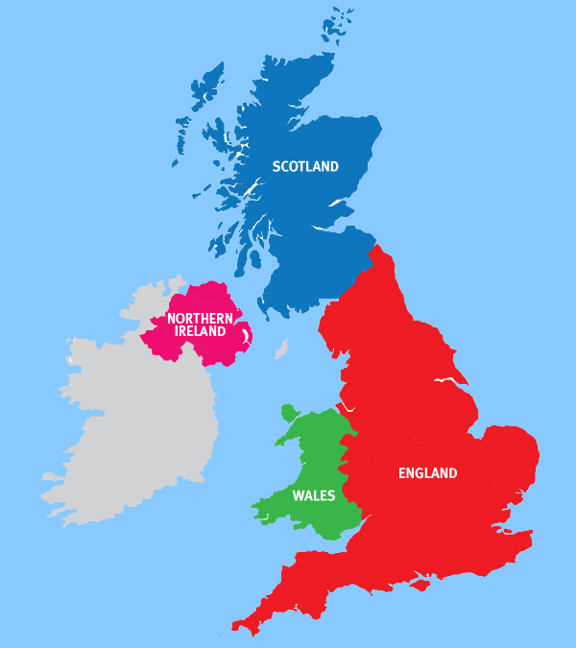
Describe a place that you like
Ireland

Slide 5

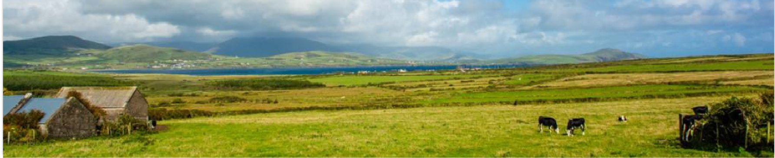
Reading for Structure
Introductory
sentence:
1: Ireland’s beautiful countryside has always had a great influence on its people and traditions.
2-6: Ireland’s influence on people
7-10: Ireland’s influence on traditions
Body:
Ending
sentence:
11: And if you introduce yourself to a friendly face, you are more than likely to experience local culture and customs first-hand.
Tip 1: Tell readers your topic in the introduction
Give readers a summary/suggestion in the ending

Slide 6



Reading for Details
hearing smell taste touch sight
sentence | sense(s) | key words/phrases
4
5
6
Read sentence 4–6 and find out the words/phrases describing sensory details in each sentence.
a true feast for the eyes, rolling green hills dotted with…
sight
roar, cries, music of the coast
“The author uses ‘___________’ to describe the sense of sight/hearing/touch/smell/taste”
hearing
feel the sun on your skin; sweet scent; greet … with their morning songs
touch smell hearing
Notes:
There are hyperlinks on sentence numbers. 句子编号处有超链接。

Slide 7
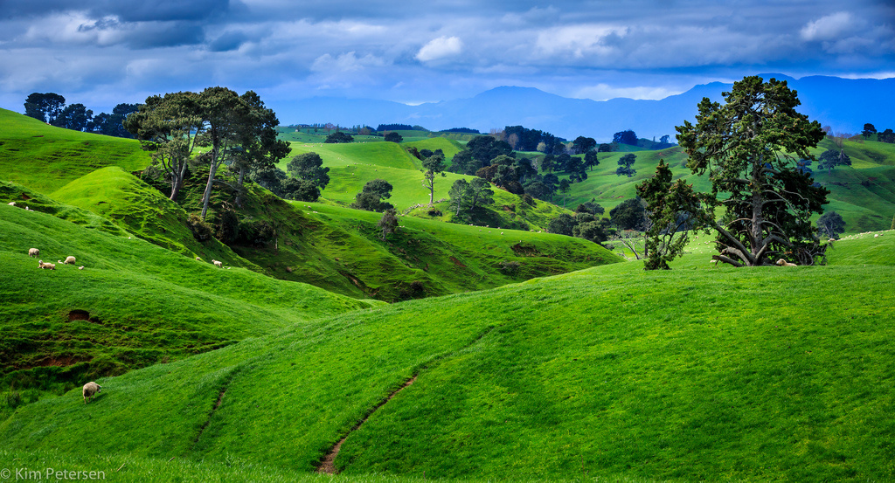
Reading for Details – sentence4
The peaceful landscape of the “Emerald Isle” and its many green counties is a true feast for the eyes, with its rolling green hills dotted with sheep and cattle.
Notes:
You may click the picture to go back, if you wish.

Slide 8
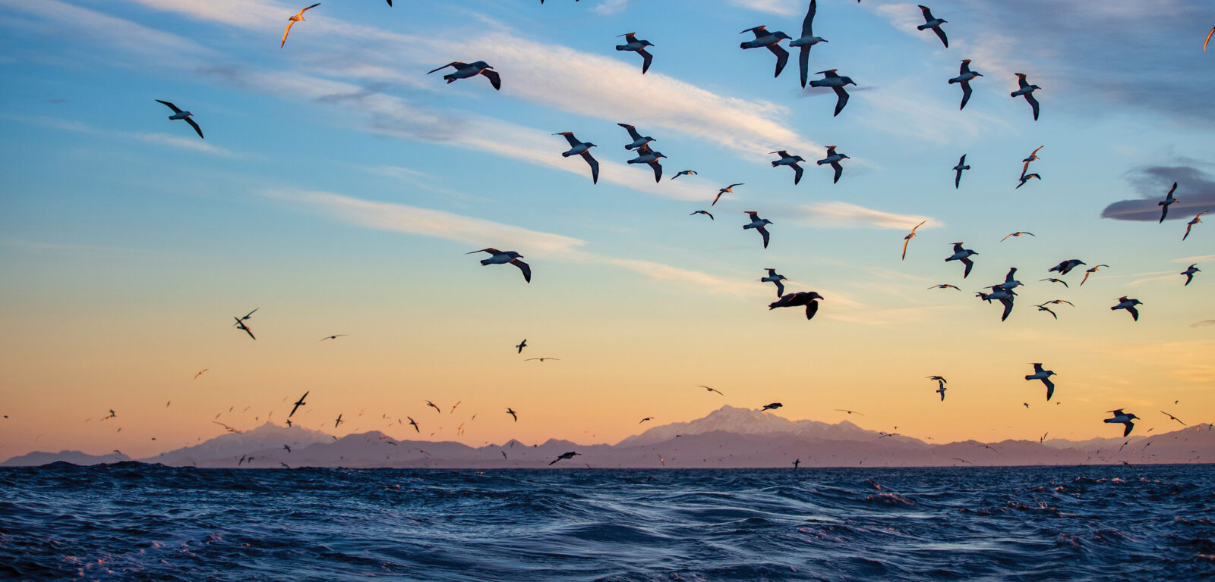
Reading for Details – sentence5
And down by the sea, the roar of the ocean waves and cries of the seabirds make up the music of the coast.

Slide 9
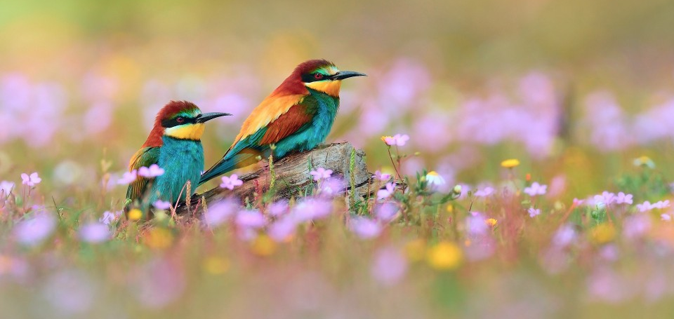
Reading for Details – sentence6
On a quiet morning in the mountains, feel the sun on your skin,
and breathe in the sweet scent of fresh flowers while
birds greet the new day with their morning song.
Notes:
Click the picture to go back for summary.

Slide 10
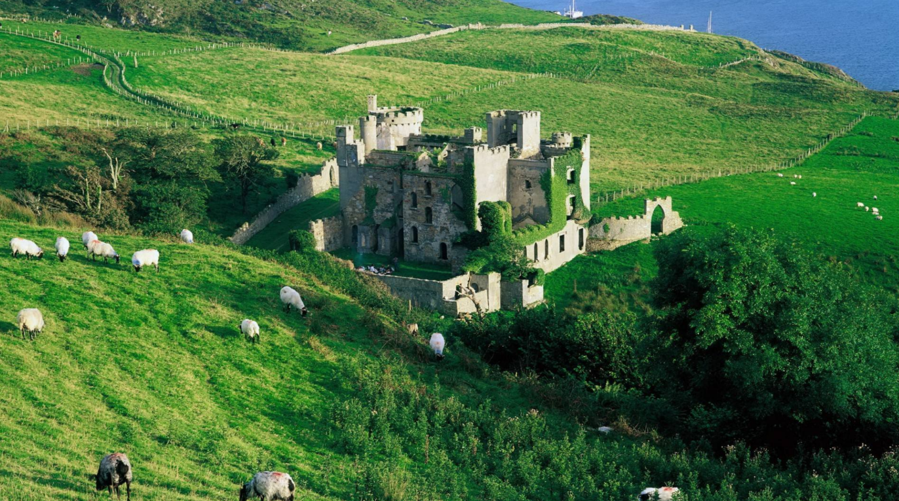
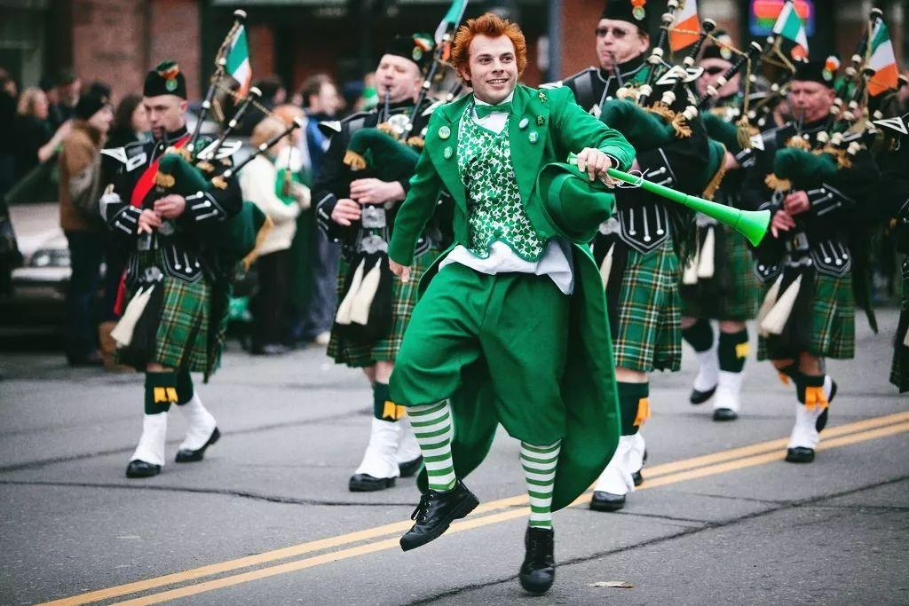
Ireland’s landscape
… With all this beauty, it’s not surprising that Ireland has developed strong traditions that include music, dancing, and dining…
Tip 2: Use transitional sentences to make
your writing cohesive
Ireland’s traditions

Slide 11

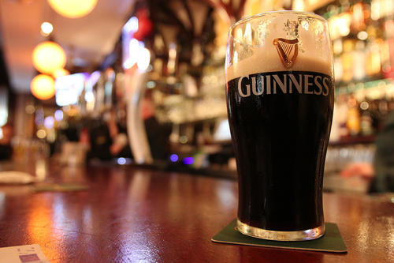
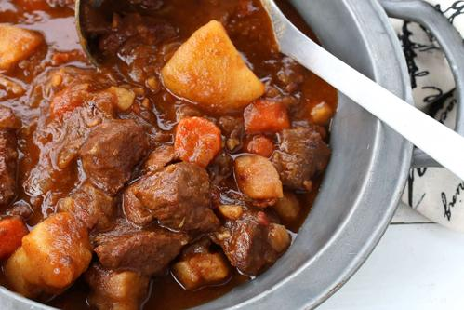
Reading for Details
How can we use our sense of taste to experience Ireland’s traditions?
relax with a glass of wine or a local beer
a delicious traditional Irish Beef Stew
taste
Tip 3: Use sensory details to
make your description vivid

Slide 12

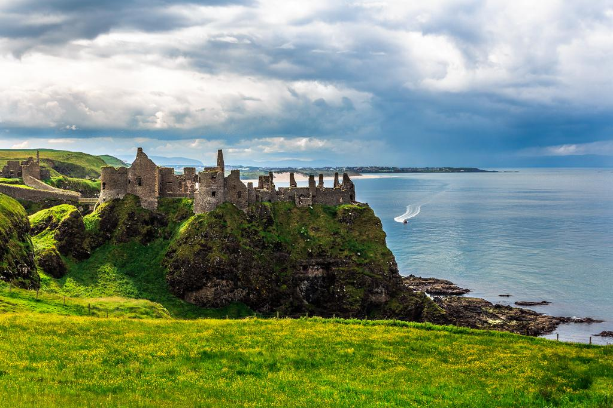
Summary: How to describe a place
introduction
Present to readers your topic in the ____________ and a summary/suggestion in the ________.
Use ______________________ to make your writing cohesive
Use _______________ to make the description more vivid
ending
transitional sentences
sensory details

Slide 13

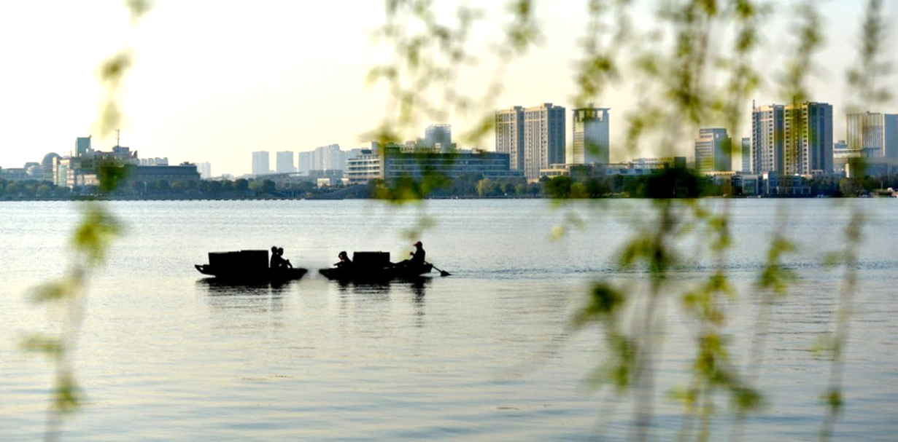
Imitation
The peaceful landscape of the “Emerald IsIe” and its many green counties is a true feast for the eyes, with its rolling green hills dotted with sheep and cattle.
The peaceful Guazhu Lake is a true feast for the eyes, with its calm surface dotted with little boats.
宁静的瓜渚湖堪称一场名副其实的视觉盛宴，伴有只只小船点缀着平静的湖面。

Slide 14

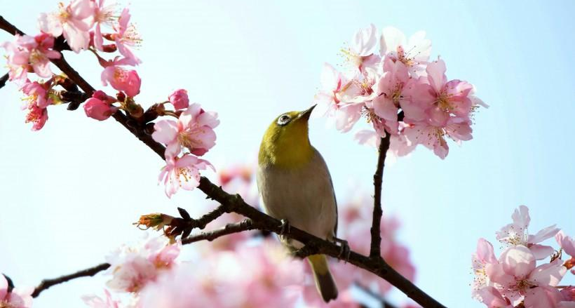
Imitation
And down by the sea, the roar of the ocean waves and cries of the seabirds make up the music of the coast.
By the lake, the rustle of the cherry blossoms and the tweets of the birds make up the music of spring.
在湖边，樱花的沙沙声与鸟雀的啾啾声构成了春天的音乐。

Slide 15

Group work
Describe Guazhu Lake Park
Write a short paragraph:
Write an introduction and an ending
The body should contain 1–3 sentences.
Use at least one sense

Slide 16
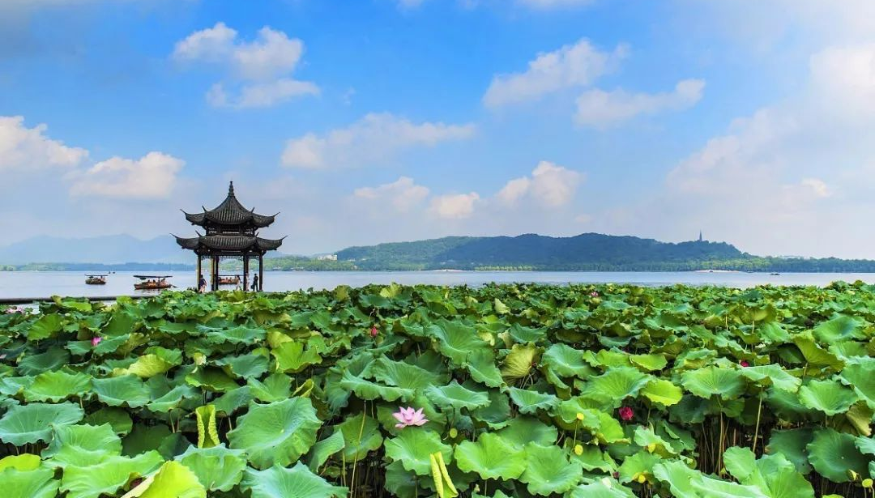
Assignment
假设你是李华，你的澳大利亚朋友Adam要来中国旅行，请你写一封信向他推荐杭州。内容要点如下：
1．推荐一处景点；
2．运用感官描写；
3. 表示欢迎。
可适当增添细节，80词左右。

Slide 17
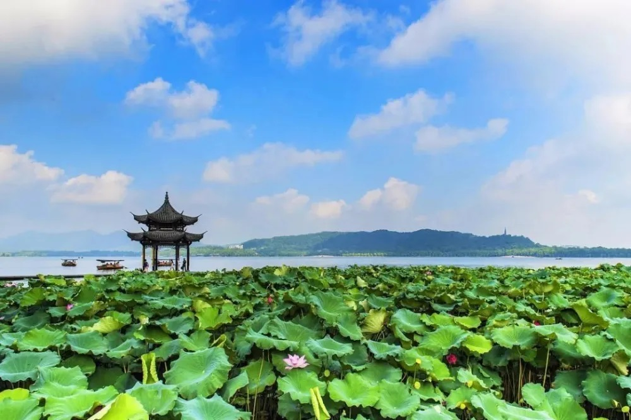
Sample
Dear Adam,
Delighted to know that you’re planning to pay a visit to China, I’m writing to recommend a historic city, Hangzhou, as your destination.
Located in eastern China, Hangzhou is one of the most fascinating tourist destinations. And among its countless tourist attractions, the West Lake is recognized as the most fantastic one. Wandering around the lake, you can have a good view of the peaceful surface dotted with little boats, which is a true feast for the eyes.
I promise it will be an unforgettable experience for you if you come. Looking forward to your arrival.
Yours,
Li Hua
Notes:
Here are some other posible sentences:
[beginning]
Informed that you’re coming to China in the near future, I sincerely recommend you come to Hangzhou, which lies in the southeastern part of China and enjoys a high reputation throughout the world for its numerous scenic spots featuring a long history.
[body]
You may ride a boat, feeling the soft wind touch your face. (the sense of touch)
In addition, there are a variety of local snacks (which are) worth having a taste. (the sense of taste)
You can walk around to admire the fantastic lake(, which is) surrounded with green trees and various flowers. (the sense of sight)
The sweet scent of fresh flowers there will definitely relieve your stress. (the sense of smell)
[ending]
I firmly believe you will fall in love with this city as long as you visit it.
You are bound to fall in love with the city.

Slide 18
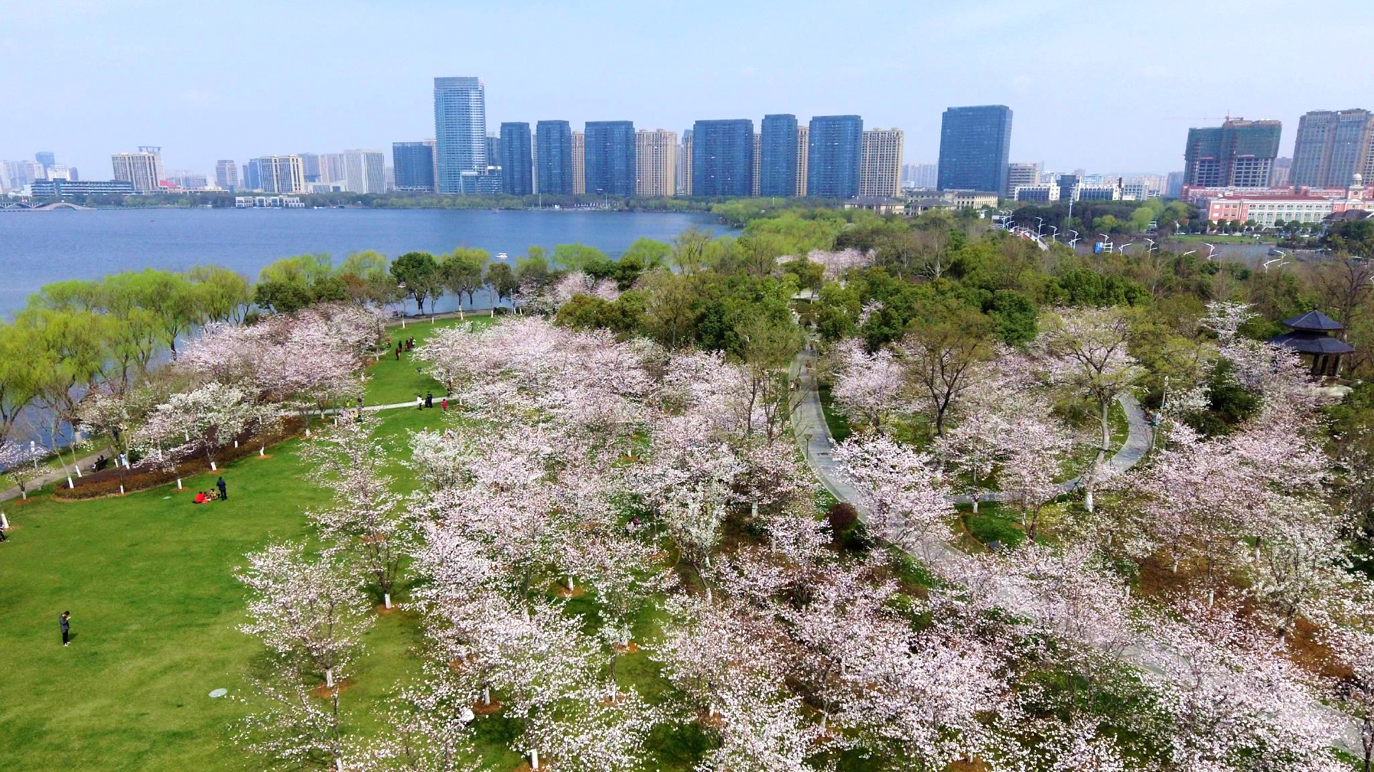
Thank you!
Notes:
discover the beauty in our life

