Slide 1

感恩遇见，相互成就，本课件资料仅供您个人参考、教学使用，严禁自行在网络传播，违者依知识产权法追究法律责任。
更多教学资源请关注
公众号：溯恩高中英语
知识产权声明

Slide 2

The Week
Apr 2nd-8th, 2022

Slide 3
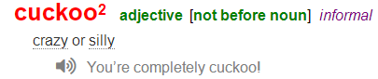
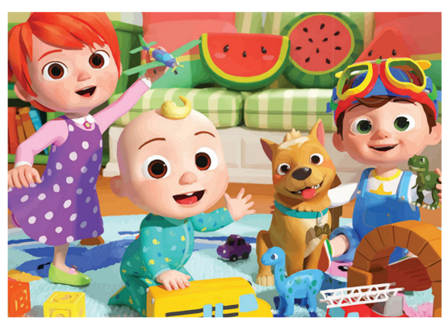
1. Cuckoo for Cocomelon
Cocomelon 风靡全球
The online makings of a children’s entertainment juggernaut

Slide 4
阅读理解
（《时代周刊》2022-03-28&04-04双周刊 34页）
The toddler’s face is glowing green from the tablet in her hands, which shows a cartoon boy singing a nursery rhyme and dancing with dinosaurs. The toddler doesn’t know what dinosaurs are or what the lyrics mean, but she’s so entranced that she doesn’t blink when her mother calls her name. “It’s literally like crack for her,” says her mom Meng Zhou at their home in Redwood City, Calif.
“It” is CoComelon, which may be the most streamed children’s entertainment program in the world. The show was watched for 33 billion minutes last year, more than the Netflix hits Squid Game and Bridgerton combined, according to market-measurement firm Nielsen. CoComelon had 3.6 billion views on YouTube in January, according to Tubular, a social-video measurement company, as many as three-quarters of whom were from outside the U.S. CoComelon was a Top 10 show on Netflix for more than 100 straight days in 2021, and its music is streamed 1.3 million times a day on Spotify.
CoComelon is not only a ratings juggernaut. It’s also a model for a new approach to children’s TV. The educators who developed hits like Sesame Street and SpongeBob Square Pants had to fight for years to get their shows on the air. A room of adults could toil on a concept that helped kids learn important ideas, only to find out viewers weren’t interested. CoComelon is part of a push to eliminate such guesswork. Its parent company, Moonbug Entertainment, scours digital platforms like YouTube for popular kids’ programming, buys them, and then tries to build them into even bigger phenomena, drawing on data from YouTube to figure out what resonates with audiences. “Data is really at the heart of everything we do,” says Richard Hickey, Moonbug’s head of creative. “With YouTube, you’ve got an audience there that literally tells you whether they want to watch something or not, in real time.”
It’s not entirely clear how much of CoComelon’s runaway popularity stems from this formula and how much it owes to the pandemic, which put more kids in front of screens. As parents juggled childcare and remote work, demand for kiddie content spiked 52% between January 2020 and February 2022, according to data from Parrot Analytics. Either way, the success of the show is attracting big money. In November, Moonbug was acquired for $3 billion by two Disney alums backed by the private-equity firm Blackstone. Since then, the company has rolled out a CoComelon live tour, a Spotify podcast, and just about every form of merchandise you can imagine, from bubble machines to throw pillows.
Both parents and programming executives say there is something rare about the hold that CoComelon exerts on babies and toddlers. You can see the proof in the dozens of TikTok videos showing kids who hear the marimba tones of its theme song and come running. Zhou’s daughter’s third word, after Mama and Dada, was CoCo. “I don’t think we’ve ever seen anything like it when it comes to generating kids’ streaming audiences,” says Brian Fuhrer, senior vice president at Nielsen.
As the show and others like it become inescapable, parents are going to have to grapple with whether this type of children’s programming works for their families. Sure, their kids may love it—but does that mean it’s any good for them?

Slide 5

阅读理解
1. What do we know about Cocomelon from the text?
A. It only attracts babies and toddlers in the U.S.
B. It is the most popular entertainment program on YouTube .
C. It serves as a model showing how to make children’s TV.
D. Its music is streamed 1.3 million times a day on Netflix.
细节理解
2.What does the underlined word “juggled” mean in Paragraph 4?
A. Balanced B. Matched C. Compared D. Associated
词义猜测
3. What’s the author’s attitude towards the popularity of Cocomelon?
A. Approving B. Critical C. Indifferent D. Objective
观点态度

Slide 6
词汇讲解1
1. juggernaut: a large and powerful force or institution that cannot be controlled 不可抗拒的强大力量；无法控制的强大机构
The group became a sales juggernaut in the commodity options business. 这个集团已经成为一个商品期权交易的销售巨头。
2. eliminate: to remove or get rid of sth/sb 排除；清除；消除
Credit cards eliminate the need to carry a lot of cash.
有了信用卡就用不着携带很多现金。
翻译句子
中国已迅速成为一个经济强国。
The country has fast become an economic juggernaut.
翻译句子
警方通过调查已经排除了两名嫌疑犯。
The police have eliminated two suspects from their investigation.

Slide 7
词汇讲解2
3. resonate: to remind sb of sth; to be similar to what sb thinks or believes 使产生联想；引起共鸣
These issues resonated with the voters. 这些问题引起了投票者的共鸣。
4. spike: increases quickly and by a large amount 激增
The US dollar spiked to a three-month high.
美元猛然升值到三个月来的最高价。
翻译句子
她的经历与我产生了强烈的共鸣。
Her experiences resonate powerfully with me.
翻译句子
在过去两年中，新的电话订单激增。
New telephone orders have spiked in the last two years.

Slide 8
句子翻译
Its parent company, Moonbug Entertainment, scours digital platforms like YouTube for popular kids’ programming, buys them, and then tries to build them into even bigger phenomena, drawing on data from YouTube to figure out what resonates with audiences.
它的母公司Moonbug娱乐公司在YouTube等数字平台上搜索受欢迎的儿童节目，将其收购，然后利用YouTube上的数据来找出哪些节目能引起观众的共鸣，试图将其打造成更大的现象。
翻译
As parents juggled childcare and remote work, demand for kiddie content spiked 52% between January 2020 and February 2022, according to data from Parrot Analytics. Either way, the success of the show is attracting big money.
根据鹦鹉分析公司的数据，由于父母要兼顾照看孩子和远程工作，2020年1月至2022年2月期间，对儿童内容的需求飙升了52%。 不管怎样，这部剧的成功吸引了大笔资金。
翻译

Slide 9
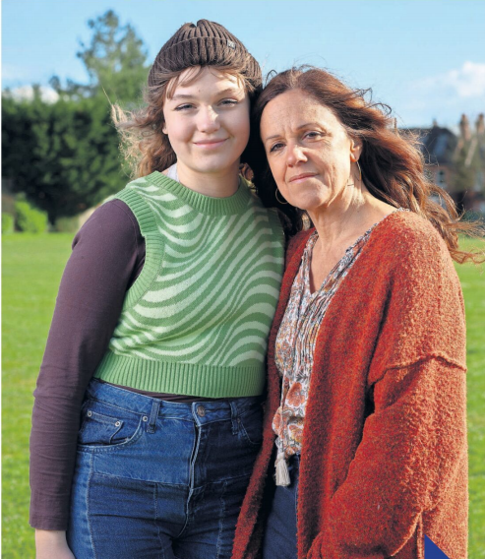
2. Children wait up to five years for NHS autism appointment
英国自闭症儿童预约就医等待时间漫长
Cathy Pyle with her daughter Eva who waited 20 months for an assessment

Slide 10
语篇填空
（《观察家报》2022年4月3日 23页）
Children are having to wait up ___ five years for an NHS autism appointment, according to figures ________ (obtain) by the Observer that lay bare the crisis in children’s mental health services.
_______ (figure) acquired under the Freedom of Information Act show that 2,835 children with autism referrals at Coventry and Warwickshire Partnership NHS Trust have still not had a first appointment ____ average of 88 weeks after being referred. The _______ (long) wait at the time the response was sent in January _____ (stand) at 251 weeks——nearly 5 years.
Across 20 NHS trusts __________ provided figures, children with outstanding autism referrals have waited nearly six months on average for their first appointment.
A spokesman for Coventry and Warwickshire CCG said, “We acknowledge that our waiting times, __________ (particular) for autism assessments, are longer than we want. We are investing 5.4 million pounds in additional diagnostic capacity.”
A government spokesperson said, “We know ____ vital it is for children to have timely diagnoses for autism and we’re working to improve __________ (assess) waiting times.”
to
obtained
Figures
an
longest
stood
that / which
particularly
how
assessment

Slide 11
词汇讲解
1. lay bare: to show sth that was covered or to make sth known that was secret
暴露；揭露
No one wants to expose themselves and lay their feelings bare.
没有人想自我剖白，将自己的情感公之于众。
2. capacity: ability to do sth 能力；才能
Her mental capacity and temperament are as remarkable as his.
她的才智和气质和他一样出众。
翻译句子
他们的私生活全面曝光了。
Every aspect of their private lives has been laid bare.
翻译句子
我们能够给予的关怀、关爱和关注是有限的。
Our capacity for giving care, love and attention is limited.

Slide 12
句子翻译
Children are having to wait up to five years for an NHS autism appointment, according to figures obtained by the Observer that lay bare the crisis in children’s mental health services.
翻译
根据《观察家报》获得的数据，儿童必须等待长达五年的时间才能获得国民医疗保健自闭症治疗的预约，这些数据暴露了儿童心理健康服务的危机。
Figures acquired under the Freedom of Information Act show that 2,835 children with autism referrals at Coventry and Warwickshire Partnership NHS Trust have still not had a first appointment an average of 88 weeks after being referred.
翻译
根据《信息自由法》获得的数据显示，考文垂和沃里克郡合作国民医疗保健信托基金的2835名自闭症儿童在被转诊后平均88周内仍未进行首次预约。

Slide 13
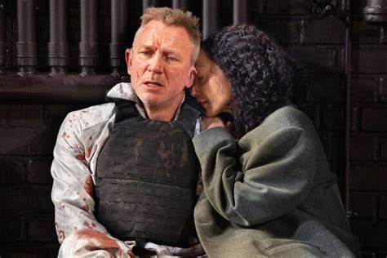
3.“Macbeth”Pauses Amid Covid Cases
《麦克白》因新冠疫情暂停上演
Daniel Craig, left, and Ruth Negga in “Macbeth” at the Longacre Theater. The production said it had canceled performances until Friday.

Slide 14
语篇填空
（《纽约时报》2022年4月4日 C4版面）
a
Daniel Craig, who is starring in the title role of __ new Broadway production of “Macbeth”, tested positive for the coronavirus on Saturday, _______ (force) the show to cancel most of this week’s performances.
The show, ______ just began previews on Tuesday and is scheduled to open April 28, had already canceled Friday night’s performance, citing another positive coronavirus test among cast ________ (member), when on Saturday it canceled both the matinee (午后场) and an evening performance, citing Mr. Craig’s positive test. Then, late Saturday night, the production said that it was canceling all performances until this coming Friday “due __ the detection of a ______ (limit) number of positive Covid test results within the company.”
Coronavirus cases have recently been rising in New York City, and several Broadway __________ (perform) have tested positive. In most instances, shows have been able to turn to understudies (替角) _______ (keep) going, but because “Macbeth” had just begun performances, it had not yet fully rehearsed the understudies.
All Broadway actors — in fact, all workers in Broadway theaters __________ (require) to be fully vaccinated. Broadway also ________ (current) requires that ticket holders be fully vaccinated and wear masks except when eating and drinking.
forcing
which
members
to
limited
performers
to keep
are required
currently

Slide 15
词汇讲解
1. cast: all the people who act in a play or film/movie 全体演员
The play has a strong cast of new young actors.
这出戏有一大批年轻的新演员。
2. rehearse: to practise or make people practise a play, piece of music, etc. in preparation for a public performance 排练；排演
We were given only two weeks to rehearse. 只给了我们两个星期排练。
翻译句子
表演非常有趣，演员都很优秀。
The show is very amusing and the cast is very good.
翻译句子
乐队正在为他们的世界巡回演出排练。
The band was rehearsing for their world tour.

Slide 16
句子翻译
Daniel Craig, who is starring in the title role of a new Broadway production of “Macbeth”, tested positive for the coronavirus on Saturday, forcing the show to cancel most of this week’s performances.
翻译
主演百老汇新剧《麦克白》的丹尼尔·克雷格，周六新冠病毒检测呈阳性，迫使该剧取消了本周的大部分演出。
Then, late Saturday night, the production said that it was canceling all performances until this coming Friday “due to the detection of a limited number of positive Covid test results within the company.”
然后，在周六深夜，制作方表示，“由于在公司内部检测出数量有限的阳性结果”，将取消所有演出，直到本周五。
翻译

Slide 17
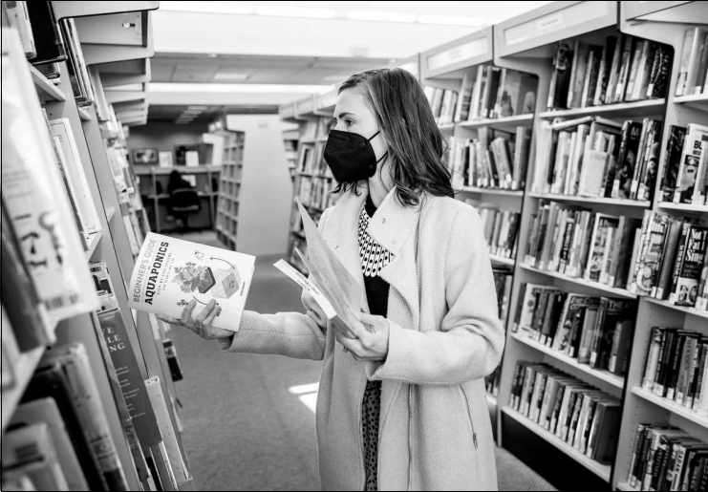
4. Surge in book bans draws congressional attention
图书禁令的激增引起了国会的关注
Schools saw 1,586 such actions over the past nine months, one study finds, with most works featuring people of color or LGBTQ themes.

Slide 18
语篇填空
（《华盛顿邮报》2022年4月8日 A3版面）
is facing
Two reports this week show the United States ________ (face) an unprecedented wave of school book banning — urging Congress to hold a hearing Thursday ________ (focus) on the issue, which free-speech advocates warn will undermine democracy.
PEN America, ___ nonprofit that advocates for freedom of expression, found there have been 1,586 book _____ (ban) in schools over the past nine months. The bans targeted 1,145 unique books by more than 800 authors, and a number of the books — 41 percent — featured famous characters _____ are people of color. Thirty-three percent of the banned books, meanwhile, included LGBTQ themes, protagonists or strong secondary characters, and 22 percent “________ (direct) address issues of race and racism.
Both reports come as an ascendant conservative-led movement is scanning and
___________ (question) almost every aspect of public education. Right-wing politicians and parents are objecting ___ how teachers discuss race, racism, history, gender and sexuality in schools, alleging that some curriculums — meant to be inclusive of a larger range of identities — amount to liberal indoctrination.
Since January 2021, 15 states have enacted laws limiting _____ teachers can discuss issues such as racism and sexism, according to a PEN America analysis, while 175 similar “educational gag order bills” ___________________ (introduce) in 40 states.
focused
a
bans
who
directly
questioning
to
how
have been introduced

Slide 19
词汇讲解 1
1. unprecedented: that has never happened, been done or been known before
前所未有的；空前的；没有先例的
We are now witnessing an unprecedented increase in violent crime.
我们现在看到暴力犯罪空前增多。
2. undermine: to make sth, especially sb’s confidence or authority, gradually weaker or less effective 逐渐削弱（信心、权威等）；使逐步减少效力
Our confidence has been seriously undermined by their recent defeats.
该队最近的几次失败已严重动摇了我们的信心 。
翻译句子
这种情况在现代还没有出现过。
The situation is unprecedented in modern times.
翻译句子
他指控我想削弱他的地位。
He accused me of trying to undermine his position.

Slide 20
词汇讲解 2
1. allege: to state sth as a fact but without giving proof
(未提出证据）断言，指称，声称
Online reviews alleging that the masterpiece was rather dull were deleted.
网上那些说这部“杰作”很闷的相关评论都被删除了。
2. amount to: to be the same 等同于
The banks have what amounts to a monopoly.
这些银行几乎接近于垄断。
翻译句子
法庭文件宣称她可能是一个间谍。
The court papers allege she may be a spy.
翻译句子
发言人强调说，这些措施并不等于全面禁止。
The spokesman stressed that the measures did not amount to an overall ban.

Slide 21
句子翻译
Two reports this week show the United States is facing an unprecedented wave of school book banning — urging Congress to hold a hearing Thursday focused on the issue, which free-speech advocates warn will undermine democracy.
这个星期的两份报告显示，美国正面临前所未有的教科书禁售潮，敦促国会星期四就这个问题举行听证会。自由言论倡导者警告说，这将破坏民主。
翻译
Right-wing politicians and parentsare objecting to how teachers discuss race, racism, history, gender and sexuality in schools, alleging that some curriculums
— meant to be inclusive of a larger range of identities — amount to liberal indoctrination .
右翼政客和家长们反对教师在学校讨论种族、种族主义、历史、性别和性取向的方式，声称某些课程——意味着包容更大范围的特征——等同于自由主义的灌输。
翻译

Slide 22

5. PBS趣味科普听写填空：什么是似曾相识？

Slide 23

PBS Digital Studios: What is déjà vu?
听力填空 1
Psychologist Endel Tulving said, “Remembering is ______ time travel”. (“Soy Latte for Joe...” “Thanks.”) Remembering is one of the greatest powers that we ______, the ability to learn from our ____ , to return to where we’ve been, so we can decide where we’re going. “Oh man...”
But can we return to where we’ve..._________? (“Soy Latte for Joe...” “Yeah, huh, thanks.” Could have sworn, I just... Is it me, or does this seem _______? Feel like I’ve seen this before. (“Oh, man.”) Or as the French would say, déjà vu.
As many as ______________ will experience déjà vu during our lives, mainly in our _____ and 20s, and almost never before age 8 or 9. Déjà vu isn’t a physical ___________ we can pinpoint in a brain scan. It’s a feeling, and not one that we totally understand.
But we’ve got a few _______. Our memories aren’t __________ that we just write once and then store like files on a computer, or pictures in a box under our bed. Remembering is really more like reliving.
mental
possess
past
never been
familiar
90 percent of us
teens
phenomenon
theories
exact copies

Slide 24
PBS Digital Studios: What is déjà vu?
听力填空 2
Our brains are constantly ________ our senses to determine if what we’re experiencing is familiar. And once we label a stimulus as familiar, a different brain region called the hippocampus recalls the memory _______________, re-firing the neural circuits that hold that piece of our past, and we _____________________ in our minds. If these steps get out of sync, if something is deemed familiar, but we ___________ the context, that could be déjà vu. But that doesn’t _______why we feel déjà vu for experiences that are truly unfamiliar, or why we don’t experience it for every familiar thing. (“Soy Latte for Joe...” “Yep.”)
We don’t realize how hard our brains work _______________, filtering our environment— Gesundheit!—_____________determining if what we’re experiencing is new... until it doesn’t work. (“Oh!” “Oh, man.”) Our various _____________, smells, sounds, sights, are normally processed and mixed together as _________.
Another déjà vu theory says if one of those stimuli is recorded out of sync, the late arriving ___________could be flagged as a different event, which makes it feel as if it’s happened before.
scanning
associated with it
live the experience again
fail to recall
explain
behind the scenes
unconsciously
sensory inputs
one event
information

Slide 25
PBS Digital Studios: What is déjà vu?
听力填空 3
Or it could be a ___________ in how memories are made in the first place. Normally, new experiences stop off in our short term memory before being written into long-term storage. _____ the first, and it could feel like we’re recalling new events as ________. Or perhaps when we ________ one part of our environment, the rest of our world _____________________, and when we snap back to ______ it feels like we’ve been there before, because we have. Just now.
These feelings of misplaced _________, are familiar to us, but the what, the where, and the why of déjà vu _______________. (“Soy Latte for...” “Got it thanks.”) All in all, there are dozens of plausible ___________ for it, maybe more than one is right. (“Bless you!”) There’s no neat answer, but no mind, or memory, is ______. The only way we’ll get to the bottom of déjà vu is to experience it all over again. (“Oh, man.”) Yeah, I could’ve. Stay curious.
malfunction
Skip
old ones
focus on
drifts to the unconscious
reality
familiarity
remain unkonwn
explanations
perfect

Slide 26
熟词生义讲解
1. flag: to put a special mark next to information that you think is important
标识（重要处）
I’ve flagged the paragraphs that we need to look at in more detail.
我已用特殊记号标出我们需要更详细考虑的段落。
2. in the first place: used at the end of a sentence to talk about why sth was done or whether it should have been done or not
（用于句尾，谈论某事为何或是否应该做）究竟；到底；当初
I should never have lied in the first place. 我当初就不该撒谎。
翻译句子
我标记了这篇论文的一部分待之后审核。
I flagged parts of the paper for later review.
翻译句子
我仍不明白，你究竟为什么取了这么个名字。
I still don’t understand why you chose that name in the first place.

Slide 27
词汇讲解
1. déjà vu: (from French) the feeling that you have previously experienced sth which is happening to you now 似曾相识的感觉
The rise in housing costs is déjà vu all over again.
房价上涨又是一种似曾相识的感觉。
2. pinpoint: to find and show the exact position of sb/sth or the exact time that sth happened 明确指出；确定（位置或时间）
Computers pinpointed where the shells were coming from.
计算机确定了炮弹发射的位置。
翻译句子
进这屋子时我有一种似曾来过的幻觉。
I had a strong sense of déjà vu as I entered the room.
翻译句子
我能在地图上指明他的准确位置。
I could pinpoint his precise location on a map.

Slide 28
句子翻译
Déjà vu isn’t a physical phenomenon we can pinpoint in a brain scan. It’s a feeling, and not one that we totally understand.
翻译
似曾相识的感觉不是我们可以在脑部扫描中查明的物理现象。 这是一种感觉，而且不是我们完全已经弄明白的感觉。
Once we label a stimulus as familiar, a different brain region called the hippocampus recalls the memory associated with it, re-firing the neural circuits that hold that piece of our past, and we live the experience again in our minds.
一旦我们将某种刺激标记为熟悉的，称为海马体的不同大脑区域会回忆与之相关的记忆，重新激活保存我们这段过去的神经回路，我们会再次在脑海中经历这种体验。
翻译
Perhaps when we focus on one part of our environment, the rest of our world drifts to the unconscious, and when we snap back to reality it feels like we’ve been there before, because we have.
翻译
也许当我们专注于周边的某一部分时，其他部分就会陷入我们的无意识，而当我们回到现实时，感觉就像我们以前去过那里，因为我们确实去过。

