Slide 1

感恩遇见，相互成就，本课件资料仅供您个人参考、教学使用，严禁自行在网络传播，违者依知识产权法追究法律责任。
更多教学资源请关注
公众号：溯恩高中英语
知识产权声明

Slide 2

2022.4绍兴市高三适应性考试
应用文

Slide 3

第一节：应用文写作（满分 15 分）
假如你是李华，你的英国朋友 Kim 将于下周访问你校，并参与学校组织的“劳动实践 周”（Labour Week）活动。请你给他写封邮件，内容包括：
1．表示欢迎；
2．介绍活动目的和内容；
3．表达祝愿。
体裁？
邮件(欢迎+介绍)
第一人称
第二人称
人称？
时态？
一般将来&一般现在
要点？
背景+写信目的
结构？
para.1
para.2
para.3
活动介绍(目的+内容)
表达祝愿

Slide 4
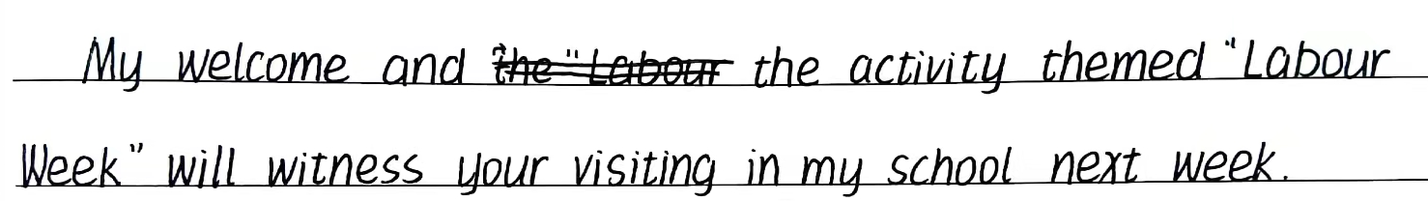


假如你是李华，你的英国朋友 Kim 将于下周访问你校，并参与学校组织的“劳动实践 周”（Labour Week）活动。请你给他写封邮件，
内容包括： 1．表示欢迎；2．介绍活动目的和内容； 3．表达祝愿。
para.1目的+背景
切忌生搬
硬套
(How is it going?) Having learnt that you will visit our school and join in our Labour Week next week, I’d like to give my warm welcome to you.
(Hope this email finds you well.) I’m overjoyed to know your coming to our school and joining in our Labour Week next week. Welcome!

Slide 5
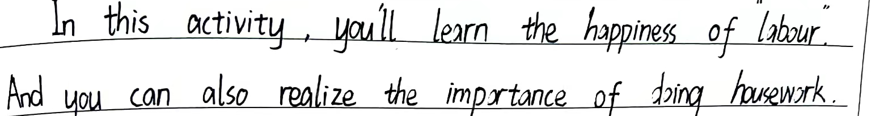
假如你是李华，你的英国朋友 Kim 将于下周访问你校，并参与学校组织的“劳动实践 周”（Labour Week）活动。请你给他写封邮件，
内容包括： 1．表示欢迎；2．介绍活动目的和内容； 3．表达祝愿。
para.2 活动介绍（目的+内容）
目的不是收获！

Slide 6
para.2 活动介绍（目的+内容）
with the purpose/aim/intention of
aimed at+活动/aiming to
be intended to do/be targeted at
for the sake of
...
目的
fuel our passion for manual work激发体力劳动的热情
understand the value of labor 明白劳动的重要性
foster our hands-on ability培养动手能力
train the basic skills of laboring 训练劳动基本技能
cultivate basic labor habits 培养基本的劳动习惯
enlighten our awareness of respecting all kinds of labor
启发劳动平等意识
develop a sense of social responsibility培养社会责任感

Slide 7
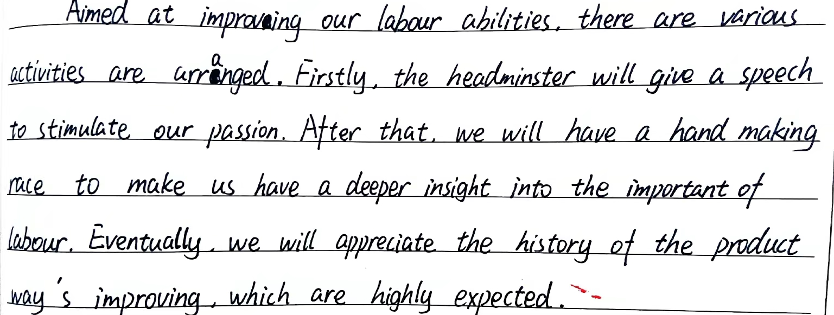
假如你是李华，你的英国朋友 Kim 将于下周访问你校，并参与学校组织的“劳动实践 周”（Labour Week）活动。请你给他写封邮件，
内容包括： 1．表示欢迎；2．介绍活动目的和内容； 3．表达祝愿。
para.2 活动介绍（目的+内容）
活动太泛泛而谈，不够具体及典型

Slide 8
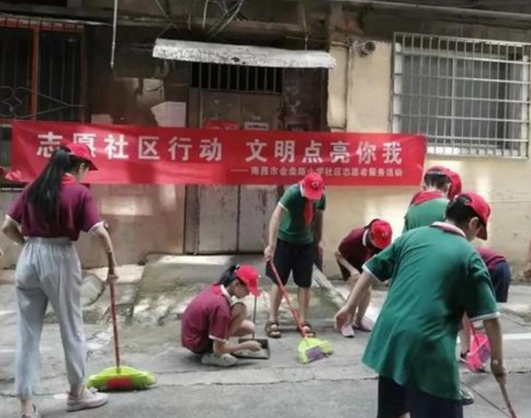
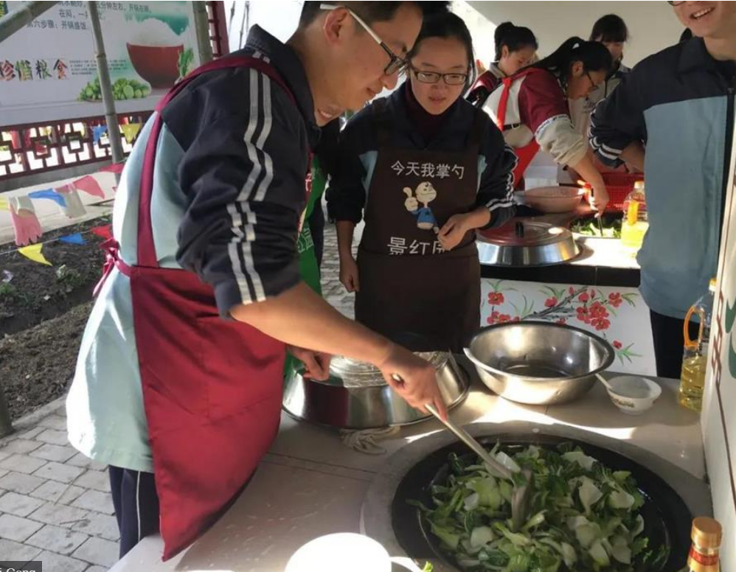
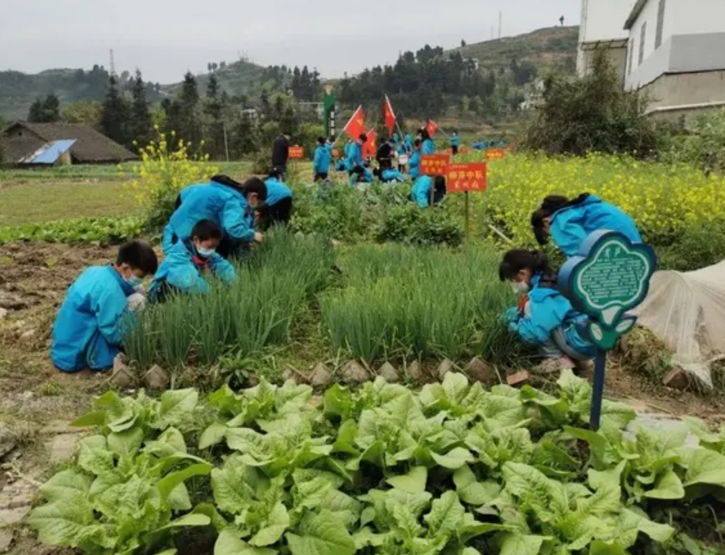
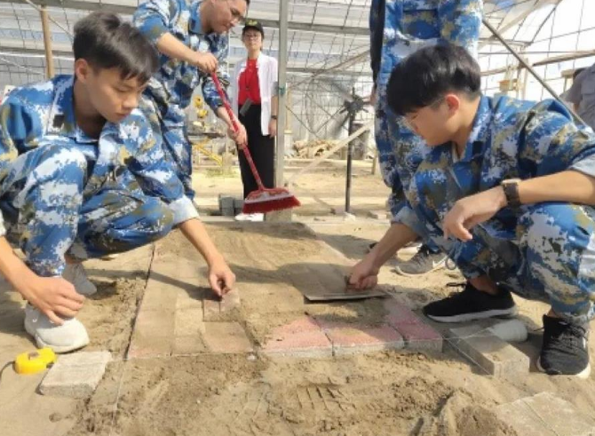
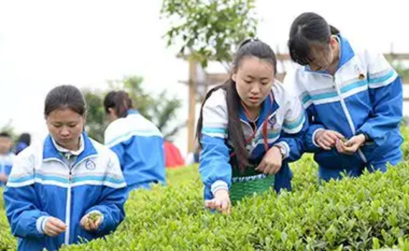
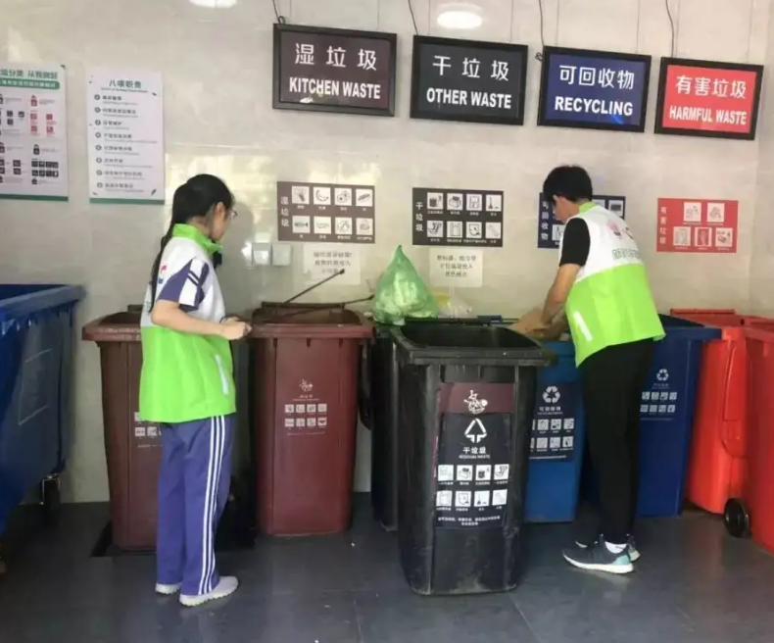
do community services
learn cooking
劳动周活动
plant vegetable
pave a road
pick tea leaves
sort garbage

Slide 9
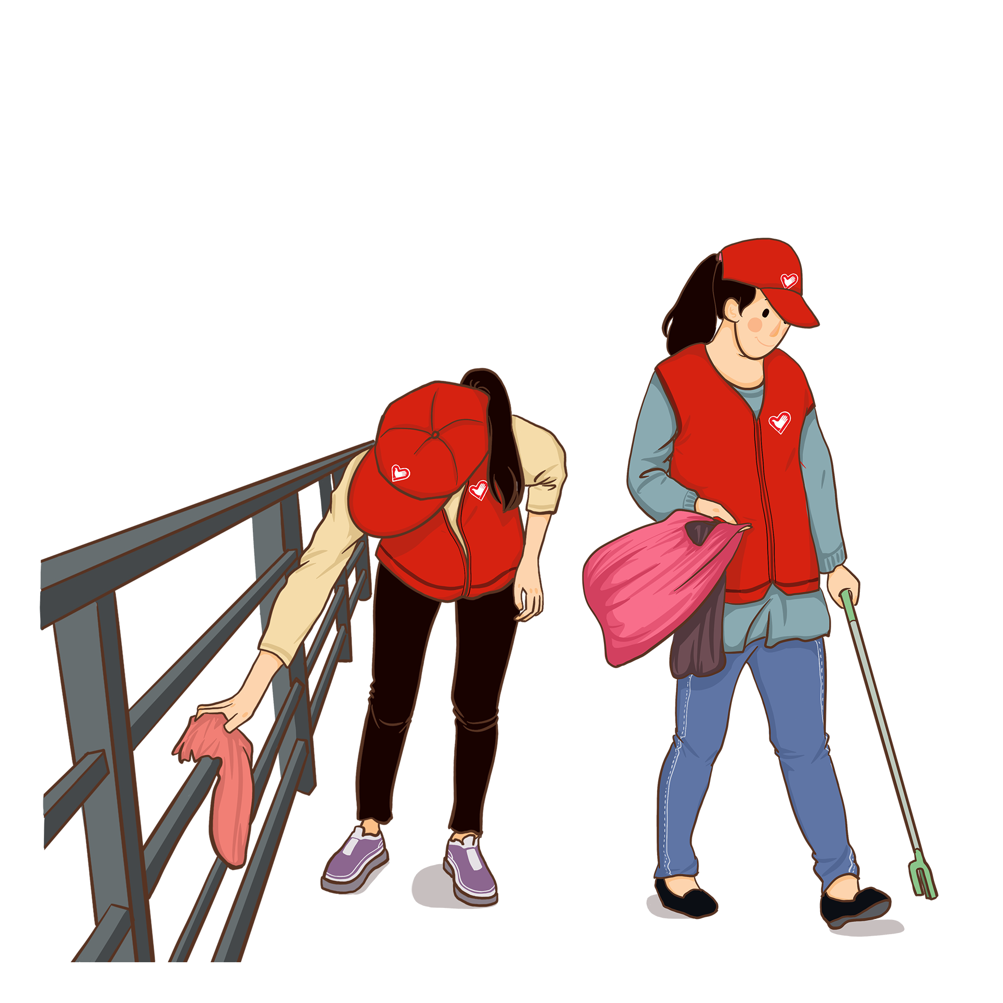
para.2 活动介绍（目的+内容）
内容
___________(如计划安排) , a variety of ______________ (定制的活动) will __________(安排) by our school next week, ____________(从...到...) planting vegetables personally in our school garden _______ picking, sorting and recycling rubbish.
As scheduled
tailor-made activities
be arranged
ranging from
to

Slide 10
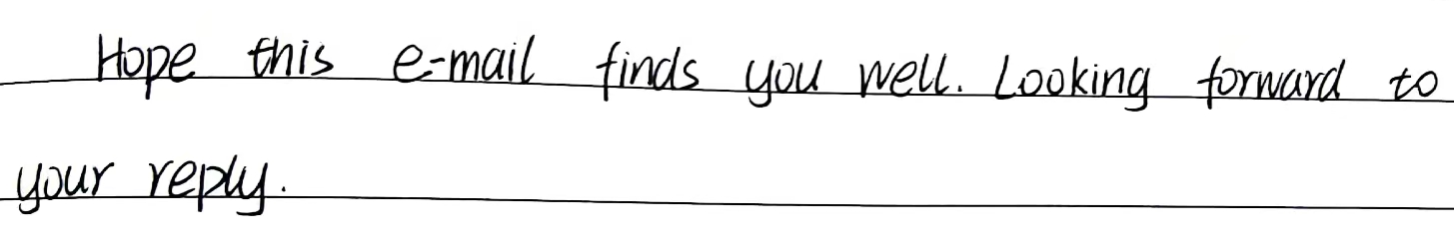

假如你是李华，你的英国朋友 Kim 将于下周访问你校，并参与学校组织的“劳动实践 周”（Labour Week）活动。请你给他写封邮件，
内容包括： 1．表示欢迎；2．介绍活动目的和内容； 3．表达祝愿。
para.3 表达祝愿
1. 祝愿不是问候。
2. 需要Kim回信
吗？

Slide 11
para.3 表达祝愿
Looking forward to your arrival/coming!
Looking forward to your joining us!
Looking forward to seeing you soon!
Expecting your arrival and best wishes!
Wish you a pleasant journey and a wonderful stay here!
I wish you all the best!
Wish you an enjoyable and unforgettable week!
Hope you have fun and more than fun during your stay here!

Slide 12
one possible version
Dear Kim,
It’s great to know you will visit our school next week and welcome to join in our Labour Week.
The event is intended to raise our awareness of labour and remind us of how valuable and respectable(值得尊敬的) hard work is. Scheduled to start on March 10th, it will last approximately a week. Various activities will be organized, ranging from planting vegetables on school farm to sorting garbage in an eco-friendly way. Especially there will be a class meeting aimed for a deeper reflection on labor experience.
Wish you a good journey and see you soon.
Yours,
Li Hua

Slide 13
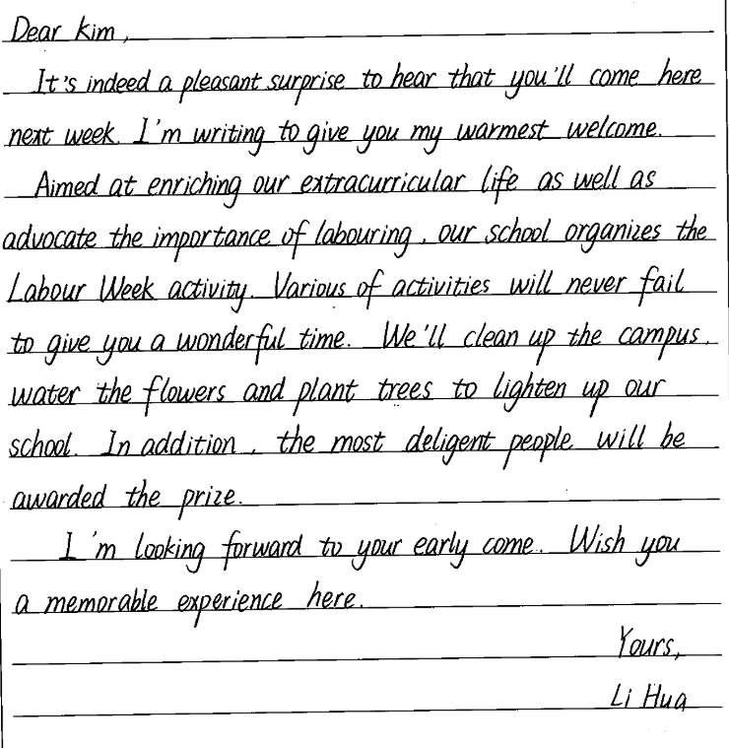
要点齐全，层次清晰，语言流畅， 书写优美。
diligent

Slide 14
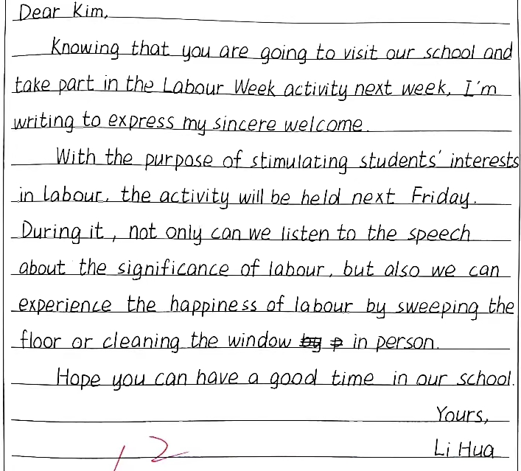
高三7 汤雨诺
1. 结构清晰
2. 语言表达丰富、多样：使用非谓语引出背景；用介词短语表达活动目的；用not only...but also...阐述活动内容及拓展活动意义。

Slide 15
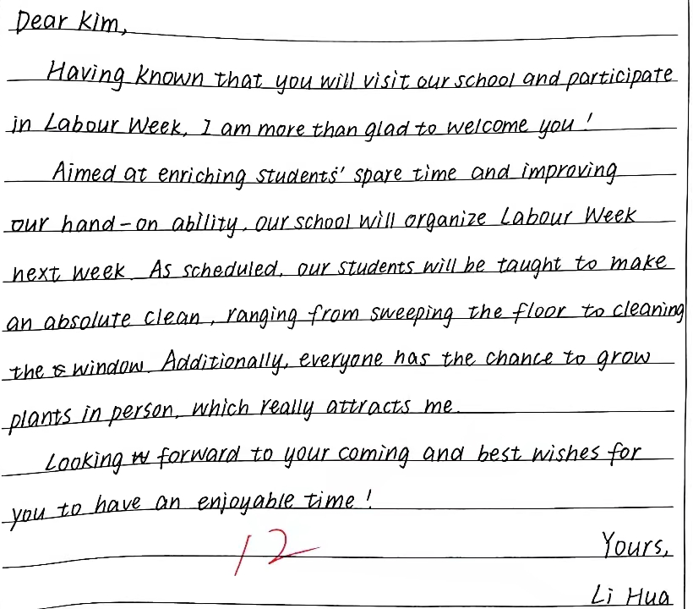
高三6 许诺
1. 书写优美
2. 语意连贯
3. 表达丰富、得体.如：第一段用非谓语传递背景信息，使语言表达简洁明了； 第二段用衔接词additionally使文章上下文连贯通顺。

Slide 16
下水作文
Dear Kim,
Hope this e-mail finds you well! Having learnt your coming to our school and joining us in Labor Week, I’m overjoyed! Welcome!
Aiming to enlighten our awareness of the value of labor and foster our hands-on ability, the event will last a whole week. As scheduled, a variety of practice-oriented activities will be mounted, ranging from picking up tea leaves in person at our school’s tea garden and learning to process them under guidance to decorating our campus by planting flowering trees(观花乔木).
Look forward to your arrival and wish you a happy journey.
(97words) Yours,
Li Hua

Slide 17
易错词块
arouse our _____________(意识) of
an _______________(难忘的) week
have_____________(variety) activities
become ____________(独立)
have a _____________(愉快的)journey
develop _________________________(一种社会责任感)
appeal __________________________(学生养成劳动习惯)
Looking forward to your __________(arrive)!
awareness
unforgettable
various
=have a variety of activities
independent
pleasant
a sense of social responsibility
to students to foster labor habits
arrival

Slide 18
the end

