Slide 1

感恩遇见，相互成就，本课件资料仅供您个人参考、教学使用，严禁自行在网络传播，违者依知识产权法追究法律责任。
更多教学资源请关注
公众号：溯恩高中英语
知识产权声明

Slide 2
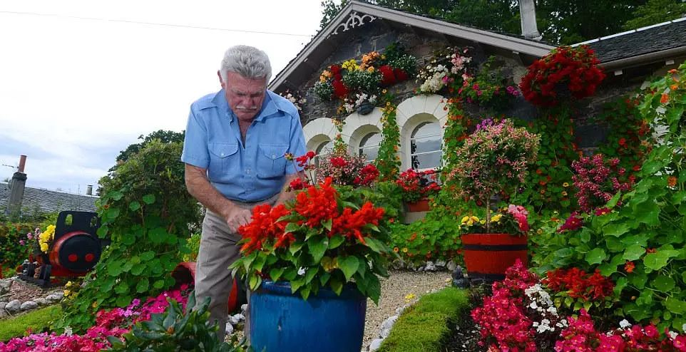
2022年4月杭州市高三教学质量检测
基于“回找伏笔，两‘情’相悦”读后续写精讲
My neighbor Bill
杭州二中许丽君

Slide 3
典题示例
第二节 读后续写（满分25分）
阅读下面短文，根据所给情节进行续写，使之构成一个完整的故事。
My family moved in a small house in Brighton, Colorado on my seventh birthday. My first memory is our neighbor Bill, an old man, handing me strawberries from his garden through a hole in the chain-link(铁丝网) fence. “We need to make the hole bigger,"” he said jokingly. Later I knew that he lived alone.
Bill spent much time working in the garden, and I was always talking to him from our yard. I was a chatterbox. I think what drew me to Bill is that he never got tired of listening to me. l also think Bill saw a lot of himself in me-we were both lonely and anxious-and that may be why he always took the time to listen to me. It was a wonderful connection.
There weren't any kids of my age in the neighborhood, and my parents were very busy, so l mostly played in the yard with my dog, I had a lot of imaginary friends-a whole family, actually, with a wife, children, a best friend...no joke. Weird kid.
One day, my parents asked Bill whether he'd watch me while they were away on business. This worked well for everyone, so it became a somewhat monthly occurrence. Bill had a spare room in his house, which became " my” room.

Slide 4
Bill promised to teach me to drive the lawn tractor(割草机)someday and I was always looking forward to it. In winter. Bill would attach a snowplow(铲雪机) to the front of the lawn tractor. I seriously told him that I would invent a better snowplow when I grew up. “Sure you will. You'll get a patent certificate. It takes a certificate to prove an important thing," Bill said with a smile.
One snowy morning, an idea suddenly hit me. My parents were watching TV when I spit it out. What if I adopted Bill as my grandpa?" My parents said I could go over and ask him.
Paragraph1:
I knocked on his door, sat down in his living room, and asked, “ Can I adopt you as my grandpa?”__________________________________________________________
Paragraph 2:
The next morning, while learning to drive the lawn tractor with a snowplow, I accidentally plowed down our chain-link fence. ________________________________

Slide 5
1
读内容 Read for the plot
2
读线索 Read for the clue
3
读语言 Read for the language
4
读文章大意和主旨 Read for the main idea and theme
Read
5
读主人公的情感 Read for emotion
6
读时间轴上的动作 Read for the actions on the timeline
7
探索主题要旨 Explore the theme
8
预测故事结尾 Predicting the ending

Slide 6

Read
01
读内容：Read for the plot 为续写的融洽性奠定基础
文本的主旨：人与自我，人与社会，主题语境下的人际交往相关的内容。一个少年与一位独居老人的忘年之交，“我”要认老人为祖父，继续一直以来友好的邻里之情。
展开文本故事解读：
故事讲述了一位独居老人和孩子之间的忘年之交，因为志趣相投，他们互相陪伴，互叙衷肠。因为意外的铁丝网篱笆被挖倒，更加深了孩子与老人之间的联系，促进了他们珍贵弥足的友情，就像是真正的一家人。

Slide 7
Read
01
读内容：Read for the plot 为续写的融洽性奠定基础
3. 语篇类型解读：记叙文-Narrative Text
语篇文本介绍：(回找伏笔）
7岁那年我随父母搬家来到了Brighton, 邻居是一个独居老人，他友好、勤劳，会耐心听我唠叨，我也是一个话匣子，与他我无话不说，老人从我身上看到了他自己的影子，我们俩成了忘年之交。老人教我使用割草机，我表示将来要发明更好用的铲雪机，与下文第二段首句提示语衔接。

Slide 8
两“情”相悦-情感连贯，情节合理（coherent in emotion and logical in plot）
要求续写的段首语分别是：
第一段: I knocked on his door, sat down in his living room, and asked, “ Can I adopt you as my grandpa?
第二段：The next morning, while learning to drive the lawn tractor with a snowplow, I accidentally plowed down our chain-link fence.
根据原文情节信息，结果应该是温暖感人的，其乐融融的一家人的氛围。根据第一段：我询问老人是否愿意做我的祖父？和第二段：学习使用铲雪机时出现了意外，我不小心把铁丝网篱笆挖倒了........，续写部分情节推断不难，可以想象一下情节：
第一段：重点要写作者想认老人为祖父，老人会有什么反应，会同意当他的祖父吗？“I”在听到Bill的回答后会有什么样的心情? 可以有动作和语言描写，也可以叙述“I”与父母汇报与老人沟通的结果。
第二段：重点写学开铲雪机时，篱笆墙被挖倒了，祖父没有责备他，而是安慰他。篱笆墙可以重建、修复，也可以拆除，拆除后两人之间的关系会更加密切，真正成为无障碍、心与心沟通的好邻居，成为真正的一家人。

Slide 9
Read
02
读线索：Read for the clue为思维逻辑发展指明方向(回找伏笔）
My family moved in a small house in Brighton, Colorado on my seventh birthday. My first memory is our neighbor Bill, an old man, handing me strawberries from his garden through a hole in the chain-link(铁丝网) fence. “We need to make the hole bigger,"” he said jokingly. Later I knew that he lived alone.
Bill spent much time working in the garden, and I was always talking to him from our yard. I was a chatterbox. I think what drew me to Bill is that he never got tired of listening to me. l also think Bill saw a lot of himself in me-we were both lonely and anxious-and that may be why he always took the time to listen to me. It was a wonderful connection.
There weren't any kids of my age in the neighborhood, and my parents were very busy, so l mostly played in the yard with my dog, I had a lot of imaginary friends-a whole family, actually, with a wife, children, a best friend...no joke. Weird kid.
One day, my parents asked Bill whether he'd watch me while they were away on business. This worked well for everyone, so it became a somewhat monthly occurrence. Bill had a spare room in his house, which became " my” room.
.
Bill’s character：joking, easy-goning, alone, anxious
故事开端：
我对邻居Bill的最初的记忆。
情节推进：
接下来作者用自己的亲身经历来诠释与Bill之间有更多的互动和联系，两人之间有很多共同之处，也有很多分享。
Author’s character：lonely, anxious, friendly, eager

Slide 10
Read
02
读线索：Read for the clue为思维逻辑发展指明方向（回找伏笔）
Bill promised to teach me to drive the lawn tractor(割草机)someday and I was always looking forward to it. In winter. Bill would attach a snowplow(铲雪机) to the front of the lawn tractor. I seriously told him that I would invent a better snowplow when I grew up. “Sure you will. You'll get a patent certificate. It takes a certificate to prove an important thing," Bill said with a smile.
One snowy morning, an idea suddenly hit me. My parents were watching TV when I spit it out. What if I adopted Bill as my grandpa?" My parents said I could go over and ask him.
Paragraph1:
I knocked on his door, sat down in his living room, and asked, “ Can I adopt you as my grandpa
Paragraph 2:
The next morning, while learning to drive the lawn tractor with a snowplow, I accidentally plowed down our chain-link fence.
故事经过：
Bill答应教我驾驶割草机，我告诉他我要发明更好用的铲雪机
author’s Emotion：expecting and passionate
故事发展：
作者突发奇想，想认Bill为祖父，父母鼓励，紧接着老人会怎么说？怎么做？我听了老人的回答后，有什么样的心情，语言和动作描写都可以有。当作者学习使用铲雪机时出现意外，把铁丝网篱笆挖倒了，后面的故事情节怎么发展？
Bill’s emotion：easy-going，helpful

Slide 11

Read
03
读语言：read for the language 为上下文连贯性提供依据
★ the psychological description
★ the dialogue description
★ the inner thought description
★ the behavior description
……

Slide 12
Read
03
读语言：read for language 为上下文连贯性提供依据
My family moved in a small house in Brighton, Colorado on my seventh birthday. My first memory is our neighbor Bill, an old man, handing me strawberries from his garden through a hole in the chain-link(铁丝网) fence. “We need to make the hole bigger,"” he said jokingly. Later I knew that he lived alone.
Bill spent much time working in the garden, and I was always talking to him from our yard. I was a chatterbox. I think what drew me to Bill is that he never got tired of listening to me. l also think Bill saw a lot of himself in me-we were both lonely and anxious-and that may be why he always took the time to listen to me. It was a wonderful connection.
There weren't any kids of my age in the neighborhood, and my parents were very busy, so l mostly played in the yard with my dog, I had a lot of imaginary friends-a whole family, actually, with a wife, children, a best friend...no joke. Weird kid.
One day, my parents asked Bill whether he'd watch me while they were away on business. This worked well for everyone, so it became a somewhat monthly occurrence. Bill had a spare room in his house, which became " my” room.
开门见山，主题引领（the theme of the story)
行为动作描写（the behavior description）

Slide 13
Read
03
读语言：read for language 为上下文连贯性提供依据
Bill promised to teach me to drive the lawn tractor(割草机)someday and I was always looking forward to it. In winter. Bill would attach a snowplow(铲雪机) to the front of the lawn tractor. I seriously told him that I would invent a better snowplow when I grew up. “Sure you will. You'll get a patent certificate. It takes a certificate to prove an important thing," Bill said with a smile.
One snowy morning, an idea suddenly hit me. My parents were watching TV when I spit it out. What if I adopted Bill as my grandpa?" My parents said I could go over and ask him.
Paragraph1:
I knocked on his door, sat down in his living room, and asked, “ Can I adopt you as my grandpa?”
Paragraph 2:
The next morning, while learning to drive the lawn tractor with a snowplow, I accidentally plowed down our chain-link fence.
行为动作描写（the behavior description）
心理描写（ the Psychology description）
行为动作描写（the behavior description）

Slide 14
Read
04
读故事中心大意和主旨：read for main idea and theme
What's the main idea of the story?
At the age of seven, we moved in a small house in Brighton, where I met my neighbor Bill. Since we were both lonely and anxious, Bill always talked to me, listened to me and promised to teach me to drive the lawn tractor. One snowy morning, I expected to adopt Bill as my grandpa. My parents encouraged me that I should ask Bill whether he was willing to be my adopted grandpa. Being my kind and helpful neighbor, Bill was sure and willing to be adopted as my grandfather.
What's the theme of the story?
There is another friendship between the kid and the elder due to the similarity such as the same interest and the same character.

Slide 15
Read
05
读主人公的情感Read for the emotion of character
Para.5: Bill promised to teach me to drive the lawn tractor and I wanted to invent a better snowplow.
Climax
Para 6. I wanted to adopt Bill as my grandfather
Para.2-4: Bill and I had more and more interaction and connection.
helpful
Continuation para.1: I asked Bill if he was willing to be adopted as my grandfather?
rising action
Eager
passionate
falling action
Para.1 At the age of 7, we moved in a small house in Brighton, where I met my neighbor Bill. There was a chain-link fence between our yards
Lonely, anxious
friendly
Continuation para.2: The next morning... I accidentally plowed down our chain—link fence.
chatterbox
resolution
background

Slide 16
Read
06
读时间轴上的动作Read for the actions on the timeline
On my seventh birthday
someday
Our neighbor Bill, handed me strawberries through a hole.
Bill promised to teach me to drive the lawn tractor.
?
B
D
A
Spent much time in the garden
C
One snowy morning
E
It was a wonderful connection.
An idea whether I could adopt Bill as my grandpa hit me.

Slide 17

Read
07
Explore the theme（探索主题要旨）
In the garden, in Bill’s house
I, neighbor Bill
Where (place)
Who (character)
Main idea: the author had a good relationship with his neighbor Bill, they had a lot in common and Bill promised to teach him to drive the lawn tractor. He desired to take the old lonely neighbor Bill as his grandpa, something unexpected about the fence happened accidently.
The author asked Bill if he could be adopted as his grandpa. Could he learn to drive the lawn tractor?
seventh birthday, one day, one snowy morning
How (solution)
When (time)
Because they had a lot in common, they were both lonely and anxious. It was a wonderful connection.
Why (reason)
The author expected to adopt his neighbor Bill as his grandpa.
What (event)

Slide 18
Read
08
Predicting the ending(预测故事结尾）
How did the author feel?
chatterbox
lonely
anxious
friendly
expecting
eager
Passionate/grateful

Slide 19
Read
08
Predicting the ending(预测故事结尾）
Make predictions with the help of given detailed information
三条线 | 时空线（明线） Time & Place (setting) | 情节线 (Plot明线) | 情感线 (Mood暗线) (author) | 情感线 (Mood暗线) (neighbor Bill)
 | On my seventh birthday, someday One snowy morning | Opening (起） inciting incident(引发事件） | chatterbox | joking
 | In the garden, in Bill’s house | Foreshadowing (伏笔） | Lonely/ anxious | Alone/anxious
 | The chain-link fence | Developing ( 承）Up | friendly | helpful
 |  | Changing （转） | Expecting/eager
 |  | Concluding （合） | passionate/grateful | caring

Slide 20
Read
08
Predicting the ending(预测故事结尾）
Trends/ending in the story’s development
Prediction：
Paragraph 1:
Q1: What would the old man react to my request? Will he agree?
Q2: Are there any special action to express their relationship?
Paragraph 2:
Q1: What would the old man say to comfort me?
Q2: How would the old man deal with the broken fence? Rebuild, repaired, or removed?

Slide 21
Predict the plot -1
Writing
Trace the hidden clues in the given sentences
Paragraph 1:
I knocked on his door, sat down in his living room, and asked, “ Can I adopt you as my grandpa?”
Paragraph 2:
The next morning, while learning to drive the lawn tractor with a snowplow, I accidentally plowed down our chain-link fence.
problem
author’s inner thought:
eager
expecting
Author’s reaction
Anxious/scared
appreciative
further problem

Slide 22
Predict the plot-2
Writing
Trace the hidden clues in the given sentences
Paragraph 2:
The next morning, while learning to drive the lawn tractor with a snowplow, I accidentally plowed down our chain-link fence.
The time I made a mistake, how would Bill react? Anything to be done to make up with the accident of our chain-link fence?
Resolution
result?
It doesn’t matter whether or not to rebuild or pull down the chain-link fence. What counts is that Bill and I became closer than ever.

Slide 23
Writing
Read
09
Make the draft, weave the story
What is the theme of the story?
先写最后一句即主题句
That’s the true meaning of connection, family and love.
Never would I forget the happiness Bill showed that day, and our harmonious life was continuing.
I always visited him frequently to ease his loneliness and been determined to learn to drive the lawn tractor well and invent a better snowplow for him.
From that day, nothing divided us apart and my imaginary family came into the reality.
It was him that let me know the true meaning of love from family.
From that day on, I had a new family member and was no longer lonely as before.

Slide 24
Writing
Read
09
Make the draft, weave the story
再写衔接句即第一段的最后一句:
1. Bill was now my grandpa who taught me to drive the lawn tractor.
2. Bill suggested teaching me to drive the lawn tractor in the garden. I agreed in exhilaration.
“I can use the lawn tractor tomorrow.” I murmured. I even couldn’t fall asleep that night.
He knew what I wanted to do, promising to teach me the next morning.
The next moment, I held the lawn tractor cautiously and he taught me how to use it hand by hand. Quickly, I became much skilled.
I must live up to his expectation, I took action immediately in the garden to learn how to use the lawn tractor.
Bill assured me that he would teach me to drive the lawn tractor tomorrow. I couldn’t wait for it.

Slide 25
Writing
Read
09
Make the draft, weave the story
紧接着根据每段的提示语句写角色的情感
根据第一段提示写：
With his eyes wide open, Bill stood still and stiff. “Are you serious, kid?”
“What? His eyebrows rose in absolutely astonishment. I cracked a smile and continued to explain, inviting him to be a member of my family, so that he would not be so lonely and anxious as before.
Firstly confused, then full of surprise, Bill’s eyes widened. “Are you serious?” he laughed, “of course, you can, buddy!”
Bill was first a bit confused by my strange question, but then he agreed happily.
Bill stiffened for seconds, then the surprised look was replaced by a gracious smile.

Slide 26
Writing
Para 2
Read
09
Make the draft, weave the story
根据第二段提示写：
Attracted by the huge noise I caused, Bill rushed out of the door and saw the fallen chain-link fence.
2. There was a big hole on the fence. Anxious and scared, I stood rooted to the spot.
3. Looking at the fence, Bill frowned, worrying that my parents would be unhappy then. He tried to fix it.
4. Frightened by the unexpected accident, I stood there, tongue-tied.
5. So nervous was I that I didn’t know what to do but sat there and glued at the fence.
6. Seeing this, Bill rushed to me and quickly shut off the tractor.

Slide 27
Writing
Para 1-2
Read
09
Make the draft, weave the story
最后就是把每段的中间补充完整
it’s my dream to have a grandson like you.
He hugged me with tears sparkling in his misty eyes. At that time, I felt my connection with him strengthened.
While I was bouncing like a rabbit, he was staring at me, all his loneliness, unhappiness fled away.
He patted me on the head. With a tune of relief, I breathed a sigh of relief.
5. No sooner had Bill realized what had happened than he laughed, announcing that since we were a family, the fence was supposed to be pulled down so that we could visit each other more easily.
6. Without that chain-link fence, we can have a more convenient connection.
7. The snowy morning, we finished the adoption ceremony by ourselves.
8. After removing the chain-link fence, he often came to our house, chatting, and neither of us was lonely any more.

Slide 28
Possible Version 1:
Paragraph 1:
I knocked on his door, sat down in his living room, and asked, “ Can I adopt you as my grandpa?” He froze to the spot, I stared at him with wild joy, noticing tears blurred his vision. No sooner had I reached for papers to wipe his tears than he uttered a firm word, “I can, of course, I can.” At that time, Bill couldn’t help sobbing, murmuring, “We’re a family!” He exclaimed that he would teach me to drive the lawn tractor. After hearing the word, I felt a sense of exhilaration mingled with excitement bubbling inside me. I dashed to Bill, giving him a big tender embrace.

Slide 29
Possible Version 1:
Paragraph 2:
The next morning, while learning to drive the lawn tractor with a snowplow, I accidentally plowed down our chain-link fence. So nervous was I that I didn’t know what to do but sat there and glued at the fence. Sweat dropping from my head, a sense of nervousness deprived my power of speech. Bill walked towards me and said, “It’s not a big deal.” The thought that he didn’t accept my idea surged through me. Tears rolling down on my face. Bill hugged me, whispering word beside my ear. “Although you didn’t make it, we have been family earlier.” A smile blossomed on my face. I seriously told him again I would invent a better snowplow when I grow up and he would never feel lonely again.

Slide 30
Possible Version 2:
Paragraph 1:
I knocked on his door, sat down in his living room, and asked, “ Can I adopt you as my grandpa?” On hearing this word, Bill stood rooted to the ground, numb with shock. Then he whispered, “ Are you serious, my kid?” “Of course I am! As you know, I have no peer friend since I moved here, and the truth is that you’re my only friend. So please don’t say no.” I begged. “I won’t, you’re right, we have a lot in common.” No sooner had he finished his word than I embraced him tightly. We smiled radiantly, as if we’re really old friends. Then an idea flashed across my mind, “it’s time to learn how to use the lawn tractor from him.” I thought. Fortunately, my advice met with his agreement. The next moment, I held the lawn tractor cautiously and he taught me how to use it hand by hand. I became much skilled.

Slide 31
Possible Version 2:
Paragraph 2:
The next morning, while learning to drive the lawn tractor with a snowplow, I accidentally plowed down our chain-link fence. Looking at the fence, Bill frowned, worrying that my parents would be unhappy then. He tried to fix it. However, I just wanted to clear it away. “Grandpa,” I shouted, attracting his attention. “Do you still remember you said we need the hole bigger, why not just remove it?” He fell into silence at my words, thinking about it seriously. At that moment, my parents appeared, agreeing with me before Bill went on to apologize. “We are the family now and forever.” I said. From that day, nothing divided us apart and my imaginary family came into the reality.

Slide 32
Possible Version 3:
Paragraph 1:
I knocked on his door, sat down in his living room, and asked, “ Can I adopt you as my grandpa?” Bill was first a bit confused by my strange question, but then he agreed happily. “Surely I will. I haven’t had a family in countless years.” He hugged me with tears sparkling in his misty eyes. At that time, I felt my connection with him strengthened. After a while, he asked me whether I wanted to learn on the next morning and I was really expecting the time to come. I went home after saying goodbye to him. I talked to my parents that Bill agreed and they were also happy to learn that. That night, I even couldn’t fall asleep.

Slide 33
Possible Version 3:
Paragraph 2:
The next morning, while learning to drive the lawn tractor with a snowplow, I accidentally plowed down our chain-link fence. I was frightened, for if my parents figured it out, they would definitely grow angry. I tried to drive back the lawn tractor but it just didn’t work. “Easy, easy.” Comforted Bill. He helped me move off the big machine. “Now it seemed that you did make the hole bigger.” joked my new grandpa. My parents went out at that time on hearing the big noise. They were shocked at first, but to my big surprise, they didn’t howl at me. Instead, my mom suggested, “Why not remove the fence so that you could play with your grandpa more conveniently!” All of us agreed. Now, with two gardens connected, two lonely hearts would never feel lonely again.

Slide 34
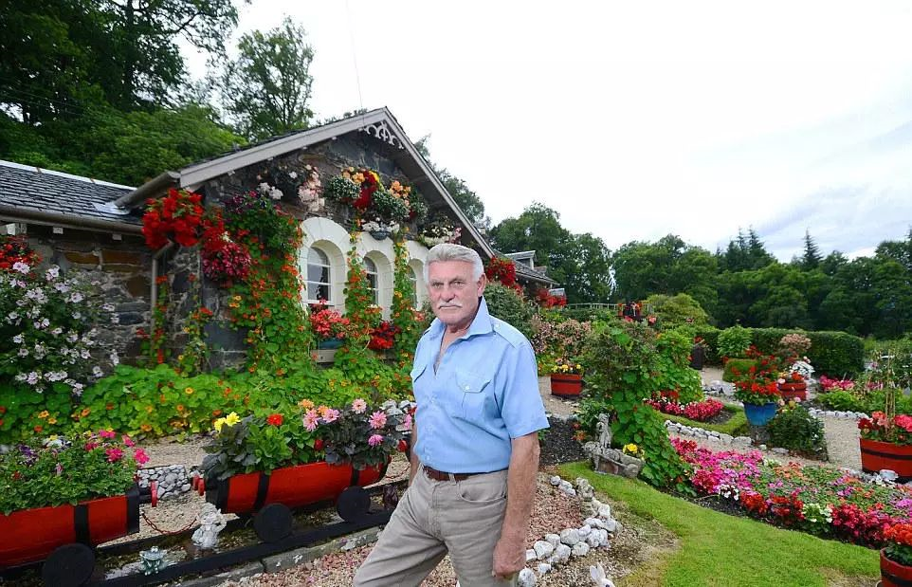
Thanks For Your Attention!

