Slide 1

感恩遇见，相互成就，本课件资料仅供您个人参考、教学使用，严禁自行在网络传播，违者依知识产权法追究法律责任。
更多教学资源请关注
公众号：溯恩高中英语
知识产权声明

Slide 2

20220414台州二模读后续写讲评
Celebrate Dad’s fiftieth birthday
陈星可 浙江省天台中学

Slide 3
试题呈现：
It was a cold yet sunny Saturday morning in February. Dad’s New Year’s resolution had been to get fit. Mum pushed him out of bed and told him to go jogging by the river. Later, after a nice lie-in, she went downstairs in her dressing gown and found the kids watching TV. She turned it off and said she was going to do something really special for Dad’s birthday. If they overheard anything, just promised to keep it secret.
Jenny looked at Mum with a puzzled expression on her forehead and promised they wouldn’t say anything whatever happened. But Jenny reminded Dad’s birthday was in June and it might be a little too early to get all steamed up about it.
Silent for a moment, Mum said she was not getting everything ready but just wanted to spare enough time for preparation as this year it’s a bigger deal than usual. Dad was going to be 50.
“50! Gosh, that’s half a century,” spluttered Gerry. “I knew he was old, but I didn’t realize he was ancient!?”
Indeed, that was why Mum started planning a special party for him. Mum talked with grandma about the plan because her house was the only one in the family that is spacious enough for all friends and relatives. Grandma quite agreed and also started preparing.

Slide 4
“But you know how Dad feels guilty to bother others. You’ve got to admit,” reminded Jenny. Thinking over the special occasion, Mum was continuing with her secret when one evening, Dad was sitting at the dinner table and he suddenly slapped his forehead, “I just realized that I am going to be 50 in June. Le’s just quietly forget about it. I want to mourn (哀悼) the passing of my youth in private.”
“Oh, come on Dad, don’ t be such a spoil-sport!” begged the kids, hoping to give mum a hand.
Realizing no more chance to hide the secret, Mum carefully worded her thought and shared her plan of having a little party at grandma’s house. Dad was stunned(震惊的) to no reply.
Paragraph 1:
Frustrated, Mum made a call to Grandma.__________________ _________________________
Paragraph 2:
They got everything ready as planned when June finally came.____________________________

Slide 5

Learning language：
1.新年决心
2.去慢跑
3.下楼
4.保守秘密
5.一副迷惑的表情
6.抽出足够的时间
7.对...感到内疚
8.在这个特殊的场合
9.坐在餐桌旁
10.私下地
1.New Year’s resolution
2.go jogging
3.do downstairs
4.keep... a secret (from...)
5.a puzzled look/expression
6.spare enough time
7.be guilty about...
8.on the special occasion
9.at the dinner table
10.in private

Slide 6
Understanding the story：
was approaching
Dad _______________(approach) 50. Mum intended to prepare a special birthday party _____ the important moment. As her house was not __________(space) enough for all the friends and relatives, she consulted with Grandma and decided to have the party at ____________(Grandma).
As Dad, whose New Year’s Resolution was ________(stay) fit, was always g______ about bothering others. To achieve her plan, she started early and shared the plan with her kids. Though ______(ask) to keep it a secret from Dad, the two kids accidentally let it _____ to Dad. Full of __________(frustrate), she made a call to Grandma...
for
spacious
Grandma’s
to stay
guilty
asked
out
frustration

Slide 7
Understanding the story：
Mum wanted to plan a special party for Dad’s 50th birthday and asked kids to keep secret
Everything ready, the big day came...
Story
Mum gave a call to Grandma...
Dad didn’t want to bother others
The kids accidentally let the secret out
expectant +?
Emotion
expectant
worried+ ？
frustrated, guilty
guilty

Slide 8
Understanding the story：
1.It was a cold yet sunny Saturday morning in February. Dad’s New Year’s resolution had been to get fit. Mum pushed him out of bed and told him to go jogging by the river. Later, after a nice lie-in, she went downstairs in her dressing gown and found the kids watching TV. She turned it off and said she was going to do something really special for Dad’s birthday. If they overheard anything, just promised to keep it secret.
2.Jenny looked at Mum with a puzzled expression on her forehead and promised they wouldn’t say anything whatever happened. But Jenny reminded Dad’s birthday was in June and it might be a little too early to get all steamed up about it.
3.Silent for a moment, Mum said she was not getting everything ready but just wanted to spare enough time for preparation as this year it’s a bigger deal than usual. Dad was going to be 50.
4. “50! Gosh, that’s half a century,” spluttered Gerry. “I knew he was old, but I didn’t realize he was ancient!?”
Q1: Why was Dad’s New Year’s resolution was mentioned at the beginning?
It can serve as a foreshadowing.
Q2: Some hints showing that party would be special.
1.asked kids to keep it a secret
-- give Dad a surprise
2.spare months for the preparation
-- make it a bigger deal
3.Dad was going to be 50
-- an important moment for Dad

Slide 9
Understanding the story：
5.Indeed, that was why Mum started planning a special party for him. Mum talked with grandma about the plan because her house was the only one in the family that is spacious enough for all friends and relatives. Grandma quite agreed and also started preparing.
6.“But you know how Dad feels guilty to bother others. You’ve got to admit,” reminded Jenny. Thinking over the special occasion, Mum was continuing with her secret when one evening, Dad was sitting at the dinner table and he suddenly slapped his forehead, “I just realized that I am going to be 50 in June. Le’s just quietly forget about it. I want to mourn (哀悼) the passing of my youth in private.”
7.“Oh, come on Dad, don’ t be such a spoil-sport!” begged the kids, hoping to give mum a hand.
8.Realizing no more chance to hide the secret, Mum carefully worded her thought and shared her plan of having a little party at grandma’s house. Dad was stunned(震惊的) to no reply.
Q2: Some hints showing that party would be special.
4.have the party at Grandma’s
-- to hold all friends and relatives
Q3: What made the party go abortive?
1.Dad felt guilty to bother others.
2.Kids accidentally let out the secret.

Slide 10
Design the plot: foreshadowing
Overshadowing | Possible plot
Dad’s New Year’s resolution had been to get fit.
Para1:她们决定以get fit 方式来庆祝生日。
promised they wouldn’t say anything whatever happened.
Para1:妈妈决定这次不在分享生日计划，以免再次被泄露。
Oh, come on Dad, don’ t be such a spoil-sport!
Dad feels guilty to bother others.
Para2:以两全其美的方式帮爸爸度过50岁生日。
Tip: Overshadowing can make the story you make up reasonable, logical and coherent.

Slide 11
Design the plot: Q-A
Paragraph 1: Frustrated, Mum made a call to Grandma._______
Paragraph 2: They got everything ready as planned when June finally came. ______________________________________
Q1:What did she say on the phone? What was Grandma’s reaction?
Q2: About the party did they finally make a new decision?
Q3: Did they share the new decision with the kids? Why?
逆推法
Q1:How did Dad feel at the new plan?
Q2:How was the new plan going on, as expected?
Q3:How did the family feel about the special birthday?

Slide 12
Design the plot: Q-A
Paragraph 1: Frustrated, Mum made a call to Grandma._______
Q1:What did she say on the phone? What was Grandma’s reaction?
Explaining the disturbing situation, Mom gave off a disappointed sigh, feeling quite sad that her idea and efforts would just go against dad’s thoughts. What a shame that all her plans for dad’s birthday would smash to ash if dad didn't want to announce his old ages to people around.
Hardly had Mum disappointedly explained the situation to grandma when grandma burst into laughter, comforting, “My son always feels too guilty to bother others but he will be happy if our family prepare the party together."
On the phone, she poured out all that happened to Grandma, at a loss about what to do next as she wanted to give Dad a sweet memory and at the same time not go against his will. At this, Grandma smiled, comforting that she might try an alternative way to celebrate the special moment.

Slide 13
Design the plot: Q-A
Paragraph 1: Frustrated, Mum made a call to Grandma._______
Q2: About the party did they finally make a new decision?
And the next quarter witnessed the two talking excitedly and brainstorming the possible ways. Finally given his New Year’s Resolution of getting fit, they decided to organize a hiking trip and buy a membership card from a nearby gym.
Sensing Mum’s sorrow, grandma comforted and advised, “Why not just prepare a simple yet special get-together?”
After pondering for a while, she suggested that they continue to do the preparation ans promised that she would talk to Dad about it.
Then Jenny broke up the atmosphere with a special idea coming up- celebrating the day as Dad fulfilled his resolution.

Slide 14
Design the plot: Q-A
Paragraph 1: Frustrated, Mum made a call to Grandma._______
Q3: Did they share the new decision with the kids? Why?
This time, she even kept it a secret from her kids for fear that they would once more let the secret out.
Hearing the news, the kids sprung to their feet, welling up with wild joy.The next several months witnessed the warm family making plans and buying gifts excitedly, waiting for the big day with broad smiles on faces.
Suddenly, it all clicked and they merrily reached an agreement to plan a secret hiking trip to the hill they once frequented and a family picnic at the top.

Slide 15
Design the plot: Q-A
Paragraph 2: They got everything ready as planned when June finally came. ______________________________________
Q1:How did Dad feel at the new plan?
As usual, Dad got up, ready for his regular workout when a sweet voice “darling, Happy birthday!” came from behind. Handing over the membership card to her dear, she shared her plan for his birthday.
That morning, when Dad was about to jog as usual, Mum hurried to tell him about their new plan. Seeing the three in sportswear , Dad realized something, and this time he nodded.
It seemed as if nothing happened when dad’s 50 birthday quietly fell.The only difference was that dad's lonely jogging was accompanied by his energetic kids, who never stopped their curious eyes on everything around them.

Slide 16
Design the plot: Q-A
Paragraph 2: They got everything ready as planned when June finally came. ______________________________________
Q2:How was the new plan going on, as expected?
All the way, the two kids bounced around, laughing and chatting. He, along with Mum, recalled a lot of sweet memories in their youth. Upon arriving at the top, the three just pitched into the picnic in sheer pleasure.
And the next moment Dad found himself on a totally different hike, with his wife and his kids for company. All the way, they enjoyed the natural beauty, gossiping abut the sweet and fun memories. It didn’t take long before they arrived at the hilltop - their destination, where they spread a cloth on the grass.
The moment Dad stepped into the house, he was greeted with broad smiles and warm “Happy birthday” from his old friends and relatives. Though informed in advance, he had never expected that, a warm current surging through his body.

Slide 17
Design the plot: Q-A
Paragraph 2: They got everything ready as planned when June finally came. ______________________________________
Q3:How did the family feel about the special birthday?
With the cool breeze, Dad gazed at them reflectively and suddenly realized that it’s no longer disturbing to celebrate birthday with the love of family.
Bathed in the warm sunshine and enjoying the company and the love of the family, Dad smiled, his mind travelling back to his youth times, dynamic.
At the party Dad chatted as if travelling back to his youth times, his face glowing with excitement. For him, it was a sweet moment that would never fade away in his mind.
“Happy birthday! Mom beamed a bright smile, hugging dad in her warm arms. “You see, 50 is only another start of your life, youth is never gone." Dad would witness his resolution in his “old” 50.

Slide 18
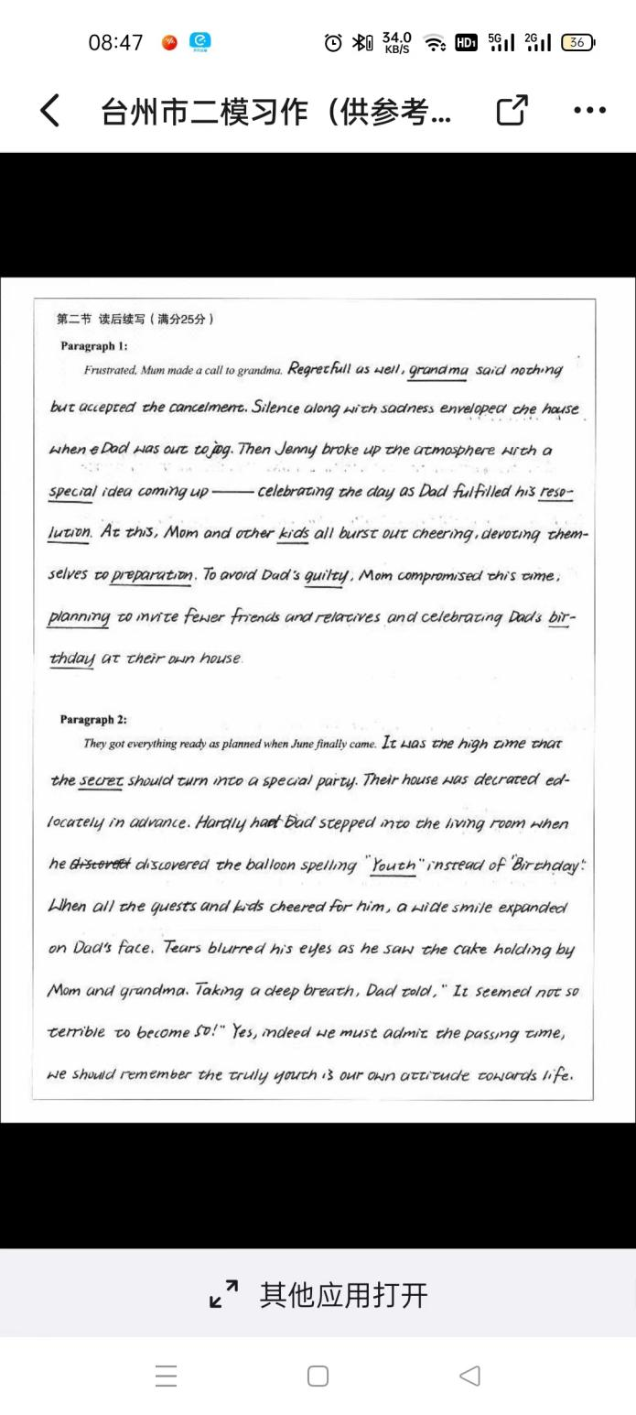
考场作文点评：
1.该生在情节设计方面很好地做到与伏笔的呼应，完美地把故事收尾。（大部分考生都忽略了这点）
2. 分词状语、无灵主语、with+复合结构以及高级表达的运用，为文章增分不少。
3.立足于划线的抽象名词youth作为点睛收尾，值得其他考生借鉴。
4.可能由于时间的限制，文章出现不少基本功方面的错误，要有意识地加以避免。

Slide 19
考场作文：
Frustrated, Mum made a call to grandma. In a disappointed voice Mum told Grandma what had happened and explained that Dad didn’t feel like bothering others. At the shocking news, Grandpa was silent. After pondering for a while, she suggested that they continue to do the preparation ans promised that she would talk to Dad about it. Hearing that, Mum heaved a sigh of relief,a smile appearing on her face. Later that day, Dad told Mum that he agreed to spend the special occasion with his friends and family.
They got everything ready as planned when June finally came. On the day of Dad‘s birthday, the family arrived at Grandma‘s house, wearing their finest clothes. The moment Dad stepped into the house, he was greeted with broad smiles and warm “Happy birthday” from his old friends and relatives. Though informed in advance, he had never expected that, a warm current surging through his body. At the party Dad chatted as if travelling back to his youth times, his face glowing with excitement. For him, it was a sweet moment that would never fade away in his mind.
考场作文点评：
1.该生的语言功底还不错，情节的推进、逻辑的转换、与原文本的呼是亮点。
2. 分词状语、无灵主语、with+复合结构、独立主格结构以及高级表达ponder, the moment, be greeted with等的运用，为文章增分不少。
3.文章的败笔：没有考虑到New Year’s resolution这个点并把它具化。使得整个内容有点空洞，没能够传达作者的写作意图。

Slide 20
参考范文：
Frustrated, Mum made a call to grandma. Sensing Mum’s sorrow, grandma comforted and advised, “Why not just prepare a simple yet special get-together?”Slapped awaken by Mum’s new plan, the two kids both burst into deafening cheers and skipped round and round. Together, they brainstormed a list of ideas when suddenly Jenny murmured, “What’s Dad’s resolution for the new year?” Suddenly, it all clicked and they merrily reached an agreement to plan a secret hiking trip to the hill they once frequented and a family picnic at the top.
They got everything ready as planned when June finally came. That morning, when Dad was about to jog as usual, Mum hurried to tell him about their new plan. Seeing the three in sportswear, Dad realized something, and this time he nodded. All the way, the two kids bounced around, laughing and chatting. He, along with Mum, recalled a lot of sweet memories in their youth. Upon arriving at the top, the three just pitched into the picnic in sheer pleasure. With the cool breeze, Dad gazed at them reflectively and suddenly realized that it’s no longer disturbing to celebrate birthday with the love of family.

Slide 21
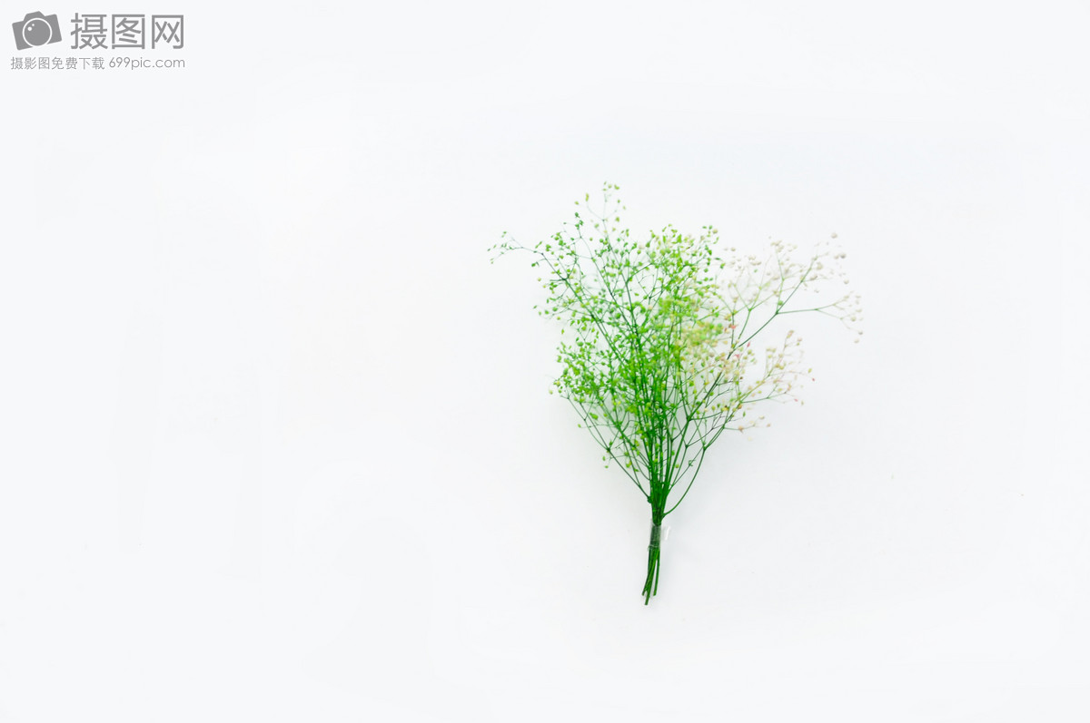
下水作文：
Frustrated, Mum made a call to grandma. On the phone, she poured out all that happened to Grandma, at a loss about what to do next as she wanted to give Dad a sweet memory and at the same time not go against his will. At this, Grandma smiled, comforting that she might try an alternative way to celebrate the special moment. And the next quarter witnessed the two talking excitedly and brainstorming the possible ways. Finally given his New Year’s Resolution of getting fit, they decided to organize a hiking trip and buy a membership card from a nearby gym. This time, she even kept it a secret from her kids for fear that they would once more let the secret out. 116

Slide 22
下水作文：
They got everything ready as planned when June finally came. As usual, Dad got up, ready for his regular workout when a sweet voice“darling, Happy birthday!”came from behind. Handing over the membership card to her dear, she shared her plan for his birthday. And the next moment Dad found himself on a totally different hike, with his wife and his kids for company. All the way, they enjoyed the natural beauty, gossiping abut the sweet and fun memories. It didn’t take long before they arrived at the hilltop - their destination, where they spread a cloth on the grass. Bathed in the warm sunshine and enjoying the company and the love of the family, Dad smiled, his mind travelling back to his youth times, dynamic. 116

Slide 23
读后续写倒计时冲刺建议：
把握读后续写动态，练就各类型微技能
读后续写话题从人与自然已经转换到人与社会和人与自我层面。这类文章更加注重考查学生合理编故事的能力、有效提取文本伏笔信息的能力，少了那些依赖素材背诵就可以的高分的可能性，在阅读、思维和表达三合一方面有了更高要求。不过我们不能偏废任何一个，要齐头并进。
分类整理、巩固素材语料：
要形成丰富扎实的语料库，按照“情绪、心理活动、动作、场景、动态场景、有意境的句子”等几方面的内容进行分类记忆。各类中又按照人、身体部位、情绪名词等三类做主语分别记忆一些有场面感的句子。这一块内容最好能够通过默写或者听写来巩固。

Slide 24
读后续写倒计时冲刺建议：
掌握高效的句子升级策略，驾驭长句子：
借助于头脑风暴模式，熟知重要的几种句子升级方法，如倒装结构、虚拟语气、各种从句、无灵主语、修饰性副词、主位推进等等，融合动作、心理活动和情绪等元素，练就长短句的交错运用。
构建合理的结尾套路：
多阅读读后续写试题，思考并判断各中类型的文本应该采用什么样的结尾比较合适，并且熟知各种结尾的一般性写法。结尾方式可以分为Message点睛式、环境描写烘托式、展望将来式、回首反思式、自然过程式、首尾呼应式等等。

Slide 25

Thank you !

