Slide 1

感恩遇见，相互成就，本课件资料仅供您个人参考、教学使用，严禁自行在网络传播，违者依知识产权法追究法律责任。
更多教学资源请关注
公众号：溯恩高中英语
知识产权声明

Slide 2

The Week
Apr 9th-15th, 2022

Slide 3
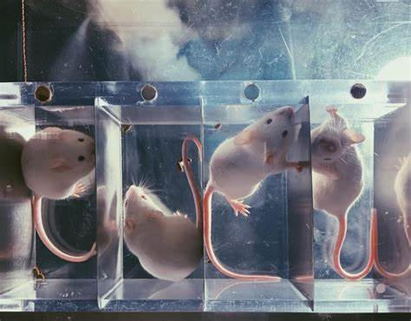
1. Mice and humans, just imagine all they’ll see
老鼠和人类的大脑或在有视力前就能形成影像

Slide 4

语篇填空
（《国家地理》2022年4月刊 23页）
Have you ever had a dream so vivid that you nearly mistook it for real life? What if you actually did open your eyes to a world you’d envisioned with them ______ (close)? According to __ Yale University study, you may have—at birth. Researchers imaged the brains of newborn _____ (mouse) and found that, in the few days before the animals’ eyes open, their still developing retinas simulate vision and dispatch informational waves. _________ (previous) random in direction, these waves start flowing from a mouse’s temple toward ___ (it) nose—the same direction visual stimuli flow when a mouse is scurrying forward. ___ lab director Michael Crair explains, this dreamlike state “allows a mouse to anticipate _____ it will experience after opening its eyes,” ________ (prepare) the animal to perceive and navigate its surroundings. Human babies also exhibit some visual ability at birth—discerning objects, detecting motion. This _______ (suggest), as Crair says, we are born capable of many of these behaviors, at least ___ rudimentary form.”
closed
a
mice
Previously
its
As
what
preparing
suggests
in

Slide 5
词汇讲解1
1. envision: to imagine what a situation will be like in the future, especially a situation you intend to work towards 展望；想象
Most people do stop at this point, not envisioning that there is anything beyond.
大多数人确实都在这里停下，想象不到在这之外还会有些什么。
2. scurry: to run with quick short steps 碎步疾跑
The rats scurry around, searching for scraps of food in the rubbish.
老鼠乱窜，在垃圾中寻找残羹剩饭。
翻译句子
他们向往一个没有贫穷和疾病的平等社会。
They envision an equal society, free of poverty and disease.
翻译句子
她说声再见，然后扭头跑回去干活了。
She said goodbye and scurried back to work.

Slide 6
词汇讲解2
3. perceive: to notice or become aware of sth 注意到；意识到；察觉到
“Precisely what other problems do you perceive?” she asked.
“你究竟还发现了什么问题？”她问道。
4. rudimentary: dealing with only the most basic matters or ideas 基础的；基本的
They cannot exercise the most rudimentary workers’ rights.
他们无法行使最基本的工人权利。
翻译句子
我注意到他举止有些变化。
I perceived a change in his behaviour.
翻译句子
他们仅仅受到过基本的职业训练。
They were given only rudimentary training in the job.

Slide 7
长难句分析
As lab director Michael Crair explains, this dreamlike state “allows a mouse to anticipate what it will experience after opening its eyes,” preparing the animal to perceive and navigate its surroundings.
分析：本句是一个复合句，“As lab director Michael Crair explains”是_________________________，“what it will experience after opening its eyes”是__________；“preparing the animal to perceive and navigate its surroundings”是_______________________。
as引导的非限制性定语从句
宾语从句
现在分词短语作结果状语
正如实验室主任迈克尔·克莱尔解释的那样，这种梦境般的状态“让老鼠能够预测它在睁开眼睛后会经历什么”，从而让动物准备好感知和应对周边环境。
翻译

Slide 8
句子翻译
Have you ever had a dream so vivid that you nearly mistook it for real life? What if you actually did open your eyes to a world you’d envisioned with them closed?
你有没有做过如此逼真的梦，以至于你几乎把它误认为是现实生活？如果你睁开眼睛真的看到了一个你想象中的世界，那又会怎么样？
翻译
Previously random in direction, these waves start flowing from a mouse’s temple toward its nose—the same direction visual stimuli flow when a mouse is scurrying forward.
之前方向随机的这些脑电波开始从老鼠的太阳穴流向它的鼻子——这种方向与老鼠向前奔跑时，视觉刺激的流向相同。
翻译

Slide 9
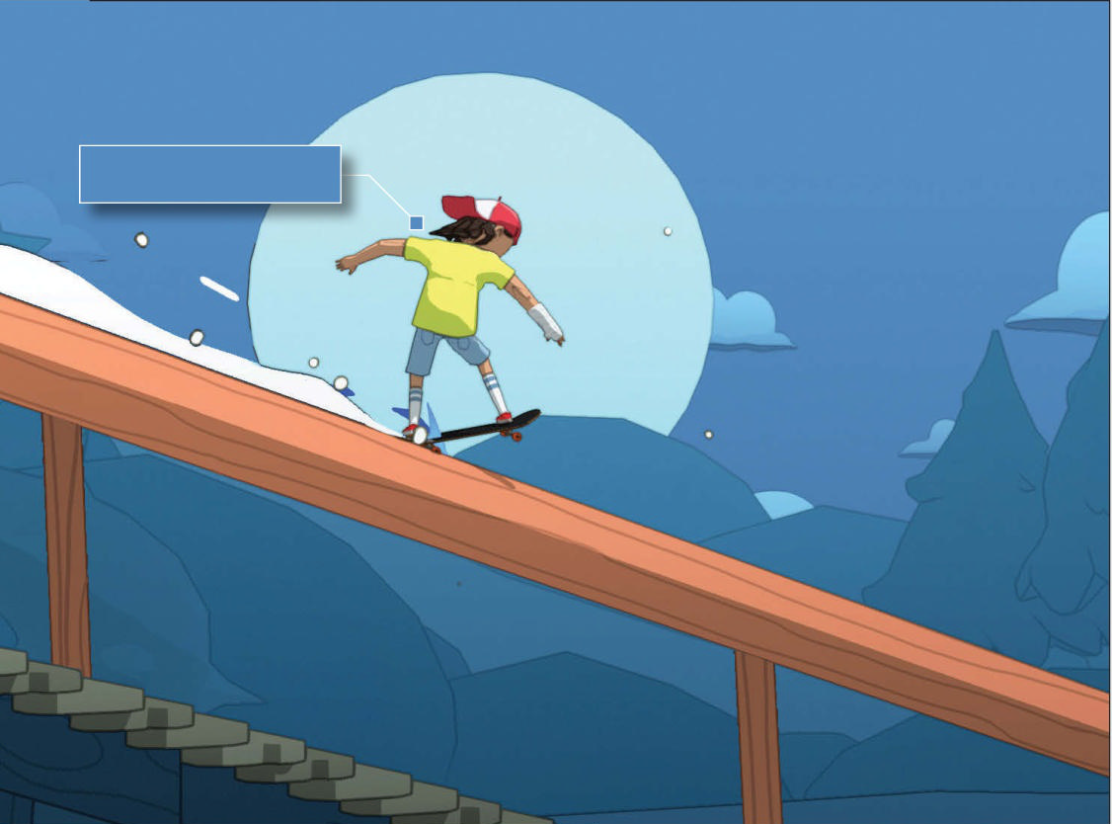

创新滑板动作平台游戏
2. OlliOlli World
《奥力奥力世界》
Don some daft sunglasses and become a wizard with this off-kilter skating game that’s also one of the best action-platformers in years

Slide 10
阅读理解
（《数字时代》2022年4月刊 80页）
Stuff
Everyone would like to be good at skateboarding in real life, but getting there usually means enduring multiple trips to A&E. Fortunately, games can give you the thrill of varial (倒板) heel flipping down a flight of stairs without worrying about the fractured wrist waiting at the bottom.
Oh, how we wish we could skate in OlliOlli World’s side-scrolling Radlandia. From the sunbathing ice creams of Sunshine Valley to the dinosaur skeletons that double as grind rails in the vast canyons of Burntrock, each of the five 2.5D areas is gorgeous to look at and a joy to explore - not to mention the superb soundtrack: an assortment of laid-back, toe-tapping and always on-vibe electronic and hip-hop beats.
But don’t let the cartoonish visuals fool you. While this is undoubtedly the friendliest OlliOlli title yet, it’s every bit as hardcore as you want it to be, and one of the most moreish skateboarding games we’ve ever played. If anything, its tendency to keep you on your board allows you to appreciate the superb animation and innovative stick-and-trigger control system even more - it just feels incredibly good to play.
You’re still going to crash and bail (退出) a lot in this game but almost entirely due to obstacle collisions, lack of speed and bad timing, rather than how you land tricks. And when retrying is so much fun anyway, it won’t bother you much to see your beanie-wearng daredevil meet his unfortunate demise yet again.
As you progress through the story campaign you’ll occasionally be taking on side-quests from characters you meet along the way, but OlliOlli World’s is as much about environmental mastery as it is tricks and scores, with each level a puzzle of traversal and timing.
This is that rarest of things: a game that is never less than extremely enjoyable to play, even when you’re failing at it, and one you can’t stop thinking about playing when you’re not.

Slide 11

阅读理解
1.What does the underlined word “assortment” mean in Paragraph 2?
A. A. mixture of B. A number of C. A variety of D. A bit of
词义猜测
2. Which of the following is NOT the benefit of OlliOlli World?
A. The players can appreciate the brilliant animation and control system.
B. The players won’t be addicted to playing the game.
C. It contains five impressive 2.5D areas and great soundtrack.
D. It will cultivate players’ skills of environmental mastery.
细节理解
3. What’s the main idea of the text?
A. To introduce a hot skateboarding game.
B. To provide some advice on playing OlliOlli World.
C. To argue against playing online games.
D. To show the development of OlliOlli World
主旨大意

Slide 12
词汇讲解
1. collision: an accident in which two or more people or vehicles hit each other while moving in different directions 碰撞
There has been a collision on the southbound stretch of the motorway. 在高速公路南向路段上发生了一起撞车事故。
2. demise: the end or failure of an institution, an idea, a company, etc. 终止；失败
The chain of events I sparked off nearly led to my untimely demise.
我引发的一连串事件几乎导致了我的早逝。
翻译句子
那个骑自行车的人与一辆公共汽车相撞。
The cyclist was in a collision with a bus.
翻译句子
该公司出人意料地突然倒闭了。
The demise of the company was sudden and unexpected.

Slide 13
句子翻译
You’re still going to crash and bail a lot in this game but almost entirely due to obstacle collsions, lack of speed and bad timing, rather than how you land tricks.
在这款游戏中，你仍然会频繁地崩溃和退出，但这几乎完全是由于障碍碰撞、缺乏速度和糟糕的时机，而不是你如何使用技巧。
翻译
As you progress through the story campaign you’ll occasionally be taking on side-quests from characters you meet along the way, but OlliOlli World’s is as much about environmental mastery as it is tricks and scores, with each level a puzzle of traversal and timing.
当你在游戏故事战役中前进时，你将偶尔接受沿途遇到的角色的支线任务，但《奥利奥利世界》不仅是关于技巧和分数，同时也是关于对环境的精通，每个关卡都是关于穿越和时间的谜题。
翻译

Slide 14
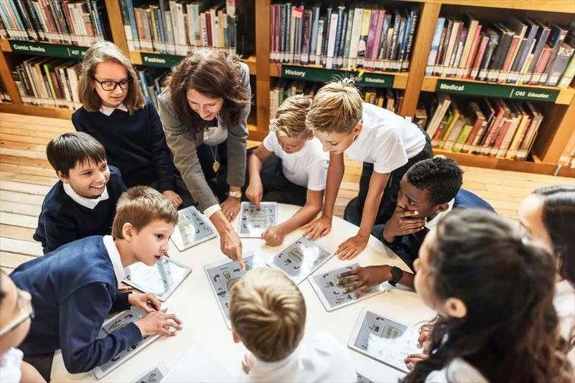
3. Half of Teachers Plan to Quit Because of Heavy Workload
由于工作负担过重，半数教师计划辞职

Slide 15
语篇填空
（《泰晤士报》2022年4月11日 4页）
Half of teachers in England will quit within five years because of the “unmanageable” workload, a survey by the National Education Union _________ (suggest). It said that 44 per cent planned to switch careers by 2027 and one in five intended _______ (quit) within two years.
The poll of 1,788 teachers, before the union’s conference this week, suggested that heavy workload was a big factor in job _____________ (satisfy). Some 52 per cent said that their workload _____ (be) “unmanageable” or “unmanageable most of the time”, up from 35 per cent last year. For those _____ planned to leave within two years, two thirds said that workload was the main reason.
Teachers also cited concerns about a lack of trust from the public and government, as well as low pay. Teachers said that schools were finding ____ difficult to fill vacancies, forcing them to take on extra roles, and 73 per cent reported the problem got _______ (bad) during the pandemic.
Mary Bousted, the union’s joint general secretary, said that teaching was a “_________ (fulfill) job . . . Yet the government makes this more difficult, and if we are to __________ (collective) do the right thing for young people then we must be able to deliver the education they deserve. That change must come from ____ top.”
suggests
to quit
dissatisfaction
was
who
it
worse
fulfilling
collectively
the

Slide 16
词汇讲解
1. cite: to mention sth as a reason or an example, or in order to support what you are saying 提及（原因）；举出（示例）；列举
It would be an endless task to cite such living examples.
这样的实例举不胜举。
2. take on: to begin to perform or deal with sth 承担；呈现；具有
I don’t feel ready to take on new responsibilities.
我不愿意承担新的责任。
翻译句子
他说繁重的工作负荷是导致他累垮的原因。
He cited his heavy workload as the reason for his breakdown.
翻译句子
她拒绝承担传统妇女的角色。
She refused to take on the traditional woman’s role.

Slide 17
句子翻译
Teachers said that schools were finding it difficult to fill vacancies, forcing them to take on extra roles, and 73 per cent reported the problem got worse during the pandemic.
教师们说，学校发现很难填补空缺，结果迫使他们承担额外的角色，而73%的教师报告说，在大流行期间，这一问题变得更糟。
翻译
Mary Bousted, the union’s joint general secretary, said that teaching was a “fulfilling job . . . Yet the government makes this more difficult, and if we are to collectively do the right thing for young people then we must be able to deliver the education they deserve.
联合会的联合秘书长玛丽·鲍斯特德说，教学是一项“令人满意的工作…… 然而，政府却让教学变得更加困难。如果我们要共同为年轻人做正确的事情，那么我们必须能够提供他们应得的教育。
翻译

Slide 18
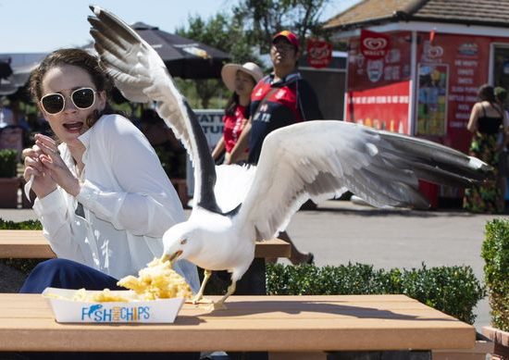
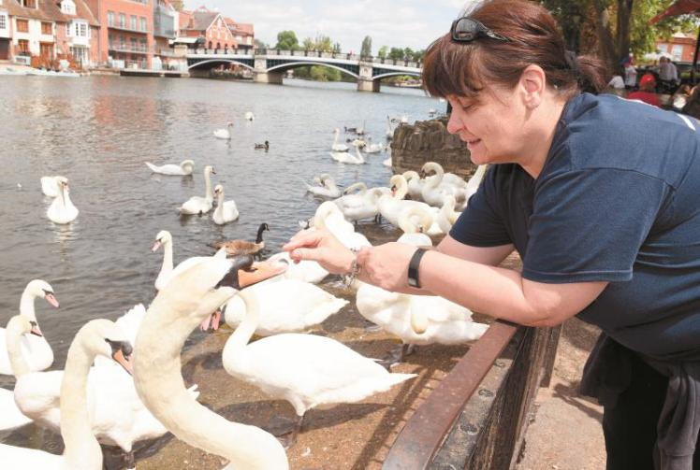
4. Venice fights an invasion of seagulls
威尼斯对抗海鸥的入侵

Slide 19
语篇填空
（《周刊报道》2022年4月15日 14页）
Venetians have never gotten along with their city’s “feathered residents”, said Roberta Brunetti. For more than a century, it was pigeons _____ harassed us and fouled our squares, thanks to feed-sellers who encouraged ________ (tourist) to surround themselves with pigeons for photos. Finally in 2008, then Mayor Massimo Cacciari banned the sale of feed in the squares, ________ (end) the scourge overnight.
Now we face a new threat: seagulls. These dirty fowl once used to confine themselves to hunting fish in the canals. But as visitor numbers have risen rapidly, so has _____ number of gulls attacking unsuspecting tourists to snatch a quick snack. In 2005, there were 25 breeding pairs _________ (record) in the city; now there are 500. The problem is ____ bad that restaurants have had to get creative about protecting their outdoors diners. Some “provide guests ______ long bamboo sticks” to poke the birds away, while others hire falconers. The Gritti Palace hotel, a famed celebrity place on the Grand Canal, __________ (start) giving guests water pistols to aim at the seagulls. Experts now recommend that Venice’s facades and towers _______________ (fit) with spikes and wires to stop the gulls from nesting. But they also warn that these birds are clever and tend to adapt ________ (quick) to challenges. This battle “won’t be easy”.
that
tourists
ending
the
recorded
so
with
has started
(should) be fitted
quickly

Slide 20
词汇讲解 1
1. harass: to annoy or worry sb by putting pressure on them or saying or doing unpleasant things to them 侵扰；骚扰
She claims she has been sexually harassed at work.
她声称在工作中受到性骚扰。
2. scourge: a person or thing that causes trouble or suffering 祸害；祸根；灾害
Smallpox was probably the single biggest scourge to hit North America.
天花可能是袭击美洲的最大的一个灾祸。
翻译句子
他投诉受到警方侵扰。
He has complained of being harassed by the police.
翻译句子
从1961年以来霍乱就成了全球性的灾害。
He accused me of trying to undermine his position.

Slide 21
词汇讲解 2
1. confine: to keep sb/sth inside the limits of a particular activity, subject, area, etc. 限制；限定
I will confine myself to looking at the period from 1900 to 1916.
我将把自己考察的范围限定在1900年至1916年这段时间以内。
2. unsuspecting: feeling no suspicion; not aware of danger or of sth bad 毫不怀疑的；无危险意识的；无戒备心的
He had crept up on his unsuspecting victim from behind.
他从背后悄悄逼近了那毫无戒备的受害者。
翻译句子
他没把自己局限于这一门语言。
He did not confine himself to the one language.
翻译句子
她为她毫不知情的丈夫举办了一个惊喜聚会。
She threw a surprise party for her unsuspecting husband.

Slide 22
句子翻译
For more than a century, it was pigeons that harassed us and fouled our squares, thanks to feed-sellers who encouraged tourists to surround themselves with pigeons for photos.
翻译
由于饲料商贩鼓励游客们在自己周围放鸽子拍照，一个多世纪以来，鸽子一直骚扰我们，扰乱我们的广场。
But as visitor numbers have risen rapidly, so has the number of gulls attacking unsuspecting tourists to snatch a quick snack.
翻译
但随着游客数量的迅速增加，海鸥攻击毫无防备的游客抢夺快餐的数量也在增加。

Slide 23
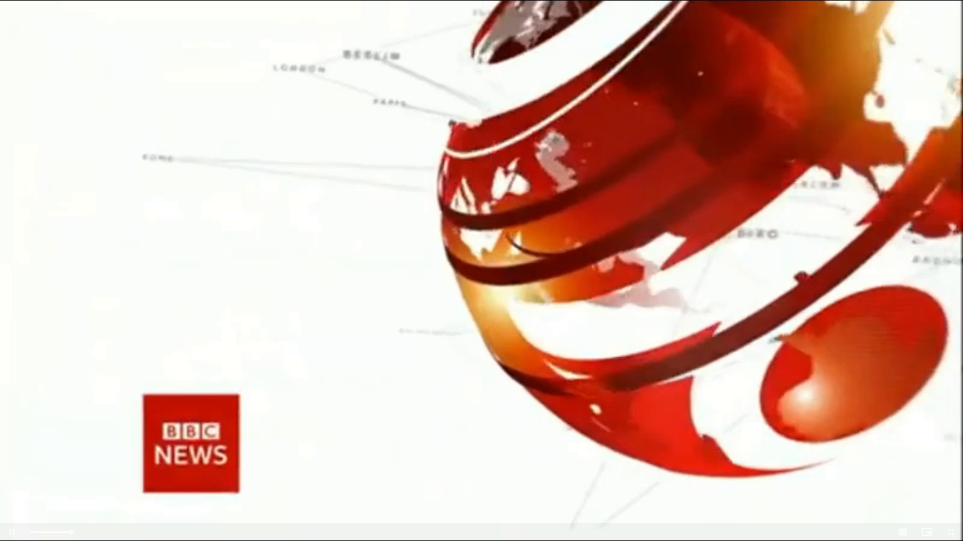
5. BBC一分钟新闻听写填空 One-minute World 04/13/22

Slide 24

听力填空
This is BBC world news, the latest headlines. Emmanuel Macron has urged voters to rally behind him for _______________________ in the French presidential election in two weeks time. It follows his _____________ over the far-right challenger Marine Le Pen on Sunday.
It comes as efforts are _______________ to evacuate residents from the Donbass region as Russia redirects its offensive to the ________________.
Tens of thousands of protesters _____________________ of Pakistan to protest against Imran Khan being removed as prime minister. His __________ is expected to be _________ by parliament in the coming minutes and hours.
Twitter’s biggest shareholder Elon Musk has decided _________ the social media companies board. Last week, Mr. Musk ________ that he had taken a 9.2% stake in the platform, ___________ its biggest shareholder.
the second round of voting
narrow victory
being stepped up
east of the country
have taken to the streets
replacement
confirmed
not to join
revealed
making him

Slide 25
词汇讲解
1. rally: to come together of bring people together in order to help or support sb/sth 召集；集合
His supporters have rallied to his defence. 他的拥护者团结起来为他辩护。
2. stake: If you have a stake in something such as a business, it matters to you, for example because you own part of it or because its success or failure will affect you. 利害关系；重大利益；（企业等中的）股本，股份
a 20% stake in the business 那家公司20%的股份
Many young people feel they have a stake in society.
很多年轻人觉得他们与社会休戚相关。
翻译句子
他把自己的拥护者召集起来准备斗争。
He rallied his own supporters for a fight.
翻译句子
这出戏成功与否对她个人有重大利害关系。
She has a personal stake in the success of the play.

Slide 26
句子翻译
Emmanuel Macron has urged voters to rally behind him for the second round of voting in the French presidential election in two weeks time.
翻译
马克龙敦促选民在两周后为法国总统大选的第二轮投票团结起来支持他。
Tens of thousands of protesters have taken to the streets of Pakistan to protest against Imran Khan being removed as prime minister.
翻译
数以万计的抗议者走上巴基斯坦街头，抗议伊姆兰汗被罢免总理一职。
Last week, Mr. Musk revealed that he had taken a 9.2% stake in the platform, making him its biggest shareholder.
翻译
上周，马斯克透露，他已持有该平台9.2%的股份，成为该平台最大的股东。

