Slide 1

感恩遇见，相互成就，本课件资料仅供您个人参考、教学使用，严禁自行在网络传播，违者依知识产权法追究法律责任。
更多教学资源请关注
公众号：溯恩高中英语
知识产权声明

Slide 2

The Week
Apr 16th-22nd, 2022

Slide 3
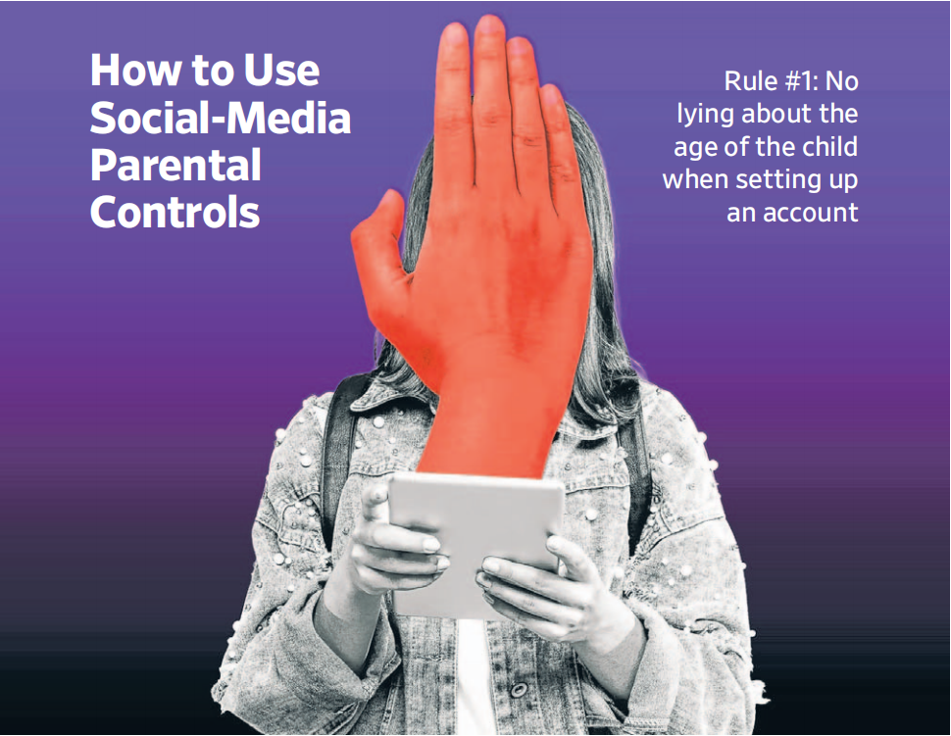
1. How to Use Social-Media Parental Controls
家长如何管控孩子的社交媒体使用情况

Slide 4
七选五任务型阅读
（《华尔街日报》2022年4月18日 A14版面）
Parents can use platform-level controls to set limits on which apps your kids can download and how much time they can spend on them. But those tools don’t allow you to manage what kids see on those apps or prevent them from communicating with strangers. __1__.
Here is a guide for using the parental controls in the social media apps. First, two big takeaways:
__2__. Apps contain default (默认的) settings that provide protections based on the declared age of the user.
Do have ongoing conversations with your children about keeping safe online. __3__.
With that in mind, here’s what to know about social media parental controls and how to use them (take Tiktok for example):
Where to start: Read TikTok’s comprehensive Guardian’s Guide.
Default settings: For teens ages 13 to 15, accounts are automatically set to private, which means no one can see their videos. Younger teens can change their account to public but their videos would be shown only to friends.
__4__. It’s also unavailable by default for 16- and 17-year-olds but they can change the setting to allow messaging with friends. Teens 13 to 15 don’t receive push notifications from the app after 9 p.m., and those 16 to 17 don’t receive push notifications after 10 p.m.
Opt-in settings: With a TikTok account, parents can use TikTok’s Family Pairing feature to limit the time their teens spend on TikTok, restrict age-inappropriate content and set messaging restrictions. Parents can also determine whether their teen’s account is private or public, if the teen’s account can be recommended to others and who can comment on a teen’s videos. __5__.

Slide 5
七选五任务型阅读
A. Direct messaging is unavailable for teens ages 13 to 15.
④
B. The settings are passcode secured, so teens can’t change them.
⑤
C. If that help is available at all, it’s found in the apps themselves.
①
D. The app doesn’t allow minors to show up as a friend suggestion.
E. Parental controls aren’t perfect—and kids can find ways around them.
③
F. Don’t lie about your kids’ ages when signing up for apps, or let them do it.
②
G. TikTok allows kids under 13 to be on the app, but in a more controlled environment.

Slide 6
词汇讲解
1. default: A default situation is what exists or happens unless someone or something changes it. 默认的
Death, not life, is the default state of cells. 细胞的常态是死亡而不是存活。
2. notification: the act of giving or receiving official information about sth.
通知；通告；告示
When someone likes your photo on Facebook and your screen lights up and says “Friend liked your photo,” that’s a push notification.
当有人在脸书上为你的照片点赞且你的屏幕亮起并说“朋友点赞了你的照片”，这就是推送通知。
翻译句子
默认设置为每五分钟存盘一次。
The default option is to save your work every five minutes.
翻译句子
关于我们的决定，下周你会接到通知。
You should receive a notification of our decision in the next week.

Slide 7
句子翻译
Parents can use platform-level controls to set limits on which apps your kids can download and how much time they can spend on them.
家长可以使用平台级别的控件来限制孩子可以下载哪些应用程序以及他们可以在这些应用程序上花费多少时间。
翻译
Parents can also determine whether their teen’s account is private or public, if the teen’s account can be recommended to others and who can comment on a teen’s videos.
翻译
家长还可以决定孩子的账号是隐秘账号还是公开账号，是否可以将孩子的账号推荐给其他人以及谁可以评论孩子的视频。

Slide 8
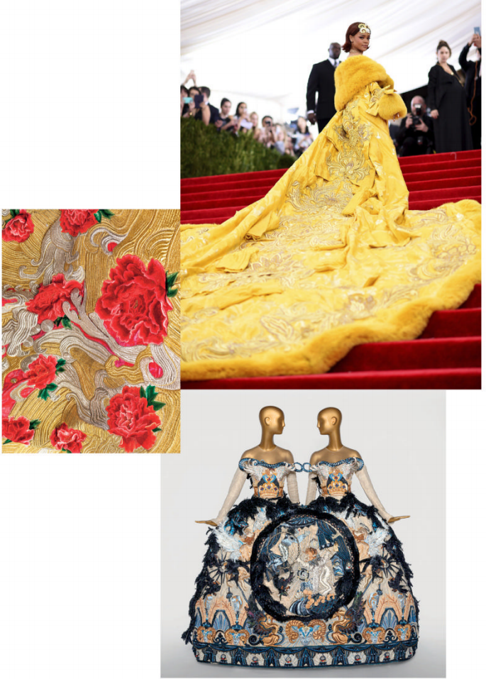
2. Art and Craft
郭培，中国高定第一人！
At San Francisco’s Legion of Honor museum, a sumptuous showcase for Chinese couturier Guo Pei

Slide 9

阅读理解
（《时尚》美国版 2022年4月刊 56页）
It was one of the great fashion moments of the internet era: For the 2015 Met gala, marking the museum’s “China: Through the Looking Glass” exhibition, Rihanna electrified the red carpet in a fur-trimmed, canary yellow cape with a traffic-stopping 16-foot train. As the fashion world descended in a joyous frenzy, the designer Guo Pei found, rather instantly, a rapt Western audience. “I did not expect such a strong reaction,” Pei says now. In hindsight, she attributes it in part to “people’s perception that China did not have fashion or design. Many people used to think of it as a developing country.” Later that year, she was invited to join the Chambre Syndicale de la Haute Couture and show on the couture week calendar in Paris.
Though you can draw a straight line from that Yellow Empress cape to “Guo Pei: Couture Fantasy,” the retrospective opening this month at the Legion of Honor museum in San Francisco, you won’t find it there. The new exhibition mines Pei’s career — characterized by sculptural silhouettes and painstaking craftsmanship — both before 2015 and since. “Our Costume program highlights extraordinary designers who have changed the course of fashion history,” says Thomas P. Campbell, director and CEO of the Fine Arts Museums of San Francisco (which includes the Legion of Honor), “and Guo Pei is a perfect fit: Her career is emblematic of a shift in global fashion narratives and China’s rise as a fashion leader.”
The show’s 80-plus looks, all sourced from Pei’s archives, are sometimes arranged by season or theme and sometimes coupled with Western artworks — medieval icons, chinoiserie, and examples from the Italian Baroque and French Rococo periods among them. As curator Jill D’Alessandro notes, Pei’s work resonates not only across cultures, but across media.
Take, for instance, pieces from her fall 2007 collection, “An Amazing Journey in a Childhood Dream,” which open the show. “When the ensembles (全套服装) first debuted, it was theater at its best — a young girl in a canopied bed above the runway dreamed, while models below acted out her dreams in pastel-colored silk confections,” D’Alessandro explains. “She paired these with separates decorated with raised metallic-thread embroidery, an homage to the costumes worn by Spanish matadors” — all part of a singular body of work that the curator describes as “occupying a space between fashion, theater, performance, and sculpture.”
There’s another element, too, related to the Chinese concept of lin (灵), or “spiritual resonance.” For Pei, fashion can also exist in a more personal realm. “Many are moved by my work, but they also say they don’t understand why I create these unwearable clothes,” she says. “I think these clothes are needed in the spiritual world.”

Slide 10

阅读理解
1. What’s the characteristic of Guo Pei’s fashion design?
A. Distinctive style B. Creative design
C. Fine workmanship D. Full of cultural elements
细节理解
2.What does the underlined word “emblematic” mean in Paragraph 2?
A. representative B. capable C. fond D. aware
词义猜测
3. What can we infer from the last paragraph?
A. Fashion should cater to the mass-market.
B. The westerners are interested in the Chinese concept of “lin”.
C. The clothes Pei has designed bring people spiritual comfort.
D. Many don’t like Pei’s work because these clothes are unwearable.
推理判断

Slide 11
熟词生义
1. train: 常见义 → n.火车 v.训练
生义 → the part of a long formal dress that spreads out on the floor behind the person wearing it 拖裾，裙裾（长礼服的曳地部分）
She wore a wedding dress with a long train. 她穿了一件拖尾的婚纱。
2. pair: 常见义 → n.一双；一对
生义 → to put people or things into groups of two 使成对；配对
We were each paired with a newcomer to help with training.
我们每人配一名新来的人帮助训练。
翻译句子
新娘的裙裾由她的两个小外甥拉着。
The bride’s train was carried by her two young nephews.
翻译句子
每个盲人学员都配了一个有视力的学员。
Each blind student was paired with a sighted student.

Slide 12
词汇讲解
1. hindsight: the ability to understand an event or situation only after it has happened 事后聪明，事后的认识
With/In hindsight, I should have seen the warning signs. 事后看来，我应该看到警告信号的。
2. retrospective: a public exhibition of the work that an artist has done in the past, showing how his or her work has developed （艺术家作品）回顾展
Let’s move onto how to run an effective retrospective. 让我们看看如何举行一次有效的回顾。
翻译句子
事后才说他们本不应该释放他，这倒容易。
With/In hindsight it is easy to say they should not have released him.
翻译句子
此次回顾展包括卡梅隆导演的12部电影中的10部。
The retrospective includes 10 of the 12 films directed by Cameron.

Slide 13
句子翻译
It was one of the great fashion moments of the internet era: For the 2015 Met Gala, marking the museum’s “China: Through the Looking Glass” exhibition, Rihanna electrified the red carpet in a fur-trimmed, canary yellow cape with a traffic-stopping 16-foot train.
这是互联网时代最伟大的时尚时刻之一：在2015年大都会艺术博物馆的“中国风：镜花水月”展览上，蕾哈娜身穿一件淡黄色皮毛镶边长袍和披风，拖着16英尺长的裙裾，在红地毯上惊艳亮相。
翻译
The show’s 80-plus looks, all sourced from Pei’s archives, are sometimes arranged by season or theme and sometimes coupled with Western artworks — medieval icons, chinoiserie, and examples from the Italian Baroque and French Rococo periods among them.
展览上的80多种造型都来自郭培的档案，有时按季节或主题排列，有时与西方艺术作品相结合——其中包括中世纪的标志、中国风格，以及意大利巴洛克和法国洛可可时期的作品。
翻译

Slide 14
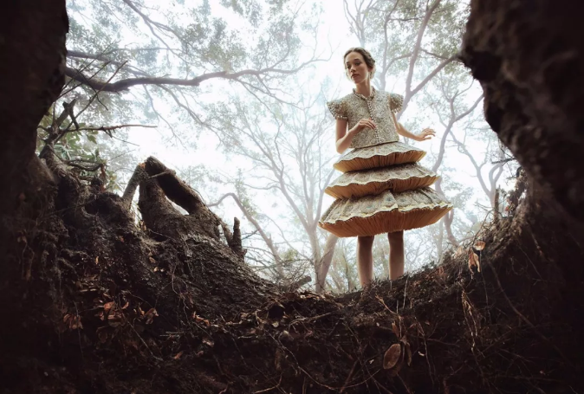
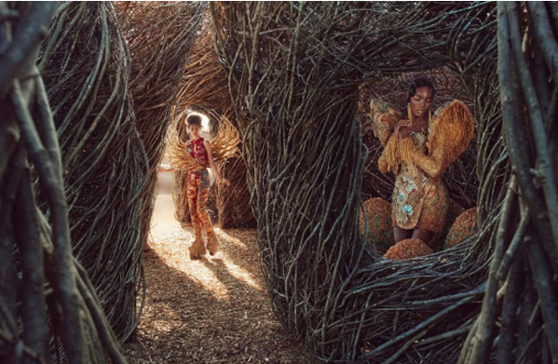
郭培时装主题展
《童梦奇缘》
An Amazing Journey in a Childhood Dream
《龙的故事》
Legend of the Dragon

Slide 15
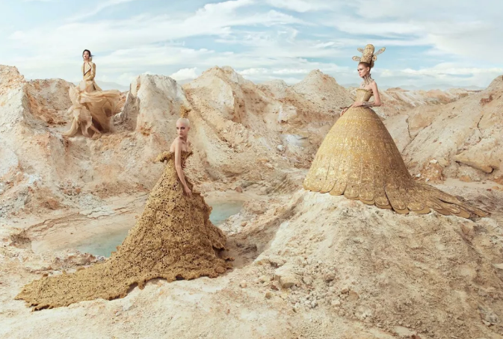
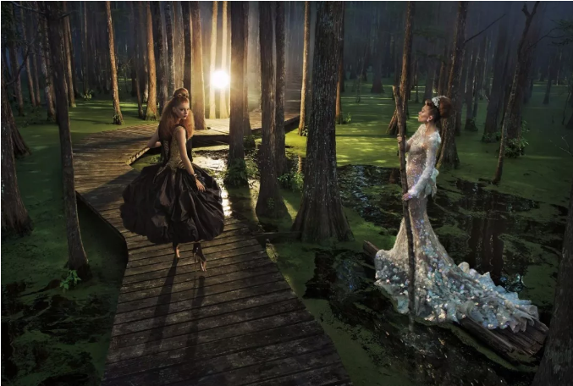
《轮回》Samsara
《遇见》Encounter

Slide 16
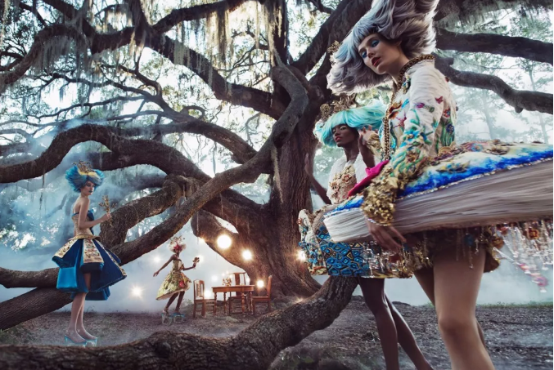
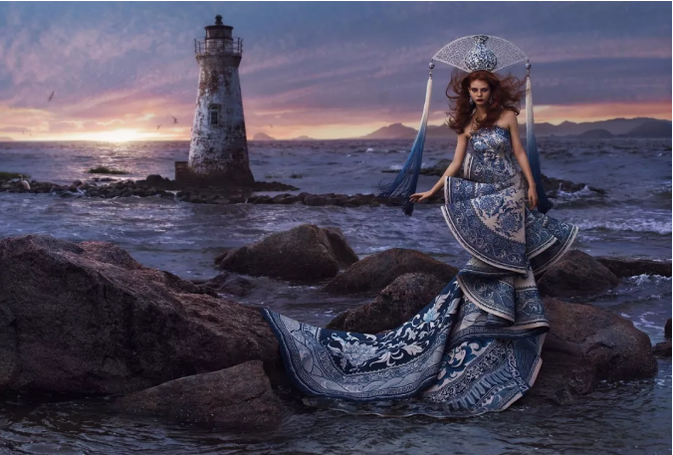
《心灵花园》
Garden of the Soul
《一千零二夜》
One Thousand and Two Nights

Slide 17
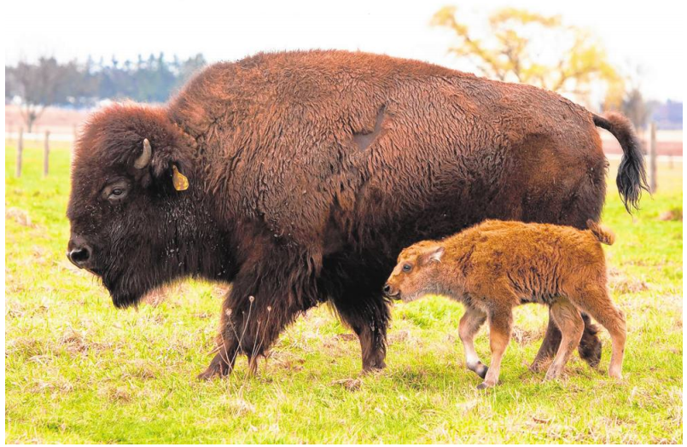
3. Fermilab Welcomes First Baby Bison of Year
费米实验室迎来了今年的第一个野牛宝宝
Fermilab’s bison population has grown by one with the birth of a calf Wednesday. FERMILAB

Slide 18

语篇填空
（《芝加哥论坛报》2022年4月17日 17页）
The ____ (one) baby bison of the spring was born to the herd at Fermilab in Batavia Wednesday, officials said. While Fermilab is ________ (primary) a national lab for particle physics research, it is not the only thing for which it ________ (know). Its first director, Robert Wilson, always wanted to be reminded of his home in Wyoming ______ he lived before moving to Batavia, so he brought bison with him. He established the herd in 1969 at Fermilab as __ symbol of the history of the Midwestern prairie, officials said. Now, the lab maintains a herd of 32 bison on nearly 1,000 acres of reconstructed tallgrass prairie as part of a National Environmental Research Park at the site _________ (establish) by the U.S.Department of Energy.
This year, Fermilab is expecting up to 20 new bison _____ (calf). To maintain the herd’s health and genetic diversity, the bulls are changed out periodically, officials said. The lab also conducts genetic testing ________ (ensure) the herd shows no evidence of cattle gene mixing. The herd is overseen by a herdsman along with _________ (assist) from Fermilab’s Roads and Grounds Department. “We have vaccinations and checks once a year, but other ____ that there is no veterinary staff, ”Fermilab spokesperson Tracy Marc said. “We let nature do its thing and leave the mom to take care of the calf”.
first
primarily
is known
where
a
established
calves
to ensure
assistance
than

Slide 19
词汇讲解
1. periodically: at regular intervals of time 定期地
Meetings are held periodically to monitor progress on the case. 定期召开会议监控案件的进展情况。
2. oversee: to watch sb/sth and make sure that a job or an activity is done correctly 监督；监视 （oversaw, overseen）
As marketing manager, her job is to oversee all the company’s advertising. 作为营销经理，她的工作是负责公司所有的广告业务。
翻译句子
邮寄名单定期更新。
Mailing lists are updated periodically.
翻译句子
一个组长被指派来监督这个项目。
A team leader was appointed to oversee the project.

Slide 20
句子翻译
Now, the lab maintains a herd of 32 bison on nearly 1,000 acres of reconstructed tallgrass prairie as part of a National Environmental Research Park at the site established by the U.S.Department of Energy.
翻译
现在，该实验室在近1000英亩重建的高草草原上饲养着32头野牛，这片草原是美国能源部建立的国家环境研究公园的一部分。
To maintain the herd’s health and genetic diversity, the bulls are changed out periodically, officials said. The lab also conducts genetic testing to ensure the herd shows no evidence of cattle gene mixing.
官员们说，为了保持牛群的健康和基因多样性，公牛会定期更换。 该实验室还进行基因检测，以确保牛群没有出现基因混合的迹象。
翻译

Slide 21
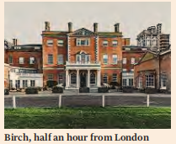
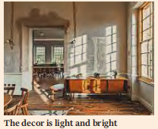
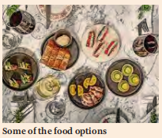
4. A Day at the Alternative Office
换一个地方工作
Forget working from home. Emma Jacobs tries working near home at Birch, a converted manor house in Hertfordshire that promises a place to ‘live, work and play’.

Slide 22
语篇填空
（《金融时报》2022年4月16日 Life& Art 版面 P7 ）
Lying on my large bed in a light room overlooking the lawns, I wondered if I ___________ (arrive) at the future of work. I was alone at Birch, ___ hotel occupying a Georgian manor in 55 acres of land on London’s northern fringe, desperate to replenish my energy after my family and I got Covid-19.
On its website, Birch _____ (bill) itself as a community of “interested, and interesting, people who live, work and play at Birch”. It is a bit work, a bit pleasure, a bit healthy, a bit gourmet. Kids can come to play in the games room, take part in a nature walk, watch a film ____ deckchairs in the screening room or do an arts activity.
Their ambition is _________ (create) an informal and blended environment that allows people to work, alongside going to gym classes, socialising and _________ (meet) colleagues. Members seemed happy enough in co-working spaces that _____ (be) fun and relaxed. Yet here again it seemed that groups of ___________ (colleague) kept breaking into peals of laughter, which gave me the sense that I was a bystander at a corporate awayday.
Here, it was quiet and, at last, I felt I’d got away. The owners have banned televisions from the rooms, ____ they want guests to go out to converse and experience the various offerings. I was __________ (delight) to seal myself off.
had arrived
a
bills
on
to create
meeting
were
colleagues
as
delighted

Slide 23
词汇讲解 1
1. replenish: to make sth full again by replacing what has been used
补充；重新装满
Three hundred thousand tons of cereals are needed to replenish stocks.
需要30万吨谷物才能重新装满仓库。
2. bill: to advertise or promote sth 宣传
She was billed to play the Wicked Queen in “Snow White” .
她已被宣布将出演《白雪公主》里狠毒的王后。
翻译句子
让我再给您斟满。
Allow me to replenish your glass.
翻译句子
他们把这宣传为加利福尼亚最令人激动的博物馆。
They bill it as California’s most exciting museum.

Slide 24
词汇讲解 2
1. converse: to have a conversation with sb 交谈；谈话
The child, feeling free and comfortable, started to converse with Peter.
孩子感到自由自在，很舒服，开始和彼得交谈。
2. seal off : to close tightly or surround something or someplace
封闭；把……封锁起来
Freezing rain can seal off your car and lock you inside.
冻雨会困住你的车，把你锁在车里。
翻译句子
两位聋哑演员只靠打手势语交谈。
The two deaf actors converse solely in signing.
翻译句子
这个城市应该封闭那些隧道。
The city should seal off those tunnels.

Slide 25
句子翻译
I was alone at Birch, a hotel occupying a Georgian manor in 55 acres of land on London’s northern fringe, desperate to replenish my energy after my family and I got Covid-19.
翻译
我独自一人在伯奇酒店(Birch)，这是一家位于伦敦北部边缘55英亩土地上的格鲁吉亚庄园，在我和家人感染了新冠后，我迫切地想补充能量。
Their ambition is to create an informal and blended environment that allows people to work, alongside going to gym classes, socialising and meeting colleagues.
翻译
他们的目标是创造一个非正式的、混合的环境，让人们在工作的同时可以去健身房、社交和会见同事。

Slide 26

5. ClickView听写填空 复活节起源 What are the origins of Easter?

Slide 27


听力填空 1
复活节起源 What are the origins of Easter?
One Friday, about two thousand years ago, a man named Jesus, who Christians believe is _____________, was crucified by the Romans. After he died, he was buried in a tomb which ________________________. When his family and friends went to visit the tomb on Sunday morning, the giant rock had moved and an angel told them that Jesus ___________________. Because he had ________________. Have you heard this story before? It’s the story of Easter.
Easter is the most important ______________ celebrated by Christians. ______ most holidays, Easter doesn’t have _________ in any calendar and changes every year. But it always happens on a Sunday between March 22nd and April 25th.
Okay, so what exactly is Easter? Easter is ____________ by some very important days. First, there’s Holy Week. The seven-day period that __________ Easter Sunday. During this week, Christians ________ Jesus’s life in different ways. The day that Jesus was crucified and buried in the tomb is part of Holy Week and is called Good Friday.
the son of God
was sealed with a giant rock
wasn’t there anymore
risen from the dead
religious holiday
Unlike
a set date
characterized
leads up to
celebrate

Slide 28
听力填空 2
复活节起源 What are the origins of Easter?
But then on Sunday Jesus rose from the dead. This is known as Easter Sunday and is the ____________________ during Easter. Many Christians ___________ on the night before Easter Sunday or on Easter morning to celebrate __________________. And even though Easter is a Christian holiday, a lot of non-Christian people also enjoy celebrating it. For many, it’s a great time to meet with family and friends, ___________________, and eat lots of delicious foods like chocolate eggs and hot cross buns.
But what do eggs have to do with Easter? Eggs are _____________________ for Christians. The egg _________ the tomb that Jesus was buried in after he died. And the way that chicks _________________ when they hatch is a symbol of how Jesus rose from the dead and left the tomb.
People _____ or dye boiled eggs with different colors and use them for __________. Some people eat these eggs but many ______ the chocolate version that comes wrapped in colorful foil instead.
main day of celebration
go to church
with a special service
go on Easter egg hunt
a symbol of birth and life
represents
break out of the egg
paint
decoration
prefer

Slide 29
听力填空 3
复活节起源 What are the origins of Easter?
Hot cross buns are another special Easter food. They are made ___________ Lent (四旬斋), which is a special 40-day period of _________ and sacrifice with the cross representing how Jesus was crucified and the spices representing the spices that were used when Jesus __________. Lots of different countries have their own special Easter foods, too. You might know some others.
Have you seen this ________ during Easter? It’s the Easter bunny and it is a super popular ______ used throughout Easter. But why? Well, it’s a bit of a _______ because nobody actually knows for certain _________________. There are lots of different stories from around the world about how the Easter bunny __________.
During Easter, you can greet people who are celebrating with “Happy Easter”.
Remember everyone celebrates special days ______________. Different people have different traditions that they enjoy during their celebrations and these are just some of the ________ ones seen during Easter.
at the end of
reflection
was buried
character
figure
mystery
where it came from
came to be
in their own way
common

Slide 30
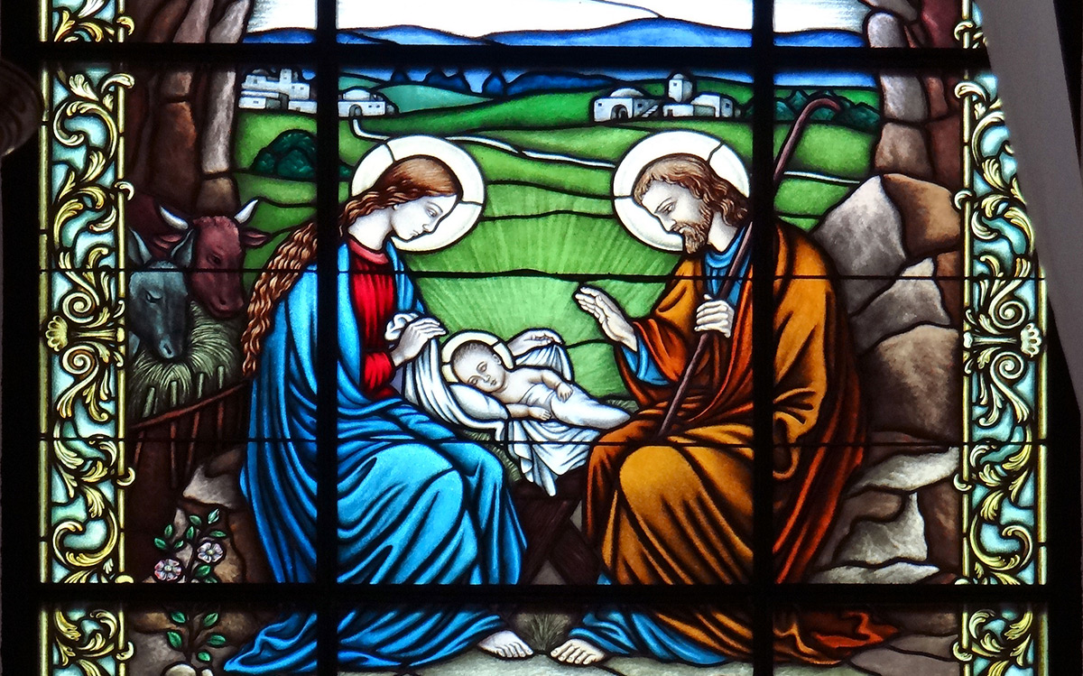
A guide to Christian festivals and dates in 2022
The Christian calendar is divided up by festivals and seasons.
Some, like Christmas Day, happen on the same date every year, while others move around within a range of dates. The main festival that moves is Easter, and since many other festivals have their dates fixed in relation to Easter, they move with it.
Epiphany (6 January 2022) 主显节
The Epiphany, or revelation, of the baby Jesus as the Son of God come into the world, is traditionally celebrated on the 6 January.
Lent (2 March - 14 April 2022) 四旬斋
Lent is the 40-day period before Easter, beginning with Ash Wednesday. During Lent Christians may fast, or give up some of their usual routine, to give time to personal examination and to reflect on their relationship with God.

Slide 31
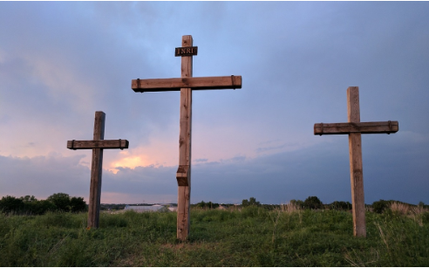
A guide to Christian festivals and dates in 2022
Holy Week (10 - 16 April 2022) 受难周
Holy Week is the last week of Lent. It is the week preceding Easter and the period in the Christian year when Christians remember the last week in Jesus’ life.
Easter 复活节
Easter is the season in which Christians remember the death and resurrection of Jesus. It is the most important festival in the Christian year.
Ascension Day (26 May 2022) 耶稣升天节
Ascension Day commemorates the ascension of Jesus into heaven 40 days after his resurrection from the dead. It can be understood traditionally as his taking up into heaven at the conclusion of his earthly ministry.

Slide 32

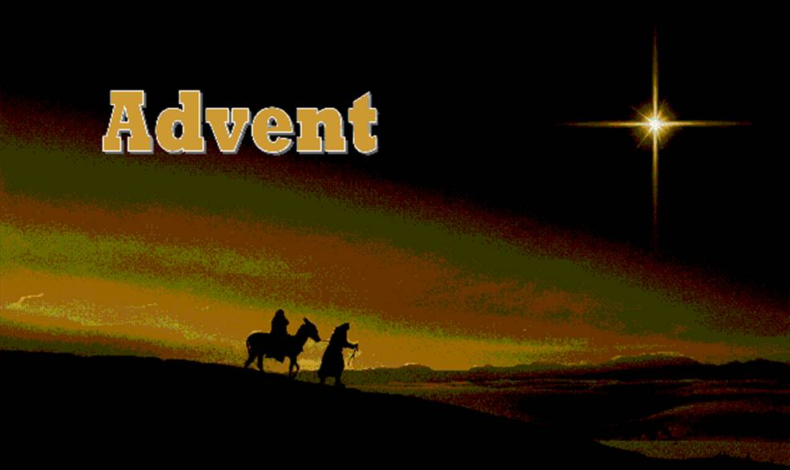
A guide to Christian festivals and dates in 2022
Trinity Sunday (12 June 2022) 圣三主日
Trinity Sunday is a day when Christians think of the nature of God rather than, as with other festivals, commemorating historical events of special significance.
Advent (27 November - 24 December 2022)
基督降临节
Advent is the four-week period before Christmas. There are four Sundays in Advent. The word “Advent” means “coming” or “arrival” and in this case points towards the birth of Jesus celebrated at Christmas. One special service involving children is called Christingle and can be held during Advent, Christmas, or Epiphany.

Slide 33
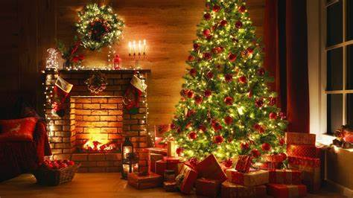
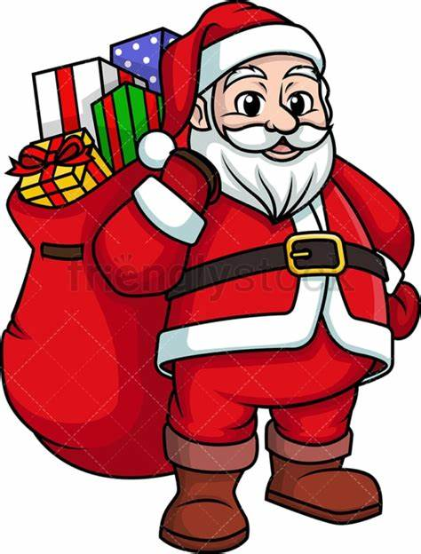
A guide to Christian festivals and dates in 2022
Christmas (25 December 2022 - 5 January 2023) 圣诞节
The season of Christmas begins on the 25 December and traditionally lasts twelve days, ending on 5 January. Christmas is the time when Christians celebrate the birth of Jesus.

Slide 34
词汇讲解
1. hatch: (of a young bird, fish, insect, etc.) to come out of an egg 孵出；出壳
The eggs hatch after a week or ten days.
蛋在1周或10天后孵化。
2. dye: to change the colour of sth, especially by using a special liquid or substance.
给…染色
The women prepared, spun and dyed the wool.
女人们处理羊毛，纺羊毛并给羊毛染色。
翻译句子
今早有十只小鸡出壳了。
Ten chicks hatched this morning.
翻译句子
她把头发染成了金黄色。
She dyed her hair blonde.

Slide 35
长难句分析
They are made at the end of Lent, which is a special 40-day period of reflection and sacrifice with the cross representing how Jesus was crucified and the spices representing the spices that were used when Jesus was buried.
分析：本句是一个复合句，“which is a... Jesus was buried”是____________________________，“with the cross represent... and the spices representing... ”是_______________，两个“representing...”是_______________________；“how Jesus was crucified”是_________；“that were used”是_________，修饰先行词________；“when Jesus was buried”是_____________。
which引导的非限制性定语从句
with的复合结构
现在分词短语宾语补足语
宾语从句
定语从句
the cross
时间状语从句
它们是在四旬斋结束时制作的，这40天里人们进行反思和提供祭品，十字架代表耶稣被钉在十字架上，而香料则代表耶稣被埋葬时使用的香料。
翻译

Slide 36
句子翻译
One Friday, about two thousand years ago, a man named Jesus, who Christians believe is the son of God, was crucified by the Romans.
翻译
大约两千多年前的一个星期五，一个名叫耶稣的人被罗马人钉死在十字架上，基督徒相信他是上帝的儿子。
Some people eat these eggs but many prefer the chocolate version that comes wrapped in colorful foil instead.
翻译
有些人吃这些鸡蛋，但许多人更喜欢用彩色箔纸包裹的巧克力版本。
There are lots of different stories from around the world about how the Easter bunny came to be.
翻译
关于复活节兔子的起源，世界各地有很多不同的故事。

