Slide 1

感恩遇见，相互成就，本课件资料仅供您个人参考、教学使用，严禁自行在网络传播，违者依知识产权法追究法律责任。
更多教学资源请关注
公众号：溯恩高中英语
知识产权声明

Slide 2
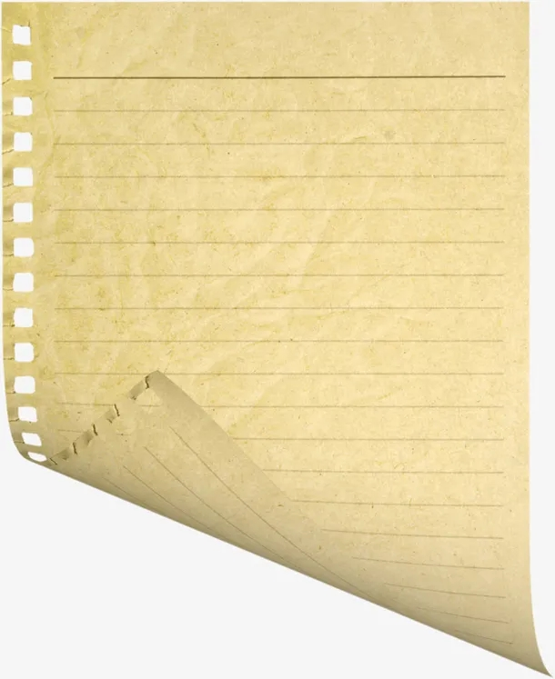
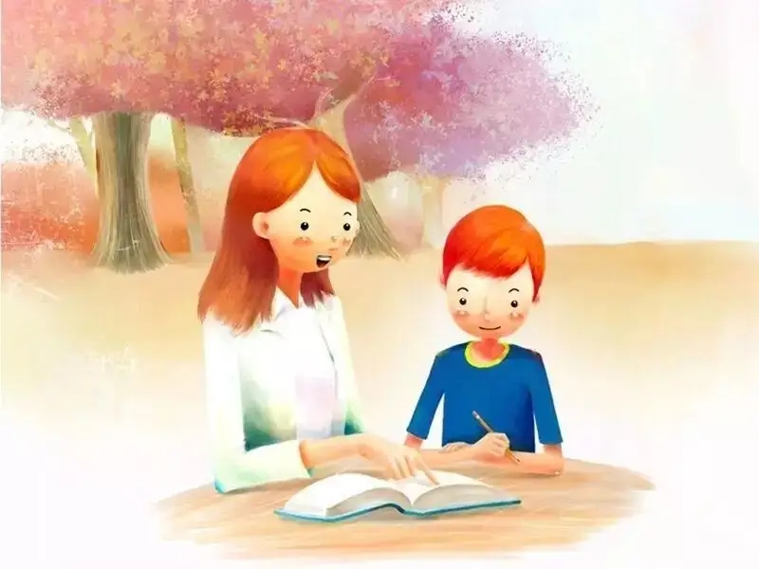
2022.4稽阳联考读后续写
浙江省春晖中学 宣晔霏

Slide 3
第二节读后续写（满分25分）
阅读下面短文，根据所给情节进行续写，使之构成一个完整的故事。
①The paper on my desk was yellow, with straight blue lines stretching across it. The lines repeated themselves all the way down the page. I counted them. Twenty-six straight lines across the paper. The yellow color reminded me of sunshine. In summer the sun is bright yellow like that, and the sky is blue like those lines. I loved blue---blue is for getting lost in..
② “You haven't written a word yet, have your?" Miss Perry had found me out. I hung my head, as in past years, and gave her the lines I'd given previous teachers.
③"I don't feel like it."
④The truth was that I wanted to write about something different. "Write about Your Best Friend," demanded the assignment on the board. I didn't have a best friend. I had a few friends, but I didn't want to claim any of them as my "best“ because I was afraid they might pick someone else. What if I picked a "best" friend and then someone different, who thought I was their best friend, heard my paragraph read aloud and then never spoke to me again? It was a stupid topic. I was disappointed in Miss Perry for choosing it.
⑤I knew Miss Perry must have heard about me from my other teachers. I had already prepared myself for another year of listening to teachers scold me. I was only nine years old, but my ears had been dull to the voices of my elders. My teachers, my parents, and the school principal had all given me the "What are we supposed to do with you?" speech. That was probably what Miss Perry was about to say, too.

Slide 4
Read for language
with straight blue lines stretching across it
the lines repeated themselves all the way down the page
the yellow color reminded me of sunshine
hung my head
claim any of them as my “best”
but my ears had been dull to the voices of my elders
蓝色的直线穿过它
这一页的每一行都在重复
黄色使我想起阳光
低垂着我的头
声称他们是我最好的
但我的耳朵长辈们的声音已然麻木

Slide 5
Read for structure
第二节读后续写（满分25分）
阅读下面短文，根据所给情节进行续写，使之构成一个完整的故事。
①The paper on my desk was yellow, with straight blue lines stretching across it. The lines repeated themselves all the way down the page. I counted them. Twenty-six straight lines across the paper. The yellow color reminded me of sunshine. In summer the sun is bright yellow like that, and the sky is blue like those lines. I loved blue---blue is for getting lost in..
② “You haven't written a word yet, have your?" Miss Perry had found me out. I hung my head, as in past years, and gave her the lines I'd given previous teachers.
③"I don't feel like it."
④The truth was that I wanted to write about something different. "Write about Your Best Friend," demanded the assignment on the board. I didn't have a best friend. I had a few friends, but I didn't want to claim any of them as my "best“ because I was afraid they might pick someone else. What if I picked a "best" friend and then someone different, who thought I was their best friend, heard my paragraph read aloud and then never spoke to me again? It was a stupid topic. I was disappointed in Miss Perry for choosing it.
⑤I knew Miss Perry must have heard about me from my other teachers. I had already prepared myself for another year of listening to teachers scold me. I was only nine years old, but my ears had been dull to the voices of my elders. My teachers, my parents, and the school principal had all given me the "What are we supposed to do with you?" speech. That was probably what Miss Perry was about to say, too.
Paragraph 1: However, there was something different about Miss Perry.
Paragraph 2: I bet I was touched.
flashback

Slide 6
Read for details
Detailed description
The paper on my desk was yellow, with straight blue lines stretching across it. The lines repeated themselves all the way down the page. I counted them. Twenty-six straight lines across the paper. The yellow color reminded me of sunshine. In summer the sun is bright yellow like that, and the sky is blue like those lines. I loved blue---blue is for getting lost in..
①The paper on my desk was yellow, with straight blue lines stretching across it. The lines repeated themselves all the way down the page. I counted them. Twenty-six straight lines across the paper. The yellow color reminded me of sunshine. In summer the sun is bright yellow like that, and the sky is blue like those lines. I loved blue---blue is for getting lost in..
② “You haven't written a word yet, have your?" Miss Perry had found me out. I hung my head, as in past years, and gave her the lines I'd given previous teachers.
③"I don't feel like it."
What can we infer from paragraph 1?
My mind was wandering aimlessly…
It seemed that I fancied nature…
foreshadowing 埋下伏笔
What did I always use do?

Slide 7
The truth was that I wanted to write about something different
④The truth was that I wanted to write about something different. "Write about Your Best Friend," demanded the assignment on the board. I didn't have a best friend. I had a few friends, but I didn't want to claim any of them as my "best“ because I was afraid they might pick someone else. What if I picked a "best" friend and then someone different, who thought I was their best friend, heard my paragraph read aloud and then never spoke to me again?
It was a stupid topic. I was disappointed in Miss Perry for choosing it.
⑤I knew Miss Perry must have heard about me from my other teachers. I had already prepared myself for another year of listening to teachers scold me. I was only nine years old, but my ears had been dull to the voices of my elders. My teachers, my parents, and the school principal had all given me the "What are we supposed to do with you?" speech. That was probably what Miss Perry was about to say, too.
I didn't have a best friend.
It was a stupid topic. I was disappointed in Miss Perry for choosing it
Why didn’t I write anything about the topic?
What kind of student I was?
What was my teachers’ reaction to me?
a naughty boy
a tough nut 难对付的人
a wayward child 不听话的孩子
scold /punishment
at a loss what to do
indifference漠视

Slide 8
So, what would miss perry do with my situation?
Paragraph 1: However, there was something different about Miss Perry.
Paragraph 2: I bet I was touched.
What was the difference between Miss Perry and my previous teachers?
What did Miss Perry do and say to deal with my situation?
What was my reaction?
A loving teacher can change a naughty boy.
A teacher’s encouragement and consideration can make a big difference.
……
What did I do and How did I feel?
What did Miss perry do and say?
What was the possible theme/ ending?
Theme?

Slide 9
Paragraph 1: However, there was something different about Miss Perry
How to describe Miss Perry?
☞With a faint smile creeping upon her cheeks, Miss Perry stroked my hair and patted my shoulder, uttering some words gently and softly…
☞ with a faint smile dancing around the corner of her mouth, Miss perry bent over to hold my hands, genuinely staring at me…
☞ After a seemingly suffocating silence, she knelt down beside me and asked gently.
☞ Instead of bullying my ears with the dull voices just like my previous teachers, she encouraged with sweet and gentle voice as well as a bright smile.
☞ She patted me gently on my shoulder and cast a warm, yet determined look at me, signaling me to follow her to the corridor.

Slide 10
Paragraph 2: I bet I was touched.
How to describe Miss Perry?
☞ Miss perry approached me, rounded me with her arms and embraced me tightly, form which I sensed her love and warmth.
☞ No scolding, no mocking嘲笑, she just stared at me gently and asked in a mild voice, “could you please tell me the reason?”
☞ Sensing my frustration and hesitation, she said nothing more but signaled me to go out.
Instead of scolding me coldly and bitterly, she bent down, looking into my eyes and whispering….
☞ In her voice was pure sincerity and gentle affection. In her eyes was strong confidence and determination. The ice in my heart seemingly commenced to melt. After this talk, I tried to integrate into every class afterwards.

Slide 11
Paragraph 1: However, there was something different about Miss Perry
How to describe my reaction?
● Dumbfounded and stunned, I slowly raised my head, with tears glittering in my eyes. I stammered in a low voice, “I , I …”
● I barely lowered my heard, hoping this action could end the embarrassing , fruitless and nonsense communication.
● A stream of warmth flooding me, my heart melted away.
● With my jaw dropping, I clenched my sleeves tightly, absolutely at a loss what to do.
● I transformed my hard appearance into a softened heart, tears welling up in my eyes.
● I stood there, silent and motionless. … A sudden surge of sorrow mingled with regret enveloped me, tears blurring my vision.
● The initial imagination racing through my mind, I summoned up courage and blurted out脱口而出, “I want to write something different.”
● In her affectionate sight, I murmured out what I thought about the assignment.
● Encouraged, I poured out my thoughts thoroughly, just like sharing with my best friend.

Slide 12
Paragraph 2: I bet I was touched.
What might happen afterwards?
★I started to write on the paper. Strangely, more and more words appeared on the blue lines and even seemed to dance in the sunshine.
★ Never had I expected that my “degusting” performance would be greeted by such tolerance! ★ There we stood, outside the classroom, the sunshine brightened the yellow paper.
★ Sitting in front of my desk, I gazed at the straight lines rendering my inspiration. Surely, it was Miss Perry that was going to be the main character in my article.
★ Golden sunshine cast its glow on the yellow paper, witnessing my devotion. Using every beautiful word I could recall, I tried my best to write down the most beautiful answer, “Miss Perry is my best friend. ”
★ Never in my wildest dreamed had I known that such a simple gesture could change my life.
★ The sun shining with bliss, the light clouds crossing the blue sky, I grabbed my pen and gradually filled the lines with my sincere words.

Slide 13
Paragraph 2: I bet I was touched.
What might happen afterwards?
★ When I ultimately wrote the whole lines down, I sent her a wide smile genuinely. Thank you, Miss Perry. Thank you, my best friend.
★ Sunshine filtered through the windows, sending me warmth and happiness.
★ I quickly finished the work and submitted it the next day. Miss perry seemed quite delighted to witness my growth and I knew it was her generous help and encouragement that really counted.
★ My tears rolling down like a broken string of beads, I held Miss Perry in my embrace, who totally changed my attitude towards life.
★ All the disappointment were melting away. What was deeply rooted in my mind was a total relief, overwhelming exhilaration and most of all, gratitude for Miss Perry’s considerate words.

Slide 14
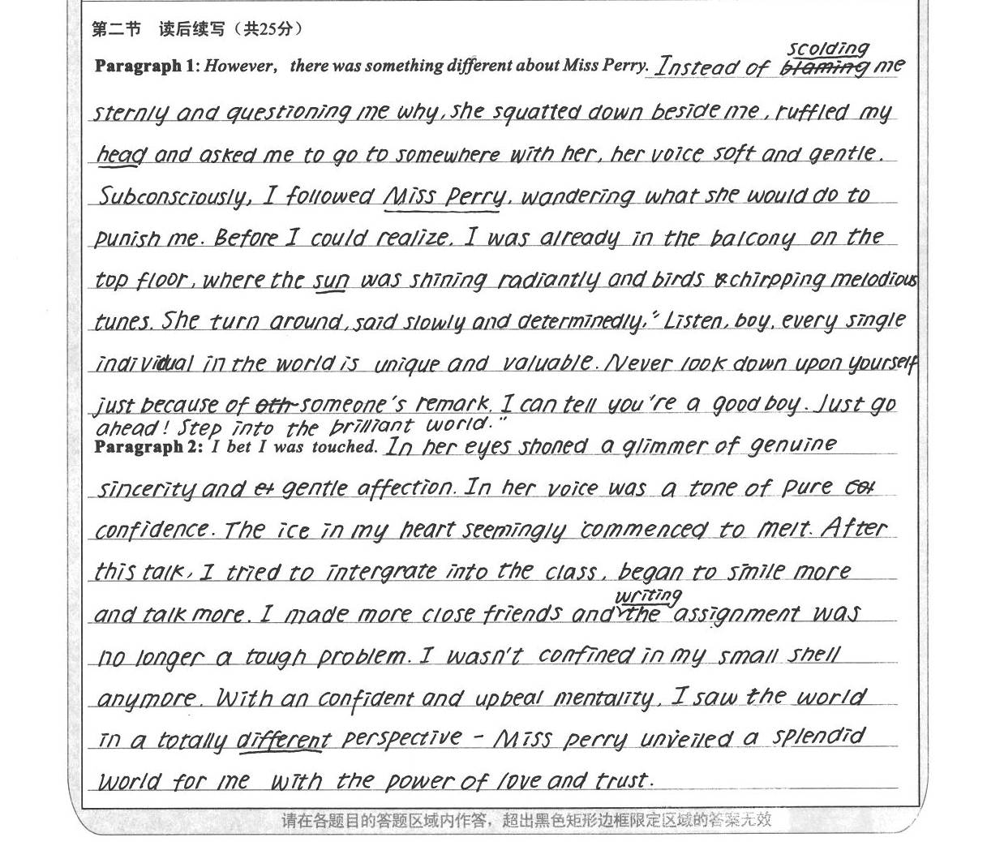
appreciation：

Slide 15
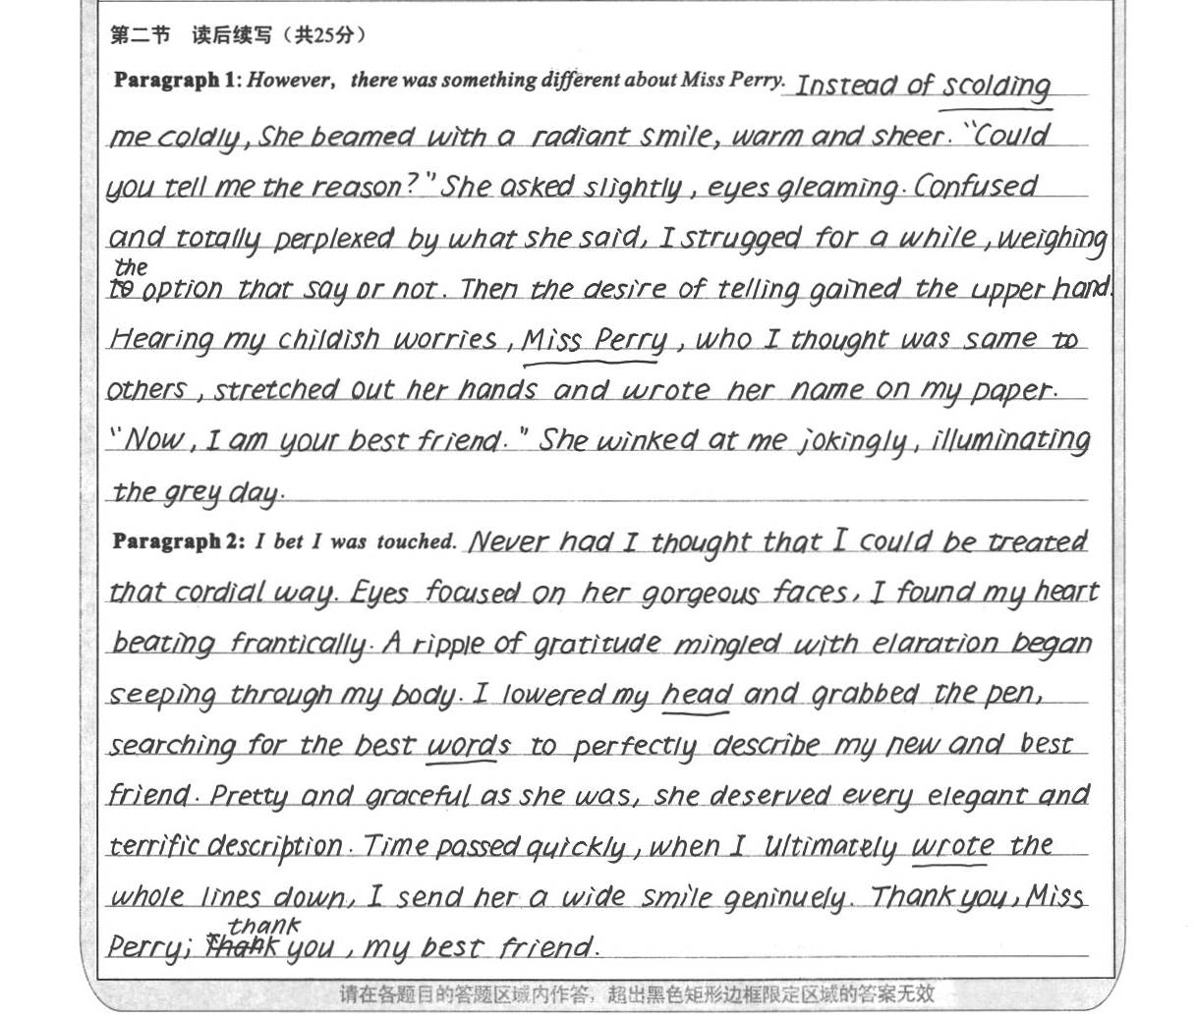
appreciation：

Slide 16
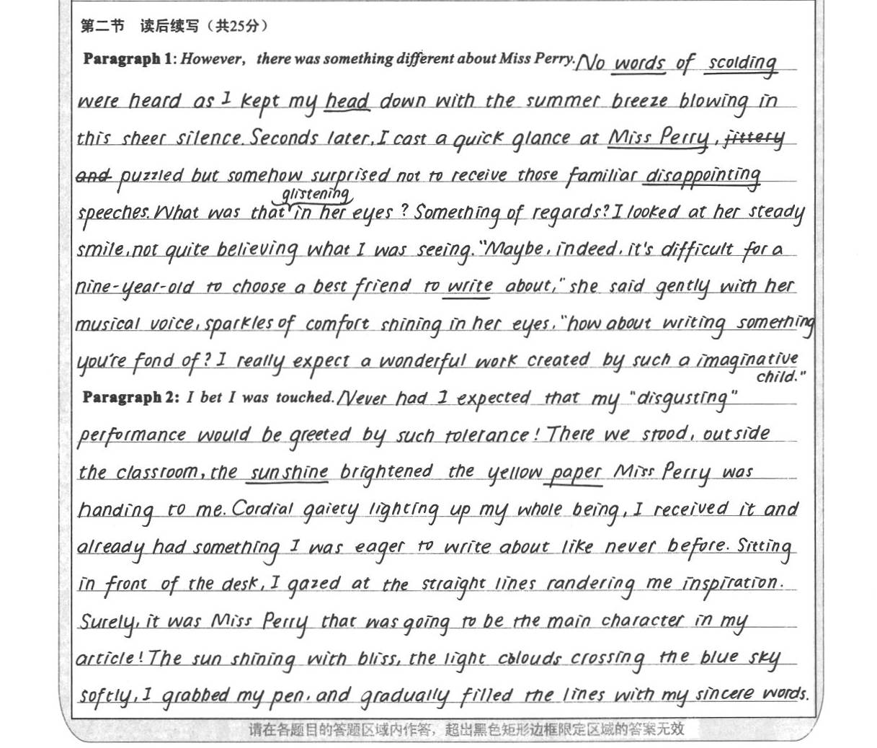
appreciation：

Slide 17
one possible version:
Paragraph 1:
However, there was something different about Miss Perry. “What do you want to do, then?” she smiled, tenderly staring at me with deep blue watery eyes. What? My previous teachers would scold me or send me to the principal’s office. Miss Perry, however, stood in front of my desk and kept her soft gaze on my face. Without a word, I lowered my head to avoid her eyes. “You just think what it is that you want to write about? Then, come to share with me, and
we’ll make some arrangements that you can live with. Fair enough?” She patted me on the back. No teacher had touched me before.
Paragraph 2:
I bet I was touched. Automatically, I raised my head and caught sight of her walking back to her desk. Wondering what to make of her, I received another glance. A sense of something different attacked. I looked out of the window. The trees, the rain, everything was in sight. Inspired, I rose from the seat. “I want to study the weather outside.” “You really like that? But promise to write down what you learn on that blank paper. Deal?” “Deal!” All that afternoon I
studied clouds, winds and the rain. Amazingly, a rainbow hung above like an upside-down smile. For the first time in years, I was really concentrating on my school work.

Slide 18
Thank you!

