Slide 1

感恩遇见，相互成就，本课件资料仅供您个人参考、教学使用，严禁自行在网络传播，违者依知识产权法追究法律责任。
更多教学资源请关注
公众号：溯恩高中英语
知识产权声明

Slide 2


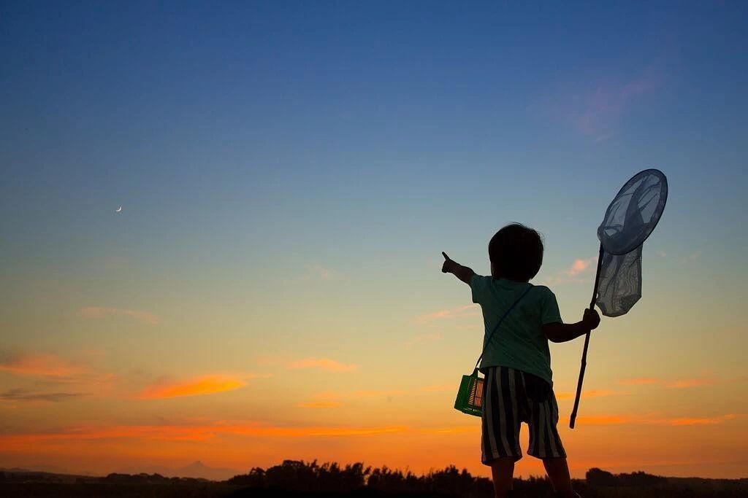
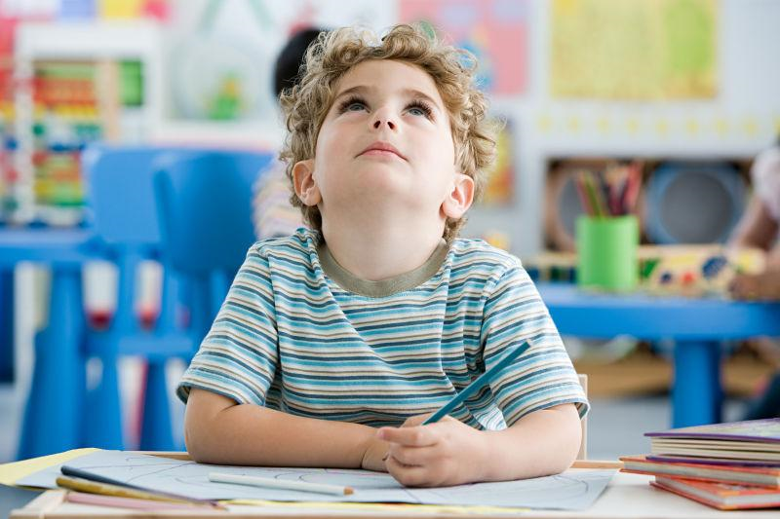
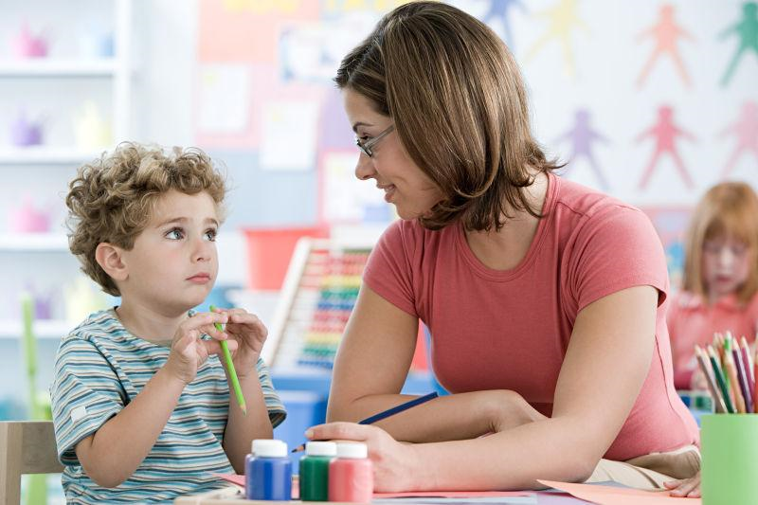
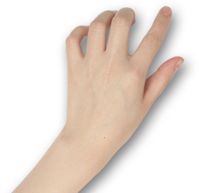
高考备考瓶颈突破
2022年4月稽阳联谊学校高三联考
Something different
可以不一样
—— 基于“主题主线逻辑建构”的读后续写讲评
浙江省常山一中 吴俊峰
浙江省春晖中学 宣晔霏

Slide 3

















01
基于叙事特征，
深度解读语篇
悬念suspense
冲突 conflict
首尾呼应inclusio
铺垫foreshadowing
人物性格 personal character
故事背景 setting

Slide 4
Clarify the expressions
The paper on my desk was yellow, with straight blue lines stretching across it. The lines repeated themselves all the way down the page. I counted them. Twenty-six straight lines ran across the paper. The yellow color reminded me of sunshine. In summer the sun is bright yellow like that, and the sky is blue like those lines. I loved blue — blue is for getting lost in...
“You haven’t written a word yet, have you?” Miss Perry had found me out. I hung my head, as in past years, and gave her the lines I’d given previous teachers.
“I don’t feel like it.”
The truth was that I wanted to write about something different. “Write about Your Best Friend,” demanded the assignment on the board. I didn’t have a best friend. I had a few friends, but I didn’t want to claim any of them as my “best” because I was afraid they might pick someone else. What if I picked a “best” friend and then someone different, who thought I was their best friend, heard my paragraph read aloud and then never spoke to me again? It was a stupid topic. I was disappointed in Miss Perry for choosing it.
I knew Miss Perry must have heard about me from my other teachers. I had already prepared myself for another year of listening to teachers scold me. I was only nine years old, but my ears had been dull to the voices of my elders. My teachers, my parents, and the school principal had all given me the “What are we supposed to do with you?” speech. That was probably what Miss Perry was about to say, too.
However, there was something different about Miss Perry. ______________________________________________
I bet I was touched. _____________________________________________________________________________
It was typical of me to be scolded often.
Can their “something different” be coordinated?
get lost in: be addicted to; be spellbound ; be fascinated with
the lines: the words spoken by an actor in a play or film/movie
assignment: a task or piece of work that you are given to do, especially as part of your job or studies
dull: slow in understanding; turn a deaf ear to
speech(=lecture): a long angry talk or criticism that sb gives to one person

Slide 5
Read and analyze according to narrative elements and structure
The paper on my desk was yellow, with straight blue lines stretching across it. The lines repeated themselves all the way down the page. I counted them. Twenty-six straight lines ran across the paper. The yellow color reminded me of sunshine. In summer the sun is bright yellow like that, and the sky is blue like those lines. I loved blue — blue is for getting lost in...
“You haven’t written a word yet, have you?” Miss Perry had found me out. I hung my head, as in past years, and gave her the lines I’d given previous teachers.
“I don’t feel like it.”
The truth was that I wanted to write about something different. “Write about Your Best Friend,” demanded the assignment on the board. I didn’t have a best friend. I had a few friends, but I didn’t want to claim any of them as my “best” because I was afraid they might pick someone else. What if I picked a “best” friend and then someone different, who thought I was their best friend, heard my paragraph read aloud and then never spoke to me again? It was a stupid topic. I was disappointed in Miss Perry for choosing it.
I knew Miss Perry must have heard about me from my other teachers. I had already prepared myself for another year of listening to teachers scold me. I was only nine years old, but my ears had been dull to the voices of my elders. My teachers, my parents, and the school principal had all given me the “What are we supposed to do with you?” speech. That was probably what Miss Perry was about to say, too.
 | When and Where
 | Who
 | What
In summer; In class, at school
故事背景
setting
I (a nine-year-old student); Miss Perry(my present teacher)
finish the assignment “Write about Your Best Friend,”

Slide 6
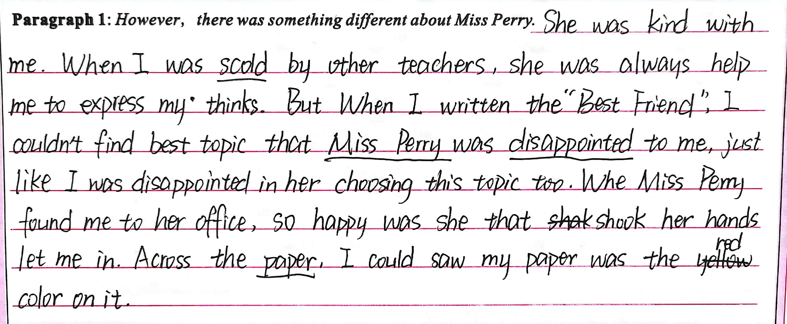

Reflect on our writings
The paper on my desk was yellow, with straight blue lines stretching across it. The lines repeated themselves all the way down the page. I counted them. Twenty-six straight lines ran across the paper. The yellow color reminded me of sunshine. In summer the sun is bright yellow like that, and the sky is blue like those lines. I loved blue — blue is for getting lost in...
“You haven’t written a word yet, have you?” Miss Perry had found me out. I hung my head, as in past years, and gave her the lines I’d given previous teachers.
“I don’t feel like it.”
The truth was that I wanted to write about something different. “Write about Your Best Friend,” demanded the assignment on the board. I didn’t have a best friend. I had a few friends, but I didn’t want to claim any of them as my “best” because I was afraid they might pick someone else. What if I picked a “best” friend and then someone different, who thought I was their best friend, heard my paragraph read aloud and then never spoke to me again? It was a stupid topic. I was disappointed in Miss Perry for choosing it.
I knew Miss Perry must have heard about me from my other teachers. I had already prepared myself for another year of listening to teachers scold me. I was only nine years old, but my ears had been dull to the voices of my elders. My teachers, my parents, and the school principal had all given me the “What are we supposed to do with you?” speech. That was probably what Miss Perry was about to say, too.
关于文本的Setting的任何细节的失真，都可能会摧毁文本的说服力，根基不牢。
Setting information is basic information.

Slide 7
Read and analyze
The paper on my desk was yellow, with straight blue lines stretching across it. The lines repeated themselves all the way down the page. I counted them. Twenty-six straight lines ran across the paper. The yellow color reminded me of sunshine. In summer the sun is bright yellow like that, and the sky is blue like those lines. I loved blue — blue is for getting lost in...
“You haven’t written a word yet, have you?” Miss Perry had found me out. I hung my head, as in past years, and gave her the lines I’d given previous teachers.
“I don’t feel like it.”
The truth was that I wanted to write about something different. “Write about Your Best Friend,” demanded the assignment on the board. I didn’t have a best friend. I had a few friends, but I didn’t want to claim any of them as my “best” because I was afraid they might pick someone else. What if I picked a “best” friend and then someone different, who thought I was their best friend, heard my paragraph read aloud and then never spoke to me again? It was a stupid topic. I was disappointed in Miss Perry for choosing it.
I knew Miss Perry must have heard about me from my other teachers. I had already prepared myself for another year of listening to teachers scold me. I was only nine years old, but my ears had been dull to the voices of my elders. My teachers, my parents, and the school principal had all given me the “What are we supposed to do with you?” speech. That was probably what Miss Perry was about to say, too.
In summer the sun is bright yellow like that, and the sky is blue like those lines. I loved blue — blue is for
getting lost in...
The truth was that I wanted to write about something different.
What can we infer from paragraph 1?
My mind was wandering aimlessly…
It seemed that I fancied nature…
I was individualized, and I had a mind of my own.
“ I didn’t have a best friend” was just an excuse.
Why didn’t I write anything about the topic?

Slide 8
Read and analyze
The paper on my desk was yellow, with straight blue lines stretching across it. The lines repeated themselves all the way down the page. I counted them. Twenty-six straight lines ran across the paper. The yellow color reminded me of sunshine. In summer the sun is bright yellow like that, and the sky is blue like those lines. I loved blue — blue is for getting lost in...
“You haven’t written a word yet, have you?” Miss Perry had found me out. I hung my head, as in past years, and gave her the lines I’d given previous teachers.
“I don’t feel like it.”
The truth was that I wanted to write about something different. “Write about Your Best Friend,” demanded the assignment on the board. I didn’t have a best friend. I had a few friends, but I didn’t want to claim any of them as my “best” because I was afraid they might pick someone else. What if I picked a “best” friend and then someone different, who thought I was their best friend, heard my paragraph read aloud and then never spoke to me again? It was a stupid topic. I was disappointed in Miss Perry for choosing it.
I knew Miss Perry must have heard about me from my other teachers. I had already prepared myself for another year of listening to teachers scold me. I was only nine years old, but my ears had been dull to the voices of my elders. My teachers, my parents, and the school principal had all given me the “What are we supposed to do with you?” speech. That was probably what Miss Perry was about to say, too.
flashback
What kind of student I was? | What was my previous teachers’reaction to me?
a naughty boy
a tough nut 难对付的人
a wayward child 不听话的孩子
scold /punishment
at a loss what to do

Slide 9
Read and analyze according to narrative elements and structure
The paper on my desk was yellow, with straight blue lines stretching across it. The lines repeated themselves all the way down the page. I counted them. Twenty-six straight lines ran across the paper. The yellow color reminded me of sunshine. In summer the sun is bright yellow like that, and the sky is blue like those lines. I loved blue — blue is for getting lost in...
“You haven’t written a word yet, have you?” Miss Perry had found me out. I hung my head, as in past years, and gave her the lines I’d given previous teachers.
“I don’t feel like it.”
The truth was that I wanted to write about something different. “Write about Your Best Friend,” demanded the assignment on the board. I didn’t have a best friend. I had a few friends, but I didn’t want to claim any of them as my “best” because I was afraid they might pick someone else. What if I picked a “best” friend and then someone different, who thought I was their best friend, heard my paragraph read aloud and then never spoke to me again? It was a stupid topic. I was disappointed in Miss Perry for choosing it.
I knew Miss Perry must have heard about me from my other teachers. I had already prepared myself for another year of listening to teachers scold me. I was only nine years old, but my ears had been dull to the voices of my elders. My teachers, my parents, and the school principal had all given me the “What are we supposed to do with you?” speech. That was probably what Miss Perry was about to say, too.
I love the sun,the sky, especially blue
Did anybody find out my love of nature?
铺垫/伏笔/暗示
foreshadowing
I truly wanted to write sth different.
Did Miss Perry agree me to write sth different?
I had prepared myself for another year of listening to teachers scold me.
Did Miss Perry scold me as others?

Slide 10
Appreciation —— possible version
...Twenty-six straight lines ran across the paper. The yellow color reminded me of sunshine. In summer the sun is bright yellow like that, and the sky is blue like those lines. I loved blue — blue is for getting lost in...
.... The truth was that I wanted to write about something different. ...
I knew Miss Perry must have heard about me from my other teachers. I had already prepared myself for another year of listening to teachers scold me. I was only nine years old, but my ears had been dull to the voices of my elders. My teachers, my parents, and the school principal had all given me the “What are we supposed to do with you?” speech. That was probably what Miss Perry was about to say, too.
However, there was something different about Miss Perry. “What do you want to do, then?” she smiled, tenderly staring at me with deep blue watery eyes. What? My previous teachers would scold me or send me to the principal’s office. Miss Perry, however, stood in front of my desk and kept her soft gaze on my face. Without a word, I lowered my head to avoid her eyes. “You just think what it is that you want to write about? Then, come to share with me, and we’ll make some arrangements that you can live with. Fair enough?” She patted me on the back. No teacher had touched me before.
I bet I was touched. Automatically, I raised my head and caught sight of her walking back to her desk. Wondering what to make of her, I received another glance. A sense of something different attacked. I looked out of the window. The trees, the rain, everything was in sight. Inspired, I rose from the seat. “I want to study the weather outside.” “You really like that? But promise to write down what you learn on that blank paper. Deal?” “Deal!” All that afternoon I studied clouds, winds and the rain. Amazingly, a rainbow hung above like an upside-down smile. For the first time in years, I was really concentrating on my school work.
理顺叙事元素，
读懂伏笔语言。
顺理协同成章，
呼应对应情节。
Sorting out makes logic out.

Slide 11
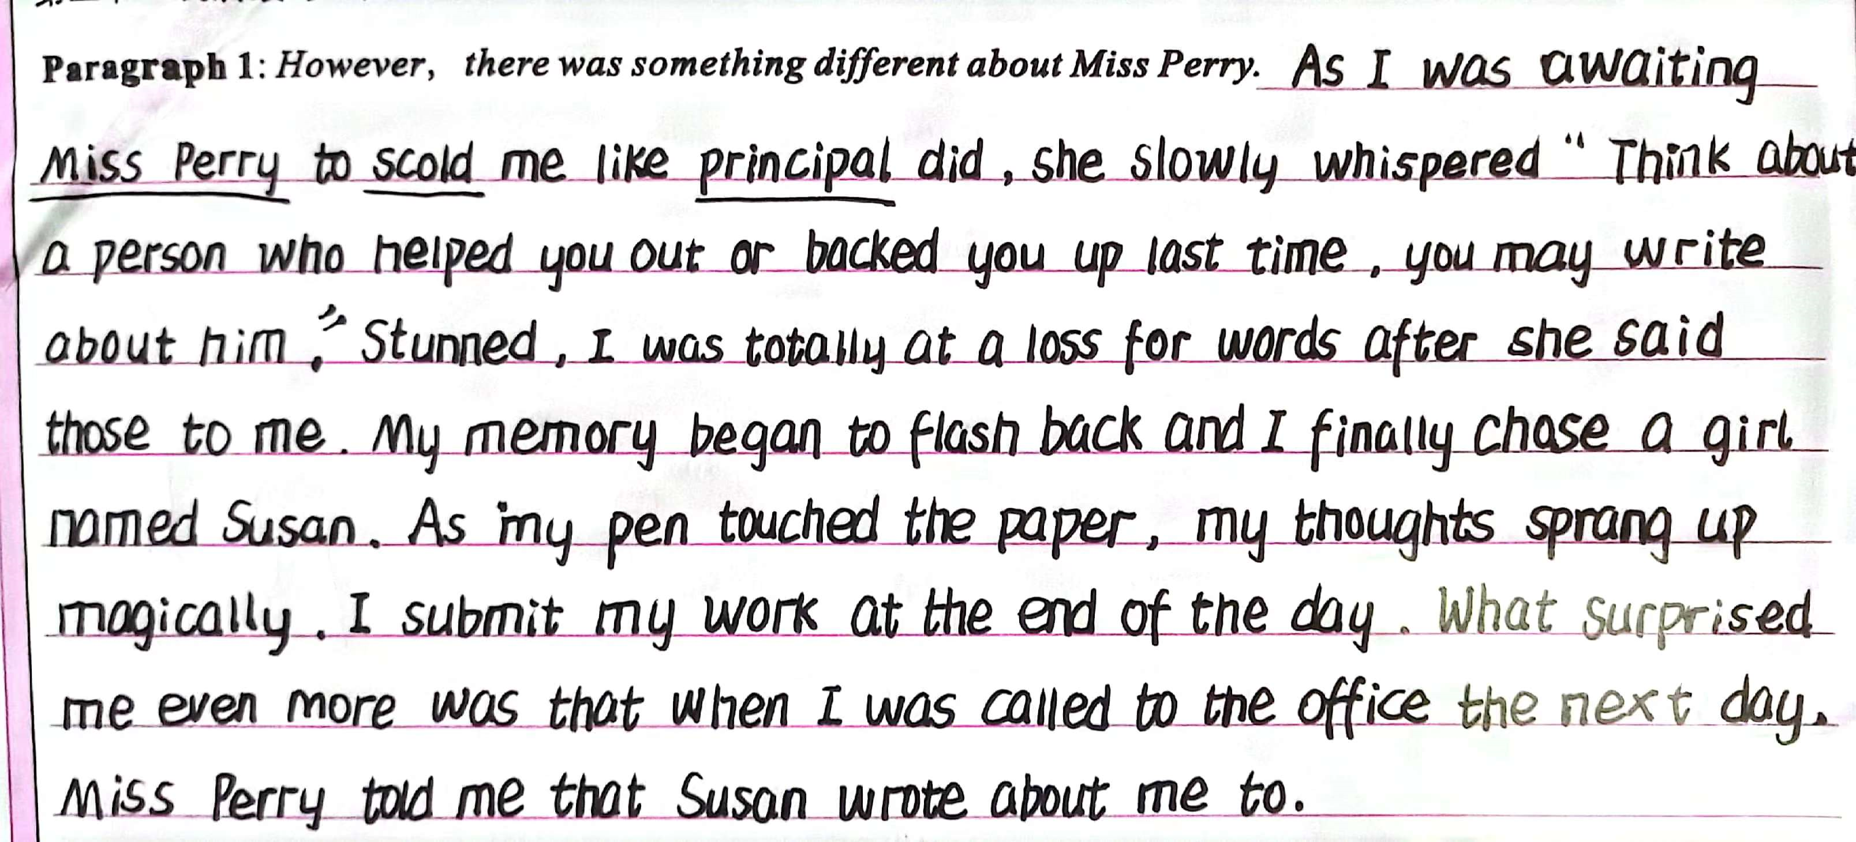
Reflect on our writings
...Twenty-six straight lines ran across the paper. The yellow color reminded me of sunshine. In summer the sun is bright yellow like that, and the sky is blue like those lines. I loved blue — blue is for getting lost in...
.... The truth was that I wanted to write about something different. ...
I knew Miss Perry must have heard about me from my other teachers. I had already prepared myself for another year of listening to teachers scold me. I was only nine years old, but my ears had been dull to the voices of my elders. My teachers, my parents, and the school principal had all given me the “What are we supposed to do with you?” speech. That was probably what Miss Perry was about to say, too.
没有读懂原文的伏笔和铺垫，尤其是The truth was that I wanted to write about something different.
习作偏离主线，与原文预设严重脱节。

Slide 12
Read and analyze according to narrative elements and structure
The paper on my desk was yellow, with straight blue lines stretching across it. The lines repeated themselves all the way down the page. I counted them. Twenty-six straight lines ran across the paper. The yellow color reminded me of sunshine. In summer the sun is bright yellow like that, and the sky is blue like those lines. I loved blue — blue is for getting lost in...
“You haven’t written a word yet, have you?” Miss Perry had found me out. I hung my head, as in past years, and gave her the lines I’d given previous teachers.
“I don’t feel like it.”
The truth was that I wanted to write about something different. “Write about Your Best Friend,” demanded the assignment on the board. I didn’t have a best friend. I had a few friends, but I didn’t want to claim any of them as my “best” because I was afraid they might pick someone else. What if I picked a “best” friend and then someone different, who thought I was their best friend, heard my paragraph read aloud and then never spoke to me again? It was a stupid topic. I was disappointed in Miss Perry for choosing it.
I knew Miss Perry must have heard about me from my other teachers. I had already prepared myself for another year of listening to teachers scold me. I was only nine years old, but my ears had been dull to the voices of my elders. My teachers, my parents, and the school principal had all given me the “What are we supposed to do with you?” speech. That was probably what Miss Perry was about to say, too.
However, there was something different about Miss Perry. ______________________________________________
I bet I was touched. _____________________________________________________________________________
冲突和悬念
conflict and suspense
Conflict : “I don’t feel like it.”
How did Miss Perry react and resolve it?
Suspense: That was probably what Miss Perry was about to say, too.
Did Miss Perry do the same ?

Slide 13
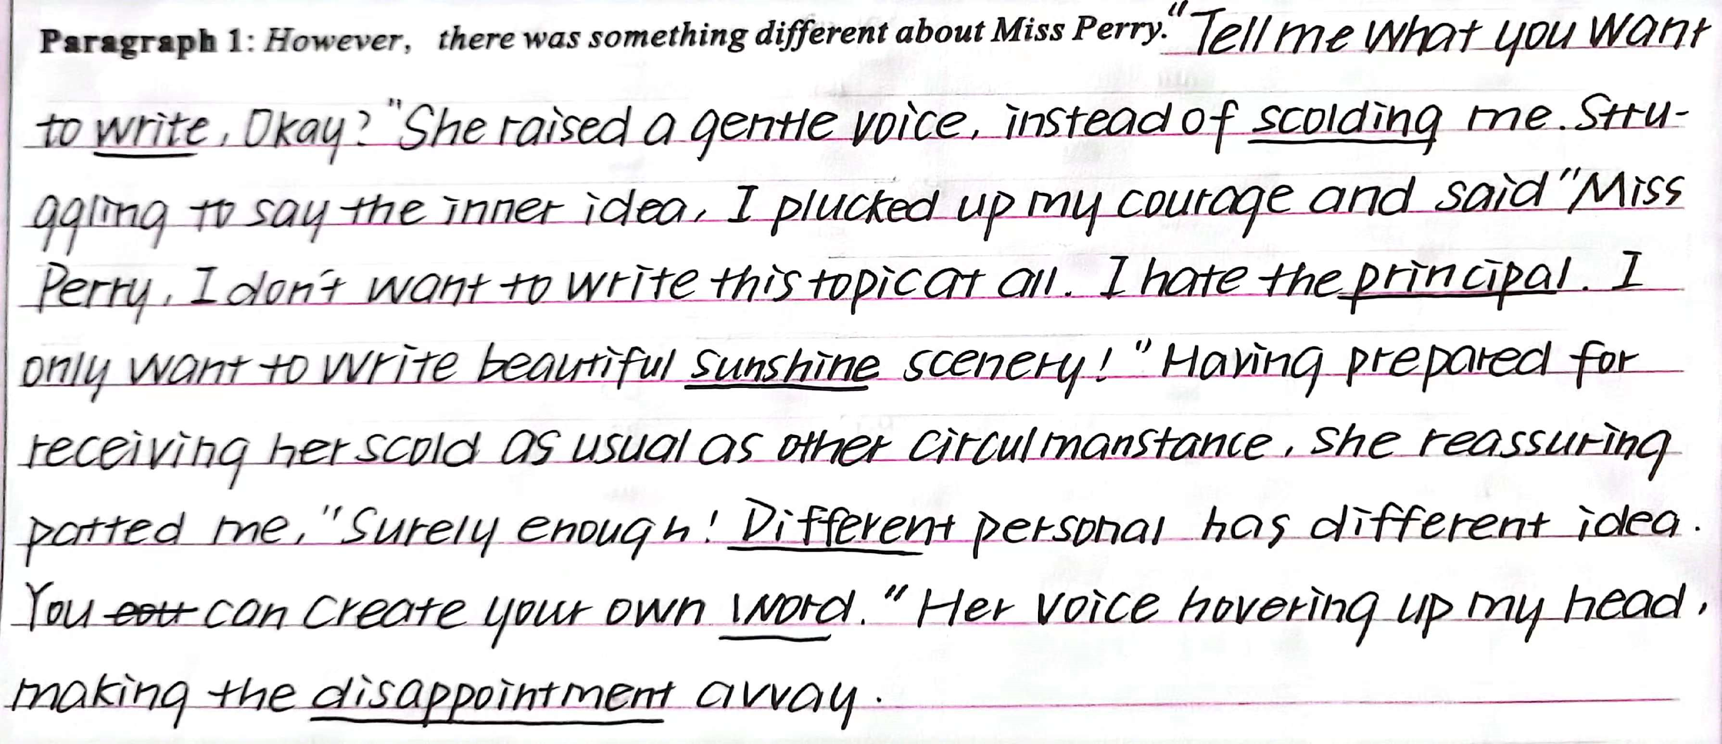

Reflect on our writings
...
“I don’t feel like it.”
The truth was that I wanted to write about something different. “Write about Your Best Friend,” demanded the assignment on the board. ... It was a stupid topic. I was disappointed in Miss Perry for choosing it.
I knew Miss Perry must have heard about me from my other teachers. I had already prepared myself for another year of listening to teachers scold me. I was only nine years old, but my ears had been dull to the voices of my elders. My teachers, my parents, and the school principal had all given me the “What are we supposed to do with you?” speech. That was probably what Miss Perry was about to say, too.
However, there was something different about Miss Perry. ______________________________________________
I bet I was touched. _____________________________________________________________________________
习作充分利用关键词“different”，善渲染矛盾，会解决冲突，且与原文高度连贯和协同。
可惜的是principal理解有误，建议改为principle

Slide 14
02
把握主题主线
合理逻辑建构
1. 人物性格决定际遇
性格
2. 主要矛盾决定主线
矛盾
连贯
5.语义连贯决定协同
5D
情感
段首
3. 情感态度决定主题
4. 段首细节决定拐点

Slide 15
Character determines fortune _{人物性格决定际遇}
The paper on my desk was yellow, with straight blue lines stretching across it. The lines repeated themselves all the way down the page. I counted them. Twenty-six straight lines ran across the paper. The yellow color reminded me of sunshine. In summer the sun is bright yellow like that, and the sky is blue like those lines. I loved blue — blue is for getting lost in...
“You haven’t written a word yet, have you?” Miss Perry had found me out. I hung my head, as in past years, and gave her the lines I’d given previous teachers.
“I don’t feel like it.”
The truth was that I wanted to write about something different. “Write about Your Best Friend,” demanded the assignment on the board. I didn’t have a best friend. I had a few friends, but I didn’t want to claim any of them as my “best” because I was afraid they might pick someone else. What if I picked a “best” friend and then someone different, who thought I was their best friend, heard my paragraph read aloud and then never spoke to me again? It was a stupid topic. I was disappointed in Miss Perry for choosing it.
I knew Miss Perry must have heard about me from my other teachers. I had already prepared myself for another year of listening to teachers scold me. I was only nine years old, but my ears had been dull to the voices of my elders. My teachers, my parents, and the school principal had all given me the “What are we supposed to do with you?” speech. That was probably what Miss Perry was about to say, too.
However, there was something different about Miss Perry. ___________________
I bet I was touched. __________________________________________________
boring _{无聊的}
disgusted with routine_{厌学常规的}
individualized _{有个性的}
rebellious _{叛逆的}
nature-loving _{热爱自然的}

Slide 16

Character determines fortune _{人物性格决定际遇}
The paper on my desk was yellow, with straight blue lines stretching across it. The lines repeated themselves all the way down the page. I counted them. Twenty-six straight lines ran across the paper. The yellow color reminded me of sunshine. In summer the sun is bright yellow like that, and the sky is blue like those lines. I loved blue — blue is for getting lost in...
“You haven’t written a word yet, have you?” Miss Perry had found me out. I hung my head, as in past years, and gave her the lines I’d given previous teachers.
“I don’t feel like it.”
The truth was that I wanted to write about something different. “Write about Your Best Friend,” demanded the assignment on the board. I didn’t have a best friend. I had a few friends, but I didn’t want to claim any of them as my “best” because I was afraid they might pick someone else. What if I picked a “best” friend and then someone different, who thought I was their best friend, heard my paragraph read aloud and then never spoke to me again? It was a stupid topic. I was disappointed in Miss Perry for choosing it.
I knew Miss Perry must have heard about me from my other teachers. I had already prepared myself for another year of listening to teachers scold me. I was only nine years old, but my ears had been dull to the voices of my elders. My teachers, my parents, and the school principal had all given me the “What are we supposed to do with you?” speech. That was probably what Miss Perry was about to say, too.
However, there was something different about Miss Perry. ___________________
I bet I was touched. __________________________________________________
What was different about Miss Perry?
No .
scold;
compulsory
...

Slide 17
Principal contradiction determines main plot _{主要矛盾决定主线}
nature-loving_{热爱自然的}
boring_{无聊的}
What was different about Miss Perry?
No .
But more .
disgusted with routine_{厌学常规的}
tolerate
the shortcomings
scold; compulsory; ...
individualized_{有个性的}
encourage; optional ...
rebellious_{叛逆的}

Slide 18
Detail determines inflection point _{段首细节决定拐点}
However, there was something different about Miss Perry. ____________
I bet I was touched. _______________________
Q1. What makes Miss Perry different from previous teachers??
Q2. How did Miss Perry communicate with me?
Q3. Why did Miss Perry make me touched?
What was my reaction?
Q1. What was my willing-to-execute plan?
Q2. How did Miss Perry encourage me?
Q3. How was my assignment going?
How can you design the ending more appealing and meaningful?

Slide 19
Appreciation —— Detailed descriptions from our writing
Paragraph 1: However, there was something different about Miss Perry
☞With a faint smile creeping upon her cheeks, Miss Perry stroked my hair and patted my shoulder, uttering some words gently and softly…
☞ with a faint smile dancing around the corner of her moth, Miss perry bent over to hold my hands, genuinely staring at me…
☞ After a seemingly suffocating silence, she knelt down beside me and asked gently.
☞ Instead of bullying my ears with the dull voices just like my previous teachers, she encouraged with sweet and gentle voice as well as a bright smile.
☞ She patted me gently on my shoulder and cast a warm, yet determined look at me, signaling me to follow her to the corridor.
How to describe Miss Perry?

Slide 20
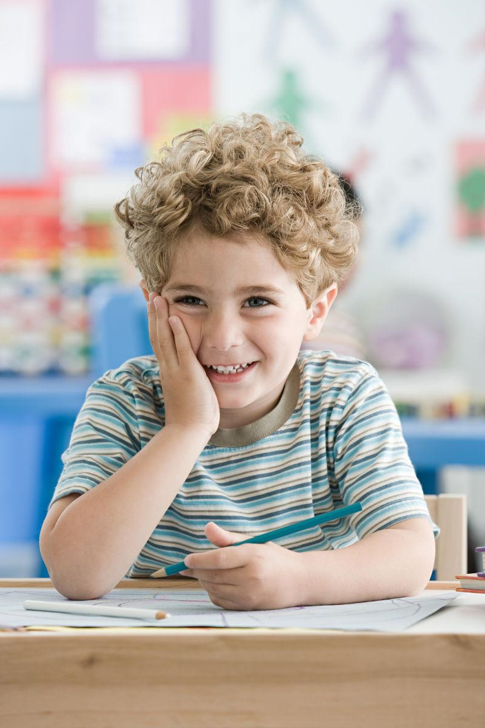
Appreciation —— Detailed descriptions from our writing
Paragraph 1: However, there was something different about Miss Perry
● Dumbfounded and stunned, I slowly raised my head, with tears glistering in my eyes. I stammered in a low voice, “I , I …”
● I barely lowered my heard, hoping this action could end the embarrassing , fruitless and nonsense communication.
● A stream of warmth flooding me, my heart melted away.
● With my jaw dropping, I clenched my sleeves tightly, absolutely at a loss what to do.
● I transformed my hard appearance into a softened heart, tears welling up in my eyes.
● I stood there, silent and motionless. … A sudden surge of sorrow mingled with regret enveloped me, tears blurring my vision.
● The initial imagination racing through my mind, I summoned up courage and blurted out_{脱口而出}, “I want to write something different.”
● In her affectionate sight, I poured out my thoughts thoroughly, just like sharing with my best friend.
How to describe my reaction?

Slide 21
Appreciation —— Detailed descriptions from our writing
Paragraph 2: I bet I was touched.
☞ Miss perry approached me, rounded me with her arms and embraced me tightly, form which I sensed her love and warmth.
☞ No scolding, no mocking, she just stared at me gently and asked in a mild voice, “could you please tell me the reason?”
☞ Sensing my frustration and hesitation, she said nothing more but signaling me to go out. Instead of scolding me coldly and bitterly, she bent down, looking into my eyes and whispered.
☞ In her voice was pure sincerity and gentle affection. In her eyes was strong confidence and determination. The ice in my heart seemingly commenced to melt. After this talk, I tried to integrate into every class afterwards.
How to describe Miss Perry?

Slide 22
Appreciation —— Detailed descriptions from our writing
Paragraph 2: I bet I was touched.
★ Never had I expected that my “degusting” performance would be greeted by such tolerance!
★ There we stood, outside the classroom, the sunshine brightened the yellow paper.
★ Golden sunshine cast its glow on the yellow paper, witnessing my devotion. My thoughts spilled out_{（洒出/溢出）}and my pen began to dance.
★ Never in my wildest dreamed had I known that such a simple gesture could change my life.
★ The sun shining with bliss, the light clouds crossing the blue sky, I grabbed my pen and gradually filled the lines with my sincere words.
What might happen afterwards?

Slide 23
Appreciation —— Detailed descriptions from our writing
Paragraph 2: I bet I was touched.
★ When I ultimately wrote the whole lines down, I sent her a wide smile genuinely. Thank you, Miss Perry. Thank you, my best friend.
★ Sunshine filtered through the windows, sending me warmth and happiness.
★ I quickly finished the work and submitted it the next day. Miss Perry seemed quite delighted to witness my growth and I knew it was her generous help and encouragement that really counted.
★ My tears rolling down like a broken string of beads, I held Miss Perry in my embrace, who totally changed my attitude towards life.
★ All the disappointment were melting away. What was deeply rooted in my mind was a total relief, overwhelming exhilaration and most of all, gratitude for Miss Perry’s considerate words.
What might happen afterwards?

Slide 24
Coherence determines synergy _{语义连贯决定协同}
The paper on my desk was yellow, with straight blue lines stretching across it. The lines repeated themselves all the way down the page. I counted them. Twenty-six straight lines ran across the paper. The yellow color reminded me of sunshine. In summer the sun is bright yellow like that, and the sky is blue like those lines. I loved blue — blue is for getting lost in...
“You haven’t written a word yet, have you?” Miss Perry had found me out. I hung my head, as in past years, and gave her the lines I’d given previous teachers.
“I don’t feel like it.”
The truth was that I wanted to write about something different. “Write about Your Best Friend,” demanded the assignment on the board. I didn’t have a best friend. I had a few friends, but I didn’t want to claim any of them as my “best” because I was afraid they might pick someone else. What if I picked a “best” friend and then someone different, who thought I was their best friend, heard my paragraph read aloud and then never spoke to me again? It was a stupid topic. I was disappointed in Miss Perry for choosing it.
I knew Miss Perry must have heard about me from my other teachers. I had already prepared myself for another year of listening to teachers scold me. I was only nine years old, but my ears had been dull to the voices of my elders. My teachers, my parents, and the school principal had all given me the “What are we supposed to do with you?” speech. That was probably what Miss Perry was about to say, too.
I bet I was touched. Automatically, I raised my head and caught sight of her walking back to her desk. Wondering what to make of her, I received another glance. A sense of something different attacked. I looked out of the window. The trees, the rain, everything was in sight. Inspired, I rose from the seat. “I want to study the weather outside.” “You really like that? But promise to write down what you learn on that blank paper. Deal?” “Deal!” All that afternoon I studied clouds, winds and the rain. Amazingly, a rainbow hung above like an upside-down smile. For the first time in years, I was really concentrating on my school work.

Slide 25
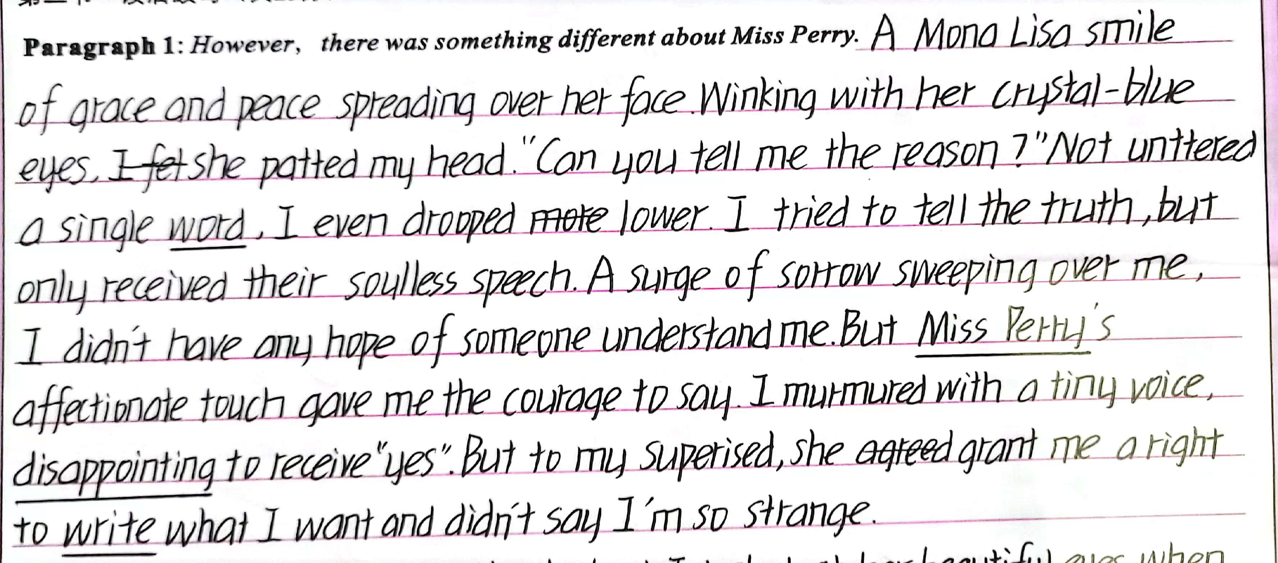
Reflect on our writings _{语义连贯决定协同}
The paper on my desk was yellow, with straight blue lines stretching across it. The lines repeated themselves all the way down the page. I counted them. Twenty-six straight lines ran across the paper. The yellow color reminded me of sunshine. In summer the sun is bright yellow like that, and the sky is blue like those lines. I loved blue — blue is for getting lost in...
“You haven’t written a word yet, have you?” Miss Perry had found me out. I hung my head, as in past years, and gave her the lines I’d given previous teachers.
“I don’t feel like it.”
The truth was that I wanted to write about something different. “Write about Your Best Friend,” demanded the assignment on the board. I didn’t have a best friend. I had a few friends, but I didn’t want to claim any of them as my “best” because I was afraid they might pick someone else. What if I picked a “best” friend and then someone different, who thought I was their best friend, heard my paragraph read aloud and then never spoke to me again? It was a stupid topic. I was disappointed in Miss Perry for choosing it.
I knew Miss Perry must have heard about me from my other teachers. I had already prepared myself for another year of listening to teachers scold me. I was only nine years old, but my ears had been dull to the voices of my elders. My teachers, my parents, and the school principal had all given me the “What are we supposed to do with you?” speech. That was probably what Miss Perry was about to say, too.

Slide 26
Attitude determines altitude _{情感态度决定主题}
The paper on my desk was yellow, with straight blue lines stretching across it. The lines repeated themselves all the way down the page. I counted them. Twenty-six straight lines ran across the paper. The yellow color reminded me of sunshine. In summer the sun is bright yellow like that, and the sky is blue like those lines. I loved blue — blue is for getting lost in...
“You haven’t written a word yet, have you?” Miss Perry had found me out. I hung my head, as in past years, and gave her the lines I’d given previous teachers.
“I don’t feel like it.”
The truth was that I wanted to write about something different. “Write about Your Best Friend,” demanded the assignment on the board. I didn’t have a best friend. I had a few friends, but I didn’t want to claim any of them as my “best” because I was afraid they might pick someone else. What if I picked a “best” friend and then someone different, who thought I was their best friend, heard my paragraph read aloud and then never spoke to me again? It was a stupid topic. I was disappointed in Miss Perry for choosing it.
I knew Miss Perry must have heard about me from my other teachers. I had already prepared myself for another year of listening to teachers scold me. I was only nine years old, but my ears had been dull to the voices of my elders. My teachers, my parents, and the school principal had all given me the “What are we supposed to do with you?” speech. That was probably what Miss Perry was about to say, too.
Discussion:
What is the best title of the text?
A. My best friend
B. My lovely writing
C. My favorite teacher
D. My first finished assignment
E. You are my sunshine
F. ...

Slide 27
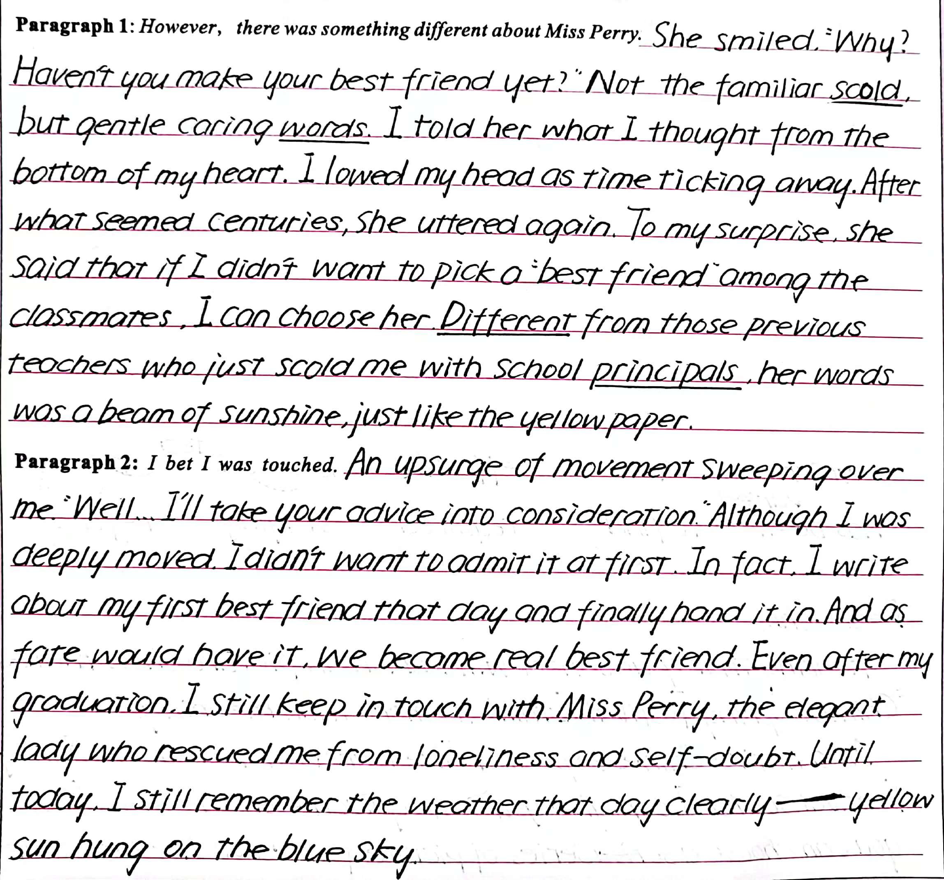

Reflect on our writings
从这篇习作的用词和语法结构来看，该考生语言运用能力不弱。
但本文在主要情节的衔接上存在明显的漏洞，没能读出伏笔和铺垫，整篇都在解决“Write about Your Best Friend,”，导致情节主线和情感主题与原文严重剥离。结尾也就生硬，不自然流畅。

Slide 28
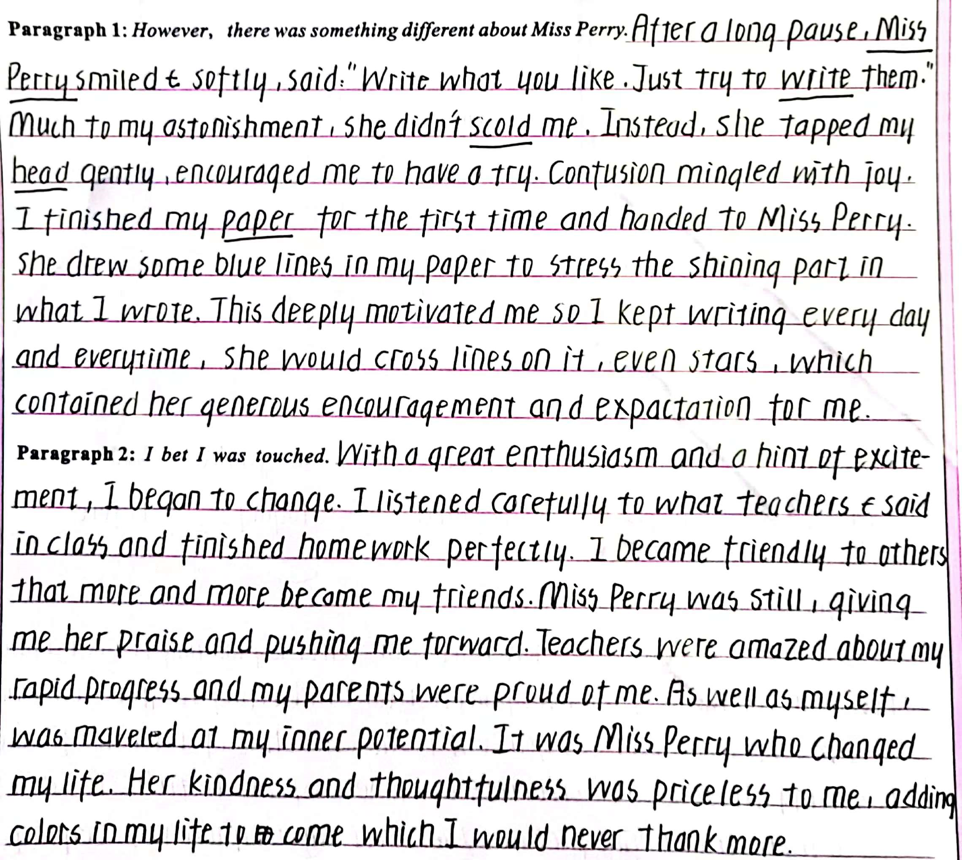
Reflect on our writings
本篇习作者能深刻地理解文本，牢牢地把握写作主线，故事情节设计自然流畅，词汇丰富，主题明确，立意深远，合乎逻辑，与原文风格契合，融洽度高。

Slide 29
Attitude determines altitude _{情感态度决定主题}
However, there was something different about Miss Perry. “What do you want to do, then?” she smiled, tenderly staring at me with deep blue watery eyes. What? My previous teachers would scold me or send me to the principal’s office. Miss Perry, however, stood in front of my desk and kept her soft gaze on my face. Without a word, I lowered my head to avoid her eyes. “You just think what it is that you want to write about? Then, come to share with me, and we’ll make some arrangements that you can live with. Fair enough?” She patted me on the back. No teacher had touched me before.
I bet I was touched. Automatically, I raised my head and caught sight of her walking back to her desk. Wondering what to make of her, I received another glance. A sense of something different attacked. I looked out of the window. The trees, the rain, everything was in sight. Inspired, I rose from the seat. “I want to study the weather outside.” “You really like that? But promise to write down what you learn on that blank paper. Deal?” “Deal!” All that afternoon I studied clouds, winds and the rain. Amazingly, a rainbow hung above like an upside-down smile. For the first time in years, I was really concentrating on my school work.
How does a good teacher open a student's inner heart?

Slide 30
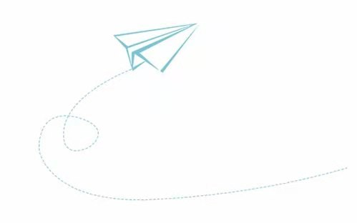



Learn to squat down, and talk to a child in an equal, tolerant，silently-waiting and empathetic way.
学会蹲下，用平等、宽容、静待的和同理心的方式与孩子交流。

