Slide 1

感恩遇见，相互成就，本课件资料仅供您个人参考、教学使用，严禁自行在网络传播，违者依知识产权法追究法律责任。
更多教学资源请关注
公众号：溯恩高中英语
知识产权声明

Slide 2
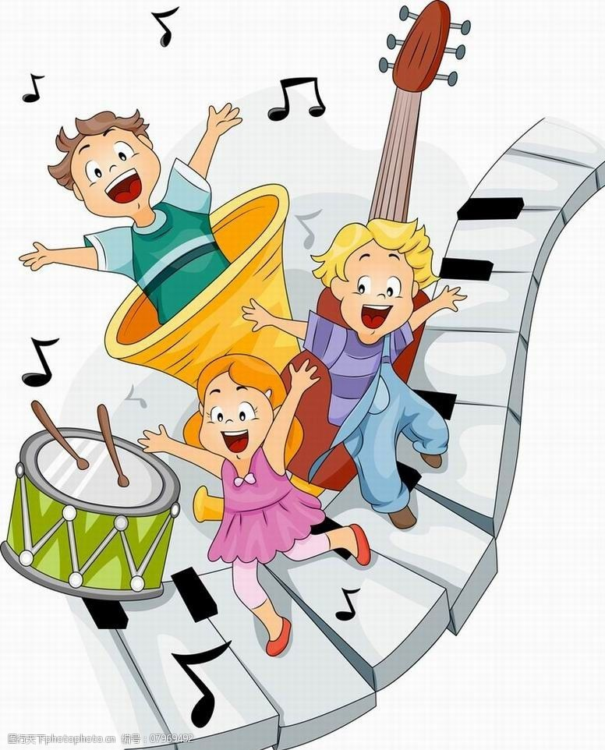
2022年4月
浙江高一9+1联盟应用文讲评
浙江省衢州第二中学 徐飞

Slide 3


试题回顾
假定你是李华, 正在美国参加一个交换项目，期间你加入了当地的musical society。这个社团正在网上分享最喜欢的音乐。请你发帖参与分享，描述你最喜欢的歌曲，乐曲或音乐形式，
内容包括:
1. 该音乐的简介;
2. 听时你的感受；
3. 对你的影响。
注意: 1. 词数 80 词左右;
2.可以适当增加细节, 以使行文连贯。

Slide 4

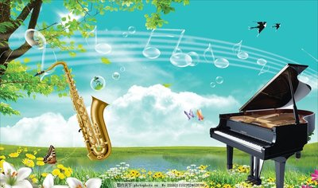
审题
文体：网络帖子
交际对象：任何网友
框架结构：网上帖子一般一个段落
内容要点：音乐介绍+听时感受+影响
语言特点：相对随意化，口语化、不应过于正式；
时态应该用“现在时”为主

Slide 5
回归教材找语料
音乐相关表达
It made my spirits fly like a kite in the wind.
Music is like a cure for sadness.
Music is like the poetry of the air.
It was the rock I learnt on to become strong.
Music is the moonlight in the gloomy night of life. (by Jean Paul Friedrich Richter)
The musician is perhaps the most modest of animals, but he is also the proudest. (by Erik Satie)

Slide 6
回归教材找语料
音乐相关表达
It (music) became my best friend.
Music drives you. It wakes you up, it gets you pumping. (by Dimebag Darrell)
John A Logan said, “Music is the medicine of the mind.”
As William Shakespeare put it, if music be the food of love, play on.
As Plato once said, music gives a soul to the universe, wings to the mind, flight to the imagination, and life to everything.
Lao Tzu once said, “Music in the soul can be heard by the universe.”
Music gave me happiness. .... Music gave me strength and brought me relief. ... Music gave me hope and a sense of satisfaction.

Slide 7
拓展语料
音乐相关表达
It’s like I had been taken out of my natural environment, and put somewhere new. And
slowly I began to lose myself, like I was being washed away.
It can bind us to reality at the same time it allows us to escape it.
Music has always been a big part of my life. To create and to perform music connects
you to people countries and lifetimes away.
The philosopher Plato once said, “Music gives a soul to the universe, wings to the mind,
flight to the imagination and life to everything.”
Henry Wadsworth Longfellow once said, “Music is the universal language of mankind.”

Slide 8
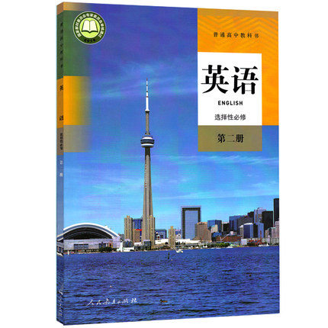
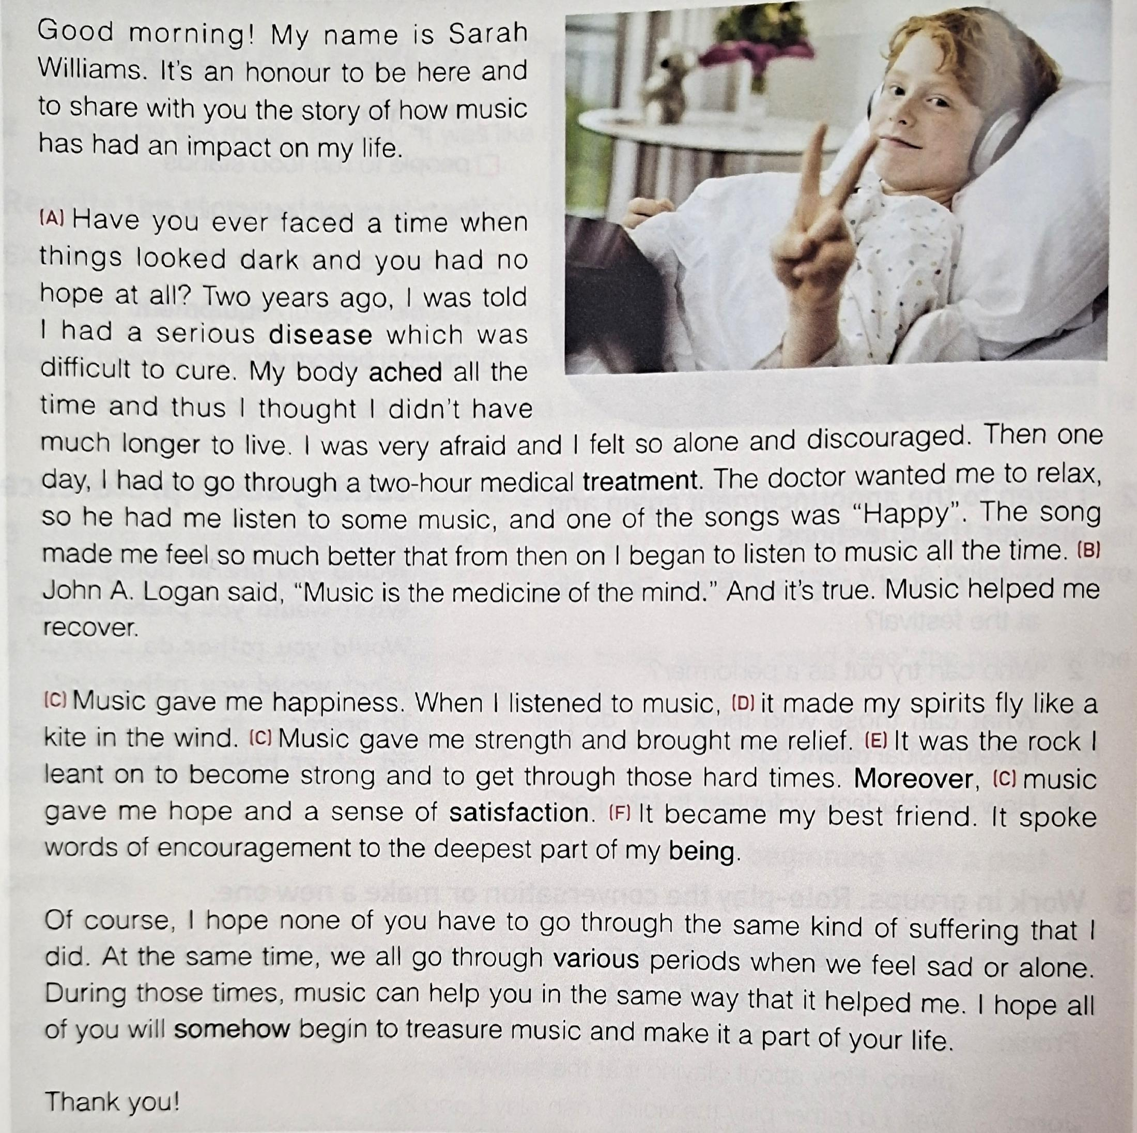
课文链接
“音乐对我的影响”语料
“个人听音乐时的感受”语料

Slide 9

音乐介绍
A Brief introduction
Concerning my favourite music among all musical styles, soft music should be put on the top of the music. So gentle and peaceful is soft music that it flows into my heart like a running stream, taking away all my exhaustion and anxiety after a long day’s hard work.
Techno music ranks first in my heart, which is a brilliant combination of modern technology and marvelous music.
The music I listen to in most cases is the light music, dating back hundreds of years and still gaining wide popularity.
My favourite music is pop music, which enjoys greater popularity than any other form of music. It is easy to understand and sing.
My favourite piece of music is Chunjianghuayueye, or A moonlight Night on the Spring River. It is a piece of traditional Chinese music played with Pipa, a traditional Chinese musical instrument looking a bit like guitar.

Slide 10
听时感受
Your feelings while listening
Every time I listen to music, it feels as if a picture of a river is spreading/unfolding before me. I can see the bright moon rising and shining and the river water shining too. I can also feel the breeze blowing softly across my face.
Whenever I listen to it, I fall in love with it because it made me feel like being in a world/paradise/fairy land of jasmine flowers, which were as pure as the fleecy clouds in the sky.
Every time I listen to it, I feel I am full of energy and overwhelmed with excitement. When I am in low spirits, techno is like a beam of sunshine,cheering me up.
When I listen to it, it seems that I am attending a classical concert, where all the players work together to finish a great piece. Its dynamic rhythem makes me carried away and immersed in the emotional changes related to the composer’s life full of ups and downs.
Whenever I feel depressed or discouraged, I tend to close my eyes, turn on the radio and listen to these wonderful songs. Immersed, I find relaxation, counrage and comfort.
Music gives a soul to the universe, wings to the mind, flight to the imagination and life to everything.

Slide 11
音乐影响
the effect of music on me
The classic piece has a comforting effect on me and I feel very proud of the traditional Chinese music.
Now in America, it reminds me of my beloved hometown and sweet/fond/nostalgic memories. Because of Jasmine Flower, I learnt pipa, a folk musical instrument in China. And now it gives memuch strength when I suffer from homesickness.
The soothing tune/melody/ cures my heart, purifies my soul and ignites my passion for life.
Not only can the classical music relieve me from the stress of daily schoolwork, but also encourage me to battle for a brighter future with passion.
It has witnessed plenty of days when I was depressed because of the awful academic performance. However, with its company, I regained confidence and managed to face difficulty bravely.

Slide 12
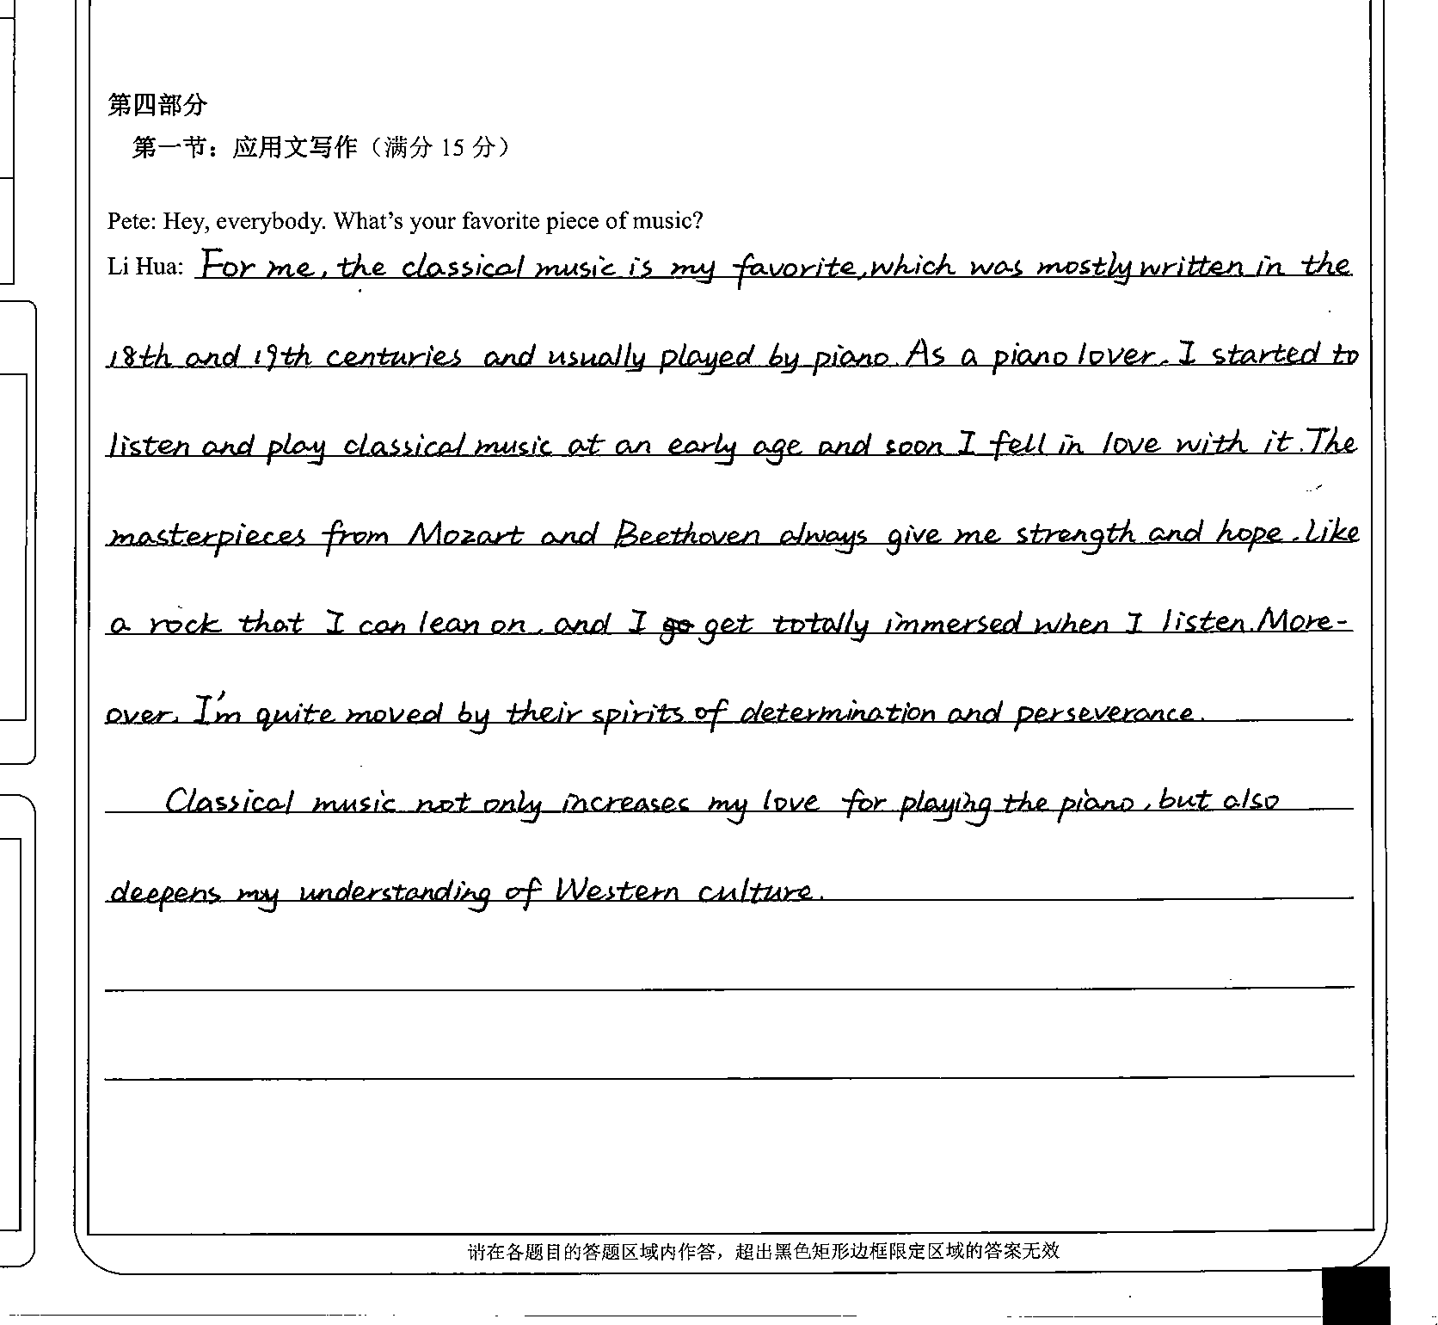
考场优秀作文
学生习作点评：
本文整体上要点齐全,语言特点符合帖子的文本特征：口语化。语言丰富灵活，语法错误少，如：非限制性定语从句的使用..., which was mostly written...; as a piano lover; fall in love with; be moved by perseverance;deepen my understanding of; get immersed in等。除此以外，考生还恰当地运用了明喻等修辞，如：like a rock that I can lean on。建议考生网上发帖通常为一个段落。

Slide 13
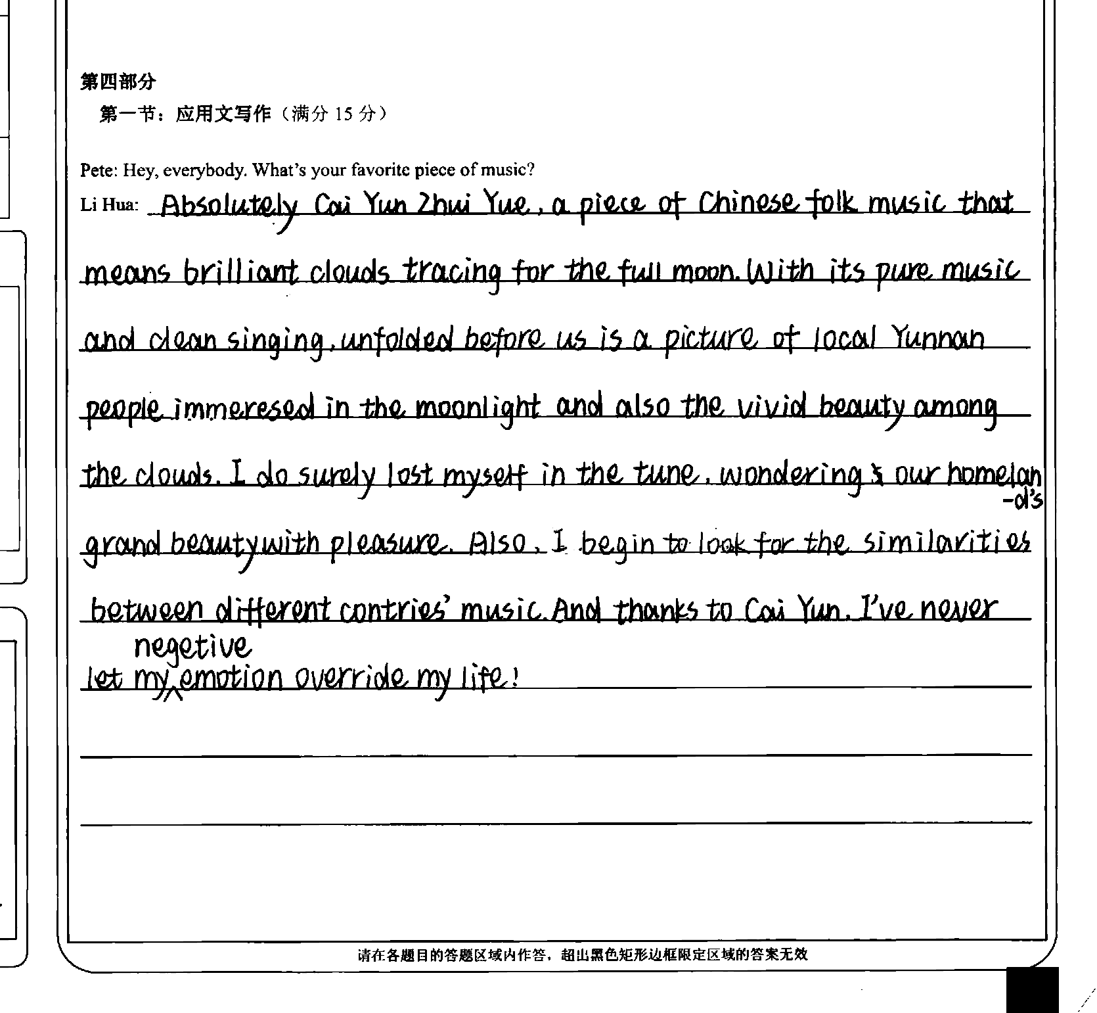
学生习作点评：
本文开篇运用同位语直入主题。文章第一句简洁明了地介绍了歌曲的特点。文章重点描述了听歌时的个人感想。最后点名彩云追月这首歌对我的影响。文章整体读下来，非常顺畅，详略得当。而且本文语言灵活多样，如：with...unfolded...; 非谓语动词people immersed in...; thanks to...等。但是本文书写有待提高，而且还出现了少许的语言错误，如I do surely lost myself in...,应改为I do surely lose myself in...;negetive emotion应该为nagative emotion。

Slide 14
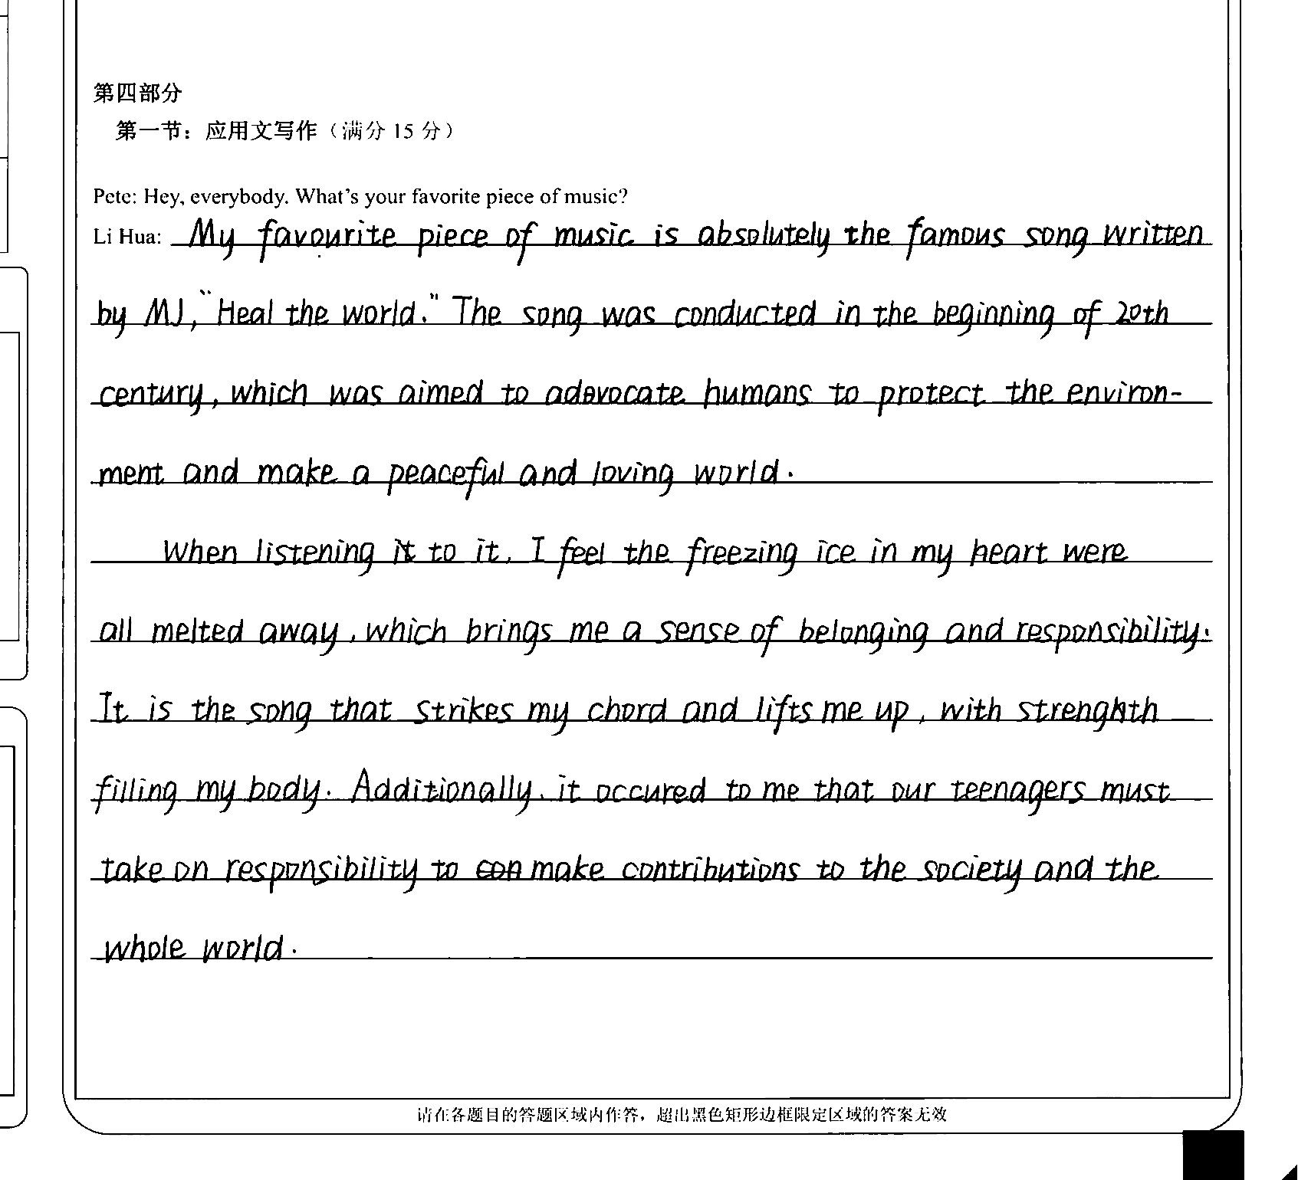
学生习作点评：
本文要点齐全，用词丰富，如：be aimed to advocate...; ...melt away; bring a sense of beonging and responsibility; strike my chord; lift me up; it occurred to me that...contribute to...等。美中不足的是语言略显拖沓，而且帖子不宜分段，容易给阅卷老师一种信件的感觉。

Slide 15
possible version I
Li Hua: My favorite piece of music is Chunjianghuayueye, or A Moonlit Night on the Spring River. It’s a piece of traditional Chinese music played with Pipa, a traditional Chinese musical instrument looking a bit like a guitar. Every time I listen to the music, it feels as if a picture of a river is spreading before me. I can see the bright moon rising and shining, and the river water shining too. I can also feel the breeze blowing softly across my face. The classic piece has a comforting effect on me and I feel very proud of the traditional Chinese music.

Slide 16
possible version II
Li Hua: Kanong, a well-known masterpiece of music played by the piano is my favourite. While the gentle and soft music streams, a new world composed of piece and beauty is being built. There bathed in the silvery moonlight, I can smell the scent of fresh roses, listen to the whisper of the river, and fall in love with the nature. Undoubtedly, it touches the deepest part of my heart and makes all the anxiety melt away.To some degree, Kanong gives a soul to my universe, wings to my mind, flight to the imagination and life to me, an ordinary boy.

Slide 17
下水作文
Li Hua:My favourite music is pop music, which enjoys greater popularity than any other form of music. Pop music is easier to understand and sing.
It usually has beautiful melody, showing us either people’s feelings or romantic stories. Whenever I feel depressed or discouraged, I tend to close my eyes, turn on the radio and listen to the marvelous songs. Immersed, I find relaxation, courage and comfort. It is actually a rock that I can lean on to be an optimistic person. No wonder people say “Music is the medicine of the mind” .

Slide 18
关于音乐话题作文之演讲稿
Good morning! My name is Elena. It’s my great pleasure to be here and share with you how music influences my life.
Have you ever written a song on your own? Recently song writing has wandered its way into my life. I believe there is no better way to express myself than through song. After a bad day, it’s nice to be able to sit down and write about it. It can make all your problems just disappear and float away. Listening to other musical artists that I like gives me inspiration. My guitar teacher also points me in the right direction and gives me guidance as I need it. I love to just sit with my guitar and make up random lyrics about past experiences or what I’m going through at the moment.
To me music is more than just something to listen to or play, it’s something to feel. Music is extremely important in my life. It helps me to get closer to my friends and family. It helps me to get through things. It helps me to prepare for the day that waits. My life without music would be totally empty. I think it is like the memoirs (传记) to my life as it has been there throughout everything with me.
That’s my story with music. Thank you for your time! (摘自衢州二中自编教材)

Slide 19
Hello, ladies and gentlemen. My name is Kathy, and I'm here to talk about how music has changed my life.
Have you ever experienced the ups and downs of life and felt frustrated or discouraged? Two years ago, when I entered the new school, I felt lost and depressed. It’s like I had been taken out of my natural environment, and put somewhere new. And slowly I began to lose myself, like I was being washed away. But then the next moment, I felt the melody, the song “Count on me”---soft and calming, comforting and powerful. It gave me strength and hope, like my old friend. It gave me company and comfort. And also it gave me courage to face all the difficulties. Gradually, I adapted to the new school. The philosopher Plato once said, “Music gives a soul to the universe, wings to the mind, flight to the imagination and life to everything.” I do benefit a lot from mysic.
So next time, if you are faced with difficulties, you can turn to music for help. It will surely help you out. Thanks!

Slide 20

THANKS!

