Slide 1

感恩遇见，相互成就，本课件资料仅供您个人参考、教学使用，严禁自行在网络传播，违者依知识产权法追究法律责任。
更多教学资源请关注
公众号：溯恩高中英语
知识产权声明

Slide 2





Happy Mother’s Day
杭州二中树兰高级中学 郭合英

Slide 3


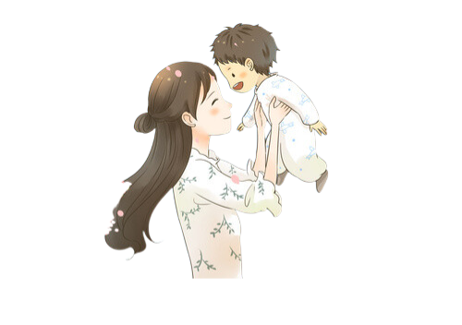
Enjoy a song: This is to mother you

Slide 4

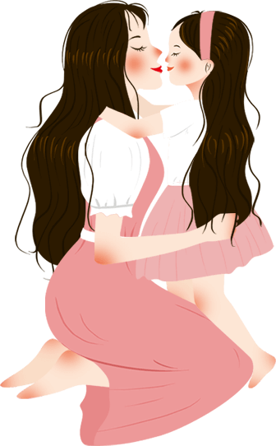

Discuss?
1. What is the first word that every child
learns to speak?
mother
2. When you are in pain or trouble, what is
the first word that comes out from you?
mother
Mother's day is a special occasion that is meant to honor all the mothers for their love, support, care, and sacrifices.

Slide 5





01
The history of Mother's Day
目录
02
Culture overview about Mother's Day
03
The feelings of maternal love
04
Famous mothers in the world
05
Expressions and blessings about Mother’s Day
06
Mother’s Day in the exams

Slide 6


The history of Mother's Day
① A brief history of Mother's Day
(题型开发：七选五)
0
1
② The ancient meaning of Mother’s Day
（题型开发：阅读理解）
③ The modern meaning of Mother’s Day
（题型开发：语篇填空）

Slide 7

A video about Mother’s Day

Slide 8
Choose 5 out of 7
In the late 1850s, Ann Jarvis, widely considered the ‘mother’ of Mother’s Day, established Mother’s Work Day. 1 This mission was driven by personal experience, as seven of her eleven children died before adulthood. This experience was anything but unique in a time before vaccines and a widespread understanding of germ theory.
Jarvis’s work took on new meaning during the Civil War. The county was flooded with wounded Confederate and Union soldiers. 2 She was not only concerned with the well-being of the young soldiers and sons, but also with that of a post-war, unified, country. The carnage of the war spurred women, like Jarvis, around the country to find ways to help where they could. 3 As a volunteer for the United States Sanitary Commission during the Civil War, she helped alleviate the effects of disease and injury. After the War, Julia wrote her“Appeal to womanhood throughout the world”.
G
B
F

Slide 9
The“Mother’s Day Proclamation”brought about a lasting peace.
4 In 1908, Anna Jarvis, daughter of the aforementioned Ann Jarvis, campaigned to make Mother’s Day a federally recognized day in honor of her mother who had died in 1905. 5 But what had been a day dedicated first to cleanliness and later to peace was again repurposed, this time to celebrate mothers themselves.
A.The war was very cruel.
B. Jarvis organized groups of mothers to tend to the injuries.
C. So the first nationally celebrated Mother’s Day was in May of 1914.
D. But it was only celebrated at local levels until the turn of the century.
E. We think back to the origins of the holiday and remember the goals of the mothers.
F. After the war, Julia Ward Howe helped to reshape what Mother’s Day could mean.
G. It was a day dedicated to teaching mothers how to better prepare food and clean to
prevent disease.
D
C

Slide 10
Choose the best answer
The earliest Mother's Day celebrations are traced back to the spring celebrations of ancient Greece in honor of Rhea, the Mother of the Gods.
During the 1600's, England celebrated a day called “Mothering Sunday”， celebrated on the 4th Sunday of Lent. “Mothering Sunday” honored the mothers of England. During this time many of the England's poor worked as servants for the wealthy. As most jobs were located far from their homes, the servants would live at the houses of their employers.
On Mothering Sunday the servants would have the day off and were encouraged to return home and spend the day with their mothers. A special cake, called the mothering cake, was often brought along to provide a festive touch.
As Christianity spread throughout Europe the celebration changed to

Slide 11
honor the “Mother Church”--- the spiritual power that gave them life and protected them from harm. Over time the church festival blended with the Mothering Sunday celebration. People began honoring their mothers as well as the church.
In the United States Mother's Day was first suggested in 1872 by Julia Ward Howe as a day dedicated to peace.
In 1907 Ana Jarvis, from Philadelphia, began a campaign to establish a national Mother's Day. Ms. Jarvis persuaded her mother's church in Grafton, West Virginia to celebrate Mother's Day on the second anniversary of her mother's death, the 2nd Sunday of May. By the next year Mother's Day was also celebrated in Philadelphia.
Ms. Jarvis and her supporters began to write to ministers, businessman, and politicians in their quest to establish a national Mother's Day. It was successful, by 1911 Mother's Day was celebrated in almost every state.

Slide 12

President Woodrow Wilson, in 1914, made the official announcement proclaiming Mother's Day a national holiday that was to be held each year on the 2nd Sunday of May.
While many countries of the world celebrate their own Mother's Day at different times throughout the year, there are some countries such as Denmark, Finland, Italy, Turkey, Australia, and Belgium which also celebrate Mother's Day on the second Sunday of May.
1. Which country is the first to observe Mother's Day?
A. America B. England C. Australia D. ancient Greece
2. What was the original purpose of Mother’s Day?
A. Its goal was to supply a festive touch.
B. Its goal was to honor the late mothers.
C. Its goal was to create the Mothering Sunday.
D. Its goal was to commemorate the mother of the Gods.

Slide 13
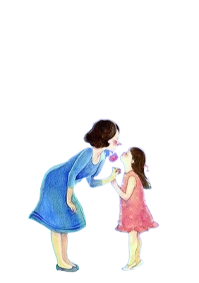
3. Which year was a national holiday for Mother’s Day in the United States?
A. 1914 B. 1907 C. 1911 D.1872
4. Why did the author write the text?
A. To introduce mainly the history of Mother’s Day.
B. To agree on the date of Mother’s Day in countries.
C. To tell the Mother’s Day in the United States in detail.
D. To introduce the differences of Mother’s Day in countries.
5. Where would you be most likely to find the text?
A. On a school website.
B. In a travel brochure.
C. In a college newspaper.
D. A book introducing main festivals.

Slide 14
To fill the correct answer
Mother’s Day, originating from the United States,was initiated by Amanm, Jarvis (1864-1948). She never married 1 accompanied her mother in her life. In the 1905s, when her mother died, Amanm was 2 (devastate). Two years later (1907) , Amanm and her friends began writing to 3 (influence) ministers, businessmen, and lawmakers 4 (seek) support to make Mother’s Day a legal holiday.
The first Mother’s Day 5 (hold) in West Virginia and Pennsylvania on May 10, 1908. On this day, carnation was chosen 6 a flower for mother and passed down from generation to generation. In 1913, the United States Congress passed a bill to make the 7 (two) Sunday of May 8 official Mother’s Day. Mother’s Day was spread from then on!
The 9 (significant) of the Mother’s Day activities is 10 (arouse) the sense of reverence for mothers, the grace of giving birth, the grace of raising children, the grace of education, its meaning is to let us always remember the mother’s virtue.
and
decastated
influential
seeking
was hold
as
second
an
significance
to arouse

Slide 15
Culture overview
about Mother’s Day
0
2

Slide 16

Complete the sentences according to its meaning
The day was first suggested by a famous poet
The woman who first 1 (propose) Mother’s Day in 1870 was the same woman 2 wrote the lyrics(歌词) to The Battle Hymn of the Republic. After the Civil War, writer Julia Ward Howe suggested a Mother’s Day 3 (recognize) peace and protest war. She organized 4 (annually) events in Boston to honor mothers, 5 despite her work, nothing official came of her efforts.
1870年最先提议设立母亲节的女性就是为《共和国战歌》写词的人。在美国内战结束后，作家朱莉娅·沃德·豪伊建议设立母亲节来赞颂和平、抗议战争。她在波斯顿组织了几场向母亲致敬的年度活动，尽管她付出了努力，但这些活动都没有被官方保留下来。
proposed
who
to recognize
annual
but

Slide 17
The founder fought back
Although Julia Ward Howe first suggested a day for mothers, Anna Jarvis (who had no children of 1 (she) own) campaigned for a national day of
2 (observe) for moms, in remembrance of her own mother, Ann Jarvis, who had spent years 3 (work) to provide resources 4 poor mothers in West Virginia. Mother’s Day became a 5 (designate) holiday in 1914, but within a few years, Jarvis became disgusted with how
commercial the day 6 (become) and started a petition ___7___
(rescind) the holiday. (That clearly didn’t come to pass)
母亲节的创立者反过来要废除这一节日。
尽管朱莉娅·沃德·豪伊最先提议设立母亲节，但安娜·贾维斯是倡议将母亲节作为一个全国性节日来庆祝的人。安娜·贾维斯本人没有小孩，她的初衷是为了纪念她自己的母亲，她的母亲安·贾维斯花了很多年时间为西维吉尼亚州的贫困母亲争取资源。1914年，母亲节成为了国家指定的节日，但几年后，贾维斯开始厌恶这个节日变得商业化，于是她发起了一个废除母亲节的请愿活动。（显然请愿没有被通过。）
her
observance
working
for
designated
had become
to rescind

Slide 18
Why do the carnations become the symbol of Mother’s Day?
Anna Jarvis used carnations at the first Mother’s Day 1 (celebrate), because carnations were her 2 (mother) favorite flowers. Carnations
3 (quick) became the symbol of Mother’s Day. In America, 76 percent of moms hope to get flowers 4 their kids or loved ones __5__
this special day.
为什么康乃馨成了母亲节的标志？
安娜·贾维斯在庆祝第一个母亲节时使用了康乃馨，因为康乃馨是她妈妈最喜爱的鲜花。康乃馨就迅速成为母亲节的标志。在美国，有76%的母亲在母亲节这一天希望从她们的孩子或是爱人那里收到鲜花。
celebration
mother’s
quickly
from
on

Slide 19




Color Meaning 康乃馨花语
Just like many other flowers, the meaning of carnation changes with the color of the flower.
Wearing red carnation stands for your mother
is alive
Light red carnations express admiration.
Dark red carnations communicate a deeper feeling of love and affection.
Wearing a white carnation means that your mother has passed away.
Pink carnations are a sign of gratitude.
During the 19th century, carnations, especially pink ones, became the traditional flower of Mother's Day symbolizing mother's undying love.
White carnations, on the other hand, are given to express purity and luck.

Slide 20

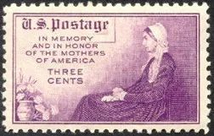
In May 1934, the United States issued the first Mother's Day 1 (commemorate) stamp. On it, a kind mother put her hands on the knees,
2 (look) at a bunch of bright and beautiful
3 (carnation) in front of her vase with joy. With the spread of stamps, Mother's Day is 4__ (associate) with carnations in many people's minds, and carnations 5 (become) flowers symbolizing maternal (adj.母亲般的) love and are respected by people. People place their __6__ (feeling) of missing and honoring their mothers on carnations, 7 has become indispensable and precious gifts for their mothers.
commemorative
looking
carnations
associated
have become
feelings
which

Slide 21

Different countries have 1 (differ) ways of celebration. Many countries have a Mother’s Day, though they don’t always fall on the 2 (two) Sunday in May like it does in the US and Australia. Flowers and gifts are a worldwide tradition for the day, but in Thailand parades 3 (hold）and jasmine
is commonly given 4 a gift. In Serbia, moms are tied up with rope or ribbon 5 they give sweets and gifts to their children.
世界各国都有自己的母亲节
许多国家都有母亲节，不过不一定和美国、澳大利亚等国家一样是在五月的第二个星期日。在母亲节送鲜花和礼物是全球的传统，但是泰国人会举行游行，而且他们普遍送母亲茉莉花作为礼物。在塞尔维亚，母亲们会被用绳子或缎带捆住，直到她们给孩子发放糖果和礼物。
different
second
are held
康乃馨
as
until
茉莉花

Slide 22
The feelings of
maternal love
0
3

Slide 23



The mother’s interpretation 母亲的诠释
美国抒情诗人霍华德·约翰逊(1887 - 1941)的这首小诗将“母亲”的形象惟妙惟肖地刻画在读者眼前。作者巧妙地将“mother”一词中的每一个字母和单词联系起来，并描绘出母亲的典型特征，既寓意深刻又耐人寻味。正是平凡的母亲用青春、泪水、心血和关爱给了我们鲜活的生命、丰富的生活和广阔的世界，才使得我们在忙碌之余、在匆匆之中，时时被心中对母亲的牵挂、惦念和感恩温暖着、鼓舞着。
M-O-T-H-E-R 母亲
--By Howard Johnson
母亲
-----霍华德·约翰逊
M 代表她给予我百万样东西，
O 意味着她渐渐老去，
T 是她为育我成人而洒落的颗颗泪滴，
H 寓意她那金子般至纯至真的心灵，
E 是她那双闪耀着慈爱之光的眼睛，
R 使我坚信她永远正确无误的言行。
把这些字幕拼在一起就是“母亲”
一个于我犹如整个世界一样的词语。
“M” is for the million things she gave me,
“O” means only that she’s growing old,
“T” if for the tears she shed to save me,
“H” is for her heart of purest gold,
“E” is for her eyes, with love-light shinning,
“R” means right, and right she’ll always be.
Put them all together, they spell “Mother”,
A word that means the world to me.

Slide 24
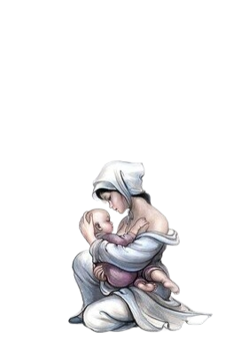

A popular saying is that God cannot be present everywhere and so he created mothers.
A Mother's Love
A Mother's love is somethingthat no on can explain,
It is made of deep devotion and of sacrifice and pain,
It is endless and unselfish and enduring come what may
For nothing can destroy it or take that love away . . .
It is patient and forgiving when all others are forsaking,
And it never fails or falters even though the heart is breaking . . .
It believes beyond believing when the world around condemns,
And it glows with all the beauty of the rarest, brightest gems . . .
It is far beyond defining, it defies all explanation,
And it still remains a secret like the mysteries of creation . . .
A many splendored miracle man cannot understand
And another wondrous evidence of God's tender guiding hand.

Slide 25
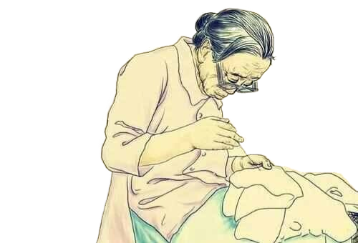

A mother’s love, for life
游子吟（中英双语）
Song of a Wanderer
作者｜孟郊(Meng Jiao)
英译｜周柯楠(Zhou Kenan)
游子吟
孟郊
慈母手中线，
游子身上衣。
临行密密缝，
意恐迟迟归。
谁言寸草心，
报得三春晖。
My kind mother has a needle and thread in her hand
Making new clothes for her son who is to travel far away
She is busy sewing closely before my leaving
Worried that I cannot come back for a long time
Who says that the heart of an inch-long plant
Can requite the radiance of full spring

Slide 26
Famous mothers
of the World
0
4

Slide 27
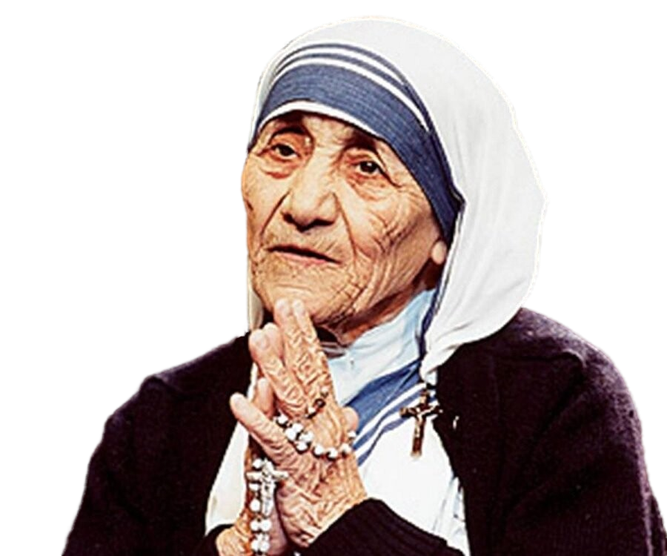
Some Famous Mothers Of The World
Mother Teresa
特蕾莎
She said, “We shold love poor people, understand poor people, so we must be a poor people!!!”
She got the Nobel Peace Prize in 1979. She donated all of the money to the poor people and the patients who suffered from the diseases. Additionally, she sold the medal to help the people who needed help.

Slide 28
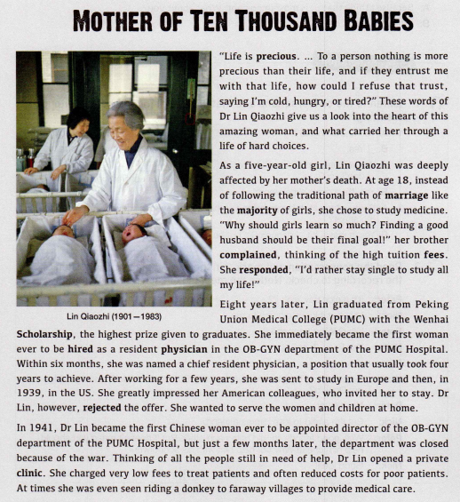
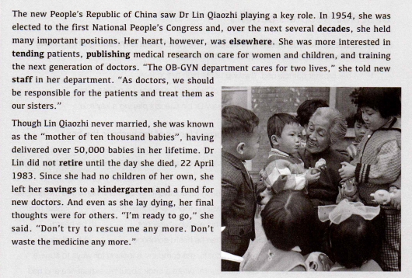
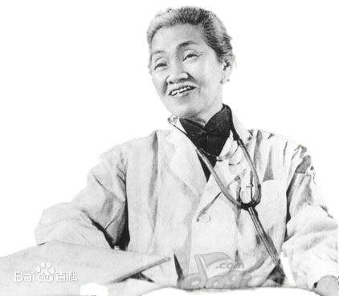
As doctors, we should be responsible for the patients and treat them as our sisters.
林巧稚被写入教材---
新人教版必修三第二单元
She had no children of her own, but she was the greatest mother.
lin Qiaozhi
林巧稚
To a person nothing is more precious than their life, and if they entrust me with that life, how could I refuse that trust.
I’m ready to go. Don’t try to rescue me any more. Don’t waste the medicine any more.
I’d rather stay single to study all my life!
Though Lin Qiaozhi never married, she was known as the “mother of ten thousand babies”.

Slide 29
Expressions and blessings for Mother’s Day
0
5

Slide 30
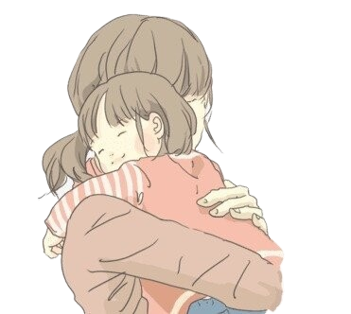
与“母亲”相关的有趣英文表达
1. mother hen 关心他人冷暖的人；婆婆妈妈的人
王老师就像个妈妈桑一样，满足学生们的各种需求。
Mr Wang is like a mother hen, catering to the students' every need.
2. mother figure 慈母般的人，母亲的化身
她就像我们的母亲一样，同时还兼任我们的健身教练。
It was similar to having a mother figure — and she was also our conditioning coach.

Slide 31
3. mother's milk hardly dries on lips 乳臭未干，形容人幼稚
你还是个乳臭未干的小子呢，竟然想着要去参军！
Your mother's milk has hardly dried on your lips and you want to go into the army!
4. mother wit 天资，常识
当你需要靠常识生存的时候，我希望你的境遇能比我好一些。
When you have to live by your mother wit, I hope you may get on better than I do.

Slide 32

5. sheep mom 羊妈 It refers to an extensive way of education.
她用一种羊妈的方式教育自己的孩子。
She educates her own children in the way of sheep mom.
6. tiger mother 虎妈；对子女学业要求严厉的母亲
我朋友约翰有个虎妈。
My friend John has a tiger mother.
7. yummy mummy 辣妈 It is a slang term used in the United Kingdom to describe young, attractive and wealthy mothers.
尽管生了三个孩子，可她仍然是辣妈一枚。
Though she has three children, she is still a yummy mummy.

Slide 33

8. mother of states
A nickname for the state of Virginia
A person who helps a mother, mainly by looking after children. 看孩子的家庭保姆
9. mother’s help
The mental or realized image of an idealized or archetypal mother. 理想化的母亲形象
10. mother imago
11. mother-in-law’s tongue
a west African plant of the agave family
虎尾兰，一种西非地区的龙舌兰属植物。
12. mother of God
a name given to the Virgin Mary圣母玛利亚

Slide 34
Blessings(祝福语)
1. On Mother's Day, I send carnations carefully picked. I wish my mother good health. Thank you for your support and love. I want to say that only mother is good in the world. My mother is your best!
母亲节送上精心采摘的康乃馨，祝妈妈身体健康，感谢您对我的支持和关爱，想说世上只有妈妈好，我的妈妈您最好！
3. It's your love that won't pass with time; it's my wish that won't fade with time: May Mother's Day be happy!
不会随光阴流逝的，是您的爱；不会随岁月淡漠的，是我的愿：愿母亲节日康乐！
2. Mother is a crutch in difficulty. When you hobble, help you find the center of gravity and support a field of hope.
母亲是困难中的一根拐杖，当你脚步蹒跚时，帮助你找好重心，支撑起一片希望的原野。
4. May my blessings, like a small flower, always blossom in this warm harvest season, embellishing you with joy all the time.

Slide 35
5. Let's give our mothers more love and care, even a fan in the heat, and a sweater in the winter, so that mothers can always feel the concern of their children.
让我们多给母亲一点爱与关怀，那怕是酷暑中的一把扇子；寒冬中的一件毛衣，让母亲也时刻感受儿女的关心。
7. May carnation, no graceful and gorgeous posture, no fragrance overflowing flavor, but a light look, just like the mother. Happy Mother's Day!
五月的康乃馨，没有雍容华丽的姿态，没有浓香四溢的味道，只是清清淡淡的样子，就象母亲。祝妈妈母亲节快乐！
8. Late at night! Countless stars light up and write your name in the sky. When the fashion goes out of date, you can send my thoughts and blessings to you!
夜深了！无数的星辰亮起，在天空写下你的名字，当流行划过时，就能将我的思念与祝福传送给你！
6. Write a warm poem, sing a moving song, draw a fresh picture, dedicate to the great mother, wish all mothers in the world can be happy and healthy!
写一段温暖的诗，唱一首动人的歌，画一幅清新的图，献给伟大的母亲，愿世上所有的母亲都能快乐健康！

Slide 36
Mother’s Day
in the exams
0
6

Slide 37
2021年普通高等学校招生全国统一考试（I卷）
阅读下面材料, 根据其内容和所给段落开头语续写两段, 使之构成一篇完整的短文。
A MOTHER’S DAY SURPRISE
The twins were filled with excitement as they thought of the surprise they were planning for Mother’s Day. How pleased and proud Mother would be when they brought her breakfast in bed. They planned to make French toast and chicken porridge. They had watched their mother in the kitchen. There was nothing to it. Jenna and Jeff knew exactly what to do.
The big day came at last. The alarm rang at 6 a.m. The pair went down the stairs quietly to the kitchen. They decided to boil the porridge first. They put some rice into a pot of water and left it to boil while they made the French toast. Jeff broke two eggs into a plate and added in some milk. Jenna found the bread and put two slices into the egg mixture. Next, Jeff turned on the second stove burner to heat up the frying pan. Everything was going smoothly until Jeff started frying the bread. The pan was too hot and the bread turned black within seconds. Jenna threw the burnt piece into the sink and put in the other slice of bread. This time, she turned down the fire so it cooked nicely.

Slide 38
Then Jeff noticed steam shooting out of the pot and the lid starting to shake. The next minute, the porridge boiled over and put out the fire. Jenna panicked. Thankfully, Jeff stayed calm and turned off the gas quickly. But the stove was a mess now. Jenna told Jeff to clean it up so they could continue to cook the rest of the porridge. But Jeff’s hand touched the hot burner and he gave a cry of pain. Jenna made him put his hand in cold water. Then she caught the smell of burning. Oh dear! The piece of bread in the pan had turned black as well.
注意：
1. 续写词数应为150左右；
2. 请按如下格式在答题卡的相应位置作答。
Para 1
As the twins looked around them in disappointment, their father appeared.__________
________________________________________________________________________
Para 2
The twins carried the breakfast upstairs and woke their mother up. ________________
________________________________________________________________________

Slide 39
A possible answer
As the twins looked around them in disappointment, their father appeared. His appearance immediately nailed them where they were, dumbfounded . Then much beyond their expectation and to their great relief, he didn’t fly into a rage . Instead he went over,saying he understood the situation and instructed them to deal with the mess. Pot cleaned , the two brothers repeated the same process, but this time under the expert and patient guidance of their understanding father. Soon the delicious and inviting French toast and chicken porridge were ready. Their father then slipped back into the bedroom.
The twins carried the breakfast upstairs and woke their mother up. When seeing her nose sniffing hard, they could hardly contain their excitement. A glance at the plates and bowls on the tray and Mum realized all that happened. Tears welling up in her eyes,she excitedly awoke her husband still “snoring”, who pretended to open his drowsy eyes, muttering he was still in a sweet dream.Gathering around the well-designed breakfast, the whole family was immersed in happiness and gratitude.

Slide 40
As the twins looked around them in disappointment, their father appeared. His jaw dropped open at the sight of the great mess. After the twins explained that they were trying to make a surprise for their mom, he smiled, put some ointment on Jeff’s hand and helped clean up the stove. “Dad, can you help us with the breakfast?” Jenna asked. “Sure! Now I am officially a member of the Mother’s-Day-surprise team!” Under their father’s instruction, Jess stood by the pot and stirred the porridge from time to time while Jenna carefully fried the French toast. “Eyes on your task!” the father reminded. Before long, the breakfast was ready.
The twins carried the breakfast upstairs and woke their mother up. Before she asked, Jenna and Jeff said in chorus, “Happy Mother’s Day!” Blushed, Jenna said, “Mom, we would like to say thank you. Thank you for bringing us to the world, which makes everything possible. Thank you for being a loving and supportive mom. You are always there for us when we are cast down, and you are happier than anyone else when we achieve something, however small the accomplishment is.” With tears welling up, the mother threw her arms around them. Never has she been more pleased and proud.

Slide 41
2021 届苏州八校联考英语读后续写： 母亲节的礼物
阅读下面材料， 根据其内容和所给段落开头语续写两段， 使之构成一篇完整的短文。
A boy on in-line skates zoomed around the corner and crashed into me before I jumped out of the way. We fell into a sprawling(摊开四肢躺着) heap as the box I’d been carrying flew from my hands and landed in the street with a sickening beat. A moment later, a car whizzed past, sending the box spinning in circles.
The skater got up, mumbled sorry, and sped off around the corner.
“Are you OK, Emily?” Aiden asked.
“I think so.” My arm had slapped the sidewalk hard. I stood and slowly moved it in circles.
“Oh no! Look at Mom’s present!” Aiden’s face was red.
I picked up the crushed box and opened it. The drinking glasses inside were broken. I
closed the box and left it in a garbage can on the sidewalk, then started hurrying toward home.
Aiden had to run at full speed to keep up with me.
When we got to the apartment, we threw ourselves down on chairs in the kitchen.

Slide 42
“It isn’t fair! Why did that happen?” Aiden said.
“I didn’t even see that guy! He came out of nowhere,” I said angrily.
Aiden’s lower lip trembled. “Mom would’ve loved these glasses.”
We’d saved our money for weeks to buy glasses with pink flowers on them for Mother’s Day. We have other glasses, but not a full set that matches. I wished I could hang something against the wall and scream, but I knew I couldn’t. I’m the older one. I had to hold it together.
“I wanted to make her happy,” Aiden said.
I thought about how Mom had been before the divorce. She used to joke around and
laugh a lot. Now she had a deep worry line between her eyes and hardly ever smiled.
“We’ll think of something else to give her for Mother’s Day,” I said, trying to cheer up
Aiden.
“Like what?” he asked. “We don’t have any money left.”
请按如下格式在相应位置作答。
I swallowed hard and said, “Maybe we can make a present for Mom.”__________
When Aiden saw tears rolling down Mon’s cheeks, ____________________________

Slide 43
A possible answer
I swallowed hard and said, “Maybe we can make a present for Mom.” Aiden’s eyes sparkled with confusion, as if to ask how. A sudden glance at the broken glasses brought me a good idea—why not make a paper glass and decorate it with pictures? I poured out my plan to Aiden and he jumped to his feet with excitement. The next three days witnessed our effort to design, make and color the paper glass. Eventually, a special work of art was born! On Mother’s Day, we carefully took it out and couldn't wait to give mom a surprise, only to find her eyes red and wet. （ 94words）
When Aiden saw tears rolling down Mom’s cheeks, he blurted out, “Mom, you are crying! Are you sad with it?”His voice was worried and upset. But mom stroked the paper glass lovingly as if it was the most precious jewel. Pulling us into her arms, she laughed brightly,“No. Never have I had a more beautiful gift than this. I am just too moved.” Hearing the familiar laughter, how happy I was to see mom’s gloomy days gone! How I wished Mom could laugh as often as before! (80words)

Slide 44
Fit 沸腾英语 （高二） 阅读理解
Low-Cost Gifts for Mother's Day
Gift No.1
Offer to be your mother's heath friend. Promise to be there for any and all of the doctor's visits whether a disease or a regular medical check-up. Most mothers always say "no need", but another set of eyes and ears is always a good idea at a doctor's visit. The best part? This one is free.
Gift No. 2
Help your mother organize all of her medical records, which include the test results and medical information. Put them all in one place. Be sure to make a list of all of her medicines and what times she takes them. "Having all this information in one place could end up saving your mother's life," Dr. Marie Savard said.
Gift No.3
Enough sleep is connected to general health conditions. "Buy your mother cotton sheets and comfortable pillows to encourage better sleep," Savard said. "We know that good sleep is very important to our health."

Slide 45

Gift No.4
Some gift companies such as Presents for Purpose allow you to pay it forward this Mother's Day by picking gifts in which 10 percent of the price you pay goes to a charity. Gift givers can choose from a wide variety of useful but inexpensive things---many of which are "green" --- and then choose a meaningful charity from a list. When your mother gets the gift, she will be told that she has helped the chosen charity.
1. What are you advised to do for your mother at the doctor's visits?
A. Take notes. B. Be with her. C. Buy medicine. D. Give her gifts.
2. Where can you find a gift idea to improve your mother's sleep?
A. In Gift No.1 B. In Gift No.2. C. In Gift No. 3. D In Gift No 4.
3. Buying gifts from Presents for Purpose allows mothers to ______.
A. enjoy good sleep B. be well-organized
C. get extra support D. give others help

Slide 46
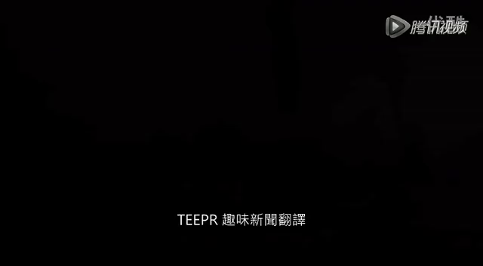

Slide 47


Discuss
There’s only one person in this
world you’ll owe ---mom.
How can you repay your mother ?

Slide 48

Happy Mother’s Day
"Such kindness of warm sun, can't be repaid by grass."
(谁言寸草心，报得三春晖)

