Slide 1

感恩遇见，相互成就，本课件资料仅供您个人参考、教学使用，严禁自行在网络传播，违者依知识产权法追究法律责任。
更多教学资源请关注
公众号：溯恩高中英语
知识产权声明

Slide 2


应用文写作技巧点拨
采用“6+2”，提升应用文的有效交际
---以2018年浙江真题为例
杭州二中树兰高级中学
郭合英

Slide 3

CONTENTS
1
The introduction of “6”
2
The introduction of “2”
3
What should be added?
4
What should be omitted?

Slide 4
“6” 指审题的6个方面
6
审体裁
审回复
审关系
审要点
体裁正确，格式才不会错
审人称
审时态
根据交际原则是否需回复
不同的关系使用不同的交际用语。不符合身份的交际用语会导致交际的不得体
要点齐全保高分
人称要与文章一致
文章涉及的往往是多种时态的混合

Slide 5
“2” 指什么？
注意：
1.词数80左右；
2.可以适当 ，以使行文连贯。
增加细节
01
02
根据交际原则，
一些必要的原因、结果、意义等细节。
根据交际原则，
不必要的或者错误的细节。
增加
删掉

Slide 6
关系：航空公司与乘客关系 （关系疏远，用语正规）
要点：三个要点不可缺少。
（1. 注意增加细节）
（2. 注意详略得当）
（3. 注意行文连贯）
（4. 注意有效交际）
时态：
抵达伦敦：一般过去时邮件联系：一般将来时
人称（角色带入）：
你是李华：第一人称
航空公司：第二人称
2018年11月浙江高考应用文
假定你是李华，乘坐FL753航班抵达伦敦后发现钱包遗失。请给航空公司写一封邮件说明情况并寻求帮助。内容包括：
1.行程信息；
2.钱包特征；
3.联系方式。
注意：
1.词数80左右；
2.可以适当增加细节，以使行文连贯。
体裁：求助信
是否回复？
根据交际原则，求助信需要回复。
（无论找到钱包与否需要告知对方）

Slide 7

2
01
02
根据交际原则，增加
一些必要的细节。如原因、目的、结果、意义、情感等，帮助学生拓展思维能力。

Slide 8

思考？哪里需要增加细节？怎么加？
行程信息
增加航班出发和到达的时间和地点
增加细节
外部：颜色、材料、图案、形状等
钱包特征
内部：钱包里装了什么？
联系方式
手机、电话、e-mail等
增加原因、目的、结果、意义、情感等，提高学生的思辨能力
其他细节

Slide 9
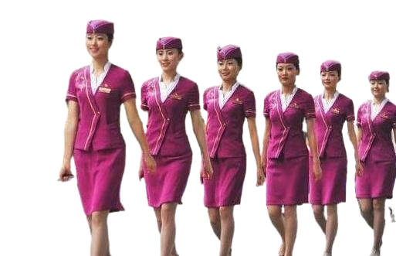
采用角色带入，增加行程信息，体现人文情怀
采用角色带入，替他人考虑，能有效减轻工作人员的负担，体现人文情怀。
虽然航空公司对航飞信息有所了解，但是工作人员的分工不同。他们对应固定的航班、航线。你提供的航班信息越详细，钱包找到的可能性就越大。

Slide 10
增加行程信息，体现人文情怀
增加前
My flight is FL753.
增加后
Yesterday, I took the airline---FL753 flying from Hangzhou to London.
I took the FL753 from Shanghai at 5 am. to London on 18th.
The flight I took is FL 753, leaving from Beijing at 5 am. to London yesterday.

Slide 11
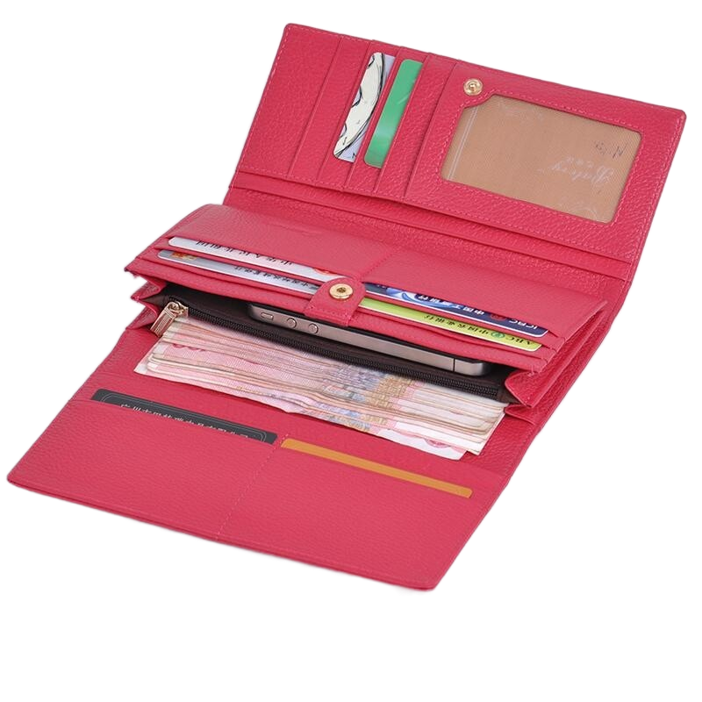
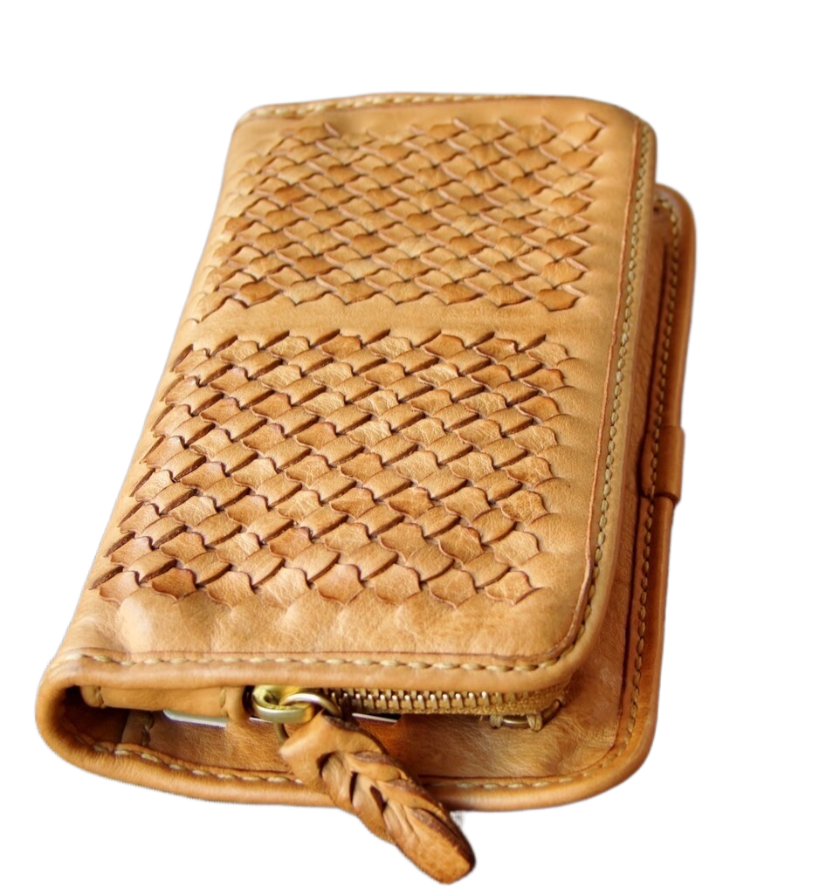
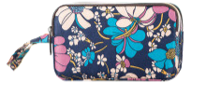
增加钱包特征,提高办事效率
钱包特征包括钱包的颜色，图案，材质、大小等。钱包特征描述的越详细越能提高工作人员的办事效率，提升有效交际。

Slide 12
钱包特征
The leather wallet is blue with a cat pattern on it, containing some money in it: five for ¥100, three for ¥50.
My wallet, whose shape is like a pencil box, is red and there are two-pink-pig pictures on it.
The wallet made of colth, dotted with pink dots, including three cards for supermarket and two keys.
The wallet, mingled colours of black and white, is decorated with flowers and grass. My late grandpa’s photo is in it.

Slide 13
适当增加联系方式，方便快捷
增加前
Please call me if you find it.
即使找到了也无法联系到你，这样就无法实现有效交际。为达到有效交际，留下正确的联系方式很有必要。
增加后
If you find it, you can call me at 13012345678.
I can be reached at 86754321 at any time.
If you find it, please email me.

Slide 14

其他细节的增加
根据交际原则，增加一些必要的细节。如原因、目的、结果、意义、情感等，不仅可帮助学生拓展思维能力，还可使文章内容丰盈饱满，有效避免逐条翻译和流水账的弊端。

Slide 15
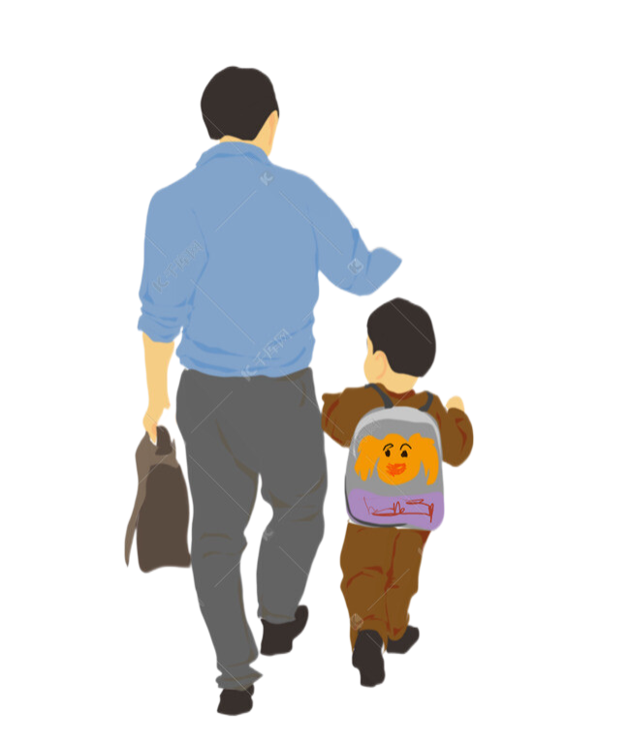
增加原因
这个钱包对我来说具有重要的意义。
增加前
The wallet is of great importance for me.
增加后
The wallet is of great importance for me. Because it was bought by my father when he was on business in Shanghai, which is monumental for me. Thereforce, I hope you can help me look for it.

Slide 16

增加目的
这个钱包对我来说具有重要的意义。
增加前
The wallet is of great importance for me.
增加后
The blue wallet was bought by me before boarding the plane to send it to my friend in London as a gift, which will be a link between me and my friend.

Slide 17
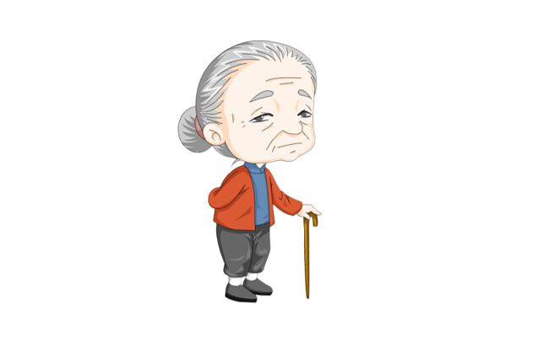
增加结果
这个钱包对我来说具有重要的意义。
增加前
The wallet is of great importance for me.
增加后
The wallet is of great importance for me. It was sent to me by my grandma on my 13th birthday. My Grandmother will be more than sad with the loss of it.

Slide 18
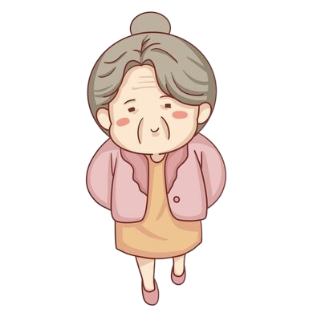
增加情感，培养学生的思维品质
这个钱包是已故奶奶留给我的唯一的念想。
打亲情牌以情感人
达到共情
The wallet is the only relic that my late grandmother left me.
钱包上的足球是我已故奶奶亲手绣上去的，奶奶希望我长大了能当一名优秀的足球运动员，为国争光。
The football on the wallet was embroidered by my late grandma. She hoped I could grow up to be an excellent football player and win glory for our country.

Slide 19

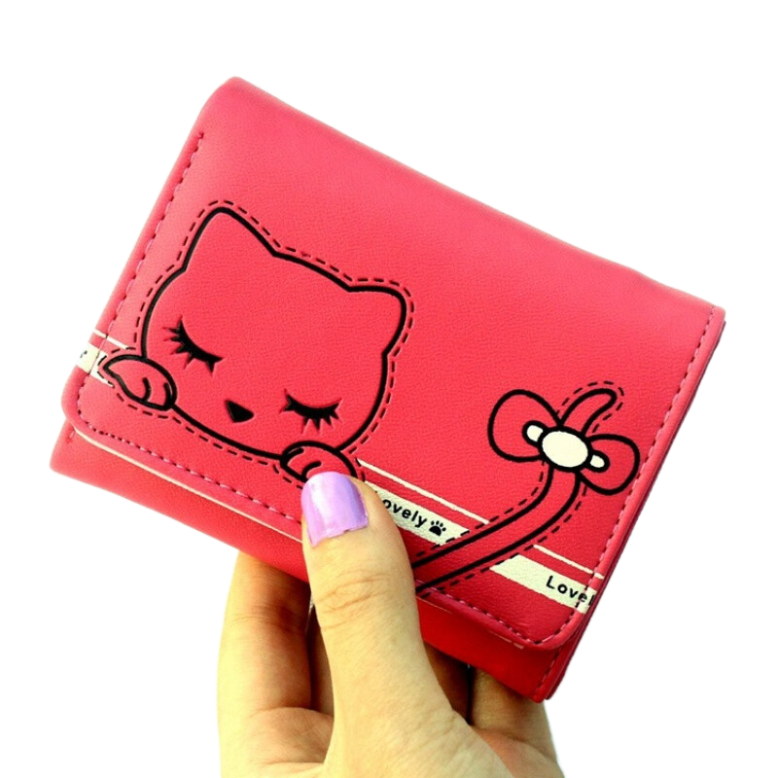
增加具体事例，使内容详实
这个钱包对我来说具有重要的意义。
增加前
The wallet is of great importance for me.
增加后
The wallet was given to me by my grandma as an amulet (护身符) when I was in hospital. Under “its protection”, I soon recovered. Therefore, the wallet is of great importance for me.

Slide 20
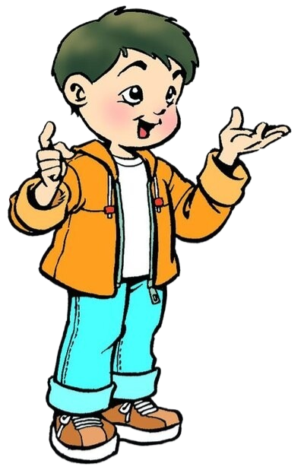
适当增加句式句型，增添语言的丰富性
例如介绍李华时可用定语从句、同位语等，使李华的身份更加透明。
I’m Li Hua, a passenger on the Fl753 plane.
同位语
同位语+定从
I’m Li Hua, a passenger who took the Fl753 .
I’m Li Hua, who is your passenger taking the Fl753 plane.
定从
I’m Li Hua, a passager who lost a wallet.
I tooke the Fl753 plane.
同位语+定从

Slide 21
增加语气思考，使事半功倍
应用文属于交际性文章，在沟通时，你的语气将会决定对方所感知到的舒适度和接受度。不同的沟通语气所表达出的效果也会不同。
本文是求助信，语气要委婉、亲切而又不失礼貌。如果遣词造句一味准求高级词汇或者套用某些模板，往往会让语言显得呆板、没有活力，那么写出来的文章就会缺少清新之感。
因此，在写作时，我们的语气一定要随题材不同而不同。

Slide 22
增加语气思考，使事半功倍
增加前
You should spare no effort to help me look for it.
“should” 语气生硬。工作人员没有这个义务帮你找。
增加后
Please let me know if any airport clerk or any other passenger happens to find it.
Hope you can relate to my feelings that I feel like finding it.
Would you be so kind as to help me look for my wallet?

Slide 23
钱包内部特征 里面装了什么？
2
01
02
根据交际原则，增加
一些必要的细节。如原因、目的、结果、意义、情感等，帮助学生拓展思维能力。
根据交际原则，
不必要的或错误的细节。
删掉

Slide 24
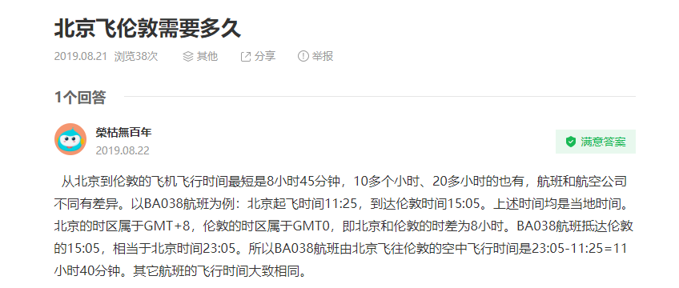
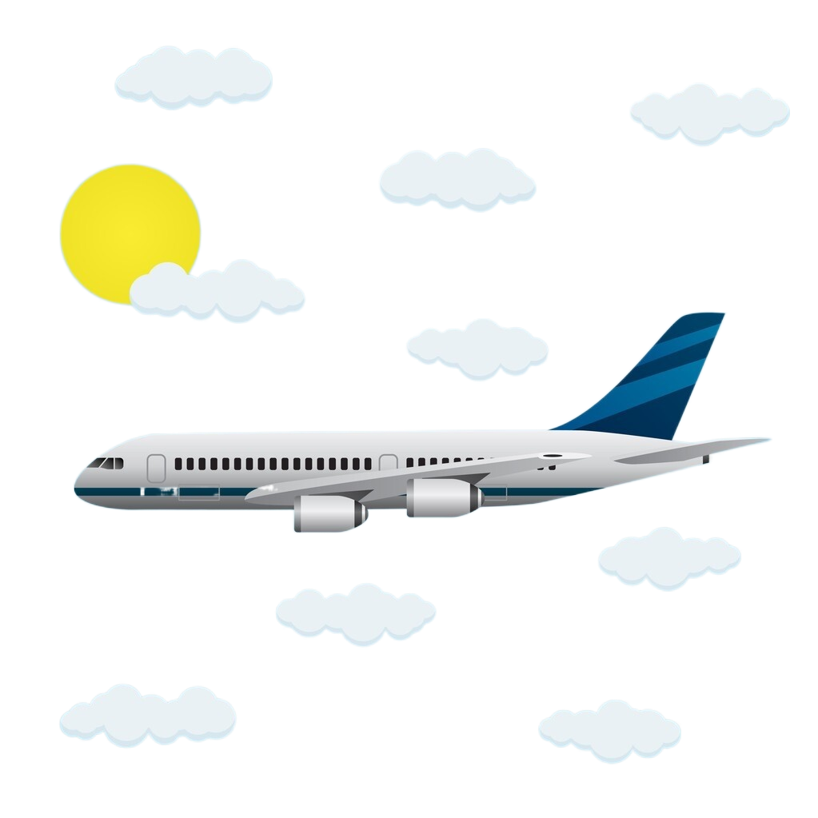
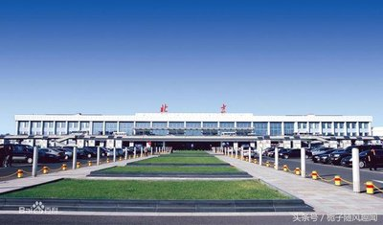
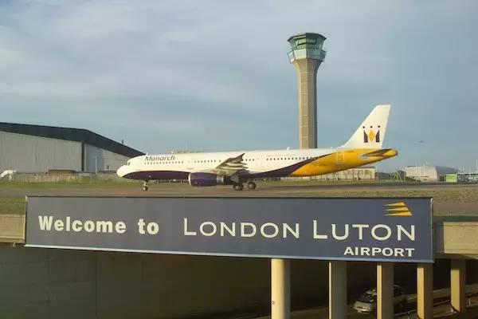
百度一下
删掉不符合交际的内容
I’m LiHua, who went to London by plane FL753. I’m writing to ask for your help. This morning, The plane took off at 7 am. from Beijing Capital Airport and landed in London at 9 am.．
2 hours?
possible?
北京首都机场
英国卢顿机场

Slide 25

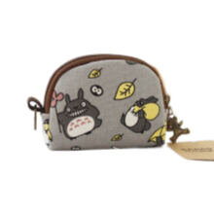
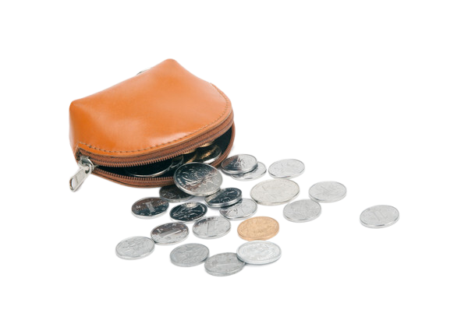
The difference between wallet and purse
删掉不符合交际的内容
The leather purse is bule with a cat pattern on it, containing my passport, ID and some money.
wallet: 一般意义上的钱包, 强调是钱夹, 皮夹子(折叠式的), 没有男女区别。
purse: (放硬币的)小钱包, 零钱包(尤指女式钱包)
Can the passport and ID
be put in the purse?
purse
wallet

Slide 26
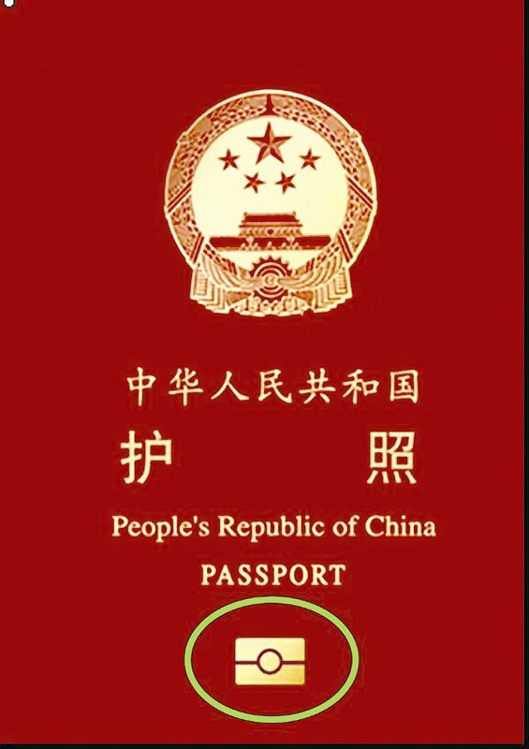
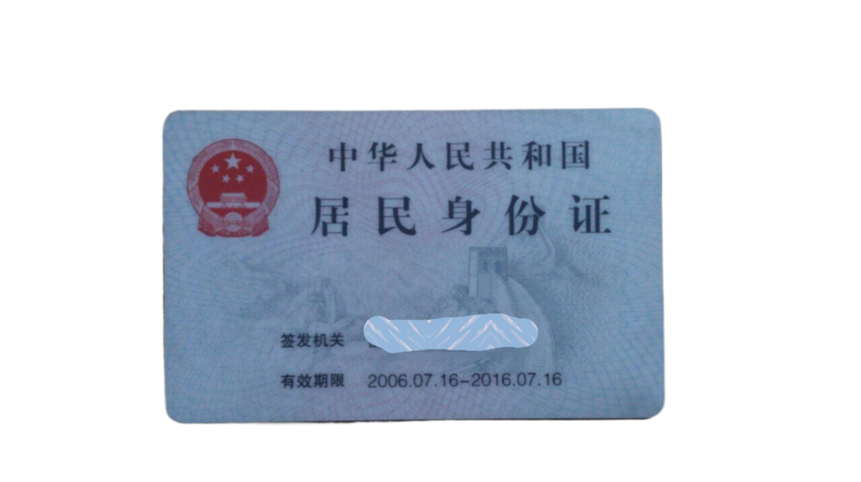
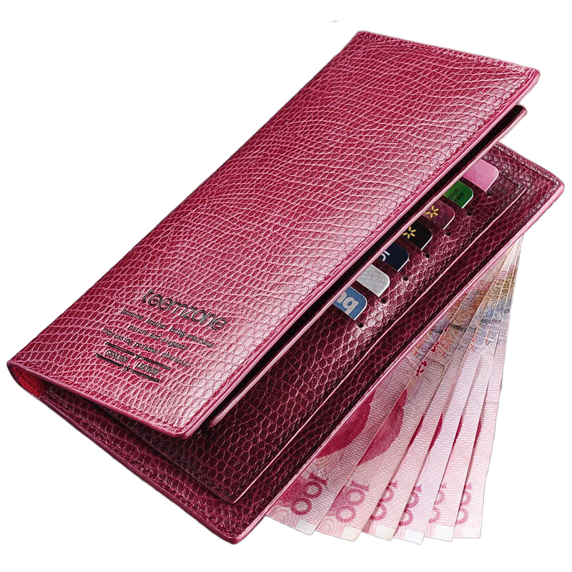
删掉不符合交际的内容
The leather wallet is bule with a cat pattern on it, containing my passport, ID and some money.
possible?
Can the passport be put in the wallet?
注意：wallet ≠ briefcase

Slide 27
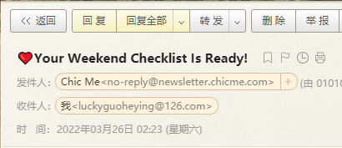
删掉不符合交际的内容
If you have found it, please email me at LiHua@163.com.
No
Is it necessary for Li Hua to leave an email？
The quickest and most effective way to get in touch is to leave your phone number.

Slide 28
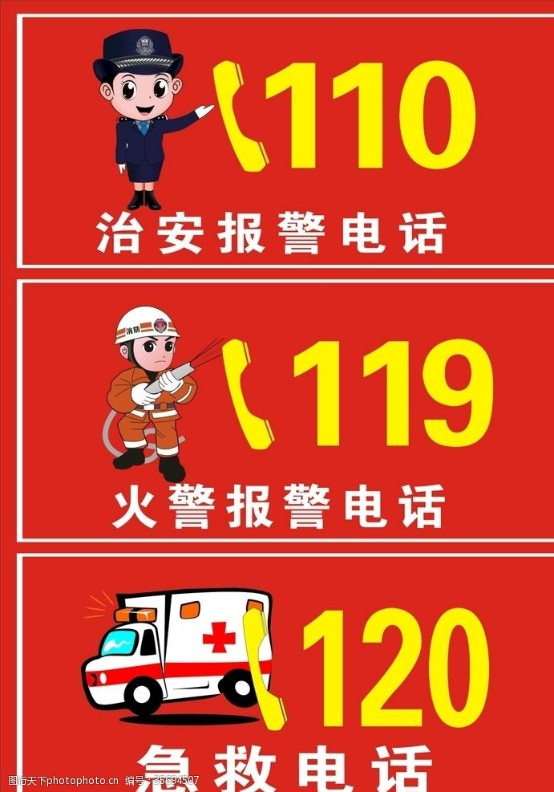
删掉不符合交际的内容
119是火警电话，随便拨打属于违法行为。
My phone number is 119.
My phone number is 10086.
10086 是中国移动的客服电话。
119，110，10086 等电话不能随便拨打。考生可以根据需要编一个电话号码或者手机号。

Slide 29
删掉不符合交际的内容
If possible, please send it to the London airport,where
I will pay much money for it.
求助信是求人帮忙的，语气一定要委婉、真诚。如：
If you find it, please call me at 158××××.
Would you be so kind as to call me at 133××××if you found it?
土豪气十足，给人不舒服的感觉
If you found it, you should give it to me. I can
give you some money.
命令式语气同样让人感到不舒服
If you found it, you should call me.

Slide 30
找出文中不符合有效交际的地方
Dear Sir，
I’m LiHua, a passenger of the flight FL753, which was scheduled to arrive in London at 8 p.m. on October 25th. During the flight, my wallet was lost by mistake and I wonder if you could help me.
with a lovely cat model on it, the brown wallet contains 200 yuan, my credit card and ID card and my ipad. If you find it, please email me at LiHua@163.com. If possible, please send it to the London airport,where I would pay a great deal of money for it.
I would be extremely grateful if you could help me find it.
Yours,
LiHua
wallet 放不下ipad
email地址自带，无需留
求助信的语气太豪横，不够委婉
缺少回复
Your prompt reply to this letter will be highly appreciated.

Slide 31
找出文中不符合有效交际的地方
Dear Sir,
I’m LiHua, a passenger in the FL753 flight. I hope you can help me look for my wallet which was lost when I arrived in London.
Yesterday, I just took FL753 flight from Shanghai to London. I realized my wallet had lost when I got to my destination.
My wallet is black and small. There are some books, a computer, money and my ID card.
You must call me if you find it.
Yours,
LiHua
钱包特征不具体，
增加工作人员的难度
books and computer太大了，wallet放不下
没留联系方式，
怎么联系你呢？
must是命令语气，
不委婉
希望对方及时回复
Your prompt reply to this letter will be highly appreciated.

Slide 32
Enjoy Students’ Composition 1
Dear leader,
My name is Li Hua, one of your passengers, writing to cordially ask for help on arriving in London this evening. I found my wallet had lost, which was likely to remain on the flight FL753 I took. Therefore, I have no choice but to turn to you for assistance. I wonder if you would be so kind as to search the plane for my wallet. The leather wallet is blue with a cat pattern on it, containing some money.
If it’s possible for you to oblige me with the information of my wallet, please drop me a line. Your prompt reply to this letter will be highly appreciated.
Yours,
Li Hua
热情地
oblige sb. with sth.
= help sb. with sth.
给某人写封短信

Slide 33
Enjoy Students’ Composition 2
on doing “一……就”
Dear Sir,
I am LiHua, a passenger of flight FL753. Upon arriving in London Airport last night, I found my wallet missing, inside which there is a credit card, eight pieces for one huandred. Most importantly, there is a photo belonging to my late grandmother. In addition, it is emerald green and is made of leather.
My wallet is of great importance to me, Therefore, please allow me to know if any airport clerk or any other passenger happens to find it. I can be reached at any time by cellphone at 86754321.
I’m much obliged to you. Looking forward to your early reply.
Sincerely yours,
LiHua
定从
作定
祖母绿
be of + n.
= be +adj.
非常感谢，不胜感激
随时联系我

Slide 34

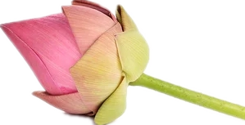
预祝学子
不忘初心 砥砺前行
百日鏖战 折桂蟾宫
T
HANK YOU

