Slide 1

感恩遇见，相互成就，本课件资料仅供您个人参考、教学使用，严禁自行在网络传播，违者依知识产权法追究法律责任。
更多教学资源请关注
公众号：溯恩高中英语
知识产权声明

Slide 2

The World
May 1st-10th, 2022

Slide 3

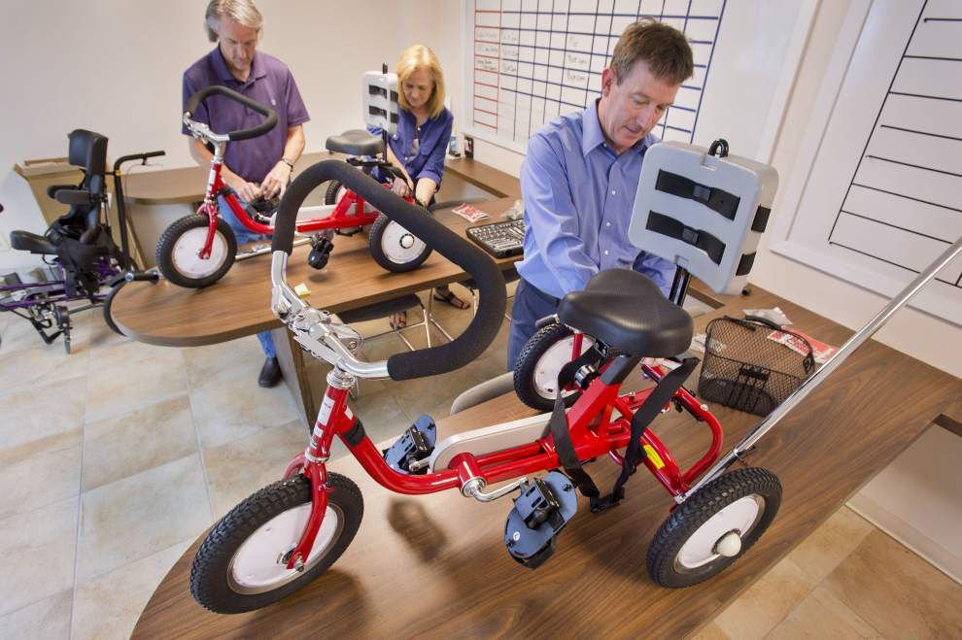
1. Life Cycles
生命之轮

Slide 4
完形填空
（《读者文摘》2022年5月版 13页）
About 15 years ago, Andrew McLindon, an entrepreneur and avid ___1___, was riding his bike in Austin, Texas, when he thought about a friend’s 12-year-old son. The boy had never known the joy of biking because he suffered from hydrocephalus (脑积水), a buildup of fluid in the brain that often causes ___2___ disturbances.
When he got home, McLindon, now 60, went online and found a three-wheel recumbent bike with a seat belt, ___3___ for a child with balance issues. Soon the boy was pedaling around the street with his peers, having fun and getting ___4___. But there was more, as McLindon gleaned from his friend’s ___5___. “To see his son interacting with other kids,” McLindon says. “I’ll never forget the ___6___on his face.”
That smile ___7___the McLindon Family Foundation. Funded by donations, the group works with pediatric rehab (儿童康复中心) clinics to find children who can ___8___from owning an adaptive bike—and to help craft each bike to the ___9___needs of the child. A bike may include a headrest, a shoulder harness, a seat belt, and a caregiver’s steering and braking mechanism in the back. The bikes are ___10___—$3,000 to $4,000, and that’s with the foundation’s steep manufacturer’s discount. For kids lucky enough to get one, they’re a life changer.
“We worked with a 14-year-old who has spina bifida (脊柱裂),” says McLindon. “She spent most ___11___on the couch watching TV. Soon after she got her bike, she was training for special-needs triathlons. In a magazine ___12___, she said, ‘I always knew there was an ___13___in me.’” So far, the foundation has ___14___ 450 bikes, and that’s just a start. “I do a lot of things. I ___15___a lot of companies,” McLindon says. “But getting these kids their bikes is the most important thing that I do.”

Slide 5
完形填空
B
1. A. scientist B. cyclist C. pianist D. environmentalist
2. A. sleep B. emotion C. diet D. balance
3. A. famous B. perfect C. eager D. responsible
4. A. exercise B. wisdom C. courage D. experience
5. A. attention B. description C. reaction D. explanation
6. A. blood B. wound C. sweat D. smile
7. A. launched B. affected C. delivered D. organized
8. A. recover B. suffer C. benefit D. differ
9. A. growing B. unusual C. urgent D. particular
10. A. fancy B. impressive C. comfortable D. expensive
11. A. days B. decades C. months D. centuries
12. A. report B. sale C. meeting D. interview
13. A. athlete B. singer C. actor D. businessman
14. A. given out B. given up C. given in D. given away
15. A. run B. found C. design D. admire
D
B
A
C
D
A
C
D
D
A
D
A
D
A

Slide 6
词汇讲解
1. glean: to find out information slowly and with difficulty 费力地收集
These figures have been gleaned from a number of studies. 这些数据是通过多次研究收集得来的。
2. interact: to communicate with sb, especially while you work, play or spend time with them 交流；沟通；合作
Teachers have a limited amount of time to interact with each child. 教师和每个孩子沟通的时间有限。
翻译句子
到目前为止，我们可以从我们的经验中吸取一些教训。
Several lessons can be gleaned from our experience so far.
翻译句子
Lucy和班上的其他孩子相处得很好。
Lucy interacts well with other children in the class.

Slide 7
句子翻译
But there was more, as McLindon gleaned from his friend’s reaction. “To see his son interacting with other kids,” McLindon says. “I’ll never forget the smile on his face.”
翻译
但麦克林登从朋友的反应中了解到，事情还不止这些。 “看到他的儿子和其他孩子互动，”麦克林登说。 “我永远不会忘记他脸上的笑容。”
Funded by donations, the group works with pediatric rehab clinics to find children who can benefit from owning an adaptive bike—and to help craft each bike to the particular needs of the child.
在捐款的资助下，该组织与儿童康复诊所合作，寻找能够从拥有一辆自适应自行车中受益的儿童，并帮助设计每一辆自行车，以满足儿童的特殊需求。
翻译

Slide 8

2. Don’t Overthink It
不要想太多
Reducing reasoning may help to learn language

Slide 9
语篇填空
（《科学美国人》2022年5月刊 18页）
unclear
Children often learn new languages more easily than adults do, but it’s ________(clear) why. Some hypothesize that grasping a language ________ (require) absorbing subtle patterns unconsciously and _____ adults’ superior conscious reasoning interferes. New research suggests that, indeed, grown-ups might just be too smart for their own good.
For a recent study, a group of Belgian adults simultaneously read and heard strings of four made-up words. Specific consonants always appeared at the ___________ (begin) or end of a word if the word contained a certain vowel. Participants next read the sequences aloud quickly. Their ability to avoid _________ (mistake) doing so indicated how well they absorbed the consonant-vowel patterns.
But before _________ (expose) to the new words, the participants had carried out a separate test: pressing keys ________ (react) to letters and numbers. Some got a much faster, more mentally draining version of this test.
Those who tackled the difficult version ________ (claim) greater cognitive fatigue afterward—but performed better on the subsequent language task. The researchers hypothesize that tired learners used ______________ (conscious) analysis on the word rules: they were free to learn like a child.
When beginning to learn a language, Eleonore Smalle a psychologist says, immerse yourself in its sounds, even—or ___________ (especial)—while distracted.
requires
that
beginning
mistakes
exposure
to react
claimed
less conscious
especially

Slide 10
词汇讲解1
1. hypothesize: to suggest a way of explaining sth when you do not definitely know about it 假设；假定
To explain this, they hypothesize that galaxies must contain a great deal of missing matter which cannot be detected.
为了解释这一点，他们假定银河系一定包含了大量无法探测到的不明物质。
2. interfere: to get involved in and try to influence a situation that does not concern
you, in a way that annoys other people 干涉；干预；介入
She never allows her personal feelings to interfere with her work.
她从不让她的个人感情妨碍工作。
翻译句子
研究人员推测，肥胖的人觉得扣上安全带会很不舒服。
The researchers hypothesize that overweight people find belts uncomfortable .
翻译句子
别人一干涉，麻烦就来了。
When others interfere, it always makes trouble.

Slide 11
词汇讲解2
3. fatigue: a feeling of being extremely tired, usually because of hard work or exercise 疲劳；劳累
She continued to have severe stomach cramps, aches, fatigue, and depression.
她仍有严重的胃痉挛、疼痛、疲惫和抑郁症状。
4. subsequent: happening or coming after sth else 随后的；后来的；之后的
Developments on this issue will be dealt with in a subsequent report.
这个问题的发展将在以后的报道中予以说明。
翻译句子
这个事故是驾驶员疲劳所致。
Driver fatigue was to blame for the accident.
翻译句子
后来发生的事证实了我们的怀疑。
Subsequent events confirmed our doubts.

Slide 12
句子翻译
Some hypothesize that grasping a language requires absorbing subtle patterns unconsciously and that adults’ superior conscious reasoning interferes.?
一些人假设，掌握一种语言需要无意识地吸收微妙的模式，而成年人的高级有意识推理会起到干扰作用。
翻译
Those who tackled the difficult version claimed greater cognitive fatigue afterward—but performed better on the subsequent language task..
那些完成了难度较大的版本的人声称在之后的认知疲劳更严重，但在随后的语言任务中表现得更好。
翻译

Slide 13

3. Doctors urged to delay retirement
医生们要推迟退休了
Plea for retired doctors to staff hospitals

Slide 14
语篇填空
（《泰晤士报》2022年5月5日 1&2页）
to postpone
Senior doctors are being asked _____________ (postpone) their retirement and work from home or part-time under a new drive to tackle record waiting lists.
NHS England bosses wrote to hospital trusts yesterday _______ (urge) them to coax elderly doctors out of retirement and persuade others to stay on. About 21,000 doctors over the age of 65 are due to retire this year, worsening a _________ (short) of 110,000 NHS staff that is undermining efforts to tackle the Covid backlog.
The letter, seen by The Times, said that hospital doctors approaching retirement could be offered jobs working ______ home monitoring “virtual wards” or giving video consultations to patients. Hospitals __________ (tell) to take advantage of the experience of retired consultants by getting them to train younger doctors, even if they did not want to return to treat patients themselves.
The initiative is part of a new package of measures to tackle the workforce crisis, ______ medical leaders have warned is making it ___________ (possible) to bring down the record waiting list of 6.2 million patients. Hospitals will also encourage all staff to take on extra hours, remove caps on the amount that __________ (surgeon) can work perweek, deploy vaccine volunteers _____ use medical students to staff wards.
_________ , Jeremy Hunt, a former health secretary, said “the NHS should not be left to beg doctors to postpone their retirement”, and that the only solution was a long-term workforce plan.
urging
shortage
from
were told
which
impossible
surgeons
and
However

Slide 15
词汇讲解1
1. tackle: to make a determined effort to deal with a difficult problem or situation 应付，处理，解决（难题或局面）
The problems are not serious. Nonetheless, we shall need to tackle them soon..
问题不严重，不过我们还是需要尽快处理。
2. coax : to persuade sb to do sth by talking to them in a kind and gentle way 哄劝；劝诱
However little there is to eat, he always saves a bit o' his bread to coax his pets.
不管吃的有多么少，他总是省下一点他的面包来哄他的宠物。
翻译句子
我们必须带着同情和谅解来处理这个问题。
We must tackle the problem with sympathy and understanding.
翻译句子
她哄着那匹马让它再靠近了一点。
She coaxed the horse into coming a little closer.

Slide 16
词汇讲解2
3. initiative: a new plan for dealing with a particular problem or for achieving a particular purpose 倡议；新方案
Britain is expected to put forward a fresh initiative on reducing the debts of the poorest countries.
预计英国将提出一项减少最贫穷国家债务的新倡议。
4. deploy: to move soldiers or weapons into a position where they are ready for military action 部署，调度
The president said he had no intention of deploying ground troops.
总统说他无意调遣地面部队。
翻译句子
他提出了一个新的试图阻止战争的外交倡议。
He proposed a new diplomatic initiative to try to stop the war.
翻译句子
沿边境至少部署了5000枚导弹。
At least 5 000 missiles were deployed along the border.

Slide 17
长难句分析
The initiative is part of a new package of measures to tackle the workforce crisis, which medical leaders have warned is making it impossible to bring down the record waiting list of 6.2 million patients.
分析：本句是一个复合句，“which medical leaders... patients”是______________________________，“to tackle the workforce crisis”是__________ 修饰___________ ；“to bring down the record waiting list of 6.2 million patients.”是_______________________, it是__________。
which引导的非限制性定语从句
后置定语
measures
is making 的真正宾语
形式宾语
翻译
这一举措是解决劳动力危机的一揽子新措施的一部分。医疗领导者警告说，劳动力危机使620万患者的等候名单无法减少。

Slide 18
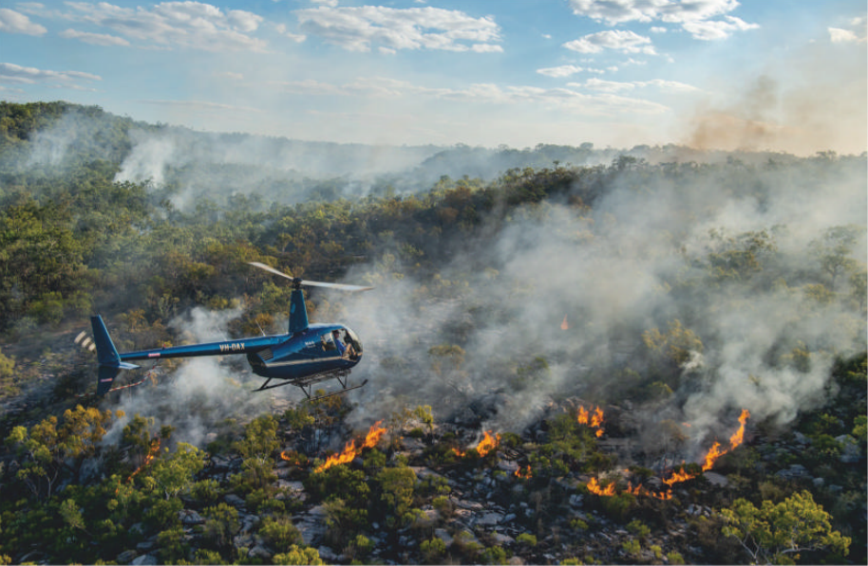
4. Fighting Fire with Fire
澳大利亚土著“以火攻火”以减少灾难性山火爆发
A helicopter guided by Terrah Guymala, a Warddeken ranger, drops incendiary devices that slowly react chemically and then ignite after they are on the ground.

Slide 19

语篇填空
（《国家地理》2022年5月刊 81页）
Between August and December, fire is relentless. Tropical savanna is the most fire-prone landscape ___ the planet, and up to one-third of northern Australia _____ (burn) every year.
But fire isn’t just the problem—here, it’s also the solution.
During the cool of northern Australia’s early dry season, _____ moisture lingered on the land, rangers weren’t fighting fires; they were lighting them. From April to July each year, rangers walk ________ (hundred) of miles armed with drip torches, setting the land alight, and conduct _________ (prescribe) burns from the air, dropping incendiary pellets from helicopters.
Moist vegetation, low winds, and lower temperatures at that time of year mean the fires they light are smaller and less intense, typically burning out overnight. If the land is burned ______(gentle), the wildfires that will inevitably come later won’t be ___ destructive. It also gives the rangers __ fighting chance at extinguishing them.
_________ (protect) the environment with fire, and from fire, is a role Aboriginal (澳大利亚土著居民的) rangers take seriously. They are the land’s owners, its caretakers, and they have a deep, spiritual __________ (connect) to it.
on
burns
when
hundreds
prescribed
gently
as
a
Protecting
connection

Slide 20
词汇讲解
1. relentless: not stopping or getting less strong 不停的；持续强烈的；不减弱的
He is campaigning relentlessly, trying to build support.
他正在不懈地竞选，试图赢得（选民）支持。
2. prone: ① (in adjectives) likely to suffer or do the thing mentioned
有做……倾向的；易于遭受……
injury-prone 容易受伤的
② likely to suffer from sth or to do sth bad 易于遭受；有做（坏事）的倾向
For all her experience, she was still prone to nerves.
尽管有经验，她还是容易紧张。
The sun is relentless.
翻译句子
太阳还是那么热。
翻译句子
连续工作不停歇使人更容易出错。
Working without a break makes you more prone to error.

Slide 21
词汇讲解
3. linger: to continue to exist for longer than expected 继续留存；缓慢消失
The scent of her perfume lingered on in the room.
她的香水味道在房间里久久不散。
4. alight: on fire 燃烧；着火
Several buildings were set alight. 几幢大楼着了火。
The gas fire was still alight. 燃气引起的大火还在熊熊燃烧。
翻译句子
房间里仍飘逸着她那淡淡的香水味。
The faint smell of her perfume lingered in the room.
翻译句子
她的衣服让火烧着了。
Her dress caught alight in the fire.

Slide 22
句子翻译
During the cool of northern Australia’s early dry season, when moisture lingered on the land, rangers weren’t fighting fires; they were lighting them.
翻译
在澳大利亚北部早期旱季凉爽的时候，当水分在土地上挥之不去时，护林员并没有扑灭大火； 他们正在点燃大火。
From April to July each year, rangers walk hundreds of miles armed with drip torches, setting the land alight, and conduct prescribed burns from the air, dropping incendiary pellets from helicopters.
翻译
每年4月到7月，护林员带着滴水枪步行数百英里，点燃土地，从空中进行规定的燃烧，从直升机上投下燃烧弹。

Slide 23
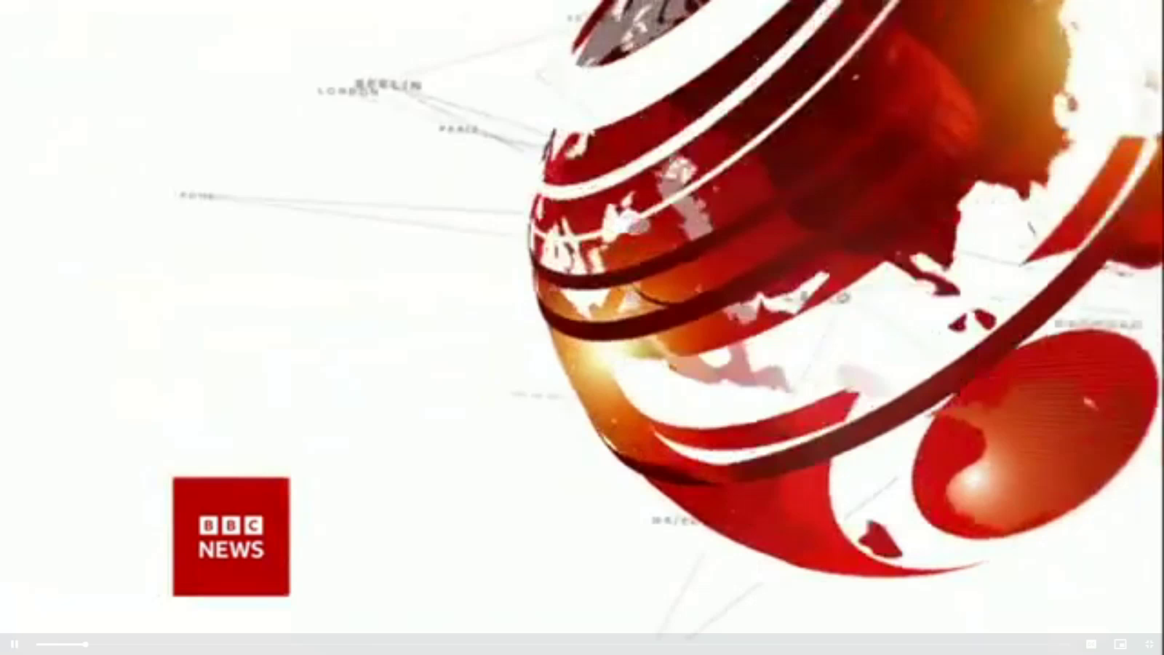
5. BBC一分钟新闻听写填空 One-minute World 05/04/22

Slide 24

听力填空
This is BBC World news, the headlines. The United Nations Secretary General Antonio Guterres has visited the ________ Ukrainian towns of Borodyanka, Bucha and Irpin ________________ President Zelensky in Kiev. Mr Guterres says he is working on a plan to ________ hundreds of civilians from Mariupol.
Russian forces must be pushed out of the whole of Ukraine according to Britain’s Foreign Secretary Liz Truss, as she says, western allies must ___________ in their support of Ukraine.
An ____________ by the US state of Minnesota following ______________ of George Floyd in 2020 has found the city’s police ________ in a pattern of race _____________ for at least the past decade.
Trade unions in Sri Lanka have called for a _______________ to increase pressure on the government of President Rajapaksa to resign, [which] made an unprecedented _____________.
war-torn
ahead of talks with
evacuate
double down
investigation
the police killing
engaged
discrimination
nationwide strike
economic crisis

Slide 25
词汇讲解
1. double down: to become more tenacious, zealous, or resolute in a position or undertaking 加倍（努力）
The administration needs to double down on the call for political reform.
政府需要加倍呼吁政治改革。
2. unprecedented: that has never happened, been done or been known before
前所未有的；空前的；没有先例的
Such a move is rare, but not unprecedented.
这种做法很罕见，但也不是没有先例的。
翻译句子
许多公司正在加倍开发移动应用程序和游戏。
Many companies are doubling down their development in mobile apps and games.
翻译句子
这种情况在现代还没有出现过。
The situation is unprecedented in modern times.

Slide 26
句子翻译
An investigation by the US state of Minnesota following the police killing of George Floyd in 2020 has found the city’s police engaged in a pattern of race discrimination for at least the past decade.
翻译
美国明尼苏达州在2020年乔治·弗洛伊德被警察杀害后进行的一项调查发现，该市警察至少在过去十年中一直存在种族歧视。
Trade unions in Sri Lanka have called for a nationwide strike to increase pressure on the government of President Rajapaksa to resign, which made an unprecedented economic crisis.
翻译
斯里兰卡工会呼吁在全国范围内举行罢工，以加大对拉贾帕克萨总统政府下台的压力，造成前所未有的经济危机。

