Slide 1

感恩遇见，相互成就，本课件资料仅供您个人参考、教学使用，严禁自行在网络传播，违者依知识产权法追究法律责任。
更多教学资源请关注
公众号：溯恩高中英语
知识产权声明

Slide 2

Unit 5 Launching your career
Using language 2
Apply for a summer job

Slide 3

Pre-reading
Have you ever applied for
a summer job?
Which job
would you like to apply for?
Which job
have you ever
applied for?

Slide 4


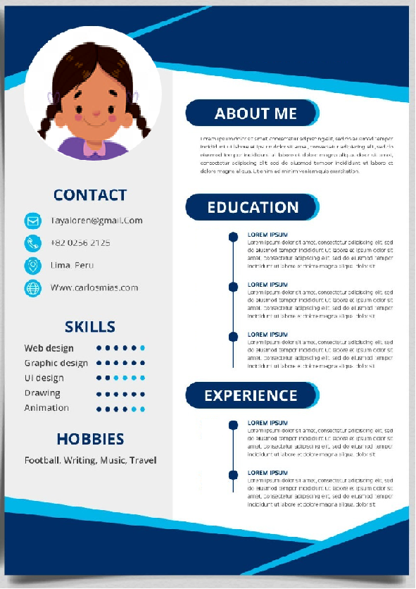
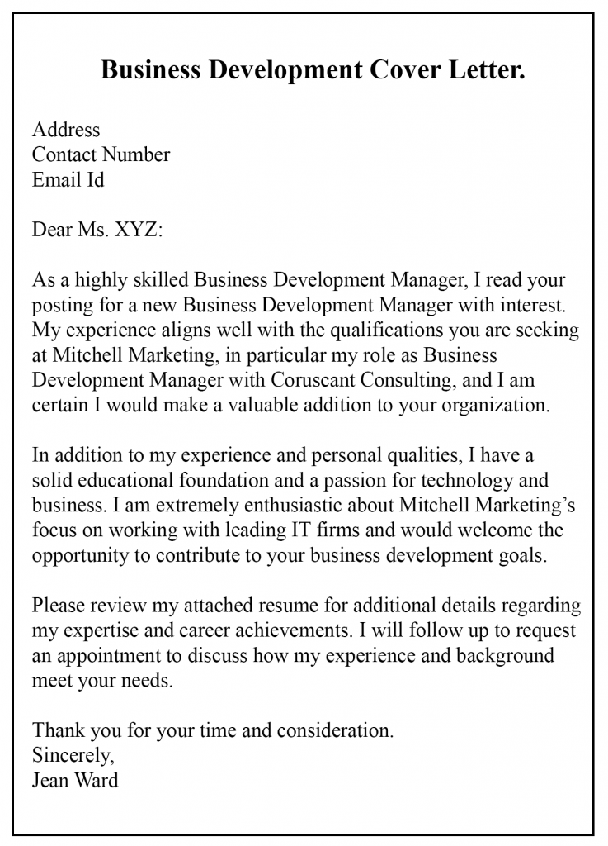

2. What are the steps for applying for a
summer job?
search for
recruitment information
list proper job information
write a CV
send CV and cover letter
write a cover letter

Slide 5
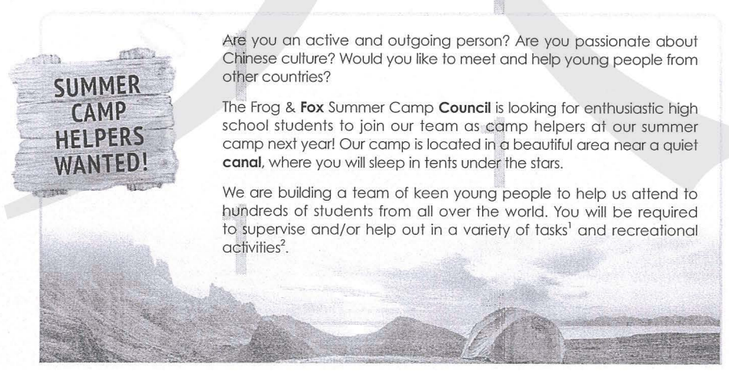
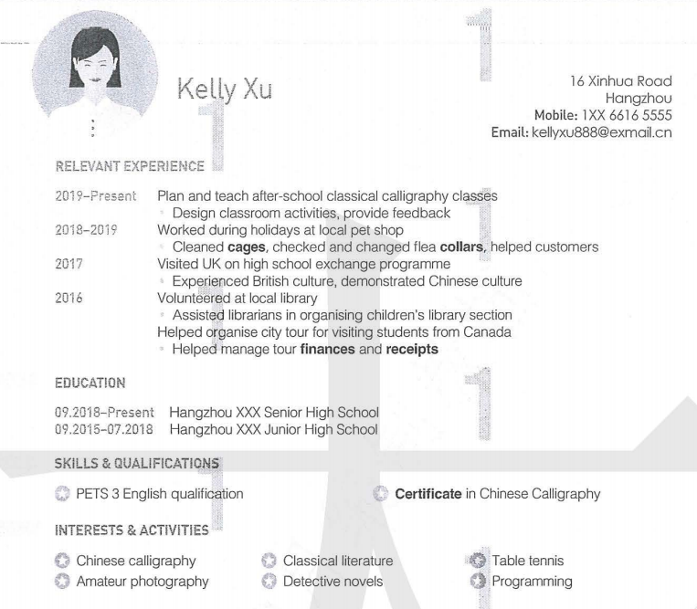
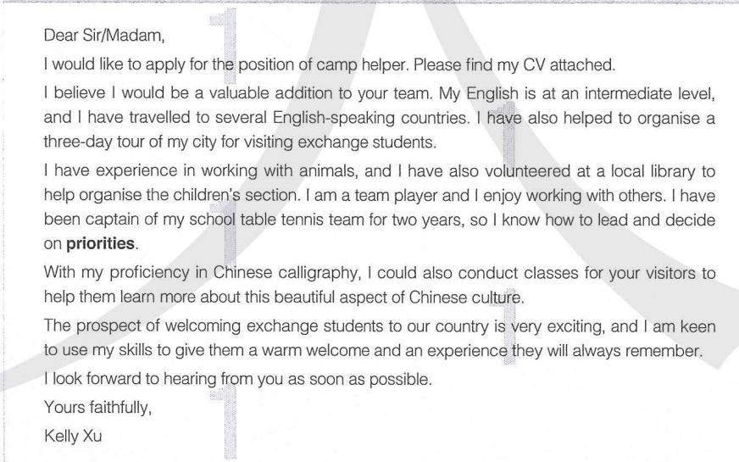
While-reading: read for text type
What are these three different texts about?
Text 1
Text 3
Text 2

Slide 6
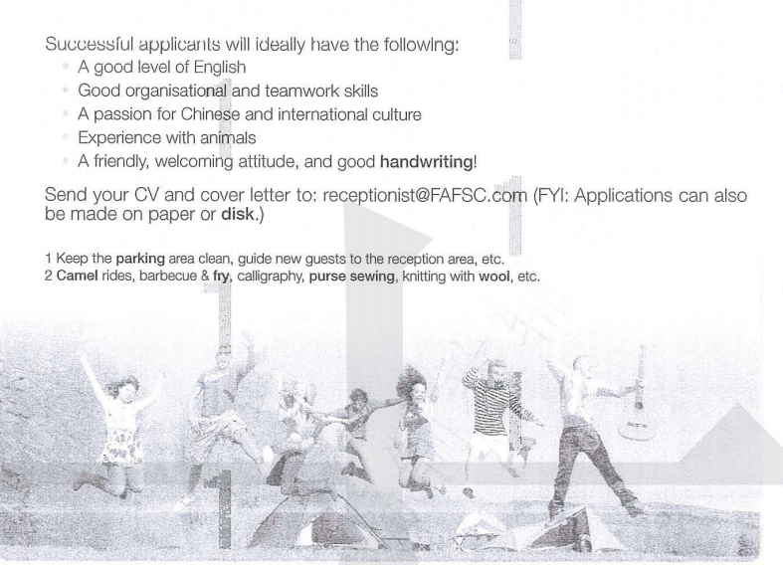
While-reading: read for text type
The first text is a job ad looking for helpers at a summer camp.

Slide 7
While-reading: read for text type
The second is an appliation letter for that job as a camp helper.

Slide 8
While-reading: read for text type
The third is the CV of the job applicant.

Slide 9
While-reading: read for content
Find the details of these requirements in the job advertisement, and report your findings to the class.
Job responsibility
Job requirement | Personality and attitude
 | Language skills
 | Experience and skills
camp helpers
active and outgoing, enthusiastic, friendly, welcoming attitude
a good level of English
good organisational and teamwork skills, a passion for Chinese and international culture, experience with animals, good handwriting

Slide 10
While-reading: read for content
Do you think she is a good match for the job? Why?

Slide 11
Job requirement | Application letter | CV
A good level of English
Good organisational and teamwork skills
A passion for Chinese and international culture
Experience with animals
A friendly, welcoming attitude and good handwriting
at an intermedia level
PETS 3 English qualification
volunteered at local library; captain of school table tennis team; knew how to lead and decide on priorities
helped organise city tour for visiting students from Canada
excited about the prospect of welcoming exchange students to our country; keen to give them a warm welcome and an experience they will always remember
visited UK on high school exchange programme
worked during holidays at local pet shop
yes
proficient in Chinese calligraphy
certificate in Chinese calligraphy

Slide 12
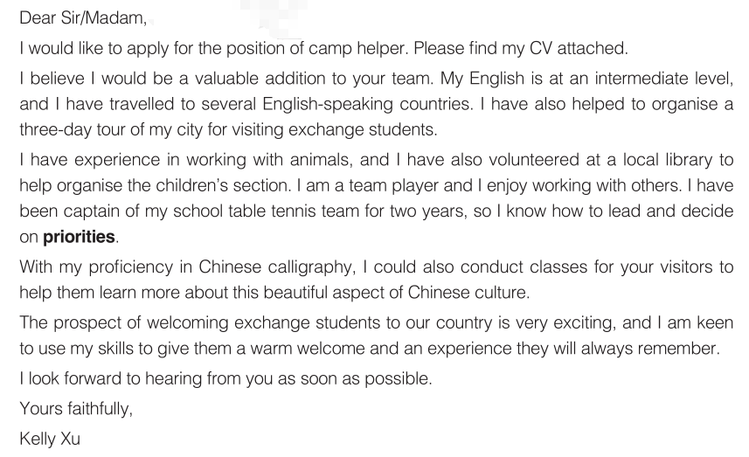
While-reading: read for content
How does the applicant respond to each of the
job requirements?
Language skills
Experience and skills
③ Experience with animals
① Good organisational and teamwork skills
② A passion for Chinese and international culture & Good handwriting
√
Personality and attitude
Do you think she is a good match for the job?

Slide 13
While-reading: read for structure
Greeting
Body
Purpose of the letter
The applicant's language skills
The applicant's organisational and teamwork skills, and her experience with animals
The applicant's passion for Chinese culture & Good handwriting
The applicant's attitude
Closing
Signature

Slide 14
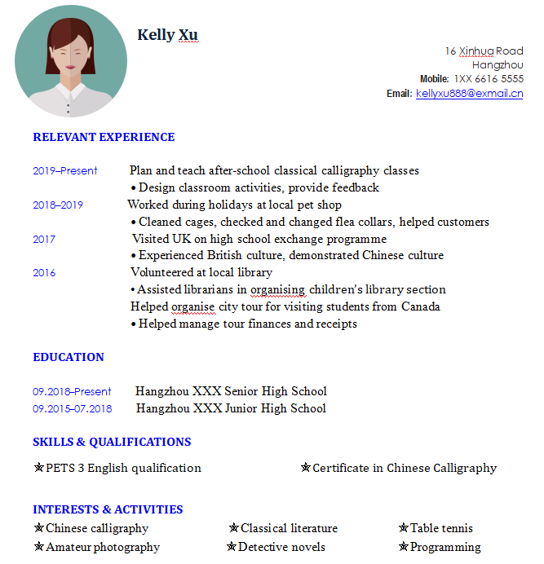
address, phone number, email address

Slide 15
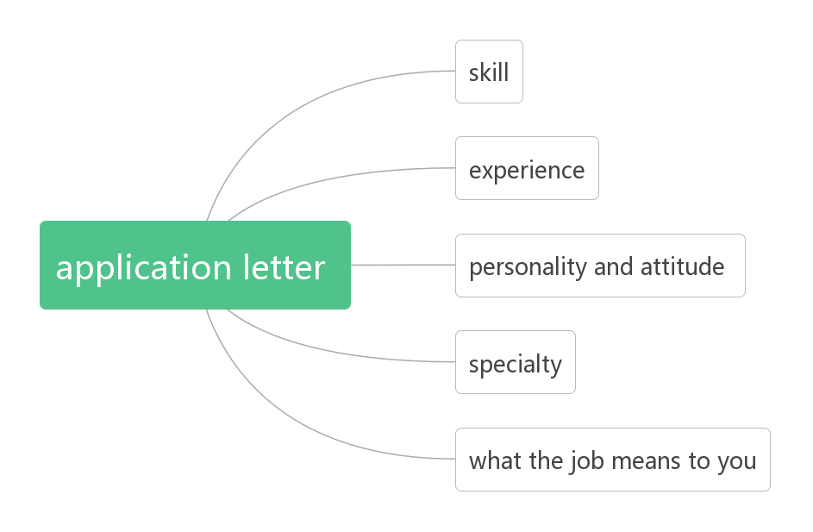
While-reading
In an application letter, what elements should be included?

Slide 16
While-reading: read for language
Letter content | Expression
Beginning
Skill
Experience
Specialty
I would like to apply for the position of...
Please consider me as an applicant for...
This letter is in response to your advertisement in ...
Please consider me for the position of ...in ...
I am writing in response/ reply to your advertisement in... for...
I believe I would be a valuable addition to your team.
I have experience in...
I have volunteered...
I worked as... before.
With my proficiency in..., I could...

Slide 17
While-reading: read for the language
Personality and attitude
What the job means to you
Ending
I am keen to...
I will be more than happy if I can...
It would be a great honour to...
I will be more than happy to...
I look forword to hearing from you as soon as possible.
Please give me a chance. Thank you for you time.
Thank you for you consideration and I am looking forward to hearing from you soon.
I would welcome an interview at any time convenient for you.
I would appreciate it if you would grant me an interview.

Slide 18
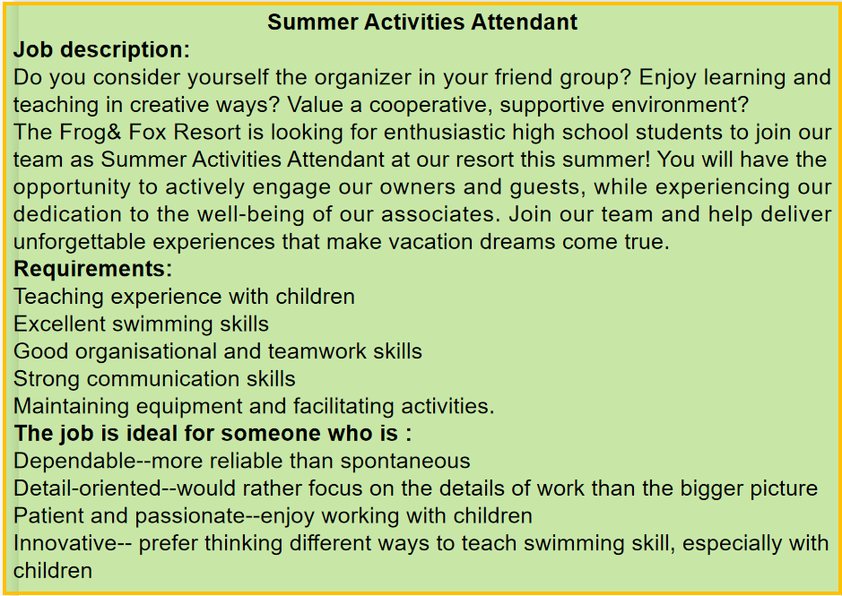
Pre-writing
Read the following job advertisement and find out the job’s requirements.

Slide 19
While-writing
Use the table below to make an outline of your application letter and CV for the job above.
Content | Personal information
My skill
My experience
My personality and attitude
What special things I can offer or bring to the job
What the job means to me

Slide 20
Sample application letter
Dear Sir/Madam,
I would like to apply for the position of Summer Activities Attendant that was posted on your website.
As you can see from my attached CV, I have experience working with children and teaching them how to swim. I have certificates in both first aid and lifesaving. I also have experience both in retail and maintenance, so I should be able to help out with these duties when required. As a physically strong and healthy young person, I absolutely love working outdoors.
On a personal note, I visited your resort several years ago with my family and took part in your summer programme. I enjoyed it immensely and would recommend it to any family wanting to give their children a wonderful summer experience. Since then, I have often thought that I would like to work there, and so I was excited when I saw the ad and made the application immediately. I hope I will have the chance to work on your fine team.
Please contact me via my email address: mike.lee@ prp.com.cn. I look forward to hearing from you!
Your faithfully,
Mike Lee

Slide 21
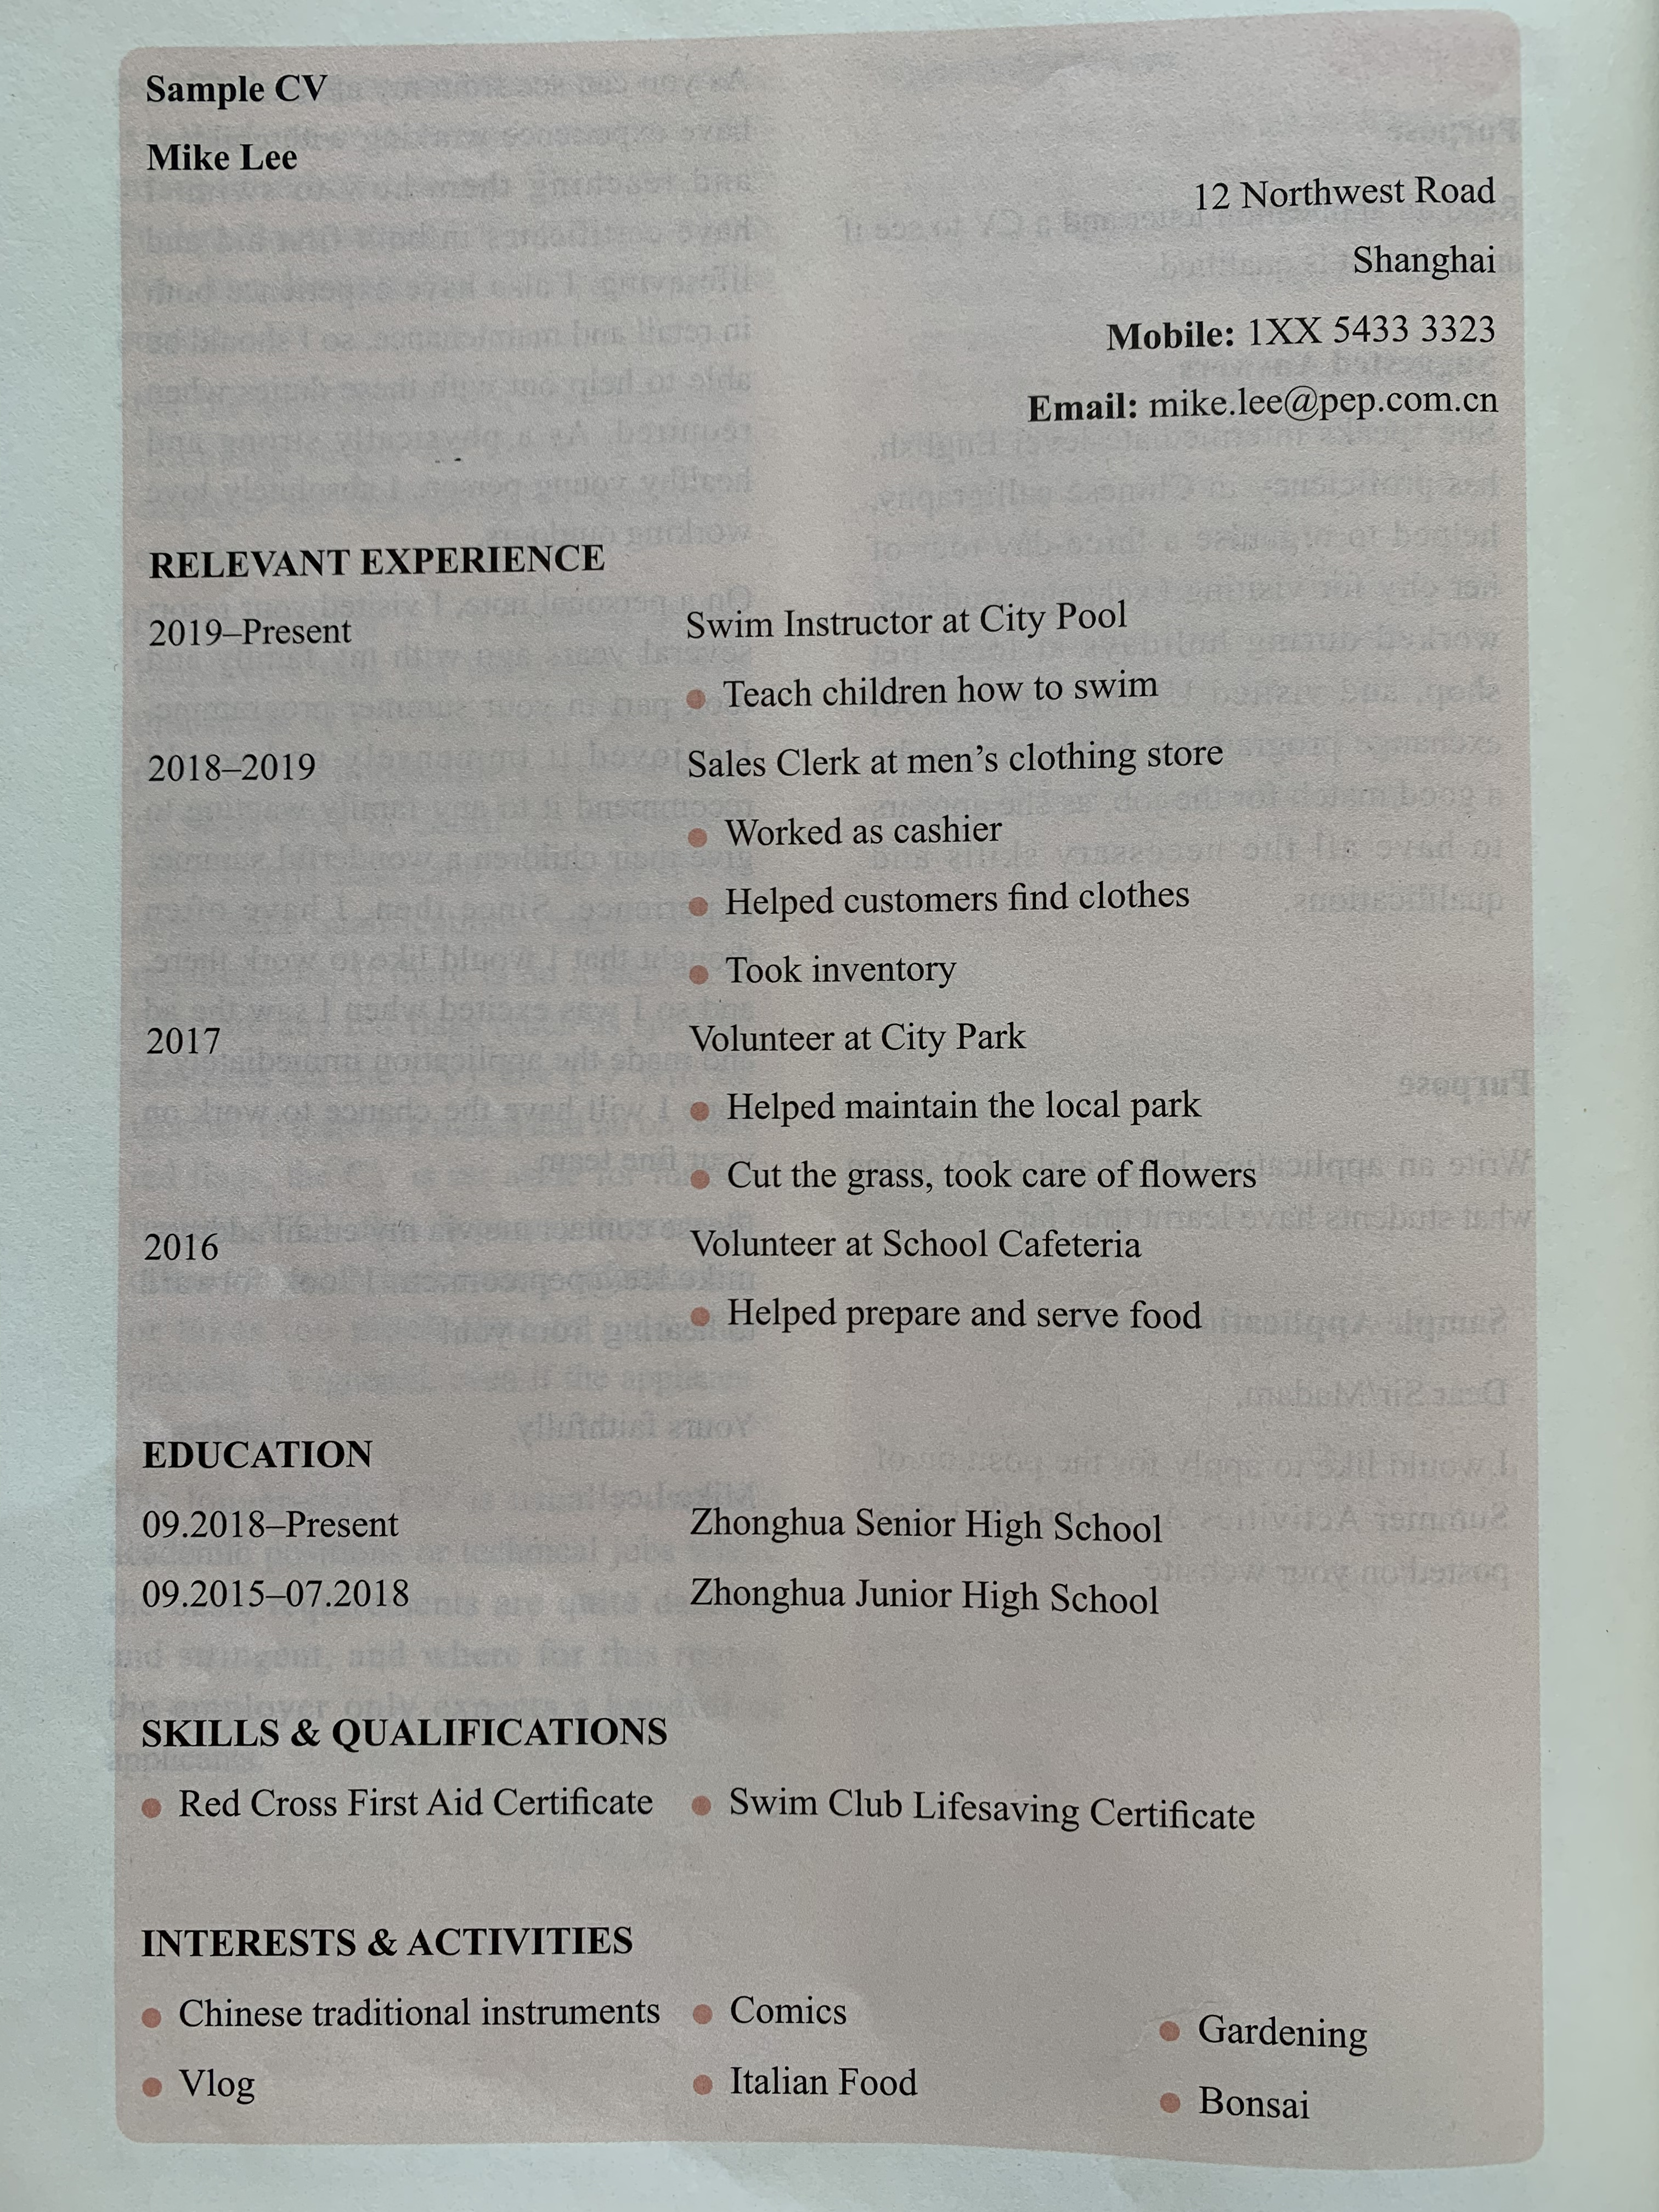
Sample CV
Notes:
这个课程可以结合一下2018年6月的真题卷，应用文也是写一封应聘信，做为课后作业。

Slide 22
Homework
（2018·浙江卷）
第一节 应用文写作
假定你是李华，你校英语协会招聘志愿者，接待来访的国外中学生。请你写信应聘，内容包括：
1. 口语能力：
2. 相关经验；
3. 应聘目的。
注意：
1. 词数80左右；
2. 可以适当增加细节，以使行文连贯。

Slide 23
Sample
Dear Sir or Madam,
My name is Li Hua. And I am writing to apply for being a volunteer of our school English association.
I have a good command of English and have been to the USA twice. So I can communicate well with native speakers of English. What’s more, I am kind and friendly to other people. So I can easily get along with foreign students.
I’m particularly interested in this job because I want to further improve my oral English capabilities and interpersonal communication skills.
Hopefully I can receive your acceptance.
Yours faithfully,
LiHua.

