Slide 1

感恩遇见，相互成就，本课件资料仅供您个人参考、教学使用，严禁自行在网络传播，违者依知识产权法追究法律责任。
更多教学资源请关注
公众号：溯恩高中英语
知识产权声明

Slide 2


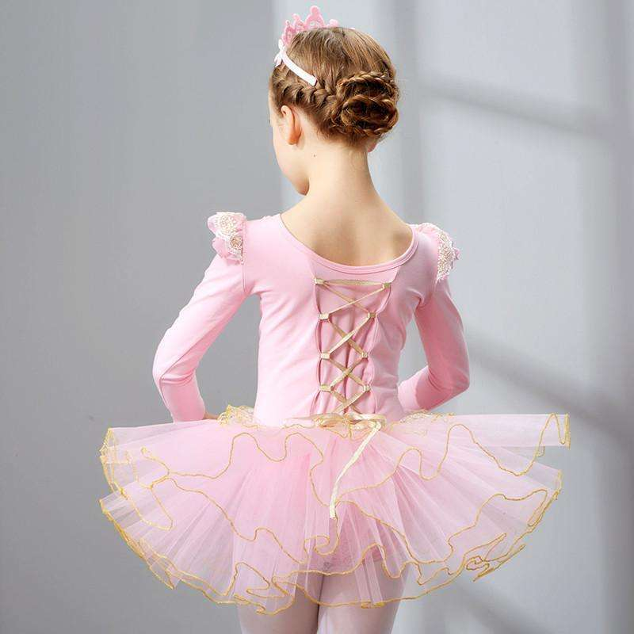
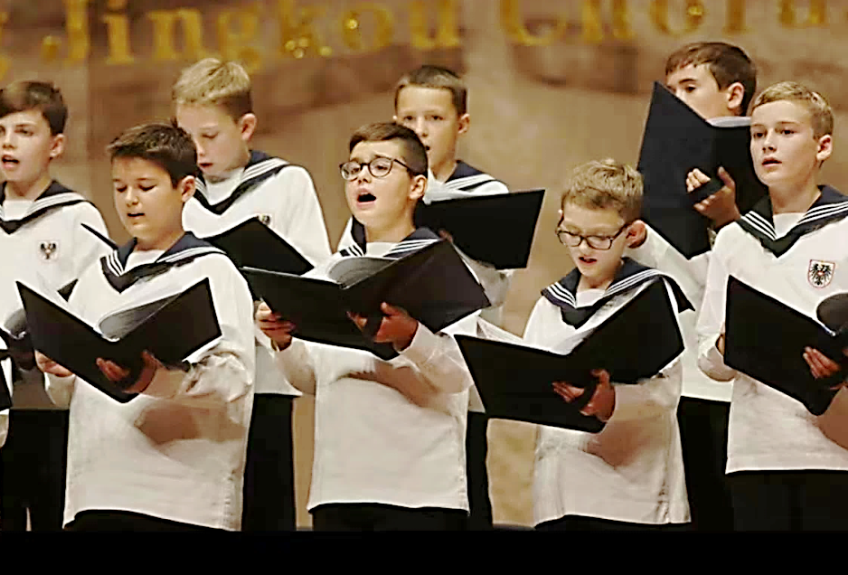
Join the School Choir
嵊州二模续写讲评
May11th, 2022.
Zheng Qiaoyan

Slide 3

解读文本提炼主题
目 录
基于原文伏笔和段首句
推理确定情节走向
构建小情节 展开细节描写
参考范文和考场优秀作文
考生典型错误分析
相似“抓伏笔”类续写考题对比

Slide 4

解读文本提炼主旨

Slide 5

阅读下面短文，根据所给情节进行续写，使之构成一个完整的故事
Looking back at my life, I found that the most important event occurred when I was in 4th grade.
From the beginning of the semester, I started learning dancing every Saturday, but I didn't do well in the first few months. Mrs. Smith, my dancing teacher, also my music teacher in my school, kept teaching me and helped me with every movement But it always enhanced too slowly. I began to give up and canceled this class. Few days later, we had a music class at school. We sang songs while Mrs. Smith was playing piano. The beautiful melody suffused (the whole classroom. Everyone was very earnest, looking up the teacher and following the rhythm. Although I was not good at singing, I was singing really hard. All the things in this classroom seemed very harmonious.
We had a free class after singing. We just sat on our chairs and talked to each other. And Mrs. Smith started to talk about the school choir that she led very well.
I've seen some members before, who are excellent and graceful. I was imagining if one day I join in the school choir that will be really awesome: we have competitions every month; we do great performance every time; we get popular in our school. Those were just my imagination. I don't think one day I can be one of the dancers. Just then, Mrs. Smith said my name in the class, "Angelina was in my dancing class. She was really hard-working and tough.
I hope she could rejoin in my class and practice more to be a member of the school choir."
Everyone turned back and looked at me with amazed face. I flushed tomato red. Mrs. Smith was pleased to laugh. We had a really silent moment. And then the bell rang, the students began to leave. There's a girl walking up to me with some of her friends. Her name is Carrie, who is a piano player and also recommended to join the school choir. She faced me, and said to her friends: "Do you think she really can join the school choir? It's unbelievable!” Her friends threw her a faint smile. I didn't even react for this brief moment, and they left.
Paragraph1: Within the time, I felt that there's a strong force striking my pride.
Paragraph 2: Finally, because of my perseverance and efforts, I joined the school choir.

Slide 6
快速解读文本,提取核心要素
Who
When
Where
What (conflict)
How
Why
I, Carrie, Mrs. Smith
In 4th grade
In the school
Mrs. Smith recommended me to join the school choir by practicing but Carrie laughed at me.
？

Slide 7
Get the main idea and the theme:
When I was in 4th grade, I __________________ my dance class because of my poor performance , but I still sang hard and imaged _________the school choir . When Mrs. Smith recommend me to rejoin her class, Carrie ______________.
成长类的文章抓表示品质议论性质的词和划线词，提炼主题
根据语篇类型 把握主题意义
Looking back at my life, I found that the most important event occurred when I was in 4th grade.
From the beginning of the semester, I started learning dancing every Saturday, but I didn't do well in the first few months. Mrs. Smith, my dancing teacher, also my music teacher in my school, kept teaching me and helped me with every movement But it always enhanced too slowly. I began to give up and canceled this class. Few days later, we had a music class at school. We sang songs while Mrs. Smith was playing piano. The beautiful melody suffused (the whole classroom. Everyone was very earnest, looking up the teacher and following the rhythm. Although I was not good at singing, I was singing really hard. All the things in this classroom seemed very harmonious.
We had a free class after singing. We just sat on our chairs and talked to each other. And Mrs. Smith started to talk about the school choir that she led very well.
I've seen some members before, who are excellent and graceful. I was imagining if one day I join in the school choir that will be really awesome: we have competitions every month; we do great performance every time; we get popular in our school. Those were just my imagination. I don't think one day I can be one of the dancers. Just then, Mrs. Smith said my name in the class, "Angelina was in my dancing class. She was really hard-working and tough.
I hope she could rejoin in my class and practice more to be a member of the school choir."
Everyone turned back and looked at me with amazed face. I flushed tomato red. Mrs. Smith was pleased to laugh. We had a really silent moment. And then the bell rang, the students began to leave. There's a girl walking up to me with some of her friends. Her name is Carrie, who is a piano player and also recommended to join the school choir. She faced me, and said to her friends: "Do you think she really can join the school choir? It's unbelievable!” Her friends threw her a faint smile. I didn't even react for this brief moment, and they left.
Paragraph1: Within the time, I felt that there's a strong force striking my pride.
Paragraph 2: Finally, because of my perseverance and efforts, I joined the school choir.
The theme: Perseverance and efforts lead to success.
gave up and canceled
joining in
laughed at me
Instead of giving up, I tried my best to practice. At last, my _____________________ paid off! I did join the school choir and became an excellent performer. It became the most important event in my life because It was from then on that I began to realize the __________ of perseverance and efforts.
perseverance and efforts
importance

Slide 8

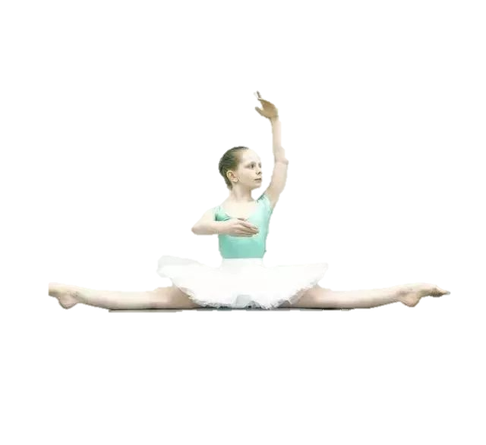
内容：主题意义要突出
形式：语言句式要漂亮
方法：收尾最好有呼应
主题升华句
1. 我明白了只有毅力和努力才能通向成功。
_______________________________________________________________
2. 那时我才意识到，我们永远不能低估坚持和努力的力量。
_________________________________________________________________
_______________________
3. 最重要的是，我明白了，有志者事竟成。
______________________________________________________
4. “正是你的毅力和努力才起了作用!”史密斯太太笑了。
_____________________________________________________Mrs. Smith laughed.
5. 相信自己，尽自己最大的努力，迟早你会证明自己!
__________________________________________________________________
It dawned on me that only perseverance and efforts could lead to success.
Only then was I aware that we should never underestimate the power of perseverance and efforts.
Above all, I learnt that nothing is impossible to a willing heart.
“It is your perseverance and effort that make a big difference!”
Believe in yourself and try your best, and you will prove yourself in time!

Slide 9
主题升华句
6. 不要让失败阻碍你的进步，因为你永远不知道你离成功还有多近。
________________________________________________________________
___________________________________________________________
7. 每当你想要放弃的时候，记得告诉自己:“我能行!”
_______________________________________________________________
8.看到闪烁的奖牌，我意识到奋斗的本质------坚持和决心。我会把它们记在心里，战胜成功路上的所有障碍!
_______________________________________________________________________________________________________________________________________________________________________________________________
9. 学校合唱团的宝贵经历无疑对我产生了终生的影响，成为我人生中最重要的事件。____________________________________________________________________________________________________________________________________
Don’t let the failure arrest your progress for you will never know how close you are to success.
Every time you want to give up, remember to tell yourself, “I can make it!”
Seeing the blinking medals, I came to realize the essence of struggling------persistence and determination. I will keep them in my mind and overcome all the obstacles in my way to success!
The precious experience in the school choir undoubtedly had a life-long impact on me, which became the most important event in my life.

Slide 10
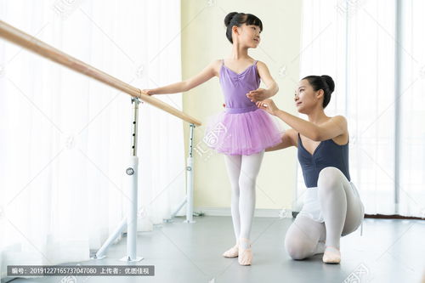
基于原文伏笔和段首句
推理 确定情节走向

Slide 11
阅读下面短文，根据所给情节进行续写，使之构成一个完整的故事
Looking back at my life, I found that the most important event occurred when I was in 4th grade.
From the beginning of the semester, I started learning dancing every Saturday, but I didn't do well in the first few months. Mrs. Smith, my dancing teacher, also my music teacher in my school, kept teaching me and helped me with every movement But it always enhanced too slowly. I began to give up and canceled this class. Few days later, we had a music class at school. We sang songs while Mrs. Smith was playing piano. The beautiful melody suffused (the whole classroom. Everyone was very earnest, looking up the teacher and following the rhythm. Although I was not good at singing, I was singing really hard. All the things in this classroom seemed very harmonious.
We had a free class after singing. We just sat on our chairs and talked to each other. And Mrs. Smith started to talk about the school choir that she led very well.
I've seen some members before, who are excellent and graceful. I was imagining if one day I join in the school choir that will be really awesome: we have competitions every month; we do great performance every time; we get popular in our school. Those were just my imagination. I don't think one day I can be one of the dancers. Just then, Mrs. Smith said my name in the class, "Angelina was in my dancing class. She was really hard-working and tough.
I hope she could rejoin in my class and practice more to be a member of the school choir."
Everyone turned back and looked at me with amazed face. I flushed tomato red. Mrs. Smith was pleased to laugh. We had a really silent moment. And then the bell rang, the students began to leave. There's a girl walking up to me with some of her friends. Her name is Carrie, who is a piano player and also recommended to join the school choir. She faced me, and said to her friends: "Do you think she really can join the school choir? It's unbelievable!” Her friends threw her a faint smile. I didn't even react for this brief moment, and they left.
Paragraph1: Within the time, I felt that there's a strong force striking my pride.
Paragraph 2: Finally, because of my perseverance and efforts, I joined the school choir.
寻找伏笔要基于主题

Slide 12




基于原文伏笔和段首句
推理 确定情节走向
I sang hard in a music class
I didn’t do well
in dancing and gave up the class.
I had an imagination of joining the school choir
With perseverance and efforts, I made it.
an important
event
I felt angry and decided to prove myself.
Mrs. Smith encouraged me to rejoin her class and practice more to join the school choir
Carrie laughed at me.

Slide 13
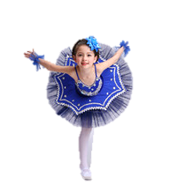
构建小情节
展开细节描写

Slide 14
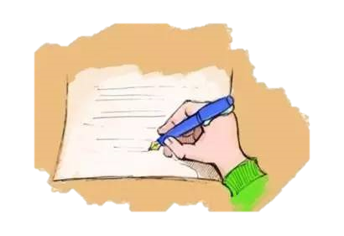
Para.1 被Carrie和她的朋友嘲笑后,我的骄傲被打击
快速设计情节
小情节 1. I was angry and I decided to prove myself.
小情节 2. I rejoined Mrs. Smith’s class and got her help.
小情节 3. I began to practice hard and made progress.
Paragraph 2 最后，因为我的坚持和努力，我加入了学校合唱团。
小情节 4. My imagination came true and I was proud and excited.
小情节 5. Carrie’s reaction to my admission into the school choir.
小情节 6. What I learned from this event.

Slide 15
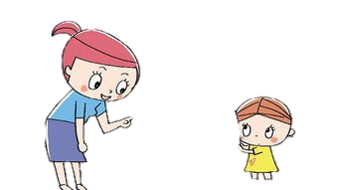

细节描写: 小情节 1. I was angry and I decided to prove myself.
郁闷笼罩着我，我不知道该怎么办。嘉莉的话萦绕在我心头，促使我
做出决定:“我必须重新参加舞蹈课。”
Depression __________me, I didn’t know what to do . Carrie’s words _______
me, _____________________________：“I must rejoin the dance class.”
2. 我咬紧牙关，握紧拳头，心中闪现出一丝愤怒夹杂着灵感。
____________________________________, I was conquered by a flicker of anger mingled with inspiration.
3. 一眨眼的功夫，我就下定决心要毫不犹豫地加入学校合唱团。
________________________, I made a determination that I must join in the school choir_________________________________.
enveloping
haunted
urging me to make a decision
Gritting my teeth and clenching my fists
In a blink of an eye
without the slightest hesitation
4. 我呆若木鸡。我说不出话来，但泪水湿润了我的眼眶。
I was glued to the spot. I failed to utter something but tears wetted my rims of eyes.

Slide 16
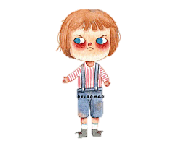
5. 我鼻子里喷着热气，脸涨得通红，我向史密斯太太求助。
With_____________________________________, I turned to
Mrs. Smith for help with tomato red face.
6. 一种尴尬和烦恼的混合情绪淹没了我，使我陷入了悲伤的深渊。
A mixture of __________________________________overwhelmed me, which plunged me into the depth of sadness.
7. 回想到嘉莉那些无礼的话，我感到我的尊严被一股羞耻感的情感海啸摧毁了。
______________Carrie’s offensive words, I sensed my dignity ___________by an emotional tsunami of shame.
8.尽管我突然有想把她撕成碎片的冲动，但我克制住了自己。冷静下来后，我问自己:“我加入学校合唱团真的难以置信吗?”
_______________________________________________, I contained myself .
After______________________, I asked myself,“Is it really unbelievable for me to join the school choir?”
hot breath blowing from my nostril
embarrassment and annoyance
Reflecting on
shattered
Despite the sudden impulse to tear her into pieces
calming myself down

Slide 17
小情节 2. I rejoined Mrs. Smith’s class and got her help.
最后，我发现自己站在史密斯夫人面前，恳求她:“我可以
重新参加你的舞蹈课吗?”
2. 带着证明自己的强烈愿望，我冲到史密斯夫人的办公室，用颤抖但坚定的语气问她:“我可以重新开始学习舞蹈吗?”让我松了一口气的是，她盯着我的眼睛点点头:“好吧，每个星期六都照常。”
Finally, I found myself ________in front of Mrs. Smith, ________her, “Can I rejoin your dance class?”
standing
begging
With__________________________, I rushed to Mrs. Smith’s office ______ I asked her_______________________,“Will I restart learning dancing?”___________, she stared at my eyes and_______,“Ok, every Saturday as usual.”
the burning desire to prove myself
where
in a shivering but firm tone
To my relief
nodded

Slide 18
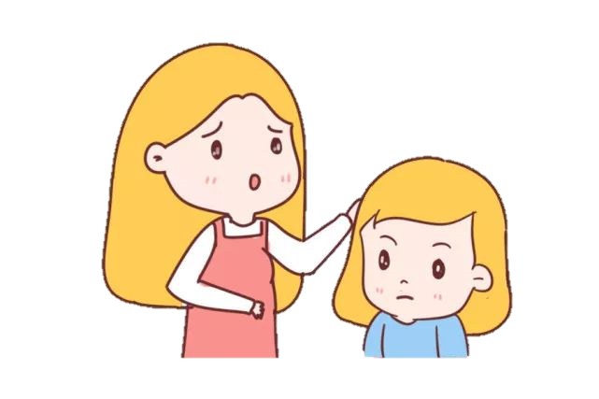
小情节 2. I rejoined Mrs. Smith’s class and got her help.
3. 看到我阴沉的脸，她问发生了什么事。她知道了整个事情和我的想法，抚摸着我的头，安慰我:“只要相信你自己。我会在这里一直帮助你。”
At the sight of my cloudy face
__________________________, she asked what had happened.
______________the whole thing and my thoughts, she_____________, _______________,“Just believe in yourself. And I’m always here helping you.”
Having known
stroke my head
soothing me

Slide 19
首段尾句衔接
小情节 3. I began to practice hard and made progress.
时间飞逝。通过大量的练习，我取得了巨大的进步，我的舞蹈技能突飞猛进。
2. 尽管很困难，我还是一有空就练习每一个舞蹈动作。
3. 渐渐地，经过无数次的练习，我变得熟练了。每次我在舞池里移动，我都觉得自己像一只白天鹅，优雅而轻盈，我对失败的恐惧被自信所取代。
flew
Time________. I ____________________through practicing a lot and my dance skills______________.
made giant progress
rocketed
Tough as it was
practicing
__________________, I kept _____________every dancing movement _______________________.
whenever I was available
countless
Gradually, with ____________practice, I became skilled. Every time I moved in the dance pool, I felt like a white swan, _________________. My fear of failure ____________confidence.
graceful and light
gave way to

Slide 20
小情节 3. I began to practice hard and made progress.
首段尾句衔接
4. 经过几周的练习，我很高兴地发现我为舞蹈打好了坚实的基础，这让我有足够的信心申请加入学校合唱团。
After weeks’ practice, I _____________________that I ___________________________ dancing, which ______________________________________________join the school chorus.
5.在她的话的鼓舞下，我更加努力地训练。我额头上渗出的汗水见证了我的努力，终于得到了回报。
____________________, I trained even harder. The _______________from my forehead ___________________and it finally____________.
6. 我重新开始了周六的舞会。 然而，这并不是小菜一碟。 停止跳舞几天后，我的动作变得僵硬，甚至更加笨拙。 嘉莉的话掠过我的脑海，我心想:“这不是难以置信的。 我能做到!” 我决心把舞跳得更好，于是埋头苦练。
I restarted the Saturday dancing. However, it was not________________. Stopping dancing for a few days, my movements became__________________________. With Carrie’s words ____________________________in my ears, I thought to myself,“It’s not unbelievable. I can make it!”__________________ better, I _________________ practice.
was delighted to find
had laid a solid foundation for
allowed me to have enough confidence to apply to
Inspired by her words
oozing sweats
witnessed my efforts
paid off
anything but easy
a piece of cake
stiff and even more clumsy
ringing/ buzzing/humming
Determined to dance
buried myself in

Slide 21
小情节 3. I began to practice hard and made progress.
首段尾句衔接
注意最好能与原文有情节和语言上的呼应
7.我开始把我所有的精力和注意力放在练习上。渐渐地，我的技能惊人地提高了。我僵硬的胳膊和腿变得伸展起来，我笨拙的动作变得自由、流畅、有力和优雅。
I began to _________________________________the practice. Gradually, my skills____________________. My _______arms and legs became _________ and my ________movements became ______________________________.
8.我全心投入了艰苦的训练。这种全神贯注的状态让我陷入了忘记了时间，甚至忘记了自己的状态。（go all-in on, sink into, lose the track of）
I ________________the tough practice. Such a state of total ____________
_______________ ___________________where I _________________ and even forgot myself.
9.虽然当我完成每天的练习时我的肌肉疼痛，我的膝盖颤抖，我从来没有想过要放弃。 Although ________________________________________when I finished daily practice,______________________________________.
put all my energy and attention on
enhanced amazingly
stiff
stretching
clumsy
free, smooth, powerful and graceful
involvement
and concentration
went all--in on
sank me into a state
lost the track of time
my muscles were aching and my knees shaking
never did I think about giving up again

Slide 22
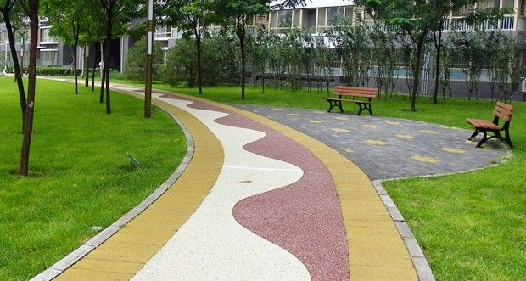
Para.2 Finally, because of my perseverance and efforts, I joined in the school choir.
小情节 4. My imagination came true and I was proud , excited and thankful.
小情节 5. Carrie’s reaction to my admission into the school choir.
小情节 6. What I learned from this event.

Slide 23
小情节 4. My imagination came true and I was proud , excited and thankful.
1.听到这个消息，我闭上眼睛，努力不哭出来让眼泪顺着脸颊滚落。
_________________, I closed my eyes, trying not to cry out ______________________________
2.收到这个令人激动的消息，我几乎要哭了。我的坚持和努力得到了回报!
Receiving the thrilling news, I was_____________________.
_________________________________________!
3. 一种强烈的自豪感涌上我的全身。
A strong feeling of pride________________________________.
4. 消息传来的那一刻，我所有的疲惫都被无尽的兴奋和骄傲所取代。我昂着头，满怀信心地走进排练室。
____________the news arrived, all my tiredness and fatigue _____________no-edge exhilaration and pride. With my head___________, I stepped into the rehearsal room ________________________.
5. 当我从史密斯太太那里得到这个消息时，言语无法表达我的兴奋和喜悦。
______________________my exhilaration and rapture when I got the news from Mrs. Smith.
Hearing the news
with tears rolling down my cheeks.
on the verge of tears
My perseverance and efforts paid off
surged through my whole body
The instant
gave way to
raised high
full of confidence
Words failed to convey

Slide 24
小情节 5. Carrie’s reaction to my admission into the school choir.
1. 当我走进舞厅时，我看到了嘉莉那有趣的表情——下巴耷拉下来，大眼睛瞪得大大的。她的喉咙似乎咕哝一声但没说出话。
As I stepped into the dancing room, ________________was Carrie’s amusing expression---_____________and____________________. Her throat seemingly _________but no words came out.
2. 令我吃惊的是，嘉莉走上前，红着脸向我道歉:“我为我之前说的话道歉。你很有才华，可以加入合唱团。”
Much to my surprise, Carrie __________________________________________, “I’m sorry for my previous words. You are talented enough to join the choir.”
3. 比赛开始时，我们做了一场非常精彩的表演:转身、跳跃和移动，为此嘉莉目瞪口呆。
When the competition began, we did a really great performance:
__________________________,____________________________.
4.知道我成功了，她脸红了，为她的无礼向我道歉。
Knowing my success, she____________________________________________.
into my sight
jaw dropping
big eyes popping out
grunted
stepped forward and apologized to me with a tomato red face
turning, leaping and moving
for which Carrie’s jaw dropped
flushed red and apologized to me for her impoliteness

Slide 25
小情节 6. What I learned from this event.(最好能主旨升华)
1. 没有她的慷慨帮助和我的坚持， 我永远不会把我的想象变成现实。
2. 我认为成为学校合唱团的一员对我来说是最重要的事情，因为它证明了努力工作的重要性。如果你不遗余力地去做一件事，没有什么是不可能的。
I thought being a member of the school choir was the most significant event to me ___________________________________________________________________. And___________________________________________________________.
3. 是史密斯夫人帮助我认识到坚持不懈的重要性，也是她鼓励我挑战自己来实现目标。面对失败永远不要退缩，否则你永远不知道你离成功还有多近。
It was Mrs. Smith __________________________________________________and it was also she_______________________________________________________________.
_________________________________, and you will never know how close you are to success.
4.这段难忘的经历见证了我的成长----我意识到，通过艰苦的努力和坚持，我们将有美好的前景。The unforgettable experience ______________________---I was aware that through ________________________________, there will be_________________________________.
Without her generous help and my perseverance, I would never have turned my imagination into reality.
as it demonstrated the vital importance of being hard-working
nothing is impossible if you spare no effort to do a thing
who helped me the importance of perseverance
who encouraged me to challenge myself to achieve the goal
Never shrink when facing failure
witnessed my growth
painstaking efforts and persistence
promising prospects in store for us

Slide 26
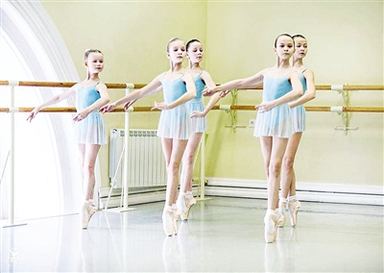
参考范文和
考场优秀作文

Slide 27
参考范文:
Within the time, I felt that there’s a strong force striking my pride. I was very angry and didn’t know what to do next. I stood up, walking out of the classroom. There’s no one else on the floor, just me. I walked very slowly with head down. The gentle breeze flicked my face. I stopped. There’s a strong voice coming from my mind, “Go back to the dancing class. Don’t give up until you get into the school choir, and you will prove to them that you can make it.” Later, I took the class again; I practiced every night.
Finally, because of my perseverance and efforts, I joined in the school choir. I did the same thing as I imagined before. Carrie was surprised about me. She said sorry to me at once. I just felt really happy and enjoyable during the rest of my school years in elementary school. At first, I was shy and lacked confidence, but afterward I was aspirant and strived really hard. I realized that I can do anything if I just put on more focus and working hard, don’t give up easily and try the best. I will never repent my final decision.

Slide 28
考场优秀作文1
Within the time, I felt that there’s a strong force striking my pride. At the
thought of Carrie and her friends laughing at me to my face, I was overcome by the urge to prove myself. My previous self-doubt gave way to the feeling of being overlooked. I rejoined the dancing class and turned to Mrs. Smith every time I had doubts with a single movement. She was patient and kind as usual While I was concentrated and careful. Over and over again, I practiced dancing after school, listening to the melodies, imitating facial expressions and managing to carve every motion into my mind. The following several months witnessed my stiff and clumsy figure turned softer and lighter. And eventually, I was capable of dancing smoothly and gracefully and then I signed up for the choir confidently.
Finally, because of my perseverance and efforts, I joined in the school choir. The first day I stepped into the classroom of the school choir , I discovered Carrie, standing among the other members, eyes glued to me, chins dropped. I enjoyed singing and dancing that day, and after class, Carrie turned to me. She shuffled up, flushed scarlet and said sorry to me. She apologized, “I shouldn’t have been so rude to you and could we become friends?”
A bright smile crept upon my face. I reached out my hands for her. Then, over the next period of time, we did great performances together and got popular in our school. Reflecting on the experience, I was grateful to her somehow. After all, it was she that helped me taste the sweet of perseverance.
情节合理
抓住伏笔点有回扣
细节生动语言丰富准确地道
主题有升华

Slide 29
考场优秀作文2
Within the time, I felt that there’s a strong force striking my pride. Reflecting on Carrie’s offensive words, I sensed an emotional tsunami of rage and unyielding dignity washing over me.“Never will I fail!”I swore to beat her, changing her mind. From then on, I rejoined Mrs. Smith’s dancing class with blazing determination. Delighted to see my presence, she offered to transform me, a stiff wood into a graceful swan. However, I was still unable to adjust my movements to follow the rhythm. One day, when I was frustrated and leaning against the window, I was inspired by a tiny bird stretching its swings to embrace the sky. Suddenly, I felt something changed in my body, I made an attempt to move like the bird, twittering and gliding and integrating myself into the music. Not only did I make it, but also put more practice in it . Then I kept practicing day after day.
Finally, because of my perseverance and efforts, I joined in the school choir. The instant the news came, all my tiredness and fatigue gave way to no-edge exhilaration and pride. The next day, I stepped into the rehearsal room, with my head raised up. There stood Carrie, her chaw opening wide and her eyes popping out! What an amusing expression! With the tongue tied and her face tomato red, she came up to me and apologized to me, “I’m really sorry and I take back what I said! Can I play the piano for your dancing?” I nodded and hugged her. To be frank, she played wonderfully, holding me entirely in her music. Amazingly, my imagination came true : we did have competitions every month; we did great performance every time; we got popular in our school! To my great surprise, Carrie became my good friend, the precious experience in the school choir undoubtedly had a life-long impact on me.
情节合理
抓住伏笔点有回扣
细节生动语言丰富准确地道
人物形象鲜明
主题有呼应

Slide 30

读后续写的
优秀表达
1
3
适当使用动作链
She shuffled up, flushed scarlet and apologized to me.
适度使用非谓语，with结构
Reflecting on the experience, I was grateful to her somehow.
The next day, I stepped into the rehearsal room, with my head raised up.
找准时机收尾， 结尾要精心设计
Only then was I aware that we should never underestimate the power of perseverance and efforts.
适当使用修辞手法（比喻，夸张，无灵主语等）
The following several months witnessed my stiff and clumsy figure turned softer and lighter.
She offered to transform me, a stiff wood into a graceful swan.
长短句（单句和从句）交替使用
There stood Carrie, the previous princess, her chaw opening wide and her eyes popping out! What an amusing expression!
2
4
5

Slide 31

考生典型错误分析
情节方面
考生典型错误分析
语言方面
内容方面
主题方面

Slide 32
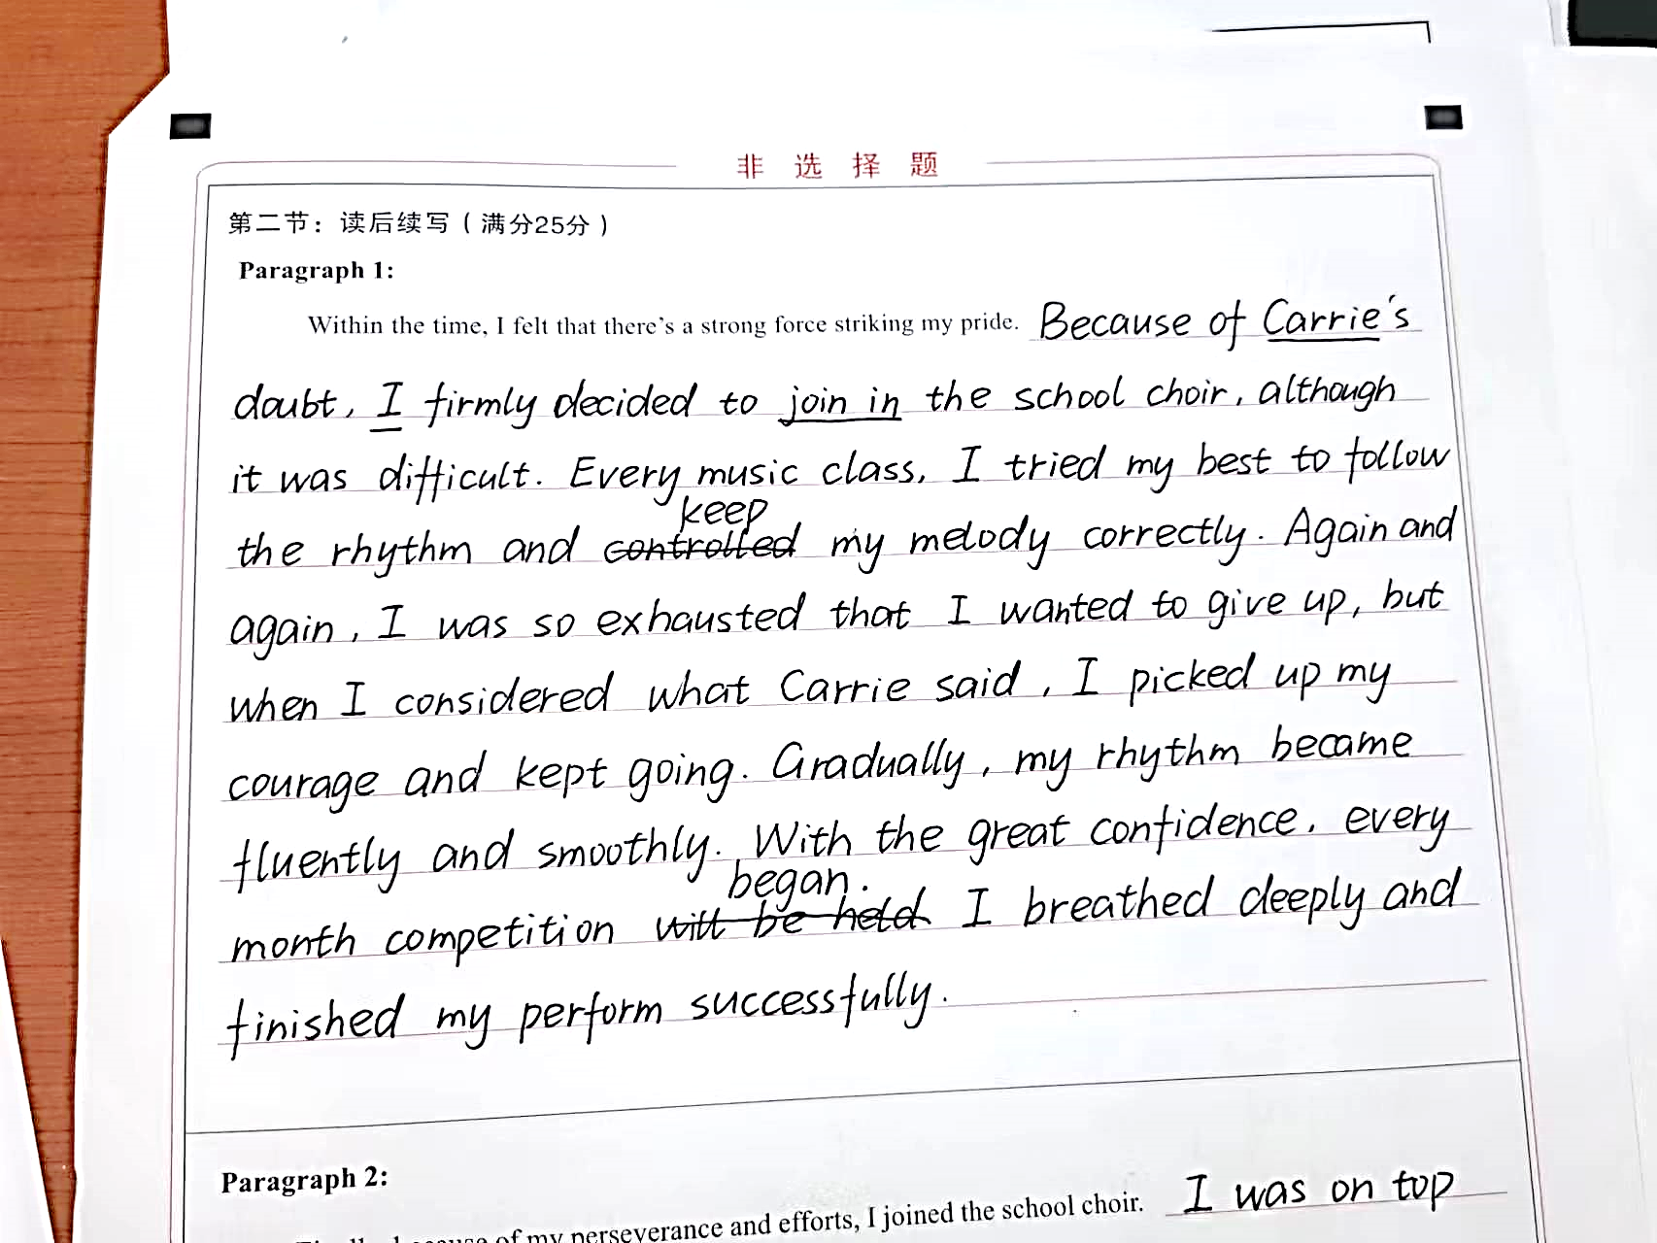
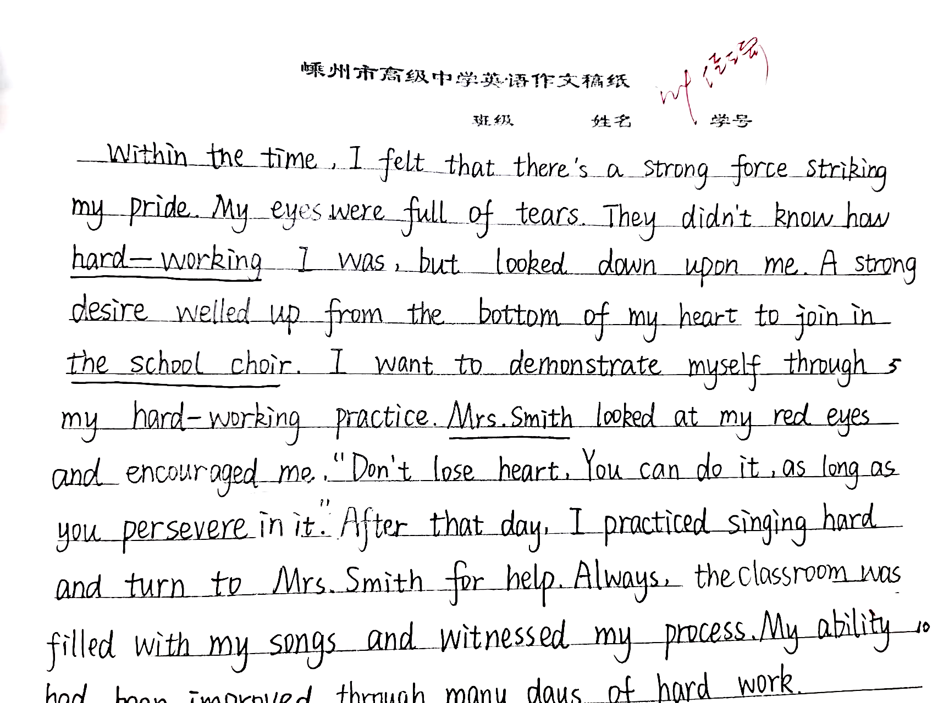
01情节方面
备考建议
领会主题，抓对伏笔点，根据原文已知条件去设计情节解决问题
参加比赛是作者想像成为合唱队成员后的活动，根据第二段段首句，作者通过努力练习成为成员，把第二段的情节提前。部分同学未能解读原文中的伏笔，没注意与第二段段首衔接，导致情节不合理。
原文作者因为”enhanced too slowly ”I began to give up and canceled this class“,
不能说很努力却被看不起，不根据原文已有元素，导致情节不合理。

Slide 33
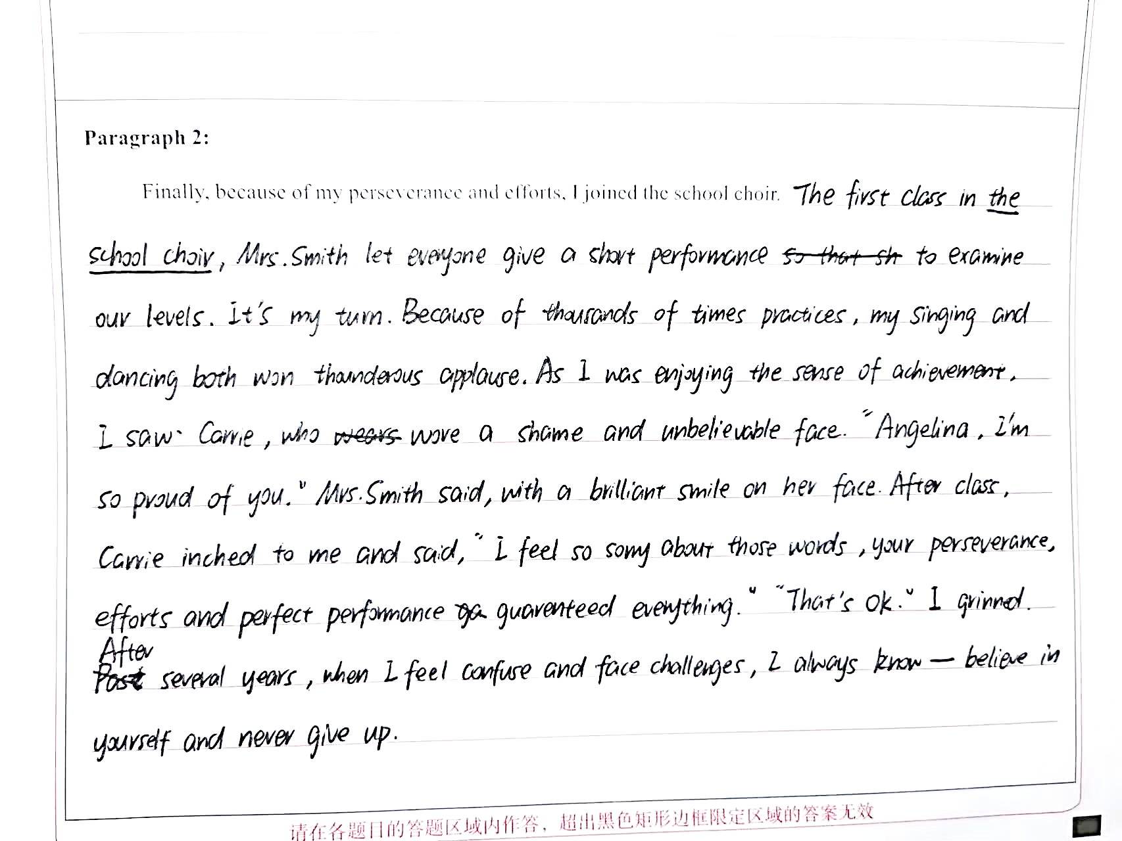
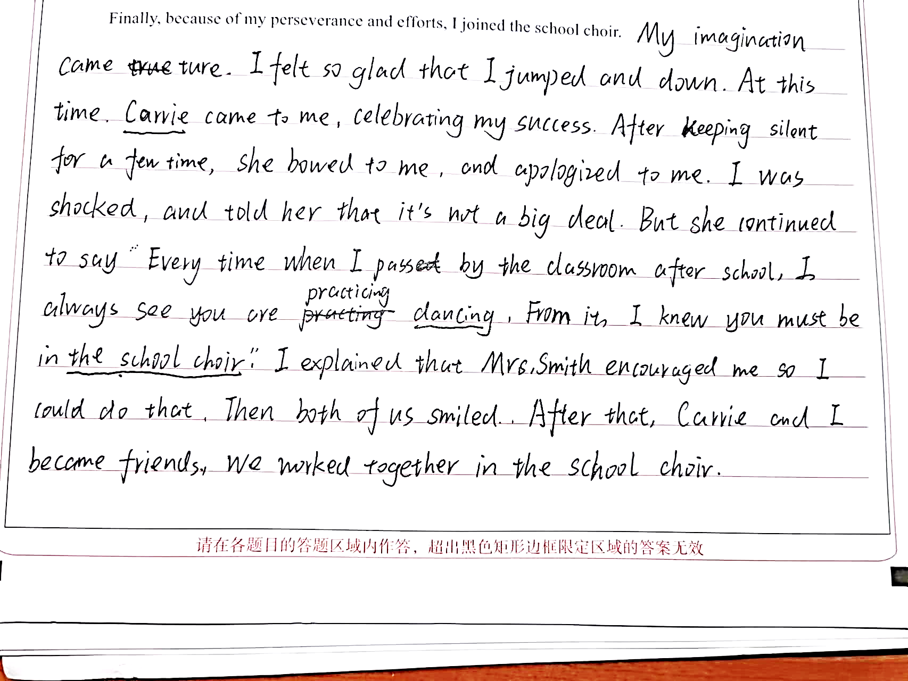
02内容方面
对话较多，详略不当。部分同学对话内容生硬，或不符合说话者的身份性格。Carrie和我是四年级的小女孩，不可能说出长辈一样的大道理
备
考建议
把握原文人物的身份和性格，言行要符合人物身份，突出人物性格和主旨。

Slide 34
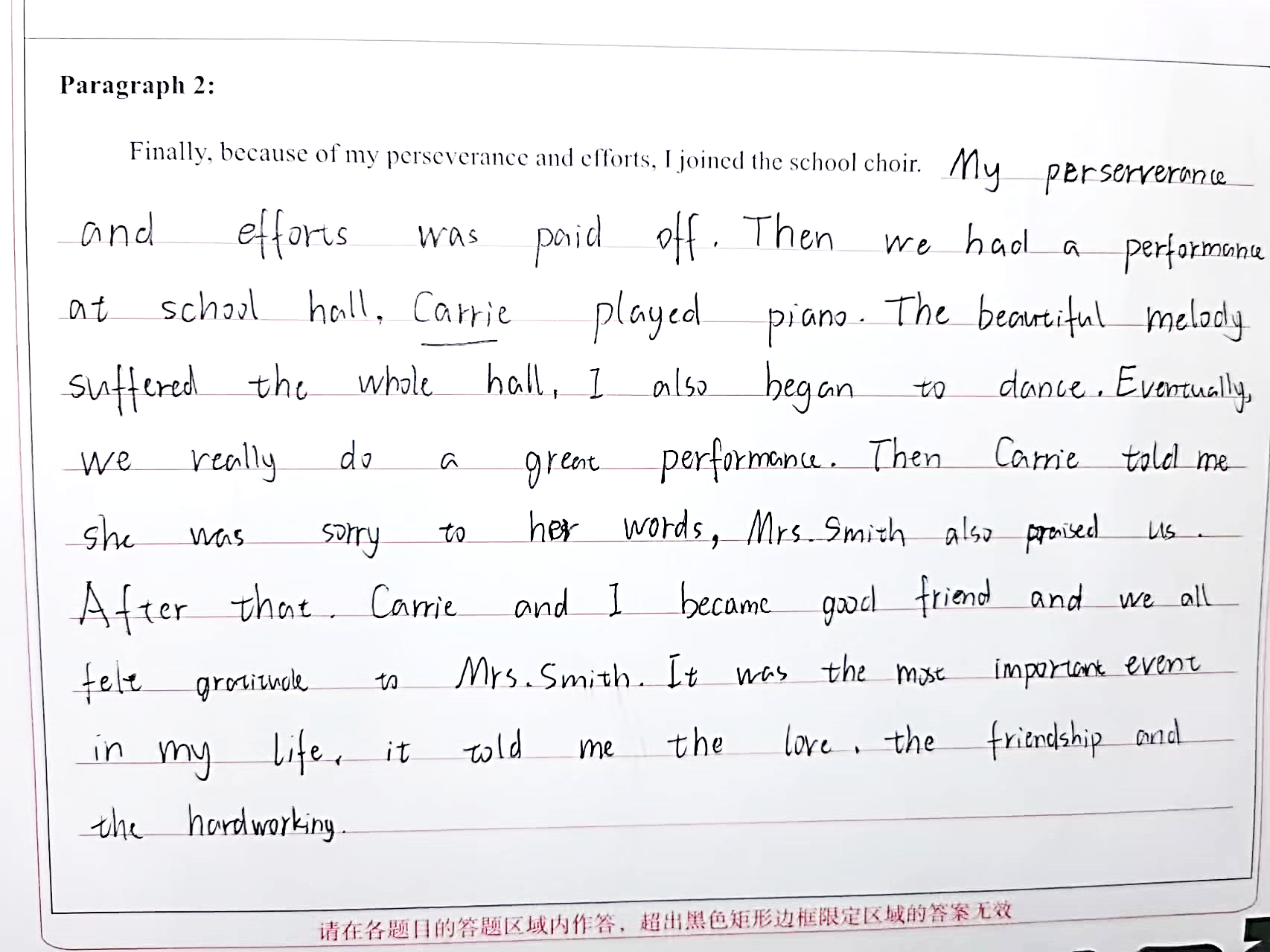
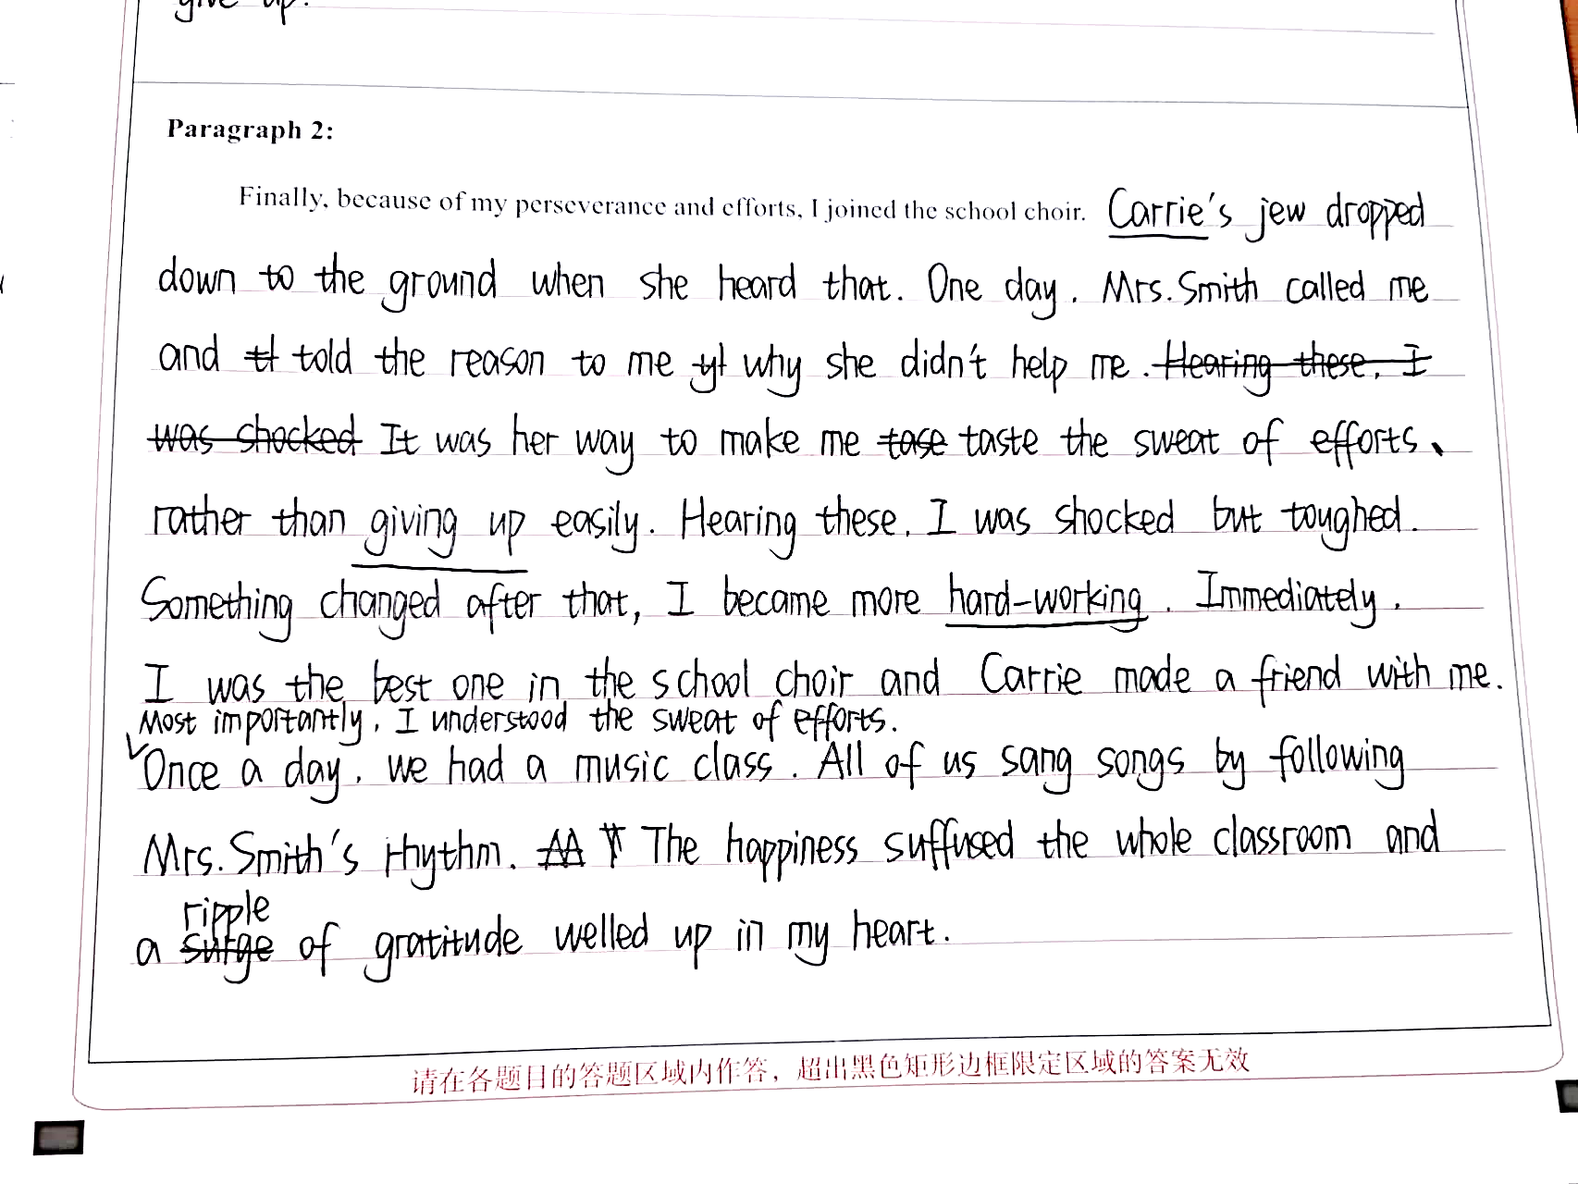
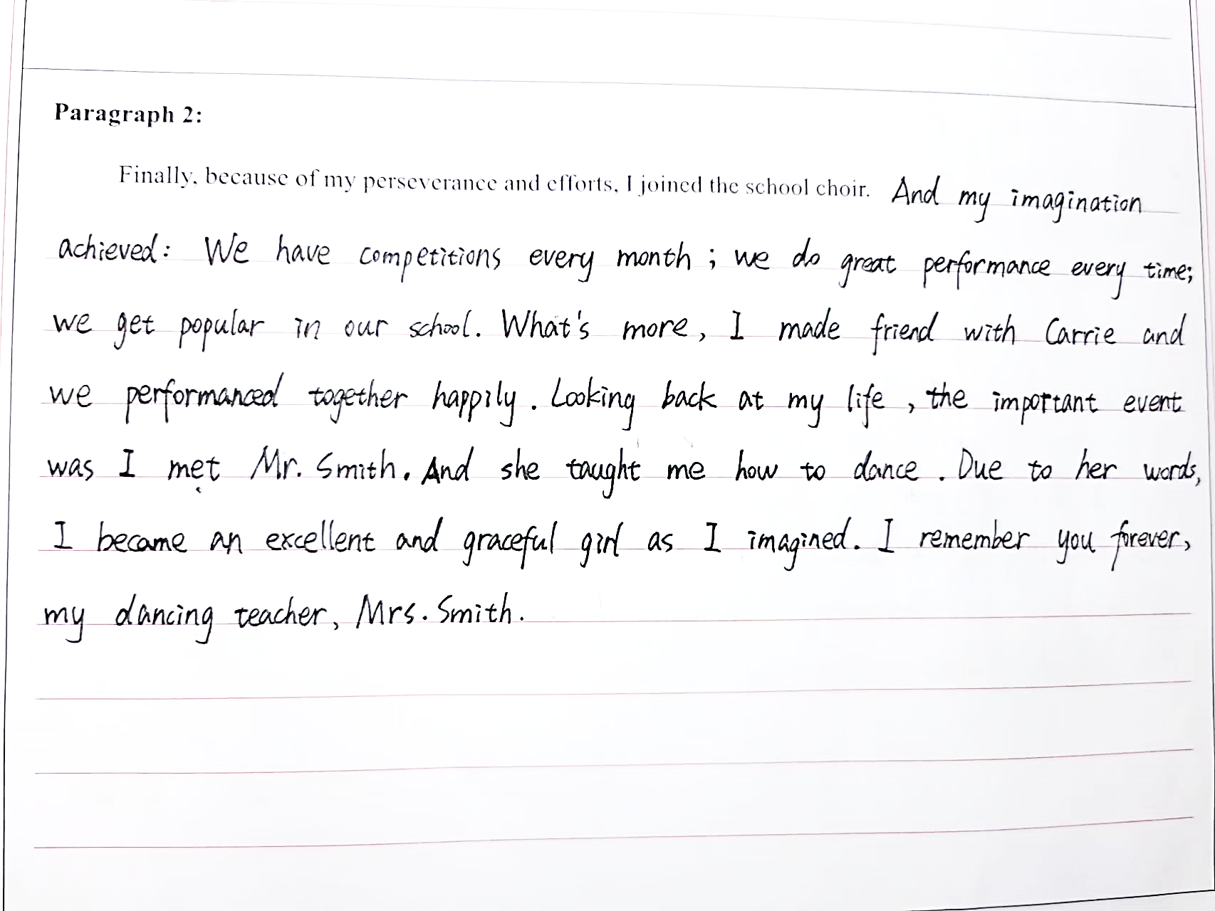
03主题方面
本文的主题：坚持和你努力能克服困难走向成功。而不是爱，友谊和感恩。
备
考建议
抓住原文的主旨，特别是的一些感悟议论方面的词汇

Slide 35
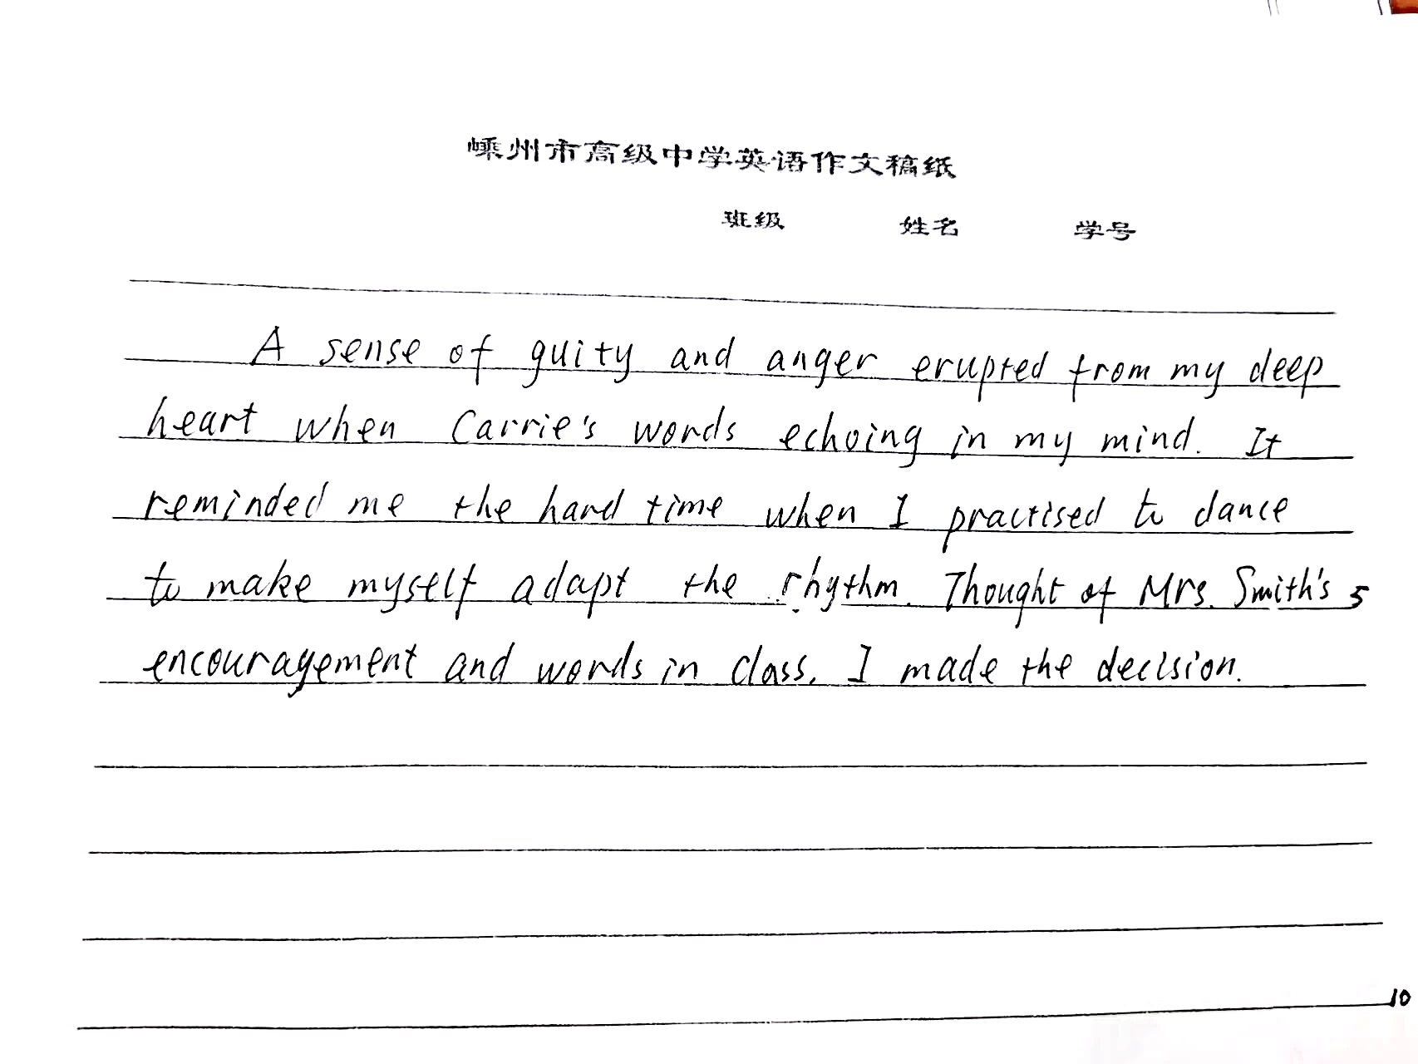
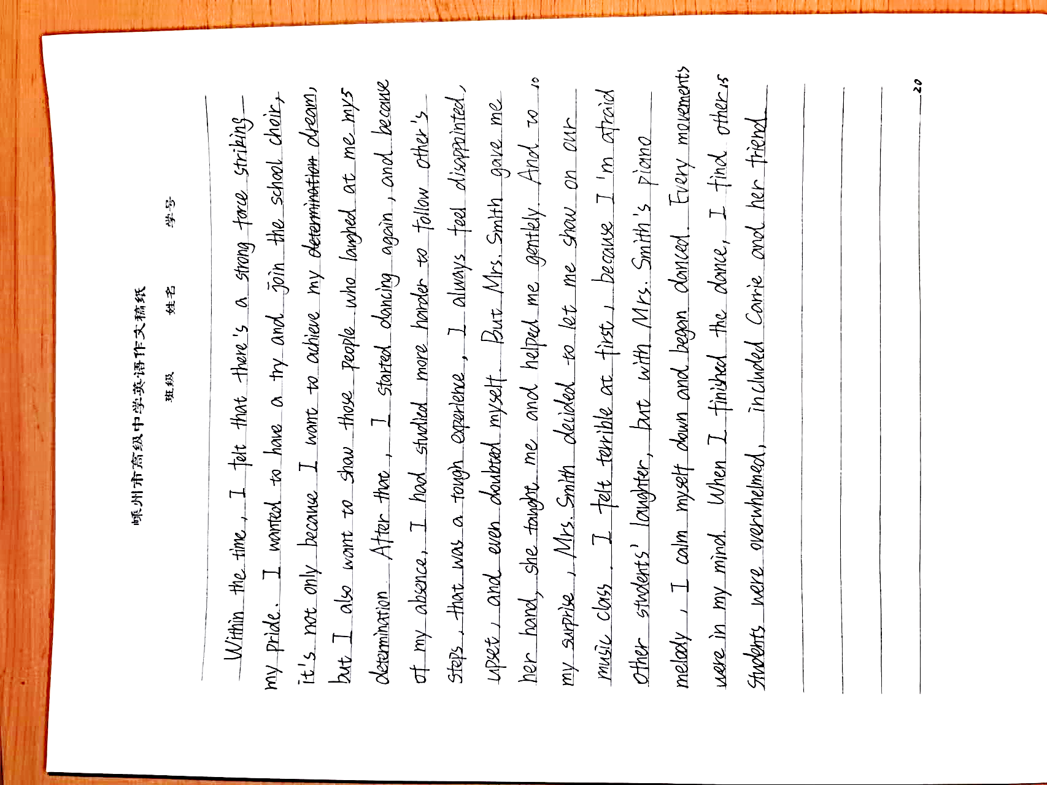
04语言问题
最易失分的语言错误
语言的准确性不够
动词形式的错误
词性的错误；词的搭配
基础词汇的拼写错误
2. 语言不地道
有明显的中式英语的痕迹
备
考建议
写好简单句，夯实语言基础，消除常见的低级错误；先写对
适当运用亮眼的词汇、句型。再写好

Slide 36
04语言问题
3. 与原文的文风不搭
部分考生词汇量大，过分追求所谓的高级词汇，长句过度，读起来非常累，有炫耀之嫌。
备考建议
尽量与原文的文风一致
长短句结合，学会小词大用。
Within the time, I felt that there’s a strong force striking my pride. Flushing tomato red, I strode briskly towards Mrs. Smith, pleading her for an opportunity to join in the school choir. With a radiant smile, Mrs. Smith nodded in satisfaction and required me to practice every day. The thought of giving up gave way to dogged determination. However, to start with, I crouched down spontaneously in a corner and squeezing my clothes simultaneously with a horrible feeling within my mind due to my poor dancing. Seeing this, Mrs. Smith would make way to me and motivated me softly in hope of seeing me promoted. As if magic, never before had I experienced such reassuring scene, my anxiety shattered into million pieces and summoned up my courage to plough on.

Slide 37

相似“成长”类续写

Slide 38
成长类型
“What’s wrong with you, dear?" said Granny Bell to a little boy, who sat near a wall at the back of her house. He had a book in his hand, and tears were in his eyes.”
“We have all got a poem called Little Jim to learn," said the boy, whose name was Tom Blair; "and the one who says it best is to get a prize from the master. But I don't think I can learn it."
“Why not?" said Granny Bell.
“The boys say that I can't, and that I need not try," said Tom in a sad tone.
Don't mind what the boys say. Let them see that you can learn it," said his friend.
“But I don't think I can," said Tom, "it is so long, and some of the words are so hard. I know I need not try for the prize. But I should like to learn the poem as well as I can; for the boys laugh at me, and call me 'Slow Tom.'
“Well, dear," said the dame, in a kind voice, "if you are slow, and can't help it, try to be 'slow and sure,' as they say. Look at the snail on the wall; how slow it is! And yet, if you watch it, you will see it will get to the top in time. So just try to learn a few lines each day, and you may gain the prize in the end. And when you feel like losing heart, think of the snail on the wall."
When Granny Bell had said this, she went on her way. And Tom thought that (though he could not keep up with the boys) he might run a race with the snail. So he determined to try to learn his task, by the time the snail got to the top of the wall.
Paragraph 1:At last, the day came on which the master was to give the prize, and after he called up five or six boys to repeat the poem, it came to Tom's turn. ____________________
Paragraph 2:“Well done. Tom. Well done. Tell us how you made it!” said the master with great joy. _____

Slide 39
参考答案:
At last, the day came on which the master was to give the prize, and after he called up five or six boys to repeat the poem, it came to Tom's turn. His heart was beating wildly. He was even tripped by a chair on his way to the front and nearly fell to the ground. Ignoring all those noises, he took a deep breath, filling his lungs with courage and confidence. The moment Tom opened his mouth and let words pour out in incredible fluency, he sank into his own world. Not until he finished the task did he notice the boys who once laughed at him and called him “slow Tom” gazing at him with their mouths open.
“Well done. Tom. Well done. Tell us how you made it!” said the master with great joy. “Please, sir, it was the snail on the wall that taught me how to do it," So Tom shared the competition he engaged against the snail and how the determination helped him in days looking up the words and struggling to make his pronunciation right. Overwhelmed by his persistence and courage the boy exhibited, the master announced the prize should go to Tom, not only as a reward for his wonderful performance, but also as a recognition for his belief in “slow and sure” attitude.

Slide 40

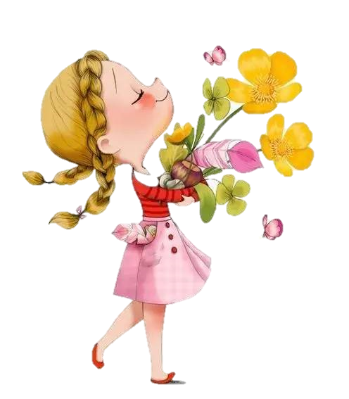
With perseverance and efforts, you can make it!
Thank you!

