Slide 1

感恩遇见，相互成就，本课件资料仅供您个人参考、教学使用，严禁自行在网络传播，违者依知识产权法追究法律责任。
更多教学资源请关注
公众号：溯恩高中英语
知识产权声明

Slide 2

2022年6月8号全国乙卷听力精听课件
瑞安新纪元高中
焦海滨老师制作

Slide 3
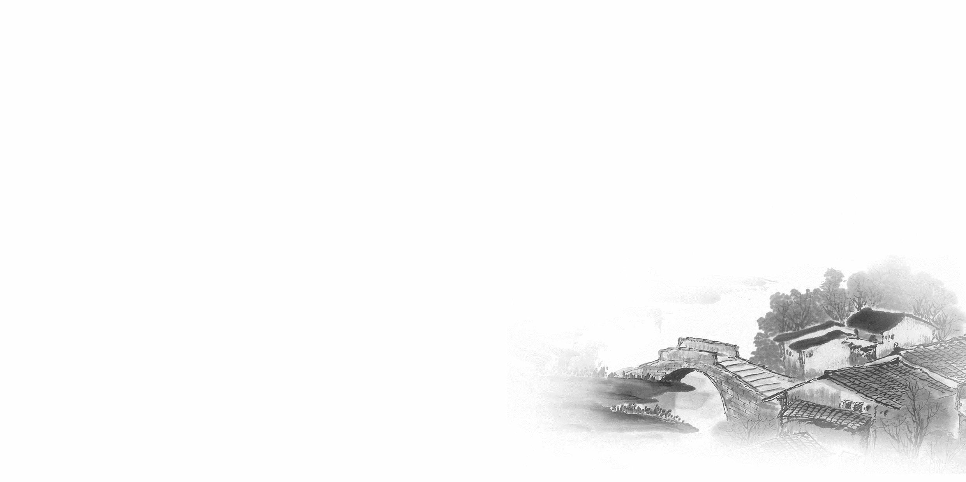

影响听力的因素
心理因素学生在进行听力练习或考试时往往表现为听音时感到紧张、焦虑因而导致无法正常听音。
壹
缺乏背景知识由于没有语言环境，学生很少了解听力材料中的背景知识，无法做出正确的判断、推理、猜测。
贰
叁
学生缺乏听力解题技巧研究发现，很多情况下由于听者未能掌握相关的听力技巧，因而不能很好地理解听力材料。
肆
词汇储备不足一个学生的听、说、读、写要达到一定的水平，必须拥有相应数量的必备词汇。

Slide 4

语音知识对听力的影响
在听力理解的过程中，语音是第一位的，听者首先接受的是语音信息，大脑接受了因素，音节，中音等因素构成的单词，短语和句子后使他们在自己的语言图式中“对号入座”，根据已有的知识结构( 图式 ),开始对该信息进行建构，以理解其意义。

Slide 5
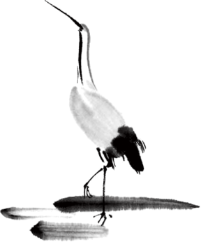
语速的加快主要有一下三种原因
壹
贰
叁
连读
（ 以下用红色标记 )
省音
（ 以下用蓝色标记 ）
音变
（以下用黄色标记 ）

Slide 6


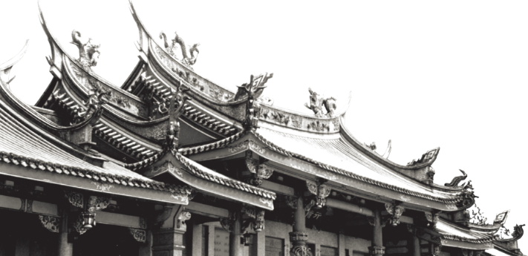
一，连读 （ 以下用红色标记 )
1，“辅音+元音”型连读（异性相吸）
如：I’d like another bowl of rice.
2、“辅音+半元音”型连读英语语音中的/j/和/w/是半元音，如果前一个词是以辅音结尾，后一个词是以半元音，特别是/j/开头，此时也要连读。Thank you .

Slide 7

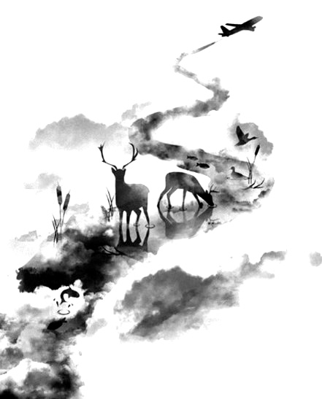

二，省音 （以下用蓝色标记）
01
壹
一、爆破音/b/ /p/ /d/ /t/ /g/ /k/
1.以上任何一个爆破音后面如果紧接着是一个辅音或者半元音，那么这个爆破音将不再发音，仅空半拍就行。如：Good morning!可以发为/gu_'mɔ:niŋ/。
2.以上任何一个爆破音在句尾时，这个爆破音不再发音。如：Good night!最后的/t/音便不再发，整句话可读作/gu_nai_/。

Slide 8
省音 （以下用蓝色标记）
01
二、不完全爆破
① 爆破音中的任何两个爆破音相邻时，前一爆破音失去爆破。如：a big car等。
② 爆破音中的任何一个后接摩擦音f,h,x,sh,s,r时，前面的爆破音失去爆破。
如：I didn't say so.
③ 爆破音后接/t/， /d/， /tr/， /dr /时，前面的爆破音失去爆破。如：a great change等。
④ 爆破音后接/m/, /n/, /l/, /s/时，前面的爆破音失去爆破。如：a bit more expensive等。

Slide 9
省音 （以下用蓝色标记）
01
三、/s/-/z/ /ts/-/dz/ /∫/-/ ʒ / /t∫/-/ dʒ / /θ/-/ ð / ds发/dz以上任何两个音相遇，只读后面的那个音，而前面的音则省略不发。
如：Who is Stone?可把前面一个/z/省掉，只读作/hu i stəun /。

Slide 10
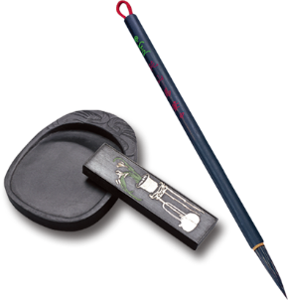
音的变化也是一种连读现象，两个词之间非常平滑的
过渡，导致一个音受临音影响而变化。
主要是以下两种方式：
1、 辅音[d]与[j]相邻时，被同化为[dʒ]：
Would you....?
2、 辅音[t]与[j]相邻时，被同化为[t∫]：
Can’t you？
三，音变
（以下用黄色标记 ）

Slide 11
听力试音材料
M:Hello ! International Friends Club , can I help you ?
W: Oh , hello ! I read about your club in the paper today . And I thought I’d phone to find out a bit more .
M:Yes , certainly . well , we’re a sort of social club for people from different countries . It’s quite a new club .we have about 50 members at the moment but we’re growing all the time .

Slide 12
听力试音材料
W: That sounds interesting .I’m British actually ,and I came to Washington about three months ago ,I’m looking for ways to meet people . . Er ,what kinds of events do you organize ?
M: well , we have social get-togethers ,and sports events ,and we also have language evenings
W: Could you tell me something about the language evenings ?

Slide 13
听力试音材料
M: Yes , every day except Thursday , we have a language evening. People can come and practice their languages .you know , over a drink or something .we have different languages on different evenings . Monday -Spanish; Tuesday- Italian ;Wednesday- German and Friday- French .On Thursday we usually have a meal in a restaurant for everyone who wants to come .

Slide 14
听力试音材料
W:well,that sounds Great , I really need to practice my French .
M: Ok , well if you can just give me your name and address I’ll send you the form and some more information .If you join now ,you can have first month free .

Slide 15


例题
M:Excuse me ,can you tell me how much the shirt is ?
W：Yes, it’s nine-fifteen.
例：How much is the shirt?
A. ￡19.15. B. ￡9.18. C. ￡9.15.

Slide 16

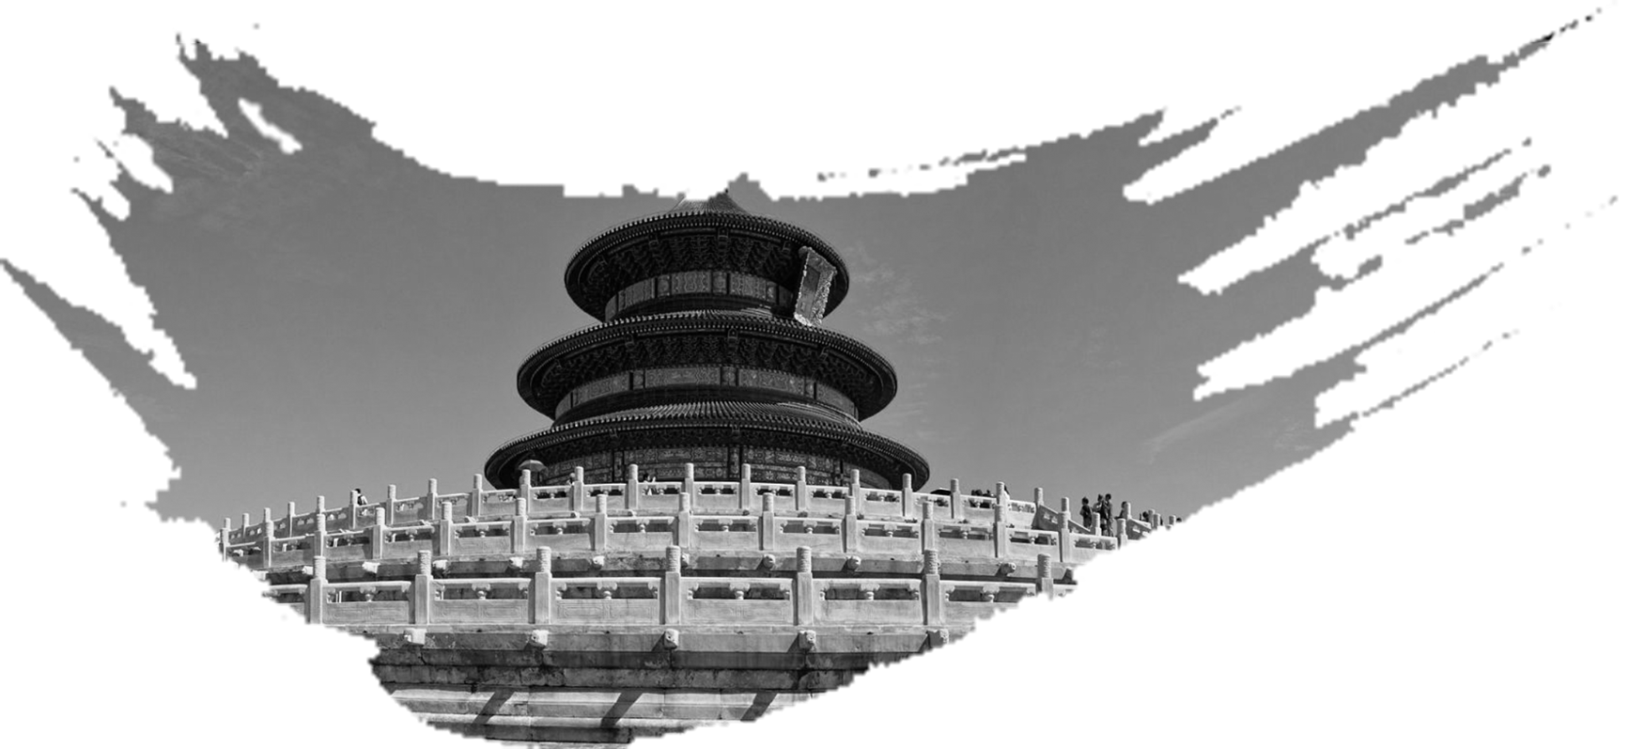
Text 1 搭便车
M:Jenny! You can just drop me here .
W:But we are two streets away from the office.
M:It's fine. I had a big breakfast and _____________.
1. What does the man want to do?
A. Have breakfast. B. Take a walk. C. Call his office.
重点词汇：drop sb 让某人下车

Slide 17

Text 1 搭便车
M:Jenny! You can just drop me here .
W:But we are two streets away from the office.
M:It's fine. I had a big breakfast and feel like a bit of walk.
1. What does the man want to do?
A. Have breakfast. B. Take a walk. C. Call his office.
重点词汇：drop sb 让某人下车

Slide 18
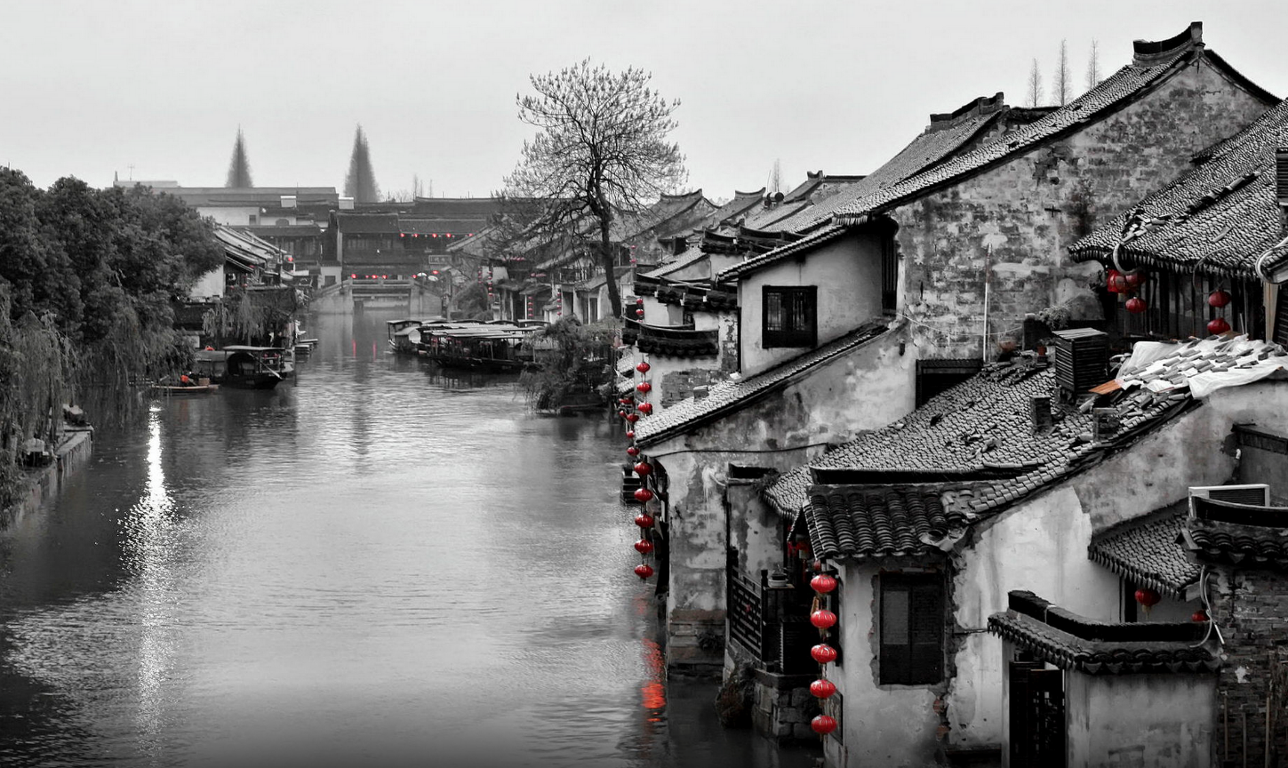
Text 2 赶工 期
W:Hello, George !You look tired, didn't sleep well last night .
M:No, not at all. I had to work flat out to _______________________ .Now I'm really feeling a bit rundown.
2. What was George doing last night?
A. Having a meeting.
B. Flying home.
C. Working on a project.
——————————

Slide 19

work flat out
全力以赴
feel a bit rundown
感觉有点疲惫
meet the project deadline
赶项目的最后期限
Text 2 赶工 期
W:Hello, George !You look tired, didn't sleep well last night .
M:No, not at all. I had to work flat out to meet the project deadline .Now I'm really feeling a bit rundown.
2. What was George doing last night?
A. Having a meeting.
B. Flying home.
C. Working on a project.
——————————

Slide 20
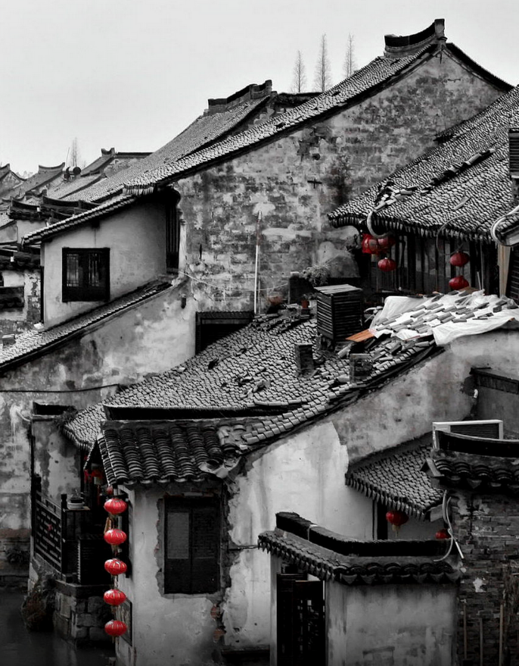
Text 3 去公园
W:John ，can’t we go someplace and talk ？It's so ______ in here .
M:Well, there’s a small park across the street .It's usually __________at this time of day.
3. Why does the man suggest going to the park?
A. It's big. B. It's quiet. C. It's new.
天人合一
天 下 皆 知 美 之 为 美 ， 斯 恶 已
皆 知 善 之 为 善 ， 斯 不 善 已
有 无 相 生 ， 难 易 相 成 ， 长 短 相 形
高 下 相 盈 ， 音 声 相 和 ， 前 后 相 随
恒 也

Slide 21
Text 3 去公园
W:John ，can’t we go someplace and talk ？It's so noisy in here .
M:Well, there’s a small park across the street .It's usually not crowded at this time of day.
3. Why does the man suggest going to the park?
A. It's big. B. It's quiet. C. It's new.
天人合一
天 下 皆 知 美 之 为 美 ， 斯 恶 已
皆 知 善 之 为 善 ， 斯 不 善 已
有 无 相 生 ， 难 易 相 成 ， 长 短 相 形
高 下 相 盈 ， 音 声 相 和 ， 前 后 相 随
恒 也

Slide 22

T Text 4 邻里关系
W：We got to ________ about the neighbour’s dog.
M: Why? Has he ________ your flower garden ______?
W: The flower garden, the garbage can and yesterday he started digging holes in the yard.
4. How does the woman sound?
A. Annoyed. B. Pleased. C. Puzzled.
重点词汇：the garbage can 垃圾箱

Slide 23
T Text 4 邻里关系
W：We got to do something about the neighbour’s dog.
M: Why? Has he been into your flower garden again?
W: The flower garden, the garbage can and yesterday he started digging holes in the yard.
4. How does the woman sound? (根据整体语气的感知）
A. Annoyed. B. Pleased. C. Puzzled.
重点词汇：the garbage can 垃圾箱

Slide 24
Text 5餐馆用餐t
M:Hello, we have a reservation in the name of Mr Jones. Is there any table by the window?
W:Sorry, we got this ________ for you. It's quiet here, not close to the door.
5. Where is the man's table?
A. Near the door.
B. By the window.
C. In the corner.
重点词汇：reservation 预定

Slide 25
Text 5餐馆用餐t
M:Hello, we have a reservation in the name of Mr Jones. Is there any table by the window?
W:Sorry, we got this corner table for you. It's quiet here, not close to the door.
5. Where is the man's table?
A. Near the door.
B. By the window.
C. In the corner.
重点词汇：reservation 预定

Slide 26
Text 6 夫妻外出赴宴
W:Dave， don’t forget we are invited __________tonight.
M:oh , yeah, I almost forgot .what time?
W:Seven thirty. we should leave the house by six thirty .You know how bad the traffic is that time of night .
M:It’s informal, isn’t it?
W: Yeah, you can wear your new sports jacket- the one I got you as an _______________.
M: okay, well, I gotta go. I will try to ___________ a little earlier today
W:Good.
informal 不正式的
anniversary gift 周年纪念日礼物

Slide 27
Text 6 夫妻外出赴宴
W:Dave， don’t forget we are invited out to dinner tonight.
M:oh , yeah, I almost forgot .what time?
W:Seven thirty. we should leave the house by six thirty .You know how bad the traffic is that time of night .
M:It’s informal, isn’t it?
W: Yeah, you can wear your new sports jacket- the one I got you as an anniversary gift.
M: okay, well, I gotta go. I will try to get home a little earlier today
W:Good.
informal 不正式的
anniversary gift 周年纪念日礼物

Slide 28


6. What are the speakers going to do tonight?
A. Eat out.
B. Go shopping.
C. Do sports.
7. What is the probable relationship between the speakers?
A. Boss and secretary.
B. Hostess and guest.
C. Husband and wife.

Slide 29
Text 7 办公室搬迁
M:We need to decide exactly when were going to move, any suggestions ?
W:I think July would be the best time. ____________________ that
month .We could move all the office equipment at the weekend .Do
everything at once .
M:I think a weekend too short .Maybe we should do it _____________ .
W:What do you mean ?
M:Well, ____ week _______department would move .That way there
would always be people here to handle customer increase, phone calls
and so on .
W:That’s a good idea.
handle vt. 解决，处理
customer increase .n. 顾客增长

Slide 30
Text 7 办公室搬迁
M:We need to decide exactly when were going to move, any suggestions ?
W:I think July would be the best time. Our sales are always down that
month .We could move all the office equipment at the weekend .Do
everything at once .
M:I think a weekend too short .Maybe we should do it department by
department .
W:What do you mean ?
M:Well, each week a different department would move .That way there
would always be people here to handle customer increase, phone calls
and so on .
W:That’s a good idea.
handle vt. 解决，处理
customer increase .n. 顾客增长

Slide 31
8. Why does the woman think July is the best time to move?
A. Their business is slow. ( 同义转述）
B. The weather is favorable.
C. It's easy to hire people.
9. How will they handle the moving?
A. Finish it all at once.
B. Have the sales section go first.
C. Do one department at a time （ 同义转述）
天人合一
天 下 皆 知 美 之 为 美 ， 斯 恶 已
皆 知 善 之 为 善 ， 斯 不 善 已
有 无 相 生 ， 难 易 相 成 ， 长 短 相 形
高 下 相 盈 ， 音 声 相 和 ， 前 后 相 随
恒 也
favorable adj 有利的
the sales section .n. 销售部

Slide 32
Text 8 采访艺术家
W:So Mr Peter Cells. I’ll be curious to know what was the early connections in your life that let you into the art field .
M:My grandfather was an art dealer in Munich. They had a great museum in Munich. He took me to the museum and I responded very strongly to what I saw on the walls there. I ____________from him. I ___________________from him. I think that's what really got me started .Then many years later ,after I got out of the army, I went to ___________ at the university of Chicago.
W: Tell us more about your experiences of looking at art with your grandfather.
M: Well, we look at the famous paintings by the great artists like Rembrandt's,Botticelli's and....
________ paintings were my________ .Yes, I remember these things. This was when I was between ten and fifteen. When I was fourteen I was so anxious to see more art that a friend of mine and I bicycled across the Alps to see Venice that was a big adventure.
an art dealer 一个艺术品经销商
responded very strongly to 对此反应强烈
the Alps 阿尔卑斯山

Slide 33
Text 8 采访艺术家
W:So Mr Peter Cells. I’ll be curious to know what was the early connections in your life that let you into the art field .
M:My grandfather was an art dealer in Munich. They had a great museum in Munich. He took me to the museum and I responded very strongly to what I saw on the walls there. I learned about art from him. I learned about looking at art from him. I think that's what really got me started .Then many years later ,after I got out of the army, I went to study art history at the university of Chicago.
W: Tell us more about your experiences of looking at art with your grandfather.
M: Well, we look at the famous paintings by the great artists like Rembrandt's,Botticelli's and....
Ruben’s paintings were my favorite .Yes, I remember these things. This was when I was between ten and fifteen. When I was fourteen I was so anxious to see more art that a friend of mine and I bicycled across the Alps to see Venice that was a big adventure.
an art dealer 一个艺术品经销商
responded very strongly to 对此反应强烈
the Alps 阿尔卑斯山

Slide 34
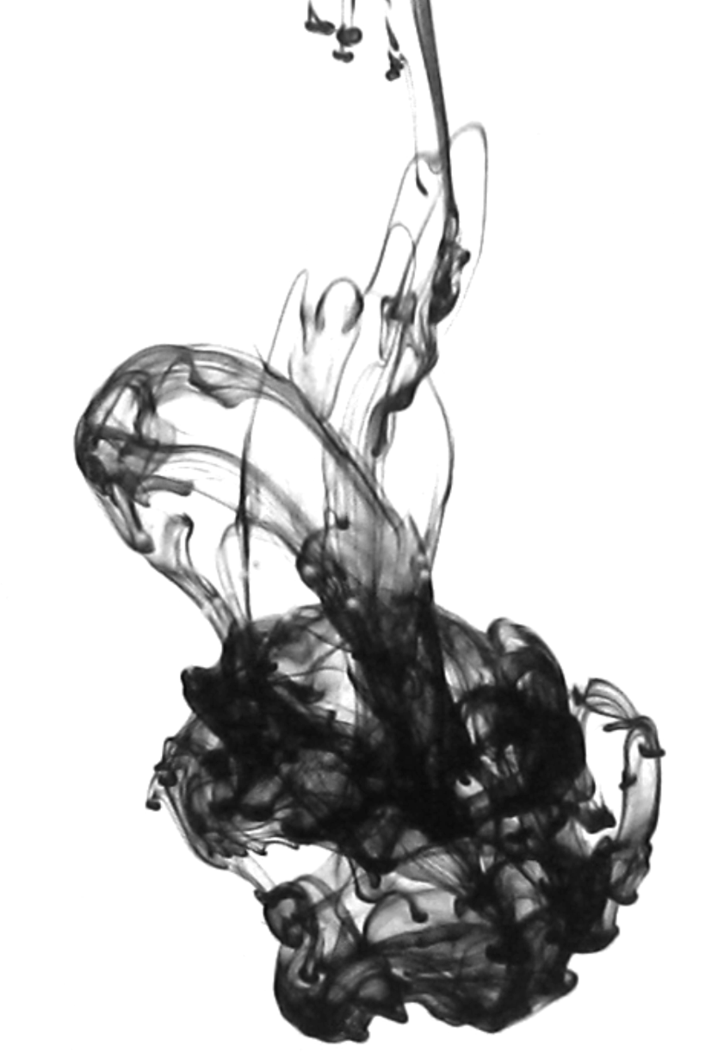
10. What did Peter learn from his grandfather? （ 同义转述）
A. How to appreciate art works. 欣赏艺术作品
B. How to deal with artists. 和艺术家相处
C. How to run a museum. 经营一个博物馆
11. What did Peter do in Chicago?
A. He studied at a college.
B. He served in the army. 在军队服役
C. He worked in a gallery. 在画廊工作
12. Whose works did Peter like best?
A. Rembrandt's.
B. Botticelli's.
C. Ruben's.

Slide 35
Text 9 老同学相遇
W:Hi, John! Hadn’t seen you for ages.
M:Hi, Susan! Fancy meeting you here _______ .
W:How is your college life?
M:What can I say? I have survived.
W: What happened ?
M:Well ,early last March I started doing a part time job in a lot forom a few weeks before I started writing my term paper I thought I could finish it by _______.
W:That was a pretty good idea.Trying to have some work experience.
M:For the first three weeks, you know, I tried. I got up early and worked for an hour on my paper before going to work. but work was so fun I met tons of new people and soon I couldn't find even a minute for my paper .so I had to ______________ and finally _______________ in October.
W:Well .it's never too late to mend. it's __________ to find a _______ between what you _____ do and what you _______ do .
M:Yeah, it's really important for me to balance study and work and I think I should learn to exercise some self control.
Fancy meeting you here .真没想到在这里见到你 survive.v.活下来，幸存
it's never too late to mend 亡羊补牢，犹未晚也 exercise some self control 锻炼自我控制能力

Slide 36
Text 9 老同学相遇
W:Hi, John! Hadn’t seen you for ages.
M:Hi, Susan! Fancy meeting you here on the train .
W:How is your college life?
M:What can I say? I have survived.
W: What happened ?
M:Well ,early last March I started doing a part time job in a lot forom a few weeks before I started writing my term paper I thought I could finish it by August .
W:That was a pretty good idea.Trying to have some work experience.
M:For the first three weeks, you know, I tried. I got up early and worked for an hour on my paper before going to work. but work was so fun I met tons of new people and soon I couldn't find even a minute for my paper .so I had to quit my part time job and finally finished my paper in October.
W:Well .it's never too late to mend. it's kind of hard to find a balance between what you have to do and what you want to do .
M:Yeah, it's really important for me to balance study and work and I think I should learn to exercise some self control.
Fancy meeting you here .真没想到在这里见到你 survive.v.活下来，幸存 kind of 稍许
it's never too late to mend 亡羊补牢，犹未晚也 exercise some self control 锻炼自我控制能力

Slide 37
13. Where does the conversation take place?
A. At a library.
B. In a law firm. 律师事务所
C. On a train.
14. By what time did John plan to finish his term paper?
A. March.
B. August.
C. October.
15. Why did John quit his part-time job?
A. He had to catch up with his study. 赶上他的学习
B. He was offered a better one.
C. He got tired of it.
16. What is Susan's attitude to John's problem?
A. Carefree. 不关心的
B. Understanding. 能理解的
C. Forgiving. 宽容的

Slide 38
Text 10 奥运会选手的心路历程
Being an athlete is very fun ，painful and exciting .Every time I come to the track, I feel like I’m out of this place .This is Barcelona national stadium. This is where I train .When I saw Usain Bolt running in 2012 London Olympics，I was amazed .Just watching him run got me motivated .I quit being ___________ and started to run. I went to the 2016 Olympics and went to the finals at the age of eighteen and while I __________, it was a dream come true to me.But I still wanted more, the training is super hard but __________ for me is that I got an injury -________ which may _________ for years. For a period of time as a young athlete I did not know what to do. I lost focus but now I’m back on the track. I really want to be there at the Olympics and do what I did before. Do much much greater .I don’t care about the gold. I don’t care about the silver .I want to do my best, you know take everything and show it to the world.

Slide 39
Text 10 奥运会选手的心路历程
Being an athlete is very fun ，painful and exciting .Every time I come to the track, I feel like I’m out of this place .This is Barcelona national stadium. This is where I train .When I saw Usain Bolt running in 2012 London Olympics，I was amazed .Just watching him run got me motivated .I quit being a chess player and started to run. I went to the 2016 Olympics and went to the finals at the age of eighteen and while I finished fifth, it was a dream come true to me.But I still wanted more, the training is super hard but the hardest part for me is that I got an injury -an injury which may take me out for years. For a period of time as a young athlete I did not know what to do. I lost focus but now I’m back on the track. I really want to be there at the Olympics and do what I did before. Do much much greater .I don’t care about the gold. I don’t care about the silver .I want to do my best, you know take everything and show it to the world.
track n 赛道；轨迹；小径 super hard 超级难

Slide 40
17. What did the speaker do before the year 2012?
A. A fitness coach. 健身教练
B. A chess player. 一个棋手
C. A marathon runner. 一个马拉松运动员
18. Why was the 2016 Olympics important for the speaker?
A. He was motivated by Bolt. 受到博尔特的激励
B. He broke a world record. 打破世界记录
C. He won fifth place.
19. Which is the hardest for the speaker?
A. Getting over an injury. 克服受伤
B. Doing strength training. 做力量训练
C. Representing Botswana. 代表博茨瓦纳（非洲国家）
20. What is the speaker mainly talking about? (主旨大意题）
A. His plan to go for the gold.
B. His experience on the track.在赛道上的经历
C. His love for his home country.

Slide 41
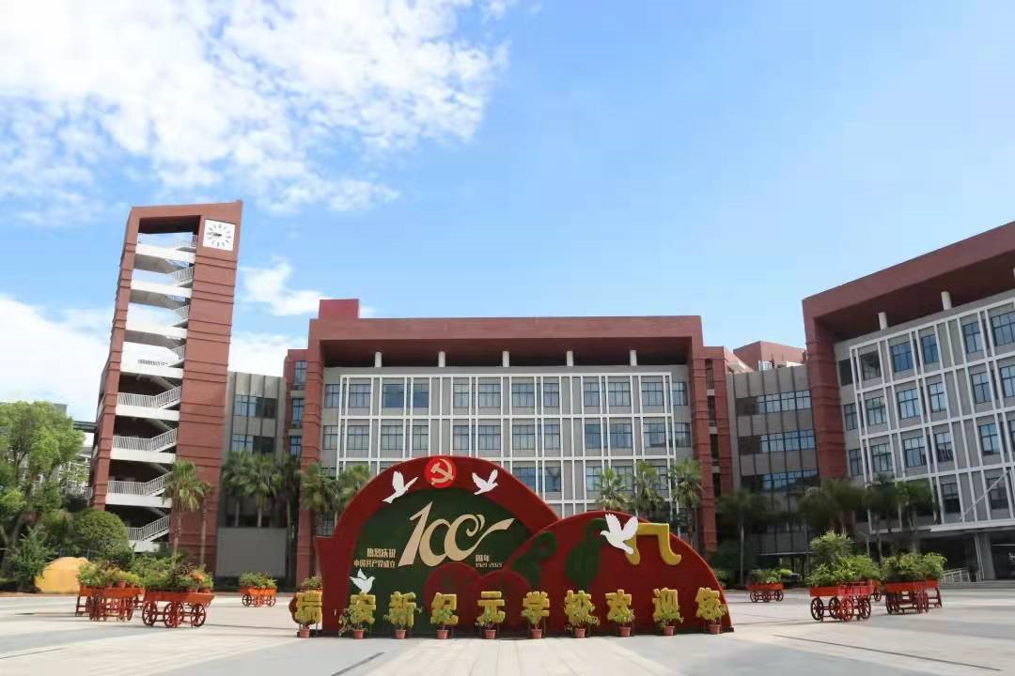
祝各位考生金榜题名！
欢迎指导

