Slide 1
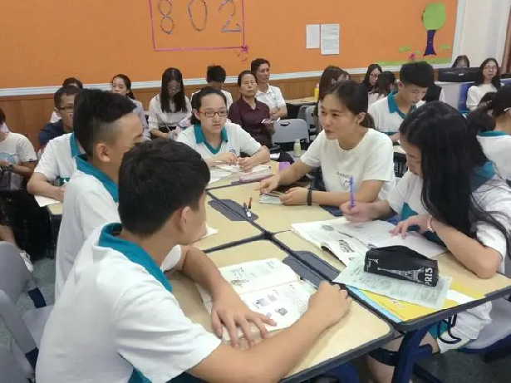

2022年6月浙江高考应用文
高
考
作文讲评（应用文）
邀请体验小组学习室+告知相关情况
杭州二中 许丽君

Slide 2

The requirements of a good practical writing
有料
有趣
要点完整: Content-complete points
交际得体：Proper tone
有用
有效
语言准确: Accurate language
布局合理，条理清晰
Layout-clear logic

Slide 3

Writing steps:
01
审题立意：看明白题目要求，要点，包括背景信息，判断文体，确定时态，确定好人称，遵守题目要求不跑题、要点全。
02
确定篇章结构和段落层次，每段写什么，拟好关键词，进行头脑风暴，构建句式。
03
衔接成文，词与词、句与句、段与段之间自然流畅，浑然一体。

Slide 4
focus of writing
审题定调
（about the topic and type）
01
思路构建
(build the construction)
写作重点：focus of writing
02
03
扩点成句
（make sentences)

Slide 5
Specific elements of practical writing
layout
三段式Binning-body-closing
content
与话题有关的小组学习室；学习室的位置和开放时间，设施和功能
language
语言符合邀请信和告知信的要求，切忌与建议信混淆
tone
符合被邀请被告知者与邀请者告知者之间的关系

Slide 6
Mind maps
朋友身份，语气温和热情
2022年6月浙江高考应用文：
假定你是李华，你校图书馆新设了小组学习室，请你给留学生Michael写邮件，邀请他同去体验，内容包括：
1. 学习室的位置和开放时间；
2．室内设施及其功能。
注意：
1.词数80左右；
2.可适当增加细节，以使行文连贯。
背景信息
邀请信+告知信结合
具体层面+抽象层面

Slide 7
Layout & contents
Group Study Room
newly opened up;
Para.1
背景+写信目的
send an invitation
地点，开放时间
设施、功能
opening time and the location of the group study room;
Para.2
the equipment in the room and its functions
expectations to attend
Para.3
期待参加
join the group studying together

Slide 8
布局谋篇之中段(设施与功能）
bright and spacious space
a brilliant atmosphere to study
The facilities in the group study room and functions:
modern computers
gain useful information from Internet
relevant books，literature study，promote our permanent friendship
a reading corner

Slide 9

布局谋篇之中段(设施与功能）
Facilities in the group study room
functions
a platform for us to search varieties of information
Technological computers
understanding Chinese and western literature，mastering scientific knowledge
brand-new TV screens
a quiet and comfortable atmosphere for many students
enough desks and chairs
to answer our questions and help to deal with our problems.
teachers will be there

Slide 10

布局谋篇之中段(设施与功能）
high-tech robots
search for knowledge
The facilities in the group study room and functions:
a platform where we can compete with excellent talents
the mobile ipads

Slide 11
布局谋篇之中段(小组学习室功能）
an ideal platform to study
study effectively
Functions of the group study room
strengthen our relationship
Add luster to our campus life

Slide 12

构思：框架（Framework）
首段
（Beginning））
*写信背景+ 写作目的
（新设了小组学习室, 邀请他同去体验 ）
中间段
（Body ）
*1. 学习室的位置和开放时间；
2. 室内设施及其功能
尾段
（Ending） (
*再次邀请，表示期待

Slide 13

构思正文内容及表述/遣词造句
Last week witnessed a newly-opened group study room which lies in the library.
1
篇首句：Beginning (background + purpose)
2
It’s my pleasure to invite you to participate in our group study there.
3
Learning that our school library has recently opened a group study room, I am writing to invite you to experience it with me.

Slide 14


构思正文内容及表述/遣词造句
主旨句：Body (facilities and functions)
The room, located in the left of the library, will open at 7:00 am and close at 9:00 pm, which provides us ample time to study.
2. The group study room is equipped with diverse hi-tech equipment, offering us chances to search information.
3. The advanced facilities could record our study progress, which will help us concentrate more on our study.

Slide 15

构思正文内容及表述/遣词造句
总结句：Ending (expectations and wishes)
。
1. Looking forward to your attendance/arrival.
2. I’m firmly convinced that you can not only study efficiently, but strengthen relationship with classmates.
3. The group study room not only provides us an ideal platform to study, but also add luster to our campus life. I’m looking forward to seeing you there.

Slide 16

润色文章的技巧
1. 使用较高级的词汇
advanced words and phrases
技 巧
2. 使用较丰富的句式
abundant
sentence patterns
3. 使用恰当的连接词
proper conjunctions

Slide 17
Possible version
Writing Sample 1:
Dear Michael，
I’m Li Hua. How is everything going? I’m writing to invite you to experience studying together in Group Study Room newly opened up in school library. Here are some details. （邀请的缘由）
It lies in the south of library, open at 9:00 am, lasting for seven hours, except weekends. （小组学习室开放时间、所在地点）Additionally, it has plenty of desks and chairs, bright and spacious space which provide us with a brilliant atmosphere to study. What’s more, the desks are equipped with modern computers, enabling students to gain useful information from Internet. Last but not least, Group Study Room has a reading corner, where bookshelves provide relevant books for us. I’m fully convinced that the Room not only offers us a deep insight into literature study but presents a valuable feast, where we promote our permanent friendship.（内部设施,功能）.
Do you have a great passion for it? I’m looking forward to your reply at your earliest convenience.（再次发出邀请）
Yours
Li Hua

Slide 18
Possible version
Writing Sample 2:
Dear Michael，
I’m more than delighted to tell you that our school library has opened up group-study rooms, which are located on the second floor in the library. I’m writing to invite you to experience it with me. （邀请的缘由）
Firstly, it opens from 9:00 am to 9:00 pm except weekends. （小组学习室开放时间、所在地点）What’s more, it is worth mentioning that there are plenty of technological computers serving as a platform for us to search varieties of information on the Internet. In addition, some brand-new TV screens can also benefit us through understanding Chinese and western literature and mastering scientific knowledge more efficiently. （内部设施,功能）
I’d appreciate it if you could accept my invitation and join us in our group study. Looking forward to your earliest reply and your attendance. （再次发出邀请）
Yours
Li Hua

Slide 19
Possible version
Writing Sample 3:
Dear Michael，
How is everything going? Knowing that our school library has opened up a new room for group learning. I sincerely invite you to participate in my group. （邀请的缘由）
The group learning room, located in the left of the library, will open at 8:00 am and close at 9:00 pm, which provides us ample time to study. （小组学习室开放时间、所在地点）What’s more, there are enough desks and chairs, thus exposing us to a quiet and comfortable atmosphere. What attracts me most is that teachers will be there to answer our questions patiently. High value attached to the chance of learning, this room is what you can’t miss. （内部设施,功能）
All in all, the group learning room not only provides us an ideal platform to study, but also add luster to our campus life. I’m looking forward to seeing you there. （再次发出邀请）
Yours
Li Hua

Slide 20
Possible version
Writing Sample 4:
Dear Michael，
Learning that our school library has recently opened group study rooms, I’m writing to invite you to experience it with me. （邀请的缘由）
This room lies in western library opening from 8:00 am to 9:00 pm every day. （小组学习室开放时间、所在地点）Additionally, the room has many new equipment, ranging from high-tech robots which enable us to search for knowledge on the Internet, to the mobile ipads, offering us a platform where we can compete with excellent talents. （内部设施,功能）
The room is like a treasure waiting for us to take chances. Looking forward to your arrival. （再次发出邀请）
Yours
Li Hu

Slide 21


