Slide 1

感恩遇见，相互成就，本课件资料仅供您个人参考、教学使用，严禁自行在网络传播，违者依知识产权法追究法律责任。
更多教学资源请关注
公众号：溯恩高中英语
知识产权声明

Slide 2

The World
May 11th-31st, 2022

Slide 3
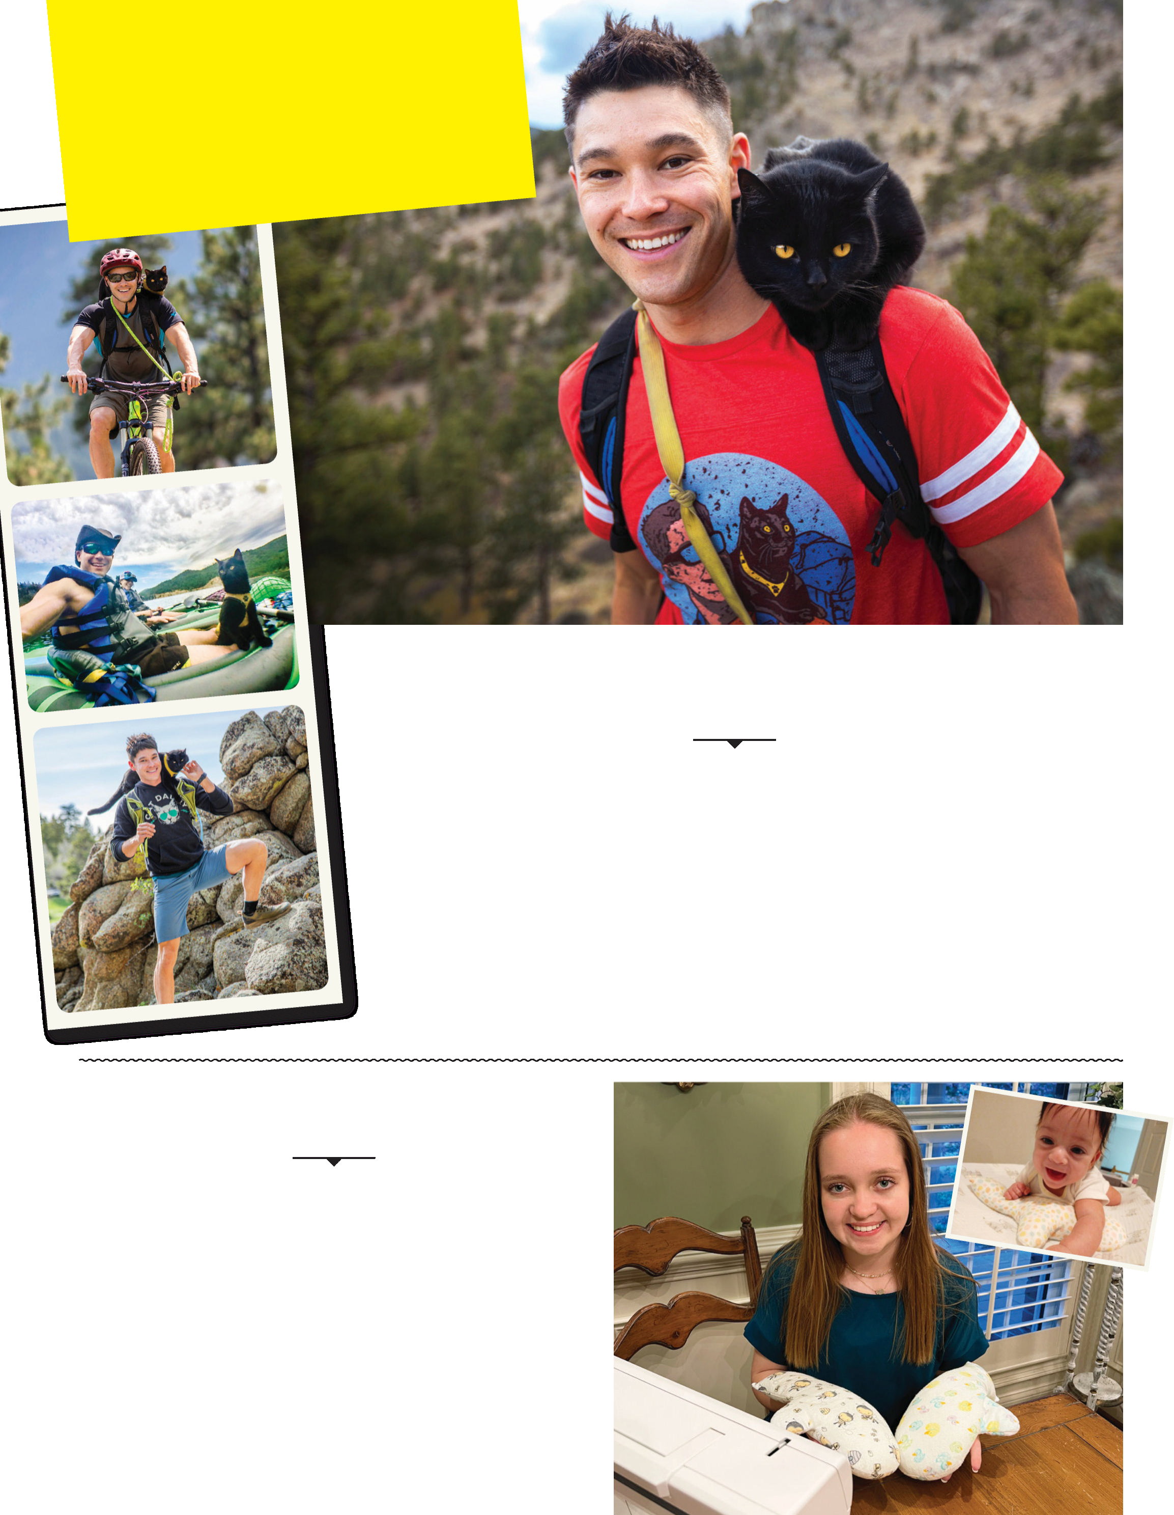
1. Stories Make You ... Smile!
暖心故事
Stories to
make you...
smile!

Slide 4
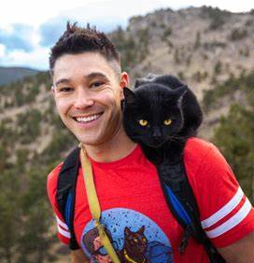
语篇填空1
（《人物》2022年5月16日刊 28页）
An adventurous traveler and his feline
‘soulmate’ explore the great outdoors
companion
For intrepid outdoorsman JJ Yosh, there’s no better travel __________ (company) than his 6-year-old Bombay cat Simon. “We’ve pretty much traveled the U.S. together,” says Yosh, 39, an influencer, ____ adopted Simon from a rescue when he was just weeks old in August 2016. “I started ______ (take) him on every adventure that I went on. He loves being outside.” Since then their sporty escapades ____________ (include) everything from rock climbing in Breckenridge, Colo., to kayaking in Key West, Fla., and camping in Death Valley, Calif. “I love how Simon is so curious about the world around him,” says Yosh, who trained the 10-lb. cat to sit on his ________ and give high fives—and chronicles their travels on Instagram (@backpackingkitty and @JJYosh) . “He makes me live in the moment and appreciate the little things,” adds Yosh. “He’s like my soulmate and my guardian angel.”
who
taking
have included
shoulders

Slide 5
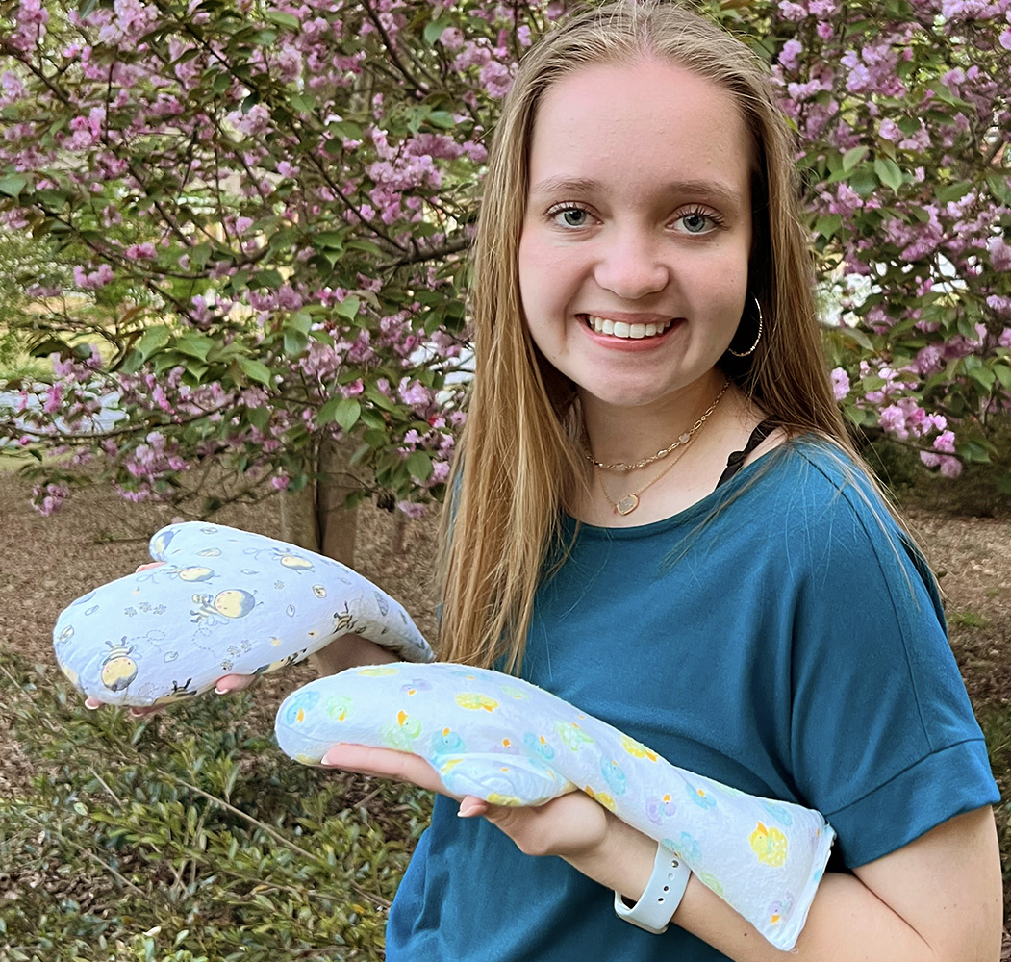
语篇填空2
（《人物》2022年5月16日刊 28页）
Teen makes special gloves to comfort NICU babies
When 18-year-old Bryn Hammock learned that babies in the local hospital NICU were limited ___ two hours a day with their parents during COVID, she wanted ______(help). Her grandmother Deanna Simmons, 73, ___ pediatric nurse, told her how a weighted hand-shaped glove can make babies feel like they’re being held by their mothers. With help from Simmons, Hammock created a pattern and a how-to video and then led a team of 18 volunteers who made 140 mitts—which Hammock dubbed Tiny Hugs. The gloves ___________ (donate) to seven Georgia hospitals. “I’ve always loved babies and kids,” says the high school senior, “so this was a perfect project for me. I was like, ‘Wow, they _____ (real) need this.’ ’’
to
to help
a
were donated
really

Slide 6
词汇讲解1
1. intrepid: very brave; not afraid of danger or difficulties 勇敢的；无畏的
Intrepid pioneers came to California by wagon train. 无畏的拓荒者乘马车来到加利福尼亚。
2. escapade: an adventure or series of events that are exciting or contain some risk
（危险而愚蠢的）冒险行为，恶作剧
Her latest escapade was to camp outside a department store last night. 她最近的一次恶作剧是昨晚在一家百货公司外露营。
翻译句子
他们勇敢、聪明，知道如何为自己谋利。
They are intrepid, clever, and know how to profit themselves.
翻译句子
你觉得我应该告诉她她丈夫的小恶作剧吗?
Do you think I should tell her about her husband’s little escapades?

Slide 7
词汇讲解2
3. chronicle: to record events in the order in which they happened 把…载入编年史；按事件发生顺序记载
Her achievements are chronicled in a new biography out this week. 她的成就已载入本周出版的一本新传记中。
4. dub (~bbed, ~bbed): to give sb/sth a particular name, often in a humorous or critical way 把…戏称为；给…起绰号
Johnson was dubbed “Magic” while playing high school basketball. 约翰逊在高中打篮球时被称为“魔术师”。
翻译句子
他的生平被记录在上周出版的一本新传记中。
His life is chronicled in a new biography published last week.
翻译句子
她被报纸戏称为“死亡天使”。
She was dubbed by the newspapers “the Angel of Death”.

Slide 8
句子翻译
For intrepid outdoorsman JJ Yosh, there’s no better travel companion than his 6-year-old Bombay cat Simon.
对于勇敢的户外爱好者JJ Yosh来说，没有比他6岁的孟买猫Simon更好的旅行伙伴了。
翻译
With help from Simmons, Hammock created a pattern and a how-to video and then led a team of 18 volunteers who made 140 mitts — which Hammock dubbed Tiny Hugs.
在Simmons的帮助下，Hammock 制作了一个式样和一个操作视频，然后带领一个由18名志愿者组成的团队制作了140只手套，Hammock戏称这些手套为“小拥抱”。
翻译

Slide 9
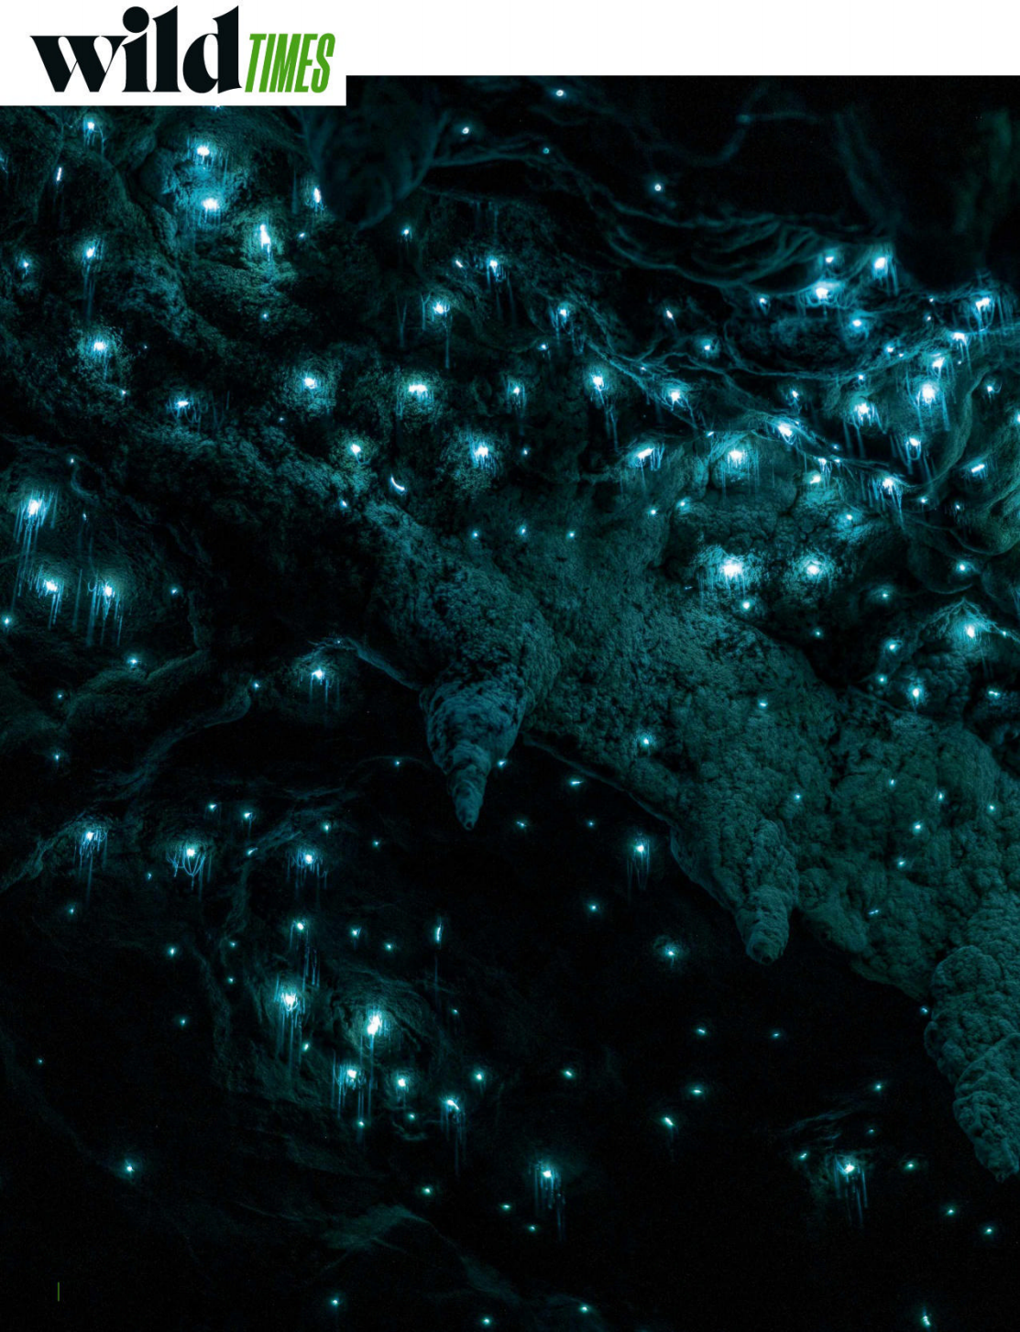
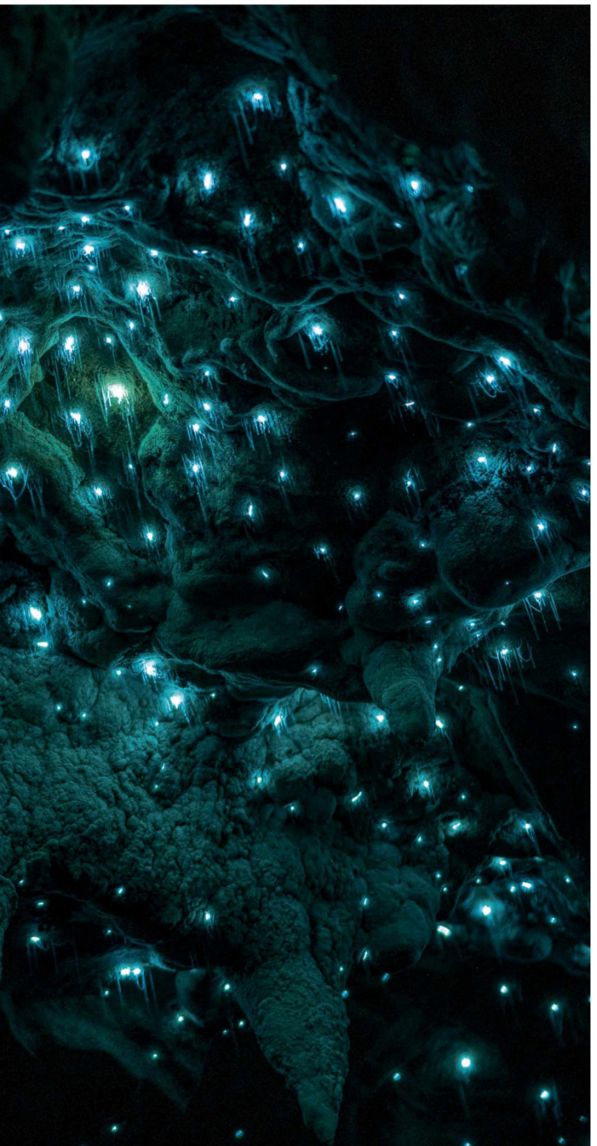
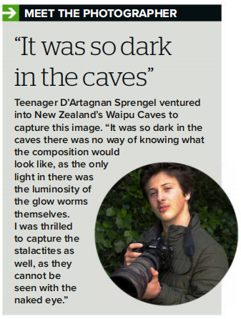
2. The Stars Beneath the Ground
洞穴里的星空
It looks like the depths of space, but it’s actually the inside of a cave.

Slide 10
语篇填空
（《BBC野生生物》2022年4月刊 11页）
If you were to ask someone to provide photographic evidence of the ________ (exist) of fairies, the picture you’d end up with would ________ (probable) look a lot like this. Needless to say, _____ you’re seeing here aren’t fairies: they’re glow ______ (worm). But despite being commonly referred __ as such, these bioluminescent (生物性发光的) bugs are actually gnats, specifically fungus gnats (Arachnocampa luminosa), photographed inside the Waipu Caves in New Zealand.
It’s only the female fungus gnats ____ glow, partly to attract males, but also to lure prey towards the sticky silk-thread snares(罗网) they produce and hang from the cave roof. Any flies or mosquitoes __________ (fortune) enough to get too close, soon find __________(them) stuck to the thread, which then gets wound in so the freshly caught meal can __________ (enjoy).
This image, taken by 14-year-old D’Artagnan Sprengel, ____ (win) WildArt Young Photographer of the Year 2021 and the Young “Light” category. You can see the rest of 2021’s winners at wildartpoty.com.
existence
probably
what
worms
to
that
unfortunate
themselves
be enjoyed
won

Slide 11
词汇讲解
1. lure: to persuade or trick sb to go somewhere or to do sth by promising them a reward 劝诱；引诱
They did not realize that they were being lured into a trap. 他们没有意识到正被人骗入圈套。
2. wind (wound, wound): to wrap or twist sth around itself or sth else 卷缠；缠绕
The hair is divided into sections and wound around heated rods. 头发被分成几部分，缠绕在加热棒上。
翻译句子
那小孩被诱骗上了车，但又设法逃掉了。
The child was lured into a car but managed to escape.
翻译句子
他在她的手指上缠了一小条绷带。
He wound a small bandage round her finger.

Slide 12
句子翻译
It’s only the female fungus gnats that glow, partly to attract males, but also to lure prey towards the sticky silk-thread snares they produce and hang from the cave roof.
翻译
只有雌性真菌蚊蚋会发光，一方面是为了吸引雄性，另一方面也是为了把猎物引诱到它们制造的粘丝线陷阱上，这些陷阱挂在洞穴顶部。
Any flies or mosquitoes unfortunate enough to get too close, soon find themselves stuck to the thread, which then gets wound in so the freshly caught meal can be enjoyed.
任何不幸靠得太近的苍蝇或蚊子，很快就会发现自己被粘在线上，然后被缠绕在线上，这样就可以享受新鲜捕获的食物了。
翻译

Slide 13
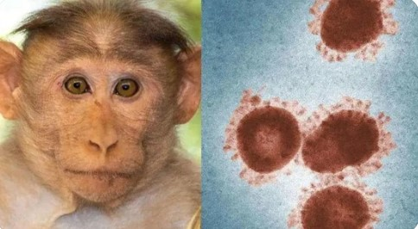
3. Monkeypox in Europe 欧洲的猴痘

Slide 14
语篇填空
（《泰晤士报》2022年5月24日 4页）
Monkeypox could become endemic in Europe if it _______ (make) the leap into animals, health officials have warned. It is spread through close person-to-person contact, or contact with items used by an _________ (infect) person. The European Centre for Disease Prevention and Control said that people with monkeypox should be told to “avoid contact with any mammal pets, and ___________ (particular) pet rodents”.
Another 36 cases of the virus, _______ causes a rash and a fever, were reported in England yesterday, _______ (take) the total to 56. Scotland reported its first case. Sajid Javid, the health secretary, said there was “community transmission” of the virus, indicated by cases confirmed from “three unlinked _________ (incident)”.
The UK Health Security Agency _______ (set) up a helpline for clinicians dealing with monkeypox, he added. Extra testing capacity was being offered. Officials described the outbreak ___ “significant and concerning” but said the risk to Britain remained low.
Close contacts of people with ____ disease are being offered a smallpox vaccine called Imvanex, which also gives people some protection against monkeypox. More than 1,000 doses are being issued to NHS trusts. _______ (give) someone the jab within four days of exposure can reduce the risk of infection and later injection protects against severe illness.
makes
infected
particularly
which
taking
incidents
has set
as
the
Giving

Slide 15
词汇讲解
1. endemic: regularly found in a particular place or among a particular group of people and difficult to get rid of地方性的；（某地）特有的，流行的
Today, this creature is known as the kangaroo, a widespread marsupial endemic to Australia. 今天，这种生物被称为袋鼠，是澳大利亚特有的有袋动物。
2. rash: an area of red spots on a person’s skin, caused by an illness or a reaction to sth. 皮疹；疹
Hot weather makes her come out in a rash.
炎热的天气使她起了皮疹。
翻译句子
疟疾是许多气候炎热国家的流行病。
Malaria is endemic in many hot countries.
翻译句子
婴儿出了皮疹。
The baby broke out in a rash.

Slide 16
词汇讲解
3. transmission: the act or process of passing sth from one person, place or thing to another 传送；传递；传达；传播；传染
The transmission of the programme was brought forward due to its unexpected topicality. 该节目提前播送是因有出人意料的热门话题。
4. exposure: the state of being in a place or situation where there is no protection from sth harmful or unpleasant 面临，遭受（危险或不快）
Their cancers are not so clearly tied to radiation exposure. 他们的癌症与接触辐射并没有太明显的联系。
翻译句子
这封信在传递中被耽误了。
The letter was delayed in transmission.
翻译句子
太阳曝晒会使皮肤粗老。
Exposure to the sun ages the skin.

Slide 17
句子翻译
The European Centre for Disease Prevention and Control said that people with monkeypox should be told to “avoid contact with any mammal pets, and particularly pet rodents”.
欧洲疾病预防和控制中心表示，应该告知猴痘患者“避免与任何哺乳动物宠物接触，尤其是宠物中的啮齿动物”。
翻译
Close contacts of people with the disease are being offered a smallpox vaccine called Imvanex, which also gives people some protection against monkeypox.
目前正在向密切接触这种疾病的人提供一种名为Imvanex的天花疫苗，这种疫苗也可以使人们免受猴痘的感染。
翻译

Slide 18
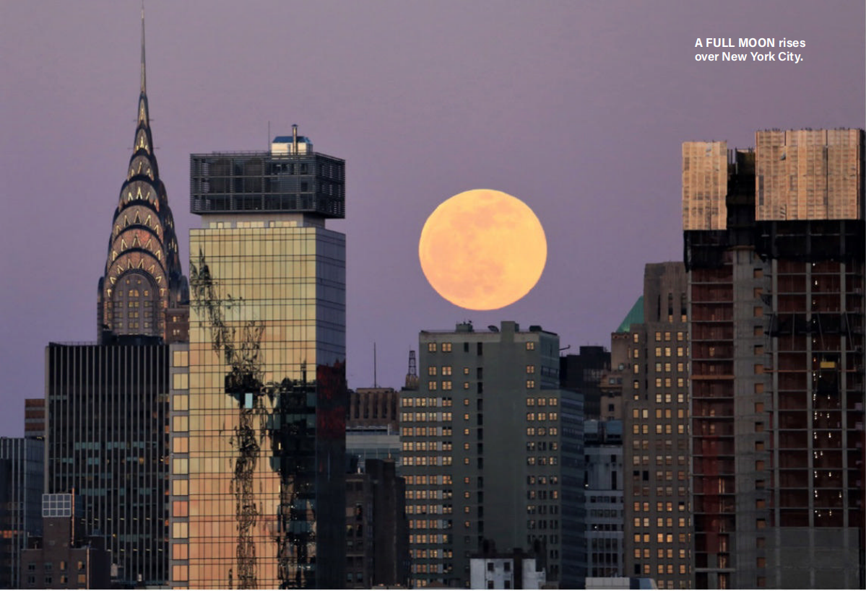
4. A Lunar Mystery 月径幻觉

Slide 19

语篇填空
（《发现》2022年5&6月合刊 66页）
Have you ever looked at the nighttime horizon and gasped ___ the sight of a spectacularly large moonrise? _________ (typical), if you glance up at the sky hours later, the moon will seem to have shrunk.
Dubbed the moon illusion, this phenomenon ________________ (witness) for thousands of years, a visual trickery that takes place all in the mind. And, even after so long, scientists still disagree on what exactly is happening in our brains. ______ (test) it, you can snap a picture of the rising moon on the horizon and compare it to ___ image taken later that night. The size will remain consistent, even if your eyes deceive in the moment. Similarly, during a supermoon, _____ the date of the full moon coincides with the point closest to Earth in the lunar orbit and the moon appears roughly 7 percent ______ (big), the naked eye can barely see the increase—even if you convince yourself otherwise.
One common __________ (explain) for the illusion is that when the moon is near the horizon, trees or buildings juxtaposed against the sky fool your brain into perceiving the moon as closer to Earth, and therefore extra big. ____ astronauts in orbit also witness the moon illusion without foreground objects, so this doesn’t quite solve the problem. While other hypotheses abound, the moon illusion still holds some intrigue for scientists — and anyone who _____ (take) the time to sit back and savor this lunar mystery.
at
Typically
has been witnessed
To test
an
when
bigger
explanation
But
takes

Slide 20
词汇讲解
1. dub: to give sb/sth a particular name, often in a humorous or critical way
把……戏称为；给……起绰号
The Belgian actor Jean Claude Van Damme has been dubbed “Muscles from Brussels”. 比利时演员尚格云顿被戏称为“布鲁塞尔的肌肉”。
2. juxtapose: to put people or things together, especially in order to show a contrast or a new relationship between them (尤指为对比或表明其关系而) 把……并列
The technique she uses most often is to juxtapose things for dramatic effect.
她最常用的手法是将事物放在一起，以产生戏剧化的效果。
翻译句子
评论家称他为新摇滚乐之王。
Critics have dubbed him the new king of rock ‘n’ roll.
翻译句子
展览会上抽象画与令人震惊的照片并列展出。
In the exhibition, abstract paintings are juxtaposed with shocking photographs.

Slide 21
词汇讲解
3. hypothesis (pl. hypotheses): an idea or explanation of sth that is based on a few known facts but that has not yet been proved to be true or correct
（有少量事实依据但未被证实的）假说，假设
Different hypotheses have been put forward to explain why these foods are more likely to cause problems.
人们已经提出不同的假说来解释为什么这些食物更有可能带来问题。
4. savor: to enjoy a feeling or an experience thoroughly 体会；体味；享受
She savored her newfound freedom. 她尽情享受刚刚获得的自由。
翻译句子
现在将开始在老鼠身上做实验以验证该假设。
Work will now begin to test the hypothesis in rats.
翻译句子
我要细心品味每一刻。
I wanted to savor every moment.

Slide 22
长难句分析 1
Similarly, during a supermoon, when the date of the full moon coincides with the point closest to Earth in the lunar orbit and the moon appears roughly 7 percent bigger, the naked eye can barely see the increase—even if you convince yourself otherwise.
分析：本句是一个复合句，“when the date of... bigger”是____________，“even if... otherwise”是_____________ 。
时间状语从句
让步状语从句
同样，在超级月亮期间，当满月的日期与月球轨道上离地球最近的点重合时，月球看起来大约大了 7%，但是肉眼几乎看不到这一增加，即使你心里告诉自己月亮变大了。
翻译

Slide 23
长难句分析 2
One common explanation for the illusion is that when the moon is near the horizon, trees or buildings juxtaposed against the sky fool your brain into perceiving the moon as closer to Earth, and therefore extra big.
分析：本句是一个复合句，“that when the moon... big”是_________，“when... horizon”是____________；“juxtaposed against the sky”是_____________作_________修饰______________。
表语从句
时间状语从句
过去分词短语
后置定语
“tree or buildings”
对这种错觉的一种常见解释是，当月亮靠近地平线时，与天空并列的树木或建筑物会欺骗你的大脑，让你认为月亮离地球更近，因此显得特别大。
翻译

Slide 24
句子翻译
Dubbed the moon illusion, this phenomenon has been witnessed for thousands of years, a visual trickery that takes place all in the mind.
翻译
这种被称为月径幻觉的现象数千年以来都被人观测到过，这是一种在脑海中发生的视觉幻象。
While other hypotheses abound, the moon illusion still holds some intrigue for scientists — and anyone who takes the time to sit back and savor this lunar mystery.
翻译
虽然其他假设比比皆是，但月径幻觉仍然对科学家以及任何愿意花时间坐下来细细品味这个月球之谜的人产生一定的吸引力。

Slide 25

5. CNN听力 05/11/22 新墨西哥州山火和干旱

Slide 26

听力填空
Two different natural disasters headline today’s show as we wrap up the first full week of May. I’m Carl Azuz. Right now, there are seven ________ burning in the U.S. state of New Mexico. The National Interagency Fire Center says that’s the most in any state. And while seven might not seem like a huge number in a state that sees hundreds of wildfires every year, the largest one is the second biggest New Mexico has had _________. More than 170 homes have been destroyed in the northern part of the state. Thousands of other houses have been _________. And if this largest fire, the Hermits Peak—Calf Canyon Fire continues to grow, it could threaten more than _______ homes in the days ahead. Earlier this week, NASA reported that the blaze was 20 percent contained, meaning firefighters had blocked it from spreading over _______ of the total area it covered, but local governments said they didn’t think authorities would have complete control of the fire ____________.
Like other parts of the American West, New Mexico has been experiencing a severe _______. It’s affected almost 99 percent of the state, according to the U.S. drought monitor. That makes fire conditions worse. Governor Michele Lujan Grisham asked the federal government to _______ a disaster in New Mexico. President Joe Biden did that. What it means is that government help in the form of money and _________________ has been sped up to the state. Governor Grisham said New Mexico has emergency funds of its own to fight the fires but that it’s not enough. According to the National Weather Service, the average number of acres that wildfires burn in New Mexico each year is around ________. That’s about how much has burned so far in this year’s fire season.
wildfires
in decades
evacuated
15,000
one-fifth
anytime soon
drought
declare
recovery assistance
300,000

Slide 27
词汇讲解
1. wrap up: to complete sth such as an agreement or a meeting in an acceptable way 圆满完成，顺利结束（协议或会议等）
That just about wraps it up for today.
这就差不多给今天画了个圆满的句号。
2. blaze: (used especially in newspapers) a very large fire, especially a dangerous one （尤用于报章）烈火；火灾
Two firemen were hurt in a blaze which swept through a tower block last night.
昨晚，一场大火吞噬了一座高层建筑，两位消防员被烧伤。
翻译句子
我可以在一个礼拜之内完成这个小项目。
I can wrap up this little project in a week.
翻译句子
火灾中有五人丧生。
Five people died in the blaze.

Slide 28
句子翻译
NASA reported that the blaze was 20 percent contained, meaning firefighters had blocked it from spreading over one-fifth of the total area it covered, but local governments said they didn’t think authorities would have complete control of the fire anytime soon.
翻译
美国宇航局报告说，大火已被控制住了 20%，这意味着消防员已经阻止它蔓延到其覆盖的总面积的五分之一，但地方政府表示，他们认为当局不会很快完全控制火势。
What it means is that government help in the form of money and recovery assistance has been sped up to the state. Governor Grisham said New Mexico has emergency funds of its own to fight the fires but that it’s not enough.
翻译
这意味着政府以金钱和恢复援助的形式提供的帮助已经加速向该州提供。 格里沙姆州长表示，新墨西哥州有自己的应急资金来扑灭大火，但这还不够。

