Slide 1

感恩遇见，相互成就，本课件资料仅供您个人参考、教学使用，严禁自行在网络传播，违者依知识产权法追究法律责任。
更多教学资源请关注
公众号：溯恩高中英语
知识产权声明

Slide 2



Unit 4 Sharing
Make a speech about China’s aid to other countries
东莞市第六高级中学 钱盈

Slide 3
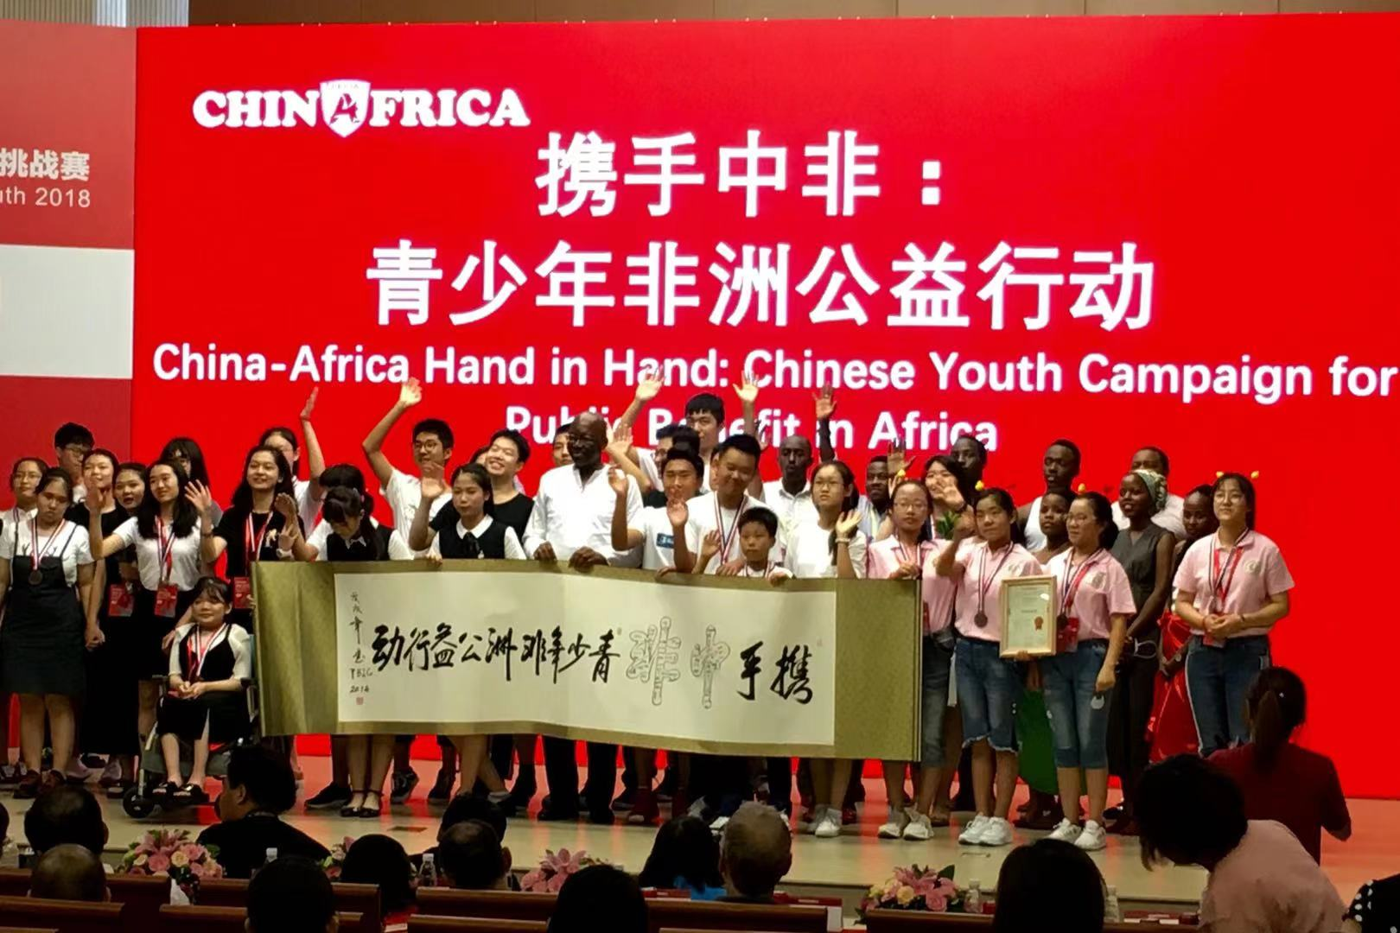
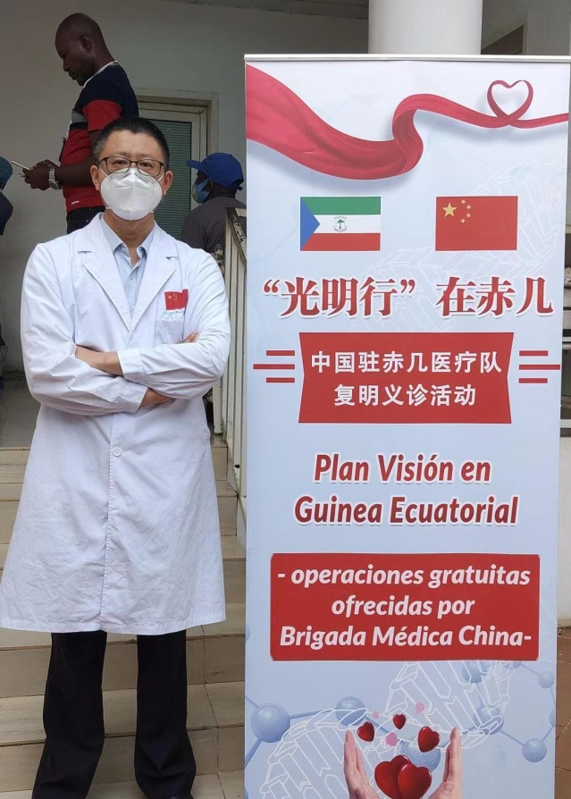
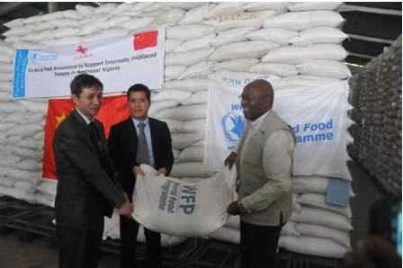
Lead in
Do you know what kind of aids does China offer to other countries?
Why does China offer aids?

Slide 4

Pre-reading: View and Predict
Zhang Bingbing is giving a speech on China’s aid to other countries.
Please view the word cloud and predict what she might share in her speech?

Slide 5
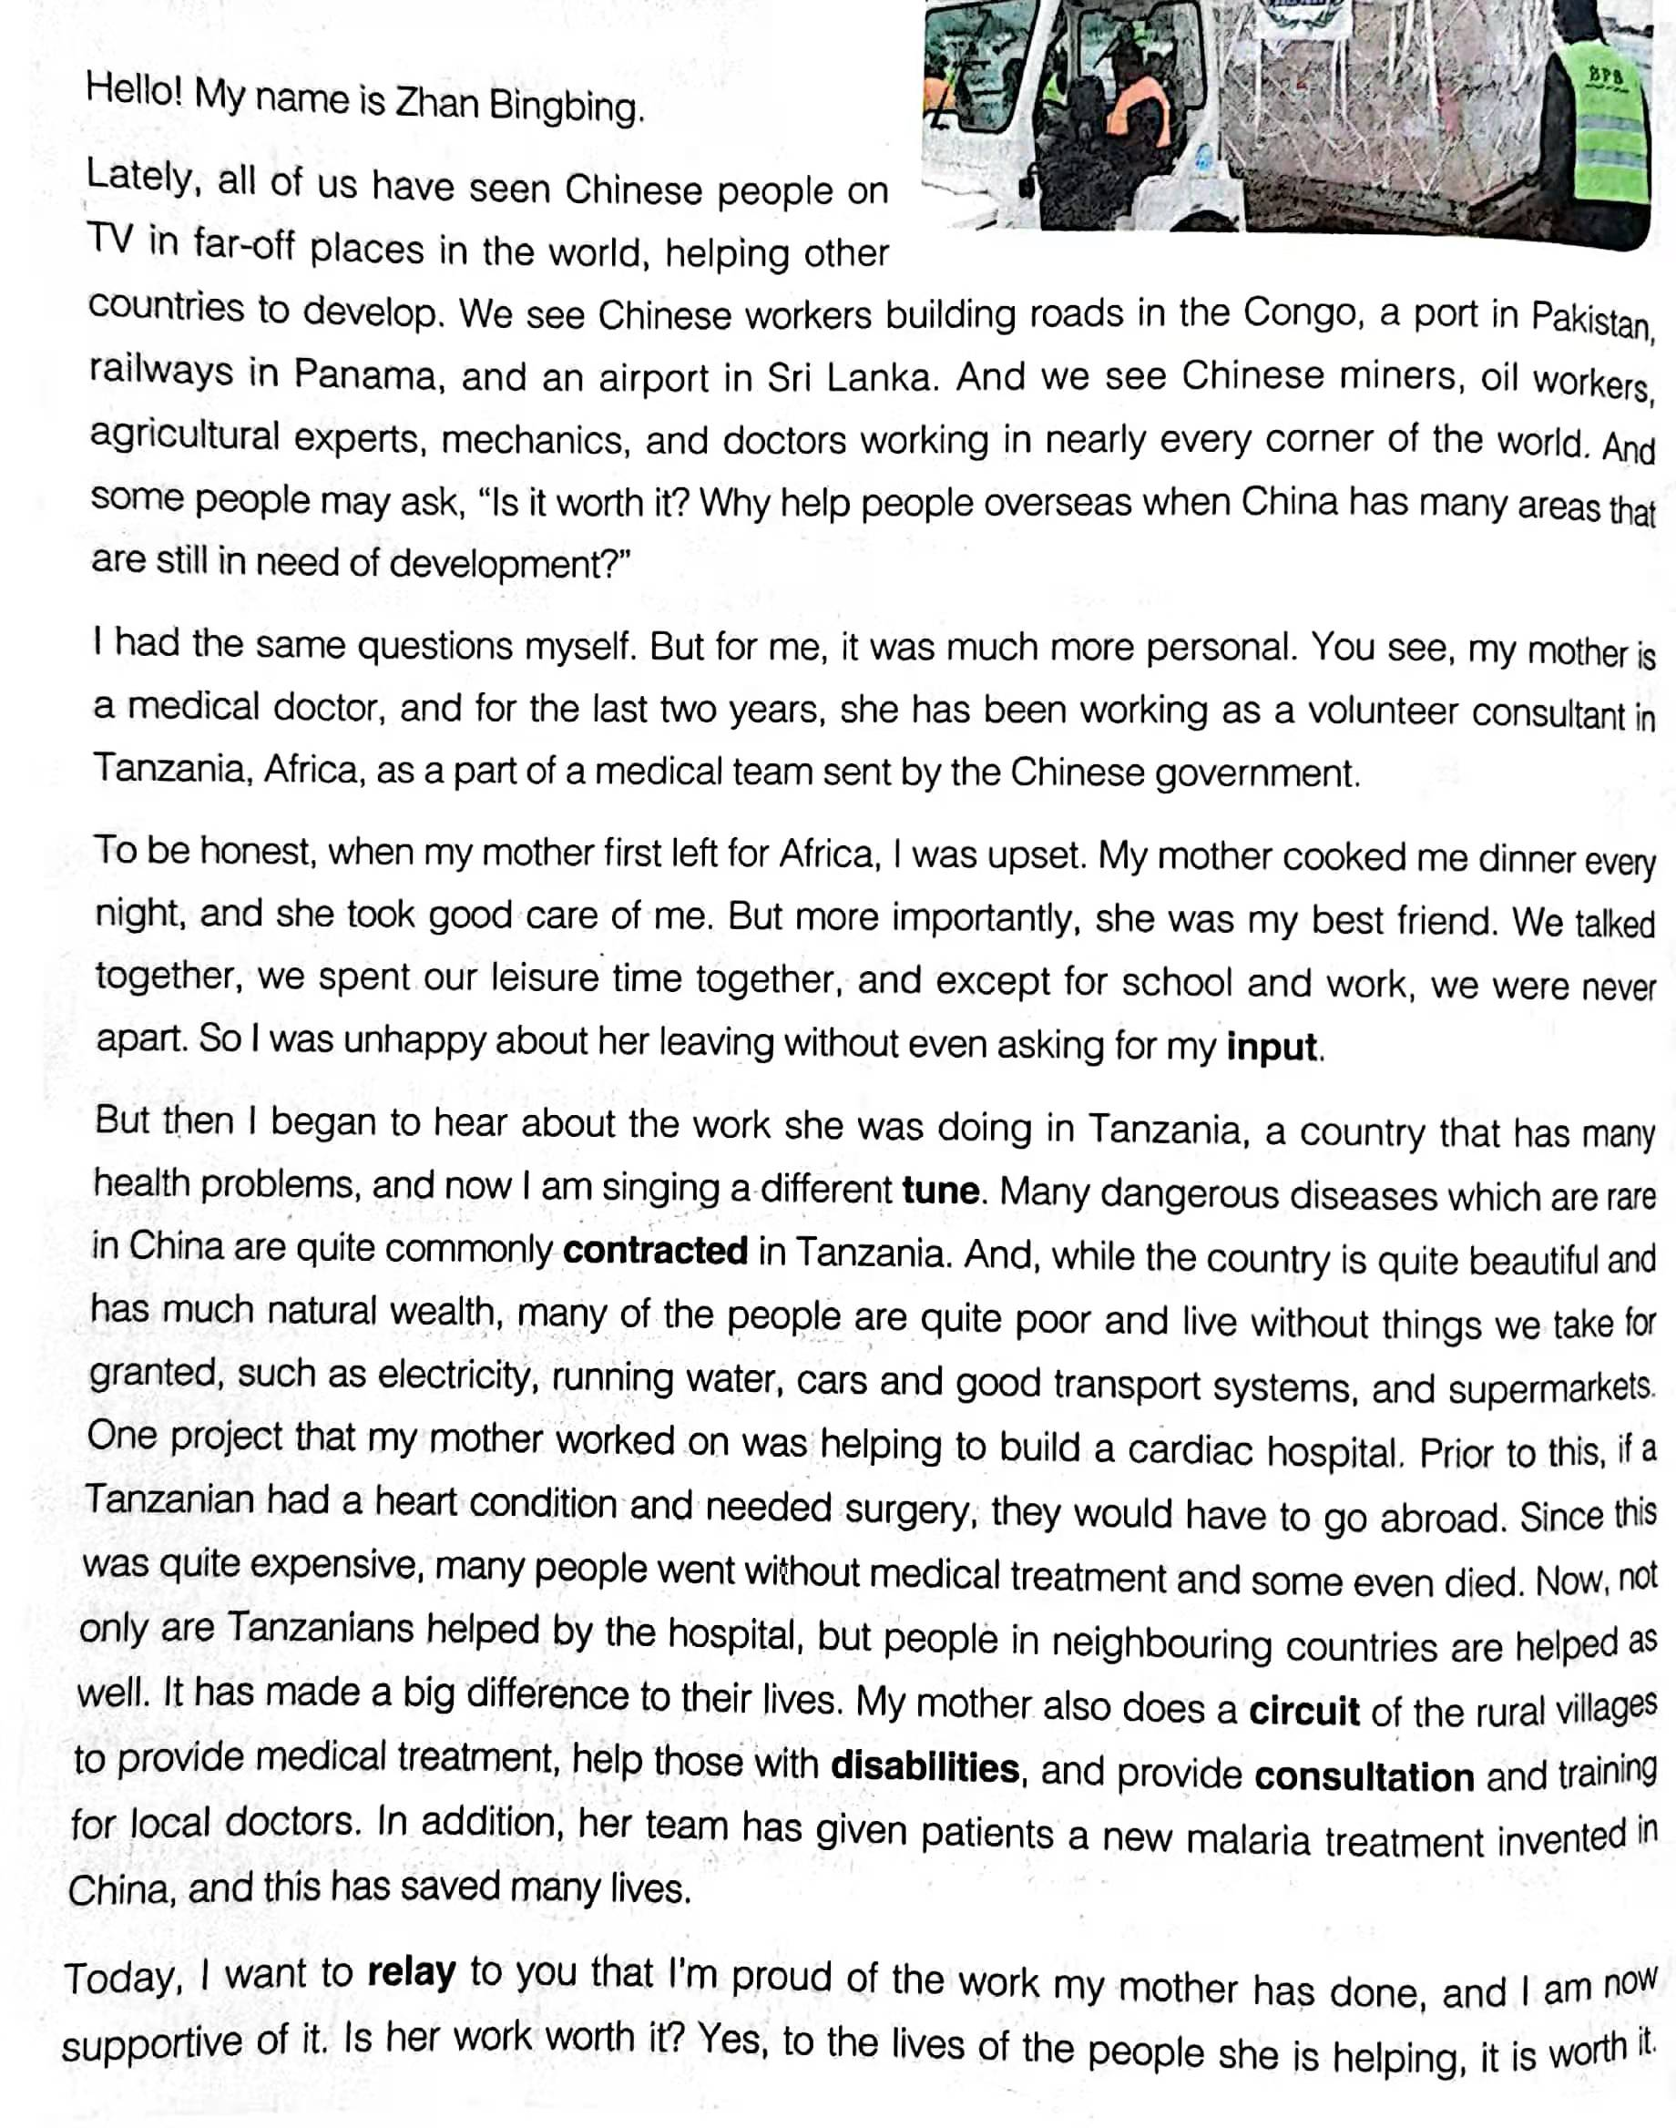
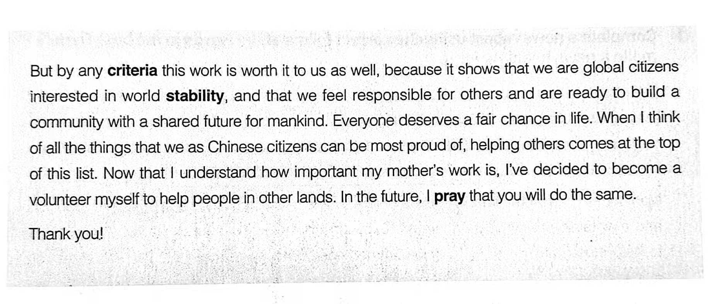
While-reading: Read for structure
The text type: Speech
Topic
Rhetorical question
我
Answer to the question
我
Ending
我
Content
Theme

Slide 6
Read for details
1. What is the rhetorical question used in this speech?
Is it worth it?
Rhetorical question:
----a statement that is formulated as a question but that is not supposed to be answered.
2. What is the answer to this rhetorical question?
Yes, to the lives of the people she is helping, it is worth it. But by any criteria this work is worth it to us as well, because it shows that we are global citizens interested in world stability, and that we feel responsible for others and are ready to build a community with a shared future for mankind.

Slide 7



Read for details
3. What does the speaker use to get her message across?
◻ a case study ◻ a joke ◻ a personal story
◻ facts and data ◻ a hypothetical example
◻ an analysis of the history and causes of the issue
4. How did Bingbing’s feelings about the topic change?
Unhappy
Proud
Her mother had left for Tanzania for volunteering
Bingbing began to see how great help her mother was bringing

Slide 8

Read for details
5. How does the speech end?
This speech ends with an appeal to the audience to consider becoming volunteers.

Slide 9
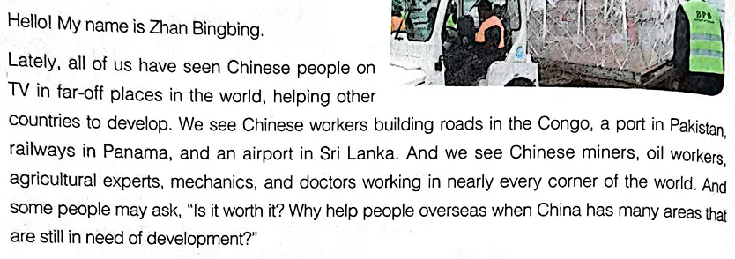
Read for language
Para. 1
Language feature:
Rhetorical question
Way of writing:
Description of a familiar phenomenon followed by a question
Function:
To attract attention of the audience to the topic

Slide 10
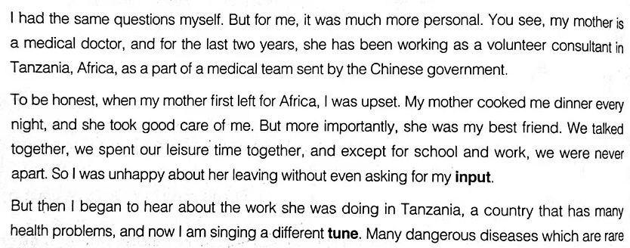
Read for language
Para. 2-3
Language feature:
I had the same question myself.
But for me…
You see, …
To be honest,…
But then I began to hear about…
Way of writing:
Telling a personal story
Using examples
Function:
To make the speech convincing, informative, and inspiring

Slide 11
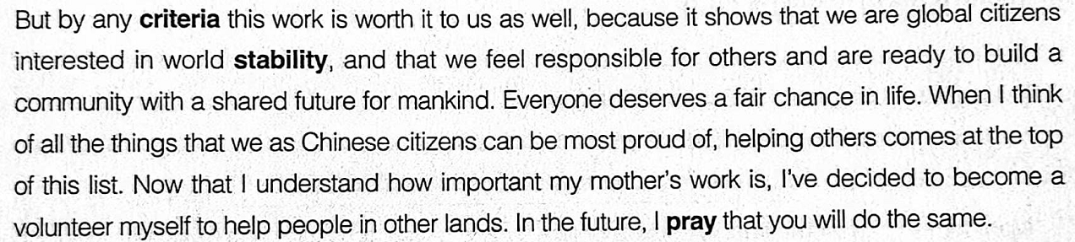
Read for language
Para. 4
Language feature:
Today, I want to relay to you that…
By any criteria this work is worth it to us all, because…
Now that I understand…
In the future, I pray that…
Way of writing:
Expressing personal reflection or attitude
Sharing future plans
Function:
To reiterate the theme

Slide 12
Read for language
More rhetorical questions for reference:
1. You don't expect me to go along with that crazy scheme, do you?
2. Why is the Belt and Road beneficial to the promotion of economy?
3. The amount of plastic in the ocean is rising at a considerable rate. How many efforts will it take you to help reduce this?
4. If Winter comes, can Spring be far behind? (O Wind)
5. Remember how things used to be 10 years ago?
To engage the audience and to personalize the question
To raise a question
To emphasize a statement and to evoke emotions
To cite a famous poem
To rise interests by making comparison

Slide 13
Read for language
More expressions for opening a speech :
1. Many of you may ask what the Belt and Road is. Well, to begin with, I want to tell stories behind it.
2. It'd like to begin by asking you to imagine a world where ...
3. Let's start by giving yourselves a round of applause.
4. As the saying goes “First impressions are lasting; you never get a second chance to create a good first impression.”
To introduce the background by telling stories
To ask the audience to imagine something different
To begin with complimenting the audience
To cite a famous saying or quote

Slide 14

Pre-writing: Background
Write a speech about China’s aid to other countries.

Slide 15
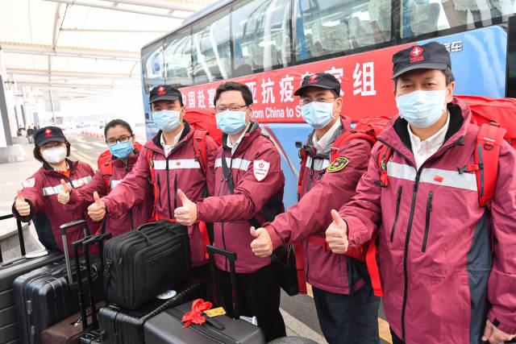
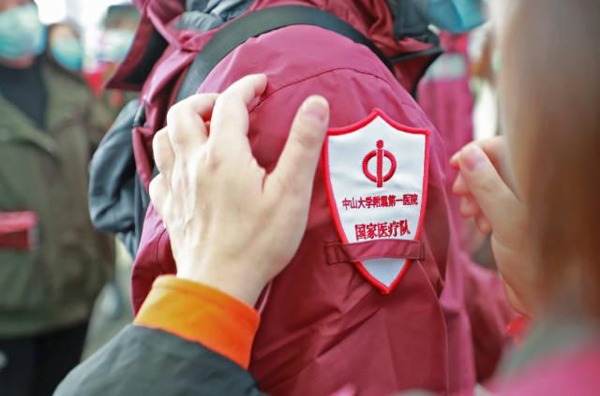
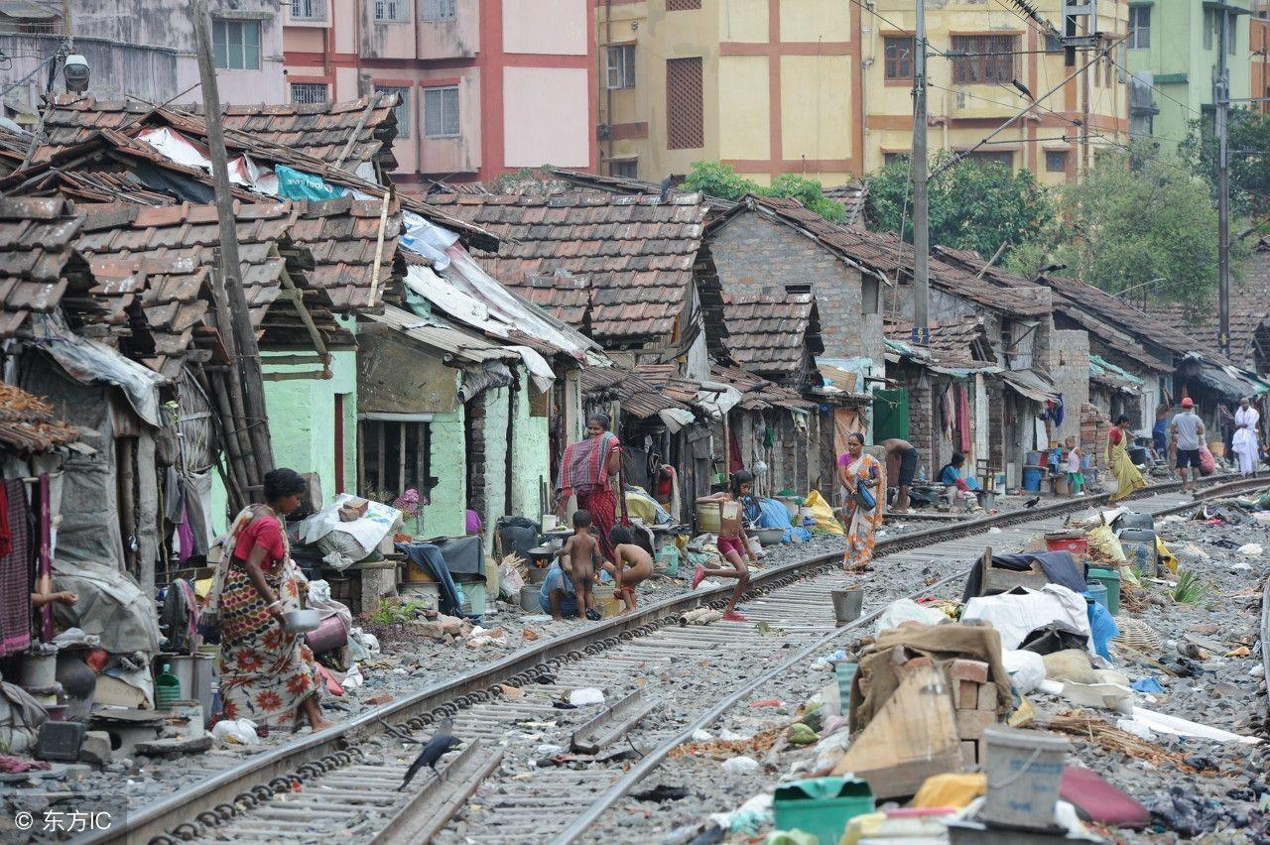
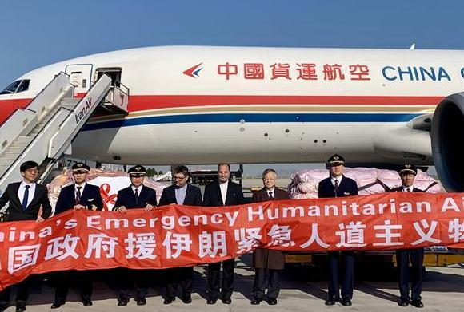

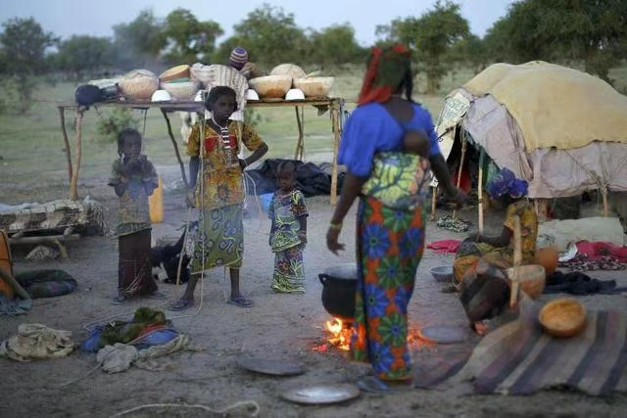
Brainstorm for ideas
In groups, brainstorm a list of possible causes that you could talk about.

Slide 16
While-writing: Design your draft
China’s Aid to Other Countries
Topic of the speech：
Rhetorical question:
Answer to the question: (Personal connection)
(A personal story)
(Your own opinion)
Ending: (Actions to take)

Slide 17
While-writing: Assessment
Checklists |  | Excellent | Good | Average
Structure & Content | Is the speech complete? (TCT) Do you have a personal connection with the cause? Are there any personal stories/examples/citations/data … you tell in relation to that cause? Are there any actions you want people to take as a result of your speech?
Language | Grammar, Punctuation, Spelling Advanced vocabulary and sentence patterns

Slide 18
Post-writing: Share your speech
Organize the min-contest in your class and share your speech orally.

Slide 19
Note-taking sheet
Listen to your classmates’ speeches. Take notes on the sheet and vote on the best one.
Name of the speaker
Role of the speaker
Audience’s identity
Topic of the speech
Important detail and fact in the speech
Personal comment | The most impressive part of the speech
 | Lesson learnt from the speech
Vote (1-10 points)

Slide 20
Assignment
Compulsory: Polish your speech according to your classmates’ comment.
Optional: Shoot a video while you are giving a speech, upload it on the social media and share with others.

Slide 21
Speech sample
Hello! My name is Li hua.
I believe many of us have worked as volunteers in other countries before. Some have experienced as teachers, while others are experienced medical workers who have volunteered to help those in need. Some people may ask, “Is it worth it?” Why help people overseas when China has many areas that are still in need of help?
Personally, I understand this very much when my father, a Chinese volunteer, served as a management consultant for AIDS projects in an African country five years ago. Frankly speaking, I was a little upset and worried about his rip. After all, he would be gone for up to two years! But more importantly, he was my best friend. So I was unhappy about his leaving.
But then I began to study up on this issue, and I learnt that what my father did was right. He was doing in Africa, a country that has many health problem. Many people there have contracted AIDS. My father worked with a local organization engaging in AIDS prevention. He shared his knowledge and skills with needy communities. For example, he worked with his teammates to deliver lectures about how the prevent AIDS in local area. Now, his team has helped raised the local people’s awareness of AIDS prevention and solved many health problems. Yes, my father did that! He helped those people!
Today, I want to say that I’m proud of the work my father has done, and I am now supportive of it. My father is an inspiration to me. I now want to make a difference to this world. Would you like to join me?

Slide 22
Summary
“
As you grow older, you will discover that you have two hands, one for helping yourself, the other for helping others.
---- Sam Levenson
”

Slide 23
Thank you for your listening!

