Slide 1

感恩遇见，相互成就，本课件资料仅供您个人参考、教学使用，严禁自行在网络传播，违者依知识产权法追究法律责任。
更多教学资源请关注
公众号：溯恩高中英语
知识产权声明

Slide 2

Unit 5 Launching Your Career
Reading and Thinking
东莞市第六高级中学
钱盈

Slide 3

Lead in: Video Time

Slide 4
Lead in: Video Time
What are the 8 steps to career planning mentioned in the video?
What are some of the ways that can help people decide which career is suitable for them?
Is it essential that teenagers decide on a career before they become adults? Why?

Slide 5

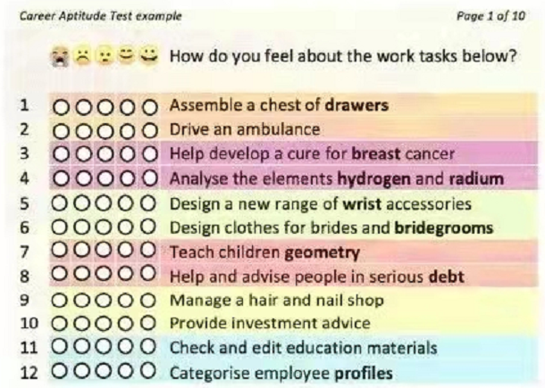
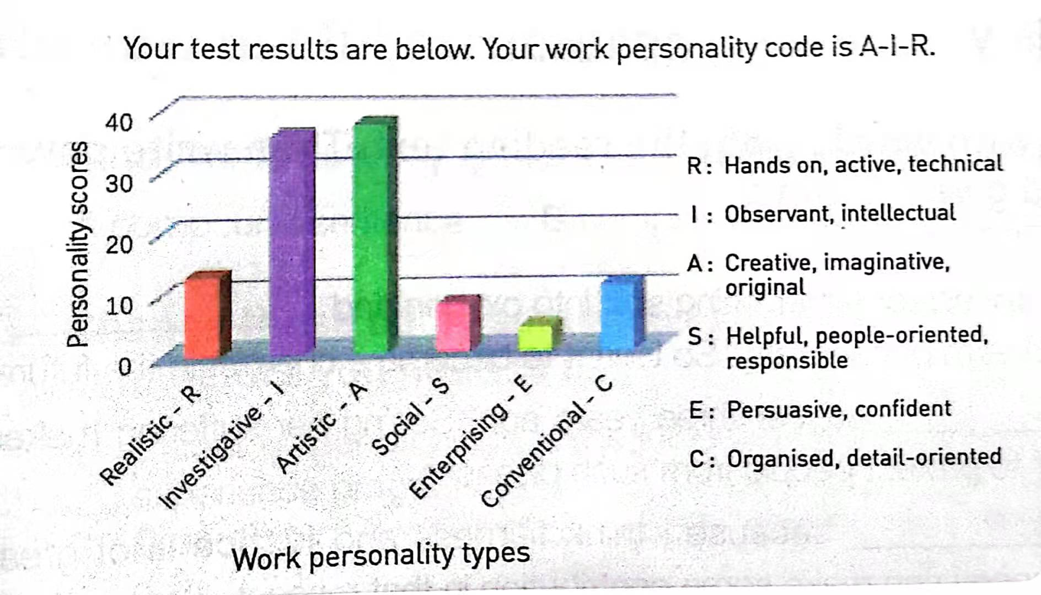
Pre-reading：View & Predict
Look at the title, the table and the chart on page 50-51. Predict the style and main idea of the text.

Slide 6
While-reading: Read for the main idea of each paragraph
Paragraph | Main idea
1 | Taking time to is an essential exercise for young people.
2 | Starting to think about dream career is not easy.
3 | can help us to get a head start in considering our future career.
4 | There are many of career aptitude tests.
5 | One popular test works to indicate the participant’s .
6 | Career suggestions can also be based on .
7 | Career aptitude tests are a useful tool, but they are only meant for .
think about dream career
at a young age
Career aptitude tests
different kinds
overall work personality
education and experience level
guidance

Slide 7
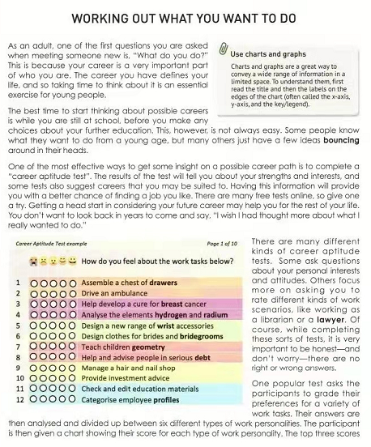
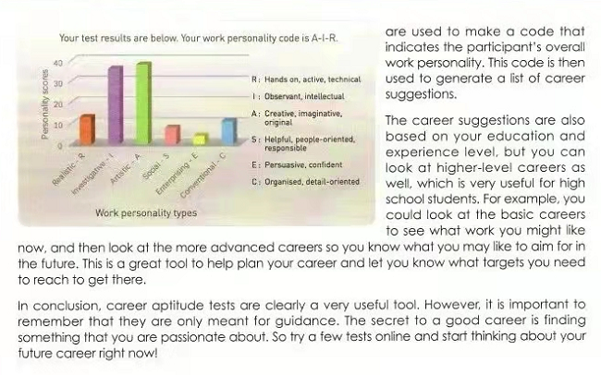
While-reading: Read for the structure
The text type: Exposition
(说明文)
Problem
Solution
Solution
Conclusion

Slide 8
Read for details (focus on the solution part)
Scan Para 3-6 and find the information about the career aptitude test.
What’s the purpose of completing career aptitude test?
What are some of the career aptitude tests mentioned in the text?
Draw a flow-chart to illustrate how the aptitude test works for participants.

Slide 9
Read for details
1. What’s the purpose of completing career aptitude test?
To help participants get some insight on a possible career path.
2. What are some of the career aptitude tests mentioned in the text?
Some ask questions about your personal interests and attitudes.
Others focus more on asking you to rate different kinds of work scenarios, like working as a librarian or a lawyer.

Slide 10
Read for details
3. Draw a flow-chart to illustrate how the aptitude test works for participants.
Participants grade their preferences for a variety of work tasks.
The answers are analyzed and divided up between six different types of work personalities.
The participant is given a chart showing their score for each type of work personality.
The code is used to generate a list of career suggestions.
The top 3 scores are used to make a code that indicates the participant’s overall work personality.

Slide 11
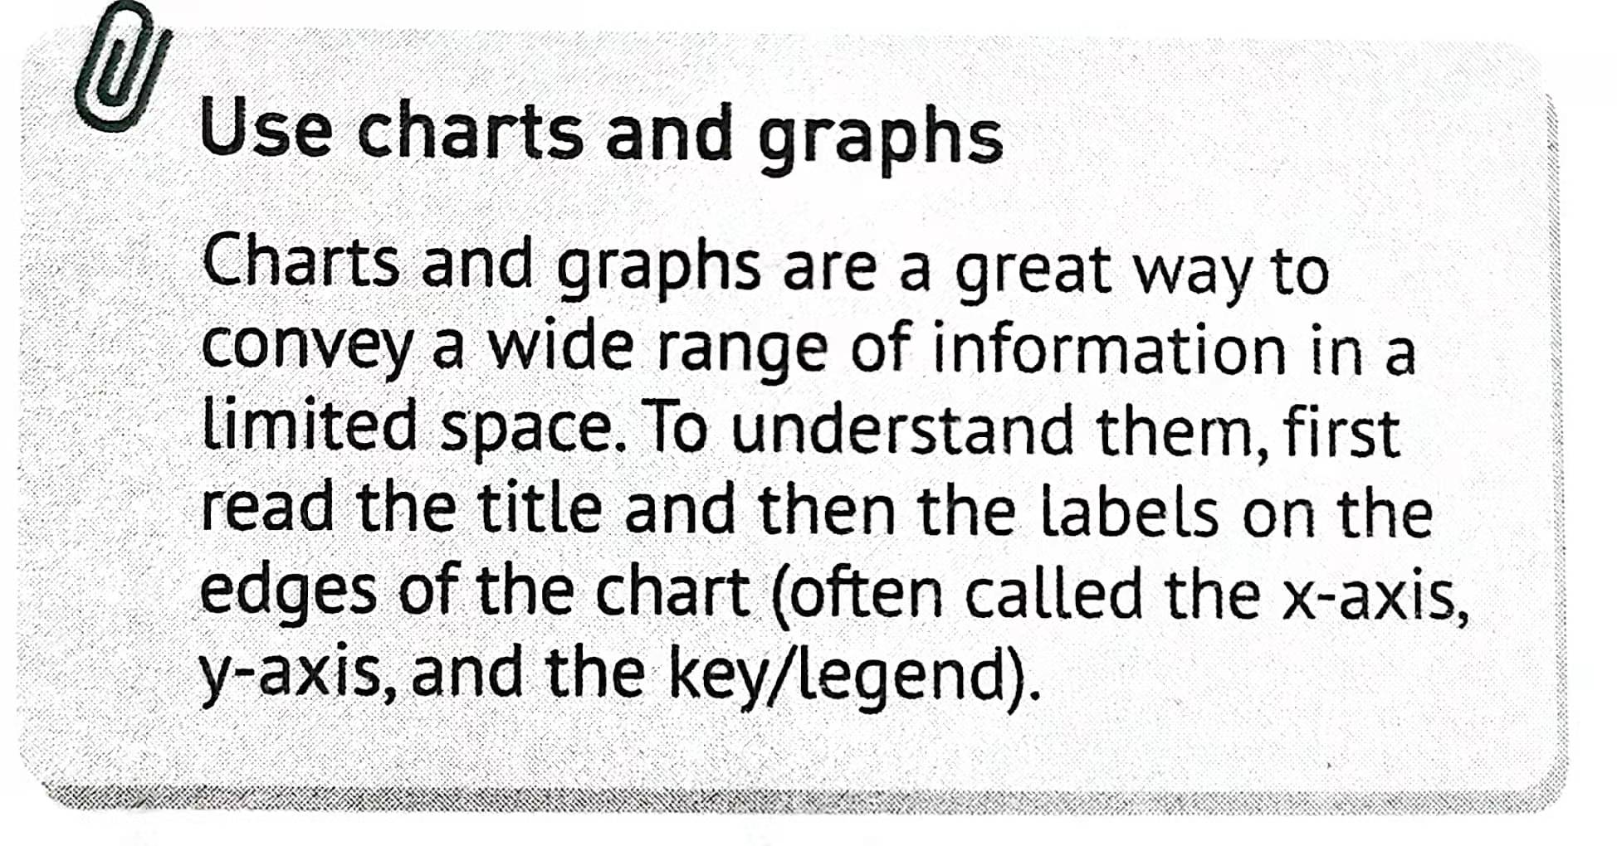
Read for details
Title
我
scale
我
1. What is the participant’s work personality code?
2. What does it mean by being an “A-I-R” ?
3. According to the participant’s work personality code, what careers would you recommend?
Body
我
legend
我

Slide 12
Read for details
Possible careers:
engineer, biologist,
astronomer, detective,
actor, director,
photographer, musician
mechanic, accountant
…

Slide 13
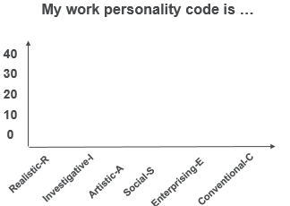
Post-reading: Report with the diagram
Complete the test on P50 according to your situation and illustrate your work personality code with the chart and share with your partner.
My possible careers are：

Slide 14
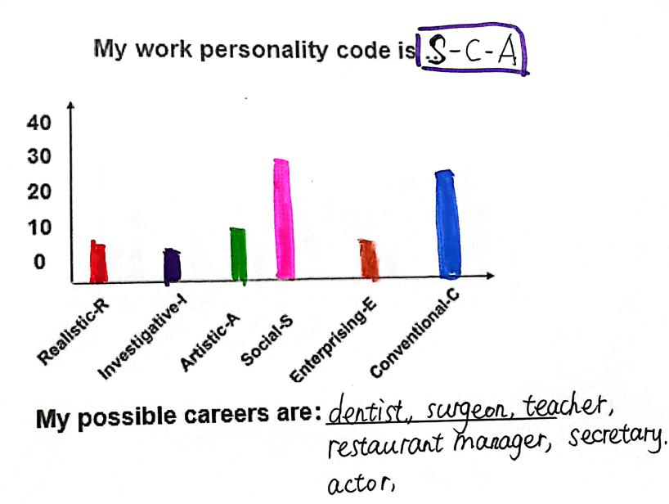
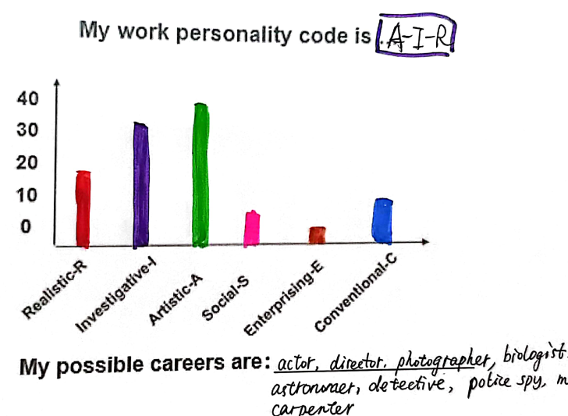
Students’ test results

Slide 15
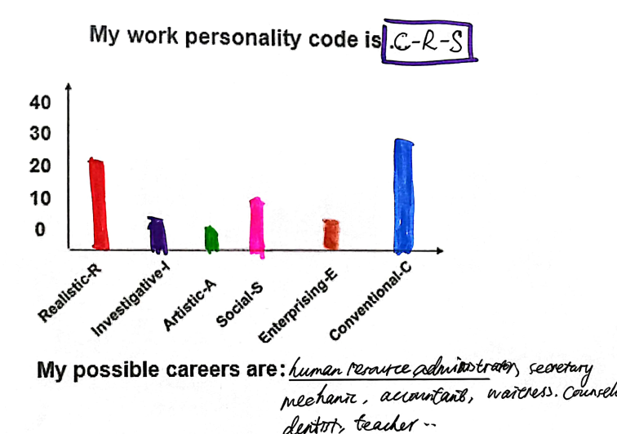
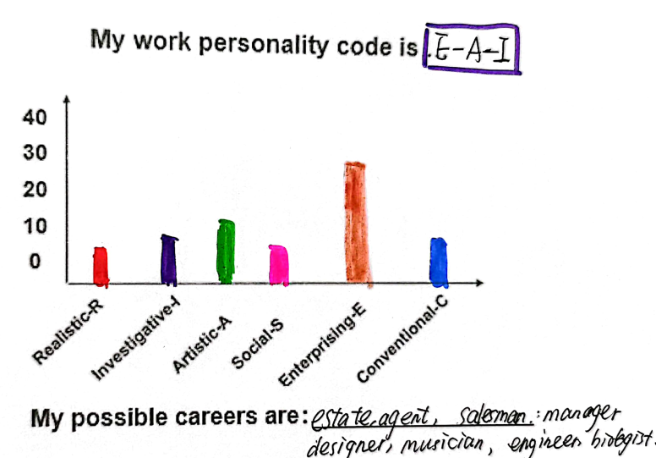
Students’ test results

Slide 16
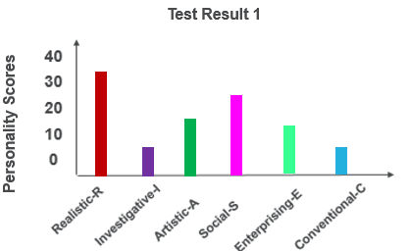
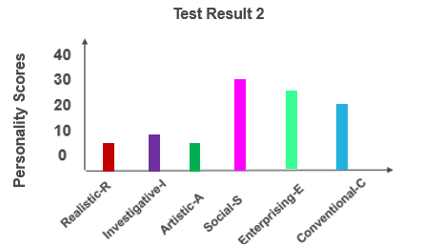
Post-reading: Evaluate the test
Suppose the Students’ union of your school is recruiting some Teaching Assistants (班级助理) during the military training period. Below are the work personality codes of two possible candidates. Please analyze their test results and choose a suitable one for the position and tell your reason.
Candidate 1
Candidate 2

Slide 17

Post-reading: Critical thinking
Do you think the test is helpful in self-discovery? Why or why not?
What factors will you take into consideration when you plan your future career? And then categorize them into two groups.

Slide 18
Post-reading: Critical thinking
Subjective factor
Objective factor
personal interest,
education,
experience,
skills and qualities,
work personalities …
socio-economic status,
influences from the family,
development and needs of the society,
…

Slide 19

Summary
Identify the significance of career planning
Interpret the diagram and analyze the career suggestions
Apply the Career Aptitude Test and report the result of the test
2
Working Out What You Want to Do
1
3

Slide 20
Always remember:
“
The future depends on what you do today.
---- Mahatma Gandhi
”

Slide 21

Assignment
Conduct the Career Aptitude Test online and work on a report on your result of the test
Website: http://www.jobtest.com.cn/select.asp

Slide 22
Thank you for your listening!

