Slide 1

感恩遇见，相互成就，本课件资料仅供您个人参考、教学使用，严禁自行在网络传播，违者依知识产权法追究法律责任。
更多教学资源请关注
公众号：溯恩高中英语
知识产权声明

Slide 2

2022.6高考浙江卷续写
之社区服务

Slide 3

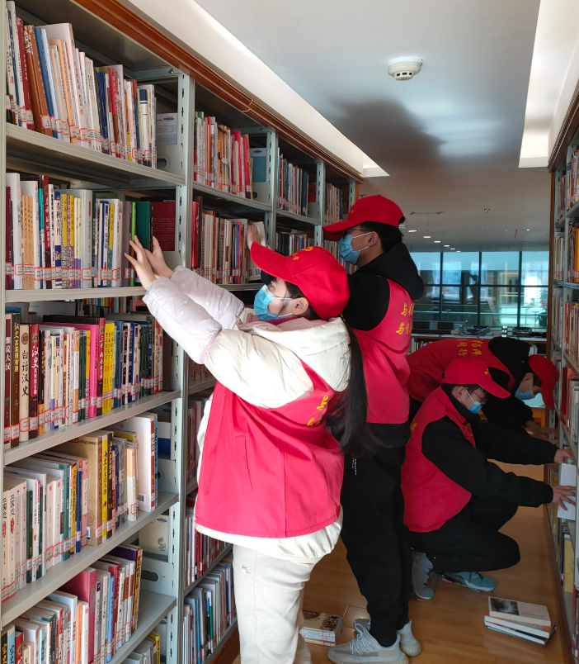
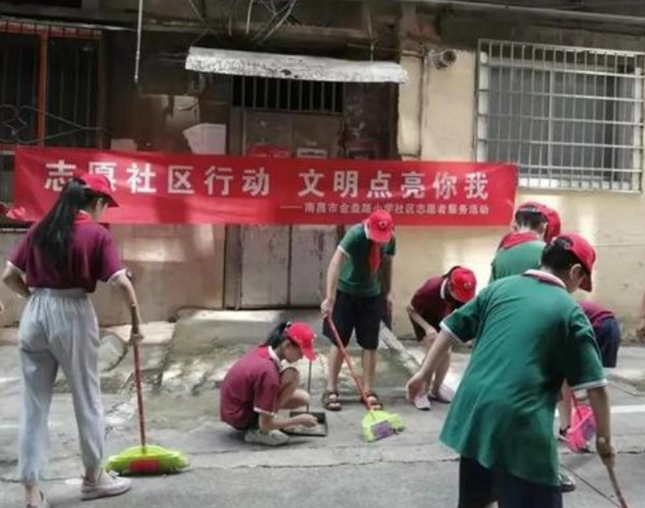
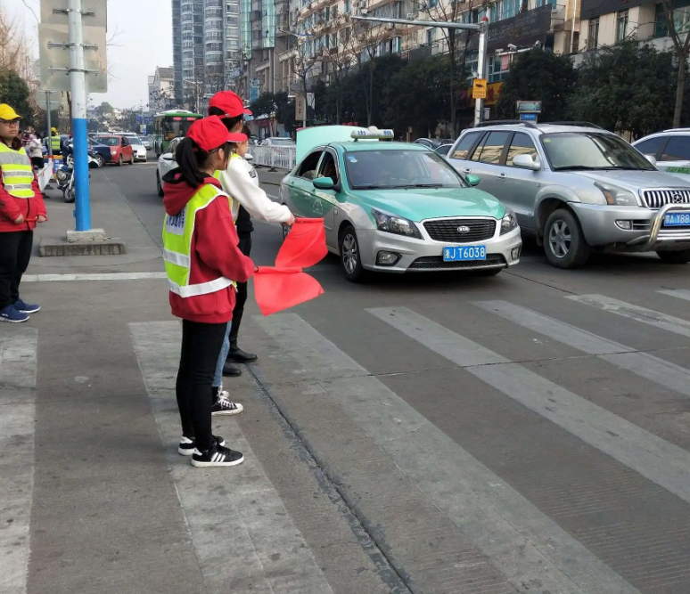

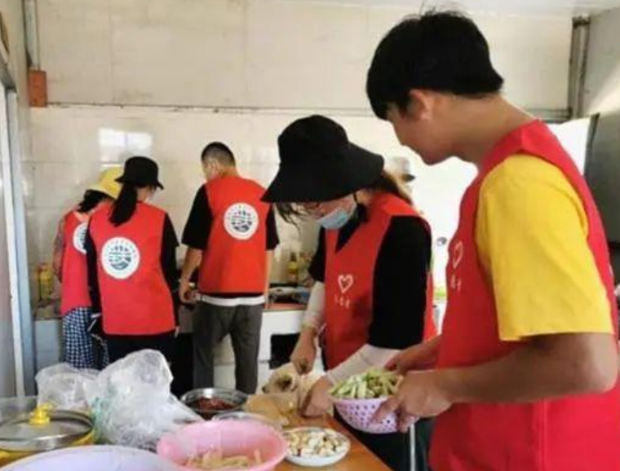
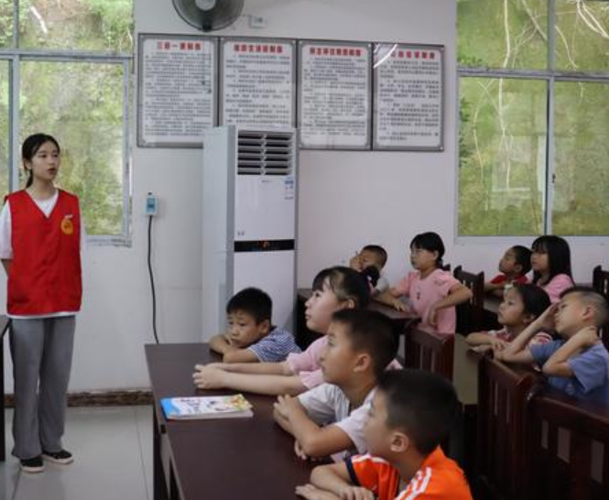
Describe pictures
Have you ever done something to your community?
In what ways have you participated in community service ?
Why did you do it?

Slide 4
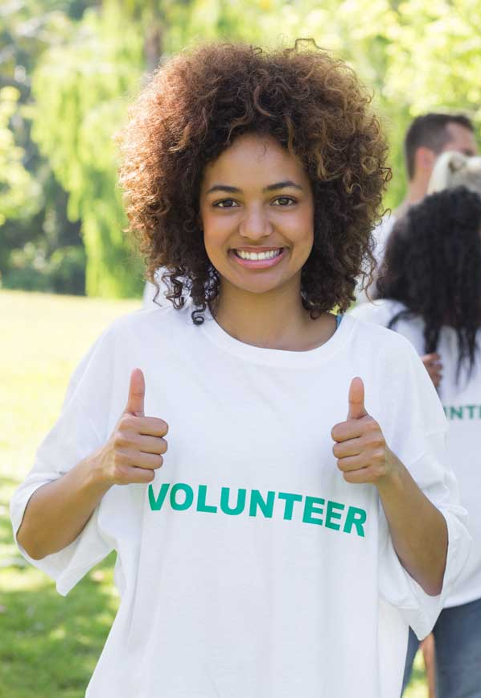
I needed to do something in my community in order to complete the community service hours required to graduate from high school. Some of my friends had signed up to spend time at a soup kitchen, so I did, too. It seemed like a good thing to do. I thought that we would just be passing out dinners to those in need, but I found out we would be doing everything from preparing to serving the dinner. We began preparing the food, from mixing salad dressing to separating frozen meat. Much still needed to be done before dinner was served, but already outside the building many homeless people were gathering. It wasn't until a couple of hours later that we opened the doors and began serving dinner. As the line of people came toward me. I got a little scared. I’d came face to face with the homeless.:How should I act? How would they treat me?Would they hate me for having more than they did? While some of the people looked very friendly, some of them looked so dangerous. I didn't have too much time to worry about it. I was assigned （分配）to serve the salad with the lady next to me. She smiled at me and said if I needed help, she'd be right there， which I found quite comforting. I had never seen so many people wanting food. They were of all ages and nationalities. Most of them wore clothes that were torn and dirty. Some looked like they had totally given up on life, while others seemed to be making the best of the situation, smiling and joking. Some were better off than others, but they all needed a good meal and a warm place to eat. It saddened me to think of how many people there were who didn't have a place to call home and the only food they got came from a soup kitchen. As they came in my direction, I put on my brightest and happiest smile. I was so happy that I had earned my service hours in this way.

Slide 5
Read for genre
I needed to do something in my community in order to complete the community service hours required to graduate from high school. Some of my friends had signed up to spend time at a soup kitchen, so I did, too. It seemed like a good thing to do. I thought that we would just be passing out dinners to those in need, but I found out we would be doing everything from preparing to serving the dinner. We began preparing the food, from mixing salad dressing to separating frozen meat. Much still needed to be done before dinner was served, but already outside the building many homeless people were gathering. It wasn't until a couple of hours later that we opened the doors and began serving dinner. As the line of people came toward me. I got a little scared. I’d came face to face with the homeless.:How should I act? How would they treat me?Would they hate me for having more than they did? While some of the people looked very friendly, some of them looked so dangerous. I didn't have too much time to worry about it. I was assigned （分配）to serve the salad with the lady next to me. She smiled at me and said if I needed help ，she'd be right there， which I found quite comforting. I had never seen so many people wanting food. They were of all ages and nationalities. Most of them wore clothes that were torn and dirty. Some looked like they had totally given up on life, while others seemed to be making the best of the situation, smiling and joking. Some were better off than others, but they all needed a good meal and a warm place to eat. It saddened me to think of how many people there were who didn't have a place to call home and the only food they got came from a soup kitchen. As they came in my direction, I put on my brightest and happiest smile. I was so happy that I had earned my service hours in this way.
saw
did
narration
felt
reflected

Slide 6
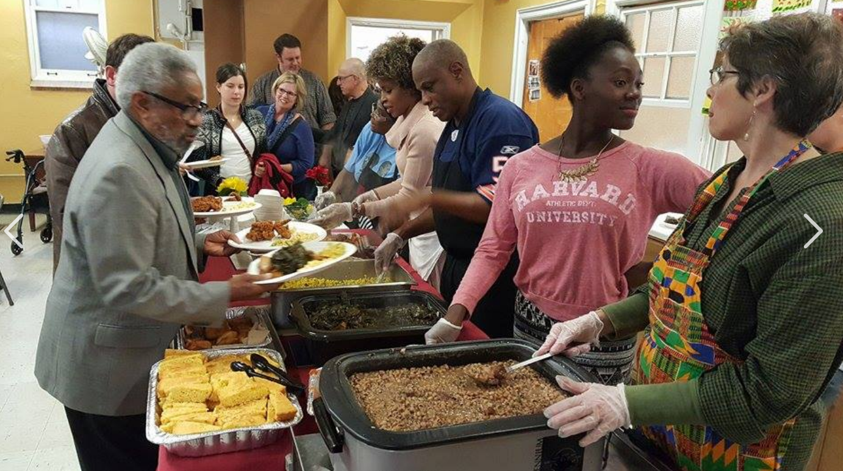
Read for main idea
1. I needed to do something in my community in order to complete the community service hours required to graduate from high school. Some of my friends had signed up to spend time at a soup kitchen, so I did, too. It seemed like a good thing to do.
character
place
event
purpose
I
at a soup kitchen
I helped out at a soup kitchen
experience: community service
to meet the requirement

Slide 7

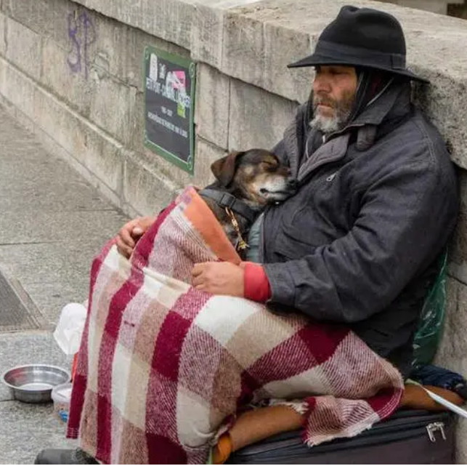

Who were my “customers”?
How were my task?
Read for plots
What would I do?
2. I thought that we would just be passing out dinners to those in need, but I found out we would be doing everything from preparing to serving the dinner. We began preparing the food, from mixing salad dressing to separating frozen meat. Much still needed to be done before dinner was served, but already outside the building many homeless people were gathering. It wasn't until a couple of hours later that we opened the doors and began serving dinner.
2. I thought that we would just be passing out dinners to those in need, but I found out we would be doing everything from preparing to serving the dinner. We began preparing the food, from mixing salad dressing to separating frozen meat. Much still needed to be done before dinner was served, but already outside the building many homeless people were gathering. It wasn't until a couple of hours later that we opened the doors and began serving dinner.
Would it be worth it?
my tiring
experience:
thought: to pass out dinners
fact: to prepare and serve dinners to homeless people at a soup kitchen
community service
I (helper)
the homeless (need help)

Slide 8
What did I see? How did I feel?
Read for feelings
Why did my emotions change?
3. As the line of people came toward me. I got a little scared. I’d came face to face with the homeless:How should I act? How would they treat me?Would they hate me for having more than they did? While some of the people looked very friendly, some of them looked so dangerous. I didn't have too much time to worry about it. I was assigned （分配）to serve the salad with the lady next to me. She smiled at me and said if I needed help, she'd be right there, which I found quite comforting. 4. I had never seen so many people wanting food. They were of all ages and nationalities. Most of them wore clothes that were torn and dirty. Some looked like they had totally given up on life, while others seemed to be making the best of the situation, smiling and joking. Some were better off than others, but they all needed a good meal and a warm place to eat. It saddened me to think of how many people there were who didn't have a place to call home and the only food they got came from a soup kitchen.
at first sight: scared+concerned
after careful observation: sad+sympathetic

Slide 9
5. As they came in my direction, I put on my brightest and happiest smile. 6. I was so happy that I had earned my service hours in this way.
?
happy
sad
lesson?
scared
experience: community service
simple
thought:
to pass out dinners to those in need
fact:
to prepare &serve dinners to the homeless
complicated &tiring

Slide 10
Read for lesson
What was the lesson “I” learnt?
Everyone shares a sense of responsibility to build a warm community.
Every small action of kindness makes an impact.
Every smile we share, everything we give, and every act of kindness we do counts.
It turned out that I could make a difference to the homeless.
We will never know how or when our acts of kindness will affect others, but it’s always better to try.
No matter how rich or poor, everyone deserves the dignity of being treated with kindness and consideration.
From that day forward, I understood the power of kindness and never missed an opportunity to spread some around.
Every single act of kindness, however small, deserves doing.
...

Slide 11
spend
need
meat
homeless
friendly
the lady
comforting
clothes
life
eat
spend
need
meat
homeless
friendly
the lady
comforting
clothes
life
eat
Read for clues
Para.1 As they came in my direction, I put on my
brightest and happiest smile.
Para. 2 I was so happy that I had earned my service hours
in this way.
What did I see & do?
How did they react?
How did I feel?
happy
lesson:
sad
Why did I feel happy to earn the service hours in this way?
What lesson did I get?
scared
experience: community service
thought
to pass out dinners to those in need
fact
to prepare &serve dinners ...

Slide 12
Para.1 As they came in my direction, I put on my brightest and happiest smile.
Q1. What did I see & do?
In front of me was a continuous stream of homeless people | 用倒装表强调；衔接首句
I found myself busy in scooping the dinner into their bowls and respectfully put them onto their hands. | 用具体动作表现画面
Q2. How did they react?
When those hungry people shuffled off, they also left with words of many blessings and much gratitude. | 用with复合结构表达人物情感
Q3. How did I feel?
It stirred me to see them beaming with a broad smile. | 用名词性从句表达情感
Though my limbs were stiff and weary, yet my heart was warm. | 用让步状语突出人物情感
Seeing what I did make their day, I felt a deep pleasure welling up inside. | 用关键信息衔接下文

Slide 13
Para. 2 I was so happy that I had earned my service hours in this way.
Q1. Why did I feel happy to earn the service hours in this way?
Never had I ever experienced a more appealing situation where I was immersed in such a fabulous mood. | 用倒装强调;衔接首句
It was truly a good and rewarding thing to do! | 原词的复现照应上文
Under the lady’s assistance, I even tried to befriend them. | 用具体动词推进叙事
the seemingly dangerous people were actually quite friendly. | 用对比凸显人物形象
My previous fear and concern suddenly vanished. | 同义词的复现照应上文
Q2. What lesson did I get?
Through the experience, apart from the service hours, I also earned something more valuable: while we can’t give the needy soul a sweet home, at least we can contribute our share to warm their heart by a dose of compassion, a dose of kindness, and a bright happy smile. | 关键词复现、升华主题

Slide 14

下水作文
As they came in my direction, I put on my brightest and happiest smile. In front of me was a continuous stream of homeless people in need of something to eat. So the next few hours I found myself busy in scooping the nearly-prepared dinner into their bowls and respectfully put them onto their hands. And it stirred me when those hungry people shuffled off, they also left with words of many blessings and much gratitude. Though my limbs were stiff and weary, yet my heart was warm. Seeing what I did make their day, I felt a deep pleasure welling up inside. I was so happy that I had earned my service hours in this way. Never had I ever experienced a more appealing situation where I was immersed in such a fabulous mood. It was truly a good and rewarding thing to do! Following the lady’s advice, I even tried to befriend them. And it turned out that the seemingly dangerous people were actually quite friendly. My previous fear and concern suddenly vanished. Through the experience, apart from the service hours, I also earned something more valuable: while we can’t give those needy soul a sweet home, at least we can contribute our share to warm their heart by a dose of compassion, a dose of kindness, and a bright happy smile.

Slide 15

不同的结尾方式
1. 道理寓意式
2. 景画式
The experience helped me grow and I was grateful to what I had, and also realized that there were people out there in need of our help and waited us to warm them with a smile.
The golden rays of sunlight flooded in through the windows of the soup kitchen, warming the whole room.

Slide 16
3. 回环照应式
4. 留问思考式
Seeing them gobbling down
the dinner I made, I felt the experience extremely rewarding. What a good thing to do! Since then, I became a “frequent visitor” to the soup kitchen to do my part.
Maybe in the near future, our community’s soup kitchen would not only just serve dinner to feed
their stomach, but also offer “soup” to feed their soul.

Slide 17


