Slide 1

感恩遇见，相互成就，本课件资料仅供您个人参考、教学使用，严禁自行在网络传播，违者依知识产权法追究法律责任。
更多教学资源请关注
公众号：溯恩高中英语
知识产权声明

Slide 2

The World
June 1st-30th, 2022

Slide 3

1.Fintech Tamara Accelerates The Buy Now Pay Later Revolution
金融科技公司塔玛拉加速了“先买后付”的革命

Slide 4
语篇填空
（《连线》2022年6月刊 28页）
Launched
_________ (launch) in September 2020 in Riyadh, Saudi Arabia, by serial entrepreneur Abdulmajeed Alsukhan and partners Turki Bin Zarah and Abdulmohsen Albabtain, after just four months Tamara closed $6 million of funding in _________ (large) seed round in the country’s history. In April the startup topped that in style by _______ (raise) no less than $110 million in a record-breaking Series A round led by global payments provider Checkout.com.
Like many ecommerce companies around the world, Tamara is benefitting ________ the massive rise in online consumer spending __________ has taken place during the pandemic. Its BNPL solution ______ (allow) consumers to pay for products in installments, without incurring any interest charges. The company’s revenues come from fees paid by merchants, who have fallen over _________ (them) to partner with Tamara and offer their customers ___ innovative and intuitive way to buy big-ticket _____ (item), both online and in-store.
Co-founder Abdulmajeed says that the pandemic is not the only reason for Tamara’s rapid ______ (grow) rate or its appeal to global investors. Authorities are also giving local startups all the support they need to roll out innovative services to Saudi Arabia’s young, aspirational and tech-savvy population.
the largest
raising
from / by
which / that
allows
themselves
an
items
growth

Slide 5
词组汇总
BNPL = The Buy Now Pay Later
serial entrepreneur
in style
global payments provider
ecommerce company
during the pandemic
pay for sth. in installments
interest charge
fall over oneself to do sth.
an innovative and intuitive way
big-ticket item
roll out
BNPL =先买后付
多次创业者
气派
全球支付供应商
电子商务公司
疫情期间
分期付款
利息费用
竭尽全力做某事
一种创新和直观的方式
大件物品
推出 (新产品或服务)

Slide 6
词汇讲解
1. top (~pped, ~pped): to be in the highest position on a list because you are the most successful, important, etc. 居…之首；为…之冠
The band topped the charts for five weeks with their first single. 这支乐队的第一张单曲唱片有五个星期高居最畅销流行音乐唱片榜榜首。
2. incur (~rred, ~rred): if you incur a cost, debt, or a fine, you have to pay money because of something you have done 引致，带来（成本、花费等）
You risk incurring bank charges if you exceed your overdraft limit. 如果超出了透支限额，就有被银行加收费用的风险。
翻译句子
伦敦塔是伦敦最受欢迎的旅游景点之一。
The Tower of London tops the list of London’s most popular tourist attractions.
翻译句子
请详细说明你参加面试所花费的费用。
Please detail any costs/expenses incurred by you in attending the interview.

Slide 7
句子翻译
In April the startup topped that in style by raising no less than $110 million in a record-breaking Series A round led by global payments provider Checkout.com.
今年4月，这家初创公司在创纪录的A轮融资中获得了不少于1.1亿美元的融资，由全球支付提供商Checkout.com领投。
翻译
The company’s revenues come from fees paid by merchants, who have fallen over themselves to partner with Tamara and offer their customers an innovative and intuitive way to buy big-ticket items, both online and in-store.
该公司的收入来自商家支付的费用，这些商家热衷于与塔玛拉合作，为顾客提供一种创新而直观的方式来购买高价商品，包括在线和实体店。
翻译

Slide 8
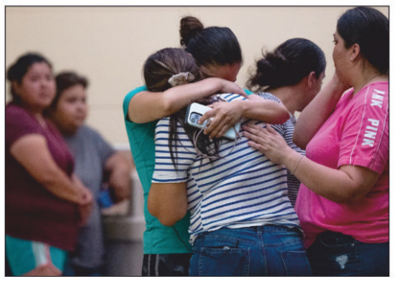
2. Anger and Heartache after Another School Massacre
校园惨案后的愤怒和心痛
At the civic center where parents awaited word about their children

Slide 9
语篇填空
（《新闻周刊》美国版2022年6月3日刊 4页）
over / about
America’s decades-long debate ___________ gun-safety laws received a horrifying jolt of _______ (urgent) this week, after an 18-year-old gunman killed 19 children and two teachers in a Texas elementary school. It was the second mass shooting in the U.S. in two weeks, and the ________ (deadly) school shooting since 2012’s Sandy Hook Elementary School massacre.
Wearing body armor and wielding a semiautomatic assault-style rifle, Salvador Ramos shot his way past three armed police officers _______ (enter) Robb Elementary School in Uvalde, Texas, and opened fire in two adjoining classrooms, ______ (kill)19 third- and fourth-graders and two teachers. As 10-year-old Amerie Jo Garza tried to dial 911, he told her, witnesses said, “You’re going to die,” and shot her. The shooter’s hour-long rampage _____ (end) only when a Border Patrol tactical unit (战术分队) raced to the school and ___ agent shot Ramos dead. At a civic center in Uvalde — a rural, poor, majority-Latino town 75 miles from the Mexican border — sobbing parents were swabbed for DNA to identify the victims, some of ______ were left unrecognizable by bullets. Screams __________ (period) erupted as some received confirmation that their _________ (child) were among the dead.
urgency
deadliest
to enter
killing
ended
an
whom
periodically
children

Slide 10
词汇讲解
1. wield: to hold sth, ready to use it as a weapon or tool 拿着（武器、工具等）
The man moved toward them, wielding a stick. 那人挥舞着一根棍子朝他们走过来。
2. adjoining: near, next to, or touching 邻近的；毗连的
His colleagues rushed him to a room in the adjoining hotel. 同事们急忙把他送到隔壁旅馆的一个房间。
翻译句子
他遭到一名持刀男子的袭击。
He was attacked by a man wielding a knife.
翻译句子
我们进来时她转身躲进了隔壁房间。
She ducked into the adjoining room as we came in.

Slide 11
句子翻译
America’s decades-long debate over gun-safety laws received a horrifying jolt of urgency this week, after an 18-year-old gunman killed 19 children and two teachers in a Texas elementary school.
本周，一名18岁的枪手在德克萨斯州的一所小学枪杀了19名儿童和两名教师，这让美国关于枪支安全法长达数十年的争论变得更加紧迫。
翻译
Wearing body armor and wielding a semiautomatic assault-style rifle, Salvador Ramos shot his way past three armed police officers to enter Robb Elementary School in Uvalde, Texas, and opened fire in two adjoining classrooms, killing 19 third- and fourth-graders and two teachers.
身穿防弹衣、手持半自动突击步枪的Salvador Ramos穿过三名武装警察，进入得克萨斯州乌瓦尔德市的罗布小学，并在相邻的两间教室开枪，造成19名三、四年级学生和两名教师死亡。
翻译

Slide 12
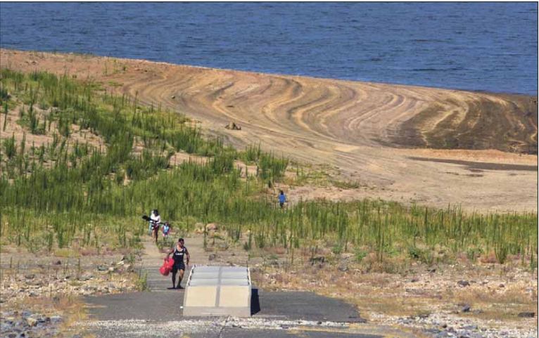
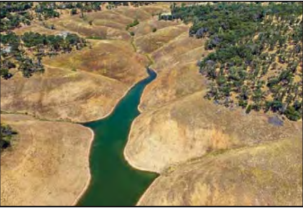
3. Lessons learned from the last drought?
从上次干旱中吸取了什么教训?
THE WEST Branch Feather River is a tributary of Lake Oroville, which stands at 54% of capacity, a sign of the effects of the drought in the state.

Slide 13
语篇填空
（《洛杉矶时报》2022年6月16日 A1 & A7版面）
The governor of California stood in a patch of dry brown grass as he made his proclamation: “We’re in a new era. The idea of your nice little green grass getting lots of water every day — that’s going to be a thing of the past,” he said. “We’re in a _______ (history) drought, and that demands unprecedented action.”
But it wasn’t Gavin Newsom _________ (speak) — it was the state’s previous governor, Jerry Brown, and the year was 2015. Seven years _____ (late), California is once again facing urgent calls for cutbacks as heat waves, record dryness and climate change converge to create _________ (critical) short supplies. But what has California learned ______ then?
While some of the promises made during the previous drought — including greater investments in water capture and recycling — __________________ (advance) or upheld, progress has been slow and conservation is slipping.
What’s more, a rash of well drilling is still threatening the state’s groundwater supply, and fish and forests are continuing to suffer as the region ______ (grow) drier.
“In some ways, ____ way we use water is pretty much like gambling,” said Felicia Marcus, a fellow at Stanford University’s Water in the West Program. “We’re going to have to learn _____ to hold back in normal times to see us ________ the longer dry times — and more frequent dry times —under climate change.”
historic
speaking
later
critically
since
have been advanced
grows
the
how
through

Slide 14
词汇讲解1
1. proclamation: an official statement about sth important that is made to the public; the act of making an official statement 宣言；公告；声明
Lincoln issued a proclamation setting aside the last Thursday in November for the holiday. 林肯发布公告，将11月的最后一个星期四定为感恩节。
2. converge: to move towards a place from different directions and meet
汇集；聚集；集中
Hundreds of tractors will converge on the capital. 成百上千的拖拉机将向首都聚集。
翻译句子
独立声明在广播里播出了。
The proclamation of independence was broadcast over the radio.
翻译句子
这5条河向南流，最终汇合在一起。
As they flow south, the five rivers converge.

Slide 15
词汇讲解2
3. capture: to catch a person or an animal and keep them as a prisoner or in a confined space 俘虏；俘获；捕获
Her paintings capture the subtle hues of the countryside in autumn. 她的油画捕捉住了秋天乡村的微妙色调。
4. slip: to fall to a lower level; to become worse 下降；退步；变差
That’s three times she’s beaten me—I must be slipping!
她已经赢了我三回了—我一定是退步了！
翻译句子
它们用听觉捕捉猎物。
They use their sense of hearing to capture their prey.
翻译句子
近来他已不如过去那样受欢迎。
His popularity has slipped recently.

Slide 16
句子翻译
While some of the promises made during the previous drought — including greater investments in water capture and recycling — have been advanced or upheld, progress has been slow and conservation is slipping.
翻译
尽管在上次干旱期间做出的一些承诺——包括加大对水收集和循环利用的投资——得到了推进或维持，但进展缓慢，保护力度正在下滑 。
What’s more, a rash of well drilling is still threatening the state’s groundwater supply, and fish and forests are continuing to suffer as the region grows drier.
翻译
更重要的是，大量的钻井仍在威胁着该州的地下水供应，随着该地区越来越干旱，鱼类和森林继续受到影响。

Slide 17
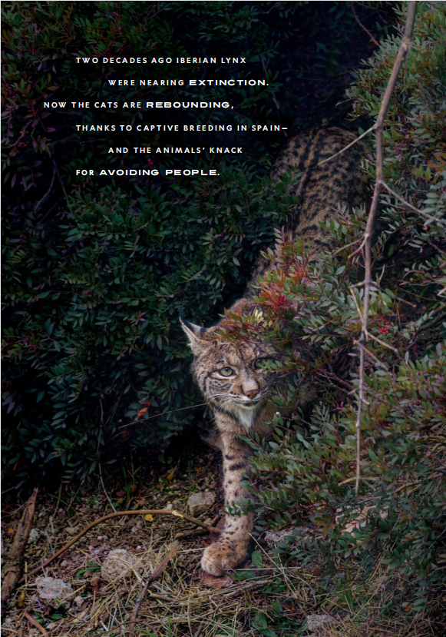
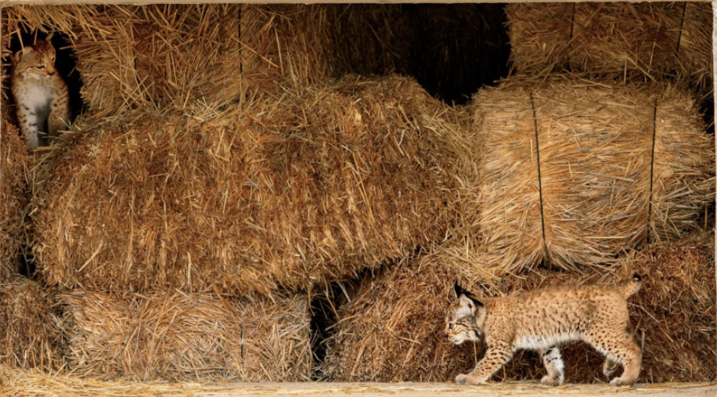
4. The Comeback Cats 东山再起的猞猁
Thanks to captive breeding, national acclaim, and an innate scrappiness, the Iberian lynx has leaped tenfold in population over the past two decades.

Slide 18

语篇填空
（《国家地理》2022年6月刊 102页）
In just 20 years, the Iberian lynx has gone from the world’s most endangered feline to the greatest triumph in cat conservation. In 2002 _____ (few) than a hundred of these bobtailed, golden-eyed predators slunk through the Mediterranean scrublands of the Iberian Peninsula. Since then, the population has grown tenfold, with at least 1,100 animals ________ (scatter) across Spain and Portugal. When the European Commission’s Life program first brought together more than 20 organizations in 2002 ________ (rescue) the lynx, the species had all but disappeared. Widespread hunting and __ virus had wiped out most of the peninsula’s European ______ (rabbit), the lynx’s main prey.
Lynx breed easily in captivity, ________, and most of the animals that _________ (eventual) were reintroduced into carefully chosen habitats throughout Spain and Portugal have thrived. Near one main release location, around southern Spain’s Sierra de Andújar Natural Park, Iberian lynx have even learned to live in neighborhoods, in commercial olive groves, and around highways—mostly by ________ (avoid) people. One mother lynx managed to hide her newborns in a house ______ people were throwing a party.
Such adaptability boosted their numbers, and by 2015, the International Union for Conservation of Nature had reclassified the lynx’s status _____ critically endangered to endangered.
fewer
scattered
to rescue
a
rabbits
however
eventually
avoiding
where
from

Slide 19
词汇讲解
1. triumph: (over sb/sth) a great success, achievement or victory
巨大成功；重大成就；伟大胜利
The championships proved to be a personal triumph for the coach.
事实证明，在这次锦标赛中教练取得了非凡的个人成就。
2. captivity: the state of being kept as a prisoner or in a confined space
监禁；关押；困住
He was held in captivity for three years. 他被监禁了三年。
翻译句子
这是现代科学最重大的成就之一。
It is one of the greatest triumphs of modern science.
翻译句子
那只鸟已经逃离樊笼。
The bird has escaped from captivity.

Slide 20
长难句分析
Lynx breed easily in captivity, however, and most of the animals that eventually were reintroduced into carefully chosen habitats throughout Spain and Portugal have thrived.
分析：整句是一个并列句, “that eventually were...Portugal”_________，修饰_______；“chosen”是__________作_________修饰________。
定语从句
animals
过去分词
前置定语
habitats
然而，猞猁在圈养中很容易繁殖，最终被重新引入西班牙和葡萄牙精心挑选的栖息地的大多数动物都茁壮成长。
翻译

Slide 21
句子翻译
When the European Commission’s Life program first brought together more than 20 organizations in 2002 to rescue the lynx, the species had all but disappeared.
翻译
当欧盟委员会的生命计划于2002年首次召集20多个组织拯救猞猁时，该物种几乎消失了。
Such adaptability boosted their numbers, and by 2015, the International Union for Conservation of Nature had reclassified the lynx’s status from critically endangered to endangered.
翻译
这种适应能力增加了它们的数量，到2015年，国际自然保护联盟已将猞猁的状态从极度濒危重新分类为濒危。

Slide 22

5. BBC一分钟新闻（One-minute World 06/01/22）

Slide 23

听力填空
This is BBC world news, the headlines. European Union leaders have ______ weeks of wrangling over how to reduce the bloc’s _______ on Russian energy by agreeing a compromised deal to immediately ____ more than two-thirds of oil imports from Moscow.
European football’s governing body UEFA has commissioned an __________ inquiry into the chaotic scenes that _______ Saturday’s Champions League final in Paris. The French authorities have blamed what they called _____________ ticket fraud.
The Canadian government has proposed new legislation to __________ on the sale, transfer and importation of handguns. Prime Minister Justin Trudeau said there was no reason anyone needed guns in their everyday lives _________ hunting or sport shooting.
A 36 year old man has been arrested after trying to smear cake on the Mona Lisa. It’s alleged he ________ himself as an elderly woman at the Louvre in Paris before ______________ on the glass that covers the famous painting.
ended
reliance
ban
independent
delayed
industrial scale
crack down
except for
disguised
wiping the food

Slide 24
词汇讲解
1. wrangle: (with sb) (over/about sth) to argue angrily and usually for a long time about sth （通常为长时间地）争吵，争辩
The two sides have spent most of their time wrangling over procedural problems. 双方大部分时间都在围绕程序问题争论不休。
2. allege: to state sth as a fact but without giving proof
（未提出证据）断言，指称，声称
It is alleged that he mistreated the prisoners.
据称他虐待犯人。
翻译句子
他们仍在为财务细节争吵。
They’re still wrangling over the financial details.
翻译句子
被告据称谋杀了一名男子。
The accused is alleged to have killed a man.

Slide 25
句子翻译
European Union leaders have ended weeks of wrangling over how to reduce the bloc’s reliance on Russian energy by agreeing a compromised deal to immediately ban more than two-thirds of oil imports from Moscow.
翻译
欧盟领导人已经结束了数周关于如何减少欧盟对俄罗斯能源依赖的争论，达成一项妥协协议，立即禁止从莫斯科进口的超过三分之二的石油。
It’s alleged he disguised himself as an elderly woman at the Louvre in Paris before wiping the food on the glass that covers the famous painting.
翻译
据称，他在巴黎卢浮宫伪装成一名老妇人，然后在覆盖着名画的玻璃上抹上了食物。

